Slide 1
SQL & JMP
An introduction to using SQL to import data into JMP

Slide 2

about: Miles Lane
Email: mlane@srhs.com
Current Role:
  Lean Engineer @ Spartanburg Regional Healthcare System
Edumacation:
  The Hills of Northeast Tennessee
  Wofford College
  B.S. in Chemistry and Computer Science/Math
Likes:
  Football, any sport except running
  Growing Facial hair… well, pretty much any body hair…
  Family, Dog, Wife, Kids (in historical order)
  Video Games (volunterrier on Xbox Live)
Dislikes:
  The futility of my short legs while trying to train for a 5K
  Poorly designed databases & slow performing queries

Slide 3
What is SQL?
… and how do you pronounce it?

Slide 4
Structured
Query
Language
From Pronouncing SQL: S-Q-L or Sequel?
  Initially developed in the early 1970s at IBM by Donald Chamberlin and Raymond Boyce, what we know as SQL today was initially called “Structured English Query Language” (SEQUEL) and pronounced “sequel”… as a bit of a pun since it was the sequel to QUEL.
  Microsoft has no official guide, but the majority of Microsoft SQL Server developers say “sequel”.
  Oracle’s docs say “sequel”.
  MySQL says it is officially pronounced “My Ess Que Ell”.
  Wikipedia says it is officially pronounced “S-Q-L”.
  ANSWER… there is no correct answer!
    Tomato / Tomahto
    Potato / Potahto
    S-Q-L / Sequel both work!
    Personally, I almost exclusively say “sequel”…
How do you pronounce SQL?!?

Slide 5
Structured
Query
Language
Non-procedural, Set-based language
  Describes what you want to get instead of how you want to get it:
    SELECT * FROM movies
    Do I, as a user, really care how the backend database gives me this data (table/index lookup/scans, hash matches, etc. etc.)?
  This is in sharp contrast to most procedural programming languages.
  Note that just because you can use SQL to ask for everything does not mean that you should!
    Client resources can be overloaded (i.e. Excel/JMP/etc. might/will crash while trying to load millions of rows of data).
    Server resources can be overwhelmed by multiple bad queries / inconsiderate users performing overly aggressive queries.
    The underlying design and/or optimization of the database may not provide adequate performance for the question you are asking.
    SELECT Year, COUNT(movieId) AS Movies
    FROM movies
    GROUP BY Year
    ORDER BY Year DESC
    Optimizing queries and becoming intimately familiar with how each backend database platform “makes its sausage” can be pretty daunting.
    ANSI SQL is an ISO standard that we can feel comfortable using to get most of our job done without too much worry…
What is SQL?

Slide 6
SAMPLE DATABASE
MovieLens.org dataset

Slide 7
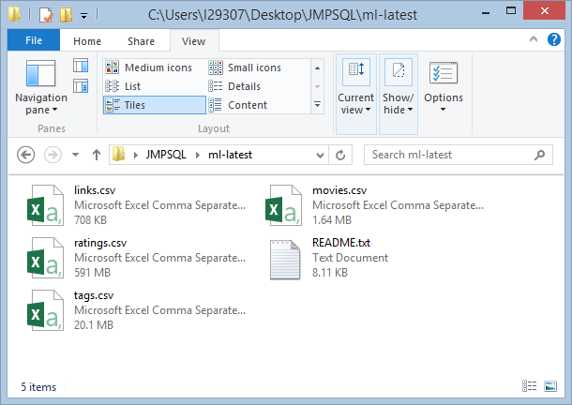
MovieLens.org
Used the “MovieLens Latest” Dataset
http://grouplens.org/datasets/movielens/latest/
~22,000,000 million ratings
~580,000 tag applications
~33,000 movies
~240,000 users
Last updated 01/2016

Slide 8
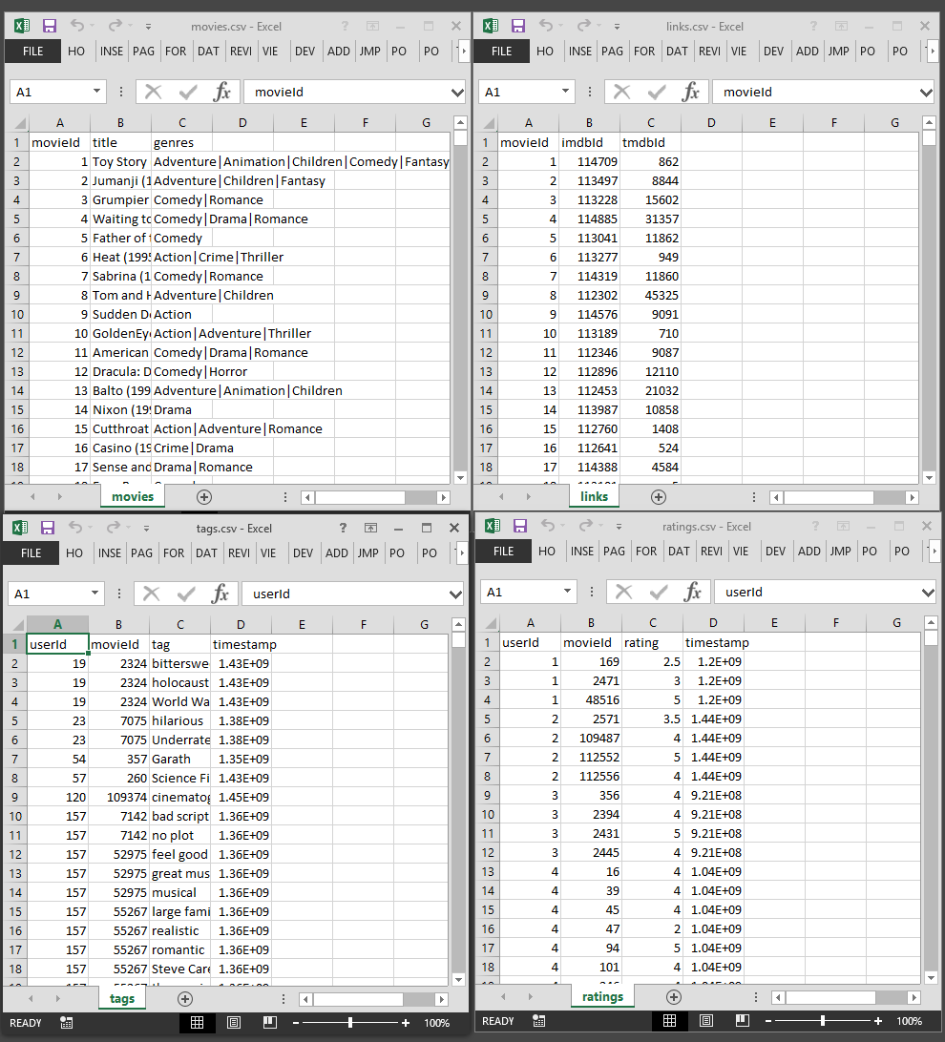
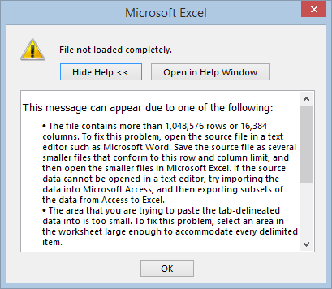
CSV Files
Movies
  Genres are delimited text
  Year appended onto some (not all!) movie titles
Links
  Pointers to MovieLens/IMDB/TheMovieDB websites
Tags/Ratings
  Potentially many per movie
  UserID is anonomized
  Timestamp stored in seconds since 1/1/1970
  Ratings.csv file way too large for Excel 2013 x32 @ 22M rows!!!
Notes:
If file contains more than 1,048,576 rows or 16,384 columns, Excel will not like it.

Slide 9
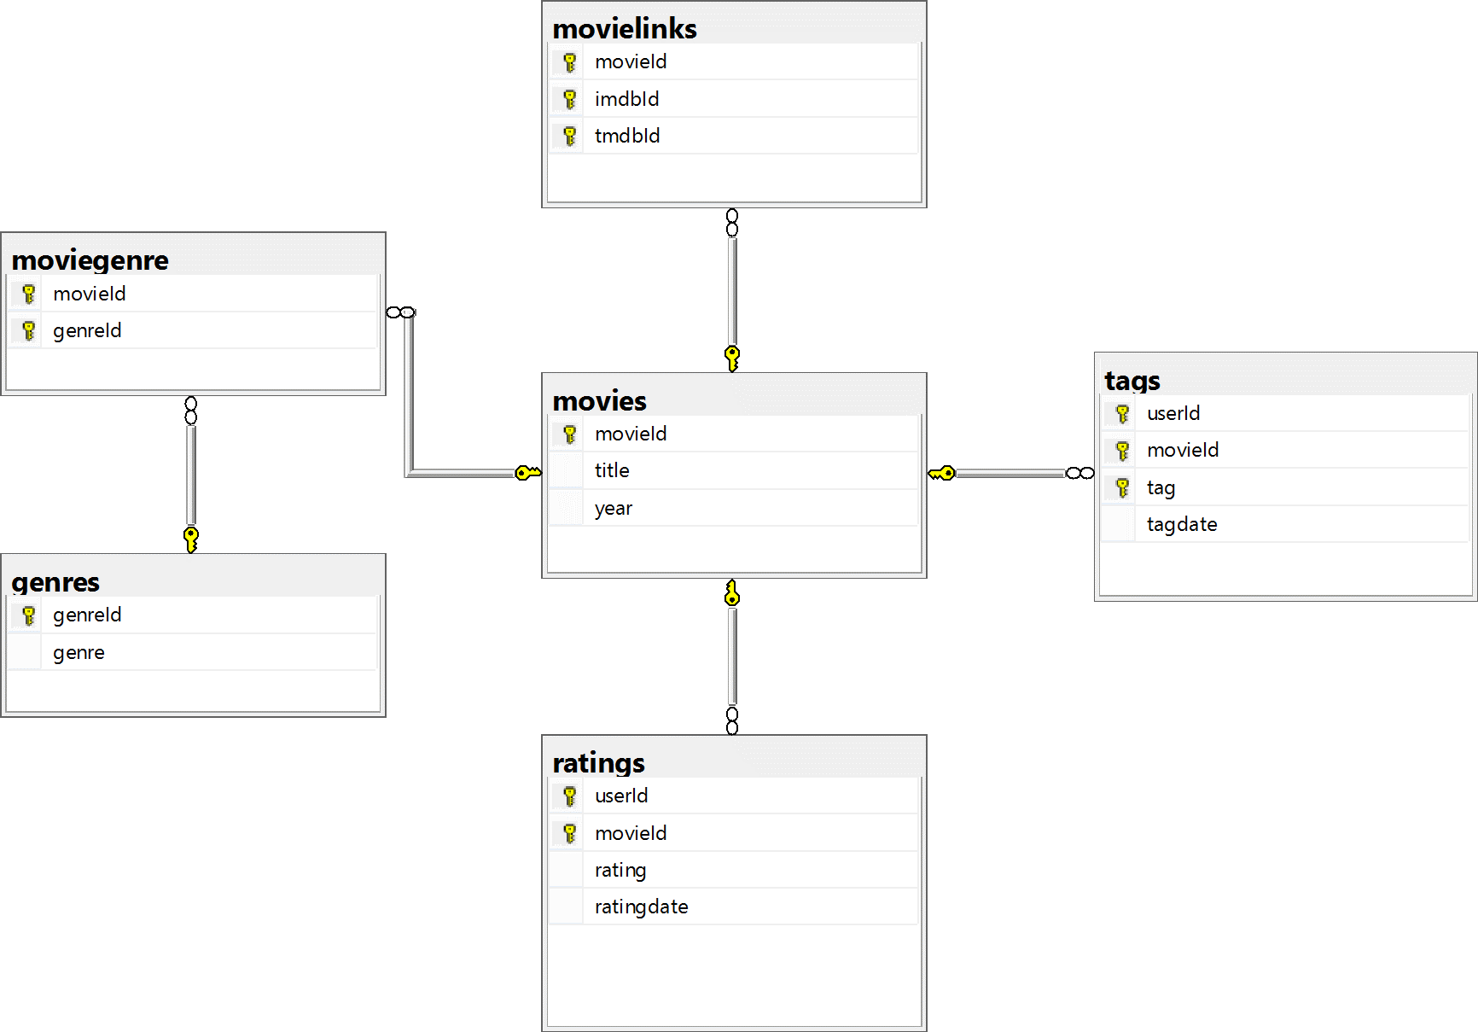
MovieLens on SQLExpress
Created MovieLens Database in SQL
Did some SQL cleanup:
  Imported CSV files into SQL via the Tasks>Import Data… option (DTS)
  Made sure to use nvarchar fields to handle UTF-8 character data for all the Unicode characters
  Normalized the Genre data
  Separated Year column from the Title
  Converted integer date to SQL tagdate/ratingdate

Slide 10
SQL Examples
Using a sample MovieLens.org database to look at movie data

Slide 11
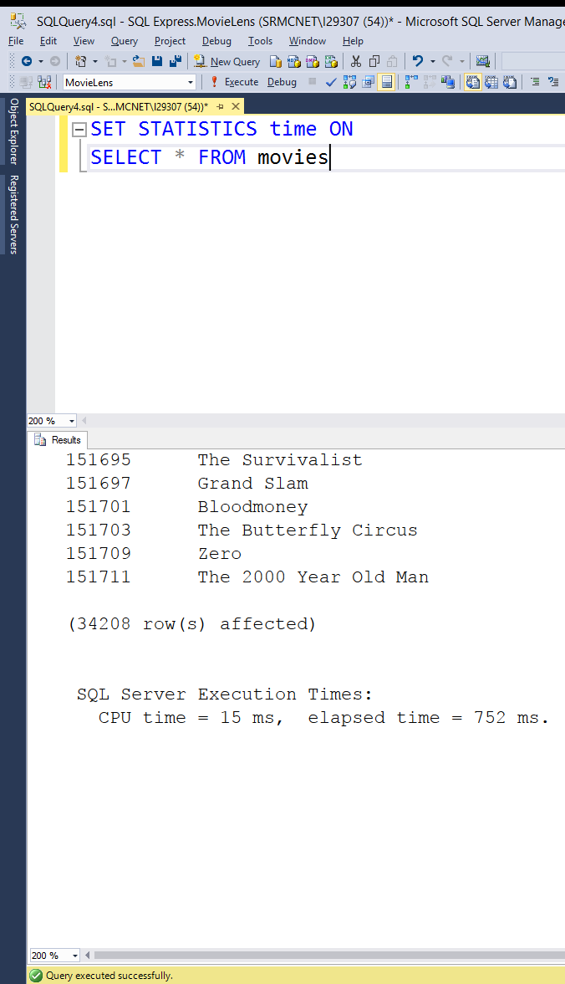
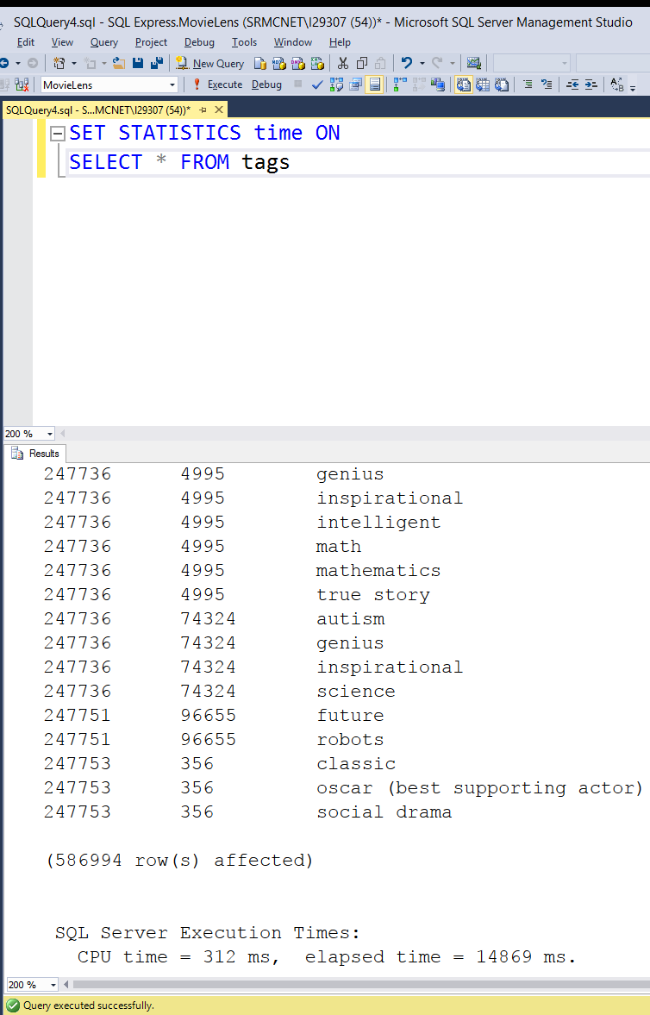
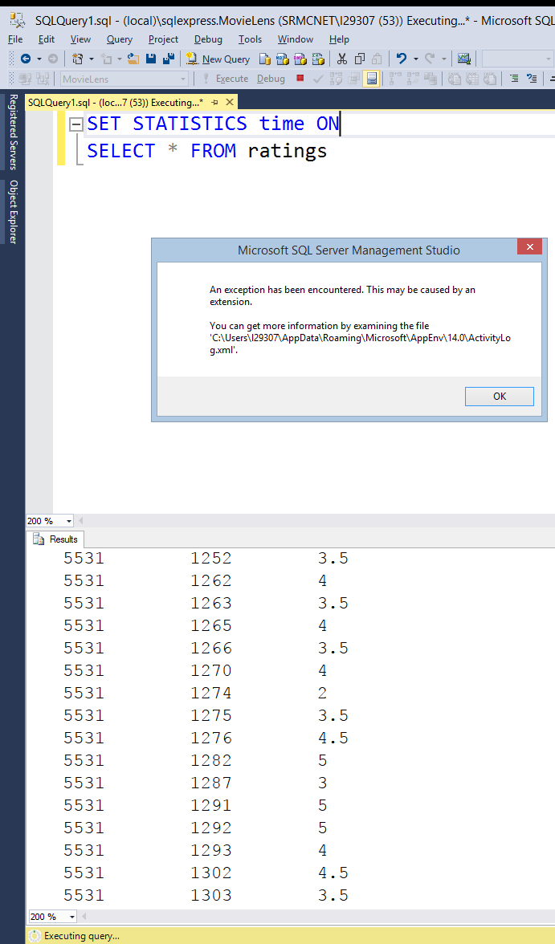
☺
😐
☹
Notes:
SELECT * is OK for smaller tables… but it obviously get a problematic when the tables get larger… and will eventually crash the client (if you are lucky) and the server (and you will be in trouble!).

Slide 12
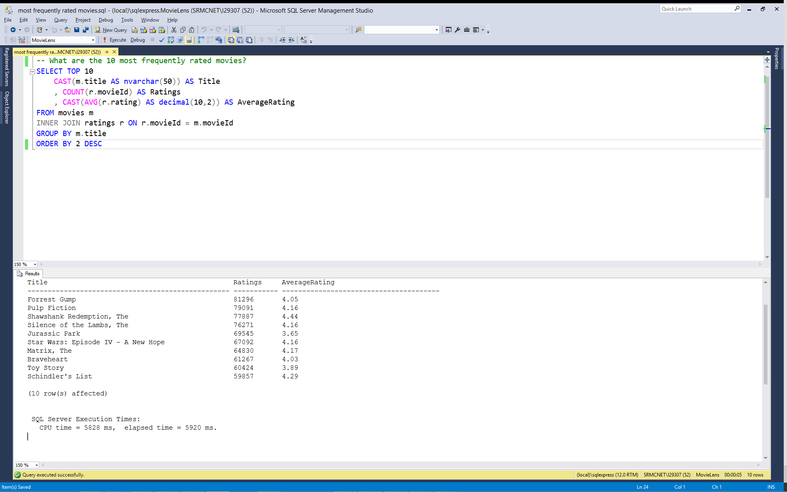
What are the 10 most frequently rated movies, and their average rating?
Note we CAST the title and AVG statements for formatting
We JOIN the movies with their ratings by movieId.
Group by title, then Order by Number of ratings (column #2), descending
Use SQL Server’s “TOP 10” phrase to limit our result set to 10 rows.
Notes:
This query shows the 10 most rated movies by total number of ratings.
We cast the title to nvarchar(50) to limit its column width on the screen.
We cast the average rating column to limit the decimal places and make the number a bit more readable.

Slide 13
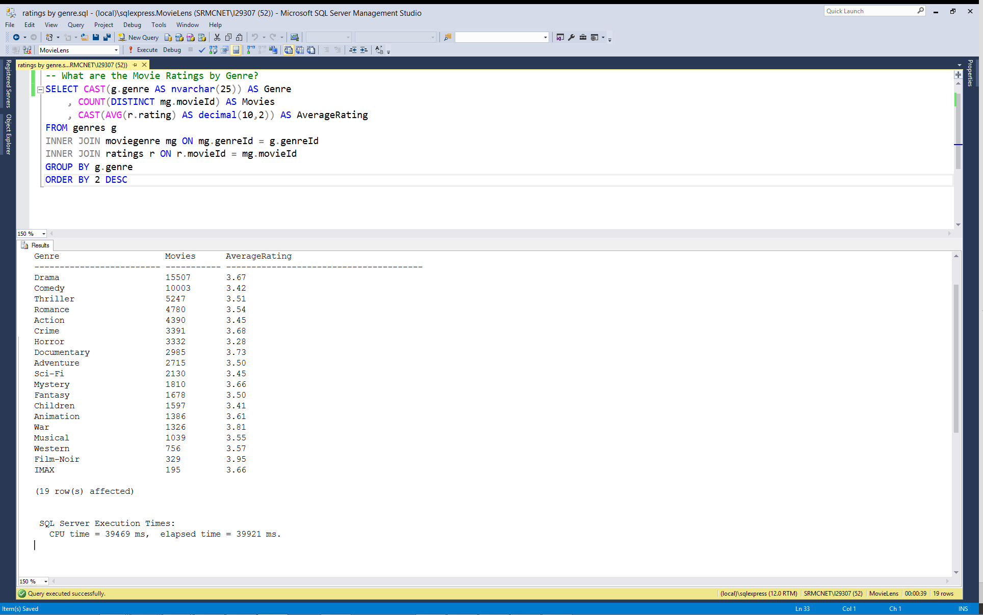
What are the Movie Ratings by Genre?
Using COUNT (DISTINCT mg.movieId) to return unique movies per genre
Uses the resolution table moviegenre to relate genre list to specific movies and their ratings.
Note there are more aggregate movies here (64,596) than total movies (34,208) since most movies have more than one Genre applied.

Slide 14
Pulling SQL data into JMP

Slide 15
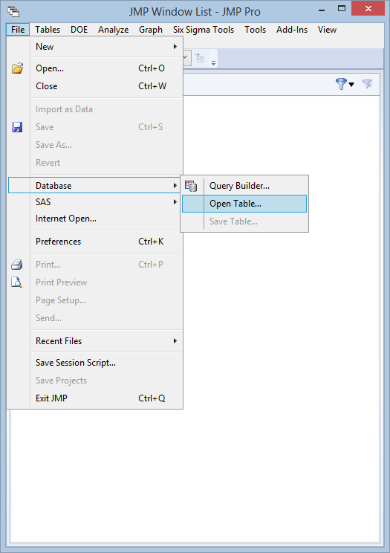
Importing ODBC data into JMP
File > Database >
Query Builder…
-OR-
Open Table…

Slide 16
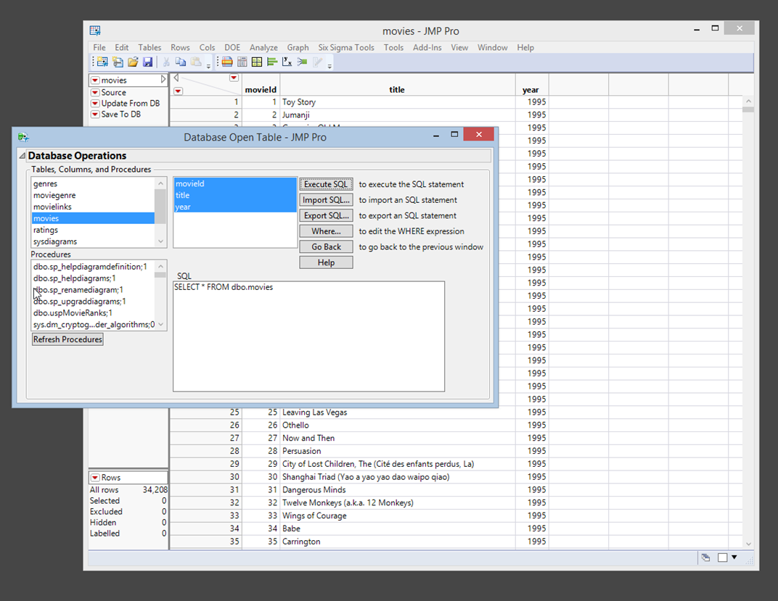
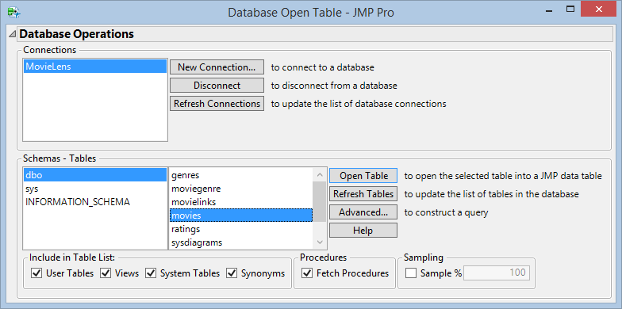
Open Table…
Useful for small/medium tables, or defined data sets.
Create/Select an ODBC connection, schema and specific table.
Clicking Advanced… gives the dialog to the right that will allow you to choose a Stored Procedure or make additional tweaks to the SQL statement.

Slide 17
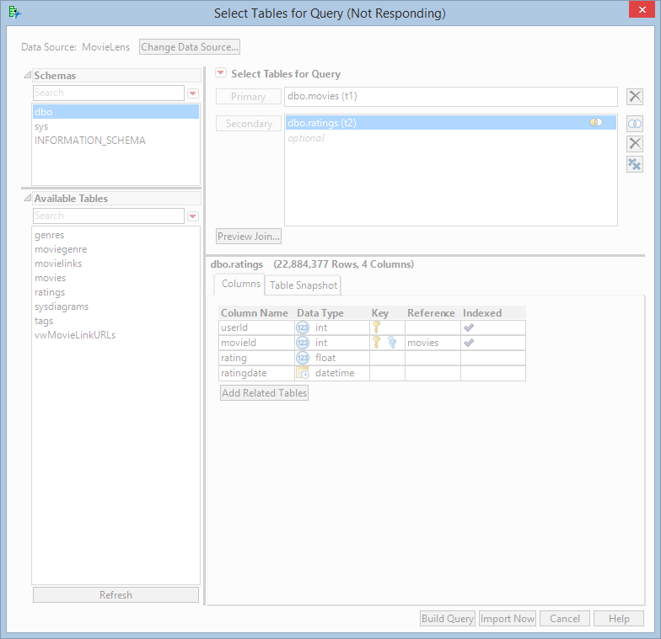
Query Builder…
Watch out when you try to preview a Join!

Slide 18
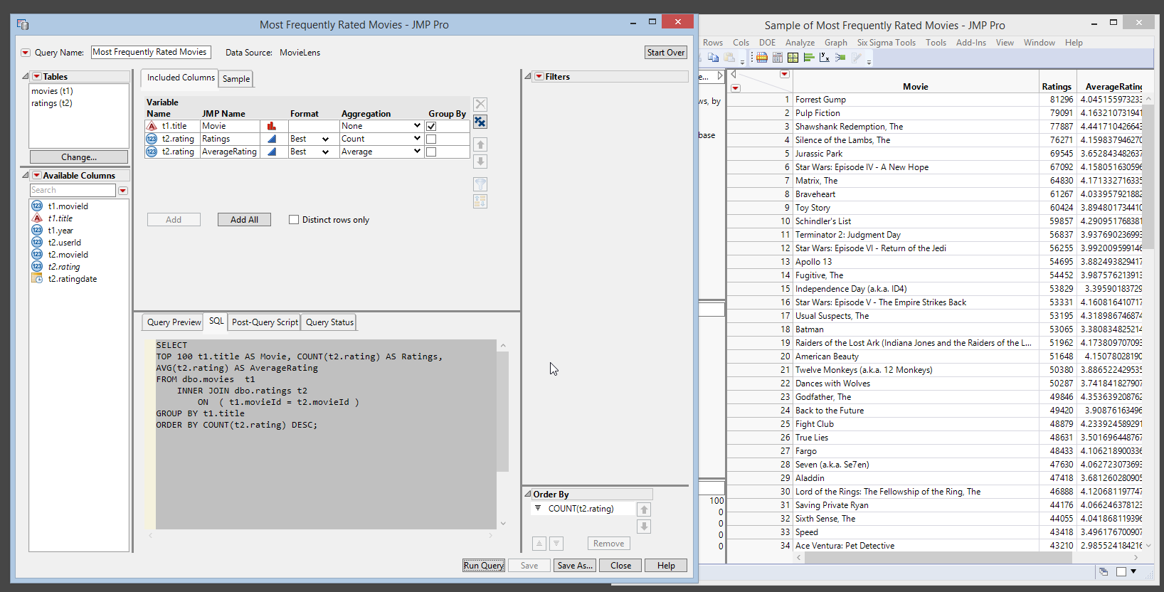
Notes:
Note that aside from query

Slide 19
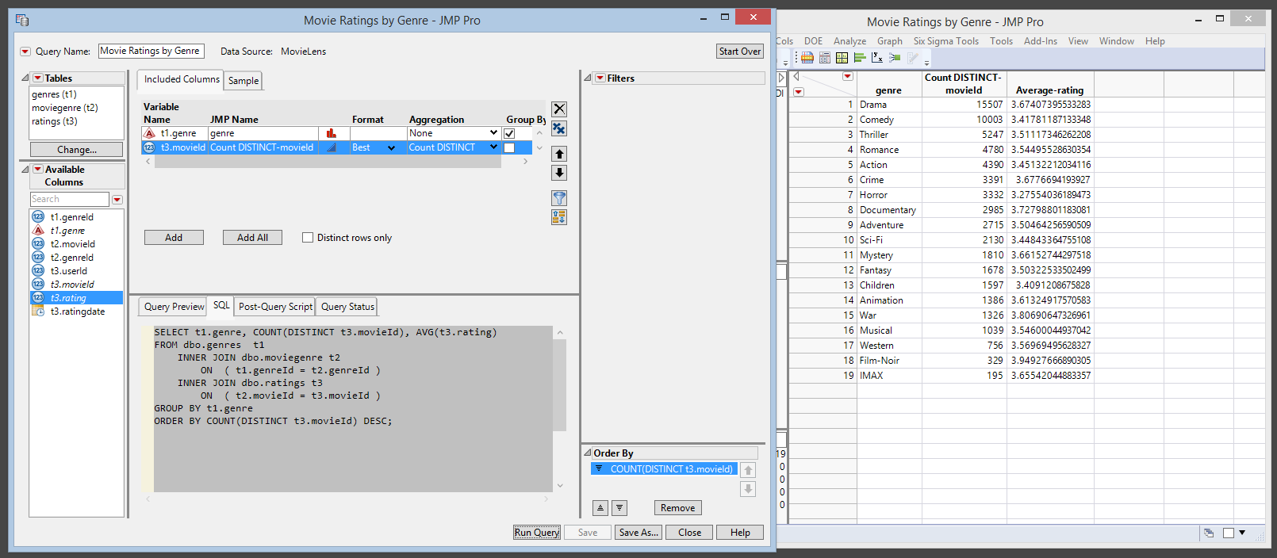

Slide 20
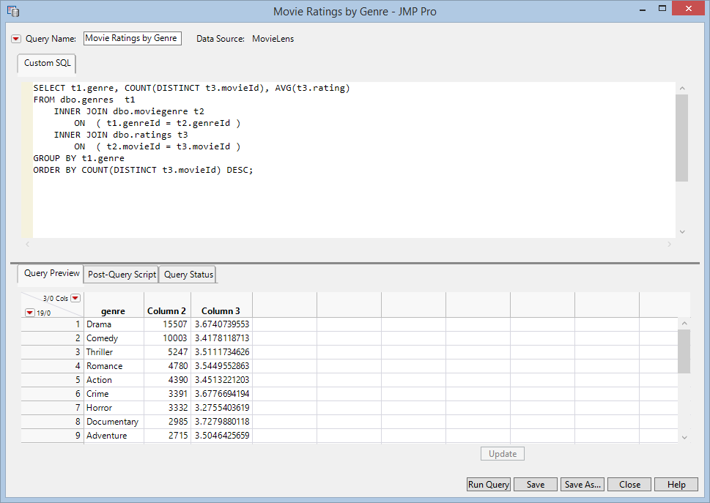
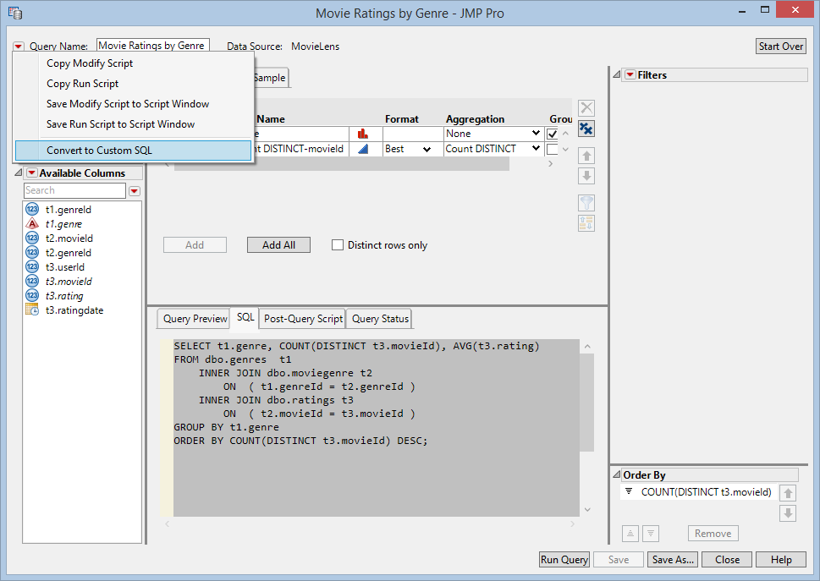
When you’re ready to get fancy…
Notes:
Convert to Custom SQL and you can go nuts!

Slide 21
QUESTIONS?

