Slide 1

FUNCTIONAL RESPONSE DOE ANALYSIS IN JMP PRO 14
Chris Gotwalt
Director of JMP Statistical R&D
JMP Division, SAS Institute

Slide 2
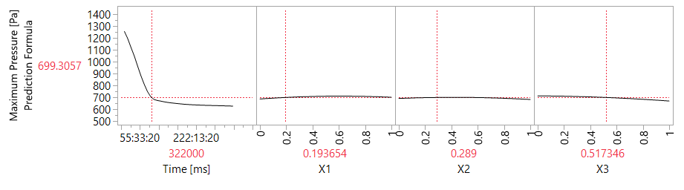

FUNCTIONAL DATA ANALYSIS
A FUNCTIONAL DOE ANALYSIS METHODOLOGY
Need an analysis approach with a few short, easy steps that lead to reliable predictions of the functional response curve as a function of the DOE factors.
Copyright © 2018, SAS Institute, Inc. All rights reserved.

Slide 3
FUNCTIONAL DATA ANALYSIS
DESIREABLE TRAITS OF A FUNCTIONAL DOE ANALYSIS METHODOLOGY
Accurate Predictions for the mean curve of a functional response changes wrt changes in the DOE factor settings.
Factor Selection - to identify which factors are important and which are ignorable.
Flexible - to a wide variety of shapes of the functional responses.
Sampling Robustness - The method should be robust to responses that:
  Are sampled at different times or sampled at different frequencies
  Have different lengths
  Have missing values.
Safe – Methodology should lead to physically realistic predicted curves, not mathematical fantasies.
Build on what we already know about analyzing DOEs.
Easy to see and understand the direct relationship between the factors and how the curve changes over time.
Copyright © 2018, SAS Institute, Inc. All rights reserved.

Slide 4














FUNCTIONAL DATA ANALYSIS
MODELING FUNCTIONAL RESPONSES
$${Y(t}_{1})$$
$${Y(t}_{2})$$
$${Y(t}_{3})$$
$$X_{3}$$
$${Y(t}_{4})$$
?
$${Y(t}_{5})$$
$$X_{3}$$
$${Y(t}_{6})$$
$${Y(t}_{7})$$
$$X_{3}$$
$${Y(t}_{8})$$
How to model the relationship between a functional response and DOE factors
$${Y(t}_{9})$$
$${Y(t}_{10})$$
$${Y(t}_{11})$$
DOE Factors
Responses
Copyright © 2018, SAS Institute, Inc. All rights reserved.

Slide 5

FUNCTIONAL DATA ANALYSIS
IDEA 1: SEPARATE LEAST SQUARES MODELS FOR EACH RESPONSE
$${Y(t}_{1})$$
$${Y(t}_{2})$$
$${Y(t}_{3})$$
$$X_{3}$$
$${Y(t}_{4})$$
$${Y(t}_{5})$$
$$X_{3}$$
$${Y(t}_{6})$$
$${Y(t}_{7})$$
$$X_{3}$$
$${Y(t}_{8})$$
$${Y(t}_{9})$$
$${Y(t}_{10})$$
$$\hat{Y}\left(t_{j}\right)=X^{T}β_{j}$$
$${Y(t}_{11})$$
DOE Factors
Responses
Copyright © 2018, SAS Institute, Inc. All rights reserved.

Slide 6
FUNCTIONAL DATA ANALYSIS
IDEA 1: SEPARATE LEAST SQUARES MODELS FOR EACH RESPONSE
Pros:
  How to model a scalar DOE response is well known.
  Each model individual model is simple.
Cons:
  In combination the models are cumbersome
  What does it mean for a DOE factor to be significant?
  Correlation among responses is ignored.
  What if different units are measured at different times?
  Continuity/ordering of the responses is ignored.
One model per response is often too many models.
Need to model summary measures of the functions.
Which measure to use, though?
Copyright © 2018, SAS Institute, Inc. All rights reserved.

Slide 7


FUNCTIONAL DATA ANALYSIS
IDEA 2: LSq MODELING OF SIMPLE SUMMARY STATISTICS
$${Y(t}_{1})$$
$${Y(t}_{2})$$
$${Y(t}_{3})$$
$$X_{3}$$
$${Y(t}_{4})$$
$${Y(t}_{5})$$
$$X_{3}$$
$$\overline{Y}$$
$${Y(t}_{6})$$
$${Y(t}_{7})$$
$$X_{3}$$
$${Y(t}_{8})$$
$${Y(t}_{9})$$
$${Y(t}_{10})$$
$${Y(t}_{11})$$
DOE Factors
Responses
Copyright © 2018, SAS Institute, Inc. All rights reserved.

Slide 8

FUNCTIONAL DATA ANALYSIS
IDEA 2: LSq MODELING OF SIMPLE SUMMARY STATISTICS
$$X_{3}$$
$$X_{3}$$
$$\overline{Y}$$
$$X_{3}$$
$$\hat{Y}\left(t\right)=x^{T}β_{1}$$
DOE Factors
Copyright © 2018, SAS Institute, Inc. All rights reserved.

Slide 9

FUNCTIONAL DATA ANALYSIS
IDEA 2: LSq MODELING OF SIMPLE SUMMARY STATISTICS
$${Y(t}_{1})$$
$${Y(t}_{2})$$
$${Y(t}_{3})$$
$$X_{3}$$
$${Y(t}_{4})$$
$${Y(t}_{5})$$
$$X_{3}$$
$$\overline{Y}$$
$${Y(t}_{6})$$
$${Y(t}_{7})$$
$$X_{3}$$
$${Y(t}_{8})$$
$${Y(t}_{9})$$
$$\hat{Y}\left(t\right)=x^{T}β_{1}$$
$${Y(t}_{10})$$
$${Y(t}_{11})$$
DOE Factors
Responses
Copyright © 2018, SAS Institute, Inc. All rights reserved.

Slide 10
FUNCTIONAL DATA ANALYSIS
IDEA 2: LSq MODELING OF SIMPLE SUMMARY STATISTICS
Pros:
  Very simple.
Cons:
  Too simple!
  All time-dependent information is lost.
  Model says nothing about the shape of the functions.
Copyright © 2018, SAS Institute, Inc. All rights reserved.

Slide 11
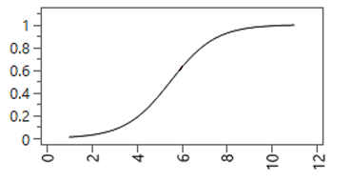





FUNCTIONAL DATA ANALYSIS
IDEA 3: NONLINEAR REGRESSION FOLLOWED
BY LSq MODELING OF NONLINEAR PARAMETERS
$${Y(t}_{1})$$
$${Y(t}_{2})$$
$${Y(t}_{3})$$
$$X_{3}$$
$${Y(t}_{4})$$
$$α_{1}$$
$${Y(t}_{5})$$
$$X_{3}$$
$$α_{2}$$
$${Y(t}_{6})$$
$$α_{3}$$
$${Y(t}_{7})$$
$$X_{3}$$
$${Y(t}_{8})$$
$${Y(t}_{9})$$
$$\hat{Y}\left(t\right)=\frac{α_{3}}{1+e^{α_{1}+α_{2}t}}$$
$${Y(t}_{10})$$
$${Y(t}_{11})$$
DOE Factors
Responses
Copyright © 2018, SAS Institute, Inc. All rights reserved.

Slide 12

FUNCTIONAL DATA ANALYSIS
IDEA 3: NONLINEAR REGRESSION FOLLOWED
BY LSq MODELING OF NONLINEAR PARAMETERS
$$X_{3}$$
$$α_{1}$$
$$X_{3}$$
$$α_{2}$$
$$α_{3}$$
$$X_{3}$$
$$\hat{α_{j}}=X^{T}β_{j}$$
DOE Factors
Copyright © 2018, SAS Institute, Inc. All rights reserved.

Slide 13

FUNCTIONAL DATA ANALYSIS
IDEA 3: NONLINEAR REGRESSION FOLLOWED
BY LSq MODELING OF NONLINEAR PARAMETERS
$${Y(t}_{1})$$
$${Y(t}_{2})$$
$${Y(t}_{3})$$
$$X_{3}$$
$${Y(t}_{4})$$
$$α_{1}$$
$${Y(t}_{5})$$
$$X_{3}$$
$$α_{2}$$
$${Y(t}_{6})$$
$$α_{3}$$
$${Y(t}_{7})$$
$$X_{3}$$
$${Y(t}_{8})$$
$${Y(t}_{9})$$
$$\hat{Y}\left(t\right)=\frac{\hat{α_{3}}}{1+e^{\hat{α_{1}}+\hat{α_{2}}t}}$$
$${Y(t}_{10})$$
$$\hat{α_{j}}=X^{T}β_{j}$$
$${Y(t}_{11})$$
DOE Factors
Responses
Copyright © 2018, SAS Institute, Inc. All rights reserved.

Slide 14

FUNCTIONAL DATA ANALYSIS
IDEA 3: NONLINEAR REGRESSION FOLLOWED
BY LSq MODELING OF NONLINEAR PARAMETERS
$${Y(t}_{1})$$
$${Y(t}_{2})$$
$${Y(t}_{3})$$
$$X_{3}$$
$${Y(t}_{4})$$
$$α_{1}$$
$${Y(t}_{5})$$
$$X_{3}$$
$$α_{2}$$
$${Y(t}_{6})$$
$$α_{3}$$
$${Y(t}_{7})$$
$$X_{3}$$
$${Y(t}_{8})$$
$${Y(t}_{9})$$
$$\hat{Y}\left(t\right)=\frac{\hat{α_{3}}}{1+e^{\hat{α_{1}}+\hat{α_{2}}t}}$$
$${Y(t}_{10})$$
$$\hat{α_{j}}=X^{T}β_{j}$$
$${Y(t}_{11})$$
DOE Factors
Responses
Copyright © 2018, SAS Institute, Inc. All rights reserved.

Slide 15
FUNCTIONAL DATA ANALYSIS
IDEA 3: NONLINEAR REGRESSION FOLLOWED
BY LSq MODELING OF NONLINEAR PARAMETERS
$${Y(t}_{1})$$
$${Y(t}_{2})$$
$${Y(t}_{3})$$
$$X_{3}$$
$${Y(t}_{4})$$
$$α_{1}$$
$${Y(t}_{5})$$
$$X_{3}$$
$$α_{2}$$
$${Y(t}_{6})$$
$$α_{3}$$
$${Y(t}_{7})$$
$$X_{3}$$
$${Y(t}_{8})$$
$${Y(t}_{9})$$
$$\hat{Y}\left(t\right)=\frac{\hat{α_{3}}}{1+e^{\hat{α_{1}}+\hat{α_{2}}t}}$$
$${Y(t}_{10})$$
$$\hat{α_{j}}=X^{T}β_{j}$$
$${Y(t}_{11})$$
DOE Factors
Responses
Copyright © 2018, SAS Institute, Inc. All rights reserved.

Slide 16
FUNCTIONAL DATA ANALYSIS
IDEA 3: NONLINEAR REGRESSION FOLLOWED
BY LSq MODELING OF NONLINEAR PARAMETERS
$${Y(t}_{1})$$
$${Y(t}_{2})$$
$${Y(t}_{3})$$
$$X_{3}$$
$${Y(t}_{4})$$
$$α_{1}$$
$${Y(t}_{5})$$
$$X_{3}$$
$$α_{2}$$
$${Y(t}_{6})$$
$$α_{3}$$
$${Y(t}_{7})$$
$$X_{3}$$
$${Y(t}_{8})$$
$${Y(t}_{9})$$
$$\hat{Y}\left(t\right)=\frac{\hat{α_{3}}}{1+e^{\hat{α_{1}}+\hat{α_{2}}t}}$$
$${Y(t}_{10})$$
$$\hat{α_{j}}=X^{T}β_{j}$$
$${Y(t}_{11})$$
DOE Factors
Responses
Copyright © 2018, SAS Institute, Inc. All rights reserved.

Slide 17
FUNCTIONAL DATA ANALYSIS
IDEA 3: NONLINEAR REGRESSION FOLLOWED
BY LSq MODELING OF NONLINEAR PARAMETERS
Pros:
  More parsimonious.
  Different length responses and time points handled.
Cons:
  Very limited in the set of shapes of curves that can be fit.
  We need more flexibility than simple logistic curves and Gaussian peak models.
Copyright © 2018, SAS Institute, Inc. All rights reserved.

Slide 18
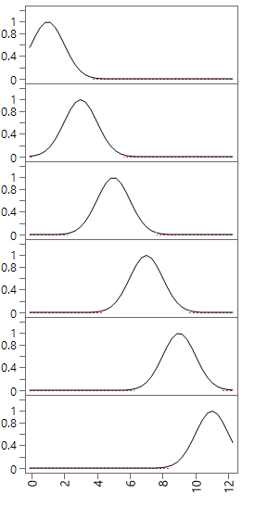









FUNCTIONAL DATA ANALYSIS
IDEA 4: SPLINE BASIS FUNCTION MODELING OF COEFFICIENTS
$${Y(t}_{1})$$
$$b_{k}\left(t\right)=max⁡(0,1−{(t−T_{k})}^{2})$$
$${Y(t}_{2})$$
$$α_{1}$$
$${Y(t}_{3})$$
$$X_{3}$$
$${Y(t}_{4})$$
$$α_{2}$$
$${Y(t}_{5})$$
$$X_{3}$$
$$α_{3}$$
$${Y(t}_{6})$$
$$α_{4}$$
$${Y(t}_{7})$$
$$X_{3}$$
$$α_{5}$$
$${Y(t}_{8})$$
$$α_{6}$$
$${Y(t}_{9})$$
$${Y(t}_{10})$$
$$\hat{Y} (t)=\sum_{k}^{6}{α_{k}{ b}_{k}(t)}$$
$${Y(t}_{11})$$
DOE Factors
Responses
Copyright © 2018, SAS Institute, Inc. All rights reserved.

Slide 19

FUNCTIONAL DATA ANALYSIS
IDEA 4: SPLINE BASIS FUNCTION MODELING OF COEFFICIENTS
$$α_{1}$$
$$X_{3}$$
$$α_{2}$$
$$X_{3}$$
$$α_{3}$$
$$α_{4}$$
$$X_{3}$$
$$α_{5}$$
$$α_{6}$$
$\hat{α_{k}} =$ $x^{T}β_{k}$
DOE Factors
Copyright © 2018, SAS Institute, Inc. All rights reserved.

Slide 20
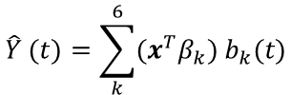
FUNCTIONAL DATA ANALYSIS
IDEA 4: SPLINE BASIS FUNCTION MODELING OF COEFFICIENTS
$${Y(t}_{1})$$
$${Y(t}_{2})$$
$$α_{1}$$
$${Y(t}_{3})$$
$$X_{3}$$
$${Y(t}_{4})$$
$$α_{2}$$
$${Y(t}_{5})$$
$$X_{3}$$
$$α_{3}$$
$${Y(t}_{6})$$
$$α_{4}$$
$${Y(t}_{7})$$
$$X_{3}$$
$$α_{5}$$
$${Y(t}_{8})$$
$$α_{6}$$
$${Y(t}_{9})$$
$${Y(t}_{10})$$
$$\hat{Y} (t)=\sum_{k}^{6}{{(x}^{T}β_{k}){ b}_{k}(t)}$$
$${Y(t}_{11})$$
DOE Factors
Responses
Copyright © 2018, SAS Institute, Inc. All rights reserved.

Slide 21
FUNCTIONAL DATA ANALYSIS
IDEA 4: SPLINE BASIS FUNCTION MODELING OF COEFFICIENTS
Pros:
  Flexible fit.
  Different length responses and time points handled.
  Time continuity respected implicitly by the model.
Cons:
  Can require many basis functions -> lots of models -> similar complexity as modeling each time point individually.
Is there a way to retain the flexibility of the splines with the parsimony of the nonlinear and simple summary statistic approaches?
Copyright © 2018, SAS Institute, Inc. All rights reserved.

Slide 22
FUNCTIONAL DATA ANALYSIS
IDEA 4: SPLINE BASIS FUNCTION MODELING OF COEFFICIENTS
Pros:
  Flexible fit.
  Different length responses and time points handled.
  Time continuity respected implicitly by the model.
Cons:
  Can require many basis functions -> lots of models -> similar complexity as modeling each time point individually.
Is there a way to retain the flexibility of the splines with the parsimony of the nonlinear and simple summary statistic approaches?
YES!
Copyright © 2018, SAS Institute, Inc. All rights reserved.

Slide 23

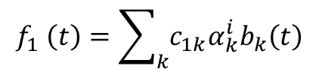
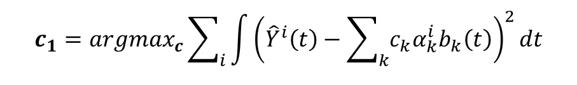
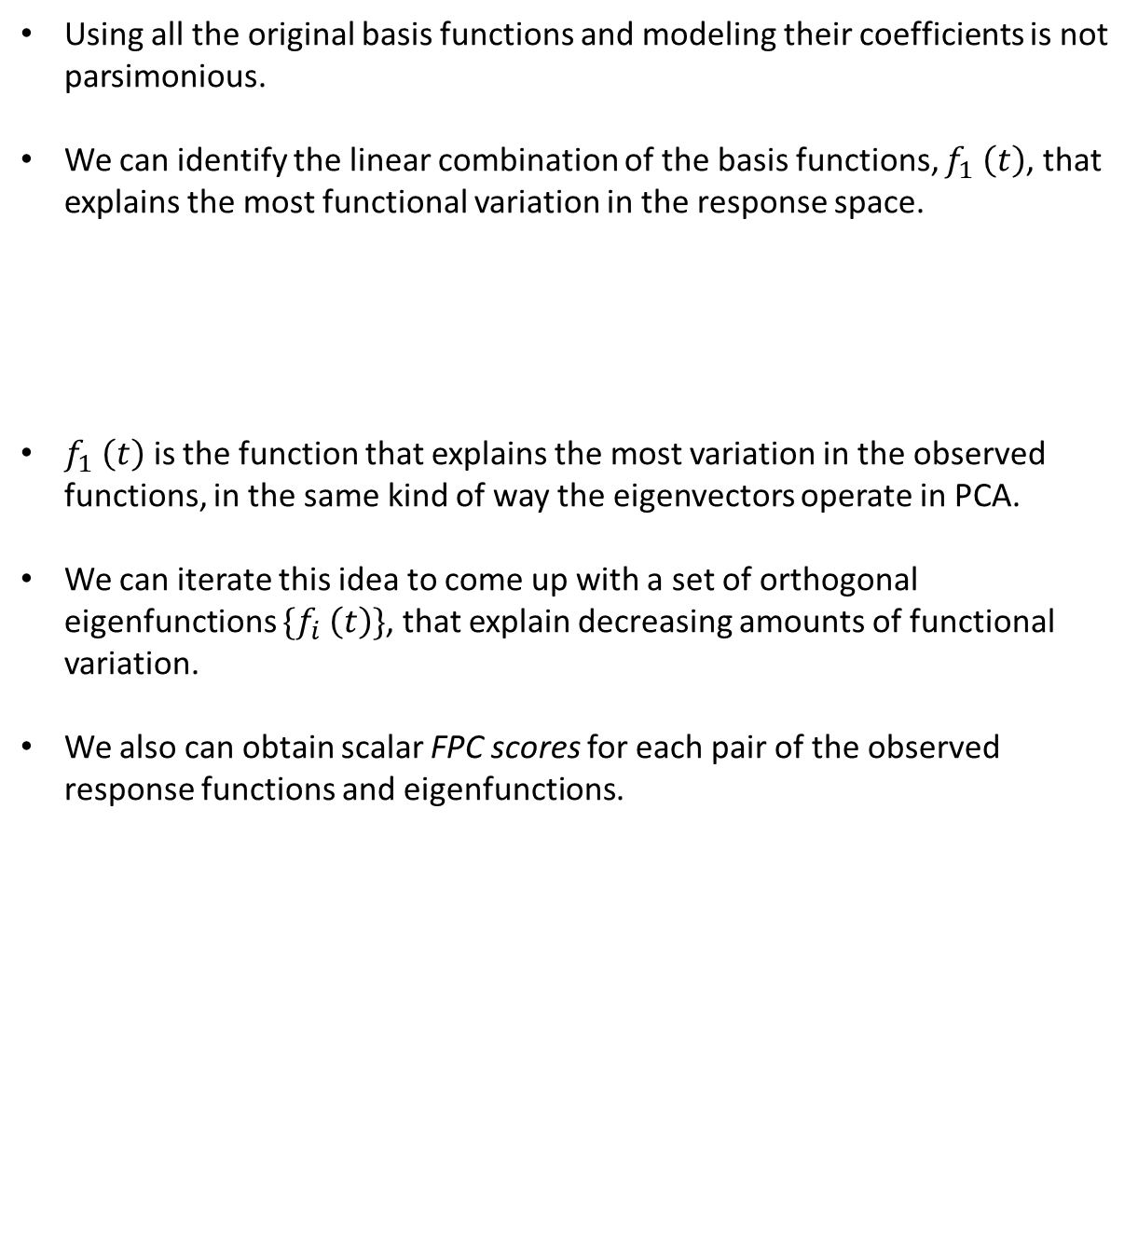
FUNCTIONAL DATA ANALYSIS
FUNCTIONAL PRINCIPAL COMPONENTS
Using all the original basis functions and modeling their coefficients is not parsimonious.
We can identify the linear combination of the basis functions, $f_{1} \left(t\right)$, that explains the most functional variation in the response space.
$f_{1} \left(t\right)$ is the function that explains the most variation in the observed functions, in the same kind of way the eigenvectors operate in PCA.
We can iterate this idea to come up with a set of orthogonal eigenfunctions $\{f_{i} \left(t\right)\}$, that explain decreasing amounts of functional variation.
We also can obtain scalar FPC scores for each pair of the observed response functions and eigenfunctions.
$$f_{1} \left(t\right)=\sum_{k}{c_{1k}α_{k}^{i}b_{k}\left(t\right)}$$
$$c_{1}={argmax}_{c}\sum_{i}{\int{{\left({\hat{Y}}^{i}\left(t\right)−\sum_{k}{c_{k}α_{k}^{i}b_{k}\left(t\right)}\right)}^{2}}dt}$$
$$c^{T}c=1$$
Copyright © 2018, SAS Institute, Inc. All rights reserved.

Slide 24
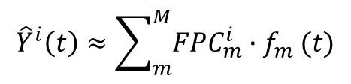
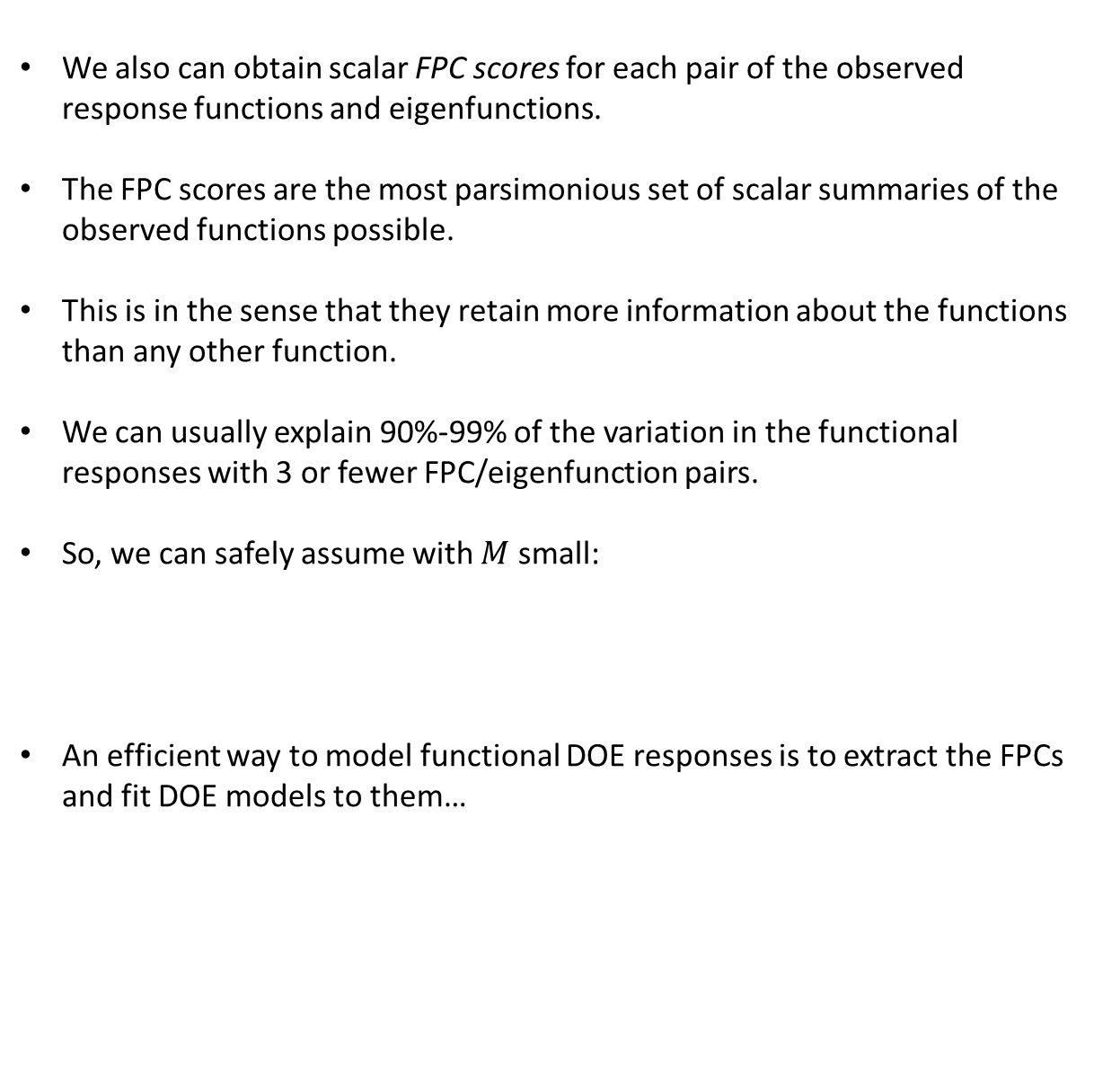
FUNCTIONAL DATA ANALYSIS
FUNCTIONAL PRINCIPAL COMPONENTS
We also can obtain scalar FPC scores for each pair of the observed response functions and eigenfunctions.
The FPC scores are the most parsimonious set of scalar summaries of the observed functions possible.
This is in the sense that they retain more information about the functions than any other function.
We can usually explain 90%-99% of the variation in the functional responses with 3 or fewer FPC/eigenfunction pairs.
So, we can safely assume with $M$ small:
An efficient way to model functional DOE responses is to extract the FPCs and fit DOE models to them…
$${\hat{Y}}^{i}\left(t\right)≈\sum_{m}^{M}{{FPC}_{m}^{i}{∙f}_{m}(t)}$$
Copyright © 2018, SAS Institute, Inc. All rights reserved.

Slide 25

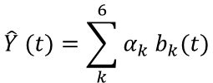
FUNCTIONAL DATA ANALYSIS
SPLINE BASIS FUNCTION MODELING OF COEFFICIENTS
$${Y(t}_{1})$$
$$b_{k}\left(t\right)=max⁡(0,1−{(t−T_{k})}^{2})$$
$${Y(t}_{2})$$
$$α_{1}$$
$${Y(t}_{3})$$
$$X_{3}$$
$$α_{2}$$
$${Y(t}_{4})$$
$$α_{3}$$
$${Y(t}_{5})$$
$$X_{3}$$
$${Y(t}_{6})$$
$$α_{4}$$
$${Y(t}_{7})$$
$$X_{3}$$
$$α_{5}$$
$${Y(t}_{8})$$
$$α_{6}$$
$${Y(t}_{9})$$
$${Y(t}_{10})$$
$$\hat{Y} (t)=\sum_{k}^{6}{α_{k}{ b}_{k}(t)}$$
$${Y(t}_{11})$$
DOE Factors
Responses
Copyright © 2018, SAS Institute, Inc. All rights reserved.

Slide 26






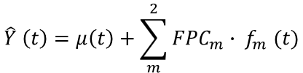
FUNCTIONAL DATA ANALYSIS
SPLINE MODEL ROTATED TO FPCs
$${Y(t}_{1})$$
$${Y(t}_{2})$$
$$α_{1}$$
$${Y(t}_{3})$$
$${FPC}_{1}$$
$$α_{2}$$
$${Y(t}_{4})$$
$$f_{1}(t)=\sum_{k}{c_{1,k}b_{k}(t)}$$
$$α_{3}$$
$${Y(t}_{5})$$
$${Y(t}_{6})$$
$$α_{4}$$
$${Y(t}_{7})$$
$$α_{5}$$
$$f_{2}(t)=\sum_{k}{c_{2,k}b_{k}(t)}$$
$${FPC}_{2}$$
$${Y(t}_{8})$$
$$α_{6}$$
$${Y(t}_{9})$$
$${Y(t}_{10})$$
$$\hat{Y} \left(t\right)=μ\left(t\right)+\sum_{m}^{2}{{FPC}_{m}{∙ f}_{m}(t)}$$
$${Y(t}_{11})$$
DOE Factors
Responses
Copyright © 2018, SAS Institute, Inc. All rights reserved.

Slide 27


FUNCTIONAL DATA ANALYSIS
LINEAR MODELS FOR THE FPCs
$$X_{3}$$
$${FPC}_{1}$$
$$X_{3}$$
$${FPC}_{2}$$
$$X_{3}$$
$${FPC}_{2} \left(t\right)=x^{T}{\hat{β}}_{m}$$
DOE Factors
Responses
Copyright © 2018, SAS Institute, Inc. All rights reserved.

Slide 28

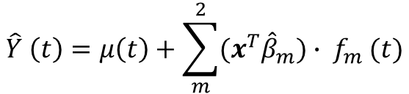
FUNCTIONAL DATA ANALYSIS
LINEAR MODELS FOR THE FPCs
$${Y(t}_{1})$$
$${Y(t}_{2})$$
$$α_{1}$$
$${Y(t}_{3})$$
$$X_{3}$$
$${FPC}_{1}$$
$$α_{2}$$
$${Y(t}_{4})$$
$$α_{3}$$
$${Y(t}_{5})$$
$$X_{3}$$
$${Y(t}_{6})$$
$$α_{4}$$
$${Y(t}_{7})$$
$$α_{5}$$
$${FPC}_{2}$$
$${Y(t}_{8})$$
$$X_{3}$$
$$α_{6}$$
$${Y(t}_{9})$$
$$\hat{Y} \left(t\right)=μ\left(t\right)+\sum_{m}^{2}{{(x}^{T}{\hat{β}}_{m}){∙ f}_{m}(t)}$$
$${Y(t}_{10})$$
$${Y(t}_{11})$$
DOE Factors
Responses
Copyright © 2018, SAS Institute, Inc. All rights reserved.

Slide 29
FUNCTIONAL DATA ANALYSIS
FORMULATION EXPERIMENT
Need to formulate an surfactant used as essential component of an ink that keeps the pigment uniformly dispersed in the base liquid.
In order for the necessary reaction to occur the primary ingredient (Active) must be mixed with water and a solvent.
After storage the product is two-phase, a highly viscous liquid or even a waxy solid.
In this state the compound will be difficult or even impossible to work with at later stages of the process.
Need to find a combination of the three ingredients (Active, Solvent, Water) that:
  Is a single phase compound (homogeneous) from 20 to 70 degrees Celsius
  Contains as much Active as possible for use at later stages, and needs to be at least 18% Active.
Copyright © 2018, SAS Institute, Inc. All rights reserved.

Slide 30
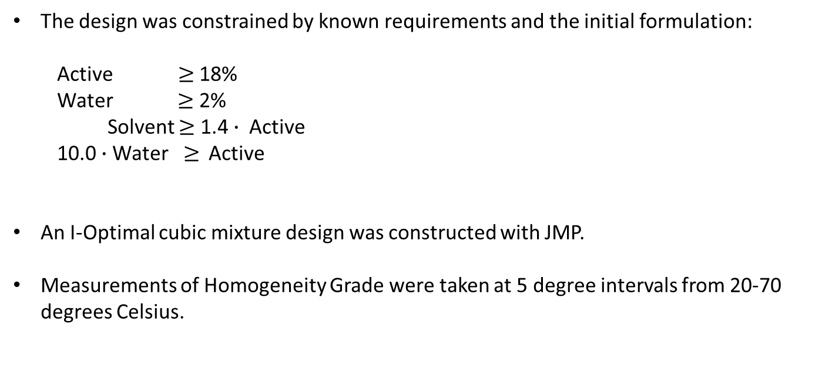
FUNCTIONAL DATA ANALYSIS
EXPERIMENTAL DESIGN
The design was constrained by known requirements and the initial formulation:
  Active $≥$ 18%
  Water $≥$ 2%
  Solvent $≥$ 1.4 $∙$Active
  10.0 $∙$Water$≥$ Active
An I-Optimal cubic mixture design was constructed with JMP.
Measurements of Homogeneity Grade were taken at 5 degree intervals from 20-70 degrees Celsius.
Copyright © 2018, SAS Institute, Inc. All rights reserved.

Slide 31
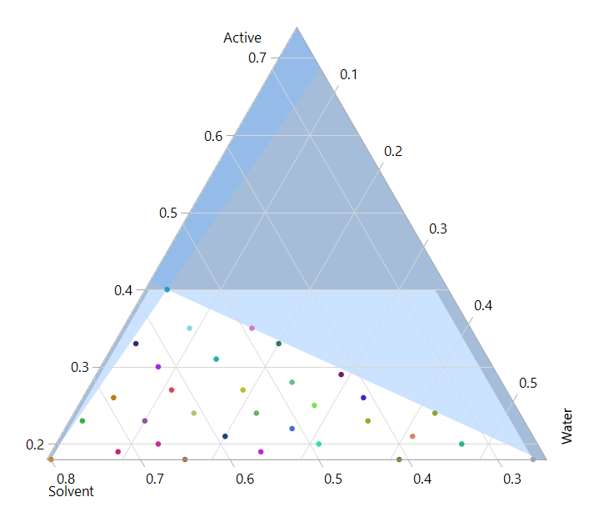
FUNCTIONAL DATA ANALYSIS
EXPERIMENTAL DESIGN
Copyright © 2018, SAS Institute, Inc. All rights reserved.

Slide 32
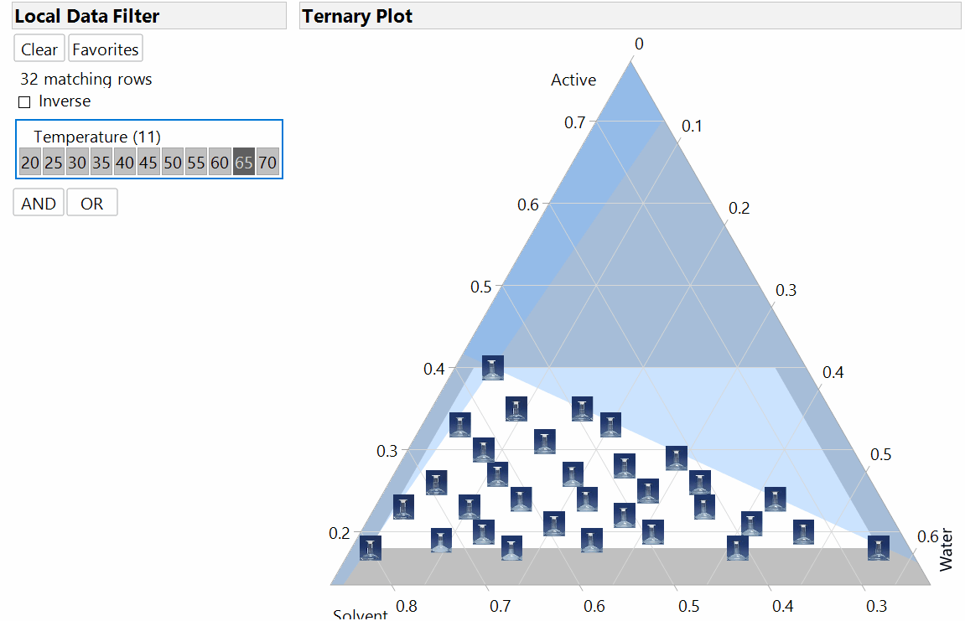
FUNCTIONAL DATA ANALYSIS
EXPERIMENTAL DESIGN
Copyright © 2018, SAS Institute, Inc. All rights reserved.

Slide 33
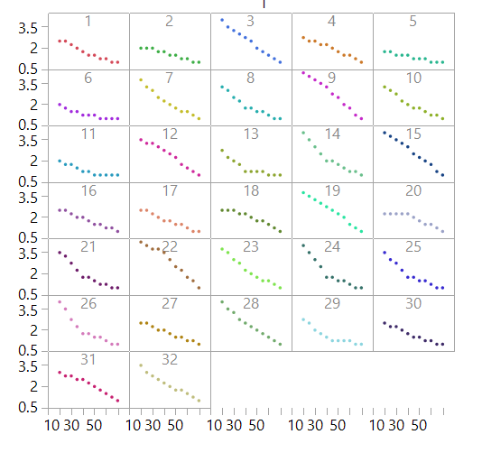
FUNCTIONAL DATA ANALYSIS
FUNCTIONAL RESPONSES
Copyright © 2018, SAS Institute, Inc. All rights reserved.

Slide 34
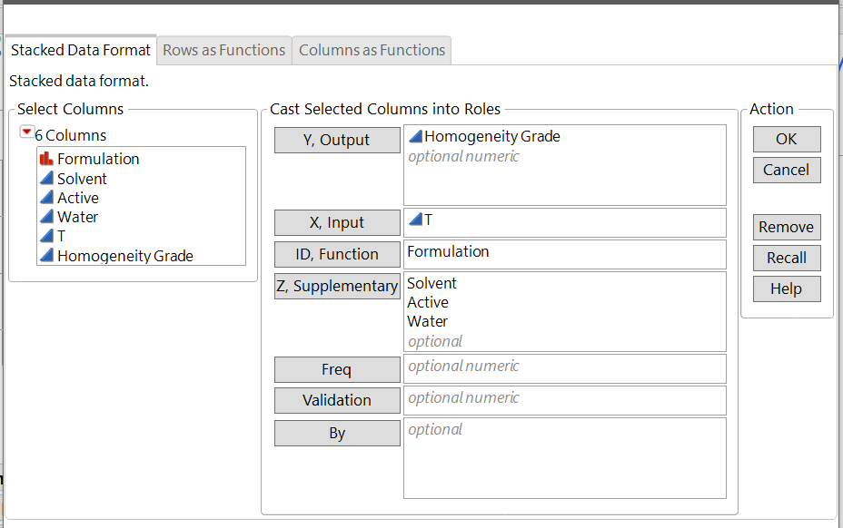
FUNCTIONAL DATA ANALYSIS
FUNCTIONAL DATA EXPLORER LAUNCH
Remember to use the DOE factors as Supplementary columns! (JMP Pro 14.2)
Copyright © 2018, SAS Institute, Inc. All rights reserved.

Slide 35
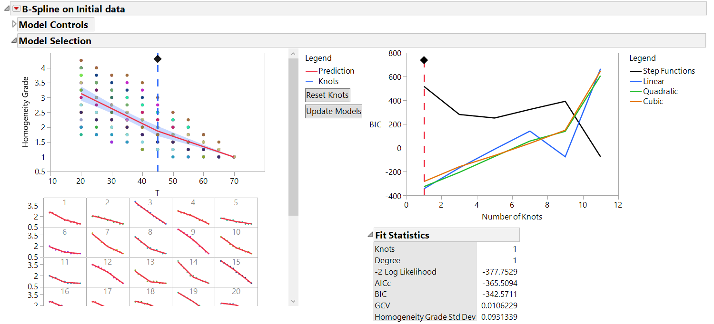
FUNCTIONAL DATA ANALYSIS
FIT B-SPLINES
A simple 1-knot B-Spline model is the best.
Copyright © 2018, SAS Institute, Inc. All rights reserved.

Slide 36
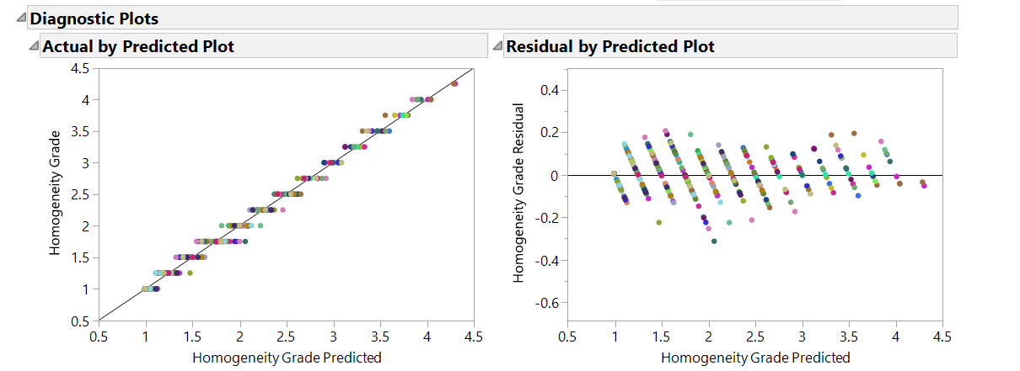
FUNCTIONAL DATA ANALYSIS
B-SPLINES DIAGNOSTIC PLOTS
Looks like a good spline fit!
Copyright © 2018, SAS Institute, Inc. All rights reserved.

Slide 37
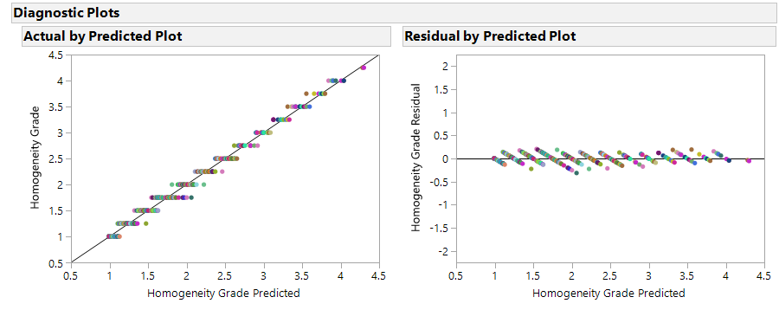
FUNCTIONAL DATA ANALYSIS
B-SPLINES DIAGNOSTIC PLOTS
Spline fit looks good!
Copyright © 2018, SAS Institute, Inc. All rights reserved.

Slide 38
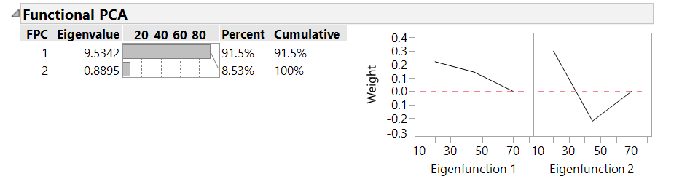
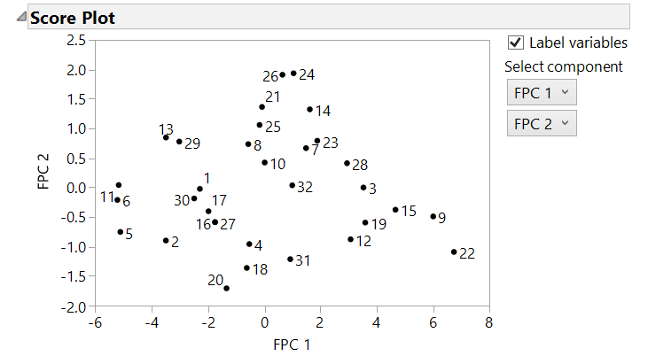
FUNCTIONAL DATA ANALYSIS
FUNCTIONAL PRINCIPAL COMPONENTS
Two FPCs model nearly 100% of the variation of the response functions.
Copyright © 2018, SAS Institute, Inc. All rights reserved.

Slide 39
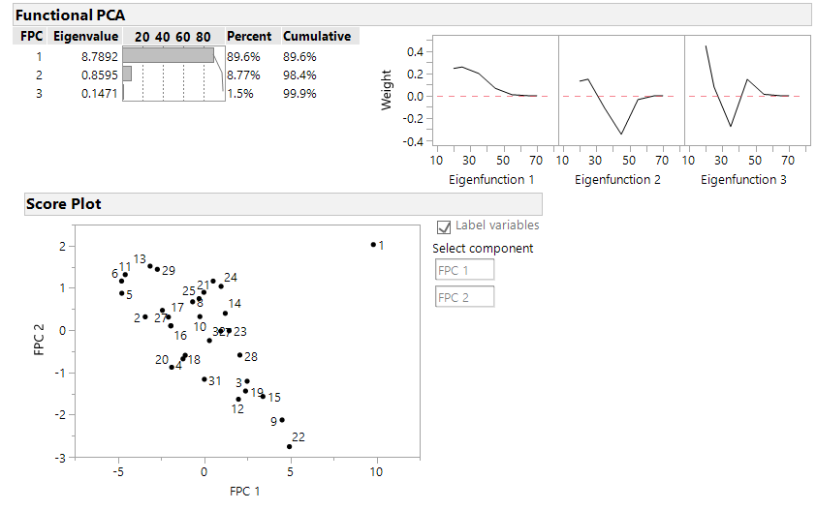
FUNCTIONAL DATA ANALYSIS
FUNCTIONAL PRINCIPAL COMPONENTS
One thing to look out for is outliers on the Score Plot…
Copyright © 2018, SAS Institute, Inc. All rights reserved.

Slide 40
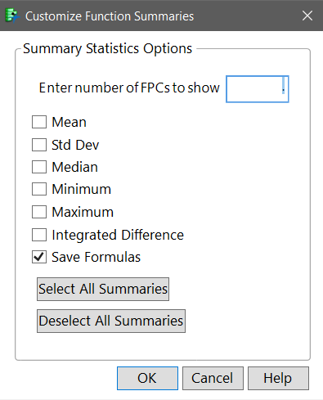
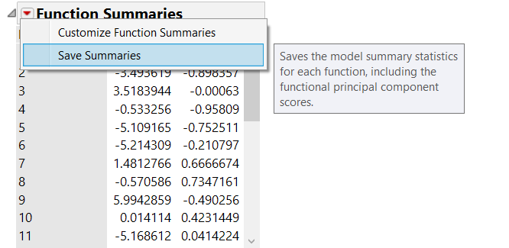
FUNCTIONAL DATA ANALYSIS
SAVING THE FPCs and FORMULAS
Copyright © 2018, SAS Institute, Inc. All rights reserved.

Slide 41
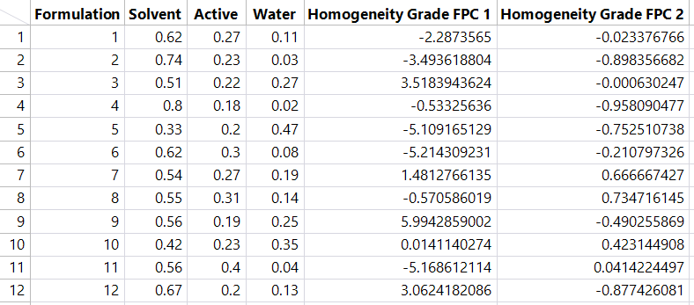
FUNCTIONAL DATA ANALYSIS
SAVING THE FPCs and FORMULAS
Now we simply have a straightforward mixture DOE in three factors and two continuous responses!
Copyright © 2018, SAS Institute, Inc. All rights reserved.

Slide 42
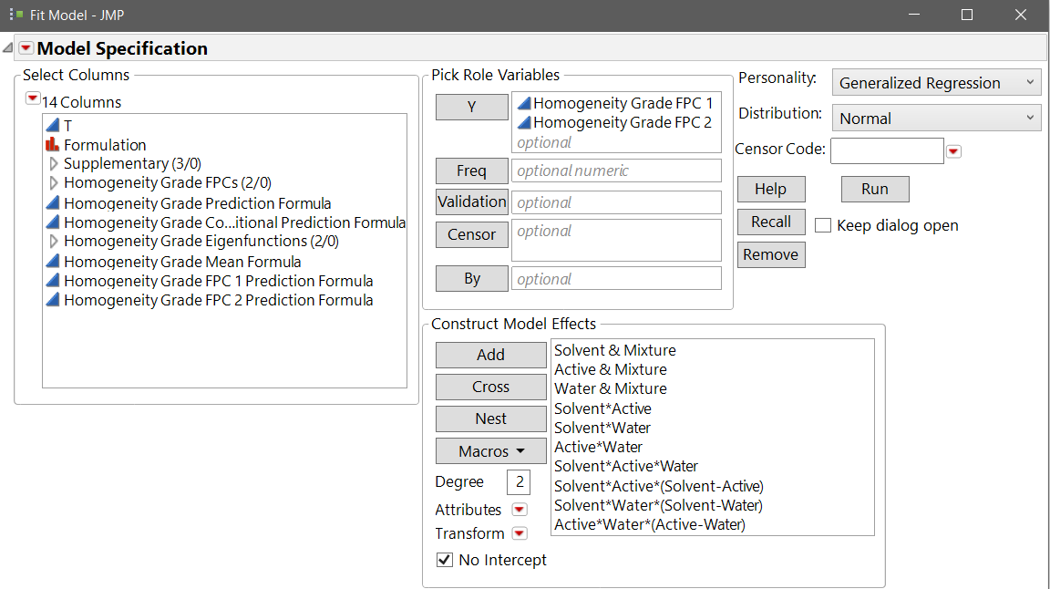
FUNCTIONAL DATA ANALYSIS
MODELING THE FPCs
Now we simply have a straightforward mixture DOE in three factors and two continuous responses!
We recommend using Generalized Regression for analyzing FPCs.
Copyright © 2018, SAS Institute, Inc. All rights reserved.

Slide 43
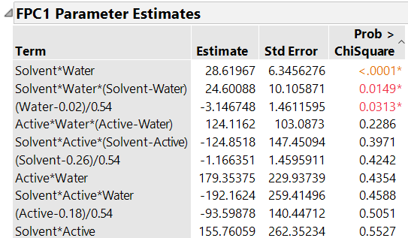
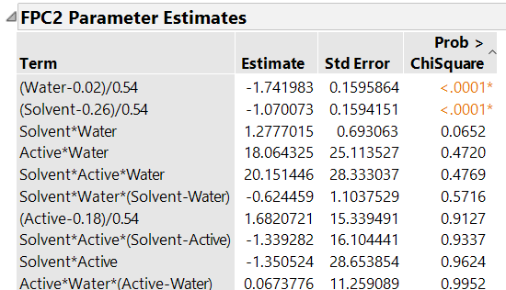
FUNCTIONAL DATA ANALYSIS
SAVE THE FPCs and FORMULAS
We fit separate Scheffe Cubic models to the FPC columns using the Generalized Regression Platform and obtain the models above.
GenReg can save the functional prediction formula and sets up the Profiler nicely for functional data, seamlessly moving through the analysis
This makes exploring the functions using DOE factors direct and straightforward.
Copyright © 2018, SAS Institute, Inc. All rights reserved.

Slide 44
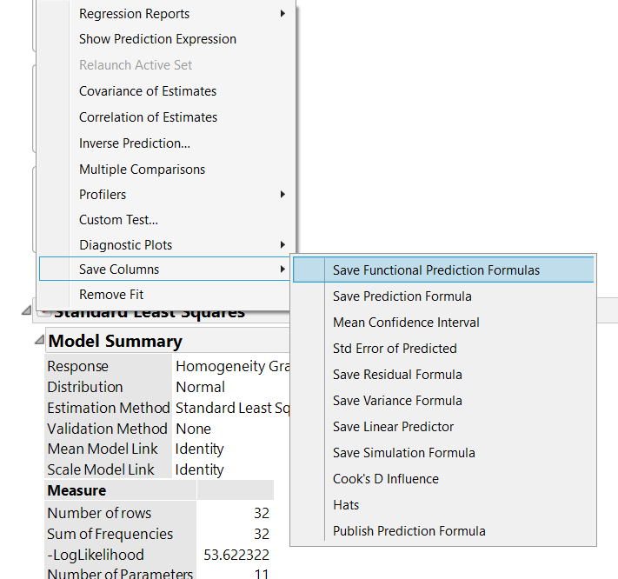
FUNCTIONAL DATA ANALYSIS
EXCTRACTING THE FUNCTIONAL DOE MODEL
GenReg in JMP Pro 14.2 saves functional response prediction formulas.
Saves you from manipulating formula columns manually error-prone and tedious.
Copyright © 2018, SAS Institute, Inc. All rights reserved.

Slide 45
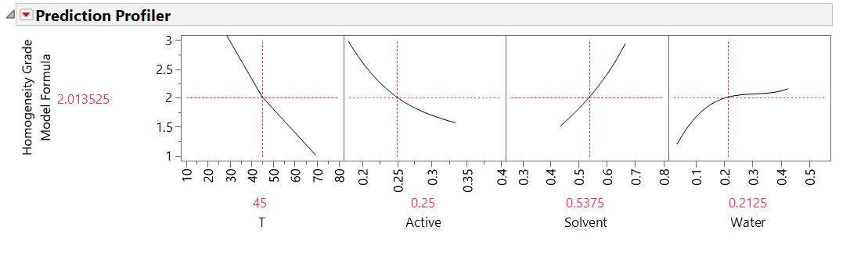
FUNCTIONAL DATA ANALYSIS
THE INITIAL PROFILER VIEW
It also adds a Profiler script to the table that nicely formats the plots.
Copyright © 2018, SAS Institute, Inc. All rights reserved.

Slide 46
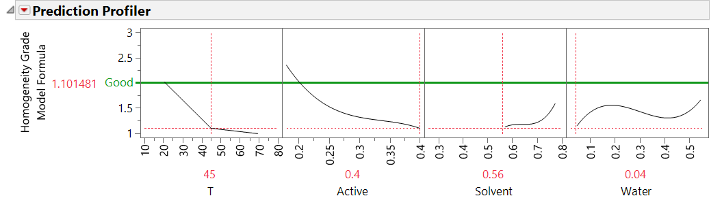
FUNCTIONAL DATA ANALYSIS
THE OPTIMAL FORMULATION
We easily explore within the Profiler to find a good formulation with Homogeneity Grade 2 or better throughout the temperature range:
  40% Active
  56% Solvent
  4% Water
Copyright © 2018, SAS Institute, Inc. All rights reserved.

