Slide 1

JMP Clinical: Conducting Medical Safety Reviews of Clinical Trials
Chris Kirchberg, M.S., Principal Systems Engineer, JMP Global Enablement Team
Chris.Kirchberg@jmp.com

Slide 2
JMP Family of Products: Software for Life Scientists
JMP
JMP Pro
JMP Live
JMP Genomics
JMP Clinical
JMP Add-Ins

Slide 3
Efficient Medical/Safety Reviews Needs
Accelerated safety reviews
  Dynamic visualization coupled with tables and reports
  Leverage data standards (CDISC)
  Statistically-driven analyses with drill-down and swim-up capabilities
  Centralized electronic data review coupled with tools that clinicians, data monitors, and biostatisticians can employ

Slide 4
JMP Clinical Leverages Standards in Review Generation
Desktop application with unique combination of JMP and SAS Software
  Point-and-click, interactive graphical interface
All analyses/reports built by leveraging SDTM/ADaM (CDISC) standards
Build Clinical Reviews for variety of consumers:
  Medical Monitoring
  Signal Detection
  Data Integrity
  Risk Based Monitoring
Patient Profiles and semi-automated Adverse Event Narratives
Open system of SAS programming macros and JMP Scripts to allow for customization

Slide 5
Nicardipine: Example Background
Nicardipine hydrochloride is a medication used to treat high blood pressure and angina. It belongs to the class of calcium channel blockers.
Nicardipine was used in a double-blind clinical study to treat subarachnoid hemorrhage (bleeding between the brain and tissues that cover the brain)
The study was a two-week trial of 906 patients assigned to one of two treatment arms (intravenous nicardipine or placebo)
All subjects were hospitalized
Delayed cerebral vasospasm was primary endpoint
Haley et al. (1993)

Slide 6
Medical Monitors/Reviewers/Clinicians

Slide 7
Medical Reviewers/Clinical Scientists
Pain vs. Benefit
Pain
  Static/non-interactive tables, figures and listings are the standard and inefficient
  Slow interaction between medical staff, scientists and biometrics/biostatistics
  Disconnection between tables and patient profiles
  Outsource pricing to be on a per study basis. Multiple studies could be occurring at the same time.
JMP Clinical Benefits
  Speed up communication between staff
  Specialized visualizations for safety and efficacy
  Ease of use with built-in reusable and editable workflows/templates
  Immediate access to patient profiles and patient narratives from any visualization or table
  Oncology specific views
  Perform in-house and have on-demand control of what reports need to be run and how often
  Feedback from regulatory agencies

Slide 8
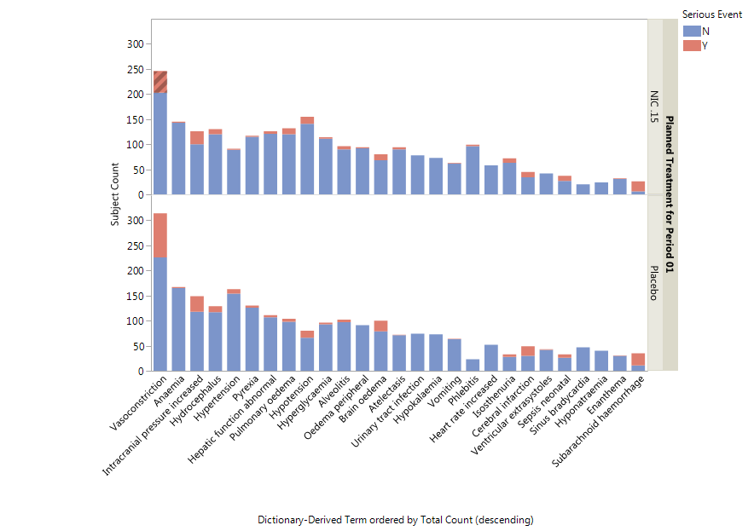
Typical Medical Monitoring Scenario
What count/percent of subjects on drug had a serious adverse event (AE)?
What medications were those subjects taking?
For selected subjects, what is the complete patient profile or narrative?
Did those subjects have abnormal lab results?

Slide 9
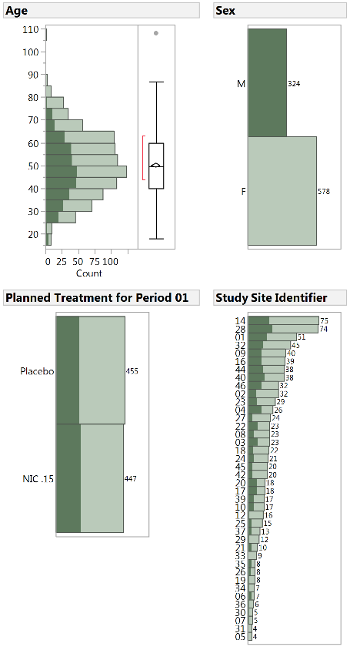
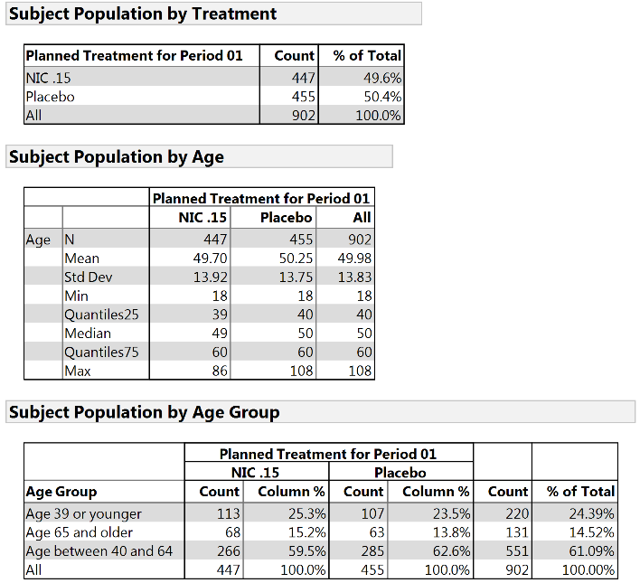
Monitoring: Demographics
Assess patient characteristics
Interactive graphical and tabular displays
Notes:
Straightforward graphical summaries of data with selection and filtering
Corresponding tables that can be immediately regenerated according to the selected patient population

Slide 10
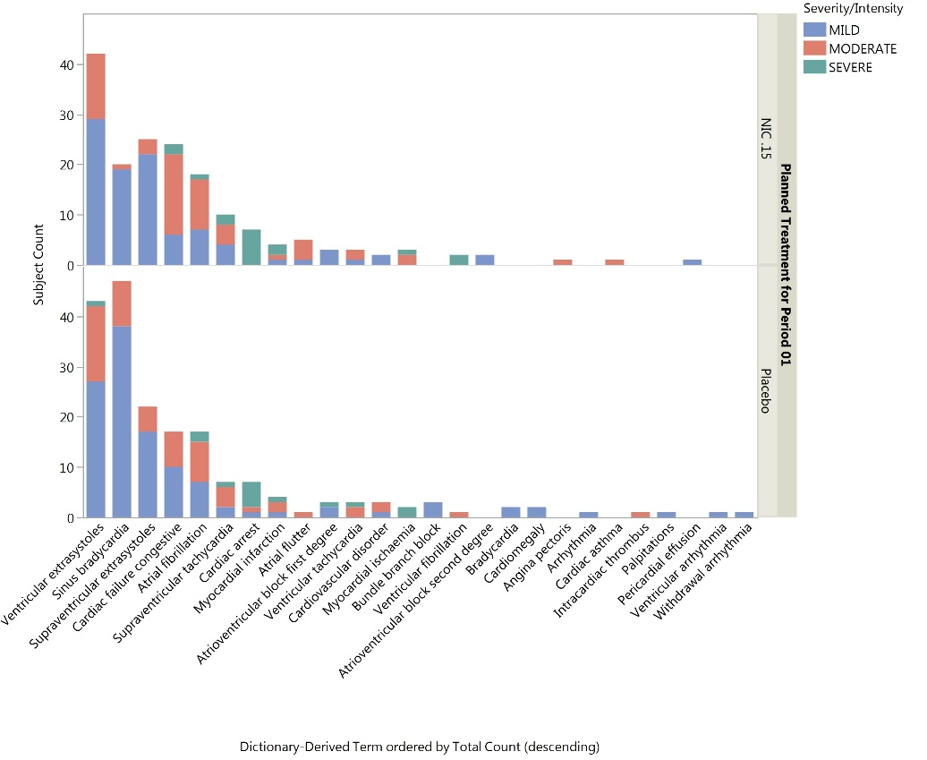
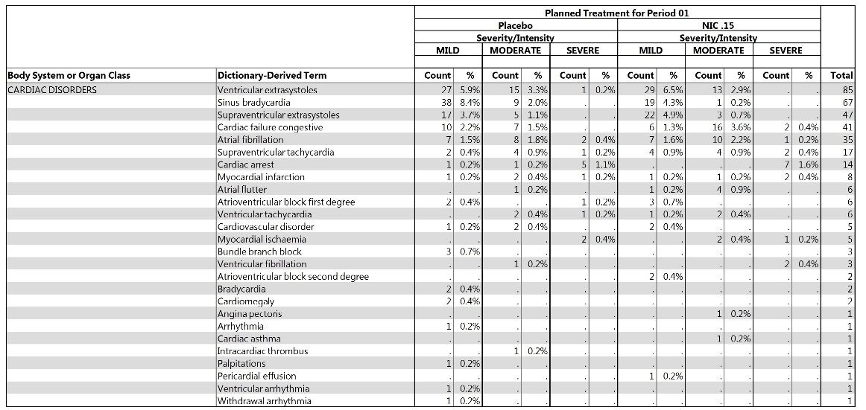
Medical Signals: Adverse Event (AE) Monitoring
Count/Percent of AE occurrence by treatment group or other demography characteristics

Slide 11
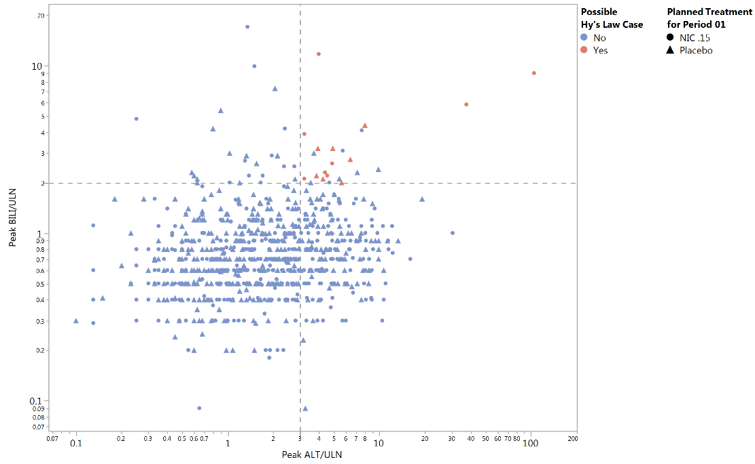
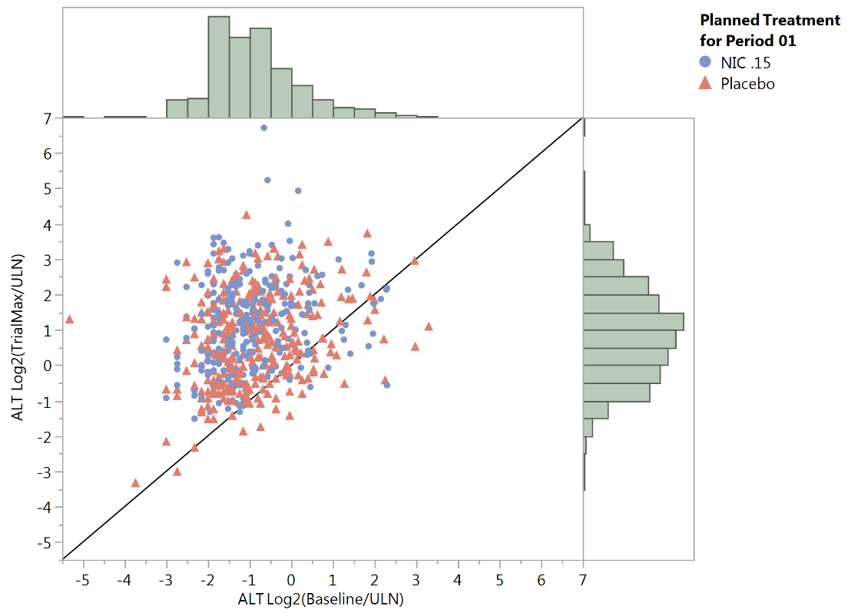
Medical Signals: Potential Drug-Induced Liver Injury
Application of Hy’s Law combined with statistical trends in relevant laboratory test elevations

Slide 12
Patient Profiles on Select Subjects of Interest

Slide 13
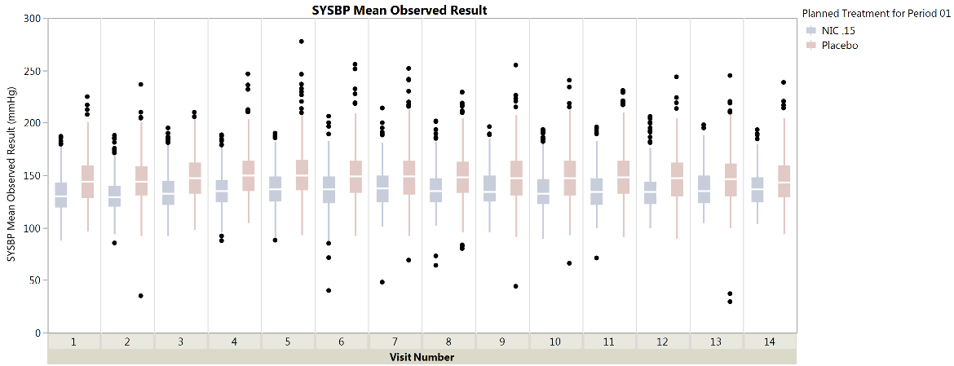
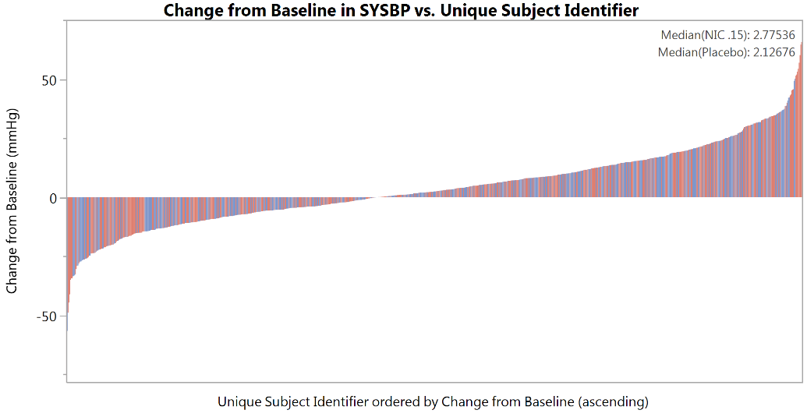
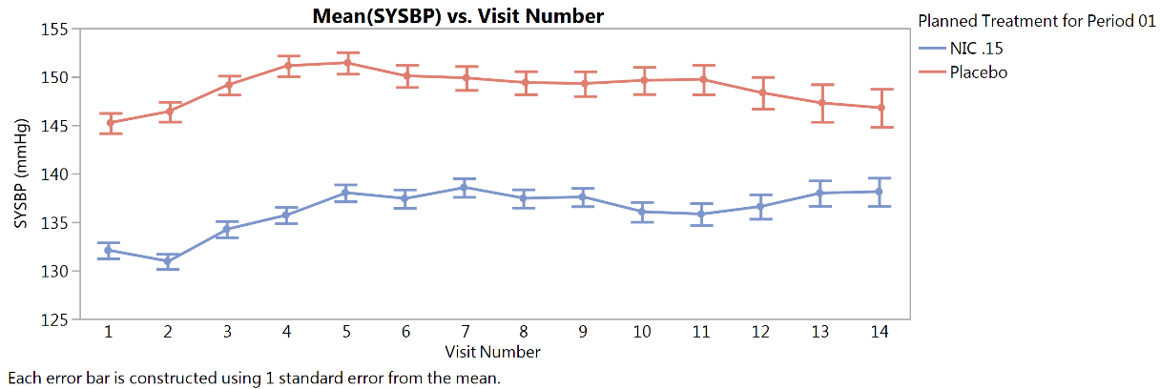
Medical and Biometric: Analytic Visualization of Findings

Slide 14
Efficacy Signals: Tumor Response
Look at tumor response over time, progression free survival and disease swimmer plots

Slide 15
Conclusions
Statistically-driven, dynamic data visualization necessary for efficient clinical review
Data standards allow for automated analyses that enable clinicians, data monitors, data managers, and statisticians
Reports summarized are not comprehensive of JMP Clinical capabilities

Slide 16
Thank you! Questions?

