Slide 1
Using FDE and DOE to Help Build Predictive models for Spectral Data
Bill WorLEY
Sr. Systems Engineer - Global Technical Enablement
JMP Division

Slide 2
A little History
This spectral analysis approach is based on a QSAR-like material selection approach that was developed previously
Looked for other opportunities to apply this approach with highly correlated data.
Spectral data was a clear choice for highly correlated data.
Continuous response for octane rating. Added mass spectral data and Near IR data with a categorical response.

Slide 3
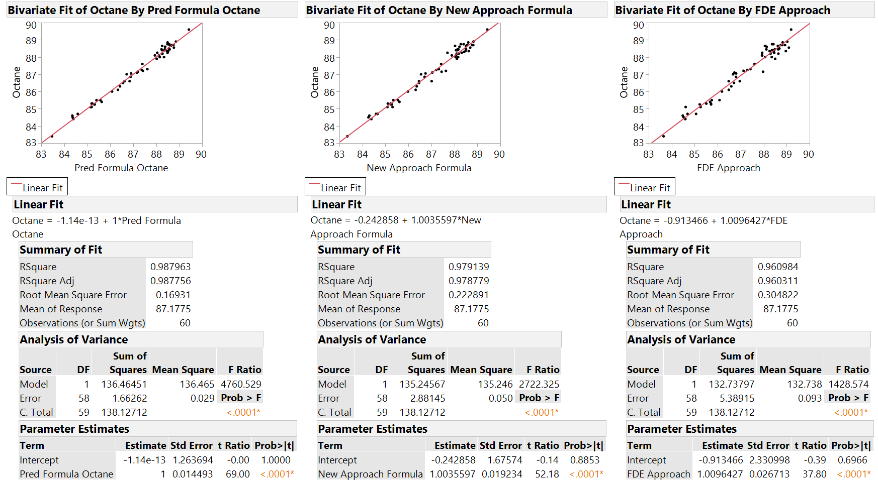

Slide 4
A twist on Analyzing Spectral Data
Partial Least Squares (PLS) has been used to analyze and build predictive models for spectral data. (ex. gasoline.jmp)
Applying multivariate techniques to show how to build good predictive models with far fewer conditions.
Why would you want to do the analysis differently?
  Time savings
  Getting as good or better predictive model with about 25 percent of the data.
  Using penalized regression helps determine the important “factors” making for simpler models.

Slide 5
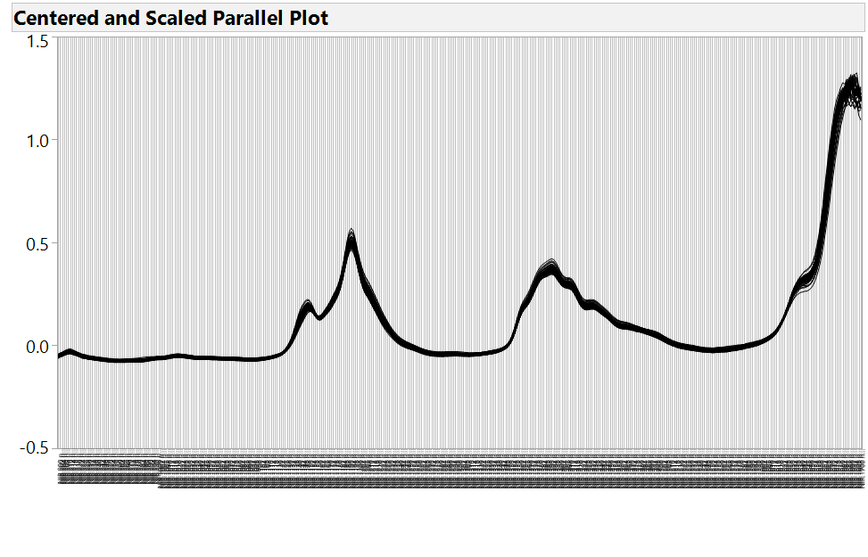
60 Gasoline NIR Spectra overlaid

Slide 6
How it’s Done
Steps
1. Take spectra of the desired samples. No need for output (Y) information at this point.
2. Identify most prominent dimensions in the spectra by Row with Functional Principal
Components, f(PC’s), from Functional Data Explorer – not for use in the traditional sense!
3. Create an experimental design using the f(PC’s) as factors (covariates)
4. Run the experiment – gather the output of interest
5. Model the results via PLS, and/or Generalized Regression (or other methods able to handle
correlated factors)
6. Determine the overall optimum solution
7. Use this sustainable model to determine the “outcome” for all future samples*
* - the model will hold true for samples analyzed using the same calibrated instrument

Slide 7
Some Important Concepts
Partial Least Squares - is a technique that reduces the predictors to a smaller set of uncorrelated latent variables – particularly well suited when there are more predictors than observations and/or when the predictors are highly correlated. *Wikipedia
Principal Components - is a technique for reducing the dimensionality of datasets, increasing interpretability but at the same time minimizing information loss. It does so by creating new uncorrelated variables that successively maximize variance. * IT Jolliffe
Functional Data Analysis - analyzes data providing information about curves, surfaces or anything else varying over a continuum. *Wikipedia
Functional Principal Components - is a statistical method for investigating the dominant modes of variation of functional data. * Wikipedia

Slide 8
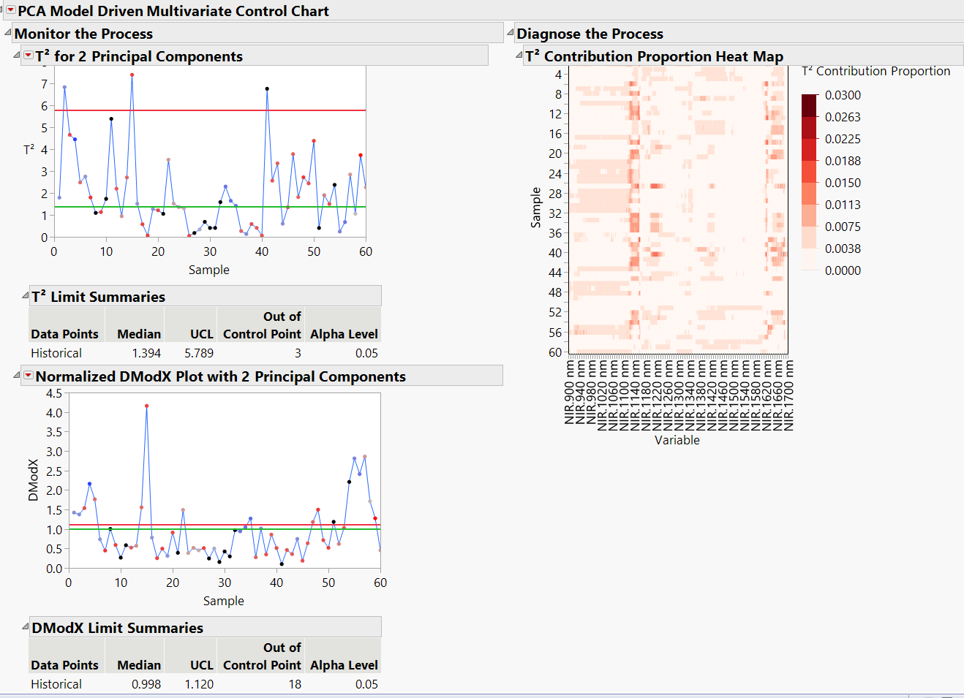
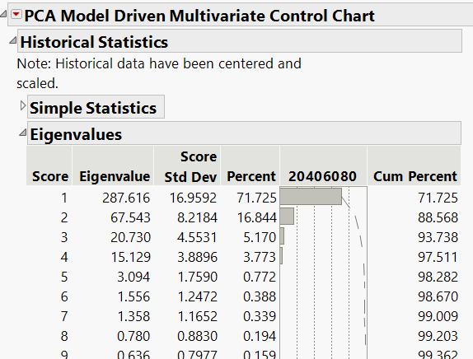
Multivariate Control Charts
Determining the number of Principle Components for the covariate DOE

Slide 9
JMP Demo

Slide 10
Conclusion
• Compress the available information regarding spectral wavelengths or mass of
different options via functional principal components
• Use covariate DOE to select the “corners of the box” for testing representative sample
spectra based on Design of Experiments
• Model the data via PLS – Generalized Regression is an excellent alternative option or you
you may need to use more sophisticated techniques including Neural Nets
• Find the overall optimum solution
• As new samples are tested the spectral data can be input into the data table to
determine level of active or desired component.
→ Highly efficient experimentation
→ Sustainable empirical model based on spectral data/wavelengths

