Slide 1

Expression/NextGen Sequencing Analysis for Translational Genomics
Chris Kirchberg, M.S., Principal Systems Engineer, Life Sciences, JMP Global Technical Enablement

Slide 2
The Role of Software
Improve Efficiency/Accessibility and Ensure Accuracy/Reproducibility
End-to-end analysis workflows
  Reduce unnecessary data manipulation that can introduce errors
Robust statistical analysis capabilities
  Fit appropriate normalization and model based on QC, distributions, and correlation patterns
Early and often visual assessment of data patterns
  Detect data anomalies, structure, quality issues and assess the right model fit
Explore, Understand, Repeat, Reproduce, Redistribute

Slide 3
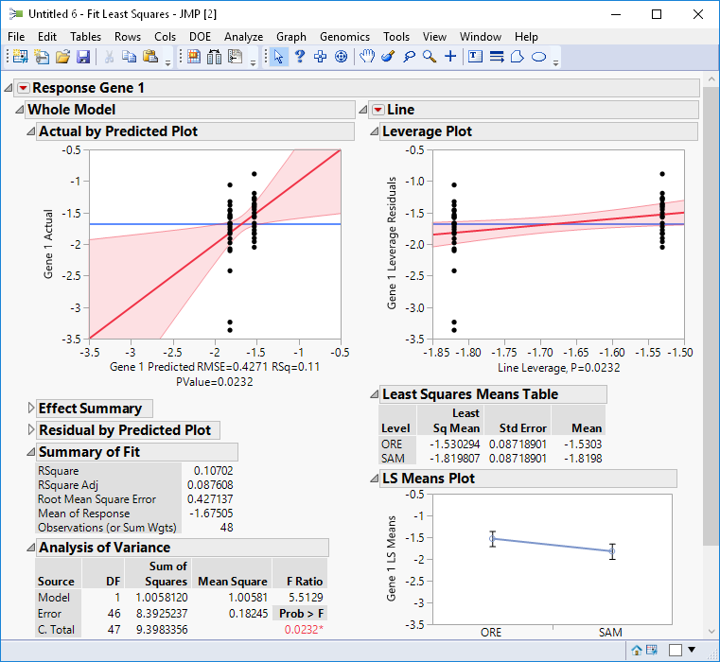
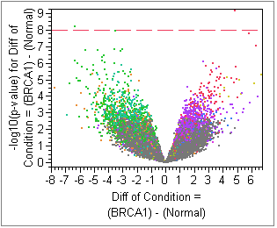
JMP Genomics
Origin Story: BIG and MANY
Are you testing for differences in DNA or gene expression?
Are you building biomarker models with large biological data?

Slide 4
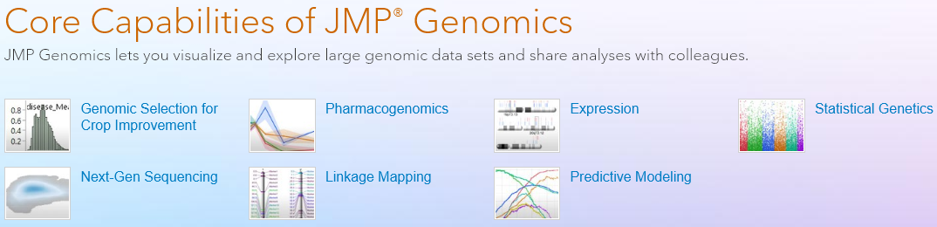
JMP Genomics Analytic Capabilities
Integrated solution of SAS and JMP analytics and data visualization
Analysis Areas
  Genetic marker data, GWAS, population analysis
  Genomic Selection and in-silico plant breeding, linkage mapping, QTL
  Exon/transcript level expression QC and Modeling
  Next-generation sequencing variant/count analysis
  Annotation and combined integrative genomic analysis
Pattern discovery, predictive modeling, and cross validation

Slide 5
Analyses Covered in Webinar Today
RNA-seq Differential Expression Analysis (DEG)
  QC and visualization,
  Principal Components Analysis
  DEG ANOVA modeling
  Cross-correlation between mRNA and miRNA

Slide 6
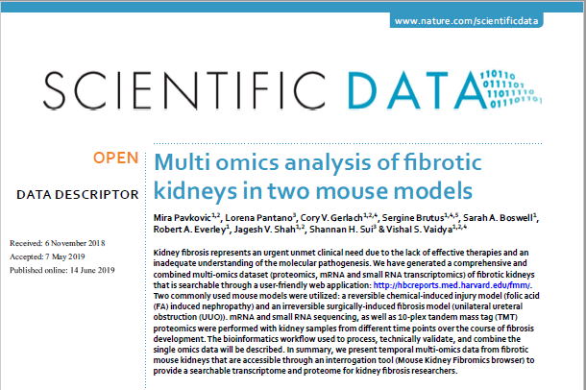
RNA-Seq Analysis in Kidney Fibrosis Models
Identify differential molecular expression signatures for kidney fibrosis to aide in molecular pathogenesis and provide potential targets for therapy (GEO Series GSE11834)
Molecular expression baseline measurements taken on normal kidney and also at different time points after induction of kidney fibrosis by folic acid (FA) or unilateral ureteral obstruction (UUO). Proteins, mRNA and miRNA measurements were collected. Only UUO will be looked at today.

Slide 7
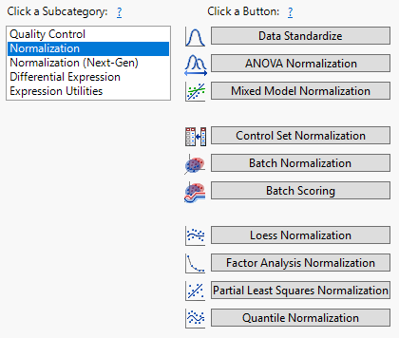
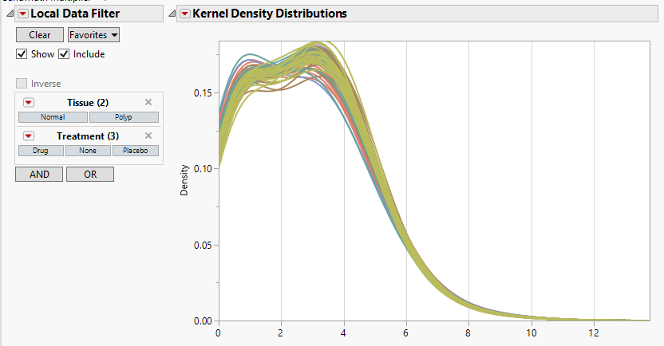
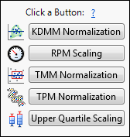
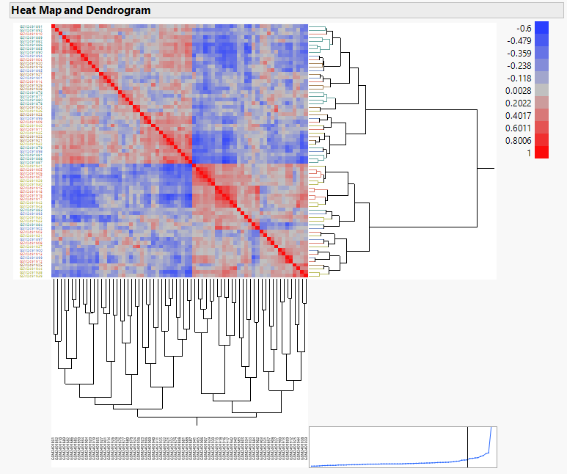
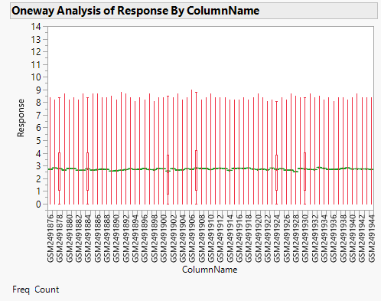
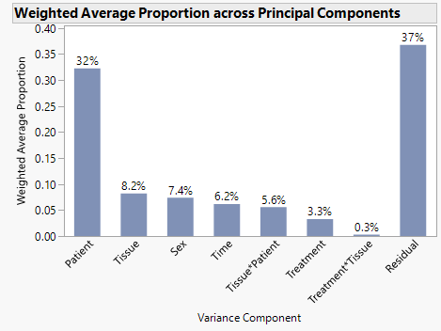
Expression/NGS
QC/Normalization

Slide 8
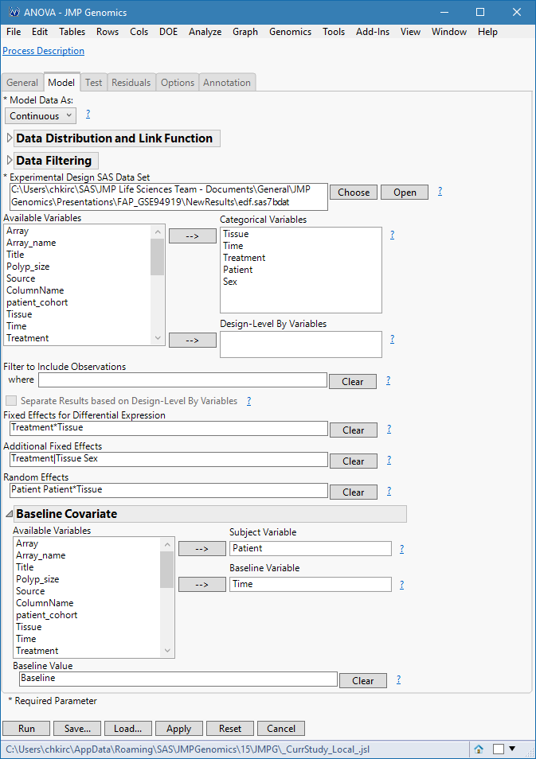
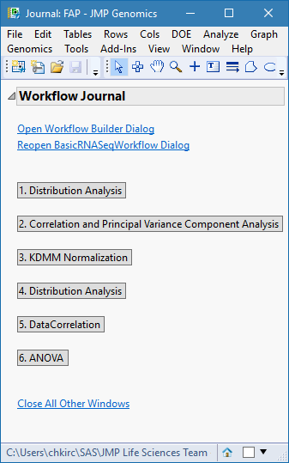
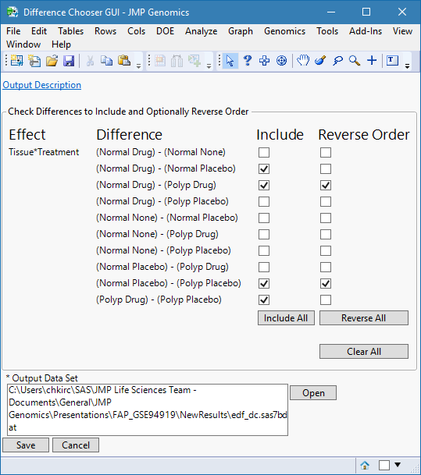
Expression/NGS
ANOVA Mixed Model Differential expression

Slide 9
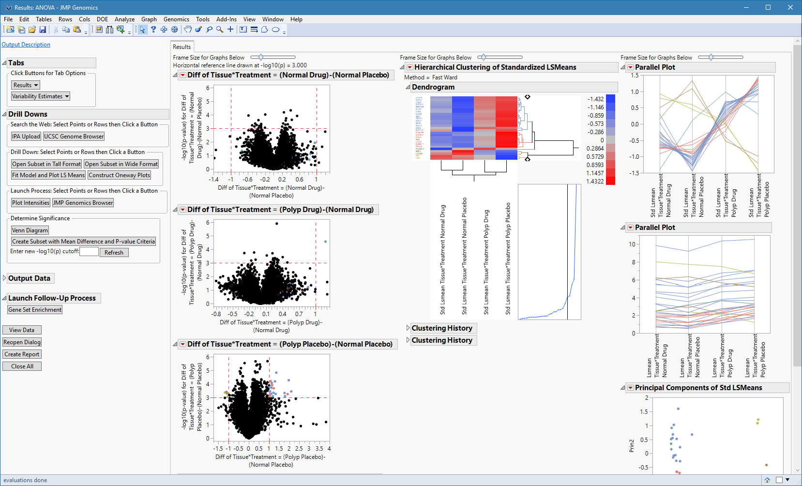
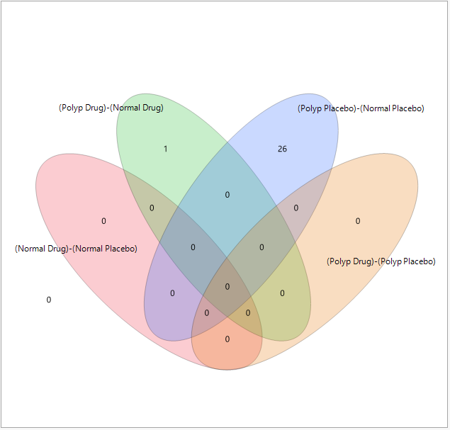
Expression/NGS
Volcano Plots and Venn Diagrams

Slide 10
Thank You! Questions?

