Slide 1

Specialized Custom DOE for Experienced Experimenters
Tom Donnelly
JMP Systems Engineer
Tom.Donnelly@jmp.com

Slide 2
Agenda
Multiple Response Optimization – Trade-Space Analysis
Review of Classic DOE
Real-World Experimental Issues – Custom DOE is about Making Designs Fit the Problem – NOT Making Problems Fit the Designs
Three Example Designs
  Augment a broken design with constraints
  Augment a screening design to RSM (sequential experimentation)
  Create a design from a candidate set of trials – a good way to examine historical (haphazard) data

Slide 3
Why use DOE?
Quicker answers, lower costs, solve bigger problems
More rapidly answer “what if?” questions
Do sensitivity and trade-space analysis
Optimize across multiple responses
By running efficient subsets of all possible combinations, one can – for the same resources and constraints – solve bigger problems
By running sequences of designs one can be as cost effective as possible and run no more trials than needed to get a useful answer

Slide 4
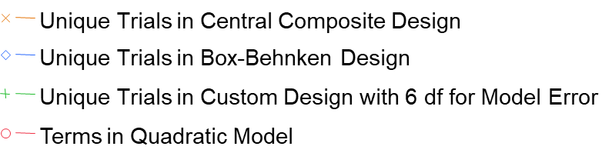
Number of Unique Trials for 3 Response-Surface Designs and Number of Quadratic Model Terms vs. Number of Continuous Factors
36 trial I-optimal response-surface design started as 10-factor DSD and was then augmented with 12 more trials in 6 most important factors
If generally running 3, 4 or 5-factor fractional-factorial designs…
How many interactions are you not investigating?
How many more trials needed to fit curvature?
Consider two stages: Definitive Screening + Augmentation

Slide 5
Real-World Design Issues
How many experimenters have any of these issues? Most of these are NOT well treated by classic DOE.
Work with these different kinds of control variables/factors:
    Continuous/quantitative? Finely adjustable like temperature, speed, force
    Categorical/qualitative? Comes in types, like material = rubber, polycarbonate, steel with mixed # of levels; 3 chemical agents, 4 decontaminants, 8 coupon materials…
    Mixture/formulation? Blend different amounts of ingredients and the process performance is dependent on the proportions more than on the amounts
    Blocking? e.g. “lots” of the same raw materials, multiple “same” machines, samples get processed in “groups” – like “eight in a tray,” run tests over multiple days – i.e. variables for which there shouldn’t be a causal effect
Work with combinations of these four kinds of variables?
Certain combinations cannot be run? (too costly, unsafe, breaks the process)
Would like to add onto existing trials? (really expensive/time consuming to run)
My design broke! Repair design by augmenting with constraints.
Certain factors are hard-to-change (temperature takes a day to stabilize)

Slide 6
Real World Variables

Slide 7
Categorical Factors and Responses
Agents
  Agent 1
  Agent 2
  Agent 3
Materials
  Steel
  Aluminum
  Glass
  Polycarbonate
  CARC (Paint)
  Viton
  Kapton
  Silicone
Responses
  Pass/Fail
  Yes/No
  Not Cracked/Cracked
  Safe/Caution/Unsafe
  Not Corroded/ Moderately Corroded/ Severely Corroded
Decontaminants
  Decon 1
  Decon 2
  Decon 3
  Decon 4

Slide 8
Continuous Factors and Responses
Factors
  Time
  Temperature
  Amount of Agent/Unit Area
  Wind Speed
  Humidity
Responses
  Evaporation Rate
  Absorption
  Adsorption
  Residual Concentration

Slide 9
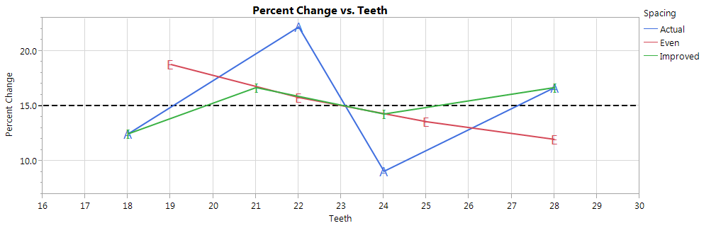

Discrete Numeric Variable
Example: Number of Teeth on Bicycle Sprockets
18
22
16
24
28

Slide 10
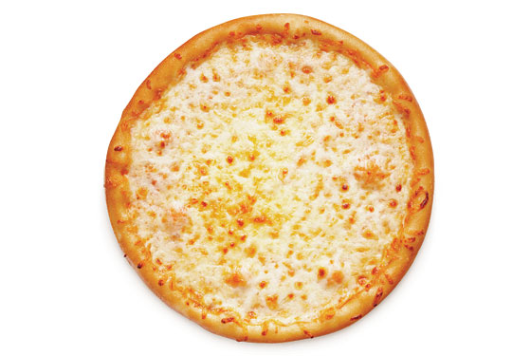
Discrete Numeric Variable
Only make four sizes of pizza 10”, 12”, 14” & 16”
Mid-point of full range is 13” diameter.
Corresponding areas in sq. in. are: 78, 113, 154 & 201
Mid-point of full range is 123 sq. in. or 12.5” diameter.
Could use either set of four actual sizes in diameter or area as levels of a discrete numeric variable.
10”
14”
16”
12”

Slide 11
Mixture Variables
Simple mixture – Making salad dressing
Relative proportions of factors or components is more important than actual quantity
Three liquid components - Oil, Water, and Vinegar
8 oz. in Cruet vs. 4 gal. in Jug
  5 oz. “O” 320 oz. 5/8
  1 oz. “W” 64 oz. 1/8
  2 oz. “V” 128 oz. 1/4
To study these mixture components in a DOE use ranges that are proportions:
    O: 0.500 to 0.750 (½ to ¾)
    W: 0.000 to 0.250 (0 to ¼)
    V: 0.125 to 0.375 (⅛ to ⅜)
Sum of proportions constrained to equal 1.
–– O ––
100.0%
–– O ––
–– W ––
37.5%
–– W ––
–– V ––
25.0%
–– V ––
0%
1 = O + W + V so therefore…
W = 1 – (O + V), O = 1 – (V + W), & V = 1 – (O + W)

Slide 12
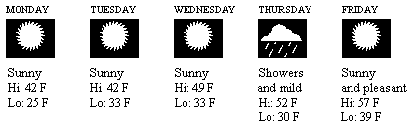
Blocking Factor like “Day”or “Batch”
A design run over 5 days that is sensitive to humidity might SHIFT on Thursday
  But what if because of the rain the tester from days 1, 2, 3 & 5 didn’t make it to work?
  What if that day the power went out briefly? Or, dept. meeting “paused” the work? Or…?
The block variable doesn’t tell you the cause of the effect - just that a shift has been detected among blocks.
Hoping block variable has no effect. If it does then how can we reliably predict other blocks? If significant it probably means we are missing a factor.
The only way to be sure that no “unknown” factor has crept into the experiment, is to test for it - and “blocking” your design is not expensive.
Block variable is a categorical factor having only 1-way effects (no interactions)

Slide 13
Time and Temperature Constraints
Uncoded
Create DOE for Pizza Process
Over baked
“Burnt”
Time: 10 20
Temp: 350 450
Pizza Size: 10, 12, 14 & 16
Pizza Type
  Cheese
  Veggies
  Meats
Batch (Size = 5)
Hi + Hi = “Burnt”
Lo + Lo = “Not Done”
Under Baked

Slide 14
Time and Temperature Constraints
Uncoded
Shorter times means more product produced per hour
Make most of our money in a few hours each evening
Make
More
$$$
Make
less
$

Slide 15
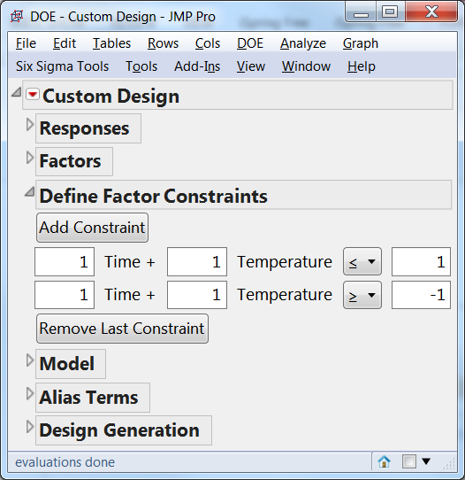

Time and Temperature Constraints
Coded vs. Uncoded

Slide 16
Time and Temperature Constraints
Coded

Slide 17
Time and Temperature Constraints
Coded
y = mx + b
Temp = m*Time + b
[1]*Temp = [-1]*Time + [1]
[1]*Time + [1]*Temp = [1]
[1]*Time + [1]*Temp <= [1]
y = mx + b
Temp = m*Time + b
[1]*Temp = [-1]*Time + [-1]
[1]*Time + [1]*Temp = [-1]
[1]*Time + [1]*Temp >= [-1]

Slide 18
Time and Temperature Constraints
Uncoded

Slide 19
Time and Temperature Constraints
Uncoded

Slide 20
Time and Temperature Constraints
Uncoded
y = mx + b
Temp = m*Time + b
[1]*Temp = [-10]*Time + [600]
[10]*Time + [1]*Temp = [600]
[10]*Time + [1]*Temp <= [600]
y = mx + b
Temp = m*Time + b
[1]*Temp = [-10]*Time + [500]
[10]*Time + [1]*Temp = [500]
[10]*Time + [1]*Temp >= [500]

Slide 21
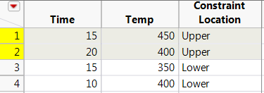
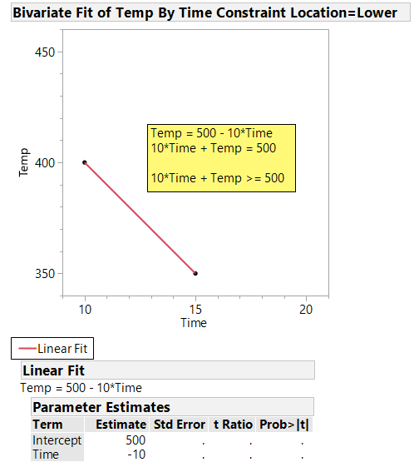
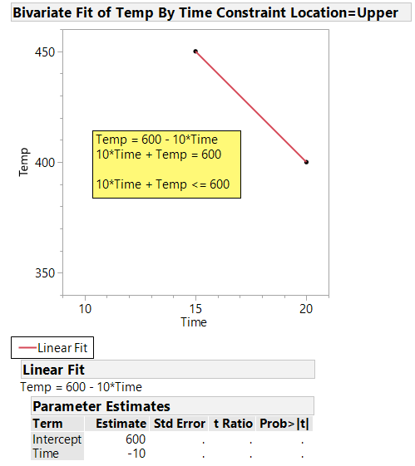
Time and Temperature Constraints
Uncoded

Slide 22
Final Design Showing Constrained Regions

Slide 23
Final Design Showing Constrained Regions

Slide 24
Definitive Screening Case Study

Slide 25
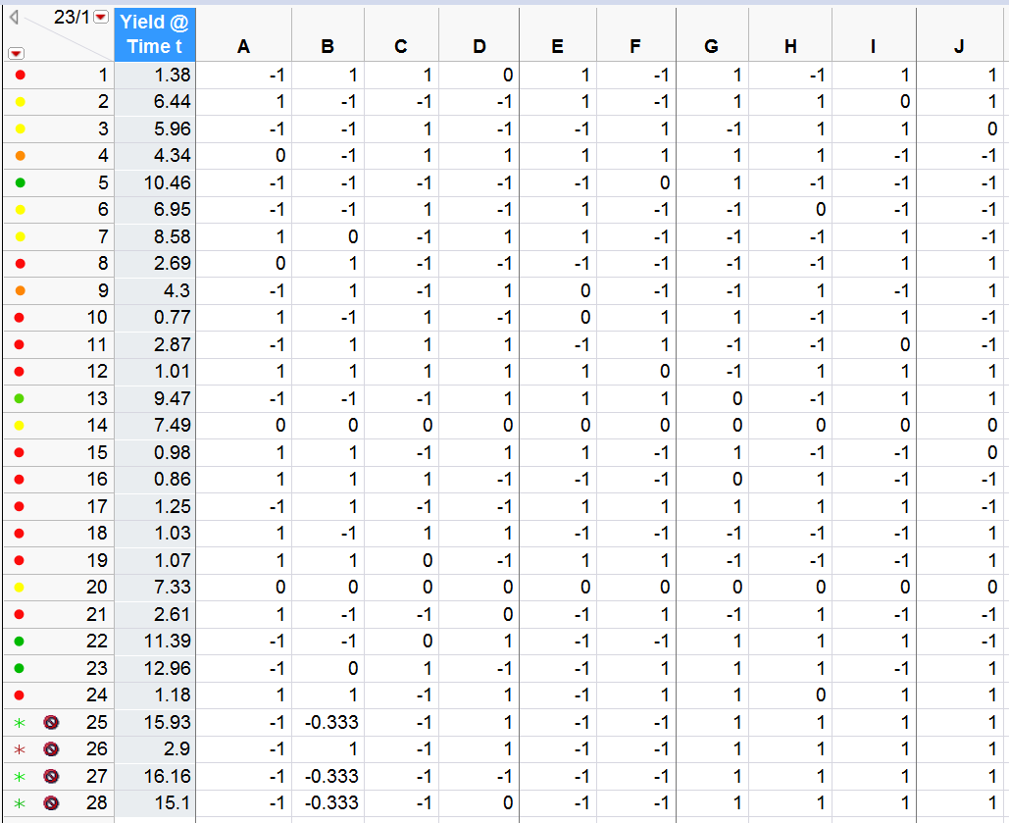
Original design was for 11 variables with 23 unique trials
and the center point replicated once.

Slide 26
Analysis Strategies
Visual Tools:
  Distribution – click on “good” and “bad” response values to see correlations with factor settings
  Graph Builder – Y vs. X graphs – all data, summarized data, fit line, smoother
    Drop factors side by side or alternatively (for coded factors) stack factors then replot
    Use Overlay field to look at possible interactions between two factors
Analytic Tools:
  Conservative: Main Effects fit – look at Scaled estimates
    Consider adding interactions among significant factors using Effects Heredity and Sparsity
  Aggressive: Strepwise with various stopping criteria
    AICc, BIC, K-fold, Excluded checkpoints,
    Fit All Possible Models
  Analytic Output:
    Stepwise Histories – Criterion or Rsquare
    Actual vs. Predicted with Graph Builder – Col Switch different models
    Create All Possible Models Table – Plot four metrics using Overlap Plot

Slide 27
All Analyses Rank Factors A, B & C as Top 3
Factor F appears to be most likely fourth factor
Linear terms only – fourth factor is F
Linear + Squared terms – fourth factor is D
Stepwise with min AICc stopping rule – fourth factor is F
Stepwise with max K-Fold R-Square stopping rule – fourth factor is F
Stepwise with max Validation R-Square as stopping rule – fourth factor is F
Generalized regression with min AICc stopping rule – fourth factor is F
All possible models – fourth factor is G
When D & F are in same 5-factor (with A, B, & C) stepwise model, D drops out
When G & F are in same 5-factor (with A, B, & C) stepwise model, G drops out
When D & G are in same 5-factor (with A, B, & C) stepwise model, both drop out
There is an important difference between saying, “Factor F has no effect.” and, “Given the amount of data taken an effect for factor F was not detected.”
Augmenting design to support 6-factor quadratic model in A, B, C, D, F & G will
  help resolve the relative contributions of D, F & G
  increase the power for all – but especially - the squared terms

Slide 28
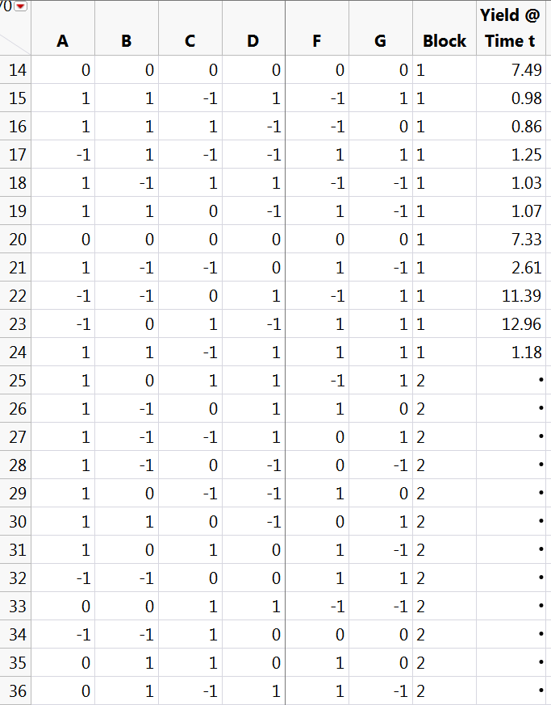
If more than a few factors are significant, then augment design to support 2nd order model
NOTE: First 13 rows of original design are not shown.
These 12 trials added onto original 24 trials to support full quadratic model in 6 most important factors plus a block effect between original and augmented trials

Slide 29
Power for squared terms in 2nd order model is increased to near that of 6-factor RSM designs

Slide 30
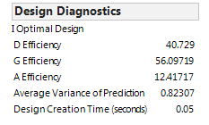
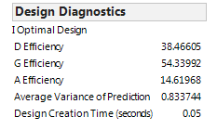
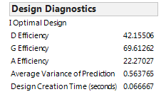
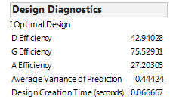
Compare Augmented Designs
Top: 10-factor fractional Factorial + C.P. augmented to support full quadratic model in 6 factors
33 + 9 = 42 total trials
Upper Middle: 10-factor Placket-Burman + C.P. augmented to support full quadratic model in 6 factors
25 + 11 = 36 total trials
Lower Middle: 10-factor definitive screening augmented to support full quadratic model in 6 factors
21 + 15 = 36 total trials
Bottom: 6-factor custom DOE for full RSM model
34 total trials

Slide 31
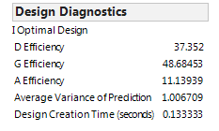
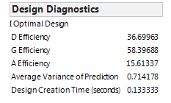
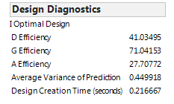
Compare Augmented Designs
Top: 14-factor fractional Factorial + C.P. augmented to
support full quadratic model in 7 factors
33 + 13 = 46 total trials
Middle: 14-factor definitive screening augmented to
Support full quadratic model in 7 factors
29 + 17 = 46 total trials
Bottom: 7-factor custom DOE for full RSM model
42 total trials

Slide 32
Number of Unique Trials for 3 Response-Surface Designs and Number of Quadratic Model Terms vs. Number of Continuous Factors
Unique Trials in Central Composite Design
Unique Trials in Box-Behnken Design
Unique Trials in Custom Design with 6 df for Model Error
Terms in Quadratic Model
36 trial I-optimal response-surface design started as 10-factor DSD and was then augmented with 12 more trials in 6 most important factors
If generally running 3, 4 or 5-factor fractional-factorial designs…
How many interactions are you not investigating?
How many more trials needed to fit curvature?
Consider two stages: Definitive Screening + Augmentation

Slide 33
Use JMP
Trade-off and Optimization

Slide 34
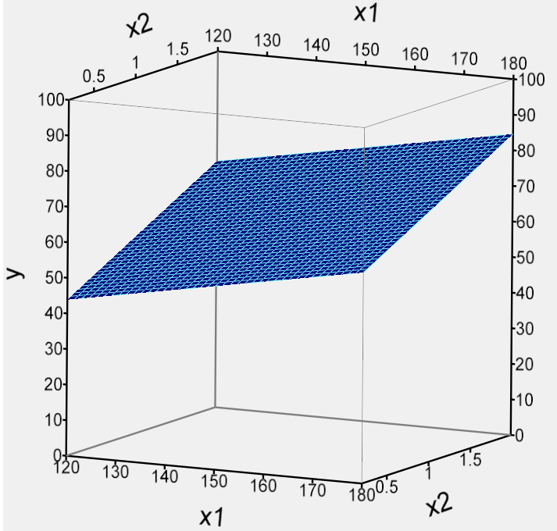
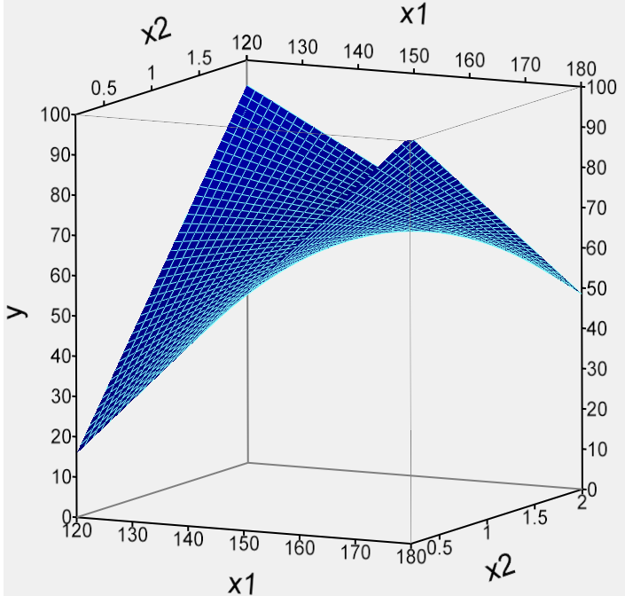
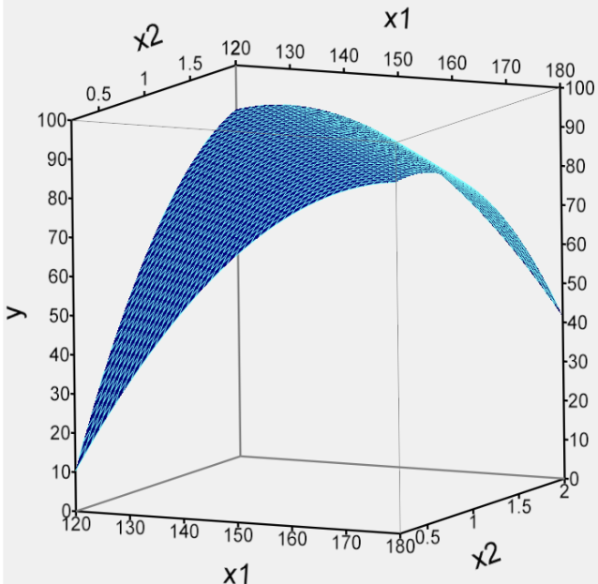
Classic Response-Surface DOE in a Nutshell
Block 1
Block 2
Block 3
x₃
x₃
x₃
x₂
x₂
x₂
x₁
x₁
x₁
Lack-of-fit
Lack-of-fit
Can fit data from blocks 1, 2 or 3
Fit requires data from blocks 1 & 2
Fit requires data from all 3 blocks

Slide 35
Polynomial Models Used to Calculate Surfaces
Block 1
Block 2
Block 3
x₃
x₃
x₃
x₂
x₂
x₂
x₁
x₁
x₁
y = a₀ + a₁x₁ + a₂x₂ + a₃x₃
Run this block 1st to:
(i) estimate the main effects* (ii) use center point to check for curvature.
y = a₀ + a₁x₁ + a₂x₂ + a₃x₃
+ a₁₂x₁x₂ + a₁₃x₁x₃ + a₂₃x₂x₃
Run this block 2nd to:
(i) repeat main effects estimate, (ii) check if process has shifted (iii) add interaction effects to model if needed.
y = a₀ + a₁x₁ + a₂x₂ + a₃x₃
+ a₁₂x₁x₂ + a₁₃x₁x₃ + a₂₃x₂x₃
+ a₁₁x₁² + a₂₂x₂² + a₃₃x₃²
Run this block 3rd to:
(i) repeat main effects estimate, (ii) check if process has shifted (iii) add curvature effects to model if needed.

Slide 36
Number of Unique Trials for 3 Response-Surface Designs and Number of Quadratic Model Terms vs. Number of Continuous Factors
Unique Trials in Central Composite Design
Unique Trials in Box-Behnken Design
Unique Trials in Custom Design with 6 df for Model Error
Terms in Quadratic Model
If generally running 3, 4 or 5-factor fractional-factorial designs…
How many interactions are you not investigating?
How many more trials needed to fit curvature?
Consider two stages: Definitive Screening + Augmentation

Slide 37
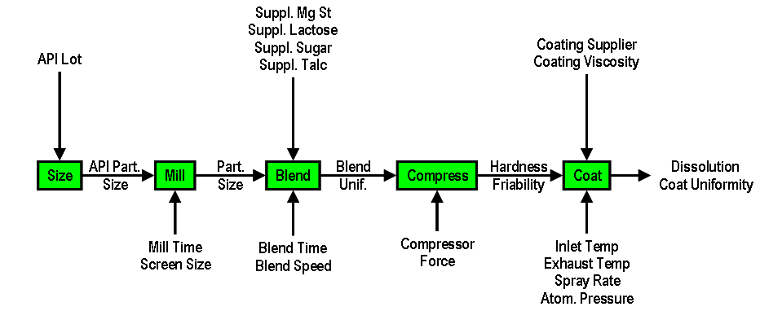
Classic Definition of DOE
Purposeful control of the inputs (factors) in such a way as to deduce their relationships (if any) with the output (responses).

Slide 38
Alternative Definition of DOE
A DOE is the specific collection of trials run to support a proposed model.
  If proposed model is simple, e.g. just main effects or 1st order effects (x₁ , x₂ , x₃, etc.), the design is called a screening DOE
    Goals include rank factor importance or find a “winner” quickly
    Used with many (> 6?) factors at start of process characterization
  If the proposed model is more complex, e.g. the model is 2nd order so that it includes two-way interaction terms (x₁x₂ , x₁x₃, x₂x₃, etc.) and in the case of continuous factors, squared terms (x₁², x₂², x₃² , etc.), the design is called a response-surface DOE
    Goal is generally to develop a predictive model of the process
    Used with a few (< 6?) factors after a screening DOE

Slide 39
Quadratic Model not that Much Bigger than Interaction Model
Lack-of-fit
Lack-of-fit
Can fit data from blocks 1, 2 or 3
Fit requires data from blocks 1 & 2
Fit requires data from all 3 blocks
1st Order
2nd Order
2nd Order
y = a₀ + a₁x₁ + a₂x₂ + a₃x₃
For k factors there are k main effects
For 3 factors Linear Model has 4 terms
For 6 factors Linear Model has 7 terms
For 10 factors Linear Model has 11 terms
y = a₀ + a₁x₁ + a₂x₂ + a₃x₃
+ a₁₂x₁x₂ + a₁₃x₁x₃ + a₂₃x₂x₃
For k factors there are k(k-1)/2 interaction effects
For 3 factors Interaction Model has 7 terms
For 6 factors Interaction Model has 22 terms
For 10 factors Interaction Model has 56 terms
y = a₀ + a₁x₁ + a₂x₂ + a₃x₃
+ a₁₂x₁x₂ + a₁₃x₁x₃ + a₂₃x₂x₃
+ a₁₁x₁² + a₂₂x₂² + a₃₃x₃²
For k factors there are k squared effects
For 3 factors Quadratic Model has 10 terms
For 6 factors Quadratic Model has 28 terms
For 10 factors Quadratic Model has 66 terms

Slide 40
Use JMP
Re-make the DOE for this analysis

Slide 41
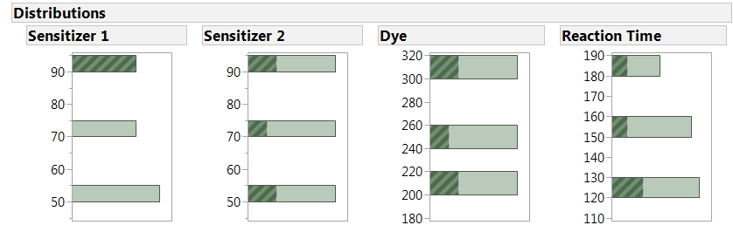
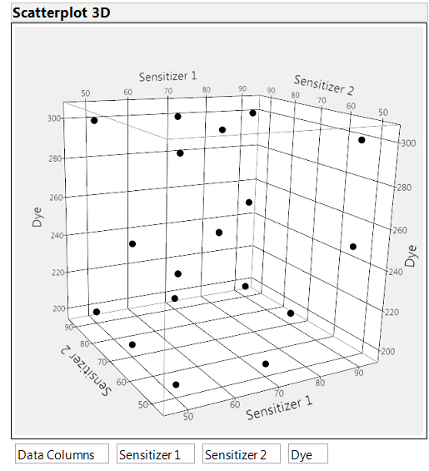
Visualize Design Balance

