Slide 1
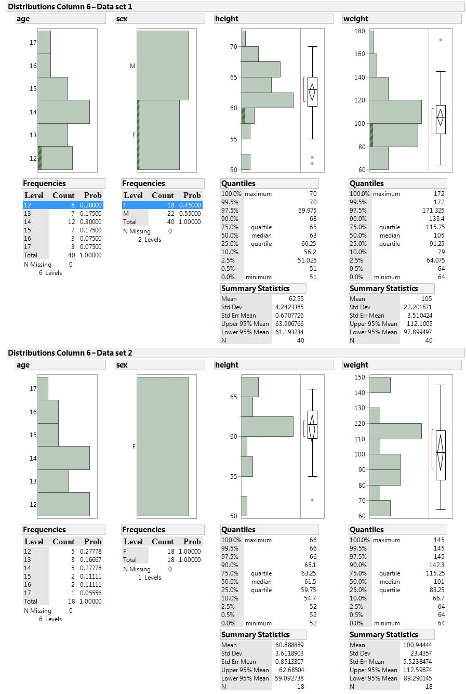

Slide 2
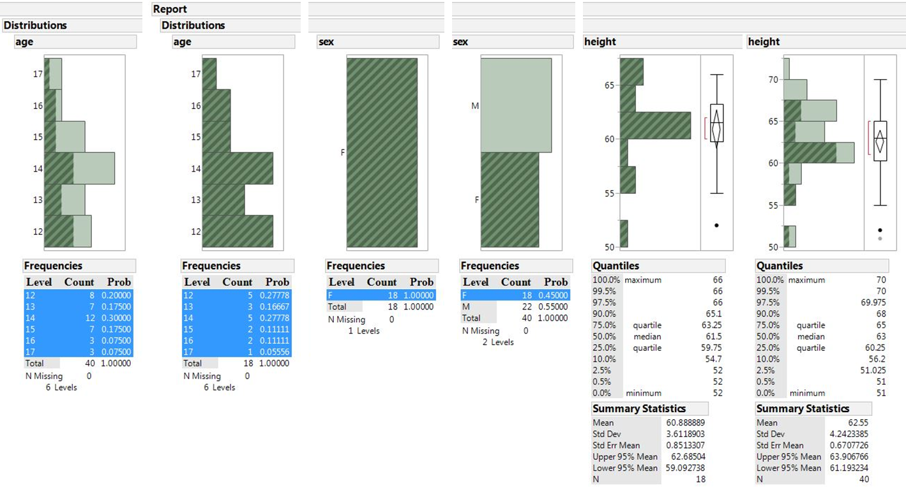
Required Distribution and similar format eg: Distribution of age of entire data set, to age of subset

