Slide 1
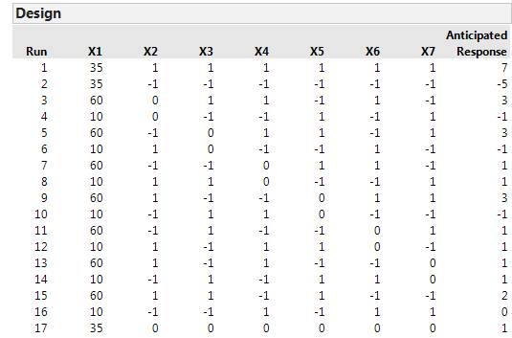
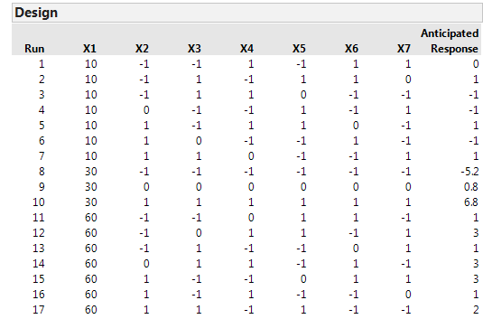


Comparison of DSD’s with default centre point and Skewed Centre points
Original DSD for 7 factor
Manually changed Centre point for 1-factor

Slide 2
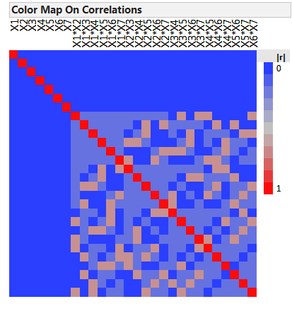
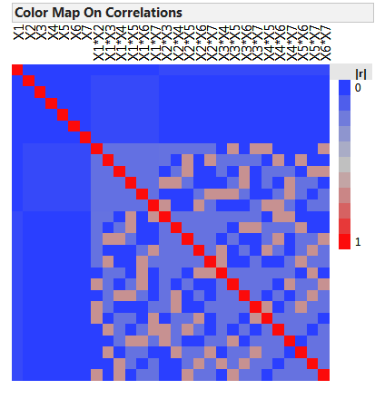
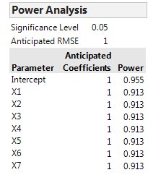
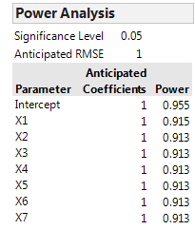


Minor alias structure
Original DSD for 7 factor
Manually changed Centre point for 1-factor

