Slide 1


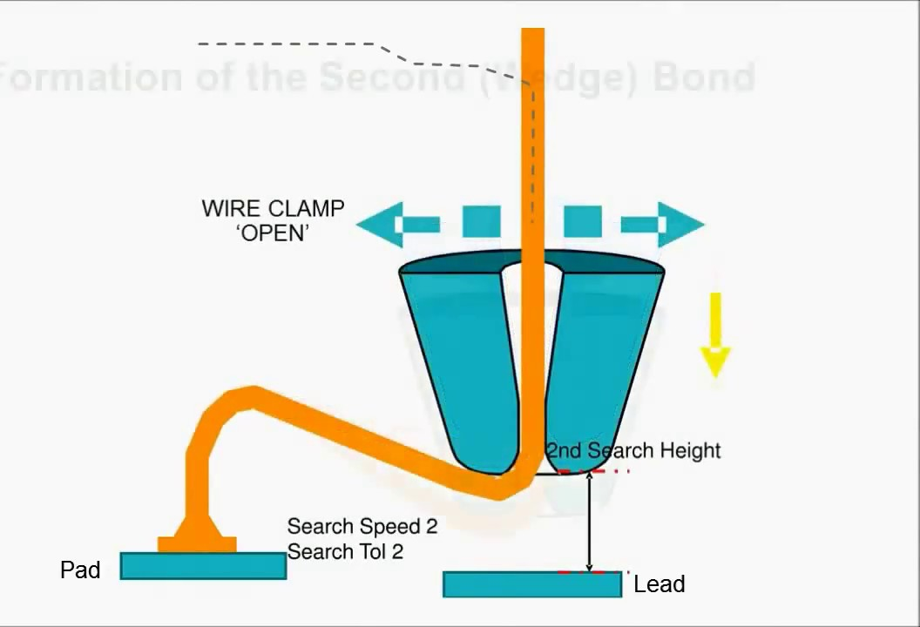
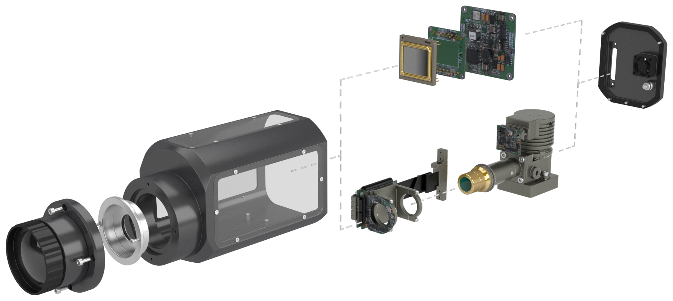
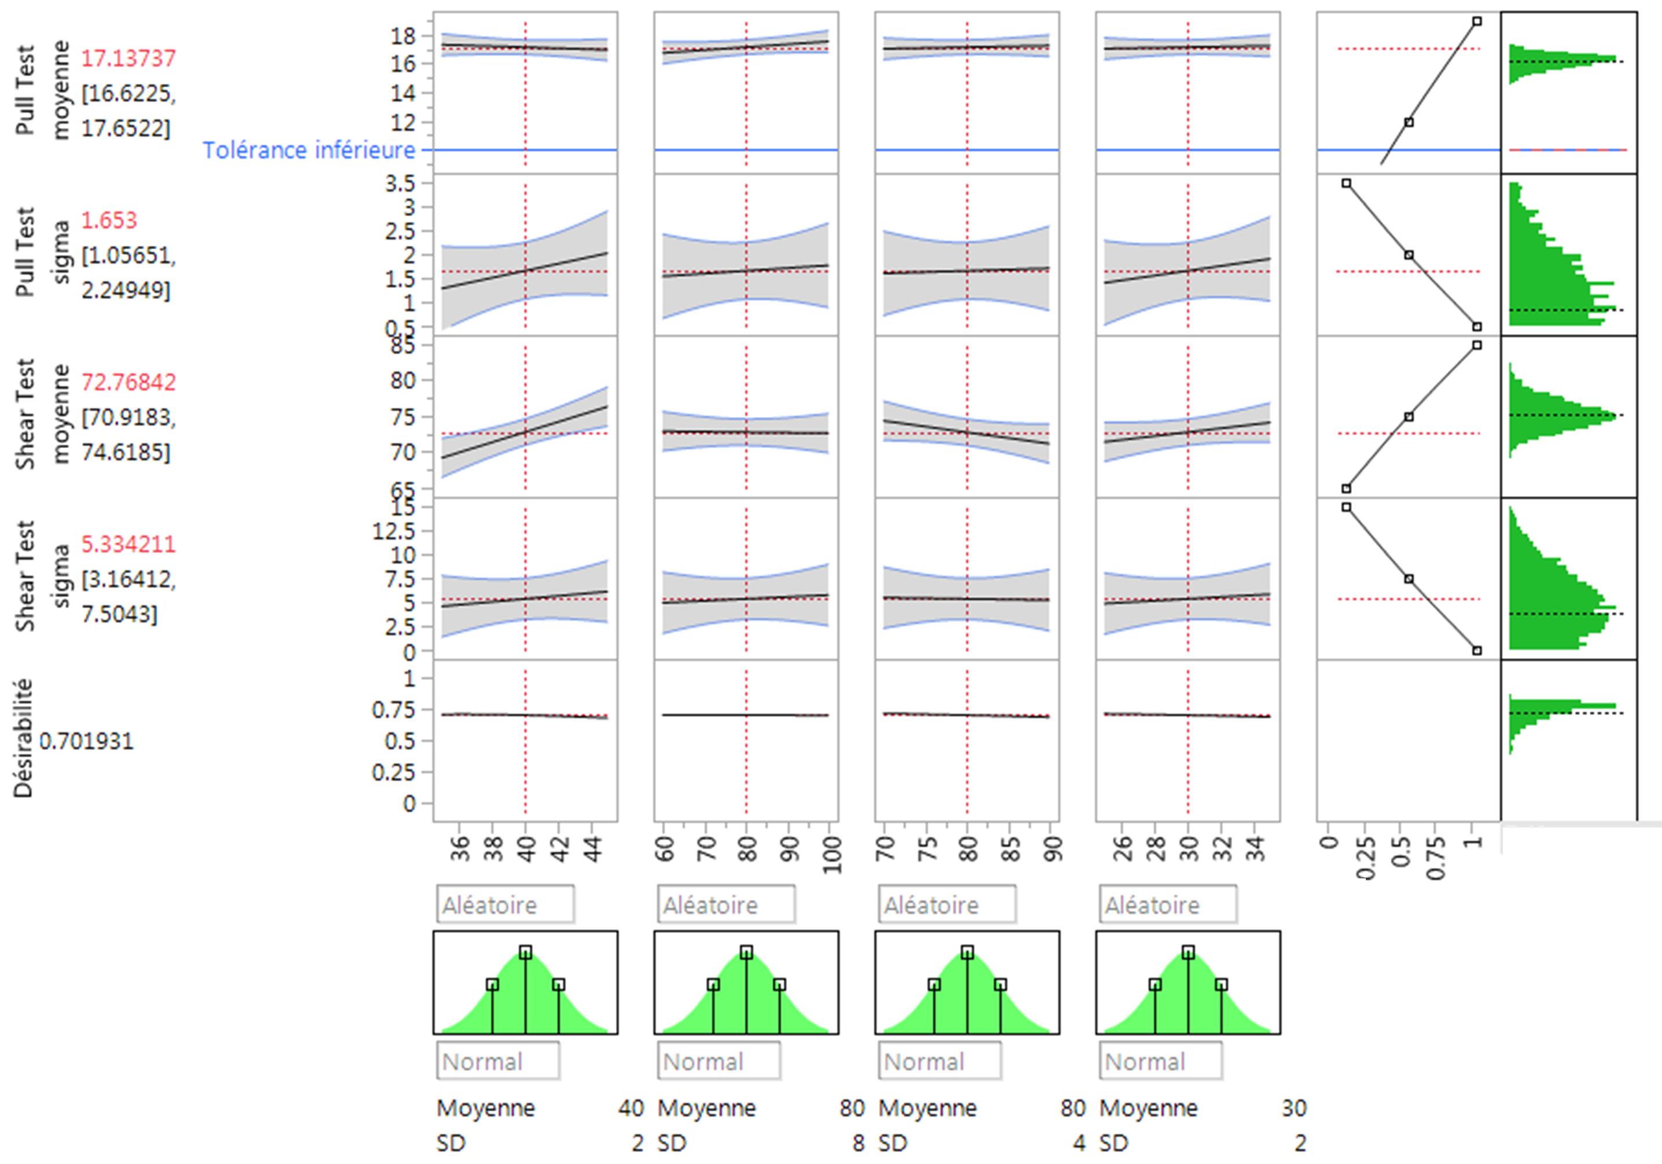
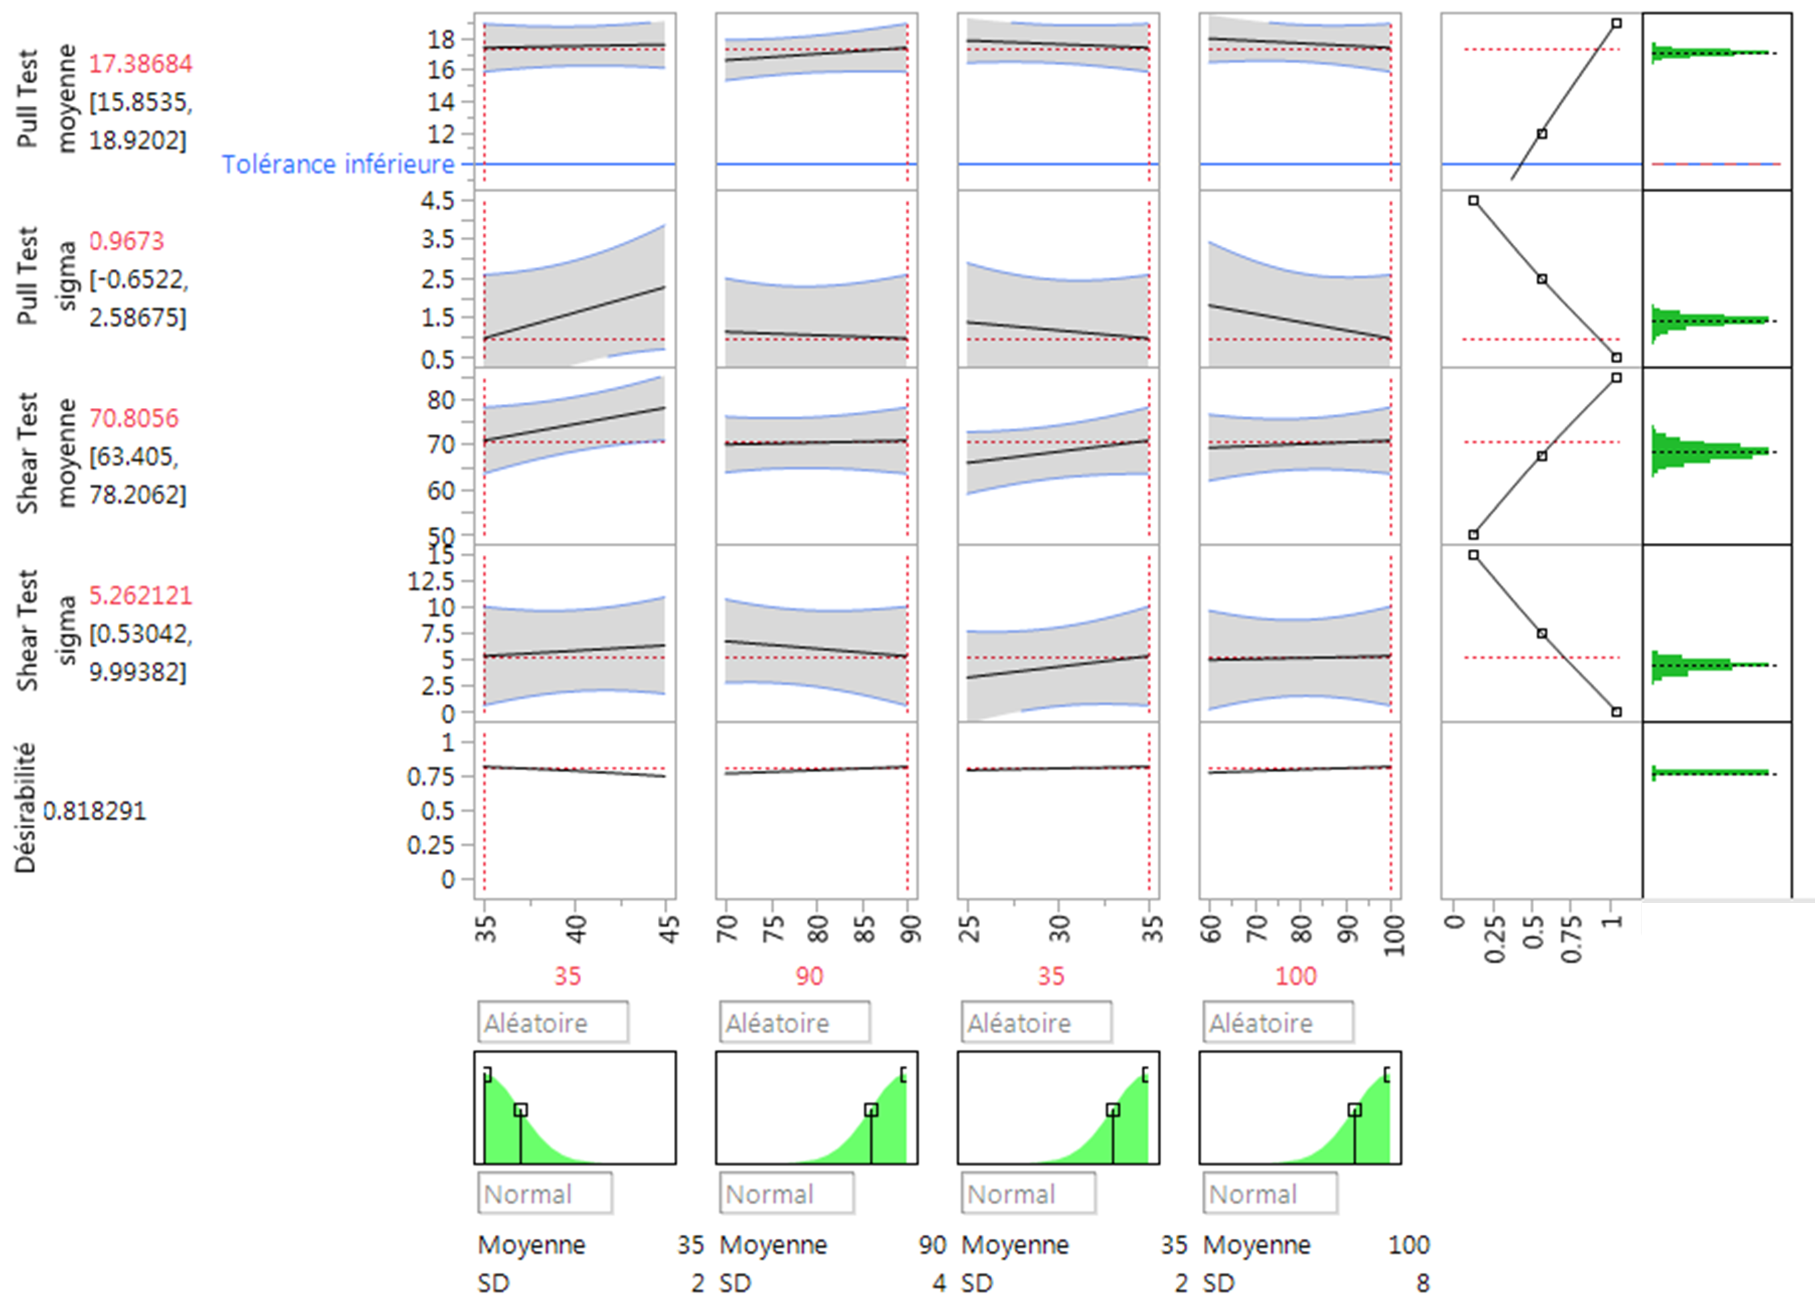
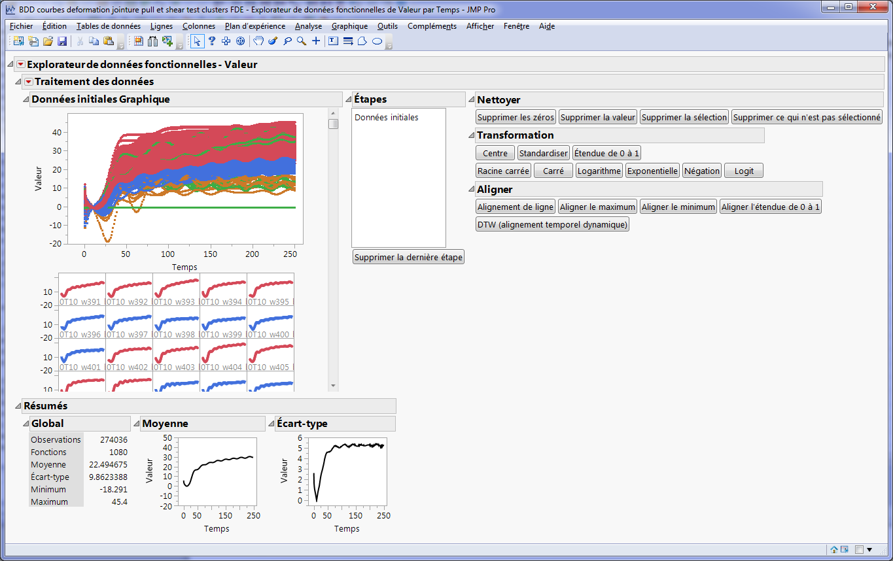
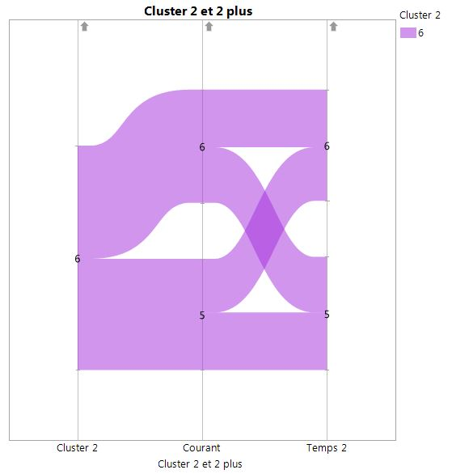
Modeling a New Equipment Behavior (2020-EU-EPO-360)
Vincent De Schuyteneer
Data Engineer, Lynred
About Lynred
Introduction
Method and objectives
Lynred is global industry leader for cooled and uncooled Infrared detectors
Lynred addresses short, middle and (very) long wave infrared
Lynred serves Defense, Space, Security, Leisure, Smart Building, Industry and Automative markets
Lynred acquired a new bonding equipment
This new equipment was not delivering expected level of performance
Objectives
  Identify key process parameter
  Identify process window
Method
  Realize first DOE with 4 factors and 4 responses
    Each try will be performed 15 times
  Realize additional DOEs to improve performance
  Analyze equipment raw data to identify additional key parameters
    JMP scripting to stack raw data in one table and aggregate them
    Use FDE to analyze stacked raw data to identify additional parameters
    Use Parallel graph to identify preferred path according to performance parameter
Engineering team decided to use DOE methodology in order to understand equipment behavior
Main responses are “pull” and “shear” tests and their variability
There is no constraint for number of tests
Uncooled
Cooled
© Ding-Ming Kwai
Results Click graphs to enlarge
DOE #1
DOE #2 & 3
FDE
Parallel chart
Conclusions References & Acknowledgements
We have been able to describe completely behavior of new bonding equipement
Combination between DOE and FDE approaches allowed to go further in understanding behavior of such equipments
We developed script to concatenate raw data of log equipment and aggregate them for summarized information
JMP helped us to fully understand an equipment way of working and helped us to have a scientific and quality approach
Thanks to technical team participated to whole demarch
Samuel Mathieu, head of support engineering
Marc Guyot, support technician, expert in bonding process
Emilie Ruel, support technician in charge of bonding equipment
Notes:
Single sided poster!

Slide 2
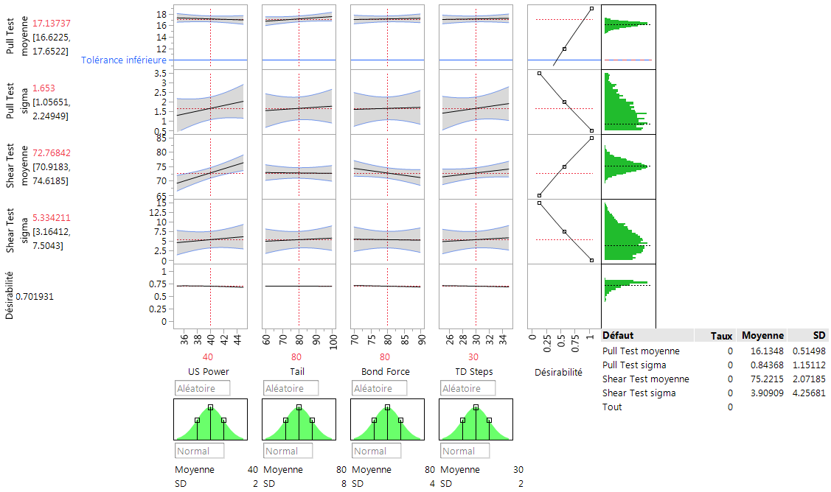
DOE #1
Optimization of responses
DOE 1
Simulation shows important dispersion on range of each test
Additional DOE : explore lower domain on the 3 main effect factors and fix the 4th one at its center
Relation between responses and factors
Desirability is to maximize Pull and Shear Tests results and to minimize Range of result

Slide 3
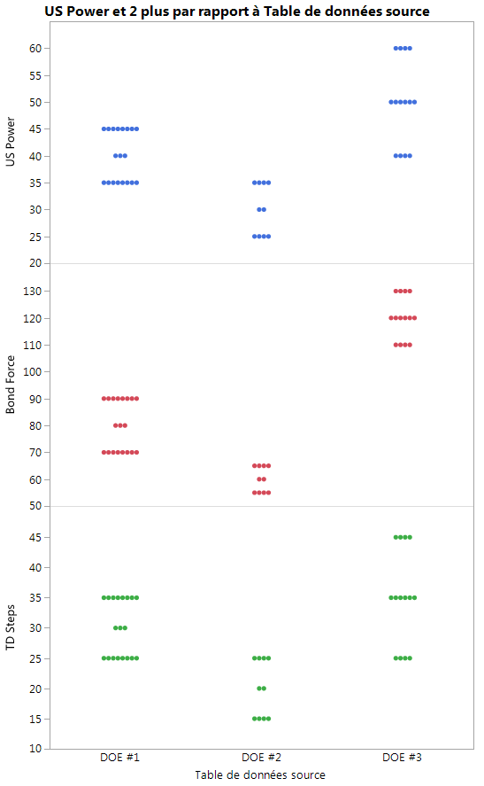
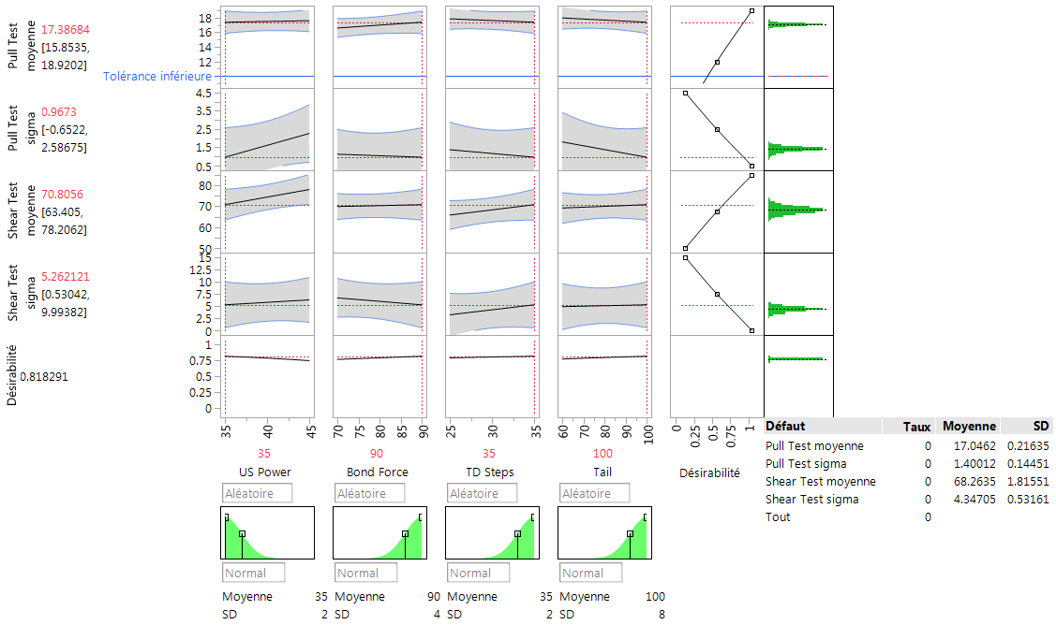
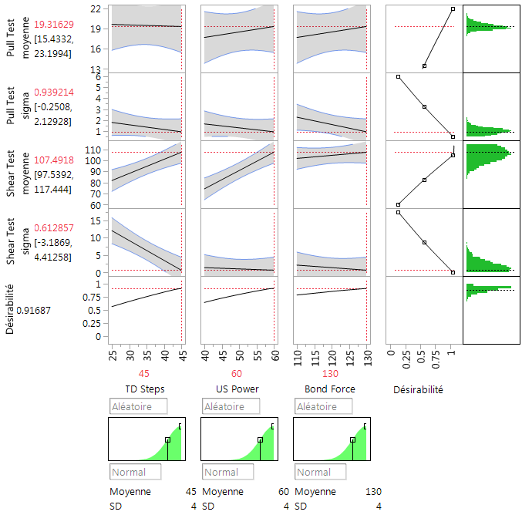
DOE #2 & 3
DOE 2
Improvement on simulation
DOE 3
Simulation with acceptable variation
Increase of uncertainty on responses
Increased value of Pull and Shear tests results
Uncertainty variation better on 3 responses

Slide 4
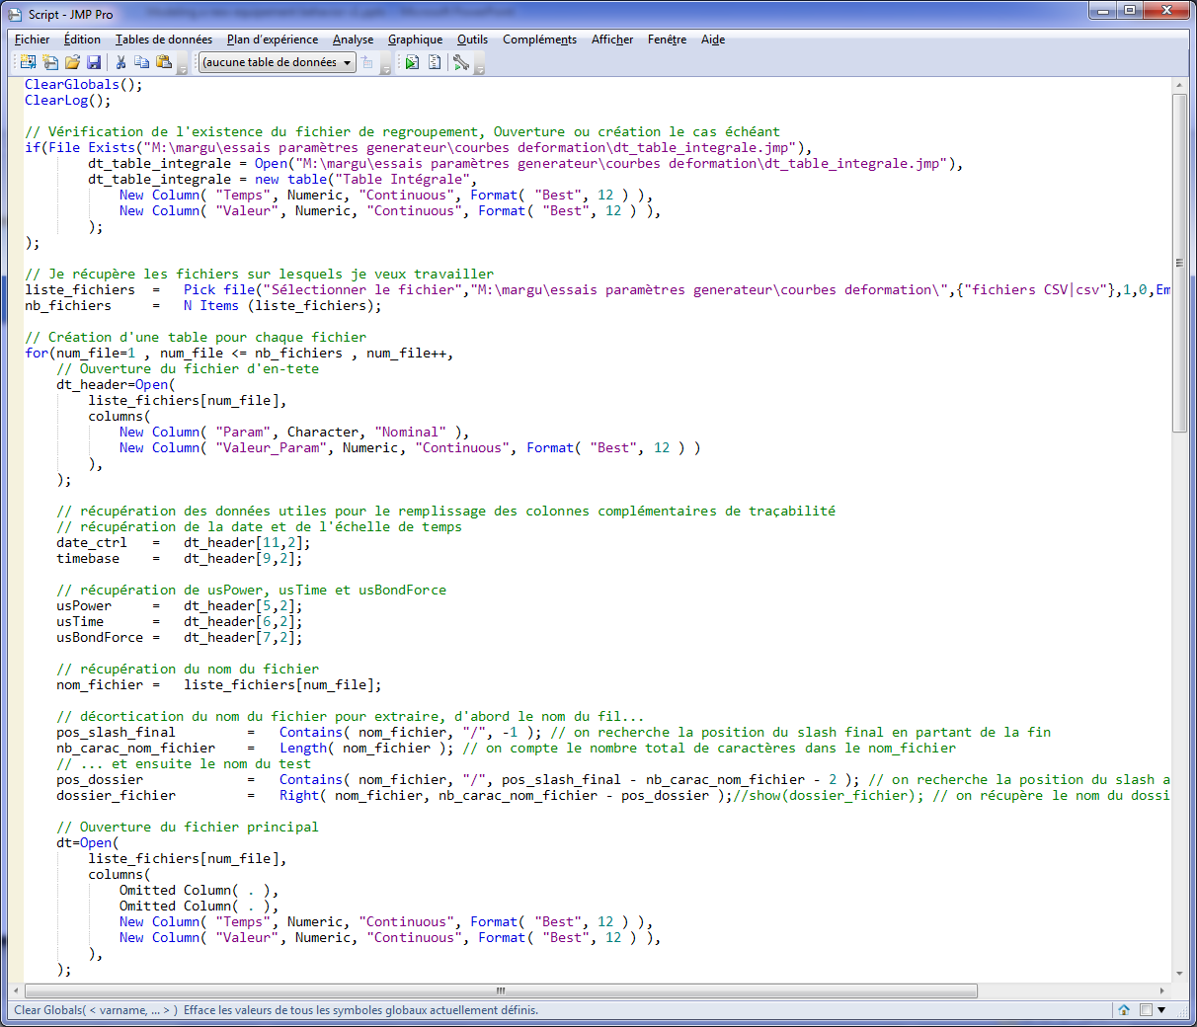
Concatenation and FDE analysis
Script development
FDE Analysis
Clustering with k-means
Create / Open synthetic table
Open set of raw data files
Store traceability information
Agregation of Raw data
Concatenate all data
Save new table

Slide 5
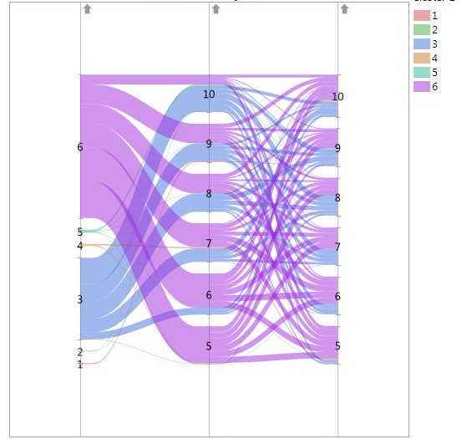
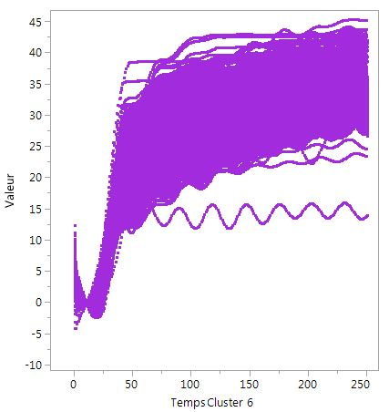
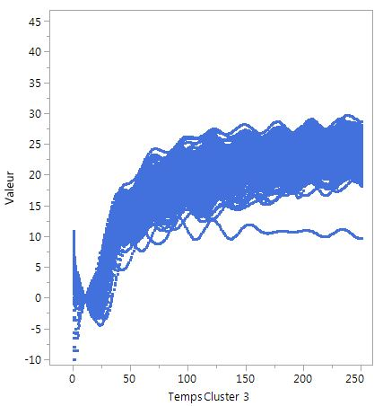
Parallel Chart
Parallel Chart
Limited to Cluster 6
2 clusters with significant differences
Cluster #6
Best Shear tests results
Cluster #3
Cluster
Param 1
Param 2
Cluster
Param 1
Param 2
Finalization of equipment behavior integrating parameters initially not planned

