Slide 1
JMP Live ADMInistration
Dieter Pisot – JMP Development

Slide 2
Administration
Business Administrator
Does not need to be in IT, can be a JMP Live user
There can be more than 1 business administrator account
Manages users
  Gives permissions to users
Manages groups
  Creates groups and added users to groups
Deals with flagged content

Slide 3
Administration
SYSTEM Administrator
Should be in IT
Usually there is only 1 system administrator account
Installs JMP Live
Manages users
  Creates business administrator
Changes site settings
  Mail settings
  Authentication
Does health checks

Slide 4

JMP Live Groups
Open
Closed
Hidden
Personal
Can be seen in a list
of groups.
Users can join open groups.
Only administrator(s) can create open groups.
Can be seen in a list of groups.
      Users can “knock” and ask to join.
      Administrator(s) decide who gains access.
      Only administrator(s) can create closed groups.
      Can’t be seen in any lists of groups.
      Administrator(s) decide who gains access.
      Only administrator(s) can create hidden groups.
      Can’t be seen in any lists of groups.
      User who created decides who gains access.
      Users create personal groups.
      Administrators can create personal groups for a user.

Slide 5







Architecture
JMP Client
Browser
Publish
Compute Requests
Authentication
JMP Web Application
PostgreSQL DB
(sessions, authorization, publish
and retrieve packages)
JMP Pool Manager

Slide 6
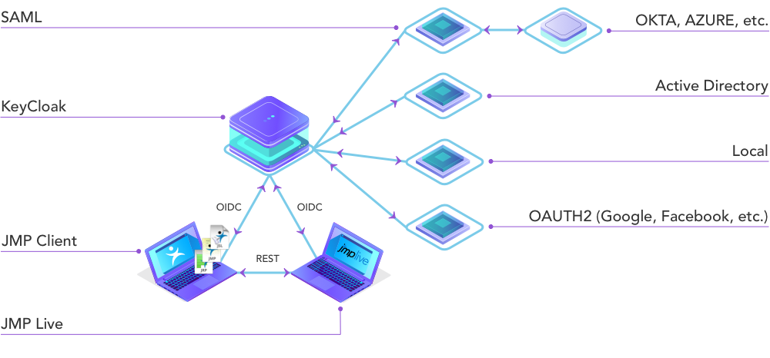
Authentication

Slide 7
Keycloak
Open Source product to allow single sign-on with Identity and Access Management
JBoss community project under Red Hat stewardship
It’s intent is to make it easy to secure applications and services
Part of the JMP Live installation package

Slide 8
Upgrade
JMP Pro License
License file:
C:\SAS Software Depot\sid_files\JMP150_09PJBJ_70256402_Win_X64.txt
Application:
C:\SAS Software Depot\JMP\JMP_Pro\15_0\Windows\Extra\JMPExtractPER64.exe
Run:
JMPExtractPER64.exe .\JMP150_09PJBJ_70256402_Win_X64.txt .\jmp.per
Copy jmp.per into:
C:\Program Files\JMPPRO\15

