Slide 1

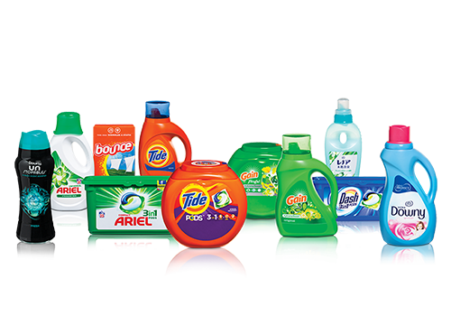

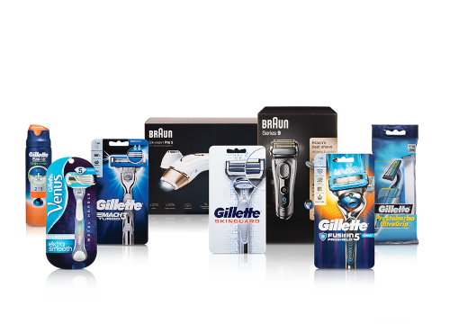
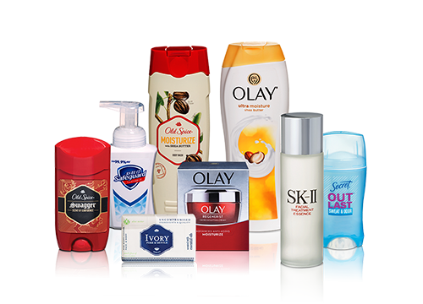
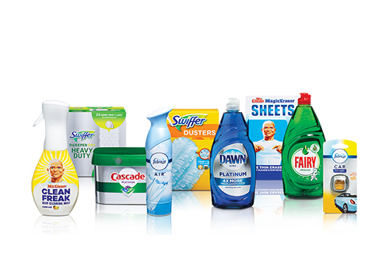

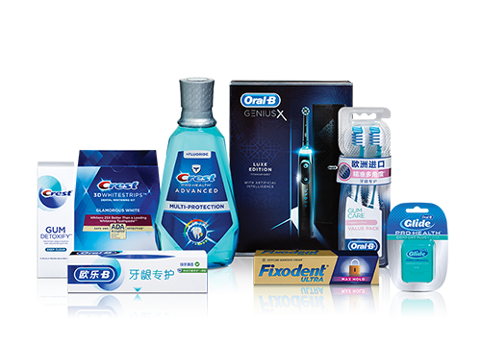
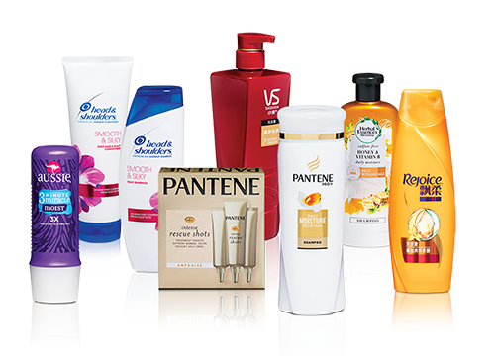
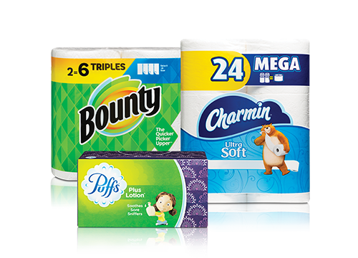
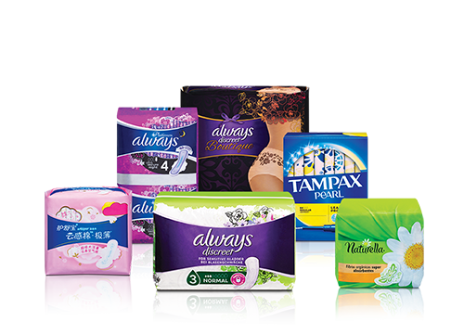
What makes a car detailing job great?
Adaptive Multi-Stage Customer DOE
Zhiwu Liang, Pablo Moreno Peláez - Procter & Gamble
Define key customer satisfaction vectors
Iterative screening-augmentation design
Model & Optimization

Slide 2
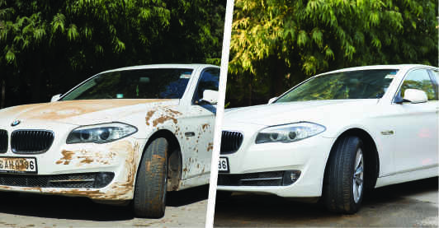
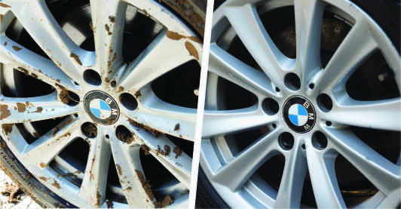
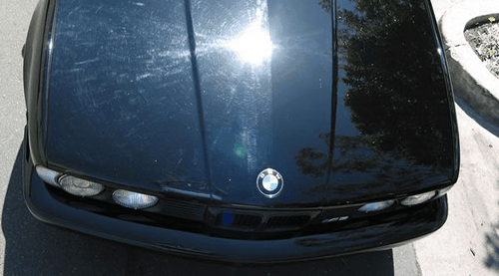
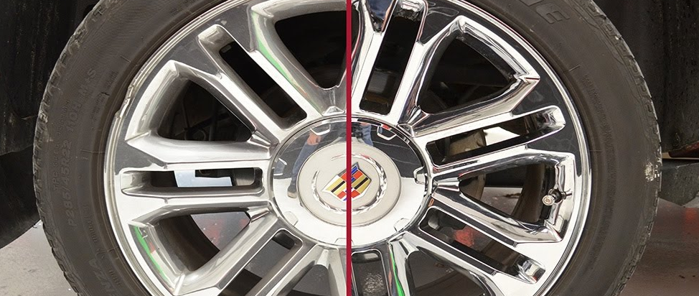

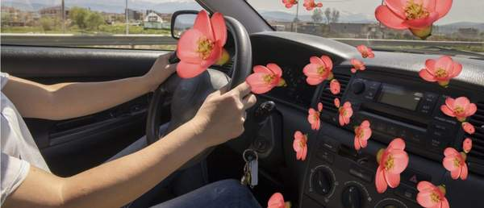
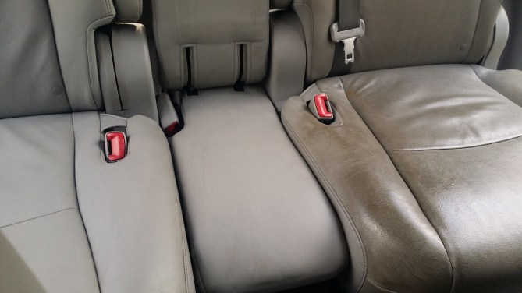
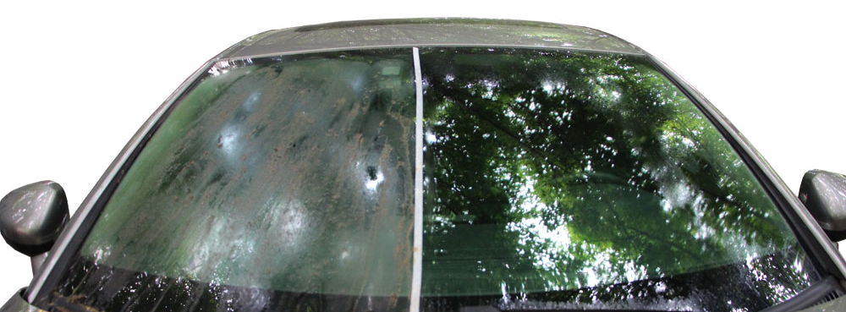

What makes a car detailing job great? – Maximizing Customer Satisfaction
Cleaning Attributes
Shine Attributes
Freshness
Exterior
Rims
Body
Rims
Interior
Windows
Predictive Model
Objective:
Maximize Customer satisfaction while optimizing the resources used (optimize the time spent per car, the products used, and the level of detailing needed at each point of the process).
Overall Satisfaction
Cleaning Satisfaction
Shine Satisfaction

Slide 3
What makes a car detailing job great? - Adaptive Multi-Stage Customer DOE
Complex 2-phase Sequential Augmentation DOX
Pilot:
Designed 5 vectors with 2 levels
Consumers: Complete block for 20 customers with each evaluating all 5 cars.
Phase 1:
Designed 7 vectors with 2/3 levels (multiple disallowed combinations – not feasible design points). 6 blocks of 15 cars to be run during ½ day.
Consumers: BIBD for 120 customers with each evaluating 5 cars per block (1/2 day testing).
Final Design: Combination of the two above designs.
Phase 2:
Augment the previous design by removing non-sign. vectors, add/remove levels where needed and add quadratic effects.
Re-worked the consumers design to randomize and include validation runs.
Pilot
Phase 1 - Screen
Phase 2 - Augment
Check methodology
Check questionnaire
Check factor range
Identify main terms
Discard any non-significant
Adjust factor levels
Focus on sign. Factors
Identify key interactions
Objectives
5 Factors
2 Levels (L/H)
20 Customers
5 Diff. Detailed Cars
All customers evaluate all 5
7 Factors
2 or 3 Levels (L/M/H)
120 Customers
90 Diff. Detailed Cars
Each customer evaluates 5
6 Factors
Extra Levels (LL or MH)
Same 120 Customers
90 Diff. Detailed Cars
Each customer evaluates 5
Design

Slide 4
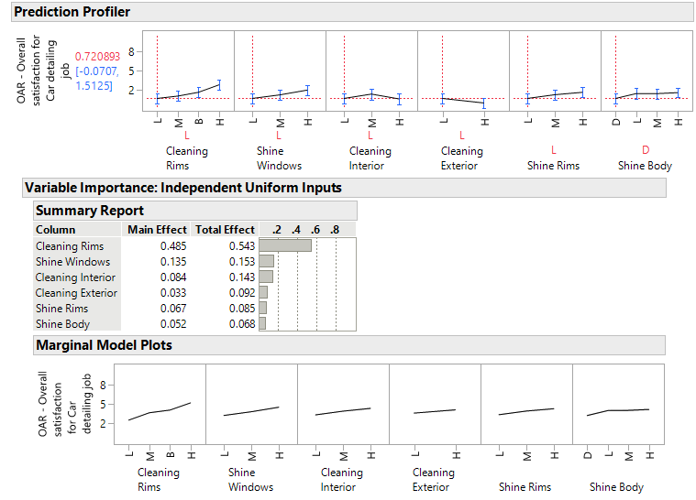
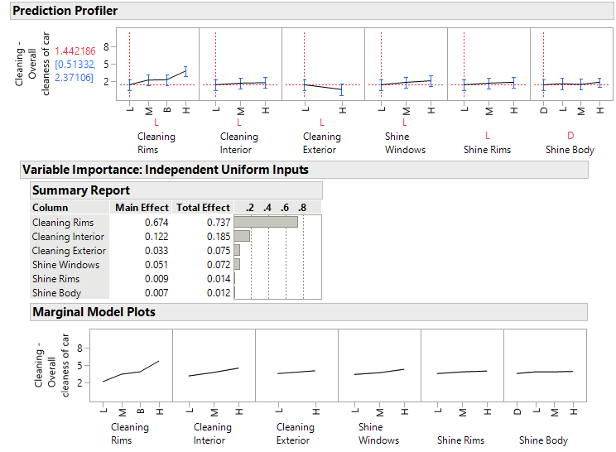
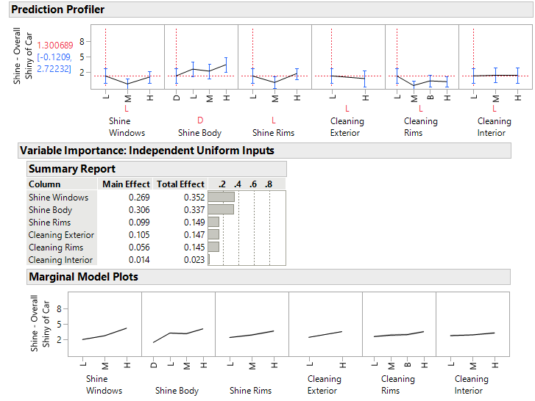
What makes a car detailing job great? – Model & Results
Predictive models with interactions
Overall Satisfaction model
Clean Rims and Shine windows are top drivers
Clean exterior and Clean interior has significant interaction.
Cleaning Satisfaction model
Clean Rims and interior are top drivers
Clean Rims and interior has significant interaction effect
Shine windows also is a driver.
Shine Satisfaction model
Shine windows and body are top drivers
Clean exterior is also a driver
Shine windows and Clean Rims has significant interaction.

Slide 5


