Slide 1

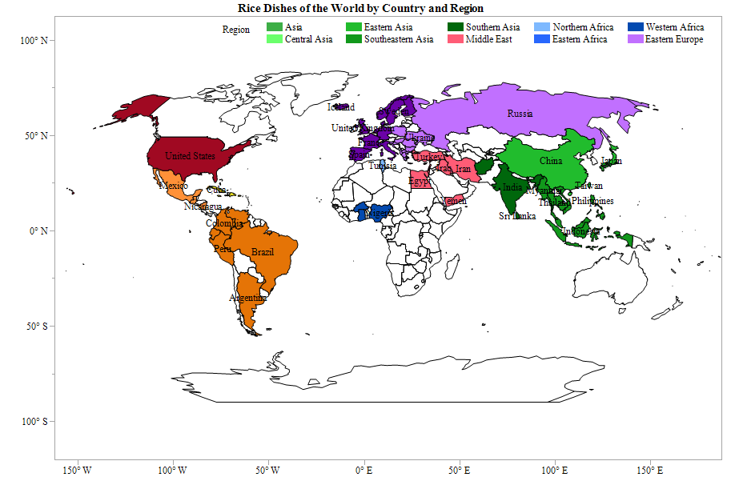
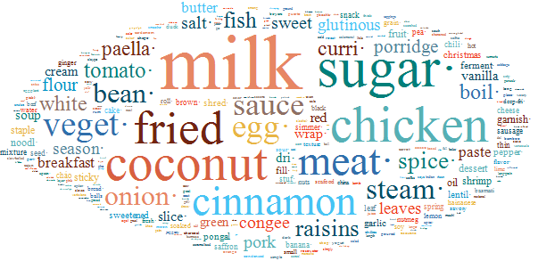
Case Study of Text Explorer
Rice Dishes of the World
Kathryn Haydon and
Andy Mauromoustakos
University of Arkansas

Slide 2
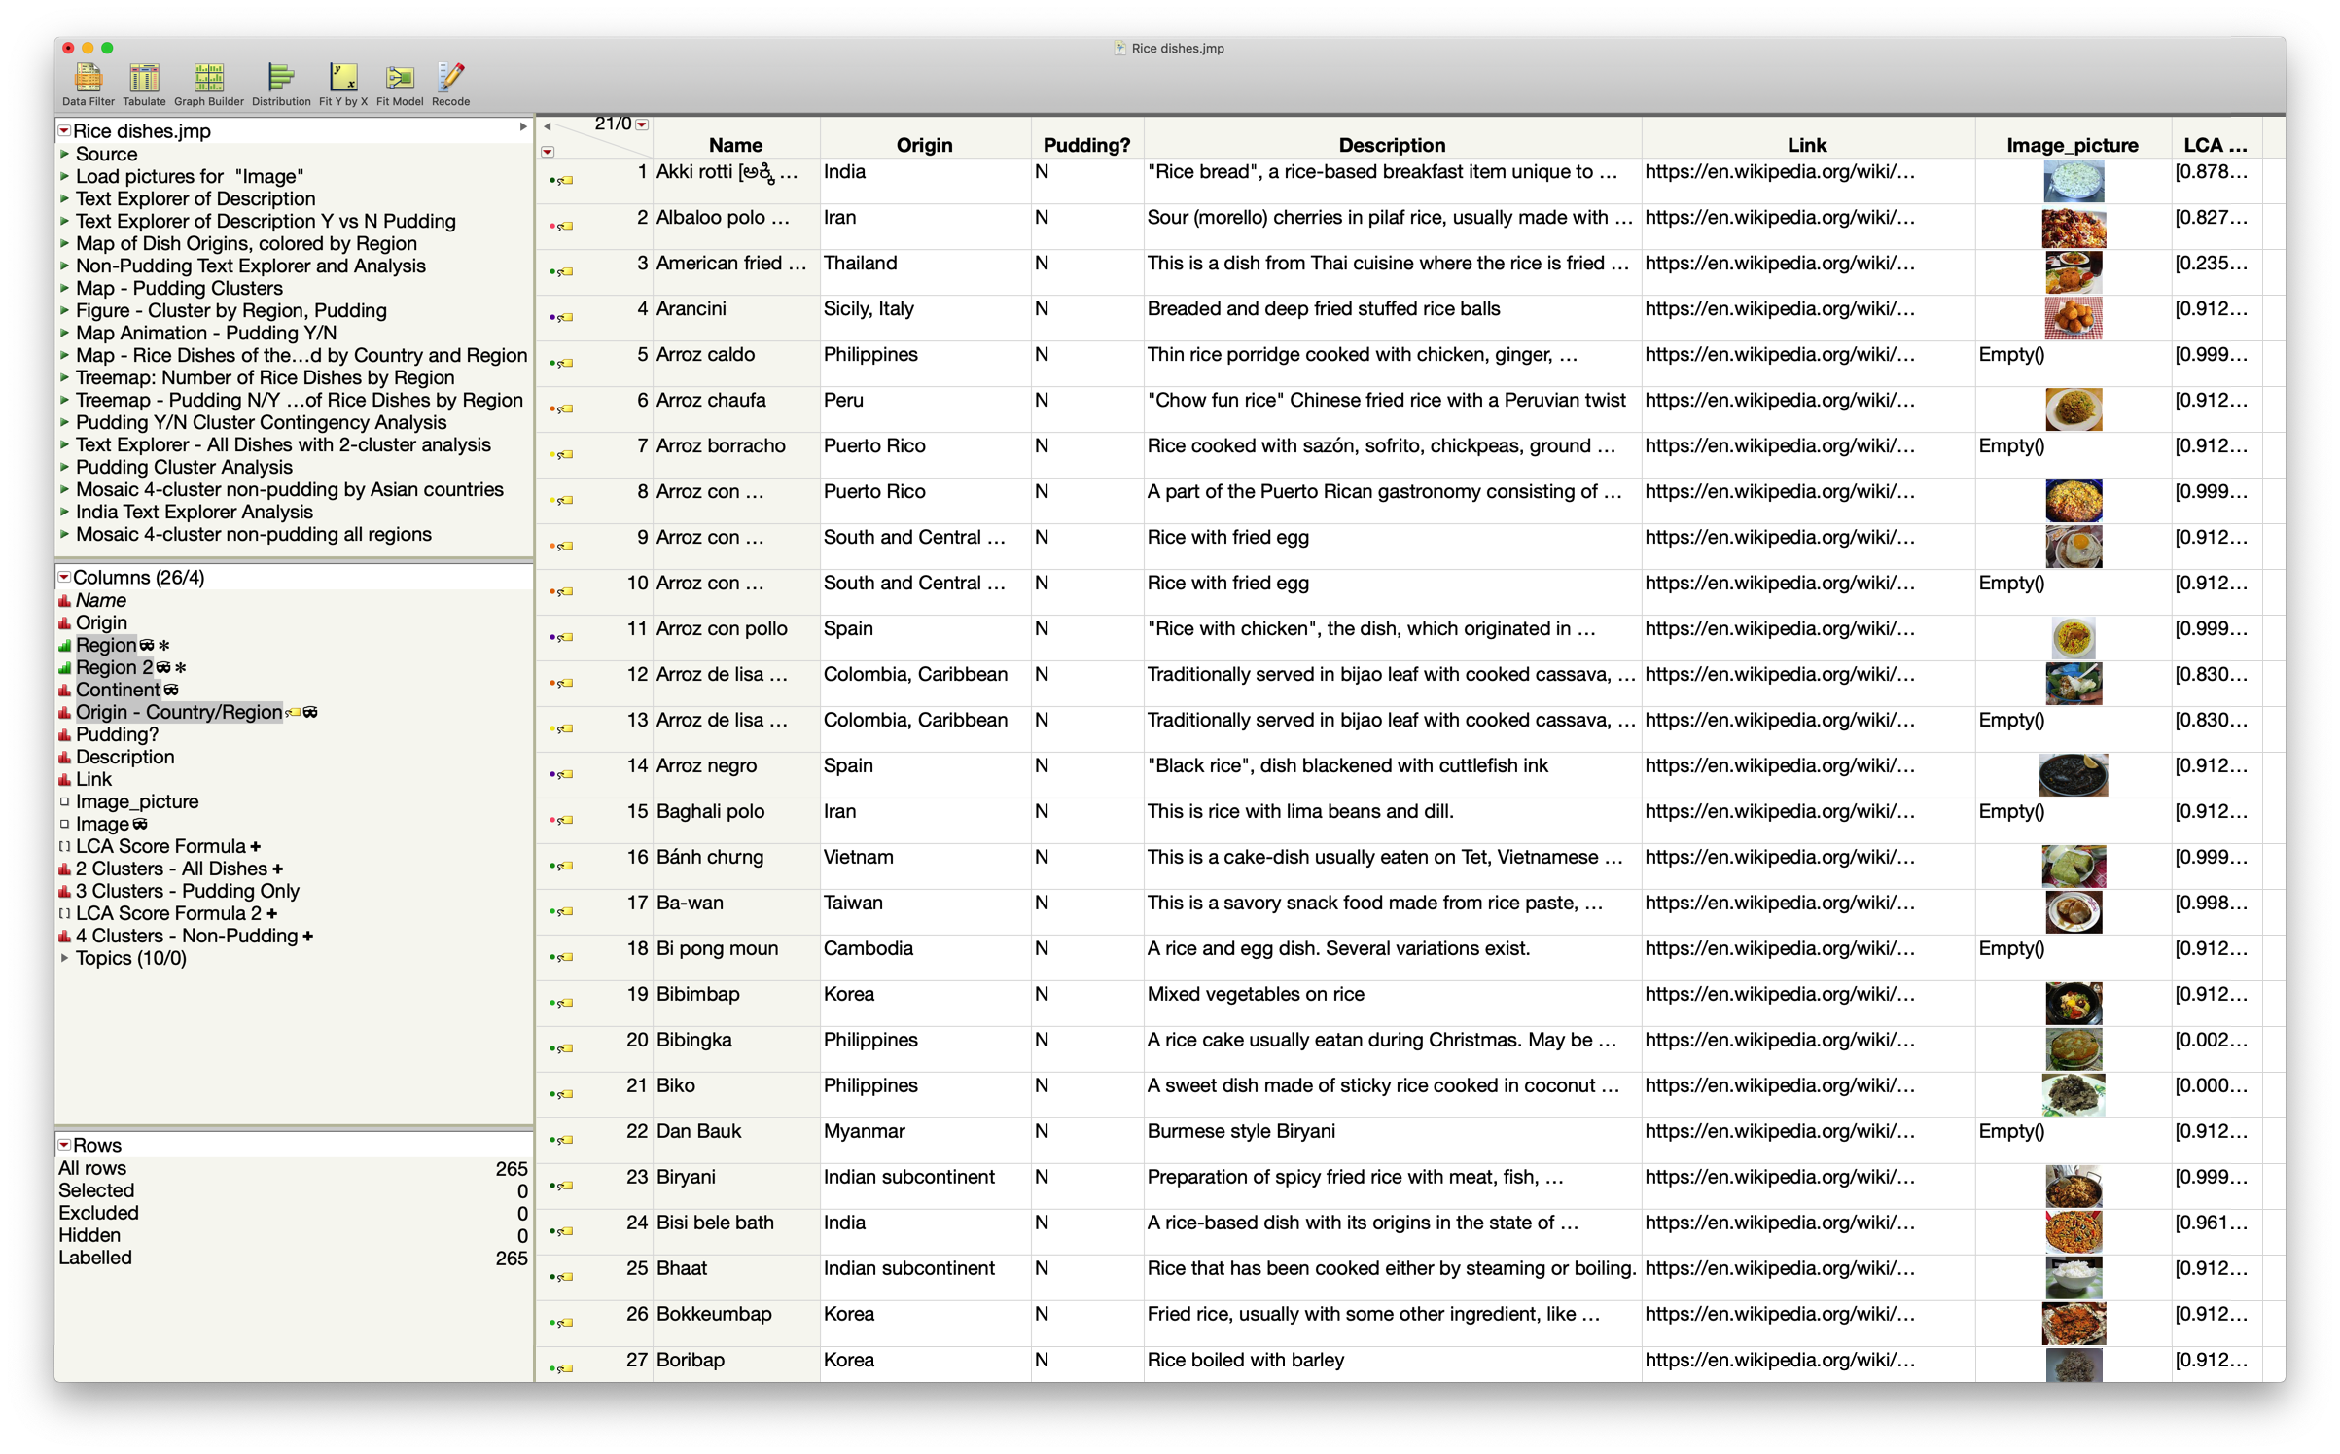
Data from Wikipedia: 265 rice recipes

Slide 3
>70 countries worldwide represented

Slide 4
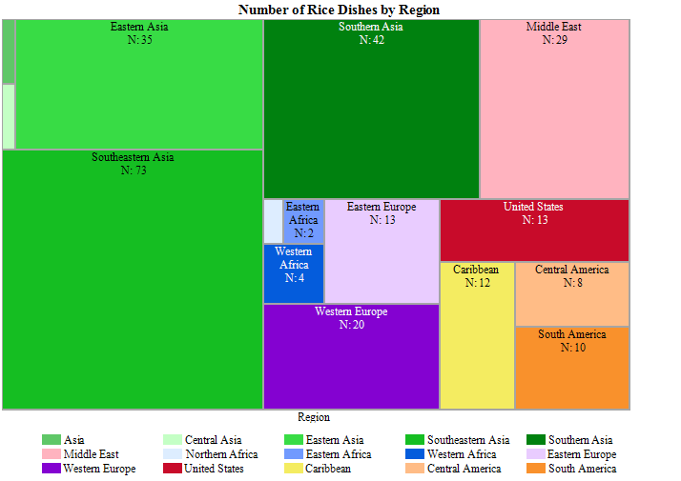
Asia: #1 in unique dishes
More than 90% of the world’s rice is produced and consumed in Asia
Notes:
http://ricepedia.org/rice-around-the-world/asia

Slide 5
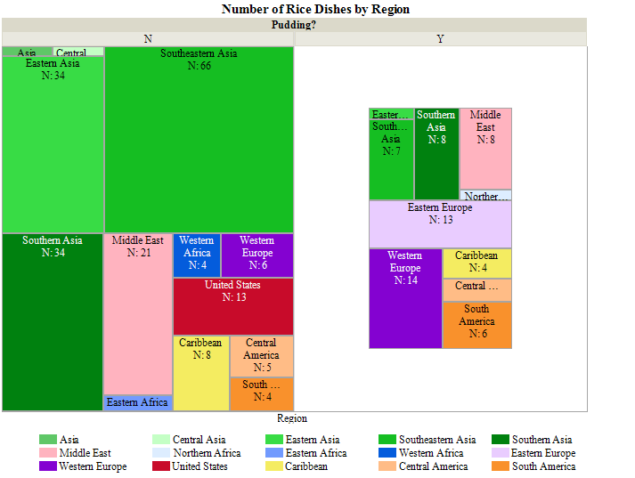
Rice puddings and non-pudding dishes
Most of the dishes here are not rice puddings
But most rice puddings are not from Asian countries, so they are unique as rice dishes overall
There are enough puddings to justify separate analysis

Slide 6
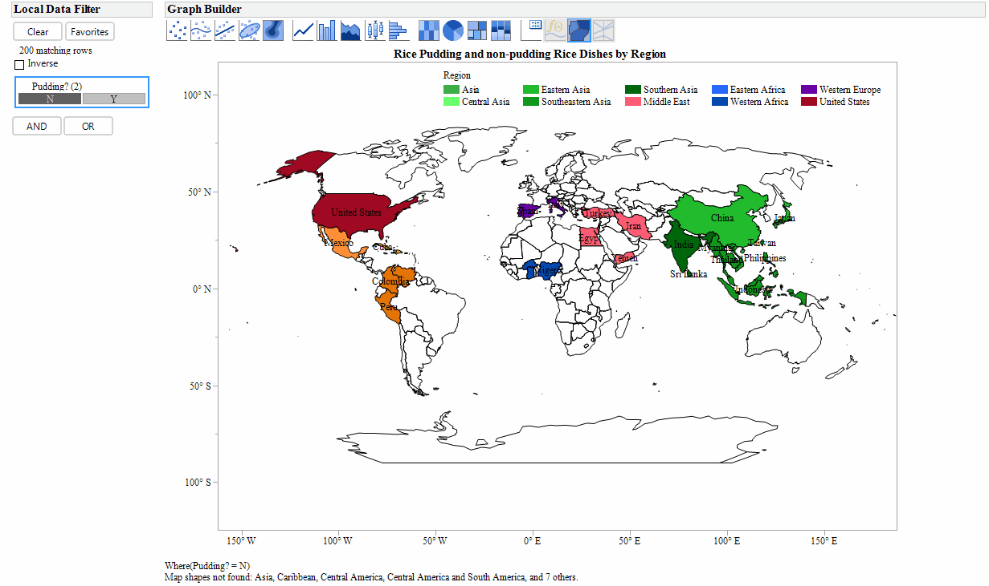
Rice puddings are concentrated in European, Middle Eastern, South and Central American countries, and India
Can puddings be predicted by description?

Slide 7
Text explorer of all dishes
Notes:
Note: terms not related to unique qualities of the dish such as “rice,” “cooked,” “served,” and “accompanied,” as well as terms that referenced region or type of cuisine (e.g. “Chinese”, “Indonesian”) were set as stop words and removed.

Slide 8
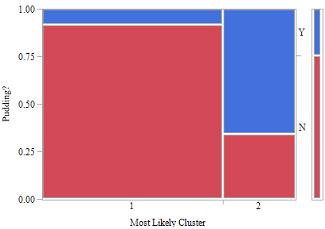
2-cluster analysis of all dishes
Top Terms by Cluster
Mosaic Plot
1 |  | 2
Term | Score | Term | Score
fri· | 2.57 | milk | 8.51
chicken | 2.42 | sugar· | 7.62
meat· | 2.03 | cinnamon | 6.01
veget· | 2.01 | coconut | 4.09
onion· | 1.45 | raisins | 2.91
fish | 1.45 | vanilla | 2.07
bean· | 1.33 | butter | 1.79
tomato· | 1.29 | dessert | 1.69
spice· | 1.12 | sweet | 1.44
pork | 1.05 | sweetened | 1.32
Very few puddings are grouped into Cluster 1
Most puddings are in Cluster 2, but so are quite a few non-puddings
    There are non-pudding rice desserts in Cluster 2
Separation of Puddings by Clustering

Slide 9
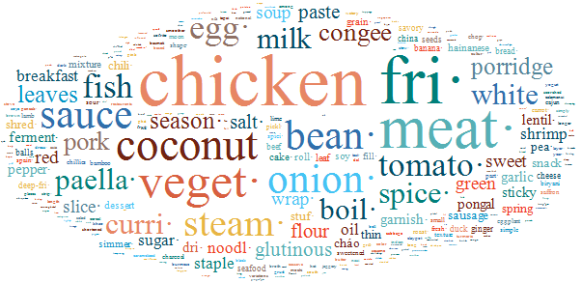
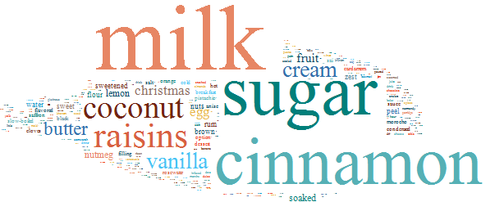
Split text exploration by pudding
Non-Pudding
Rice Pudding

Slide 10
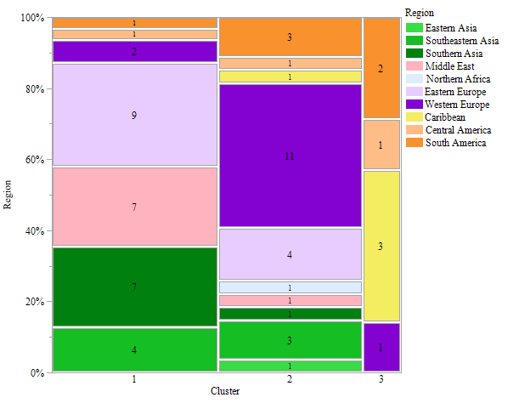
3-cluster analysis of rice puddings
Top Terms by Cluster
Mosaic Plot
1 |  | 2 |  | 3
Term | Score | Term | Score | Term | Score
cardamom | 1.51 | sugar | 12.92 | raisins | 14.23
black | 1.51 | cinnamon | 5.23 | vanilla | 12.32
saffron | 1.51 | milk | 4.03 | milk | 10.82
slow-boiled | 1.51 | brown· | 2.37 | soaked | 7.83
flavored | 1.01 | sweet | 2.37 | rum | 7.77
anise | 1.01 | flour | 2.37 | butter | 7.71
rosewater | 0.90 | fruit· | 2.24 | coconut | 7.59
cold | 0.89 | lemon | 1.84 | peel | 5.89
dessert | 0.88 | sauce | 1.78 | nutmeg | 5.85
nuts | 0.76 | salt· | 1.78 | cloves | 5.83
Cluster 1 includes flavors typical of Indian and Middle Eastern cooking: cardamom, saffron, anise, rosewater
Cluster 2 emphasizes sweetness, cinnamon, and fruit
Cluster 3 contains warm flavors like vanilla, nutmeg, and cloves, as well as rum and coconut that suggest Caribbean flavors

Slide 11
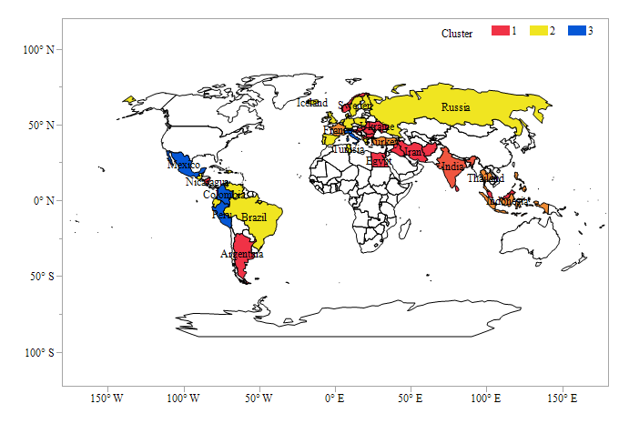
Rice pudding cluster analysis, mapped:
Cluster 1 is associated with the Middle East, Southern Asia, and Eastern European countries
Cluster 2 is associated with Western Europe and some Eastern European countries
Cluster 3 is dominated by countries in the Western Hemisphere

Slide 12
Non-pudding rice dish analysis
More dishes, more complicated
Clear dominance of Asian cuisine

Slide 13
4-cluster analysis of non-pudding
Cluster Characteristics
Top Terms by Cluster
Cluster 1 populated by flour-containing foods (cakes and breads), and basics like soup, eggs, lentils
Cluster 2 includes sticky rice dishes
Cluster 3 is savory and spicy, but vegetarian
Cluster 4 is dominated by proteins like chicken and fish and flavors like onion and garlic
1 |  | 2 |  | 3 |  | 4
Term | Score | Term | Score | Term | Score | Term | Score
cake· | 0.70 | coconut | 6.49 | paste | 5.15 | sauce | 8.67
soup | 0.68 | milk | 4.48 | tomato· | 4.70 | chicken | 7.74
spice· | 0.67 | glutinous | 2.90 | sweet | 4.62 | onion· | 6.27
egg· | 0.57 | wrap· | 2.75 | pepper· | 3.89 | veget· | 5.95
bread· | 0.56 | sticky | 2.74 | red | 3.88 | meat· | 5.61
curri· | 0.53 | steam· | 2.65 | white | 3.87 | fish | 5.22
lentil· | 0.52 | boil· | 2.13 | bean· | 3.54 | season· | 4.54
flour | 0.49 | sugar· | 2.12 | oil | 3.51 | salt· | 4.43
breakfast | 0.30 | shred· | 1.98 | onion· | 3.09 | garlic | 3.74
pea· | 0.16 | leaf | 1.88 | savory | 2.34 | slice· | 3.67

Slide 14
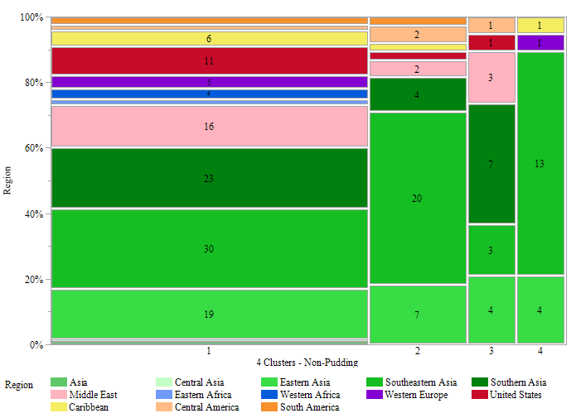
Asian countries occupy >50% of every cluster
Mosaic Plot
Patterns in the Data
A simple clustering scheme does not separate by region neatly
Non-Asian countries most represented in Cluster 1
    Many basic food terms in Cluster 1
Great diversity among Asian countries and cuisines
Just looking at Asian countries might show some patterns

Slide 15
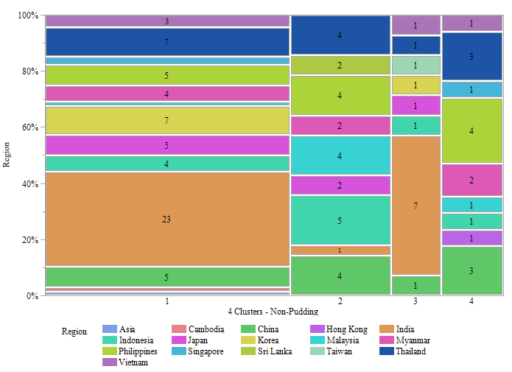
Asian countries by cluster
Most Indian food is in Clusters 1 and 3
    Sticky rice (Cluster 2) not common in India – shows preference for different type of rice
Most countries are represented in every other cluster, indicating the great extent to which cultural cuisine is shared

Slide 16
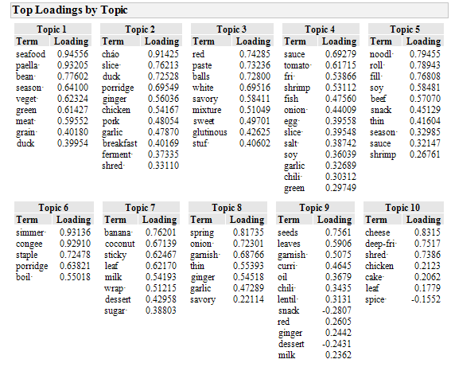
Single vector decomposition of non-puddings
Characteristics of 10 SVD Topics:
Duck and seafood, beans, paella
Pork and poultry; fermented foods
Sweet and savory glutinous rice dishes
Savory dishes with eggs, seafood and strong flavors of tomato, garlic, chili
Rice noodles and rolls with meat
Porridge and congee; simple staple foods
Sweets with tropical flavors
Strong vegetal flavors
Pungent vegetarian dishes, some desserts
Rich foods: cake, deep-fried, cheese

Slide 17
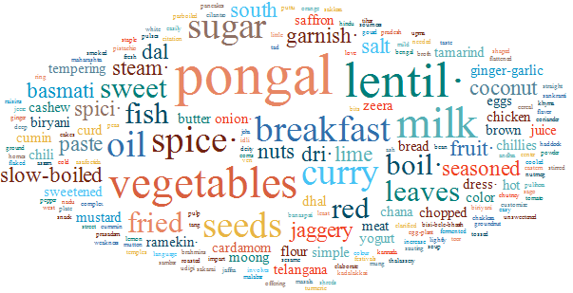
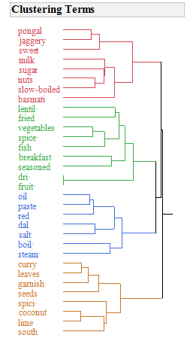
Indian rice dishes(inc. puddings):
Latent Class or SVD Clustering
Simple foods with vegetables, and fish; especially breakfast foods
Pungent curry and dal
Sweet dishes with milk, fruit, and/or nuts
1 |  | 2 |  | 3
Term | Score | Term | Score | Term | Score
breakfast | 3.49 | seeds | 10.24 | sugar | 9.70
vegetables | 2.97 | curry | 8.28 | milk | 8.75
fish | 2.80 | leaves | 8.20 | slow-boiled | 6.58
spice· | 2.17 | oil | 8.13 | sweet | 6.50
seasoned | 2.10 | paste | 6.16 | dri· | 4.45
boil· | 1.34 | garnish· | 6.16 | fruit· | 4.45
fried | 1.32 | salt | 6.16 | nuts | 4.21
lentil· | 0.81 | dal | 6.16 | jaggery | 4.21
steam· | 0.39 | red | 6.16 | basmati | 2.12
basmati | 0.21 | south | 4.15 | pongal | 1.73

Slide 18
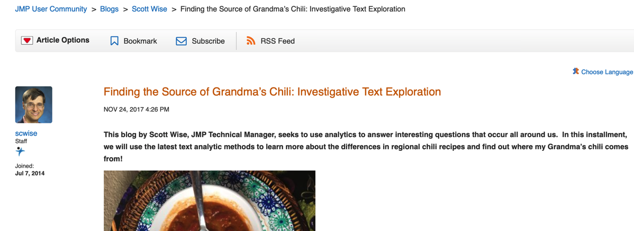
Conclusions
JMP’s Text Explorer capable of telling the story of world cuisines in a quantitative way
  Paints a picture of how people eat
  Shows typical combinations and regional flavor preferences
  More diversity of rice dishes in a culture: they likely eat rice as a staple
There are many ways to analyze rice dishes in this dataset
  We just showed examples by type of food, by region, and within an individual country
  Can be general or specific (as long as you have enough data)
References
Inspired by JMP blog story
abour Chili Recipes by Scott Wise

