Slide 1
Modern Design of Experiments for Rapid and Active Learning
Bradley Jones
Distinguished Research Fellow
JMP Division/SAS

Slide 2
Outline
Introduction
Textbook Designs – restrictions and limitations
Examples of Computer Generated Designs
  When the region of interest is not regular
  When design runs need to be run in groups – blocking
  When characteristics of the experimental material are known in advance

Slide 3
Introduction: Main Message
Use the Custom Designer as an alternative to textbook designs.
Why?
Textbook designs are restrictive
The Custom Designer can generate textbook designs when they are appropriate.

Slide 4
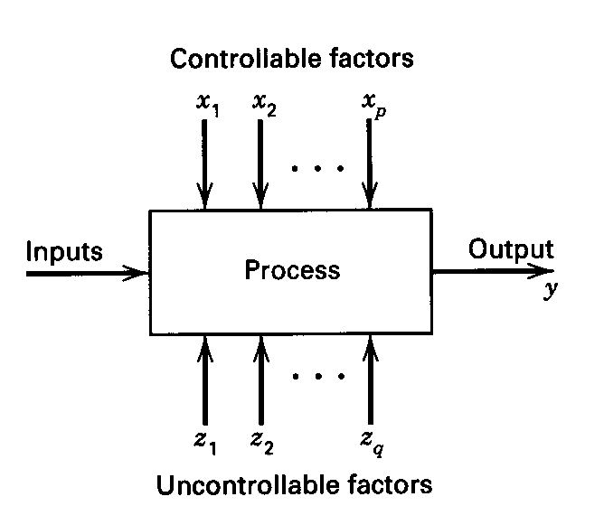
What Is a Designed Experiment?
  a structured set of tests of a system or process

Slide 5
Fundamental to designed experiments are…
Response(s) - outputs
Factor(s) - inputs
Mathematical Model

Slide 6
Why design experiments?
  To establish causal relationships between inputs & outputs
  To use this understanding to match desired outputs
  To do the above efficiently & inexpensively

Slide 7
How do you start doing designed experiments?
  The most frequently used industrial experiment is a factor screening experiment.
  Screening experiments are a useful starting point.

Slide 8
What is a screening experiment?
… screening experiments – [are] experiments in which many factors are considered and the objective is to identify those factors (if any) that have large effects.
Montgomery, D.C. (2005) Design and Analysis of Experiments, Wiley, New York, page 283.

Slide 9
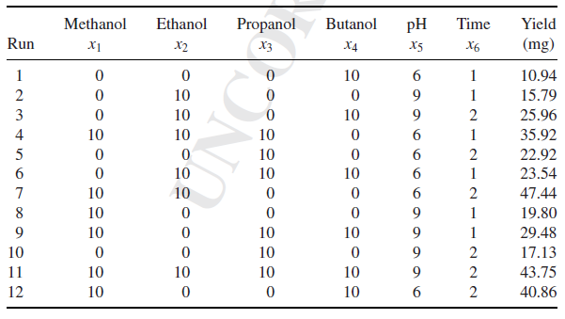
A textbook screening design
Bie, Xiaomei, et. al. “Screening the main factors affecting extraction of the antimicrobial substance from Bacillus sp. fmbJ using the Plackett–Burman method” World Journal of Microbiology & Biotechnology (2005) 21: 925–928 Springer 2005

Slide 10
Implicit Restrictive Assumptions
  Factor effects are linear
    Why? – Every factor has only two settings
  All factor combinations are feasible
    Why? – All pairs of low and high factor settings appear

Slide 11
More textbook design limitations
  Lack of flexibility for replicating runs to estimate error variance
  Lack of flexibility to augment a design to resolve model ambiguity
  Lack of flexibility in numbers of runs in a group (block)
  No ability to use knowledge about the experimental material
  Designs are prespecified – the number of required runs is fixed
  Applicable models are limited
  Lack of flexibility in the types of factors
  Lack of flexibility in dealing with hard-to-change factors

Slide 12
Consequence of Textbook Design Limitation
  Experimenters simplify the problem description to accommodate the use of a prespecified design.
  Preferable alternative to textbook design
  use computer algorithms to construct designs that match all the problem specific requirements
  “Design to fit the problem – Don’t change the problem to fit the design”

Slide 13
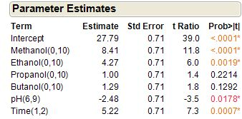
Software Demonstration
All Main Effects Model

Slide 14

Optimal replication of runs in a design
Replication is one of R. A. Fisher’s 4 design principles
  Randomization
  Blocking
  Replication
  Factorial principle

Slide 15
Reasons to Replicate Runs
  To provide a model independent estimate of the error variance.
  To lower the variance of model coefficients.
  To allow for a lack-of-fit test.

Slide 16
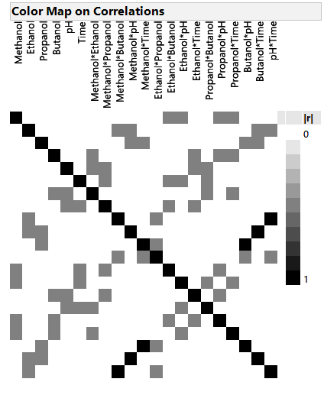
Software Demonstration

Slide 17
Optimal Design Augmentation
Augmenting Previous Experiments with New Runs
Augmenting experiments supports the strategy of sequential experimentation.

Slide 18
Reasons to Augment
  To lower the variance of model coefficients.
  To confirm model predictions.
  To resolve model ambiguity.

Slide 19
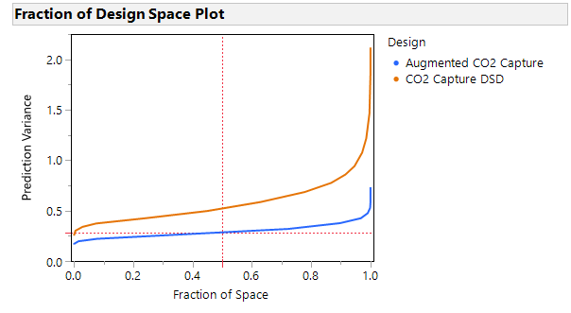
Software Demonstration

Slide 20
DOE when not all factor combinations are feasible
Accommodating a Constrained Factor Space
Goals
  Show the practical need for design when there are restrictions on the factor settings.
  Provide an example of an experiment with factor constraints that also accommodates curvature in the factor-response relationship.

Slide 21
Reasons to Impose Factor Constraints
Certain combinations of factor settings may not work and you know this in advance.
Other combinations of factor settings may be dangerous.
Other combinations could damage the processing system.

Slide 22
Design employing constrained factors
Scenario – Bonding electronic chip to a pacemaker
  Two factors – adhesive and temperature
  Response is peel strength of the bond
  Combinations involving high settings of both factors or low settings of both factors are known to result in low yield.

Slide 23
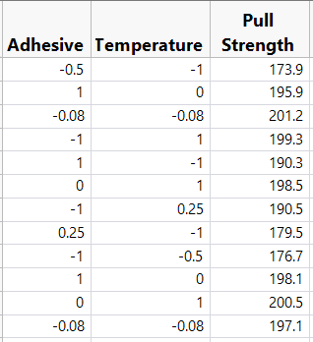
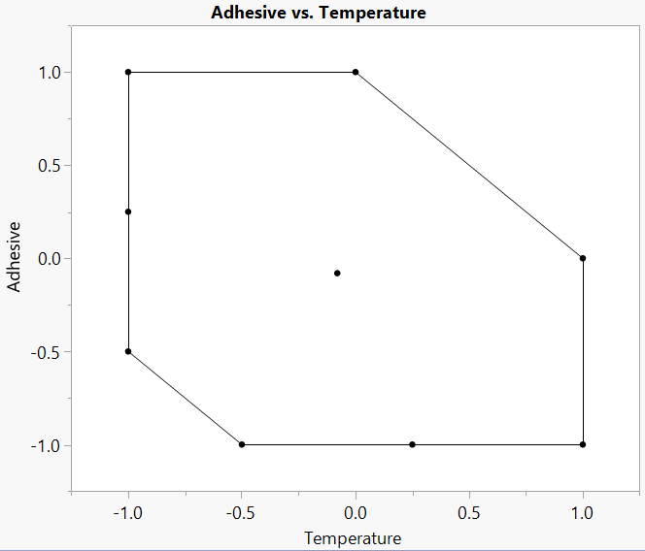
Design with Response Data

Slide 24
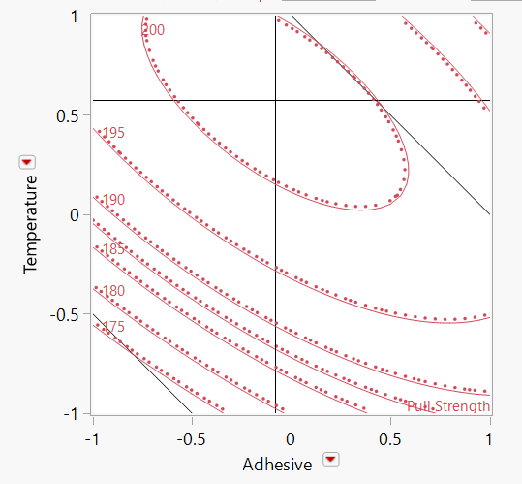
Software Demonstration

Slide 25
A design with homogeneous groups of runs - blocks
Many processes have sources of variability that are not controllable factors.
Example: day-to-day variability
This leads to groups of observations.
The groups are called blocks.
The grouping variable, day, in this case is called a blocking factor.
We expect that runs within a day are more similar than runs between days

Slide 26

Vitamin Stability Experiment

Slide 27
Vitamin Stability Experiment
Vitamins degrade when exposed to light
Can be stabilized when embedded in a fatty molecule
Five different fatty molecule possibilities
Binding with sugar might help as well to stabilize the vitamins
Day-to-day variation due to calibration of measurement apparatus

Slide 28
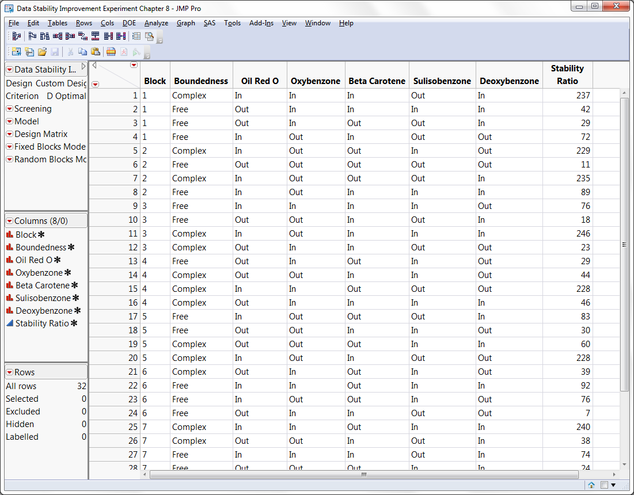
The data

Slide 29
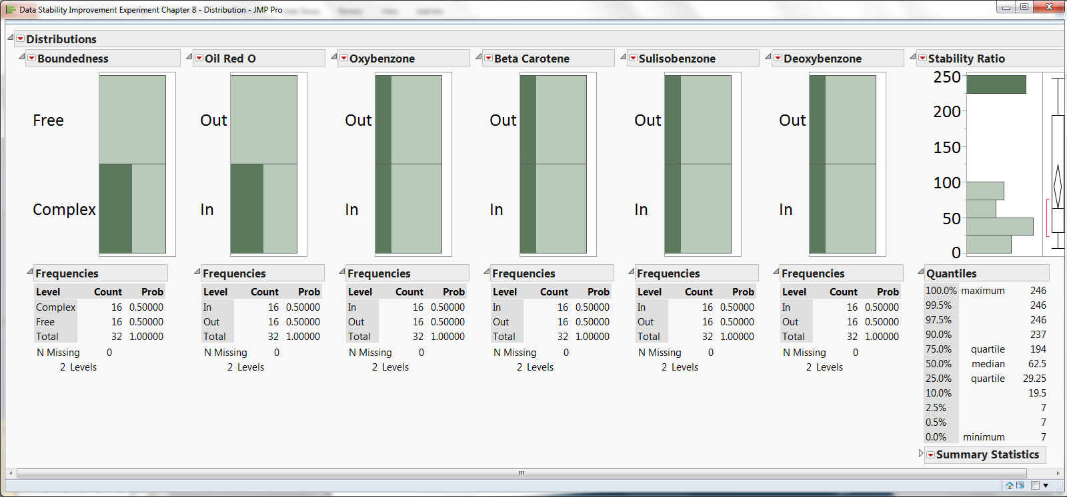
Graphical descriptive analysis

Slide 30
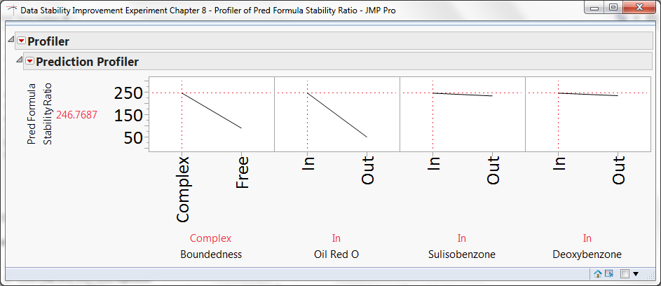
Software Demonstration

Slide 31
DOE With Covariate Factors Known in Advance
Designing around prior information about experimental units
Goals
  Explain the practical utility of taking information about the experimental units into account in design
  Provide an example of an experiment with a covariate factor.

Slide 32
Reasons to Use Covariate Factor Information
You may have more experimental material than necessary and need to choose which material to use.
Certain characteristics of the experimental material may strongly influence the response and you want to make sure that these characteristics are as little correlated with the effects of your control factors as possible.

Slide 33
Case Study Using Covariate Information
Scenario
  You have 40 batches of polypropylene to use in your study.
  You have a budget of 18 runs.
  You have information about two continuous and one categorical characteristic for each batch.

Slide 34
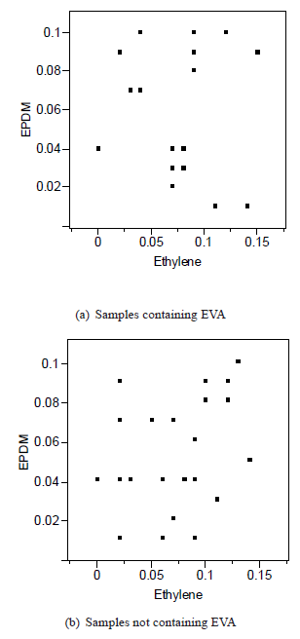
Graphical View of Covariate Information

Slide 35
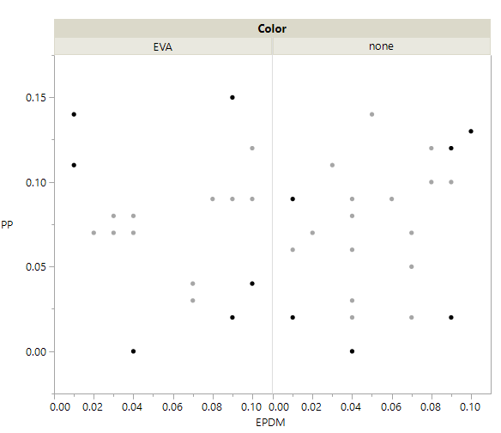
Software Demonstration

Slide 36
Summary of DOE with Covariate Factors
Including covariate information, when it is available, is a powerful way to account for known sources of variability.
This approach can also be used to adjust the time order of runs when the response is subject to linear drift over time.

Slide 37
Summary
This talk provided a taste of a new approach to industrial design of experiments.
Each of the examples emphasizes the approach of designing experiments to solve the problem as stated rather than to change the requirements in order to use a textbook design.

