Slide 1

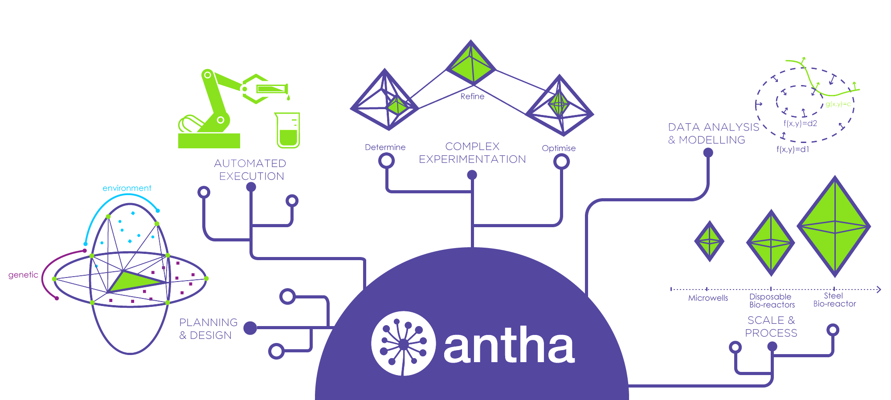
Computer Aided Biology & Automation
of Rationally Designed Experiments
Click above for an introduction to SYNTHACE
Steven R. Brown, Charlotte Ward, Vishal Sanchania, Christopher Grant, Lily Nematollahi, Michael Sadowski & Markus Gershater
WestWorks, 195 Wood Lane, London, W12 7FQ
Biology is complex.
There is a necessity to embrace this complexity and adopt ways of working that focus around iteratively understanding dynamic and multifactorial ‘biological parameter landscapes’, particularly for the development of therapeutics.
We at Synthace have introduced Computer Aided Biology as a conceptual framework and an emerging ecosystem of digital-to-physical research tools that allows biological researchers to approach experiments of increasing complexity in a higher throughput, non-reductionist and iterative manner.
Researchers at Synthace use the JMP DOE platform to rationally design and evaluate experiments. Experimental designs are interpreted by our own software (Antha) into low level liquid handling instructions that are device agnostic, yielding protocols that can easily be reproduced and shared across teams. Moreover, Antha optimises protocols by identifying commonalities to be transferred and can specify constraints such as order of transfer. The combination of these tools is allowing us to increase the factor space in our experiments and gain knowledge about dynamic and multifactorial ‘biological parameter landscapes’.
Computer Aided Biology
Antha DOE Workflow
Industrial Case Study
Click above to learn more
Click above to learn more
Click above to learn more
Figure 1. Synthace's software platform Antha. Eloquent control of liquid handling is at the core of the Antha platform, resulting in a biology-centric user experience that improves reproducibility and traceability, all whilst enabling the scientist to undertake more complex experimentation.
s.brown@synthace.com | synthace.com

Slide 2

(Executive Summary)
Design: Simulate: Execute: Analyse: Repeat
Computer Aided Biology
Click above for an introduction to SYNTHACE
Bio Design
Executive Summary
Computer Aided Biology is the emerging ecosystem of tools that augments human capabilities in biological research. It is comprised of two domains: the Digital and the Physical.
The Digital, powered by artificial intelligence, includes software for designing and simulating biological systems, as well as methods of collating, connecting, structuring and analysing experimental data from wet lab experiments.
The Physical, enabled by automation, includes systems that allow for the seamless transfer of simulated biological designs into real ‘wet lab’ experiments via abstracted experimental design, logistics simulation and execution.
This digital-to-physical workflow is similar to what previously occurred in electronic design automation, the aerospace industry, and the automobile industry. Only by connecting all aspects of the ecosystem together, creating an integrated loop, will scientists be able to address the challenges of 21st century biology.
DIGITAL
Powered by AI
Models
Bio Simulation
Experiment Design
PHYSICAL
Powered by Automation
Building Blocks
Experiment Simulation
Analysis
Experiment Execution
Data Management
Figure 2. The Computer Aided Biology cycle, connecting the digital world with the physical; powered by AI and Automation.
In this white paper, we further show how the emerging Computer Aided Biology ecosystem is evolving, and how many companies are striving towards the same goal of an integrated suite of tools.
⤺Abstract
Click above to return
s.brown@synthace.com | synthace.com

Slide 3


Antha DOE workflow
Click above for an introduction to SYNTHACE
Experimental Design
Design complex, multi-factorial experiments using predefined protocols, such as Type IIs Construct assembly, or create your own using the visual workflow editor.
Using Antha, scientists can now afford to move away from OFAT experimentation, enabling the testing of genetic and process factor interactions within complex biological parameter landscapes.
By leveraging Antha’s DOE capabilities: DOE planning and execution is made more accessible and flexible, experimental provenance is logged and data structured.
The Antha DOE workflow delivers the following benefits for scientists:
Automated DOEs in days rather than weeks
Greater experimental resolution of complex systems
Better understanding of the scientific principle of a process
A big step towards building a robust bioprocess
Increased likelihood of success
Scientists can expect to save up to 250% more time when compared to manual DOE planning and execution (Figure 3).
Simulate & Execute
With device drivers for automated liquid handling platforms and other lab hardware, Antha automates experiment execution and management.
Data Integration & Management
Antha connects to your analytical equipment to automatically capture and record data during the experiment workflow, allowing for dynamic data visualisation and rapid insight into any aspect of your protocols
The following links will take you through the execution of the Antha DOE workflow
1. Planning & Design
Click above to learn more
2. Automated Execution
Figure 3. Manual DOE (blue) versus Antha DOE workflow (green)
⤺Abstract
⤺Industrial Case Study
3. Import Results
Click above to return
Click above to return
s.brown@synthace.com | synthace.com

Slide 4
Antha DOE workflow
Planning & Design
Click above for an introduction to SYNTHACE
Other key factors names interpreted by the Antha DOE workflow and affected during the execution of the experiment
Inoculum: the source(s) of the seed culture
E.coli DH5alpha, E.coli BL21
Inoculum Dilution: the dilution factor(s) by which the inoculum will dilute the media within each well
Total Volume: the total volume(s) of media that will be dispensed into each well
RPM: the rate(s) at which an incubator would shake the culture during an experiment
Reaction Temp & Reaction Time: the temperature(s) & duration(s) at which an experiment is to be performed
Base Medium: the diluent(s) required to add to each well providing the base media up to the specified total volume of a well
Replicates: indicates the replicate number for a run within the experiment
Antha permits blocking by any specified factor, particularly useful if there is a physical or temporal constraint during the execution of the experiment i.e. two different reaction temperatures
The JMP DOE platform is used to rationally design biological experiments (Figure 4). The design table is exported as a .csv, which is then parsed into Antha defining the runs required for the experiment.
Antha will interpret factors (column headers in the .csv) that include a concentration or volume unit as a liquid component of the experiment e.g.
Glycerol (g/L), Glycerol (mM), Glycerol (X) Glycerol (v/v) or Glycerol (µl)
A value included in the factor column will then be interpreted as its set point e.g. 100 mM of Glycerol
The order in which the liquid components are included in the .csv determines the order in which the liquid handling device will dispense them.
If a factor is used that describes different types of a liquid component e.g. Yeast Extract Source, and another factor that describes the concentration of those types, Antha can “pair” these factors dispensing the type of liquid component at the stated concentration during the automated execution of the experiment.
1. Planning & Design
2. Automated Execution
Figure 4. Simplified creation of experimental design using the JMP DOE platform
Click above to learn more
⤺Abstract
⤺Back to previous
3. Import Results
Click above to return
Click above to return
s.brown@synthace.com | synthace.com

Slide 5
Antha DOE workflow
Automated Execution
Click above for an introduction to SYNTHACE
Auto Merge Factors: to make intermediate master mixes of compatible sets of liquid components
Antha identifies commonalities within the liquid component concentrations to be transferred for each experiment run and performs intermediate dilutions of the commonalities in order to optimise tip usage and protocol run time
Key user defined inputs of the workflow include:
Design file: to upload a .csv to update the experiment design as determined within the JMP DOE platform
Fixed stock concentrations: to specify fixed concentrations of stock liquid components
Antha will use this information to calculate the required volumes to execute the experiment removing the need for the scientist to calculate such low level details
Liquids on specific labware: to accommodate liquids that may require special handling such as enzymes stored in a vial, on a cooler block at 4˚C
Plate type: to specify the hardware required in the experiment, unless this is included as a factor in the design of the experiment
Stages to run: where liquid components can be grouped together in order to partially fill plates or provide prompting before performing a liquid handling action. A useful feature for the execution of multi-phase processes such as the addition of an inducer to a bioprocess
Devices: different labware and automated liquid handling platforms can be chosen to execute the required DOE workflow
(a)
(b)
Figure 6. (a) The inputs provided by a user into the high level Antha DOE workflow are used by the software to calculate the low level automation instructions to perform the experiment in an optimised and robust manner. (b) The execution of the DOE workflow is facilitated with the experimentalist being provided all the details required to start the experiment including materials (labware), stocks and the devices deck configuration.
1. Planning & Design
2. Automated Execution
Figure 5. The user interface for the Antha DOE workflow
⤺Abstract
⤺Back to previous
3. Import Results
Click above to return
Click above to return
s.brown@synthace.com | synthace.com
Click above to learn more

Slide 6
Antha DOE workflow
Import Results
Click above for an introduction to SYNTHACE
Antha provides a formatted results file to use within the JMP software, permitting multivariate analysis of the automated experiment. The file includes the experimental design, responses, utilised labware (including positional information for each run), liquid component volumes and associated orders of addition.
“The combination of these tools are allowing us to increase the factor space in our experiments and gain knowledge about dynamic and multifactorial ‘biological parameter landscapes’.”
Steven Richard Brown PhD
Bioprocess Scientist
”please feel free to come and find me at the conference to discuss any questions or comments you may have"
Figure 7. The user interface within Antha to download the experiment design and results
Figure 8. How to upload the Antha experiment results file into the JMP Analysis platform
⤺Abstract
⤺Back to previous
Click above to return
Click above to return
s.brown@synthace.com | synthace.com

Slide 7
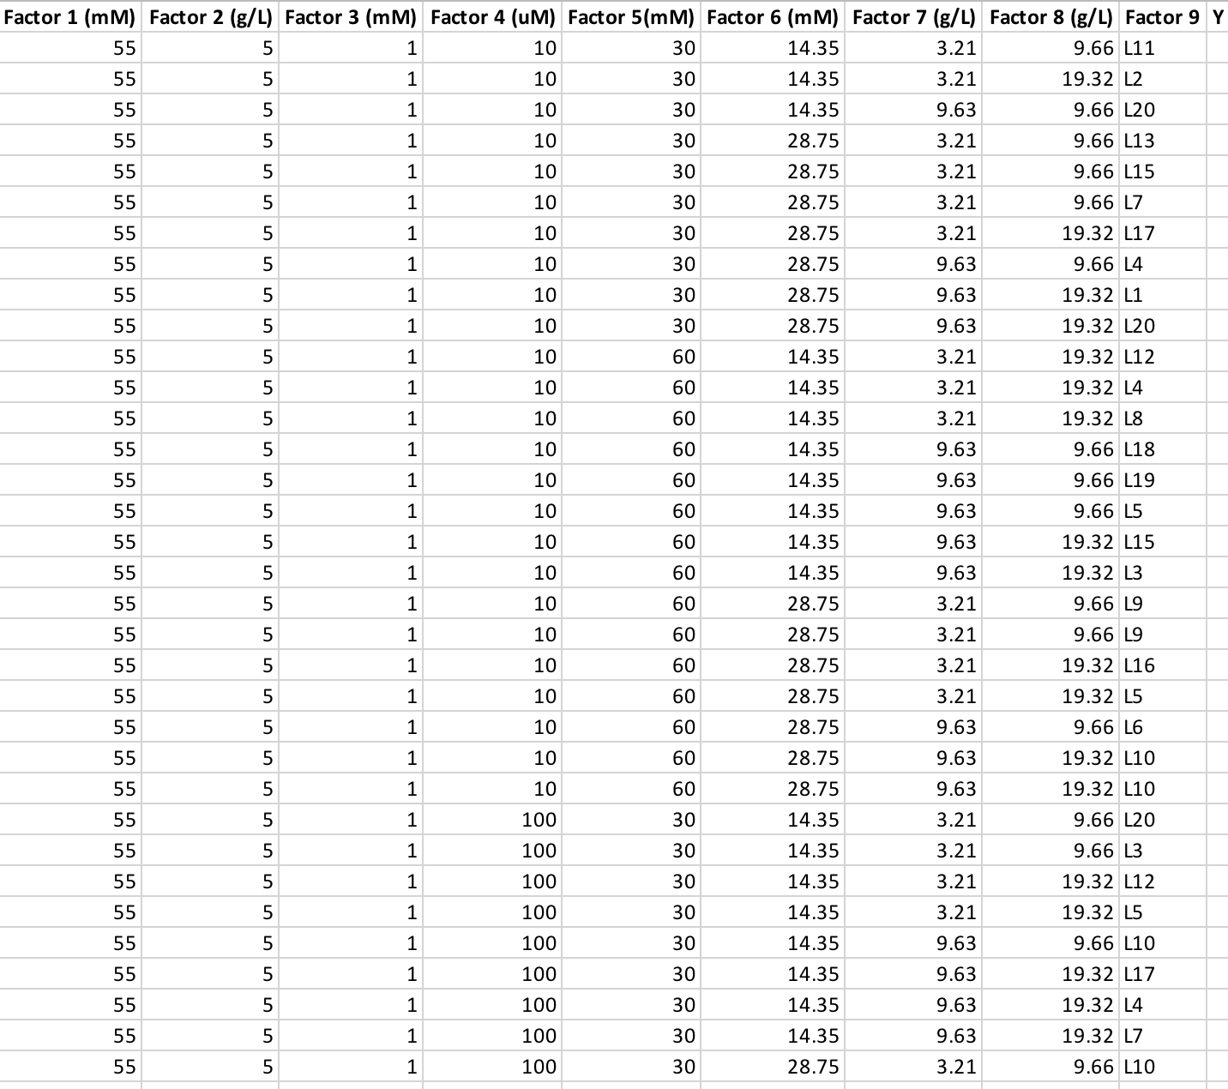
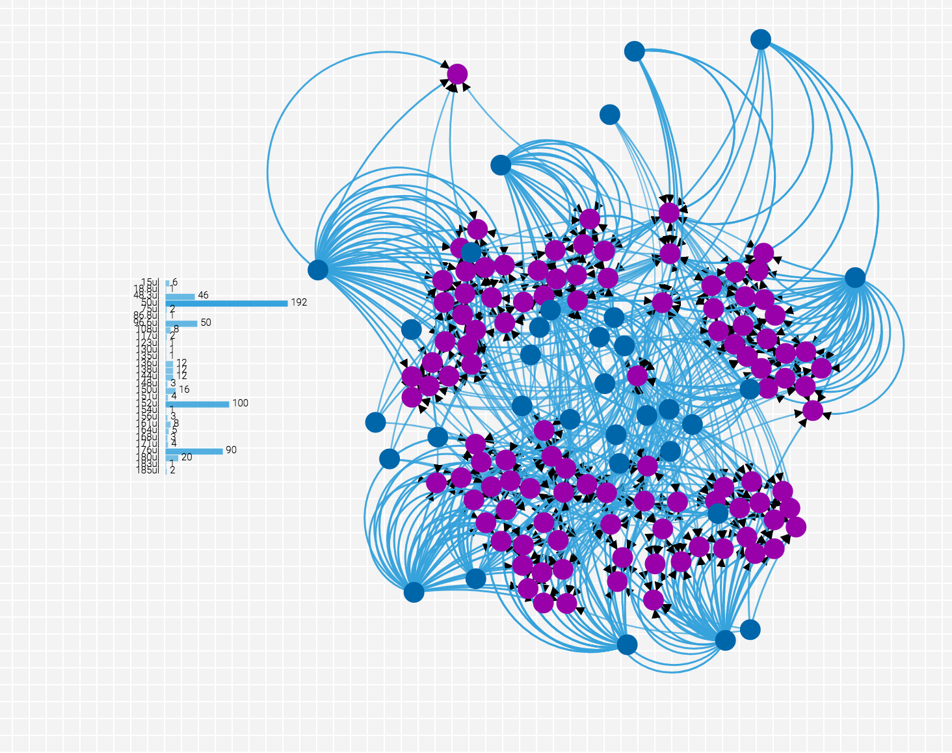
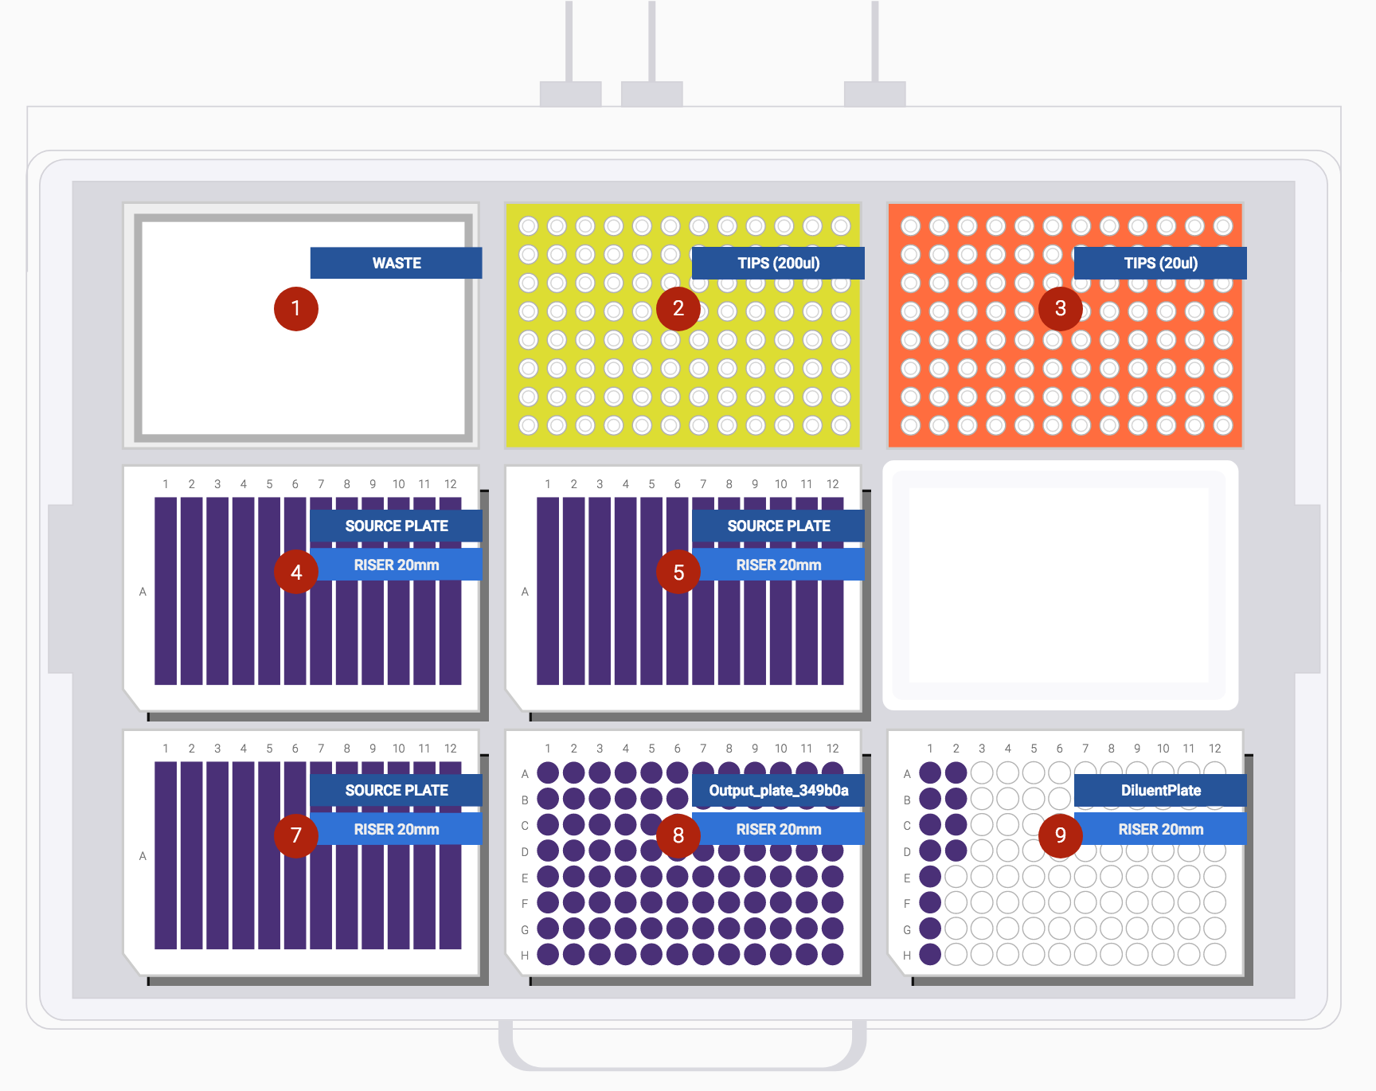
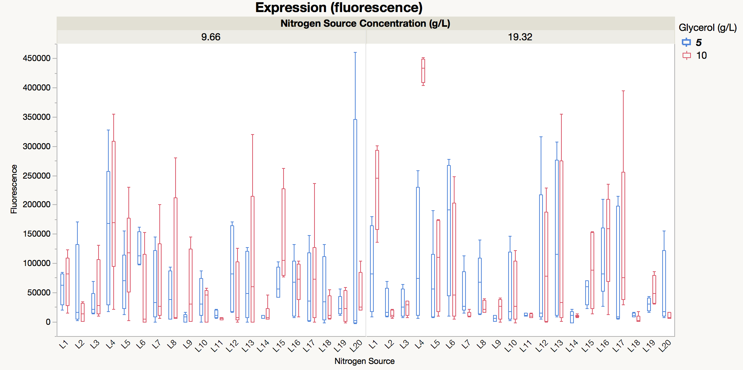
Industrial Case Study
Antha DOE Growth Medium Optimisation
Click above for an introduction to SYNTHACE
Aim
Maximise the yield of a high value biologic, by exploring the impact of twenty different peptone sources simultaneously in the context of eight 2-level growth medium factors.
Method
An efficient custom design, exploring 384 unique experimental runs, of an otherwise 5,120 run full-factorial experiment, were seamlessly executed by Antha. During execution and planning, Antha implements a grouping algorithm to reduce the number of liquid handling actions and tips required to perform the DOE. In this case, Antha reduced the number of liquid handling actions by 74% in comparison to manual execution.
Result
The best growth medium combination was identified (Figure 9e) and scaled successfully in bioreactors, performing better than the state-of-the-art available to the user.
Upload .csv into Antha DOE Workflow
(a)
(c)
Antha DOE Workflow
(d)
(b)
Click above to learn more
Figure 9. (a) an example .csv experimental design generated in JMP, (b) Antha DOE workflow, (c) quarter of the high-dimensional liquid handling actions performed by Antha to execute the workflow, (d) simple deck layout requested by Antha for DOE set-up and (e) impact of Nitrogen Source Type and, concentration and glycerol concentration on amount of product formed in the context of other factors. Nitrogen source L4 resulted in greatest product formation, which was further increased by doubling the amount of glycerol.
“Antha increased throughput by an order of magnitude and enabled an estimated 25% reduction in overall vector construction time lines, a 33% reduction in costs, while dramatically reducing manual steps and increasing robustness” multinational bio-pharmaceutical client
⤺Abstract
(e)
Click above to return
s.brown@synthace.com | synthace.com

Slide 8
We believe that technology can empower scientists to unleash the infinite potential of biology
About Synthace
Synthace is an interdisciplinary team of computer scientists, biologists, mathematicians, and chemists pioneering new ways of working digitally in biology. We’re backed by world-class investors and a growing collection of partners working on the hardware, software, and wetware required to truly industrialise biology’s potential
We were founded by a team of biologists in 2011 as a bio-process service provider, optimising the existing bio-processes of our clients using a multi-factorial experimental approach. We used automated robotic equipment to run our high-dimensional, complex experiments. But we quickly learned that it was difficult to achieve the level of complexity and throughput we needed with the equipment’s software.
Workflow Editor
A unique drag and drop design environment rapidly reduces time to insight
Dashboard
Our platform delivers end to end integration, and is compatible with a wide range of lab hardware
Easy Execution
Control of liquid handling is at the core of Computer Aided Biology; this allows the rapid translation of ideas into results
So we decided to build our own software - something that would not only communicate with our lab hardware but also help us plan and execute complex, multi-factorial experiments.
Our software platform, Antha, produced a hundred-fold increase in our experimental throughput. As a result, we shifted our focus to empowering our clients to run these complex experiments themselves using Antha.
Deck Layout
Designed by scientists to enable you to focus on the science: not the pipetting
⤺Abstract
Click above to return
s.brown@synthace.com | synthace.com

