Slide 1
Analyzing Textual Patent Data to Create a Patent Landscape
March 14, 2019
JMP-Discovery Summit, Copenhagen, March 13 – 14, 2019
Markus Schafheutle, allnex
Mahmoud Hammoud, JMP/SAS
Johann Billiani, allnex

Slide 2
Background
Patents are …
  not only a source of technical information and a legal tool to forbit other companies / individuals activities on a given field of interest
  also interesting sources of information to analyze customers and competitors areas of activities
  Following this trends it becomes visible, what a company‘s strategy is and how it has developed over time
Patents are an important information source in business intelligence
To stay on track with all this information a manual analysis is nearly impossible. Potential corpuses include several thousands, up to millions of documents
A statistical approach becomes very necessary …
March 14, 2019

Slide 3
Abstract
Recent advances in processor technology have made possible the analysis of large amounts of free-form text data, which requires computationally intensive (sparse) matrix-based techniques. Tools like JMP Text Explorer allow the user to explore and model this type of data from the comfort of their own laptops. In this paper, we show a workflow that was used to analyze textual patent data (descriptions, summaries, ratings) acquired from a patent database in order to create a patent landscape. The latter shall allow a better understanding of current industry trends and also help identify “anomalies” or gaps, e.g., areas that are not being researched much. Special emphasis will be placed on the importance of sharpening the parsing procedure (e.g., stop list, phrase list, stop words) in order to better extract the signal from the noise, as well as tips and tricks for text analysis based on our experience working with this kind of data.
March 14, 2019

Slide 4
Content
Guide through the flow of
  Defining the correct corpus
  Data cleansing
  Setting up stop-words, phrases and recodes
  Singular value decomposition
  Topic analysis
  Topic spectra clustering
  Do all correlations of interest
Building a dashboard for all these analytical results
March 14, 2019

Slide 5
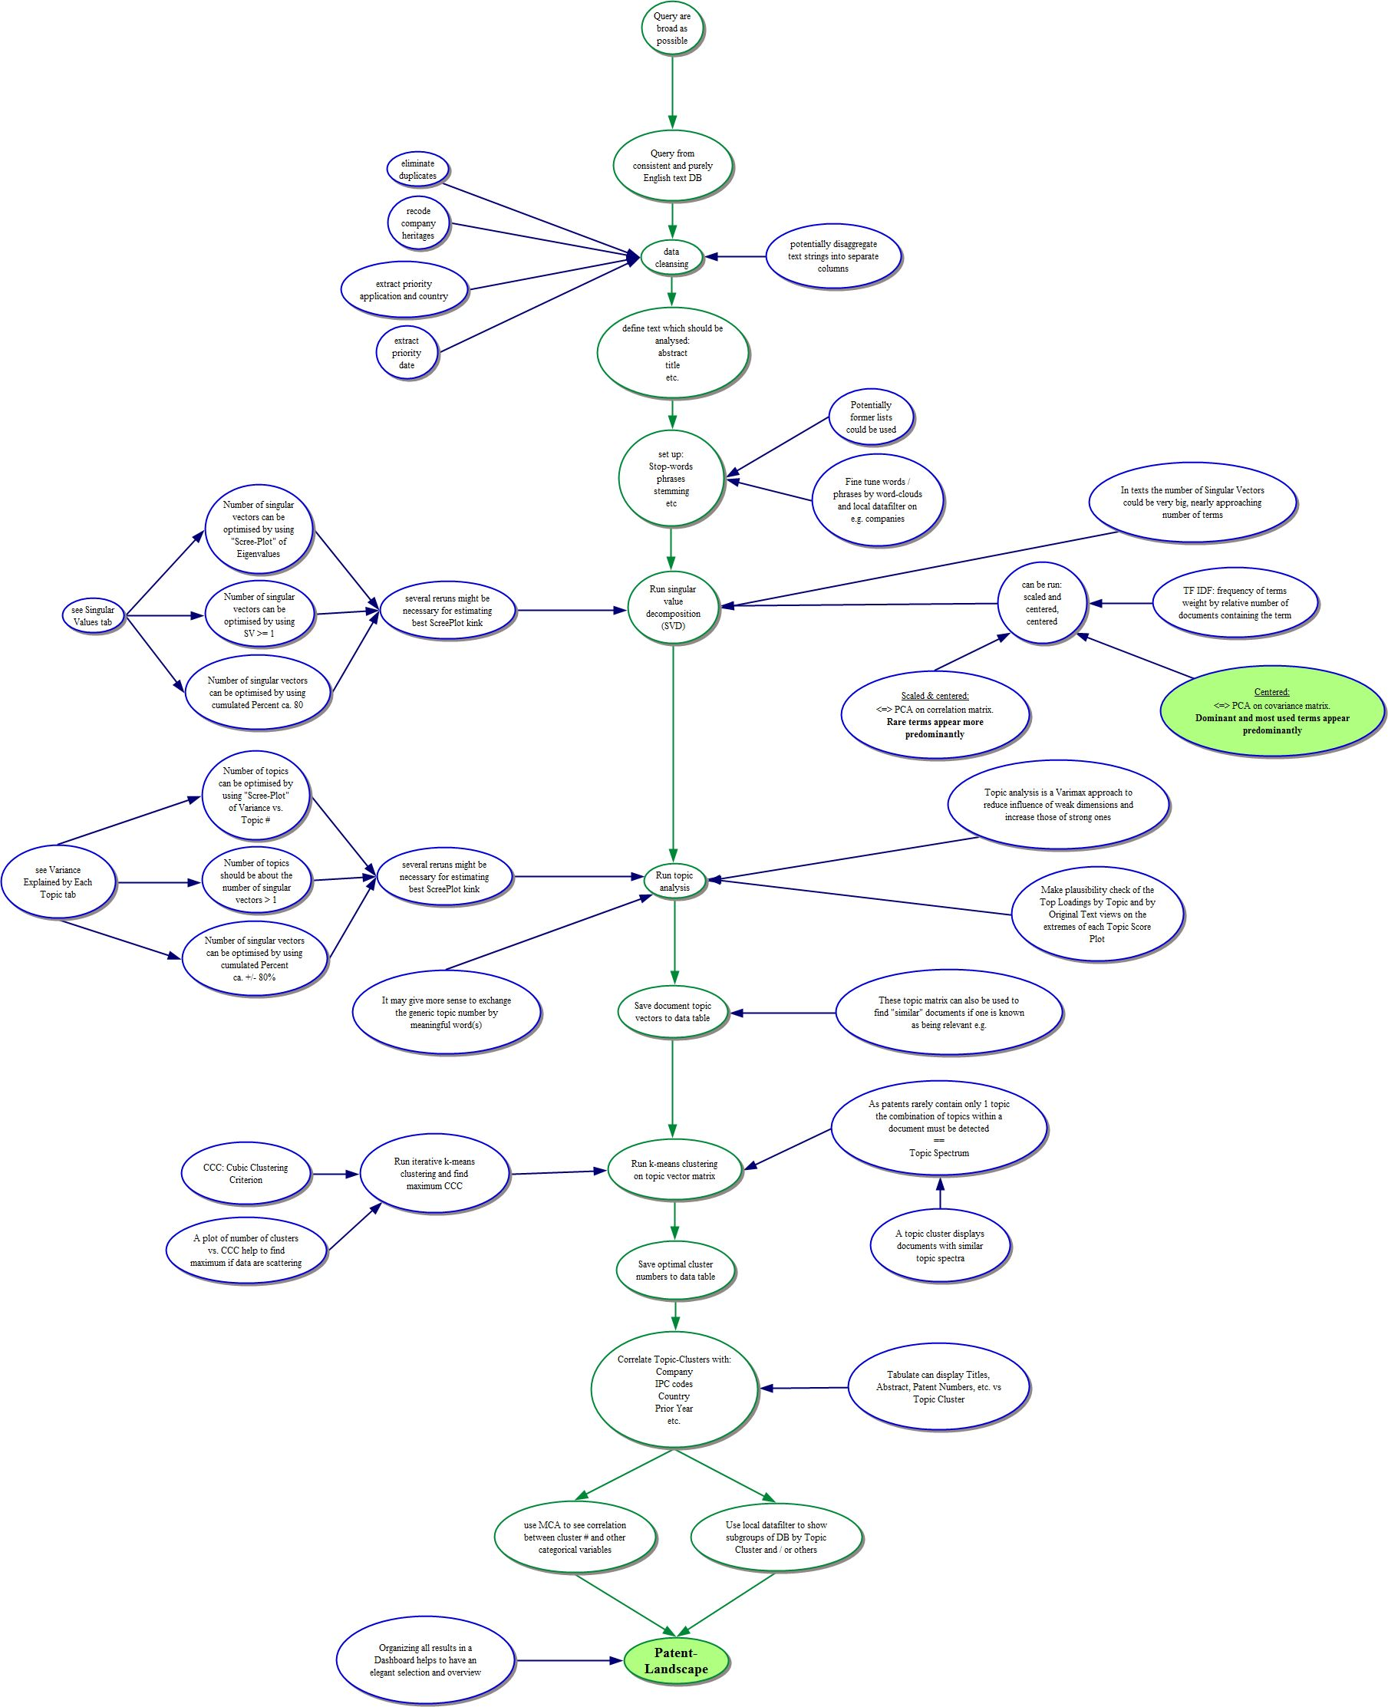
Flow chart
Please find the big flow-chart of our analysis, in the attached jpg-file
The JMP file cannot be published here for copyright reasons
General Flow for Patentmining.jpg
March 14, 2019

Slide 6
March 14, 2019

