Slide 1




An add-in to analyze field trial data: the Custom ANOVA
Anne Saint-Amans
Cédric Loi

Slide 2

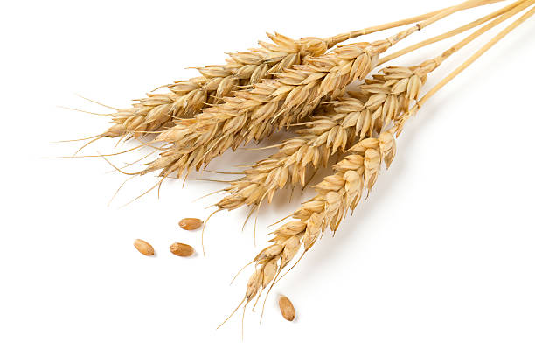
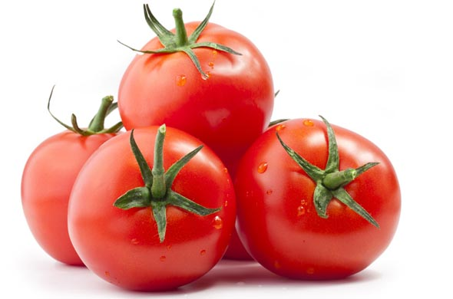
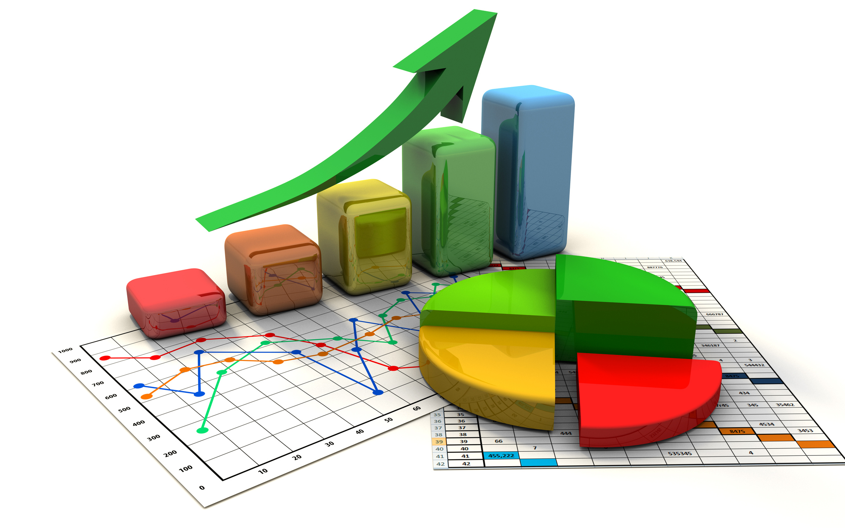
1/
Context
Introduction
Trial design
Analyses
JMP Add-In

Slide 3
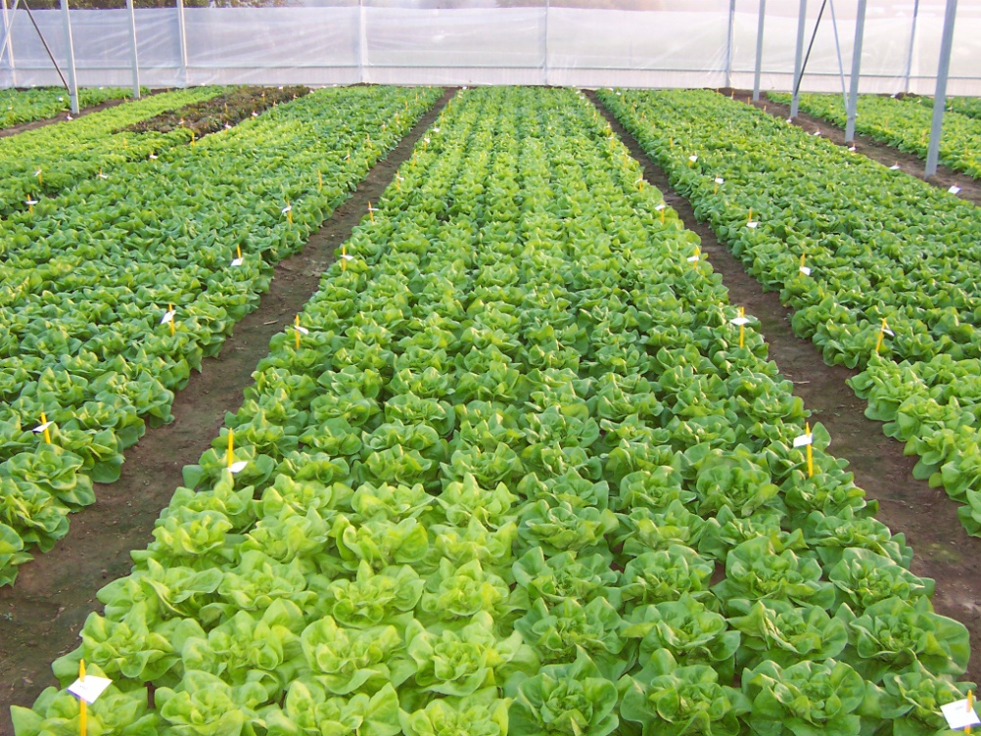
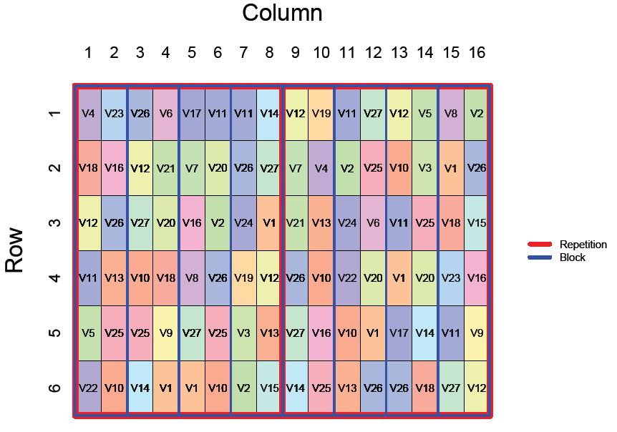
Context
Introduction
Limagrain (4th largest seed company worldwide)
→ creation of new varieties with added value for
vegetable and field crops
  Tests in fields or greenhouses
  Several variables measured: yield, height of plant, weight
  of fruits, disease resistance…
  Undesired environmental effects (border, ventilation, soil
  fertility…) can impact the results
  Experimental design: strategic layout of varieties in a trial
  Statistical analyses: to take into account environmental effects

Slide 4
Context
Column
Trial design
Column 1 2 3 4 5 6
Trial vocabulary
  Plot = basic unit within a trial
  which contains one or several
  plants of a given variety
  Block = group of adjacent plots
  with similar environmental
  characteristics
  Repetition = replicate of the trial
  with a different plot arrangement
1
2
3
4
V11
V7
V4
V9
V8
V10
V3
V12
V5
V1
V6
V2
Row
V6
V10
V8
V3
V5
V9
V4
V2
V7
V12
V1
V11
Plot
Block
Repetition
Trial

Slide 5
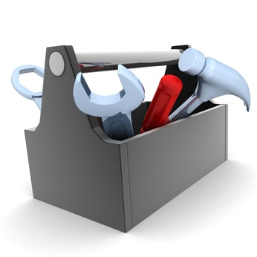

Context
Analyses
Analysis of variance / mixed models → to extract the real genetic potential of the varieties (without parasitic effects)
  Example: Response → Yield ; Effects → {Variety ; Repetition}
D
ST
GB
FM
FM
D
FM
GB
Descriptive statistics
  Statistics of the model
  Hypotheses validation
  Effects study
FM
GB
GB
FM
GB
Distribution
Summary Table
Graph Builder
Fit Model
  Multiple comparisons
  Field maps
  Adjusted values

Slide 6
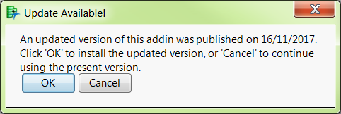
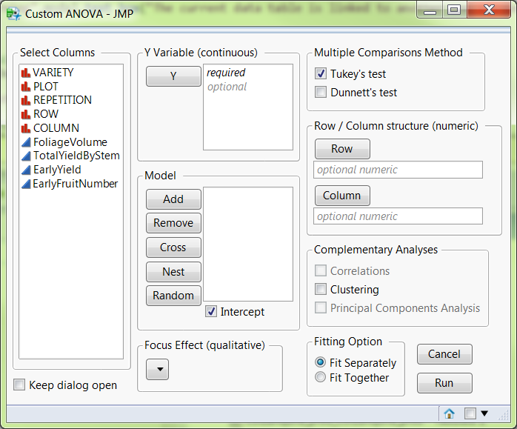

Context
JMP add-in
Objective → to offer a complete and easy to use report, adapted to the group’s researchers needs
Add-in Custom ANOVA
  Automatic update of the latest version https://community.jmp.com/docs/DOC-6239
  Simplified launch interface

Slide 7
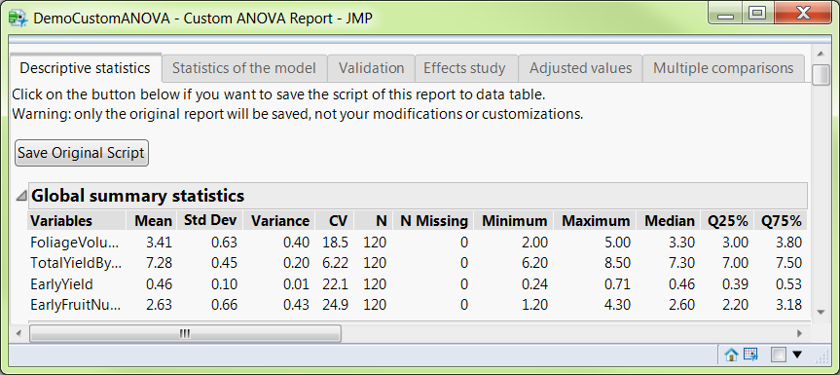


Context
JMP add-in
Objective → to offer a complete and easy to use report, adapted to the group’s researchers needs
Add-in Custom ANOVA
  Intuitive report: 1 tab = 1 step
  All information immediately accessible for non-regular users
  Interactivity within and between tabs
  Possibility to save the script in the data table

Slide 8


2/
Demo

Slide 9

























Thank you!

