Slide 1

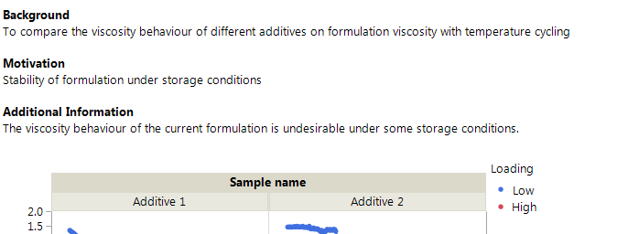
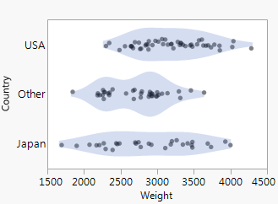
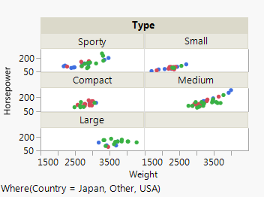
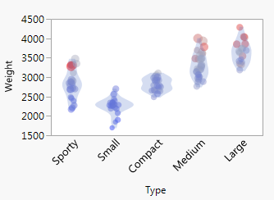
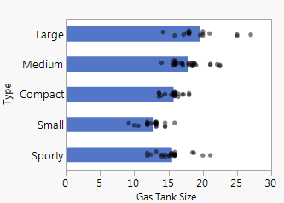
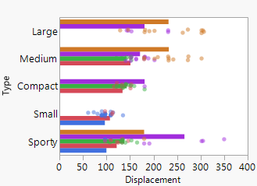
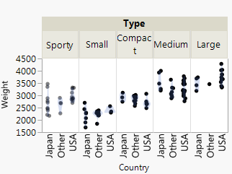

Visual exploration of datasets using self-assembling Graph Builder previews
Stephen Pearson, Chemical Process Statistician
Syngenta
The power and flexibility of Graph Builder makes it a key tool for both exploratory data analysis (EDA).
The number of possible graphs for any given dataset can be overwhelming. So how do you select the most useful graph?
The possibilities can be narrowed with an algorithm that understands the structure of a dataset and the columns that form the basis of the research question.
The process of deciding which columns form the basis of the research question can be incorporated into an EDA and reporting workflow.
This can help inexperienced users get started with journals and show some of graph builders features they might not have explored.
For those with more experience it can help structure the analysis process, avoid common data visualisation mistakes and save time. All of which enables a culture of data-driven decision making.
Using the Add-in to Structure EDA ➔
Example Data Analysis ➔
Details about the Add-in ➔
Notes:
First button links to slide 2, second to slide 3 and third to slide 4.

Slide 2
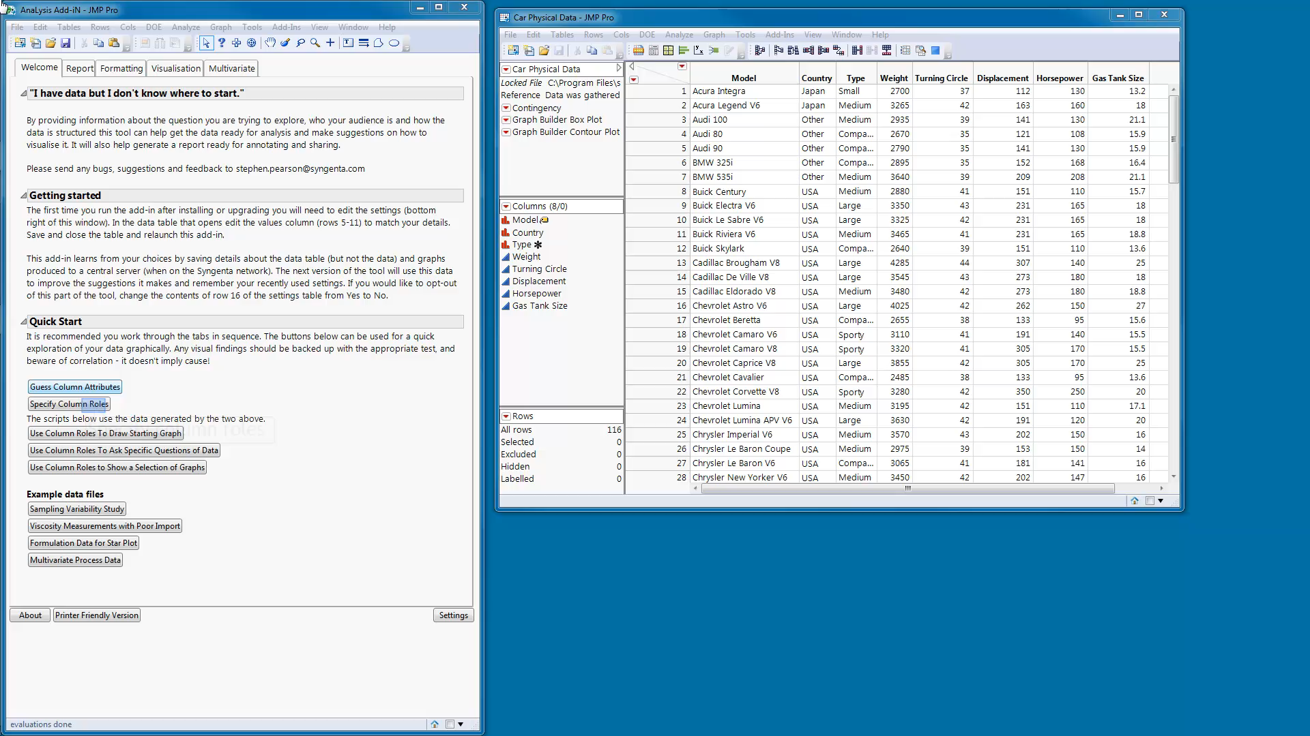
Exploratory Data Analysis (2:25)
Back
Pause the video to read the details.
Notes:
The video is set to start automatically and run in a loop. There is no sound.

Slide 3
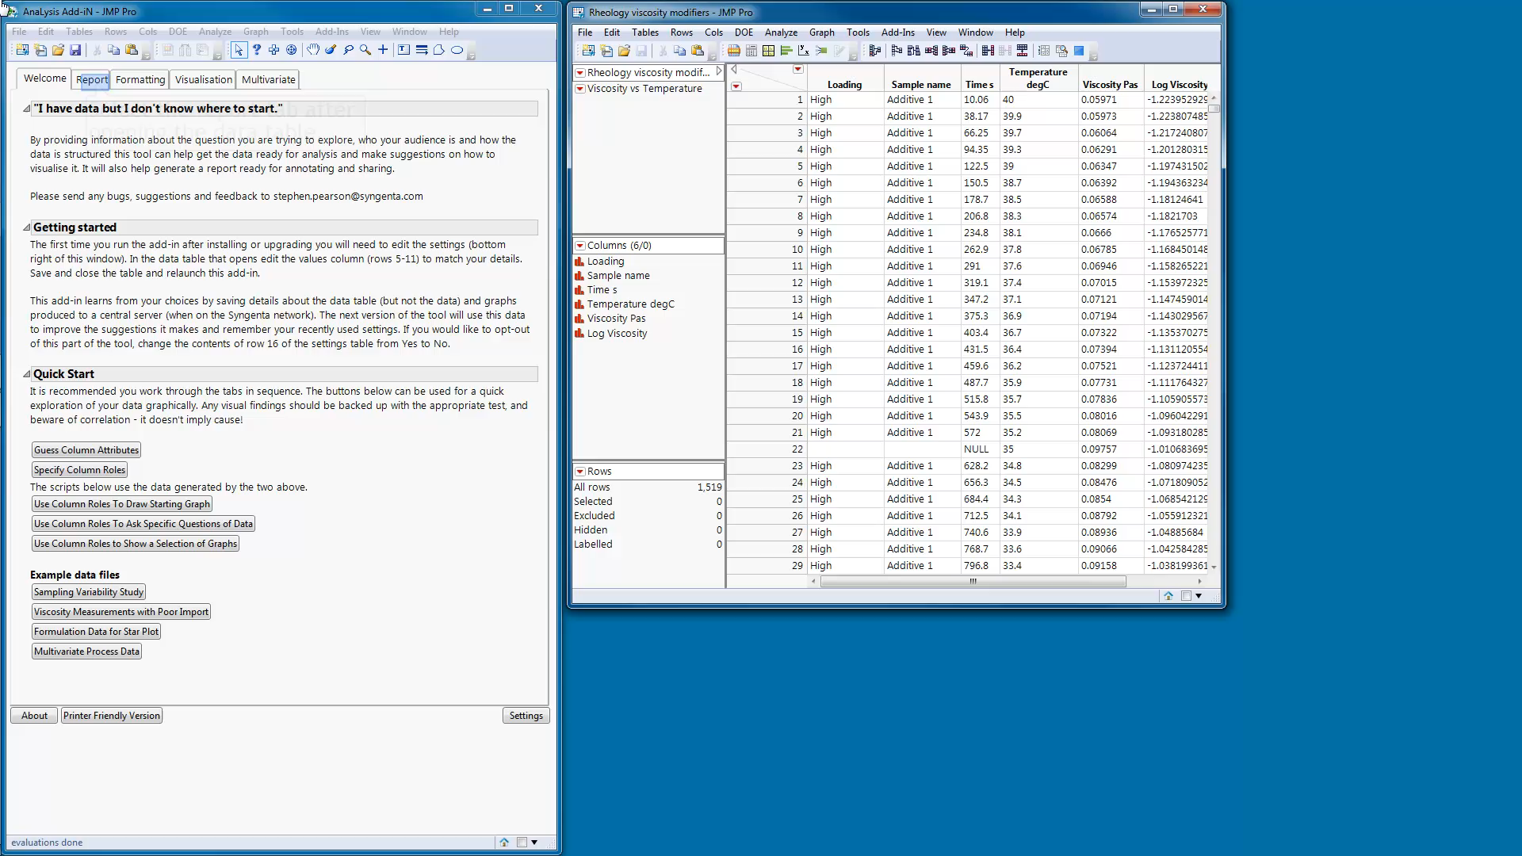
Structuring the EDA and Reporting (2:40)
Back
Pause the video to read the details.
Notes:
The video is set to start automatically and run in a loop. There is no sound.

Slide 4

Some details of how the Add-in is constructed (1:42)
Back
Pause the video to read the details.
Notes:
The video is set to start automatically and run in a loop. There is no sound.

