Slide 1

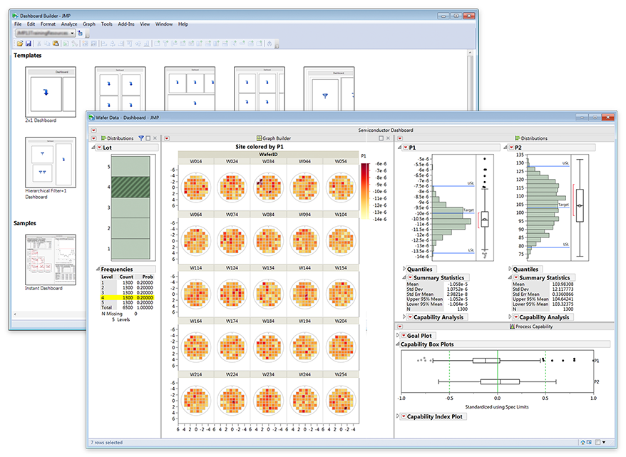
Solving Common Data Table Problems with JMP® 13:
Can We Replace Summary and Join with the New JMP® Query Builder?
Daniel Valente, PhD, JMP Senior Product Manager, SAS
Jon Weisz, JMP Vice President Sales and Marketing, SAS
Highlights
JMP Self-Service Workflow
The JMP Query Builder is a flexible and powerful platform for performing multi-table queries and joins, creating prompting filters and generating SQL code.
The Query Builder fits in with other tools available in the JMP self-service analytical workflow.
The interface in Query Builder is designed to abstract out the details of the data source (ODBC-accessed database, SAS, JMP tables). Engineers and scientists can learn the interface once and apply it broadly.
The Query Builder can be chained together with the Dashboard Builder and Add-In Builder to create custom analytic dashboards, which are auto-updated with new data and can be shared to communicate findings.
The Query Builder requires no knowledge of SQL code for the scientist or engineer user to be productive.
Data Access
Poster Focus
Data Shaping and Pre-Processing
Data Visualization
Statistical Model Building
Content Organization
Sharing
JMP is a self-service analytic tool that lets scientists and engineers go from data to decision in one platform with no coding required. The Query Builder (the focus of the poster) is part of the Data Access and Data Shaping and Pre-Processing step. The goal of the Query Builder is to take raw data from any number of sources and get it to an analysis-ready JMP table quickly, so that data can be visualized and modeled, and results organized and shared with others.

Slide 2
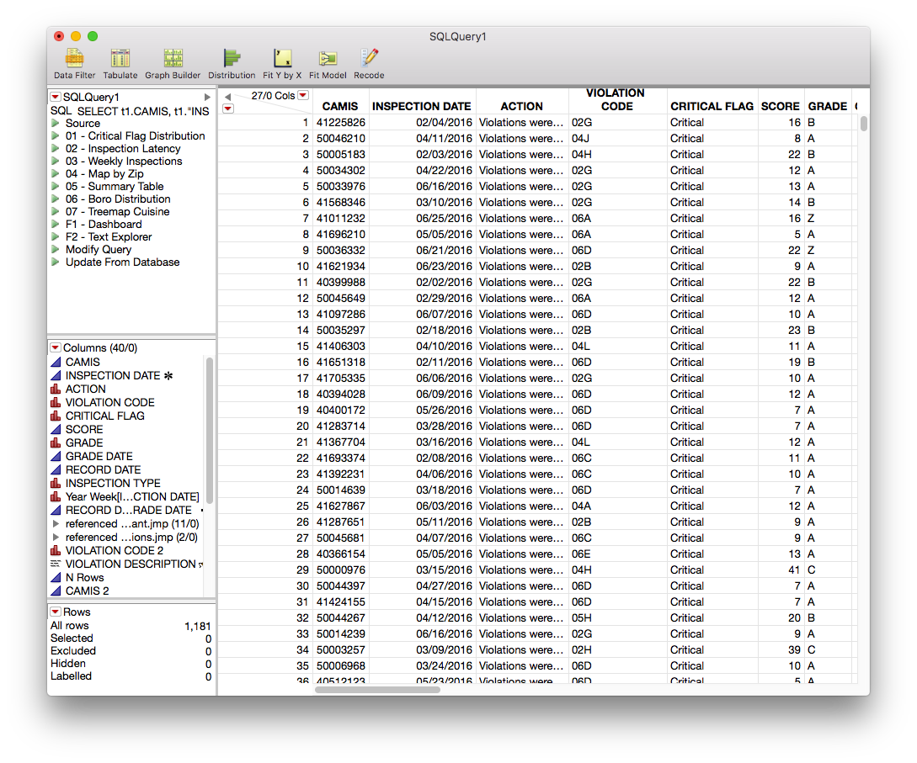
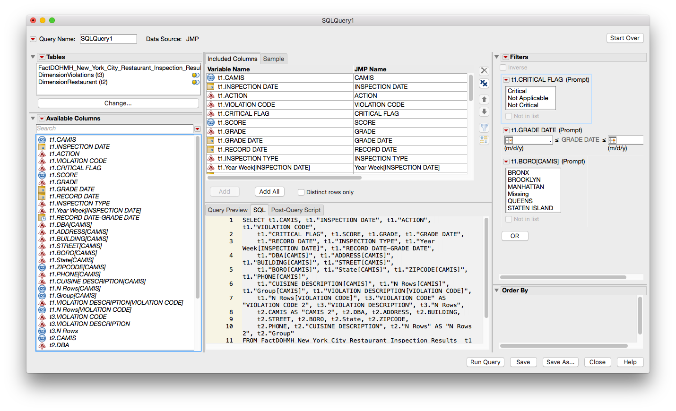
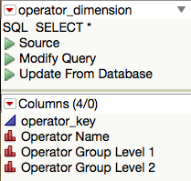
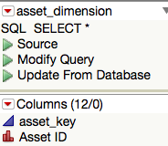
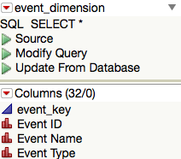
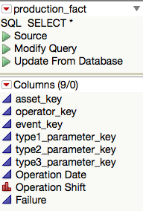
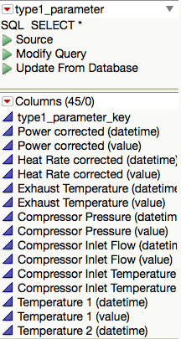
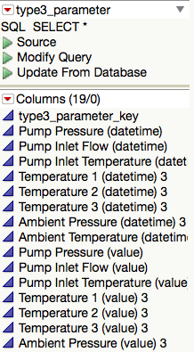
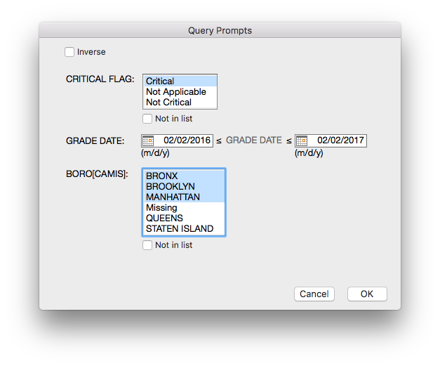
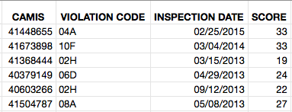
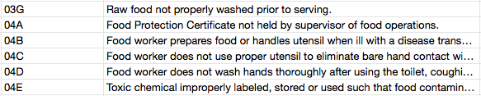
Solving Common Data Table Problems with JMP® 13:
Can We Replace Summary and Join with the New JMP® Query Builder?
Daniel Valente, PhD, JMP Senior Product Manager, SAS
Jon Weisz, JMP Vice President Sales and Marketing, SAS
JMP Query Builder
Definitions
Star Schema – Separates data into facts, which hold the measurable data about a process; and dimensions, which are descriptive attributes related to fact data.
Fact Table – Center of the star schema. Store measurements for a specific event. Consists of values and foreign keys to dimensions data where descriptive information is kept.
Dimension Table – Stores attributes to describe the fact data. Includes a primary key to relate the attributes to the facts.
The Query Builder for relational databases and SAS data sets has quickly become the preferred way to easily create accurate, repeatable and sharable queries—without having to write SQL code. However, until now you could not use Query Builder to join JMP tables already in memory, and nobody wants to create a database just to join data that is already in JMP. The JMP 13 Query Builder for JMP tables provides multi-table query and join capability through the same interface as the SQL Query Builder and SAS Query Builder. The Query Builder can also be used to join across physical boundaries (e.g., data in databases with Excel, SAS, JMP or text files.)
Normalized – Process of organizing the columns and tables to reduce data redundancy and improve integrity.
Foreign Key – A foreign key in a secondary table matches the primary key in one of the joined tables.
Primary Key – A primary key identifies a column that uniquely describes the data (for example, a customer ID number).

Slide 3
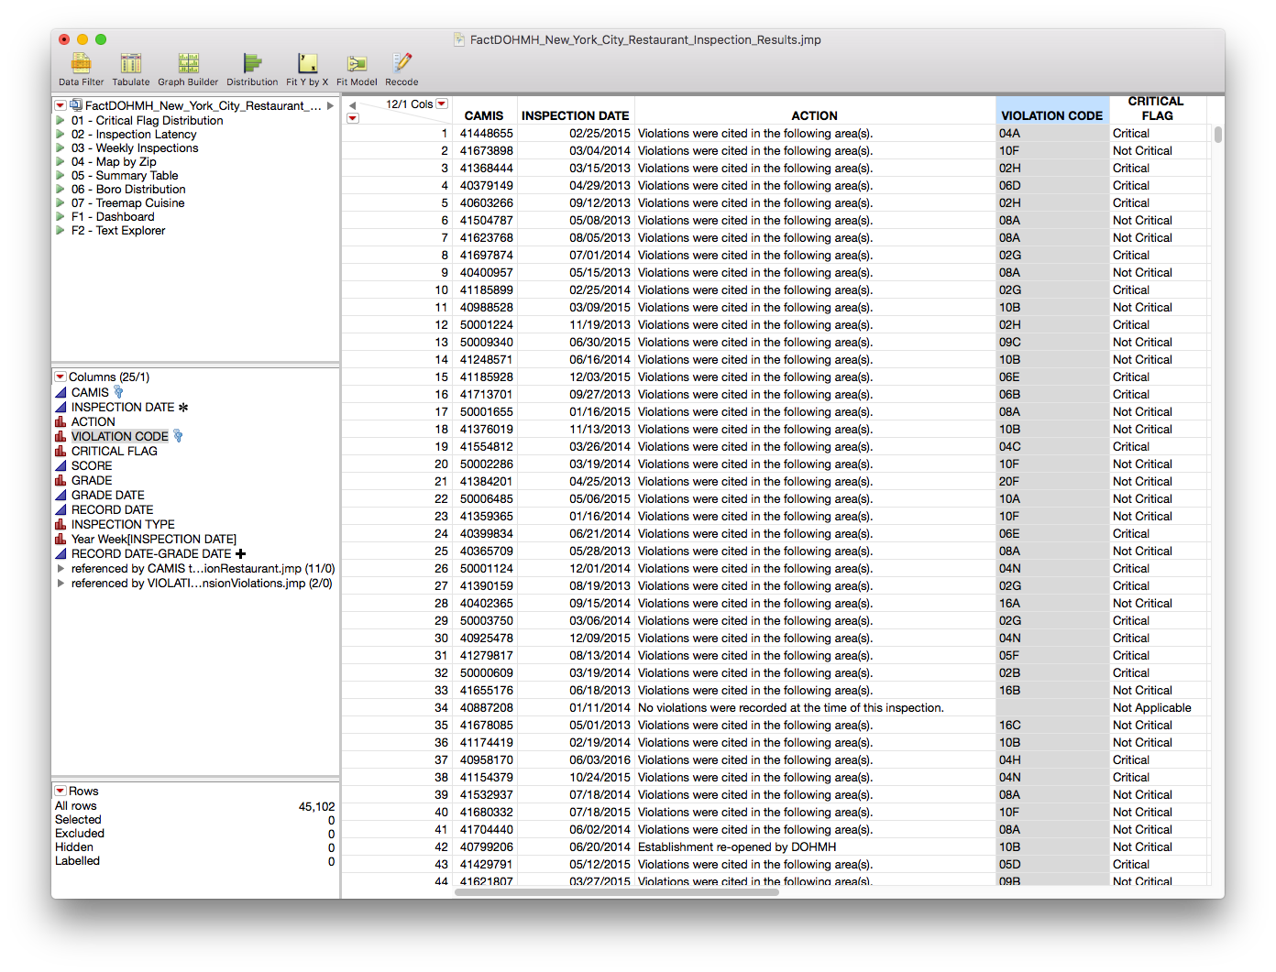
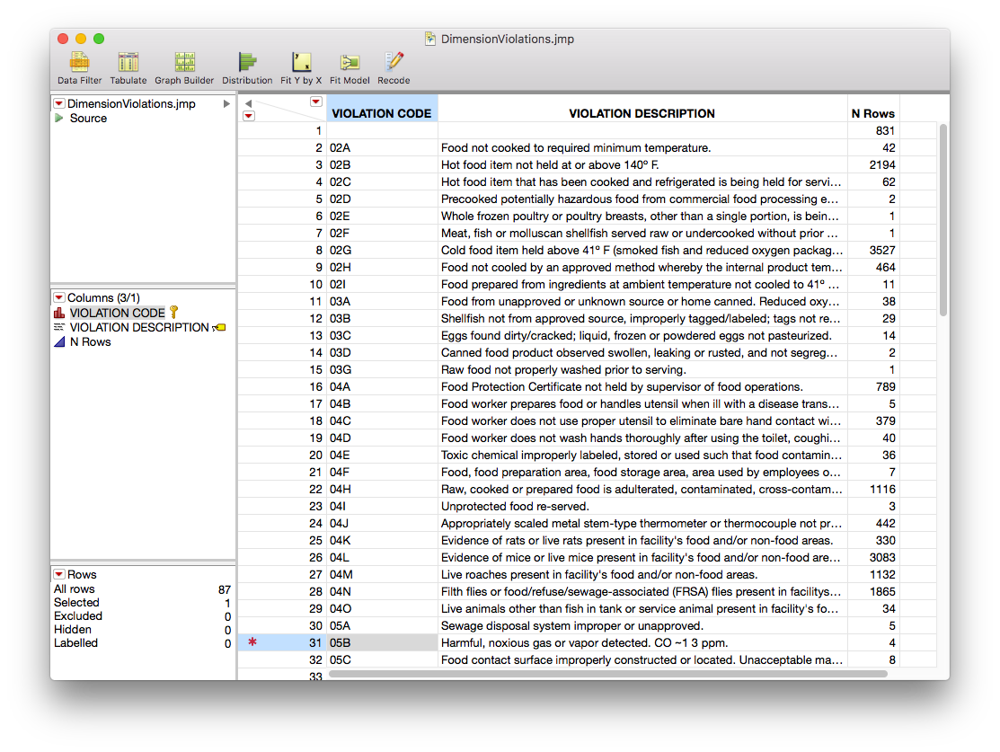
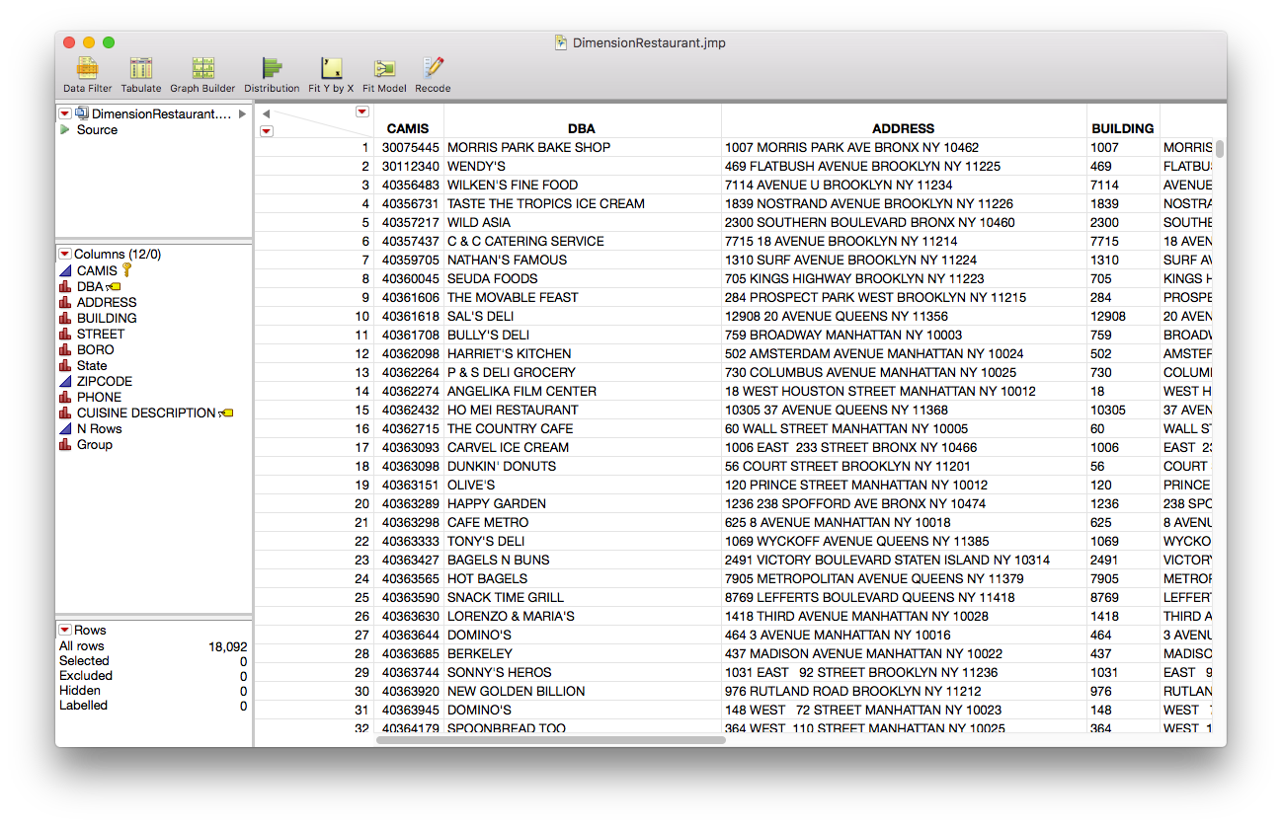
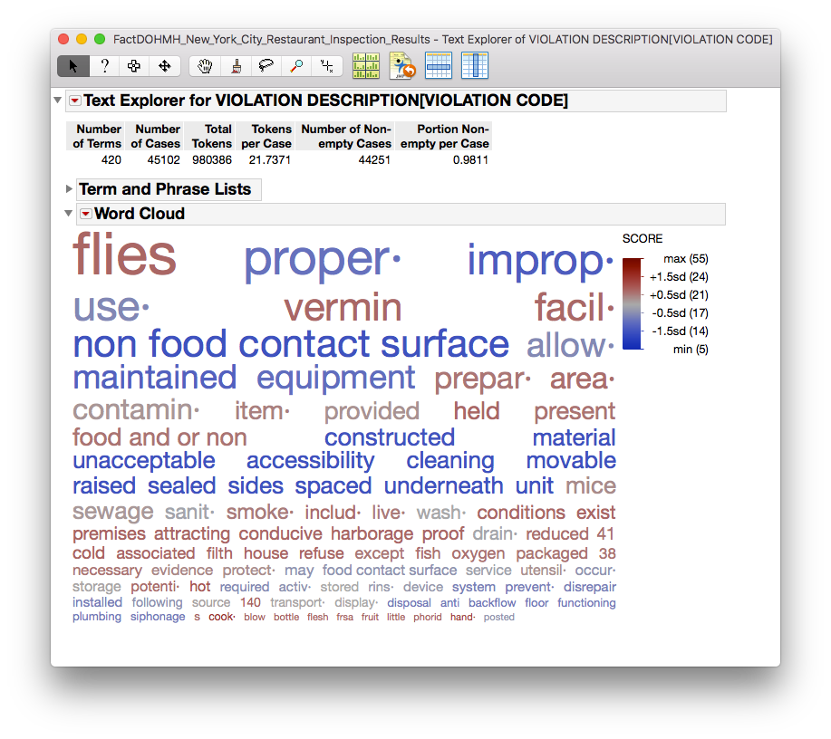
Solving Common Data Table Problems with JMP® 13:
Can We Replace Summary and Join with the New JMP® Query Builder?
Daniel Valente, PhD, JMP Senior Product Manager, SAS
Jon Weisz, JMP Vice President Sales and Marketing, SAS
Inspection Transactions Data Case
Inspection Transactions Data Case
I want to use a fun illustration of how to use the Query Builder. I travel a fair bit for work and often am looking for new restaurants to eat when I arrive in a city. While some may use apps that provide reviews on restaurants and popular dishes, I wanted to see health inspections and the violations that a restaurant may have before eating there. New York City makes all of these data public in its DOHMH New York City Restaurant Inspection Results data set[DOHMH].
Basic data wrangling steps to pre-process data for analysis:
Use JMP Query Builder to normalize data. Convert un-normalized flat .csv file to inspections fact table and restaurant and violations dimension tables.
Geo-enrich unique restaurants in restaurants dimension table with latitude and longitude columns using Open Street Map Geo-coding Add-In available at community.jmp.com [GREGG].
Clean up violations paragraphs with Recode, correcting for misspellings and incorrectly imported characters.
Query and join using the Query Builder.
Dimension: Violations
Fact: Inspections
Dimension: Restaurants
Organization of Restaurant Inspections data: Inspections has the transaction data. Dimension restaurant has a primary key, CAMIS, which is the ID of the restaurant. Dimension violations has a primary key, Violation Code.
Text Explorer of Violation Description colored by Score: Quickly see what common words and phrases are associated with high and low inspection scores.

Slide 4
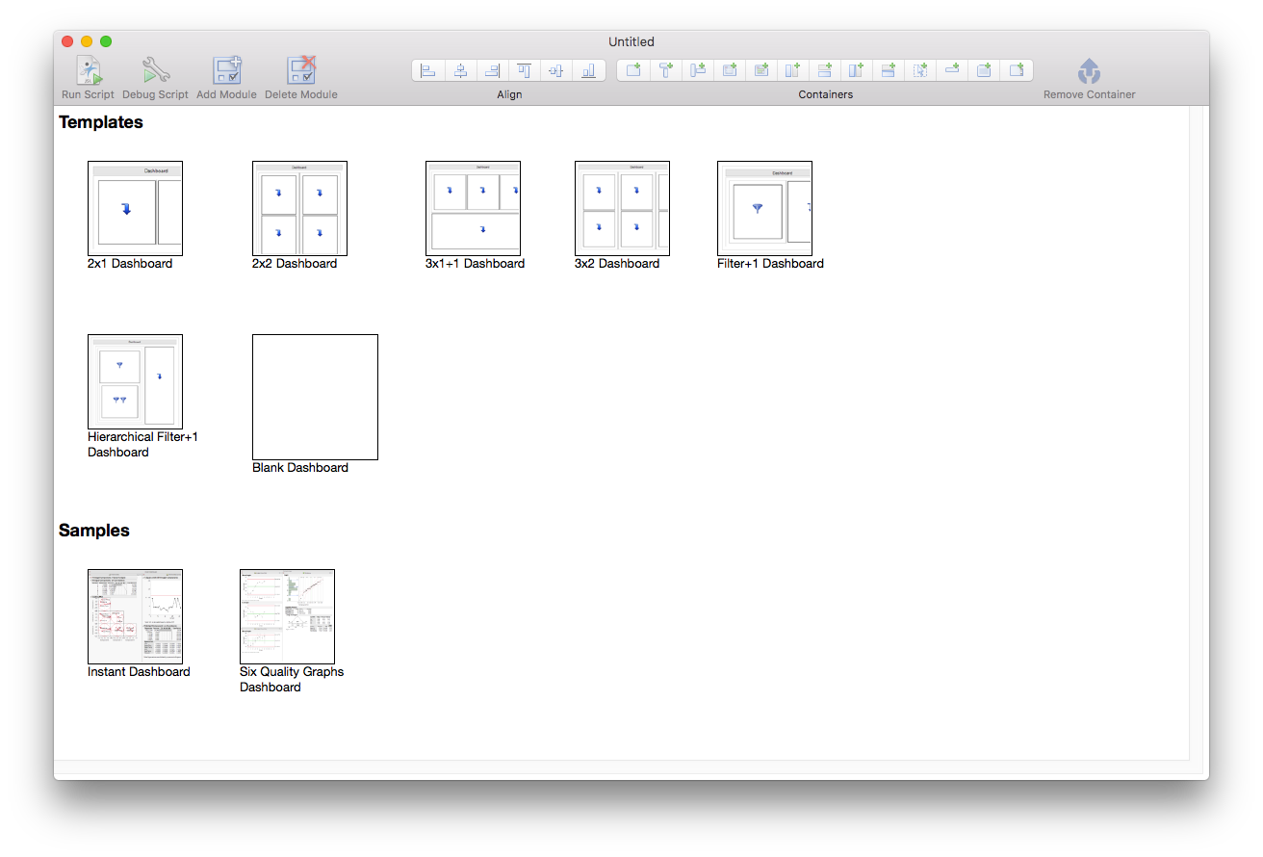
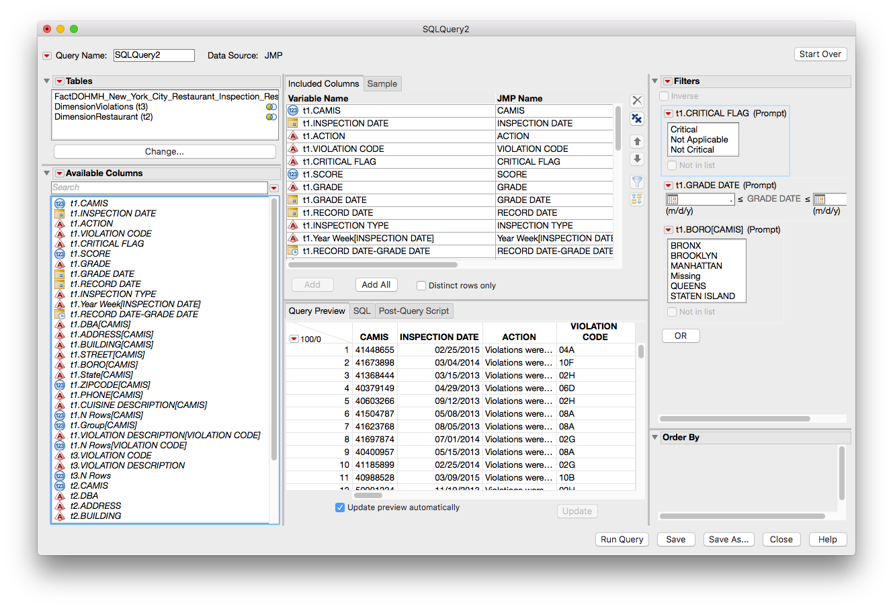
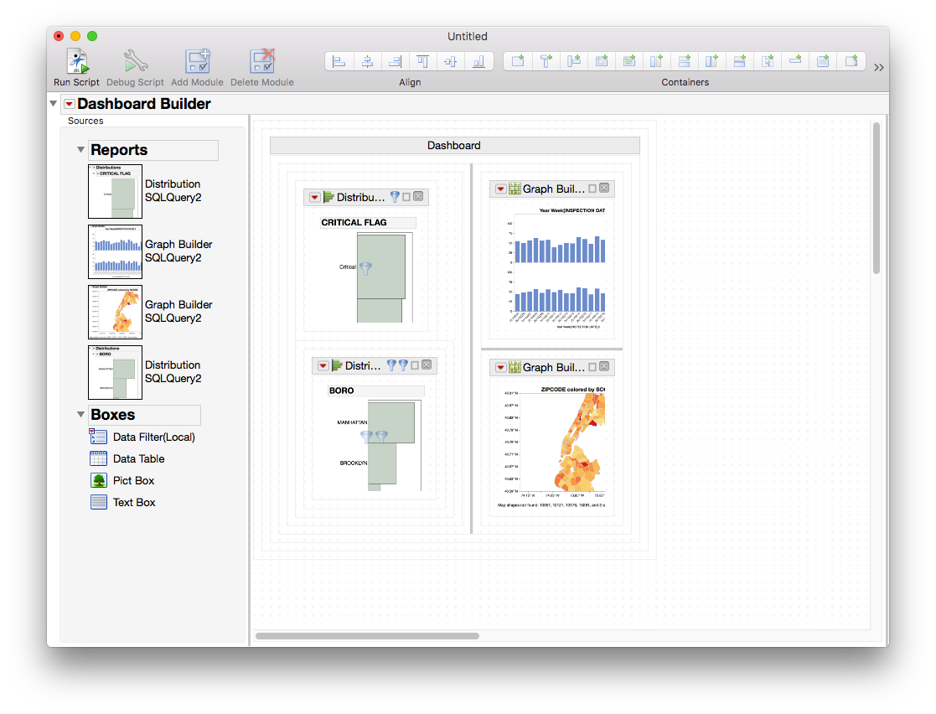
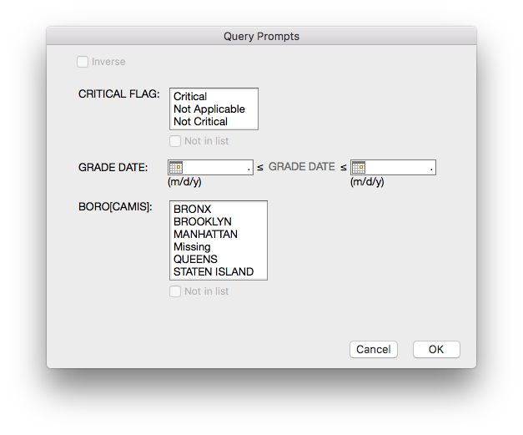
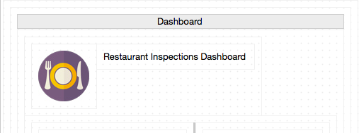
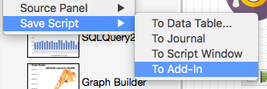
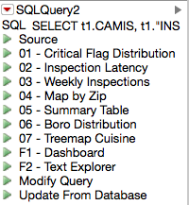
Solving Common Data Table Problems with JMP® 13:
Can We Replace Summary and Join with the New JMP® Query Builder?
Daniel Valente, PhD, JMP Senior Product Manager, SAS
Jon Weisz, JMP Vice President Sales and Marketing, SAS
Building a Dashboard Add-In
Building a Dashboard Add-In
Using the Query Builder, Dashboard Builder and Add-In Builder, we can build and deploy an analytic dashboard that can be shared without having to write any code or involve an IT department.
(Above) Setting up the Query Builder with prompting filters for Critical Flag, Grade Date and Boro so that consumer of the dashboard gets just the right subset of data. Query Builder provides a preview to see that your join is working correctly.
Dashboard Builder (File > New Dashboard) starts with a set of standard templates. Filtering templates let you use graphs as data filters.
Running a set of standard scripts, which will become the building blocks of the dashboard. Scripts are stored JSL in the joined JMP data table.
Customize Dashboard with icon and title. Save the Dashboard to an add-in to share with others in a single click.

Slide 5
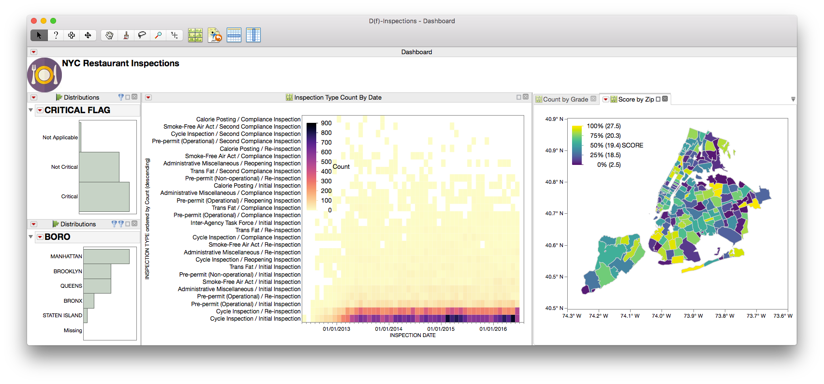
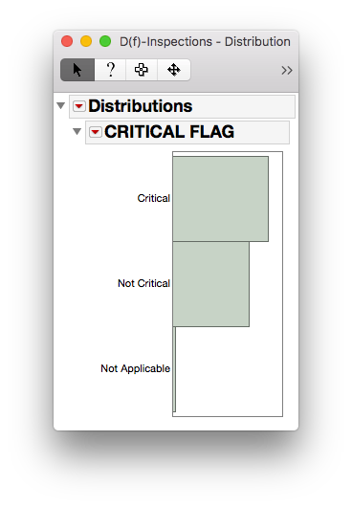
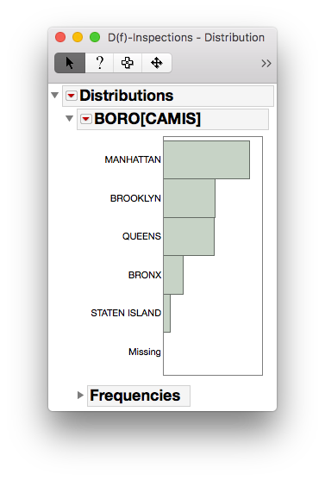
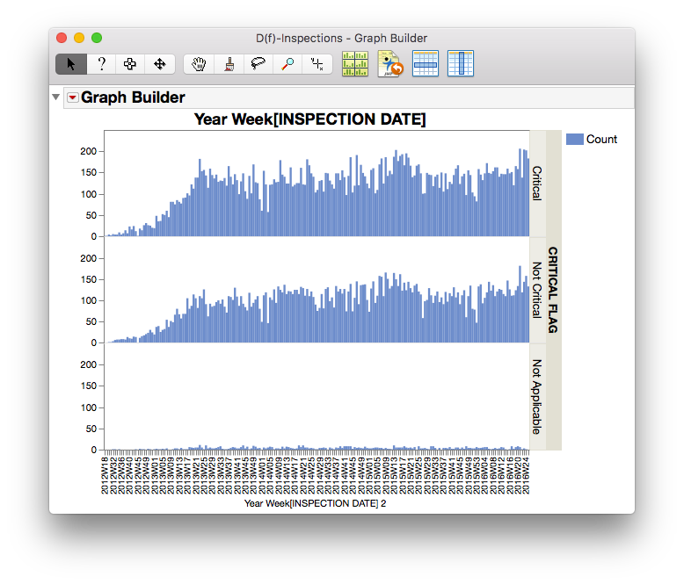
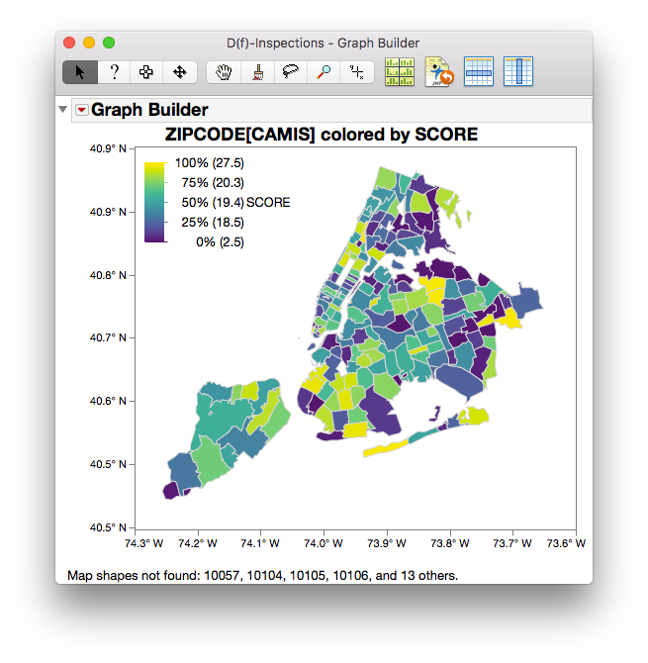
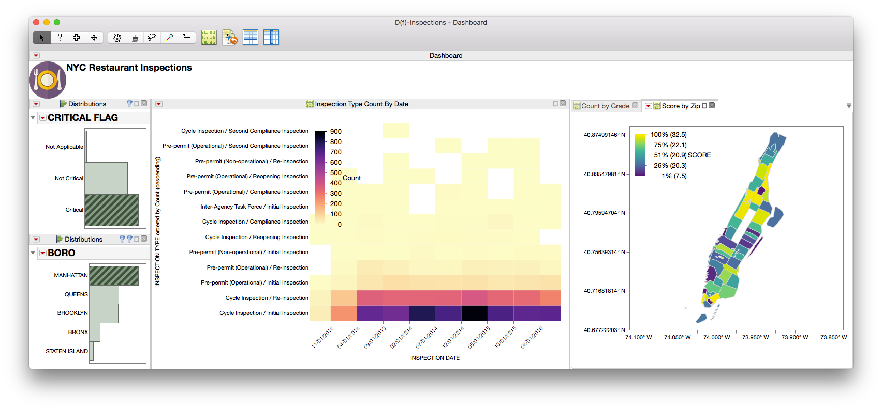
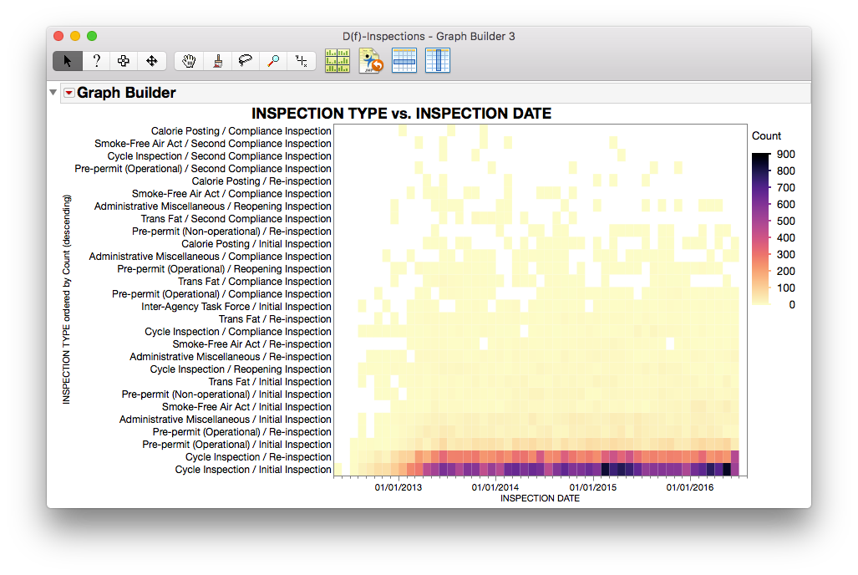
Solving Common Data Table Problems with JMP® 13:
Can We Replace Summary and Join with the New JMP® Query Builder?
Daniel Valente, PhD, JMP Senior Product Manager, SAS
Jon Weisz, JMP Vice President Sales and Marketing, SAS
Building a Dashboard Add-In
Building a Dashboard Add-In
(1) and (2): Graph filters. Distributions of Critical Flag and Boro. (3) Inspection counts by week by category. (4) Map of score quantiles by zip. (5) Heat Map of count by inspection type by date.
1
2
Final Dashboard. Hierarchical filter of Critical Flag > Boro, which updates subsequent graphs. Drilling down to Critical > Manhattan (below).
3
4
5

Slide 6
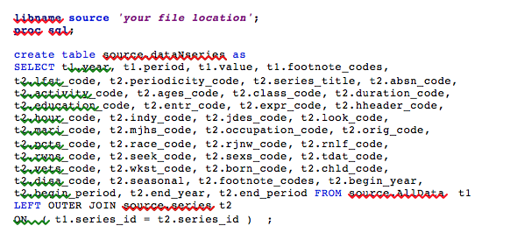
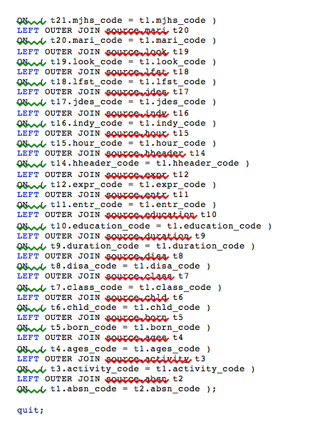
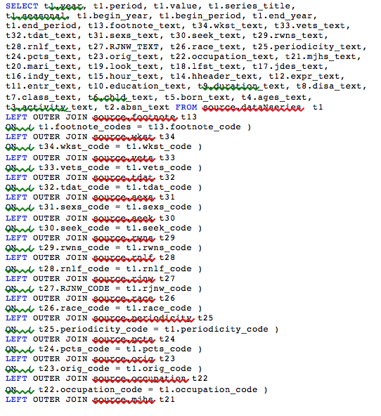
Solving Common Data Table Problems with JMP® 13:
Can We Replace Summary and Join with the New JMP® Query Builder?
Daniel Valente, PhD, JMP Senior Product Manager, SAS
Jon Weisz, JMP Vice President Sales and Marketing, SAS
SQL Generation and Deployment
Summary
Another major advantage of using Query Builder is the generation
of SQL code. SAS can use SQL within Proc SQL, and most databases use SQL as a programming language to join and manage tables. SQL can be generated from a query you define in the point-and-click interface of Query Builder.
Below is an example SQL created by Query Builder for the join of all the dimension tables to the joined table. The libname statement, associated libname references on the tables and the proc sql statement were added. The rest of the code was generated by Query Builder. Notice that most of the code is a listing of the
columns within the SELECT statements. Using Query Builder to
generate such code is a great help, even if the user knows SQL. Why
type that many table and column names if you don’t have to?
Analysts need data in one table, organized in a way that makes
visualization and analysis possible. However, data is often organized
for loading, maintaining and storing in many tables (normalized) so
that analysts are challenged to join and summarize many tables into
one analysis-ready table.
JMP Query Builder is a powerful way to join multiple tables from
within JMP. The preview feature allows the user to see if the join is
properly defined before running a time-consuming table join
operation. The generated SQL can be deployed into SAS or a
database, saving considerable time from writing such code by hand.
References
[DOHMH] DOHMH New York City Restaurant Inspection Results. Retrieved August 17, 2016, from https://data.cityofnewyork.us/Health/DOHMH-New-York-City-Restaurant-Inspection-Results/xx67-kt59.
[GREGG] Gregg, X. (2014, May 28). Geocoding Place Names. Retrieved August 18, 2016, from https://community.jmp.com/docs/DOC-6175.

