Slide 1
Object Oriented JSL
Techniques for Writing Maintainable/Extendable JSL Code
DREW FOGLIA

Slide 2
WHAT?
The concepts of Object Oriented Programming
Classes and Objects
Member Variables and Methods
Inheritance
Encapsulation

Slide 3
WHY?
The benefits of Object Oriented Programming
Improved opportunities for code reuse and extension
Improved stability/robustness
Easier and better testing
Improved maintainability

Slide 4
WHEN?
The appropriate uses of Object Oriented Programming
Size of project
Collaboration
Longevity of project

Slide 5
HOW?
Bringing Object Oriented concepts to JSL
Classes and Objects
Member Variables and Methods
Inheritance
Encapsulation

Slide 6
HOW?
Bringing Object Oriented concepts to JSL
Classes and Objects
Member Variables and Methods
Inheritance
Encapsulation

Slide 7
HOW?
Bringing Object Oriented concepts to JSL
Classes and Objects
Member Variables and Methods
Inheritance
Encapsulation

Slide 8
HOW?
Bringing Object Oriented concepts to JSL
Classes and Objects
Member Variables and Methods
Inheritance
Encapsulation

Slide 9
HOW?
Bringing Object Oriented concepts to JSL
Classes and Objects
Member Variables and Methods
Inheritance
Encapsulation

Slide 10
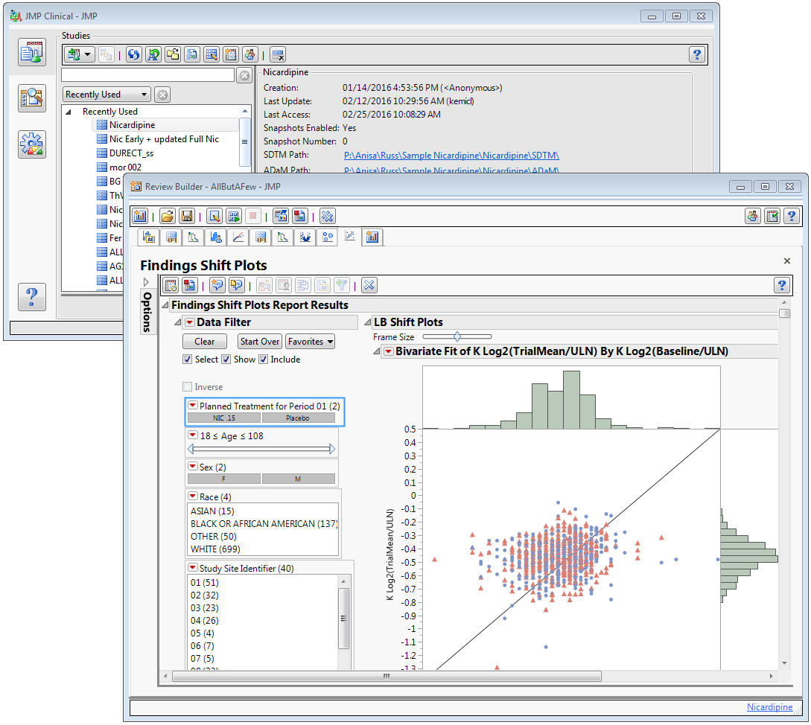
REAL-WORLD
JMP Clinical 6.0

Slide 11
FUTURE
Object Oriented JSL in JMP 13
New syntax structures
First-class citizen behaviors
Better lifecycle management

Slide 12
QUESTIONS
Answers

