Slide 1
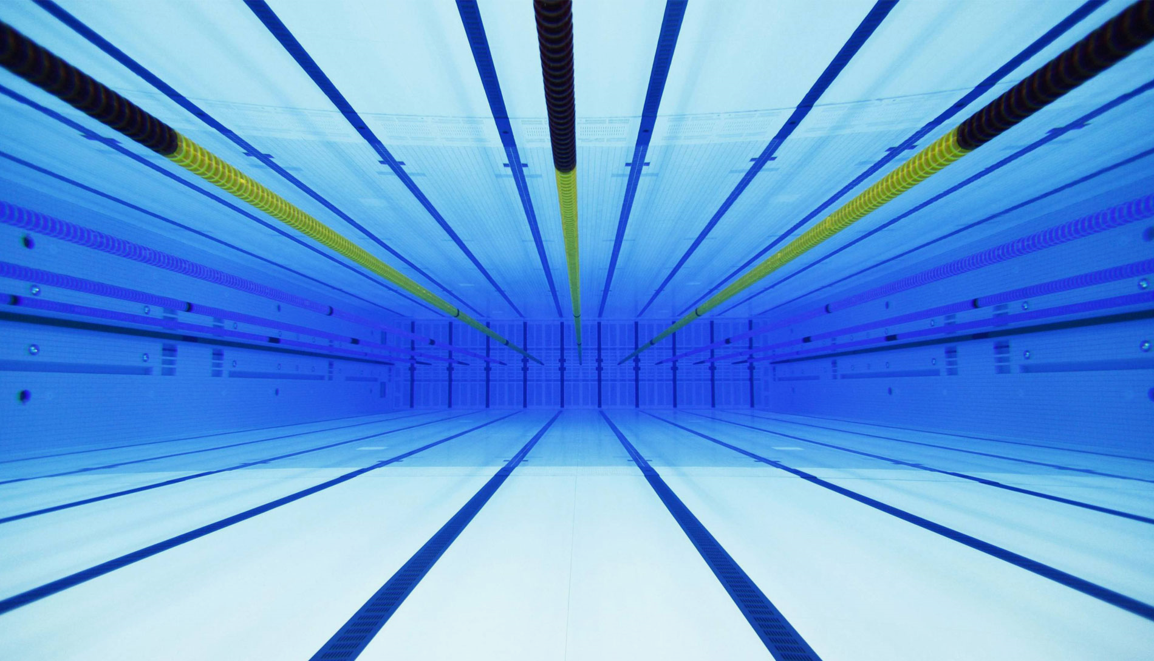

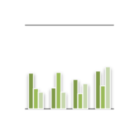
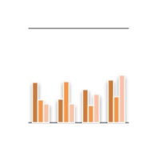
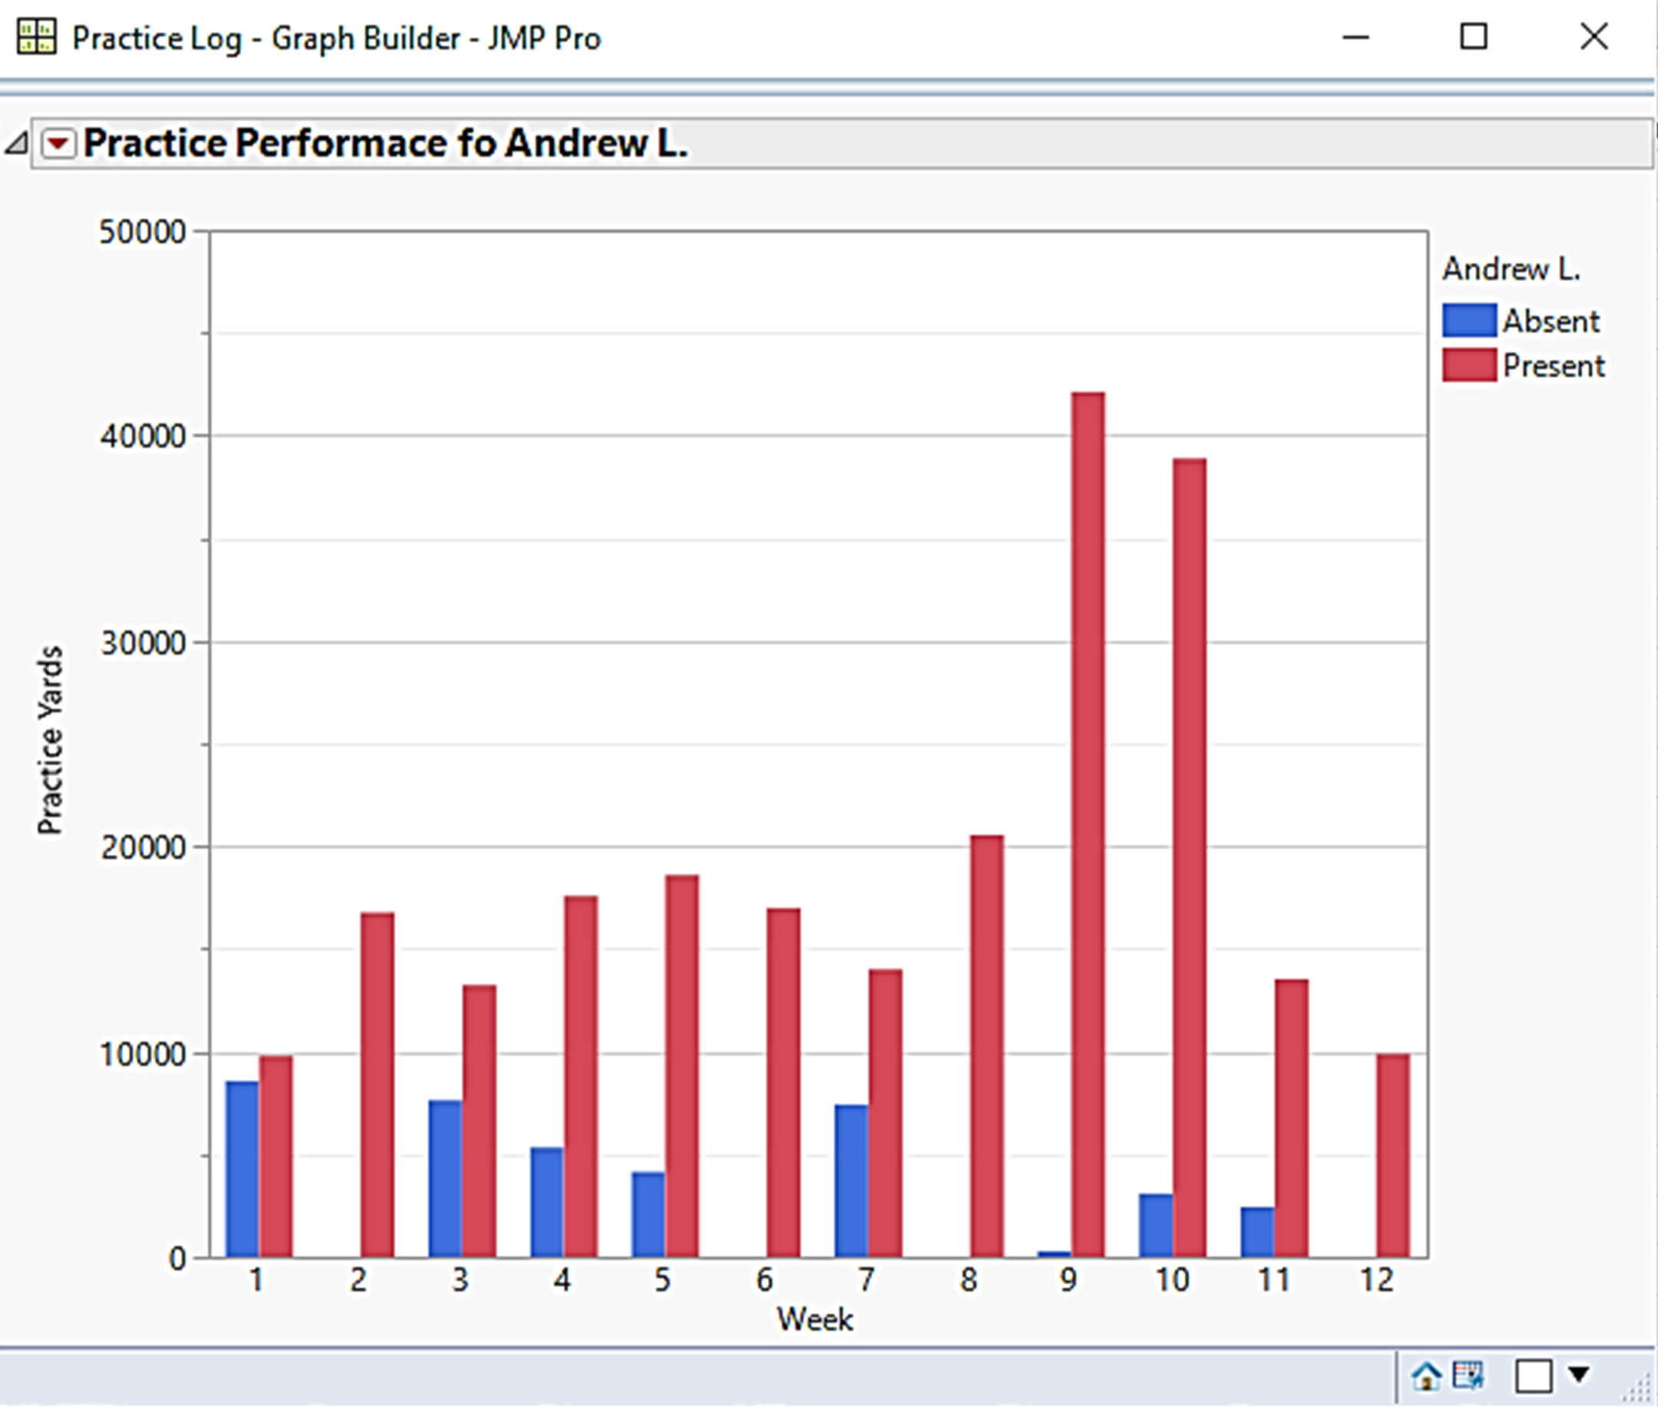
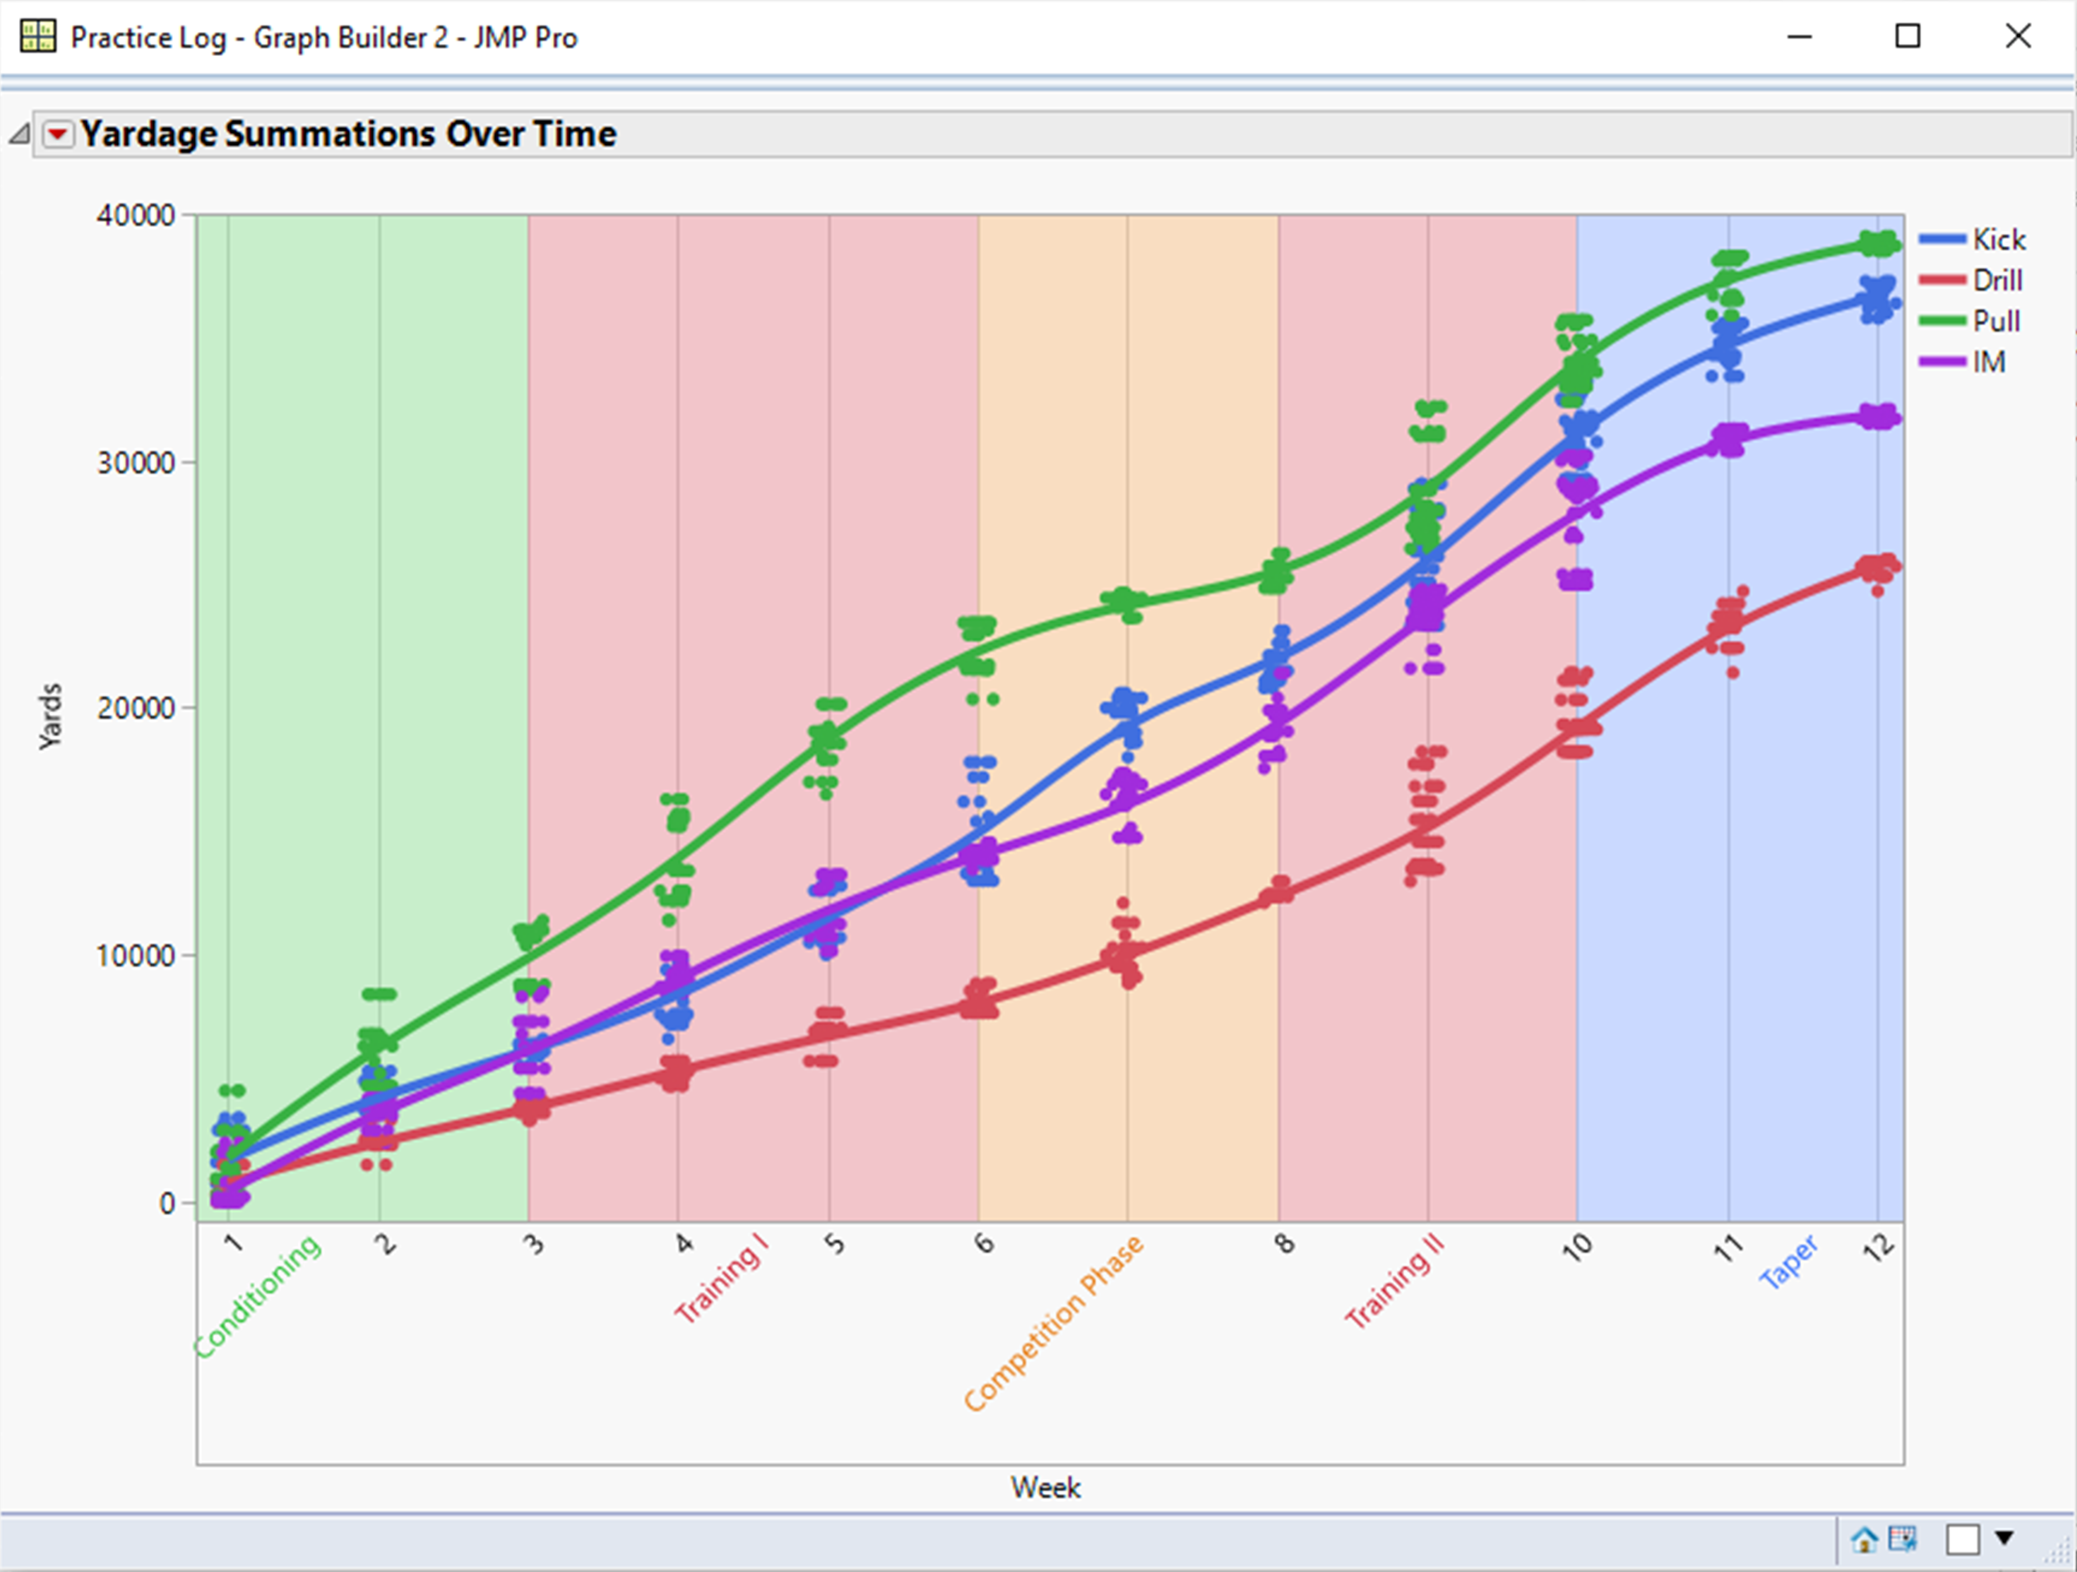
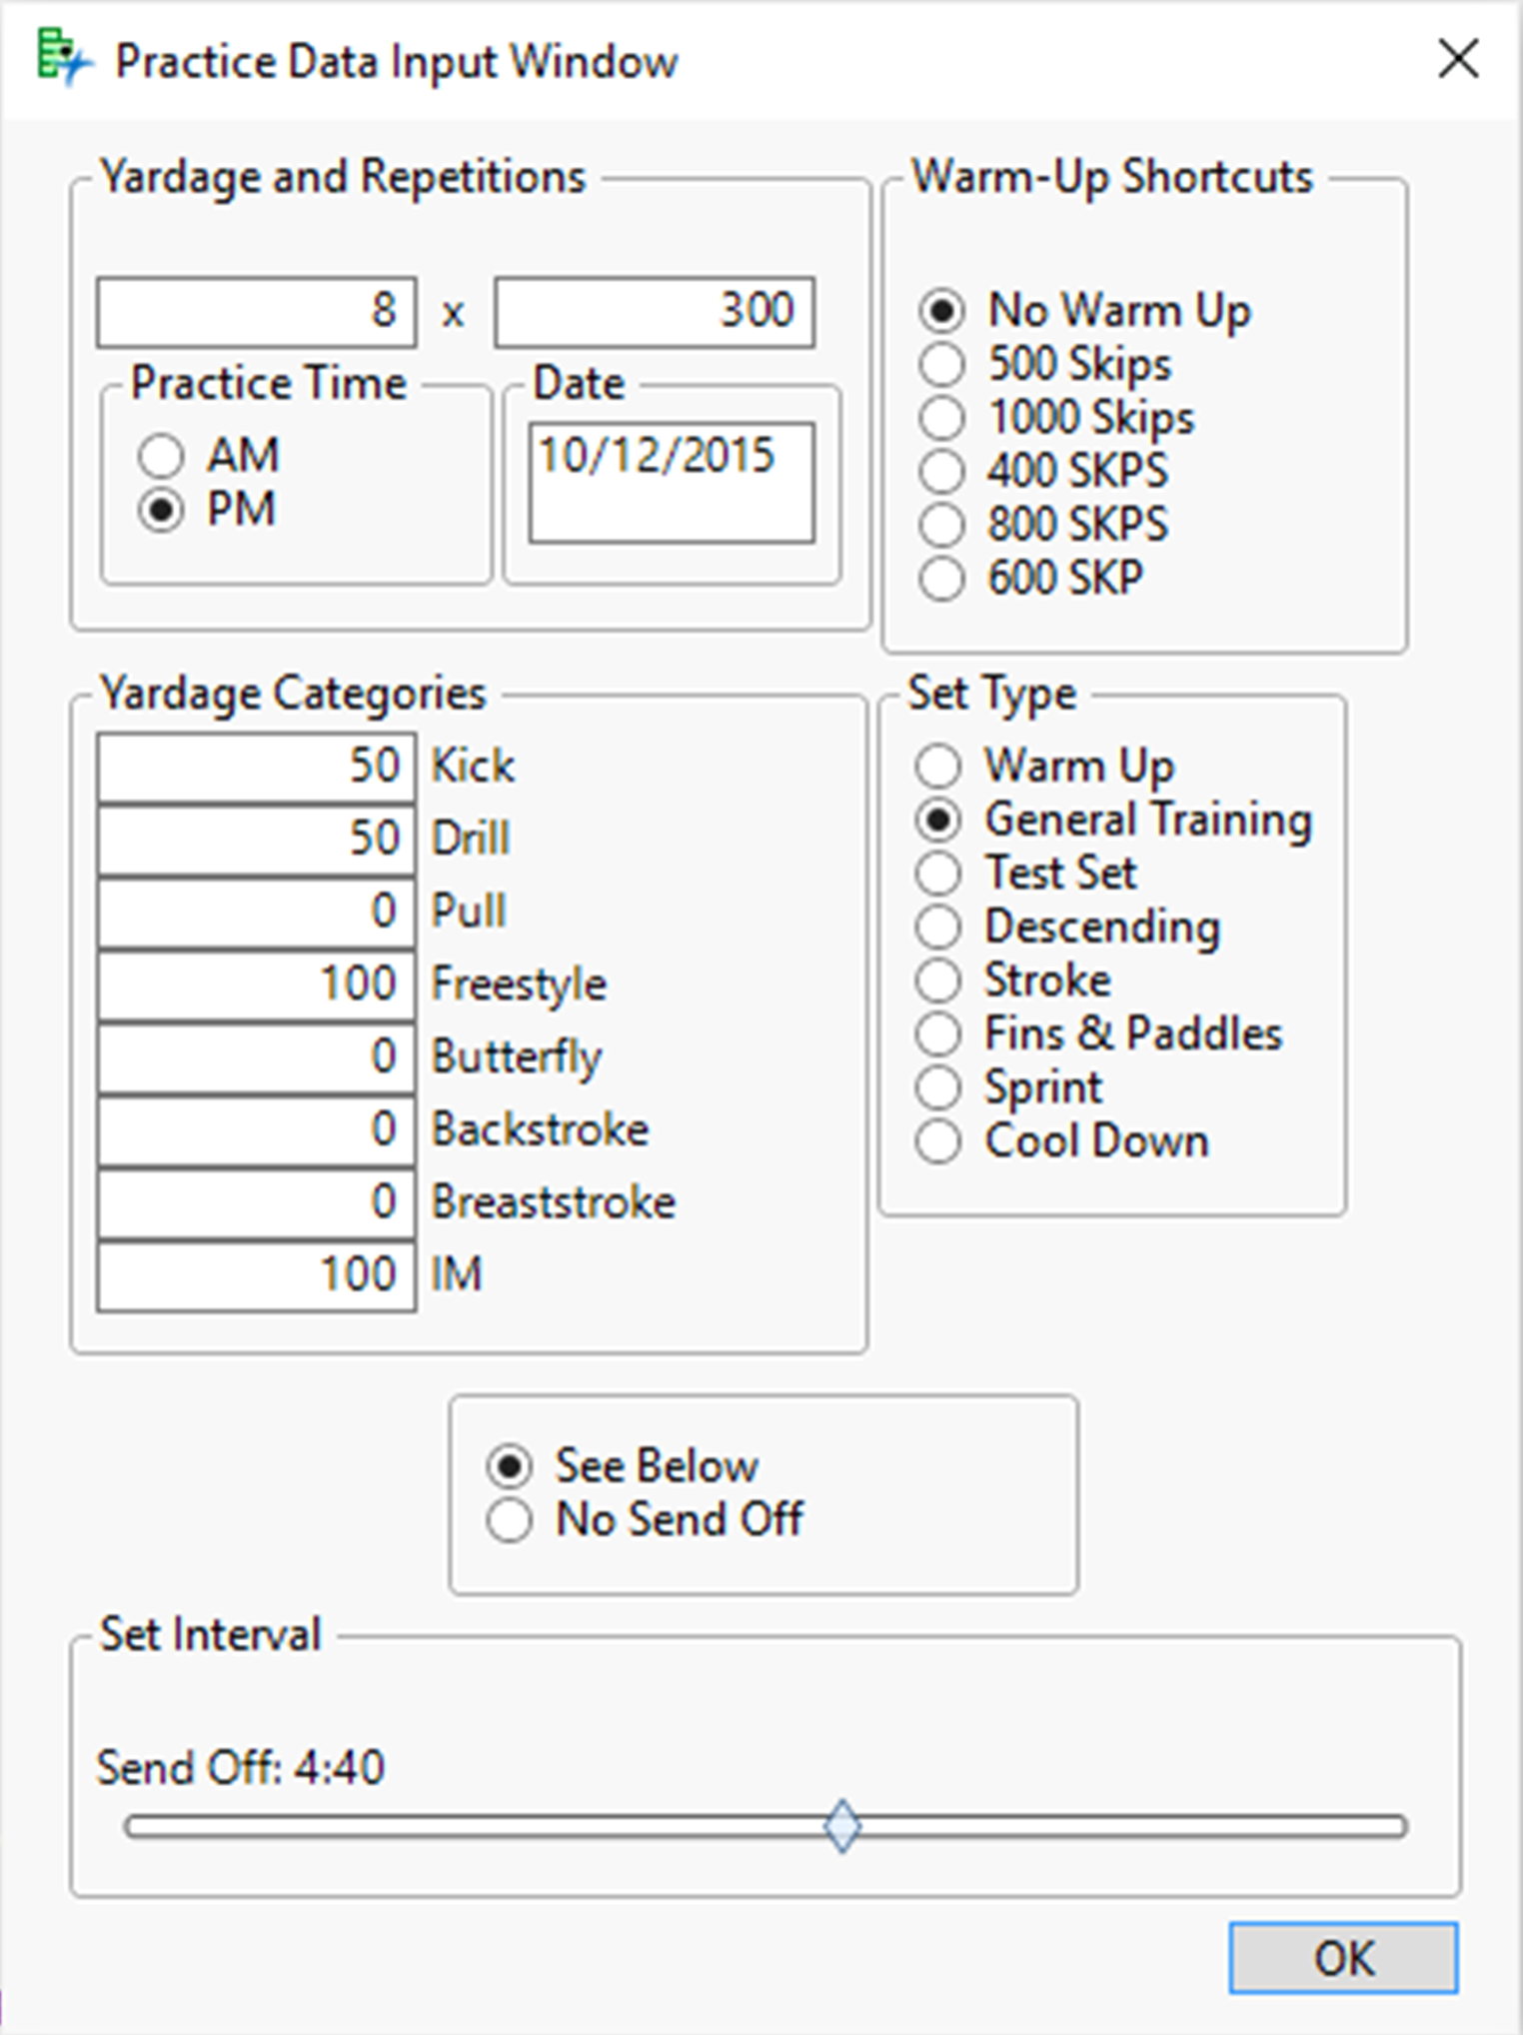
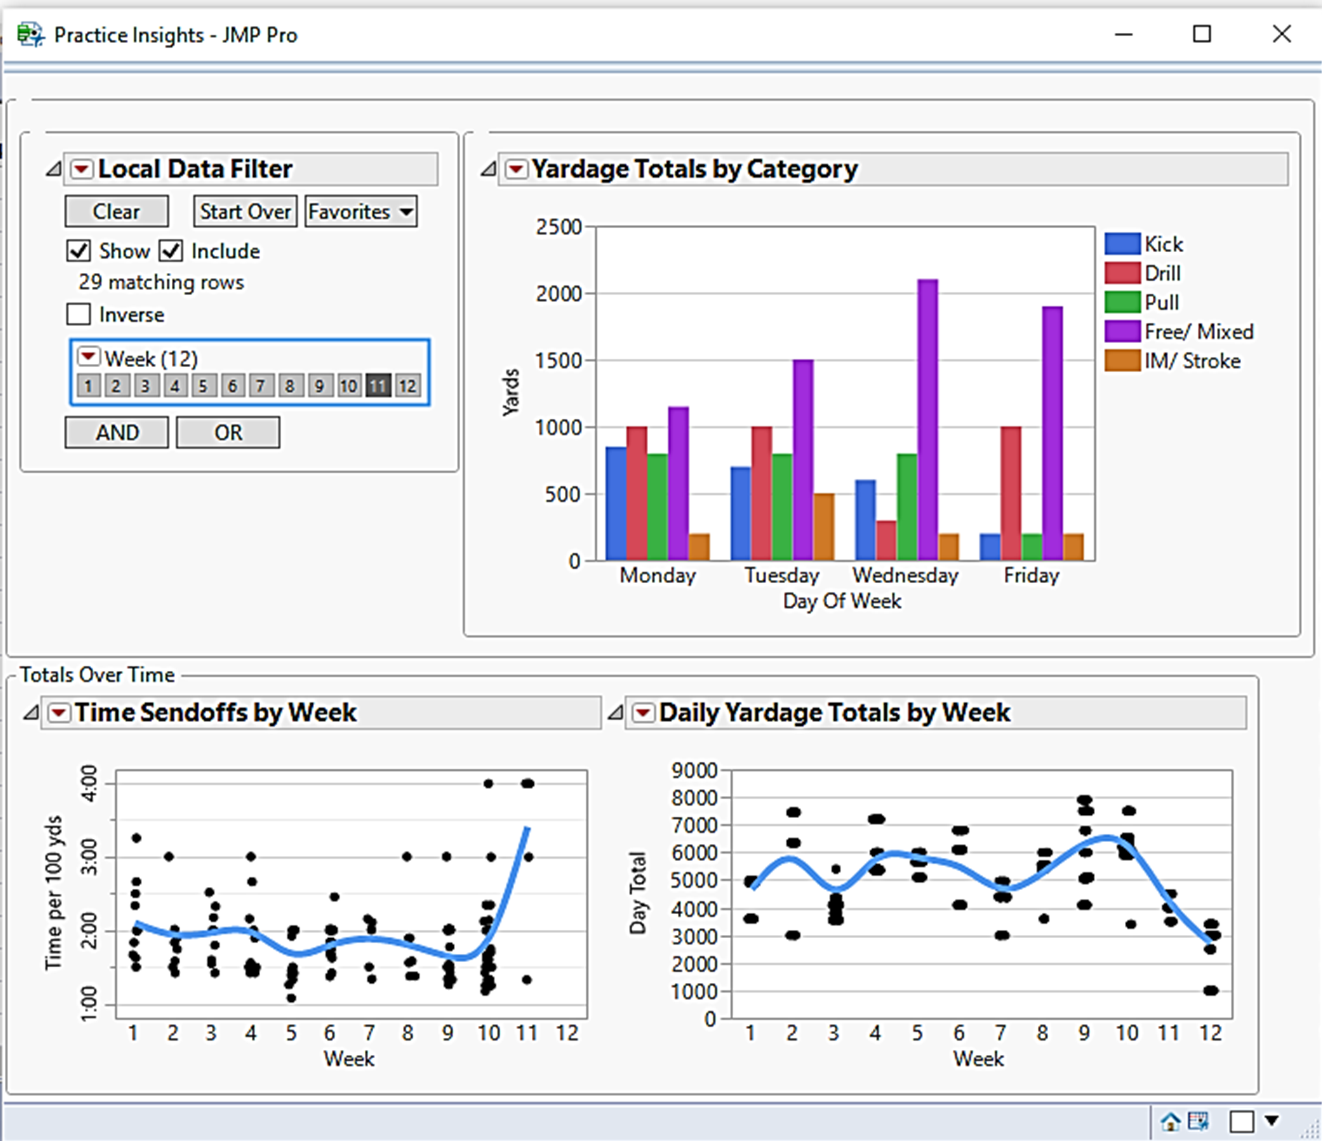
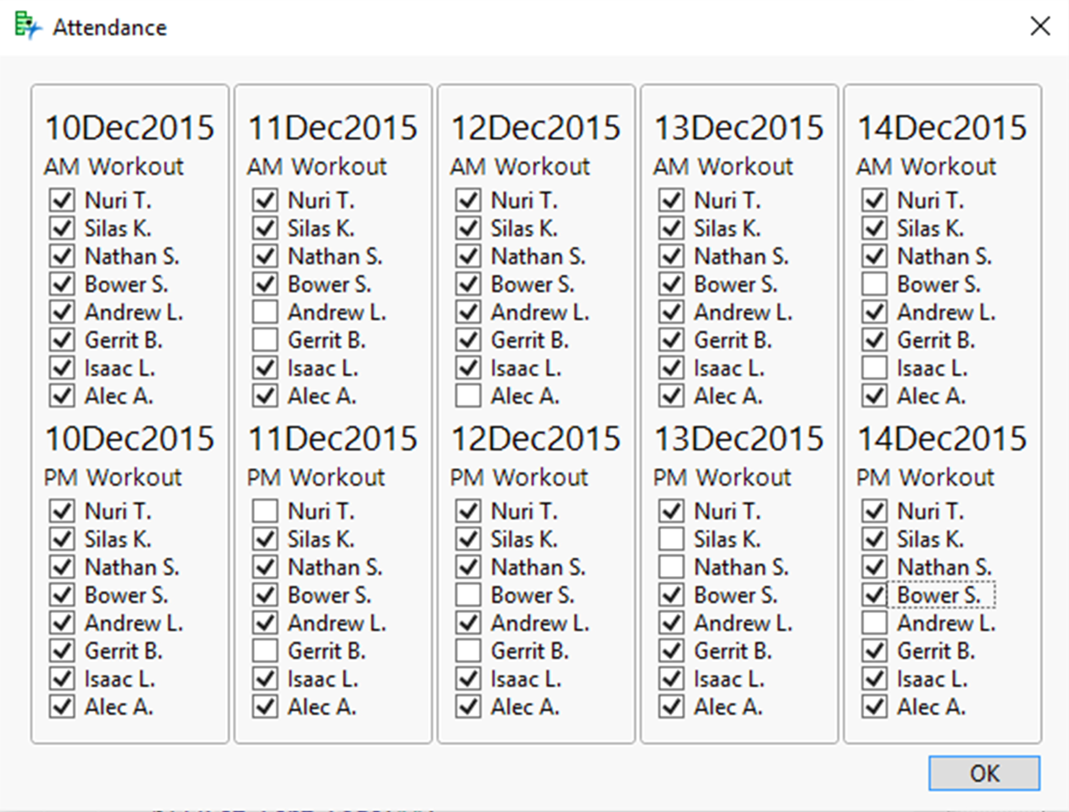
Using JMP® to Organise, Manage, and Analyse Swimming Data: An Alternative to Traditional Software
Andrew Kampfschulte
Grand Valley State University
Abstract
Tracking Workouts and Yardage
The field of sports analytics has grown exceptionally over the past decade. Many sports organizations now recognize the utility that data analysis and visualization can provide. However, in the swimming community, the options for analytic software specific to the sport are sparse, and the packages that are available are often difficult to use or lacking in any sort of comprehensive analytics. In a sport as quantitative as swimming, where every aspect of practice and competition can measured rather easily, it is surprising that most software packages for this sport are lacking substantially in any analytic perspective.
To gain a better understanding of what an analytics platform could look like for swimming, and to assist Area Coaches in their season planning and training schedules. JMP JSL scripting was used to create a multi-faceted program designed to let coaches easily input their practice data, track team attendance, and better prepare their athletes for competition.
The initial scope of the project was to create an interface that coaches could use to input their practice data and analyse it easily. In the below left window, coaches enter the date, practice time (AM or PM), yardage increment and the number of repetitions, type of workout, and the corresponding yardage categories (Kick, Pull, IM, Freestyle, etc.). A slider box is utilized should the workout need an associate time interval. Once entered the data is placed into an organized data table, and coaches have the to option to view a few graphics displaying their data throughout the season. The interactive bar charts help reassure that workouts are remaining heterogeneous over the long term, a key component to avoiding repetitive stress injuries.
( Click Figures to Enlarge )
Conclusions
Modern software for organizing and managing swim data is largely out of date or difficult to use. The goal of this program was to create a user-friendly, easy to use interface that allows coaches to quickly enter data in a real-time, organised fashion. The JSL scripting application was used effectively to enter several seasons of swimming data quickly and input it into organised tables. Interactive graphical displays available at the click of a button made analysing this data easy to do. This allowed coaches to track their practice yardage and workouts easily over the course of the season, gave insight into their practice patterns, and allowed them to set more stringent, specific training goals. The ability to track attendance allowed coaches to look at training on a person-to-person basis, making the depth of analysis even greater. While the program is a good start to a comprehensive platform for swimming analytics, more work needs to be done to properly track competitive performance data and competition trends.
Objective
Tracking Athlete Attendance and Performance
Create a user interface that is both effective and easy to use for non-JMP users with little analytic background.
Have the interface organise inputted data into a table, and produce easy to read graphical displays of practice patterns.
Allow the tracking of attendance of the team roster to follow season training on a person-to-person basis.
Take the mystery out of training patterns and easily measure workout progress.
To provide a view of training progress on a person-to-person basis, a simple attendance program was created allowing coaches to track what athletes were present at specific workouts on a weekly basis. Utilizing check boxes, the selection of a swimmers name would associate with all workouts assigned on a particular date. Further graphical displays were used to track an athletes practice attendance and performance over time.

Slide 2


Workout Tracking
Click Here to Return

Slide 3
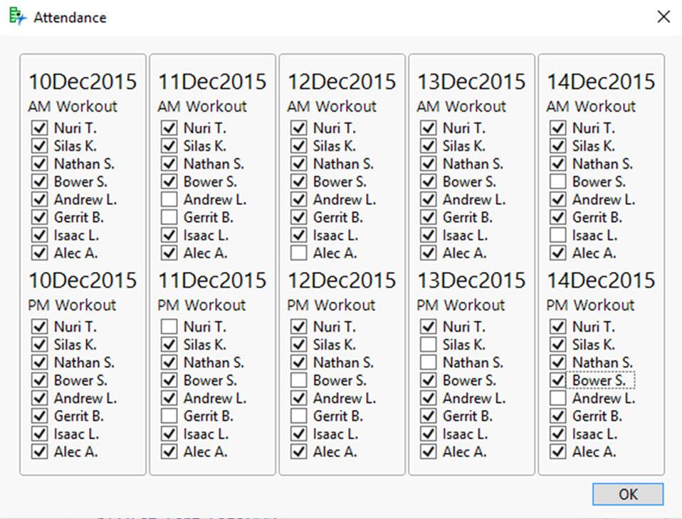

Attendance Tracking
Click Here to Return

