Slide 1

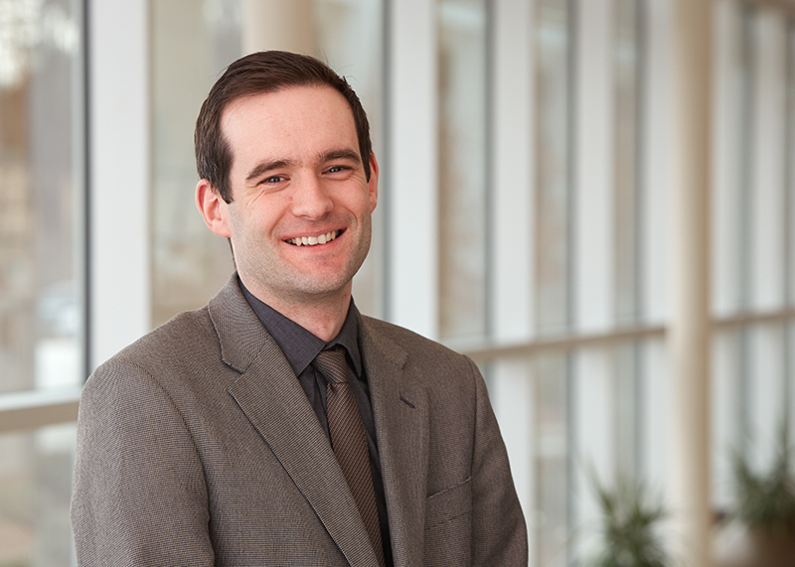
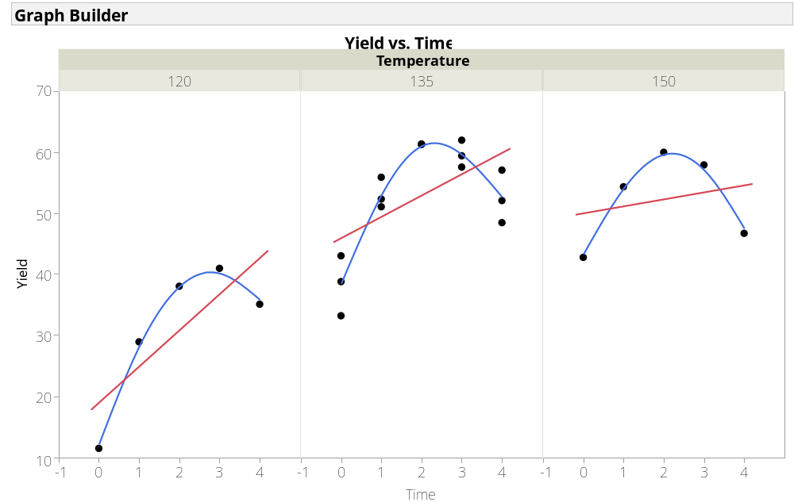
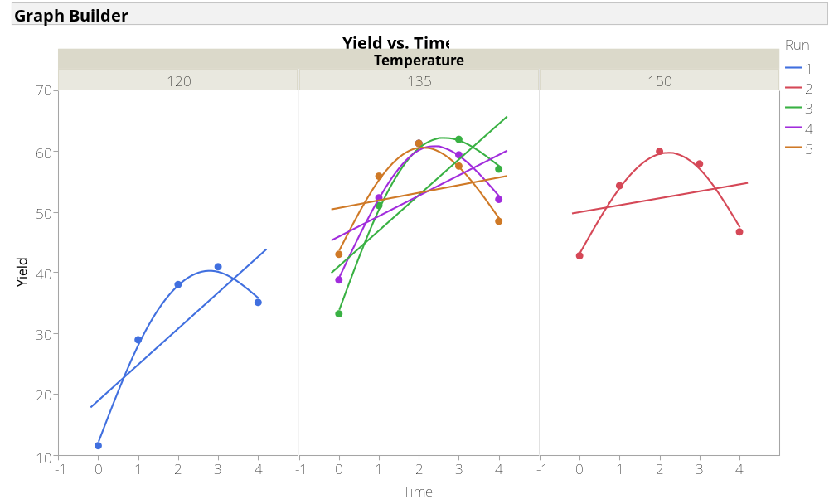
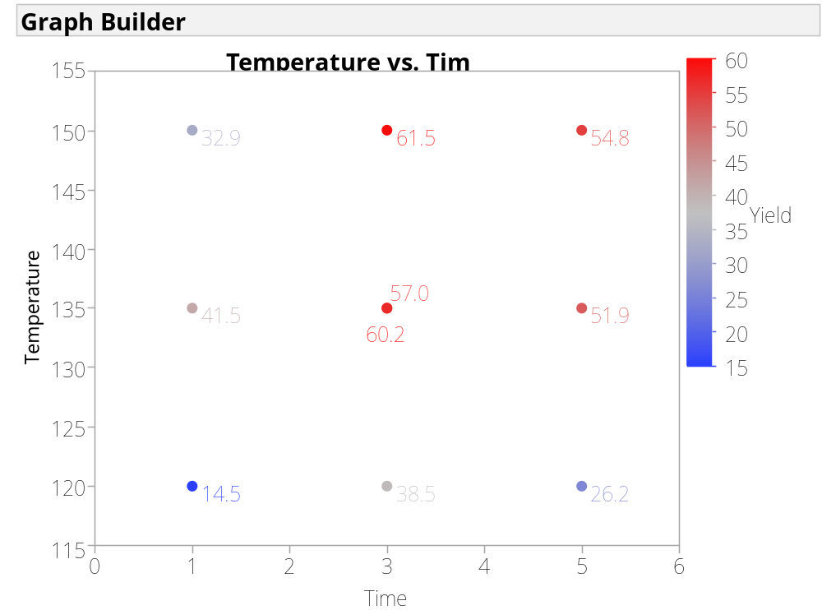
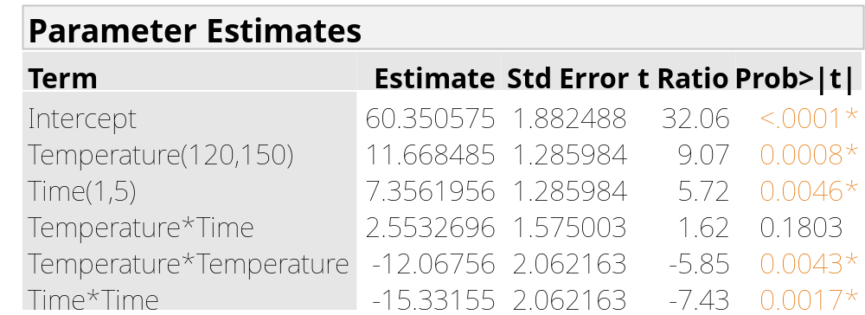
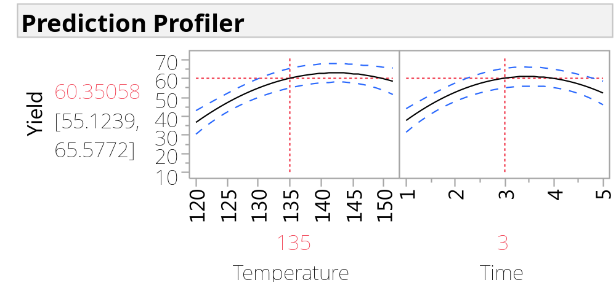
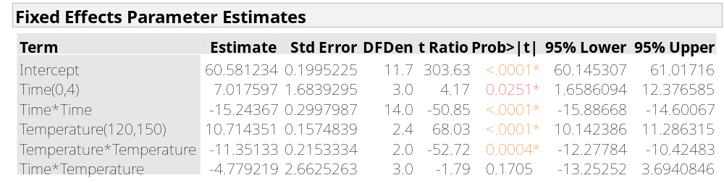
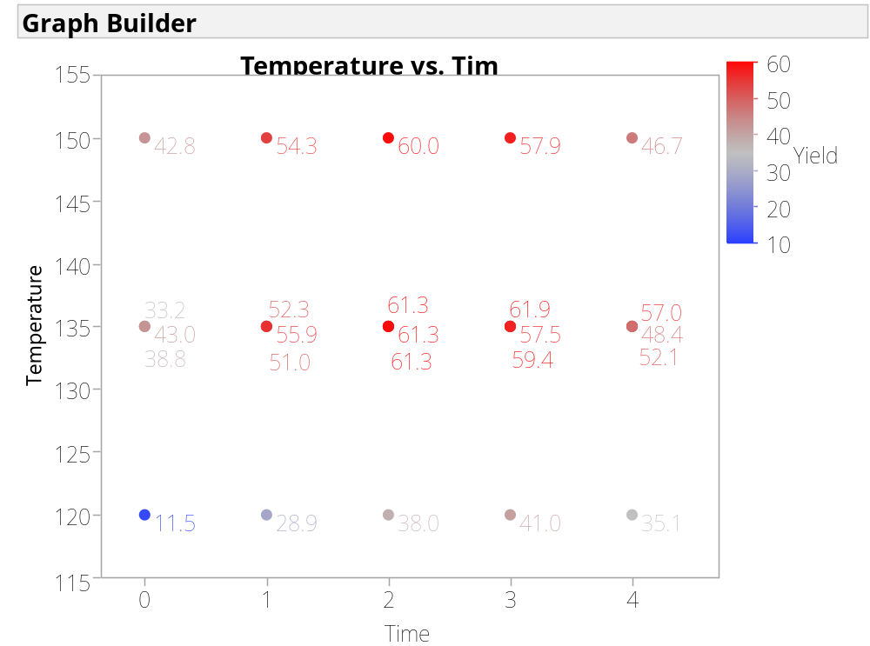
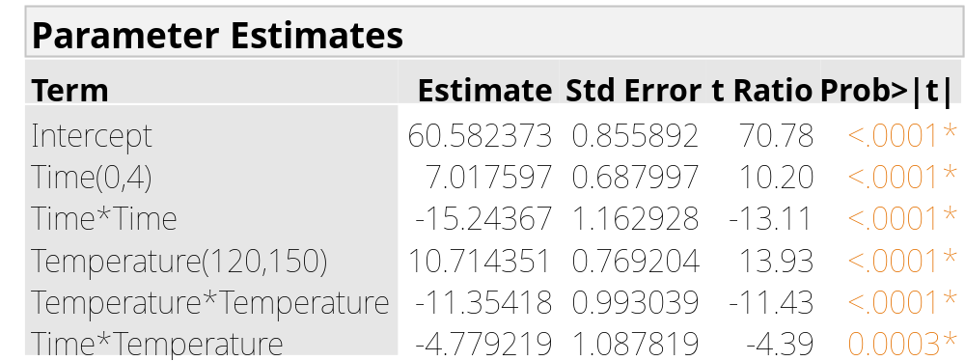
We Have All the Time in the World
Use Your Time Wisely in Designing Experiments
Phil Kay, JMP Systems Engineer, SAS
Abstract
1. Time set for each run
Finding the best use of time is a challenge
Need to understand the effect of time in industrial experimentation
Need to understand if the effect of time changes with other factors
CCD design, 2 centre points = 10 runs
(click to enlarge images)
(click to enlarge images)
Seems slope of Yield vs t changes with T
However, slope changes just as much within runs of the centre point
Our model doesn’t reflect this
Simple Example Objective
Solution
Fitting appropriate RSM model is simple
T*t interaction declared unimportant
Chemical yield optimisation
Temperature, T, and Time, t, as X’s
Method 1.: T and t as factors in DoE
Method 2.: Cheaper to sample at t-intervals during runs at different T
Can these be modelled the same way?
JMP Pro enables exploration of Mixed Models¹ to properly account for correlated measures
2. Sample at time intervals in run
T at 3 levels, 3 centre points = 5 runs
Yield at 5 t-intervals = 25 observations
50% less runs and more information?
(click to enlarge image)
(click to enlarge images)
You can also model systems with many more factors
References
Fit same model
T*t is highly significant! Why?
1. Linear Mixed Models with JMP® Pro: One Face, Many Flavours, Jian Cao, JMP Discovery Summit Europe, March 24, 2015 Brussels, Belgium

Slide 2
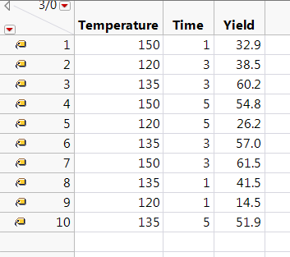
1. Time set for each run
Click Here to Return

Slide 3
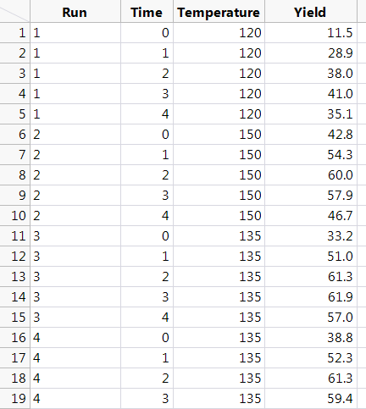
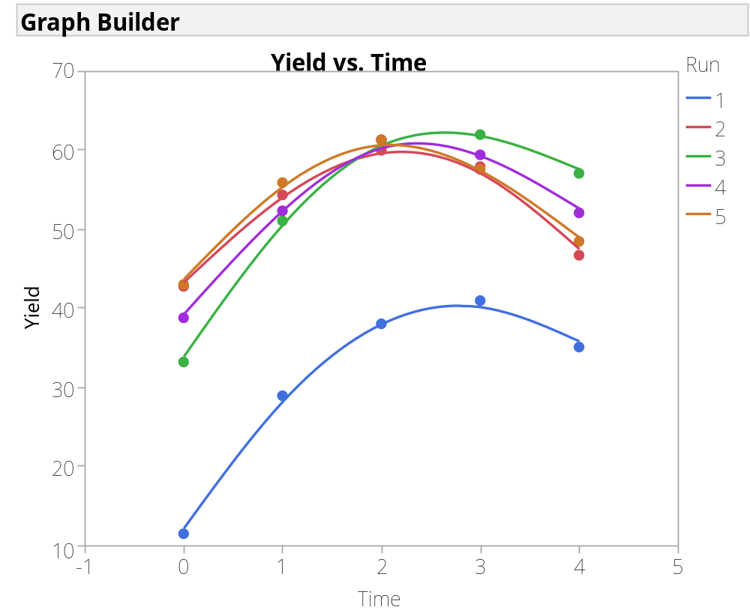
2. Sample at time intervals in run
Click Here to Return

Slide 4
2. Sample at time intervals in run
Click Here to Return

Slide 5
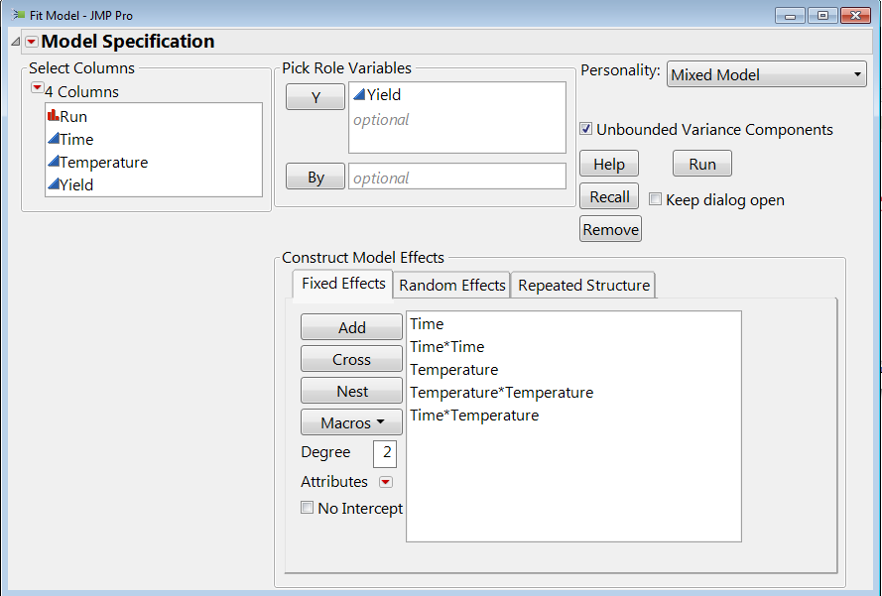
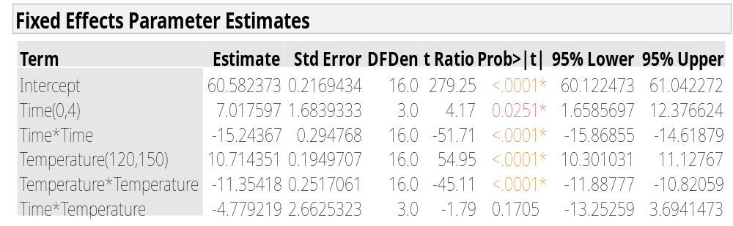
Solution
Click Here to Return

