Slide 1


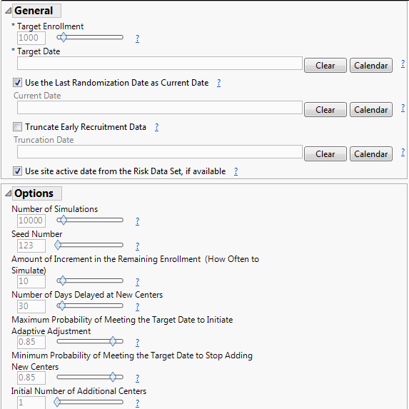
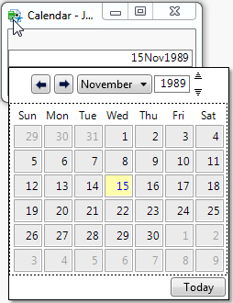
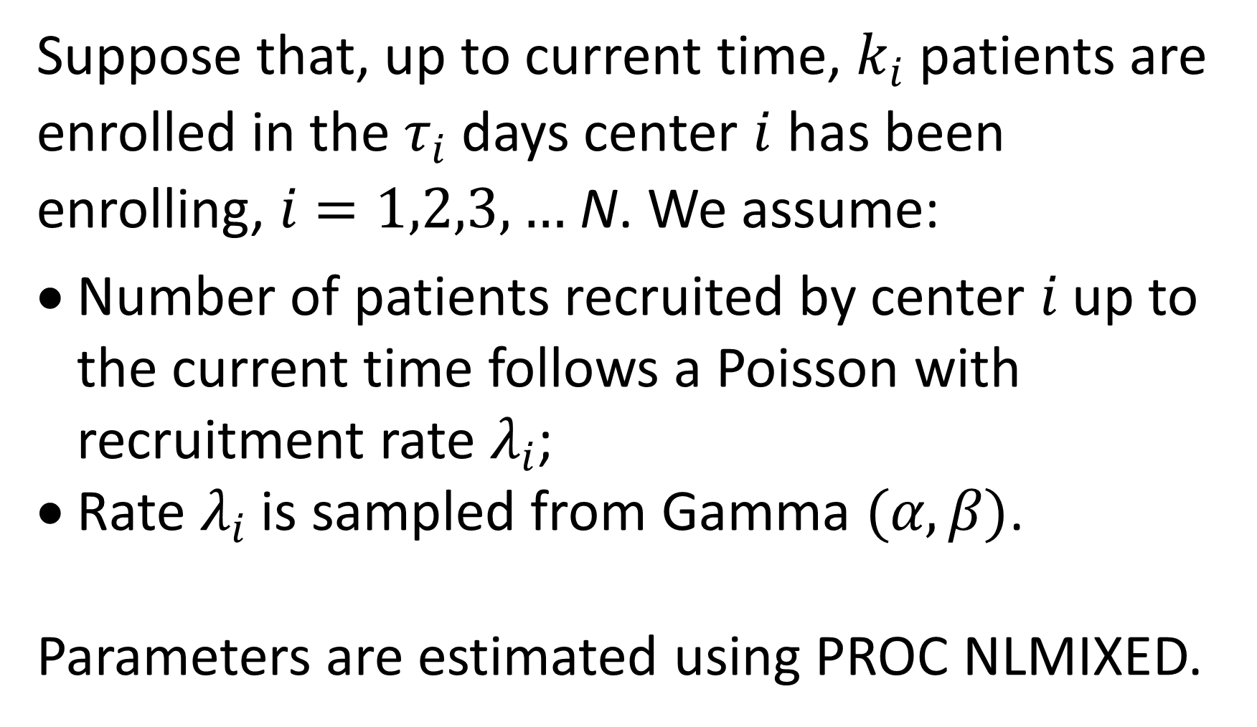
Predictive Modeling for Patient Recruitment in Multicenter Trials
Xiaotong Jiang¹, Richard C. Zink, PhD^{1,2}
Department of Biostatistics, University of North Carolina at Chapel Hill¹; JMP Life Sciences, SAS Institute, Inc.²
Background
Model Assumptions
User Interface
Clinical trials are experiments that study patients, which can be analyzed only after sufficient patients have been enrolled to meet the power requirements for the primary endpoint. Therefore, it is very important for researchers to be able to recruit enough patients by a given deadline. The current problem: how can investigators know the trial will be completed on time?
Suppose that, up to current time, $k_{i}$ patients are enrolled in the $τ_{i}$ days center $i$ has been enrolling, $i=1,2,3,…$ N. We assume:
Number of patients recruited by center $i$ up to the current time follows a Poisson with recruitment rate $λ_{i}$;
Rate $λ_{i}$ is sampled from Gamma $(α, β)$.
Parameters are estimated using PROC NLMIXED.
Recruitment Model
Workflow
A recruitment model is implemented in JMP Clinical where, given current enrollment information, the estimated remaining recruitment time and confidence bands are generated using maximum likelihood estimation and Bayesian simulation, providing the future recruitment prediction to users in advance. If there is a high probability of missing the recruitment deadline, JMP Clinical will calculate the number of additional centers needed to meet the deadline, helping users adjust the recruitment process to reach the target time.
Current Enrollment Data Read-In
⬇
Parameter Estimation
⬇
Recruitment Prediction
⬇
Adaptive Adjustment (if necessary)

Slide 2
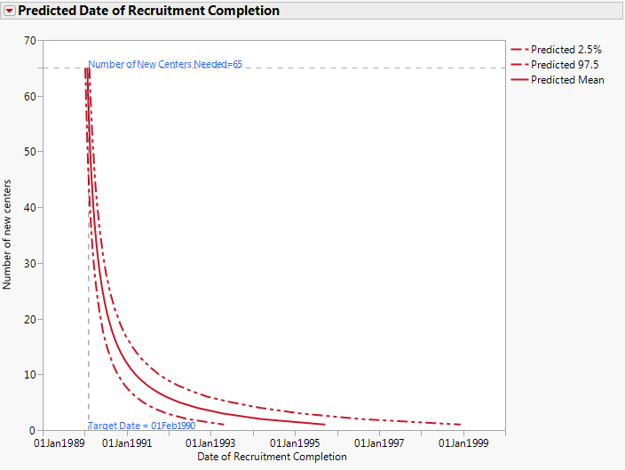
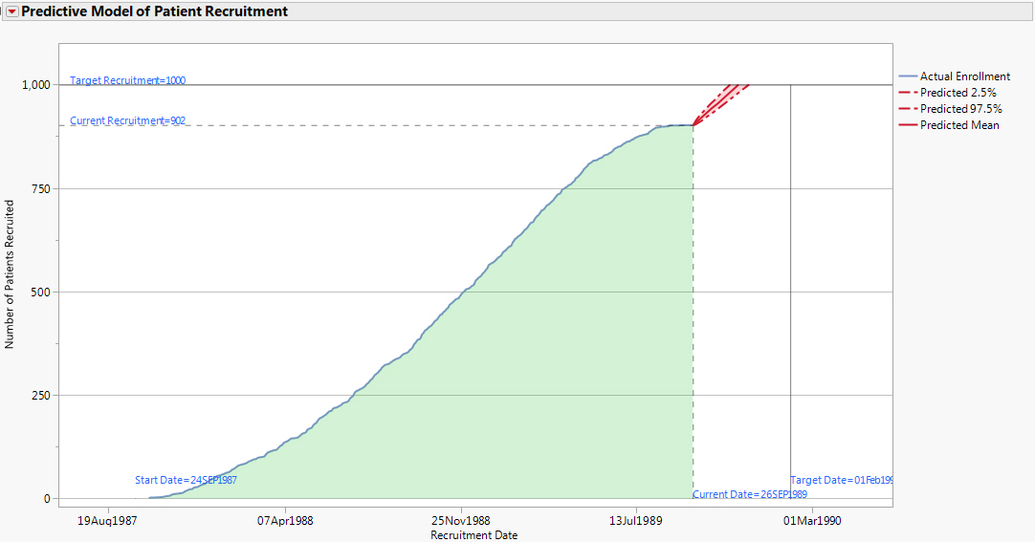
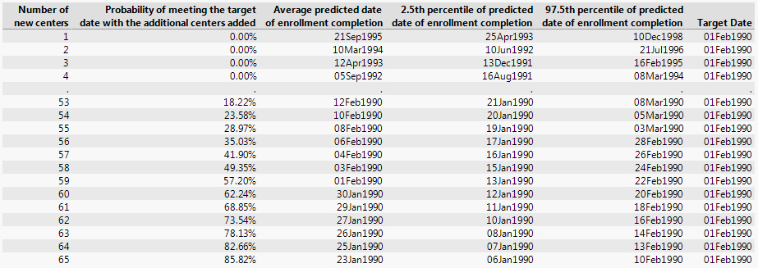
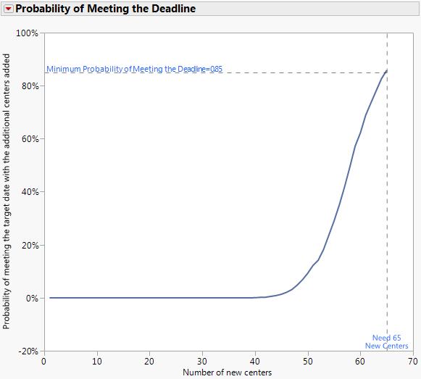
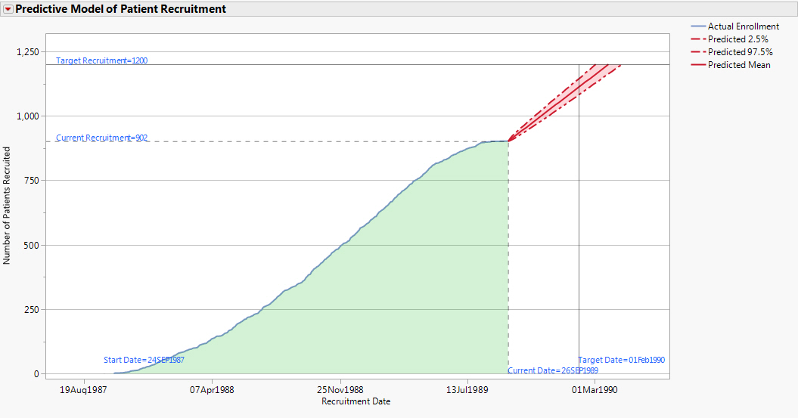
Predictive Modeling for Patient Recruitment in Multicenter Trials
Xiaotong Jiang¹, Richard C. Zink, PhD^{1,2}
Department of Biostatistics, University of North Carolina at Chapel Hill¹; JMP Life Sciences, SAS Institute, Inc.²
Recruitment Prediction
Adaptive Adjustment
01Feb1990 deadline not missed with a 1000 patient target.
If deadline is missed, simulate the number of additional centers needed to meet the target sample size by the deadline with a high probability.
01Feb1990 deadline missed with a 1200 patient target.
Reference
Anisimov VV & Fedorov VV. (2007). Modelling, prediction and adaptive adjustment of recruitment in multicenter trials. Statistics in Medicine, 26: 4958-4975.

Slide 3
User Interface
Click Here to Return

Slide 4
Recruitment Prediction
01Feb1990 deadline not missed with a 1000 patient target.
Click Here to Return

Slide 5
Recruitment Prediction
01Feb1990 deadline missed with a 1200 patient target.
Click Here to Return

Slide 6
Adaptive Adjustment
Click Here to Return

Slide 7
Adaptive Adjustment
Click Here to Return

