Slide 1

Multimodality distribution analysis
Discover variability sources hidden in density distributions by using JMP scripting capability

Slide 2


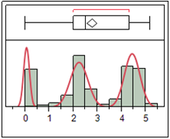
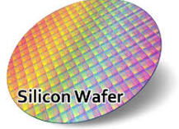
Multimodality Distribution analysis
Antonio D’Angelo, Felice Russo
Lfoundry s.r.l Italy
Abstract
Objective
Methods
JMP script, integrating the analytical capabilities of R:
    to estimate the probability density function using a suitable kernel estimator
    to identify and filter the distribution modes according to an empirical rule
In a semiconductor Fab several electrical measurements are collected on different silicon wafers. Distributions associated to them typically are normal even though this is not always the case. Many times those distributions show multiple modes because of processes shift, tools deviation or offset
Identify the distributions with multiples modes among the large number of registers measured on each silicon wafer
Reduce the candidates for real multimodal distributions
JMP addin to automate the entire process

Slide 3
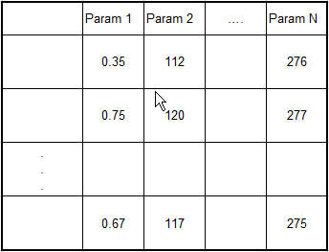




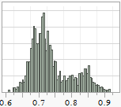
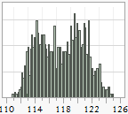
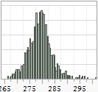
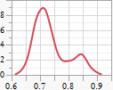
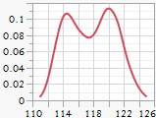
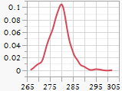
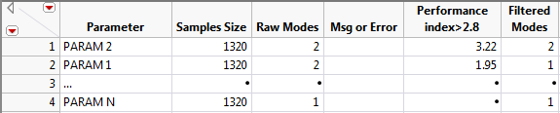
Multimodality Distribution analysis
Antonio D’Angelo, Felice Russo
Lfoundry s.r.l Italy
Data
Density function
estimation
Discrete bins
References
Density func
estimation
Density Estimation - S.J. Sheather - Statistical science 2004, vol19, No 4, 588-597
Density Estimation for Statistics and Data Analysis - B.W. Silverman - Monographs on Statistics and Applied Probability, London: Chapman and Hall, 1986
Kernel Smoothing - M. P. Wand & M. C. Jones - Monographs on Statistics and Applied Probability Chapman & Hall, 1995.
Continous
Modes Filtering
Distance
Sigma
Index=
Modes
filtering
Result
Notes:
Density function estimation box: Hyperlink to page 4
Modes filtering box: Hyperlink to page 5
Picture Table “Result”: Hyperlink to page 6

Slide 4
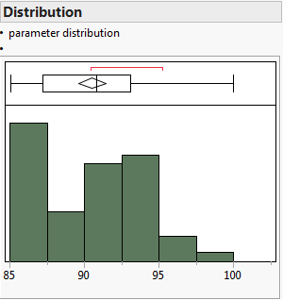
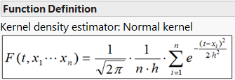



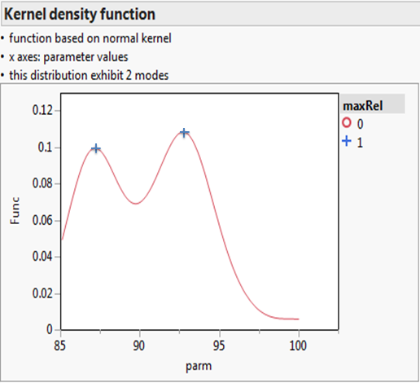
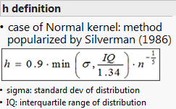
Multimodality Distribution analysis
Antonio D’Angelo, Felice Russo
Lfoundry s.r.l Italy
Density function estimation
General form for kernel estimation
K : kernel function
h : bandwidth = smoothing factor
Kernel function satisfies:

Slide 5
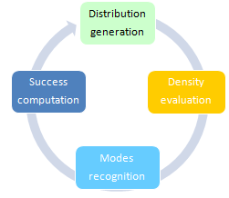
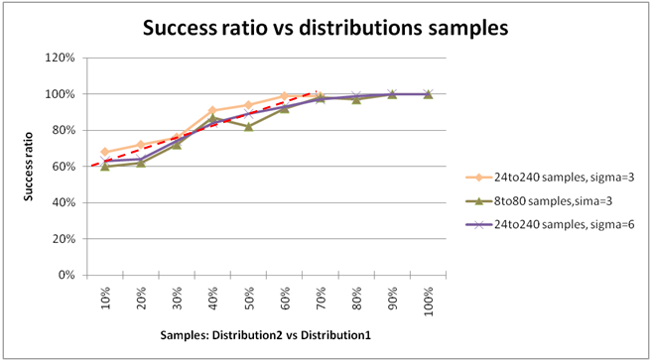
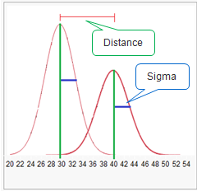
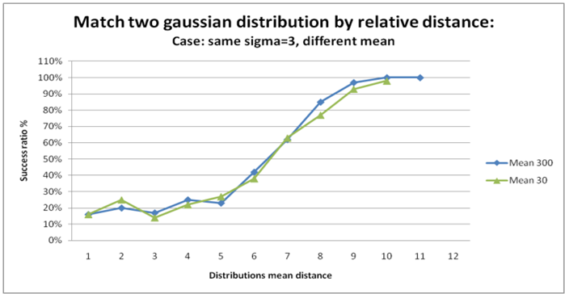
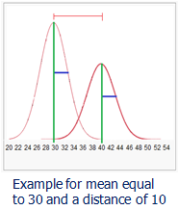
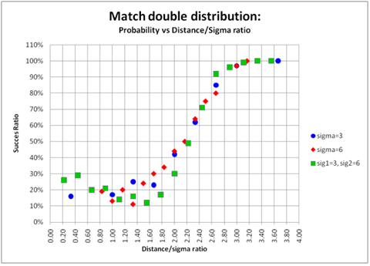
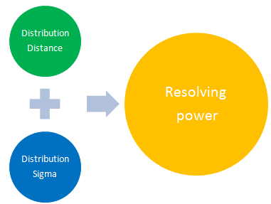
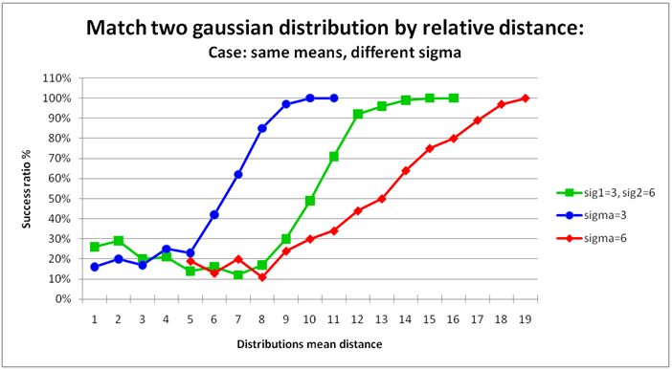
Multimodality Distribution analysis
Antonio D’Angelo, Felice Russo
Lfoundry s.r.l Italy
Modes Filtering
Montecarlo simulation
unbalanced samples
Problem: how to separate a real signal from noise?
Simulation to identify a suitable figure of merit
Success ratio vs Distance and Sigma
Same Sigma
Different Mean
Figure of merit
Different Sigma
Same Mean
Figure of
merit

Slide 6
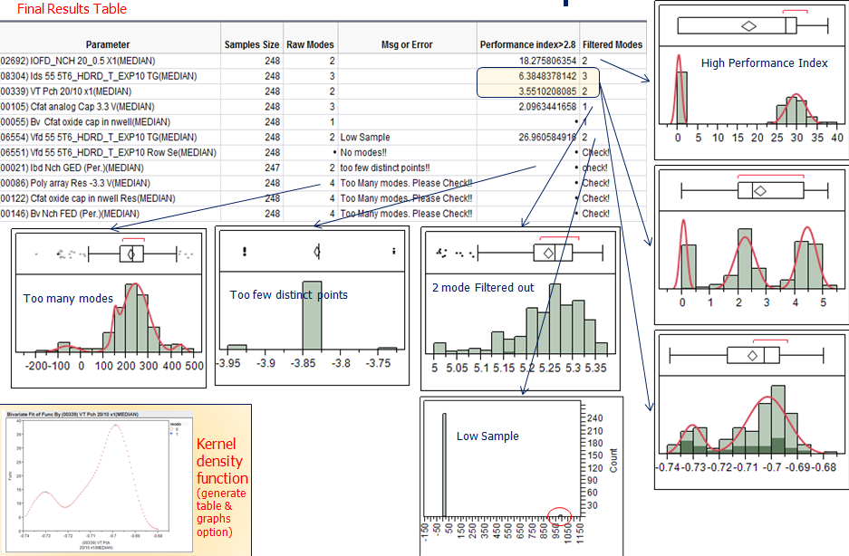
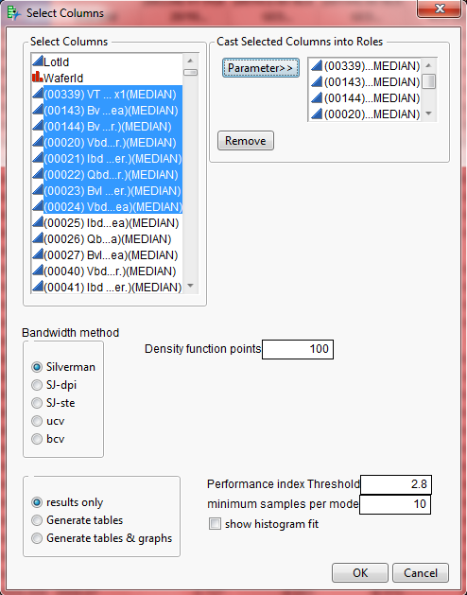
Multimodality Distribution analysis
Antonio D’Angelo, Felice Russo
Lfoundry s.r.l Italy
Input mask

