Slide 1
Modelling Percent Body Fat in a Human Body Using Design of Experiments and Regression Analysis
Frank Deruyck, Dr. Sc., Lecturer, University College Ghent

Slide 2
CONTENT
Approach
Input Parameter Selection
DOE Sample extraction - Model Selection
DOE Evaluation
Regression Analysis - Body Volume Model
Regression Analysis - %Fat by body volume
Regression Analysis - %Fat by body shape ratio’s
Model Validation → K-Fold Cross Validadion
%Fat Capability Analysis
%Fat Simulation - Space Filling DOE

Slide 3
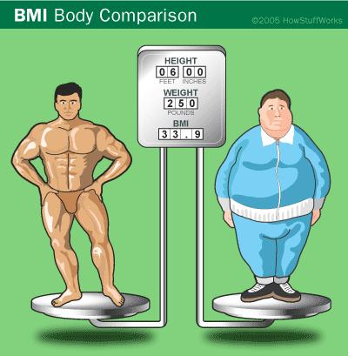
BODY FAT ≠ BMI
BMI = weight/length²

Slide 4
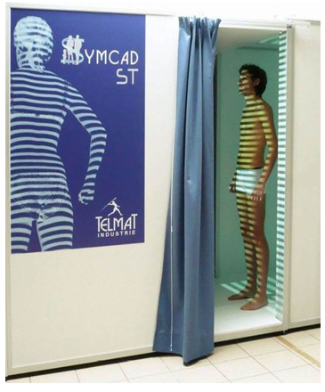
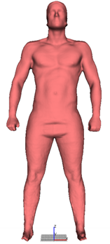

Approach
Calculation Body Volume by numerical integration → Time consuming!
%Fat = f(volume/weight)
+ Weight
Easy, manual measurements
Regression Analysis
Body Volume = f(body measurements)
Model %Fat
SMARTFIT database
> 50 body measurements n = 1200 adult records
Parameter selection → PCA
Sample extraction → DOE

Slide 5

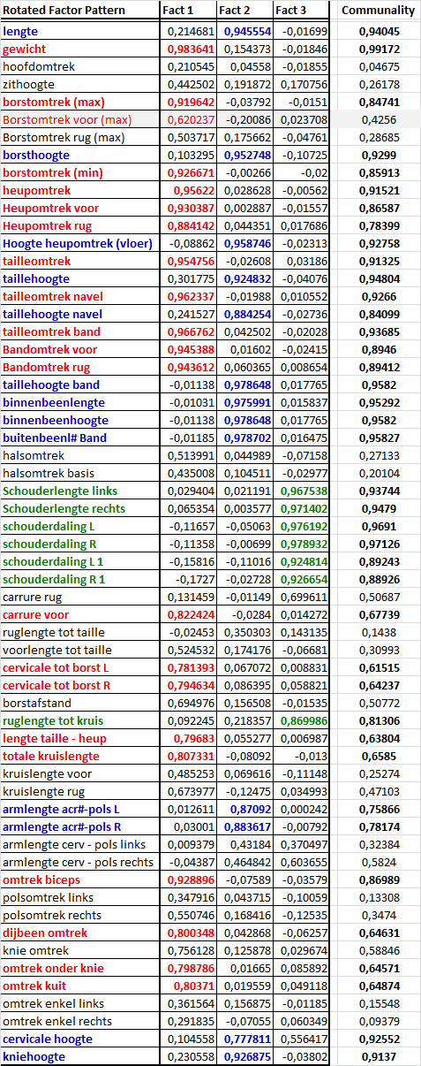
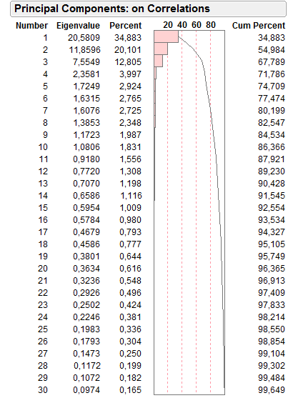
Input parameter selection
correlated parameters
PCA/FACTOR ANALYSIS
Selection input parameters
DOE

Slide 6
Doe sample extraction - Model Selection
DOE 1 (DSD)
4 continuous
1 categorical
Body Volume calculation
Training sample
n = 3x18 records
male & female
Input Regression Analysis
Cross validation
Candidate %Fat Models
DOE 2 (2⁵⁻³_{IV})
5 continuous
Body Volume calculation
Validation sample
n = 2x16 records
male & female
SMARTFIT database
n = 1200 records
Input Regression Analysis
K-fold Cross validation
DOE settings can only be approximated
%Fat Model
Collinearity!

Slide 7
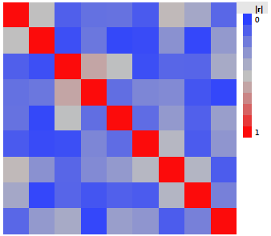
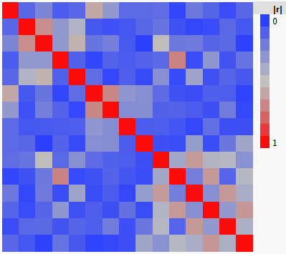


Doe evaluation
Color Map On Correlations
DOE 1(DSD)
DOE 2 (2⁵⁻³_{IV})
Main effects
Main effects
categorical
Significant collinearity!
Significant collinearity!

Slide 8
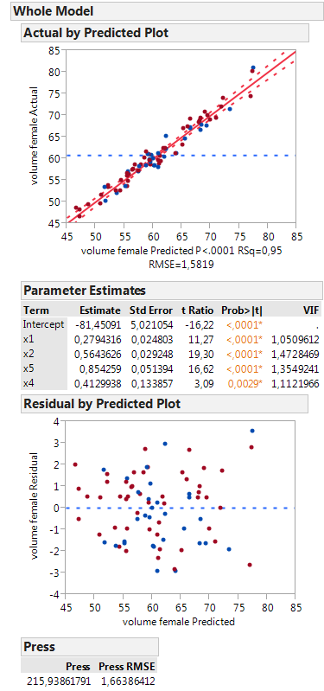
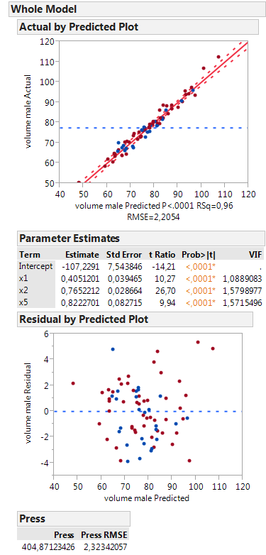
Regression analysis - Body Volume Model
Female
Male
DOE 1 Training
n = 54
DOE 2 Validation
n = 32
Good linear body volume models!
Leave one out cross validation

Slide 9
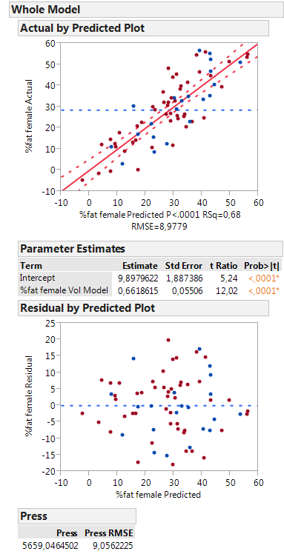
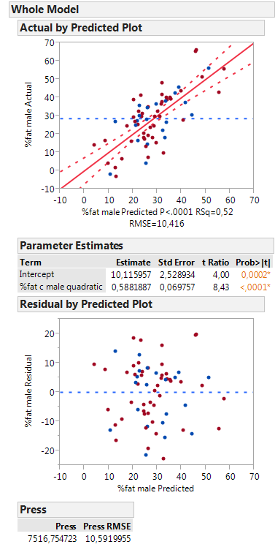
Regression analysis - %Fat = f(volume, weight)
Female
Male
Measured Volume
Measured Volume
DOE 1 Training
n = 54
DOE 2 Validation
n = 32
Calculated Volume
Calculated Volume
Poor predictive power

Slide 10
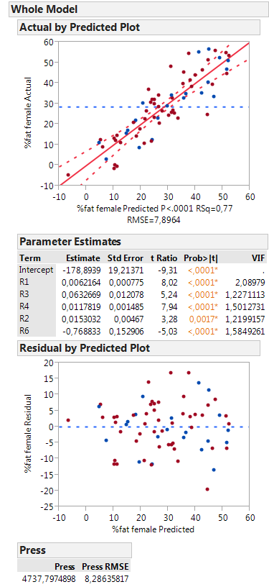
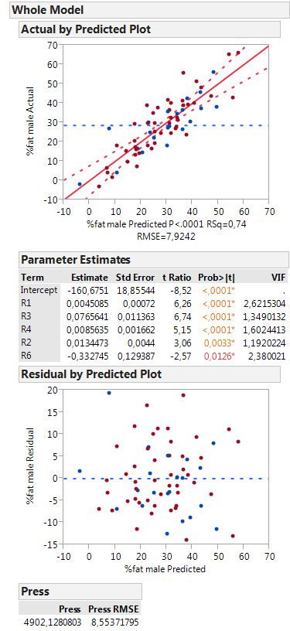
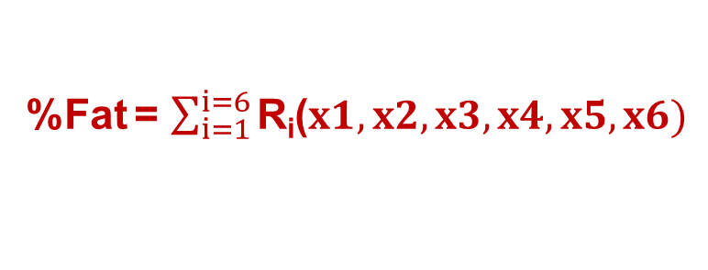
Regression analysis - %Fat = f(body shape ratios)
%Fat = $\sum_{i=1}^{i=6}{\text{R}\text{i}\text{(}x1, x2, x3, x4, x5, x6)}$
R_{i} → ratio’s body shape
Female
Male
DOE 1 Training
n = 54
DOE 2 Validation
n = 32
Improved predictive power

Slide 11
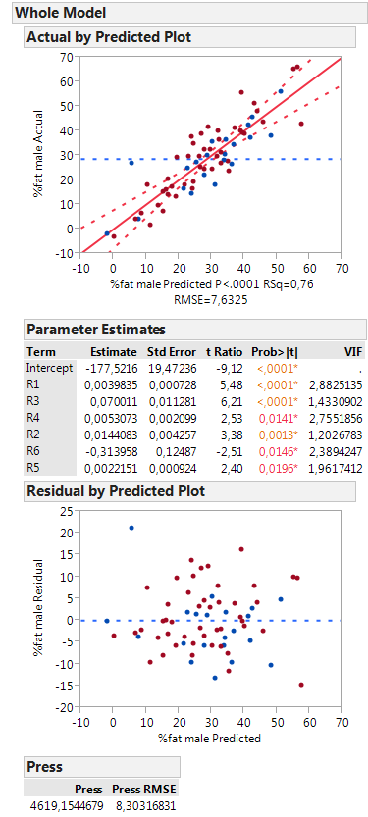
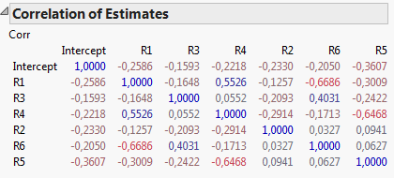
Regression analysis - %Fat = f(body shape ratios)
Model Ri 2 Male + R5
DOE 1 Training
n = 54
DOE 2 Validation
n = 32
Slightly better predictive power
Collinearity!

Slide 12
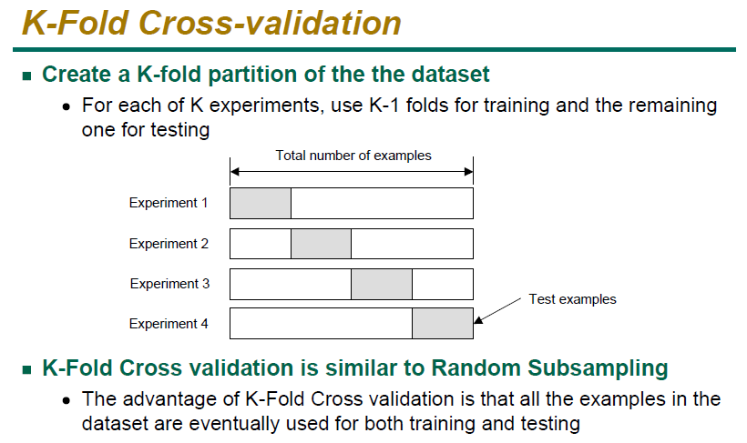
Model validation - K-Fold Cross Validadion

Slide 13
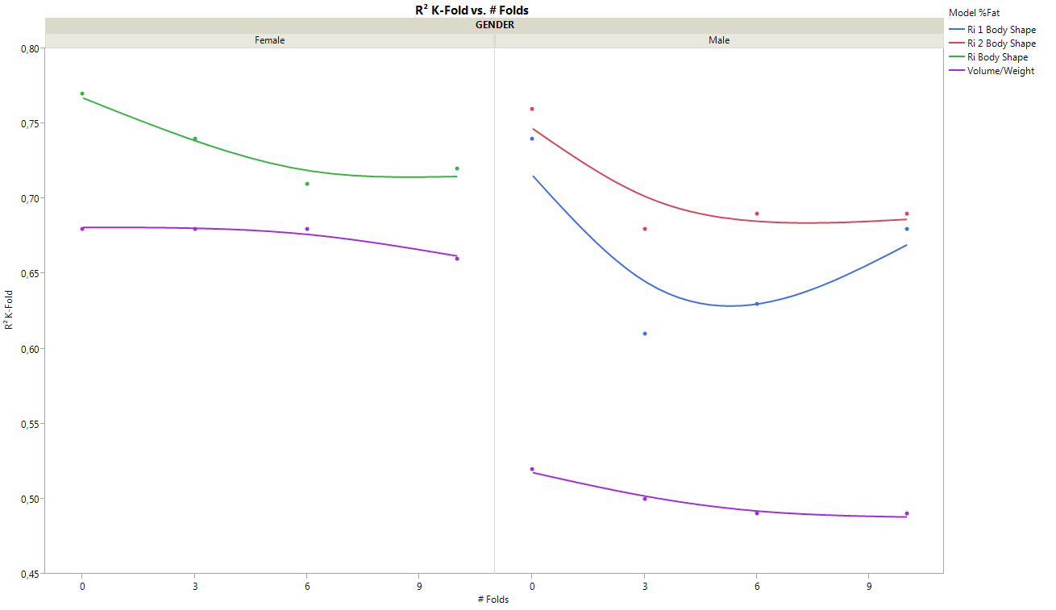
Model validation - K-Fold Cross Validadion
JMP Graph Builder
Better model despite of collinearity
Lower R² but robust vs. #Folds

Slide 14
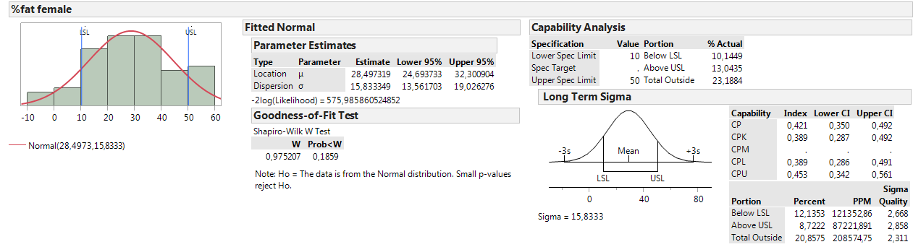
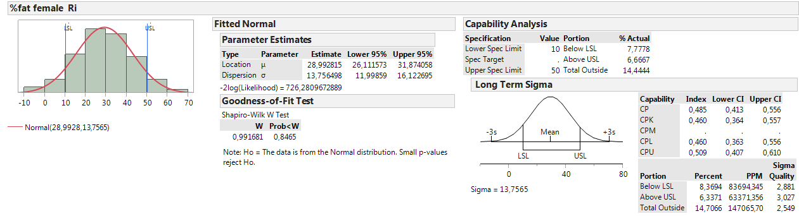
%Fat capability analysis
Body volume measurement
Ri Body Shape model
%Out of spec acceptable

Slide 15
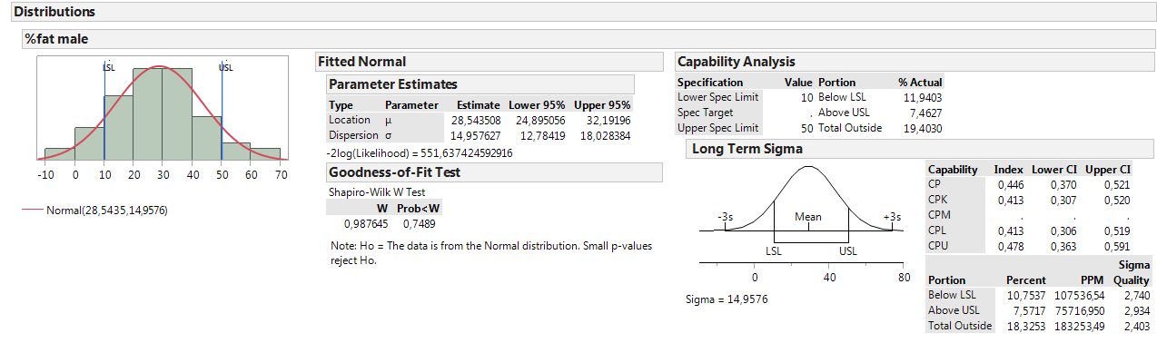

%Fat capability analysis
Body volume measurement
Ri2 Body Shape model
%Out of spec acceptable

Slide 16
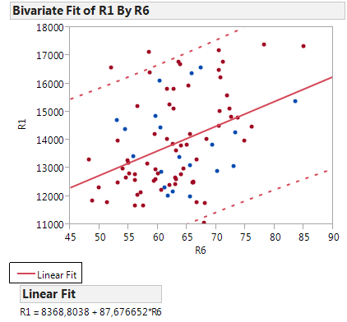
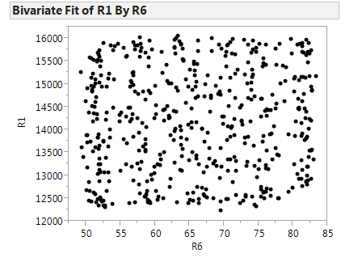
%Fat simulation - Space Filling DOE
Linear constraint
Linear constraint
Generate lacking data
“Fast Flexible Filling Design”
#runs = 500
Simulation %Fat

Slide 17
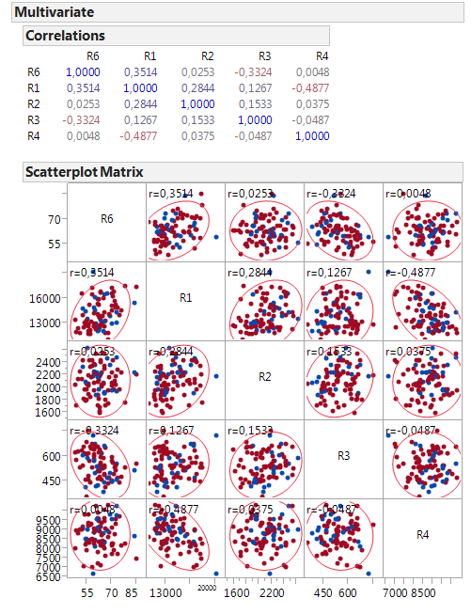
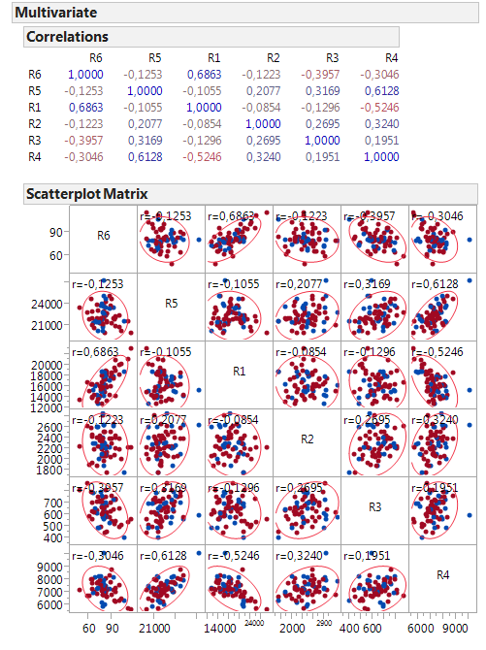
%Fat simulation - Space Filling DOE
Linear Constraints
# linear constraints = 6
# linear constraints = 14

Slide 18
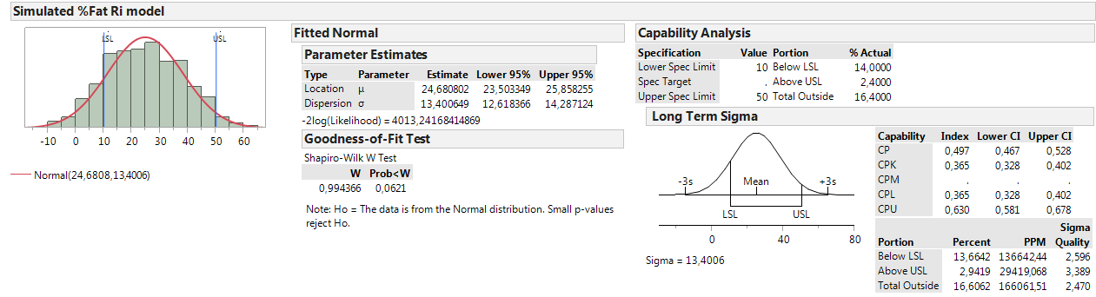
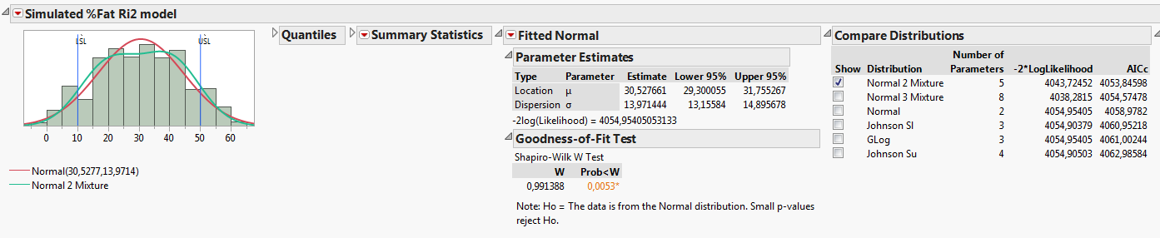
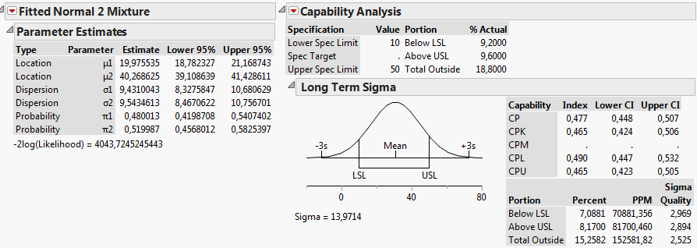
%Fat simulation - Space Filling DOE
Capability Analysis
FEMALE
Borderline
BIMODAL DISTRIBUTION
MALE
%Out of spec acceptable

Slide 19
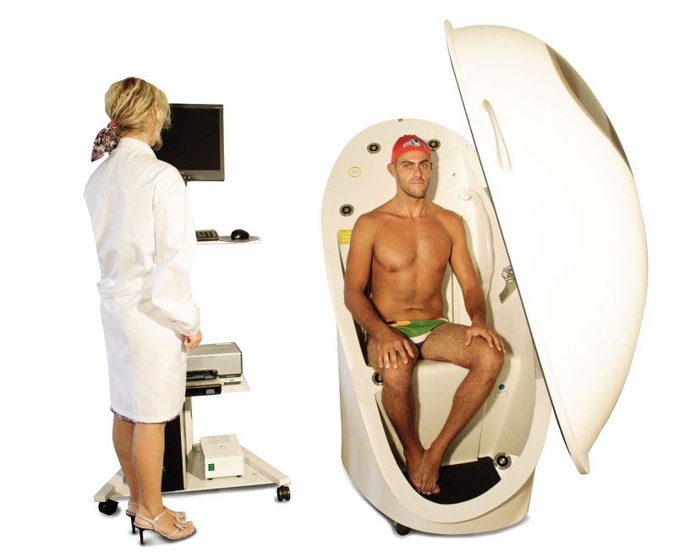
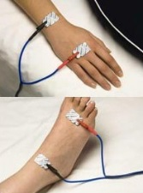
Validation
200 new measurements
Bodyscan (Symcad)
Body volume (BodPod)
Impedance measurement (Quadscan 4000)
body measurements
Accurate %Fat measurement

Slide 20

www.adeps.net
Project Coordinator
dr. Willem De Keyzer
Collaborators
dr. Frank Deruyck, ir. Benjamin Van Der Smissen, dr. Simona Vasile, Joris
Cools, Alexandra De Raeve, prof. dr. Stefaan De Henauw, dr. ir. Peter Van Ransbeeck
Departments
Bio- and food sciences
Exact sciences
Mechatronics
Fashion, textile and wood technology

