Slide 1


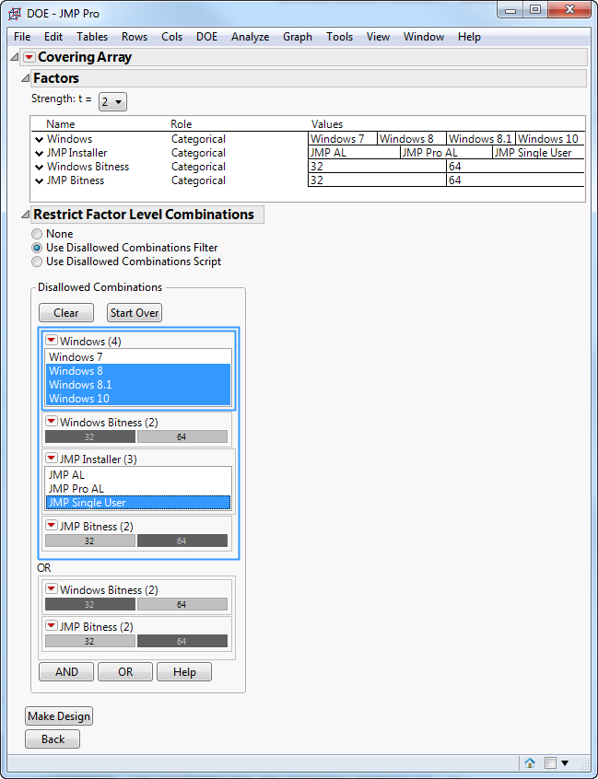
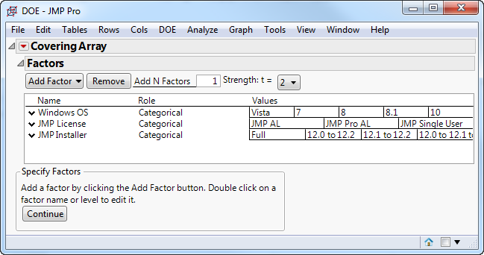
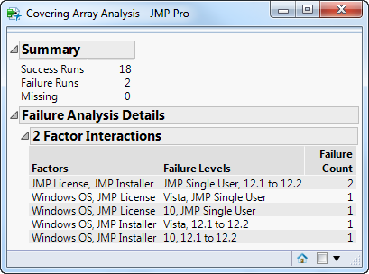
Effective Test Design Using Covering Arrays
Melanie J. Drake
Sr. Development Tester, JMP Division, SAS
Abstract
Define the Problem
Complications
Testing a simple system is simple. Testing a complex system is very complex. Problems are often found in the interactions amongst different factors. Constructing a full factorial design, which tests every possible combination, will find all problems, but only if there is time to perform all tests. Covering arrays can help restrict the test space while still performing tests capable of catching many problems. The important take-away is to balance risk and available resources.
Installer Validation
Several Versions of Windows
Full and Upgrade Installers
Several different upgrade paths
Three different JMP licenses
Test 2-way interactions
What if one factor is dependent on another?
Use Disallowed Combinations!
Create the Design
What is a covering array?
Click here for a mathematical definition
Click here for a practical definition
Click image for more details
Click image for more details
Conclusions
Objectives
Analyze the Results
Using covering arrays in test design can optimize your testing by balancing risk and resources.
Once testing is completed, the analysis script can help narrow your focus to the possible causes of problems.
Click here for references
Define the problem to be tested
Determine the level of testing required
Create the design
Use the design to perform the tests
Analyze the test results to find what factors cause problems
Click image for more details

Slide 2
Mathematical Definition of a Covering Array
A covering array CA(N; t, k, v) is an N × k array such that the i-th column contains v distinct symbols. If a CA(N; t, k, v) has the property that for any t coordinate projection, all v^{t} combinations of symbols exist at least once, then it is a t-covering array (or strength t covering array). A t-covering array is optimal if N is minimal for fixed t, k, and v. ¹
Return to Poster

Slide 3
What is a Covering Array?
A covering array is a tool you can use to optimize your testing to get enough information with limited resources. Covering arrays help with this by optimally sampling from the input space, thus maximizing your chances of finding defects while minimizing time-resources-cost.
Use covering arrays to balance your resources and manage your risk.
You must know what is enough information, and you must know how your resources are limited.
Garbage In, Garbage Out – You must understand what you are testing.
Design test plans to use covering arrays from the start.
Return to Poster

Slide 4
Inputs to a Covering Array
Factor: An input, something to test. In software, it might be a GUI option, or an argument to a function. For example, a checkbox in a dialog.
For this test, our factors are the Windows OS version, the JMP License type, and the JMP Installer type.
Level: The possible settings for a factor. For example, a single checkbox is a 2-level factor. It’s on or it’s off. A radio box with 3 settings is a 3-level factor. Note that factors can be continuous. To handle continuous values, divide the continuous values into partitions of equivalent data.
Example: The levels for Windows OS are the versions we need to test.
Strength: How many factors to cover. A strength 2 covering array provides a test for every possible pair of factor-levels. Strength 3 provides a test for every possible combination of 3 factor-levels. Many software problems are caused by 2-way interactions. ²

Slide 5
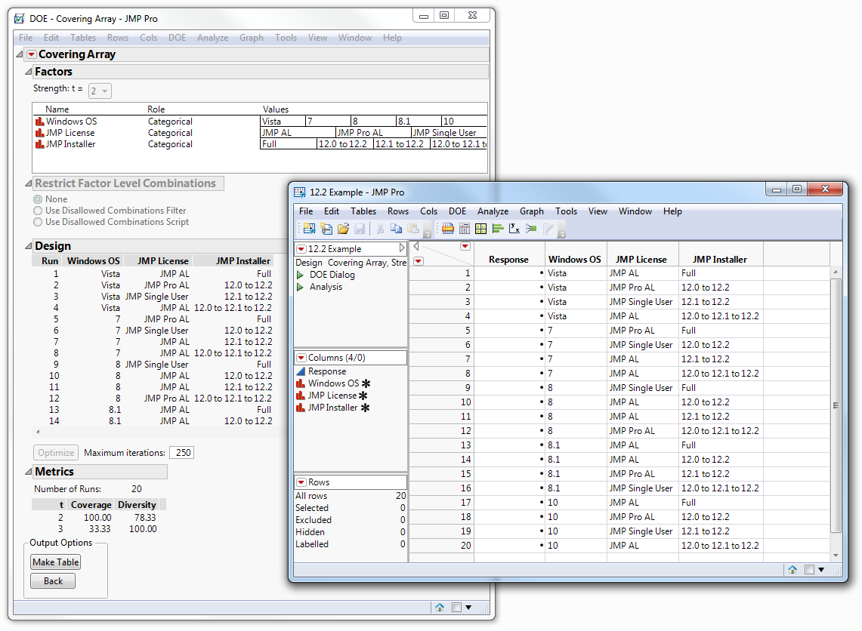
The Test Design
To cover all 2-way interactions, the final design has 20 runs. Under metrics (circled in red), the test coverage is shown: 100% of all 2-way interactions, and 33% of all 3-way interactions are included in this test design.
In contrast, a full factorial design (to cover all 3-way interactions) requires 60 runs. If your test takes 3 hours to complete, that’s 60 hours vs. 180 hours. You might not be able to complete that testing in the time allowed, and only increase the chance of finding problems by a small amount.
Return to Poster

Slide 6
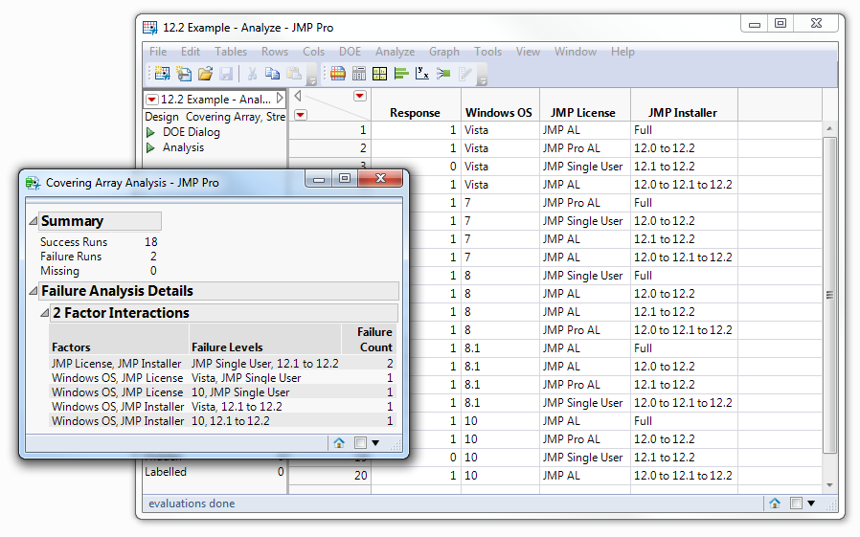
Analyze the Results
After running each test, we entered a 1 for Pass and a 0 for Fail in the Response column (highlighted).
Once all tests are completed, we ran the Analysis script (circled in red).
The Failure Analysis Details shows possible interactions that might have caused the failures. In this case, the first case listed (JMP Single User license, upgrade path from 12.1 to 12.2 – 2 failures) was the culprit.
This analysis is a huge time-saver when the test design has a large number of runs.
Return to Poster

Slide 7
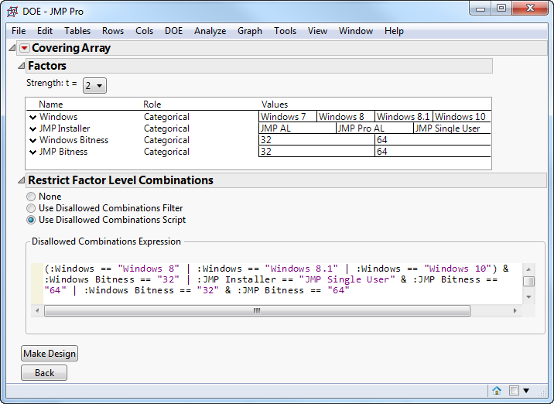
Disallowed Combinations
The Restrict Factor Level Combinations section uses a tool like the data filter. Select the combinations that you want to disallow.
In this case, we have three sets of combinations that are impossible:
Windows 8, 8.1, and 10 are 64-bit only. To disallow these combinations, we select those three OS versions and 32-bit.
JMP Single User is 32-bit only. To disallow this combination, we select JMP Single User and 64-bit.
You cannot install a 64-bit application on a 32-bit operating system. To disallow this combination, we select Windows 32-bit and JMP 64-bit.
You can also add restrictions using JSL rather than the filter. When you create the data table, the disallowed combinations are saved to the data table in a script, whichever way you enter them.
Return to Poster

Slide 8
References
¹ Joseph Morgan. (2015, June). “Covering Arrays & Software Testing”. Paper presented at the Quality & Productivity Research Conference, Raleigh, NC.
      return to slide
² D. Kuhn, D. R. Wallace, & A. M. Gallo, “Software Fault Interactions & Implications for Software Testing,” IEEE TSE, 30(6), 2004, 418-421.
      return to slide
Return to Poster

