Slide 1
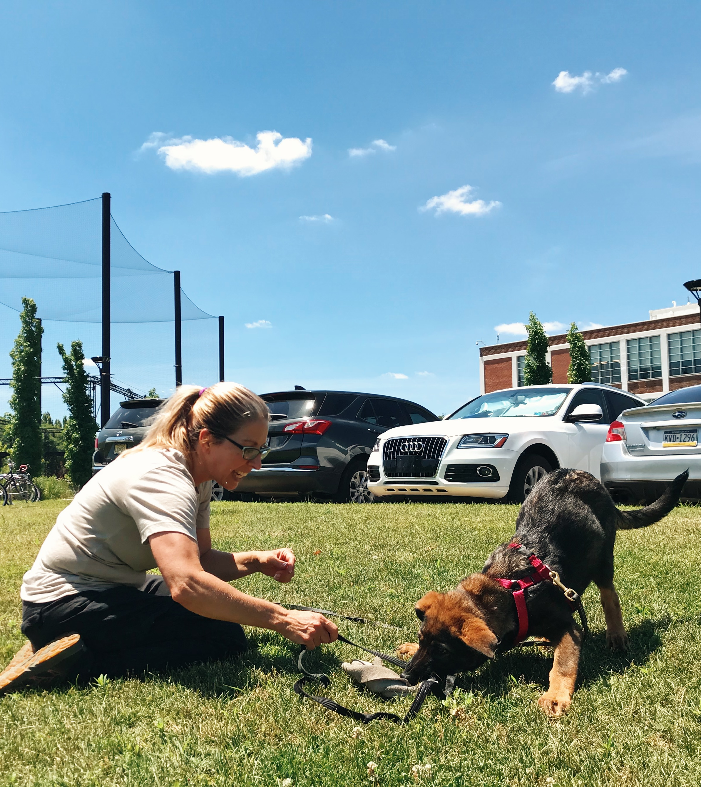

Determining Behavioral Patterns Associated with Success as a Dual-Purpose Police K9
Jordan Gillespie, Jennifer L. Essler, Alisa Rubinstein, Kaylee Krapp, Ceara Byrne, Cynthia M. Otto

Slide 2

Behavioral Testing and Canines
Behavioral testing has often been used in selecting service dog candidates^{1,2}
Testing also aids in determining future success of working dogs³
1. Asher, L. et al. A standardized behavior test for potential guide dog puppies: Methods and association with subsequent success in guide dog training. Journal of Veterinary Behavior: Clinical Applications and Research 8, 431–438 (2013).
2. Serpell, J. A. & Hsu, Y. Development and validation of a novel method for evaluating behavior and temperament in guide dogs. Applied Animal Behaviour Science 72, 347–364 (2001).
3. Sinn, D. L., Gosling, S. D. & Hilliard, S. Personality and performance in military working dogs: Reliability and predictive validity of behavioral tests. Applied Animal Behaviour Science 127, 51–65 (2010).

Slide 3
Purpose of Behavioral Tests for Working Dogs
To determine trends of behavior associated with career success
Minimize resources spent on training

Slide 4

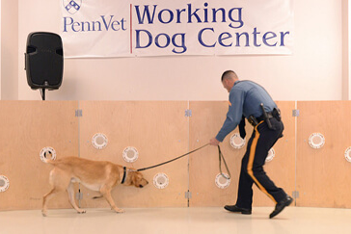
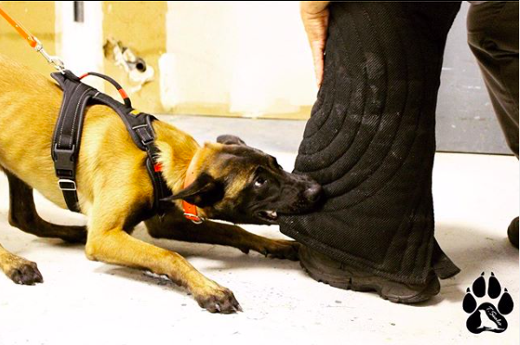
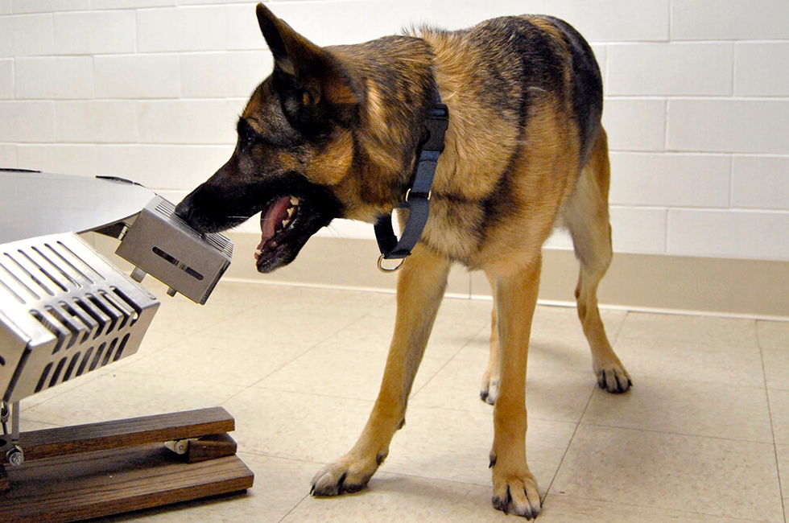
Training at the Penn Vet Working Dog Center
Career Options
  Urban Search and Rescue (USAR)
  Single-Purpose Scent Detection (SP)
    Medical Detection
  Dual-Purpose Police K9’s (DP)
Training Protocol
  Training begins around 8 weeks of age
  Each dog is trained for all careers until they “choose” one

Slide 5
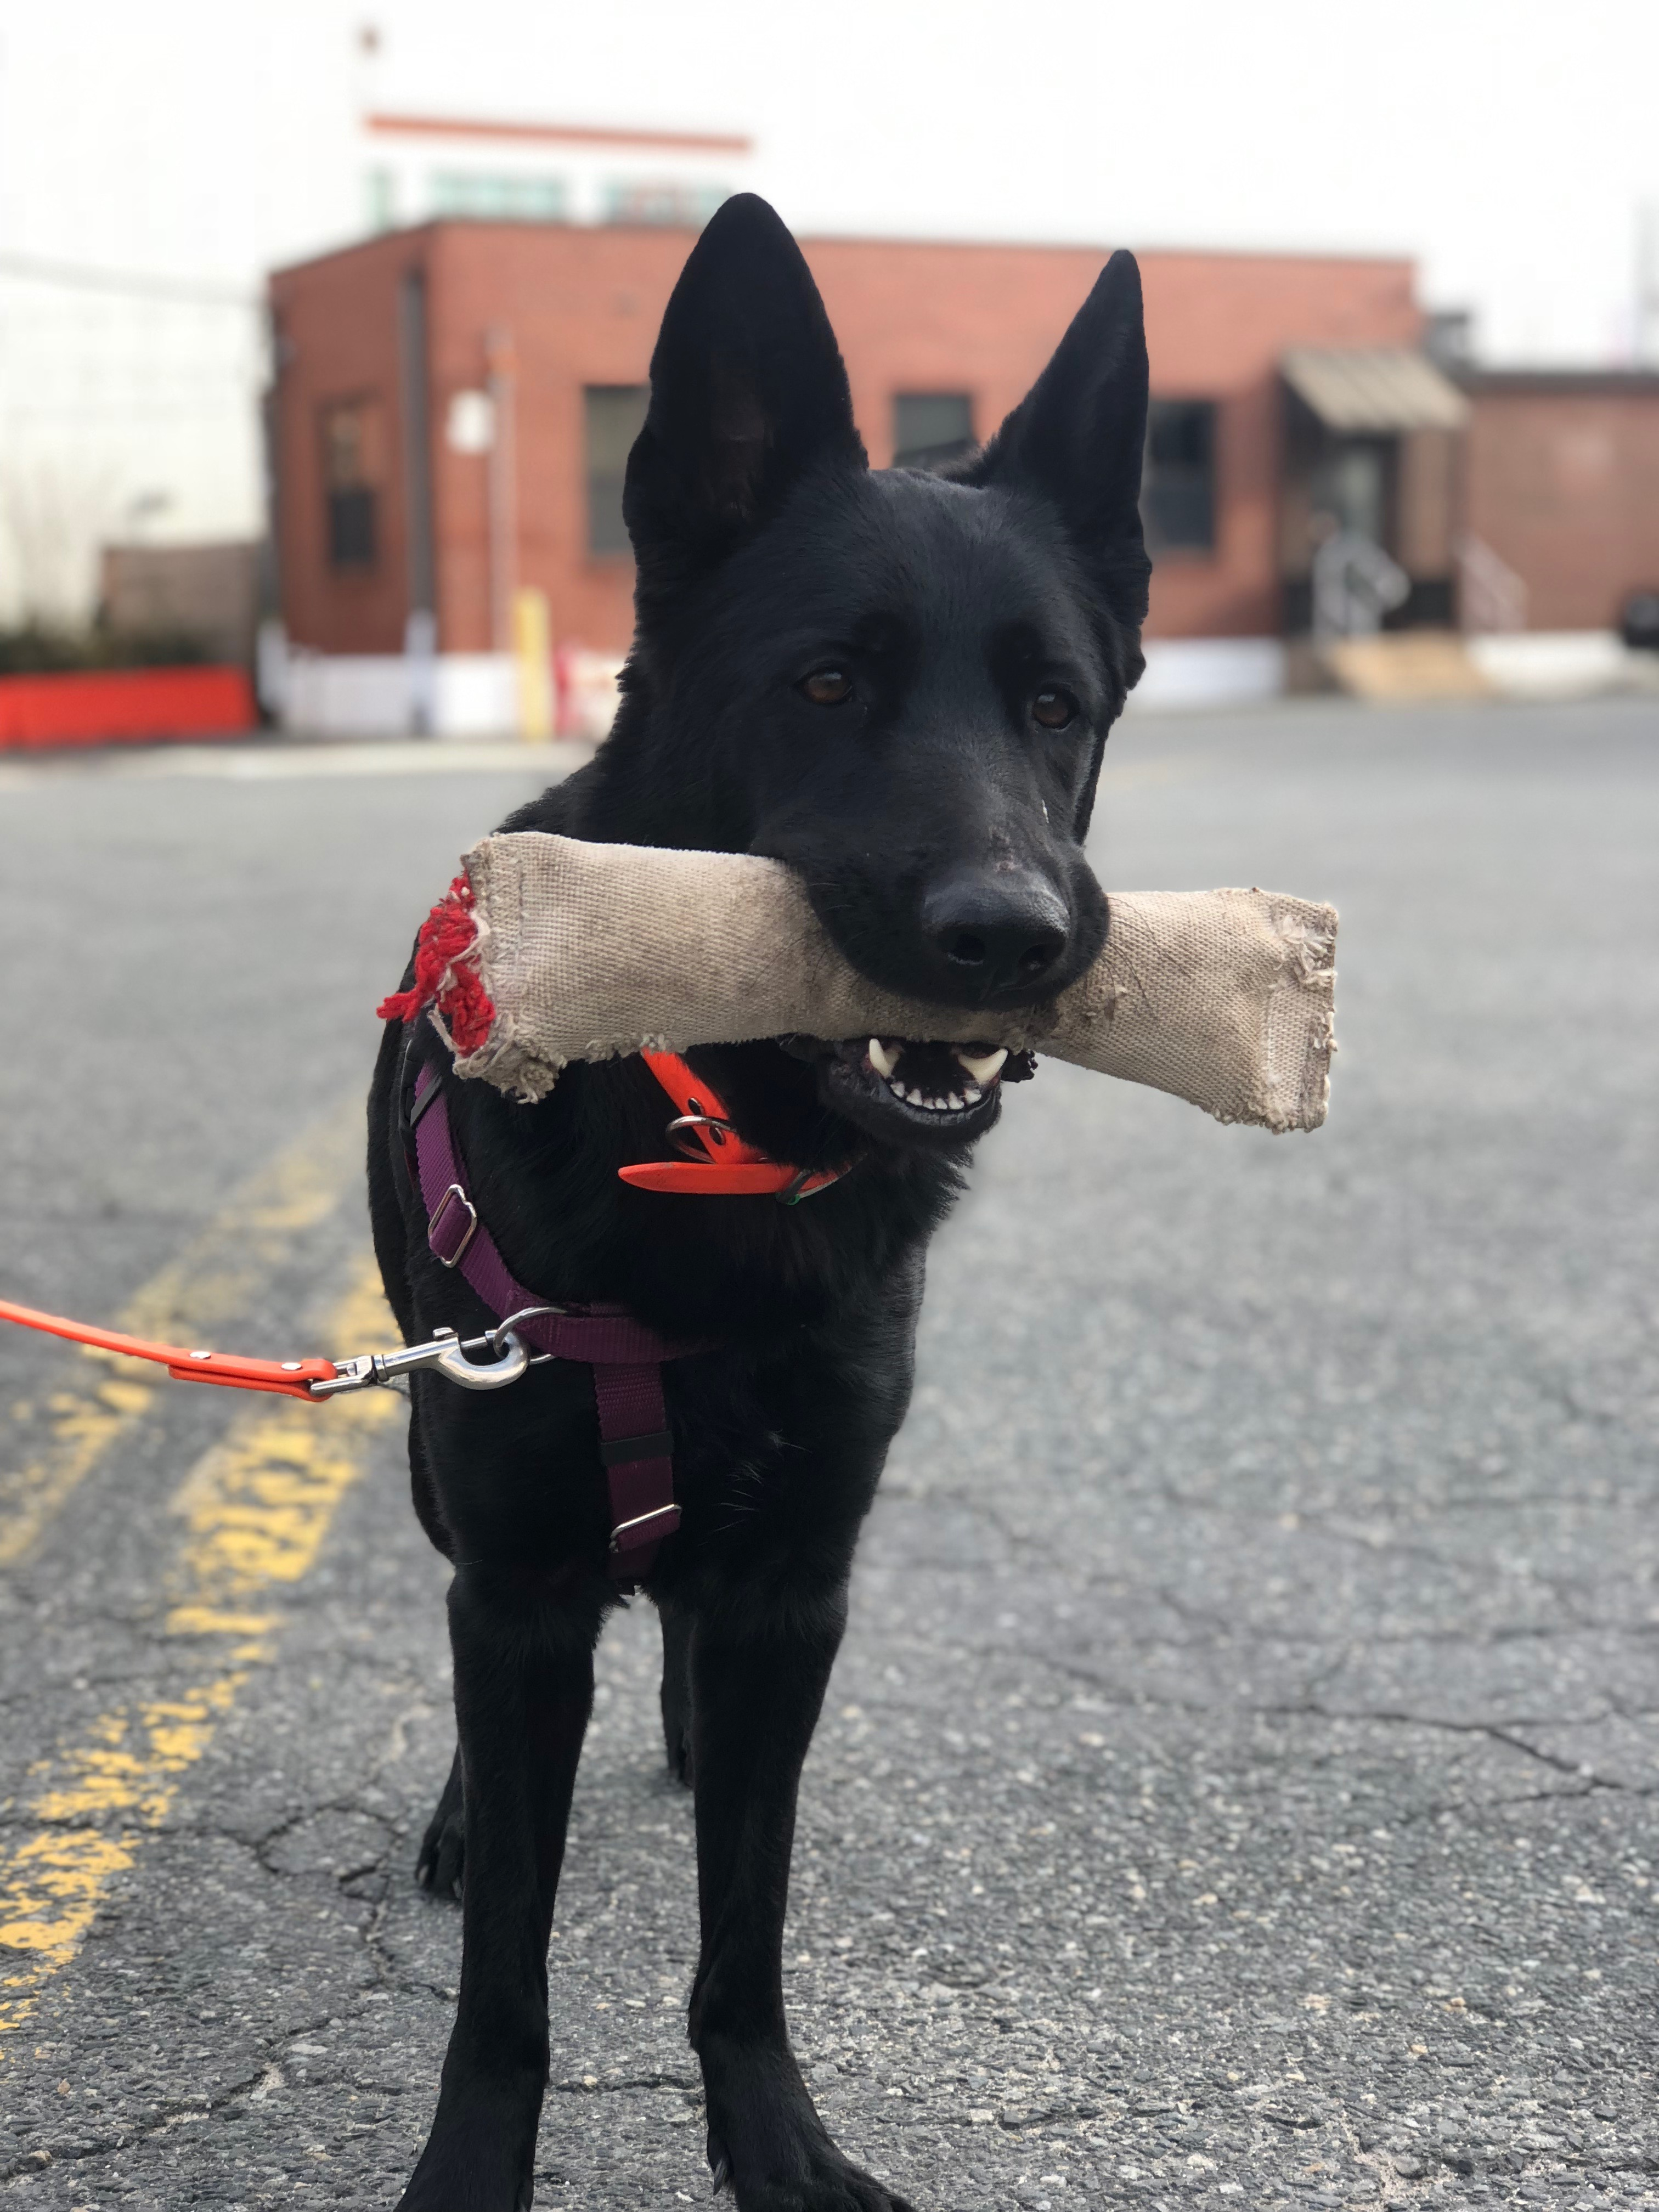
Hunt and Drive Test: Behavioral Evaluation
Purpose: Evaluate toy drive, hunt drive, and environmental soundness
Dogs are tested at 3, 6, 9, and 12 months of age
Goal: Analyze behavioral trends indicative of success in various careers during early development

Slide 6
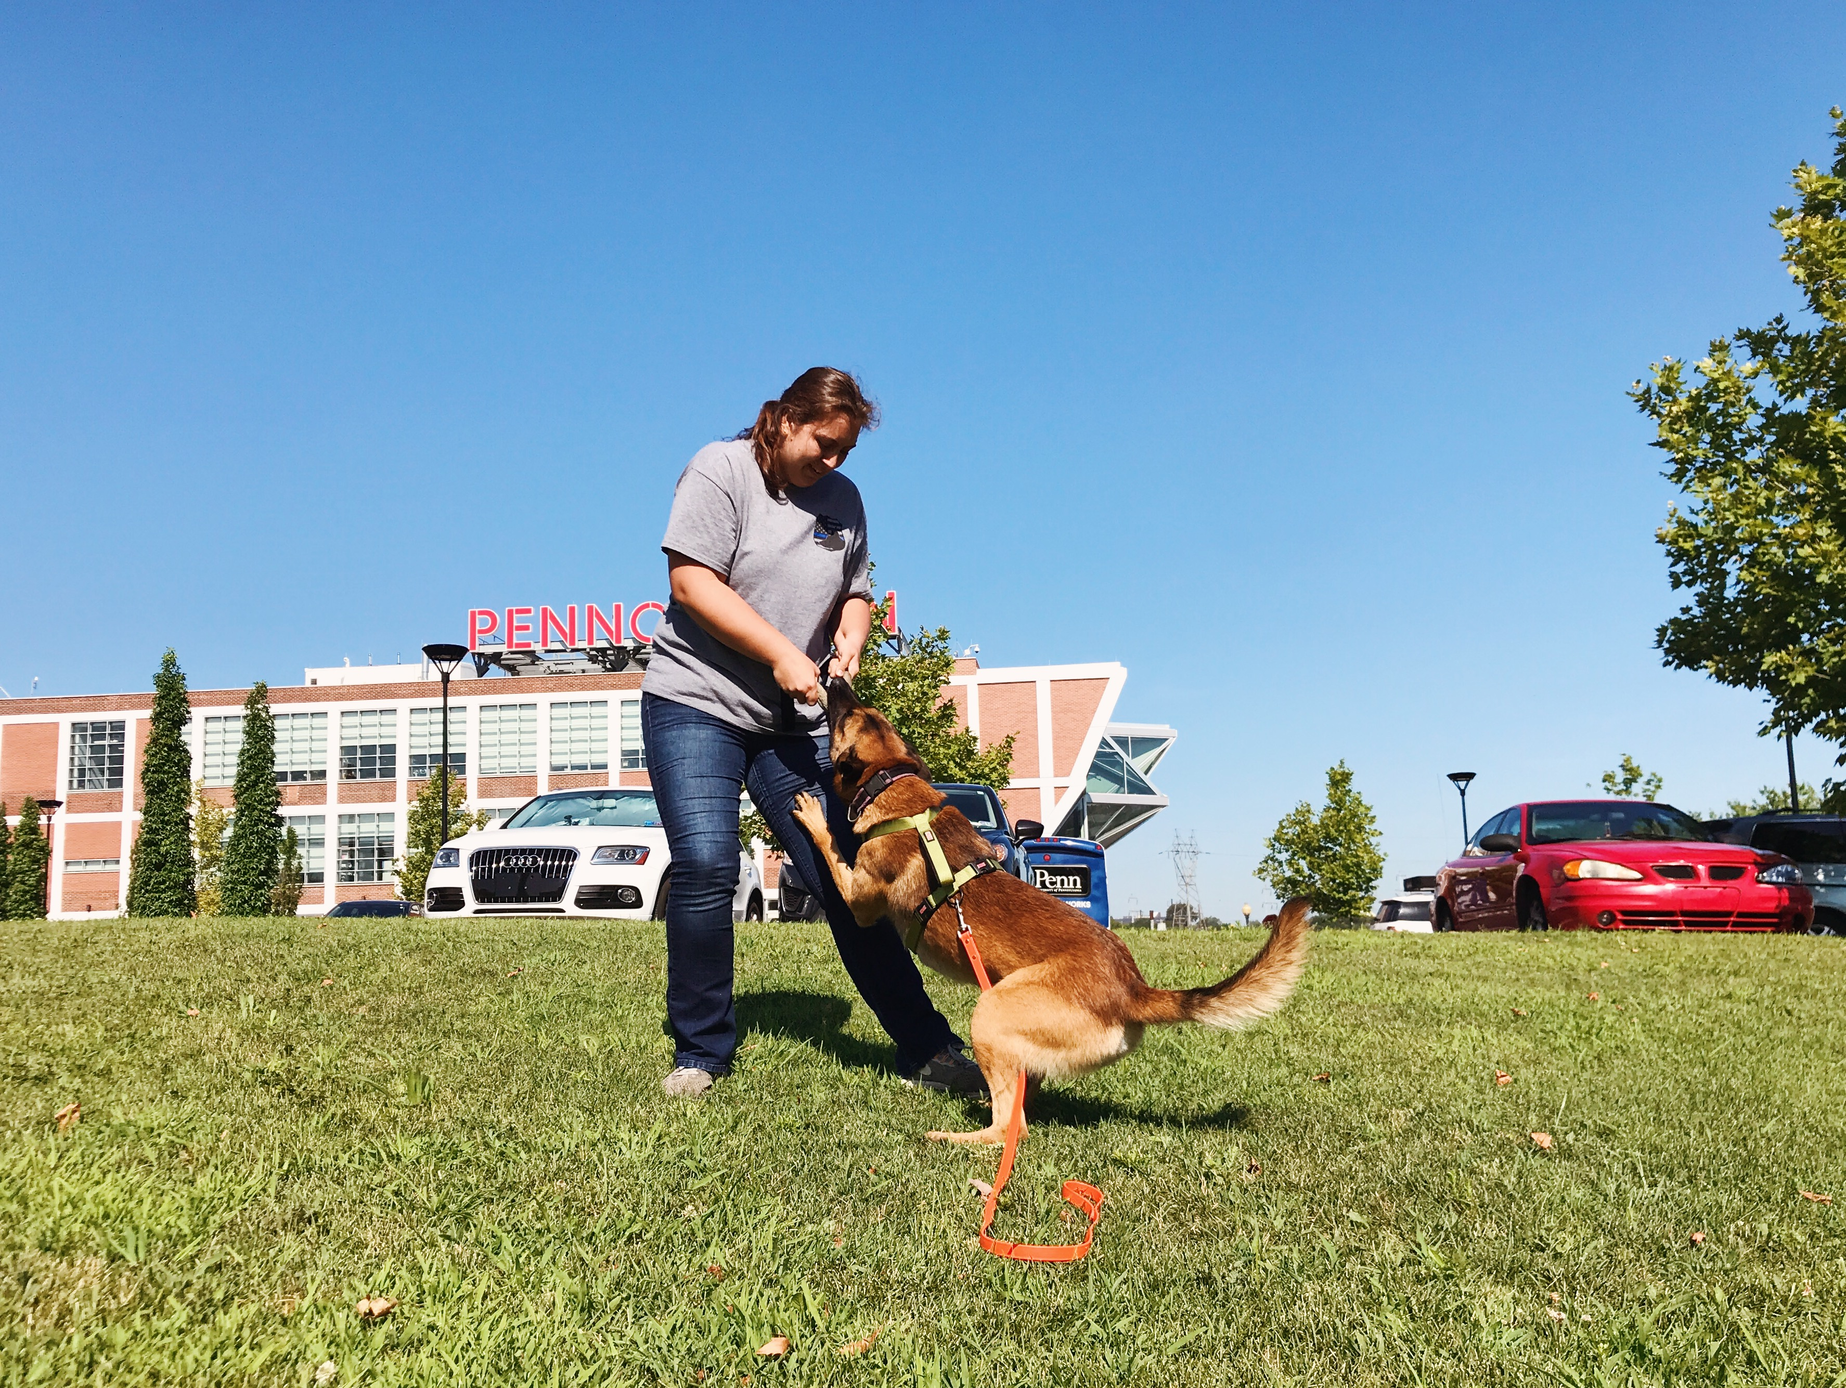
Hunt and Drive Test: Behavioral Evaluation
3 Part Evaluation
  1st evaluation – 2 minutes of toy engagement (TTT)

Slide 7
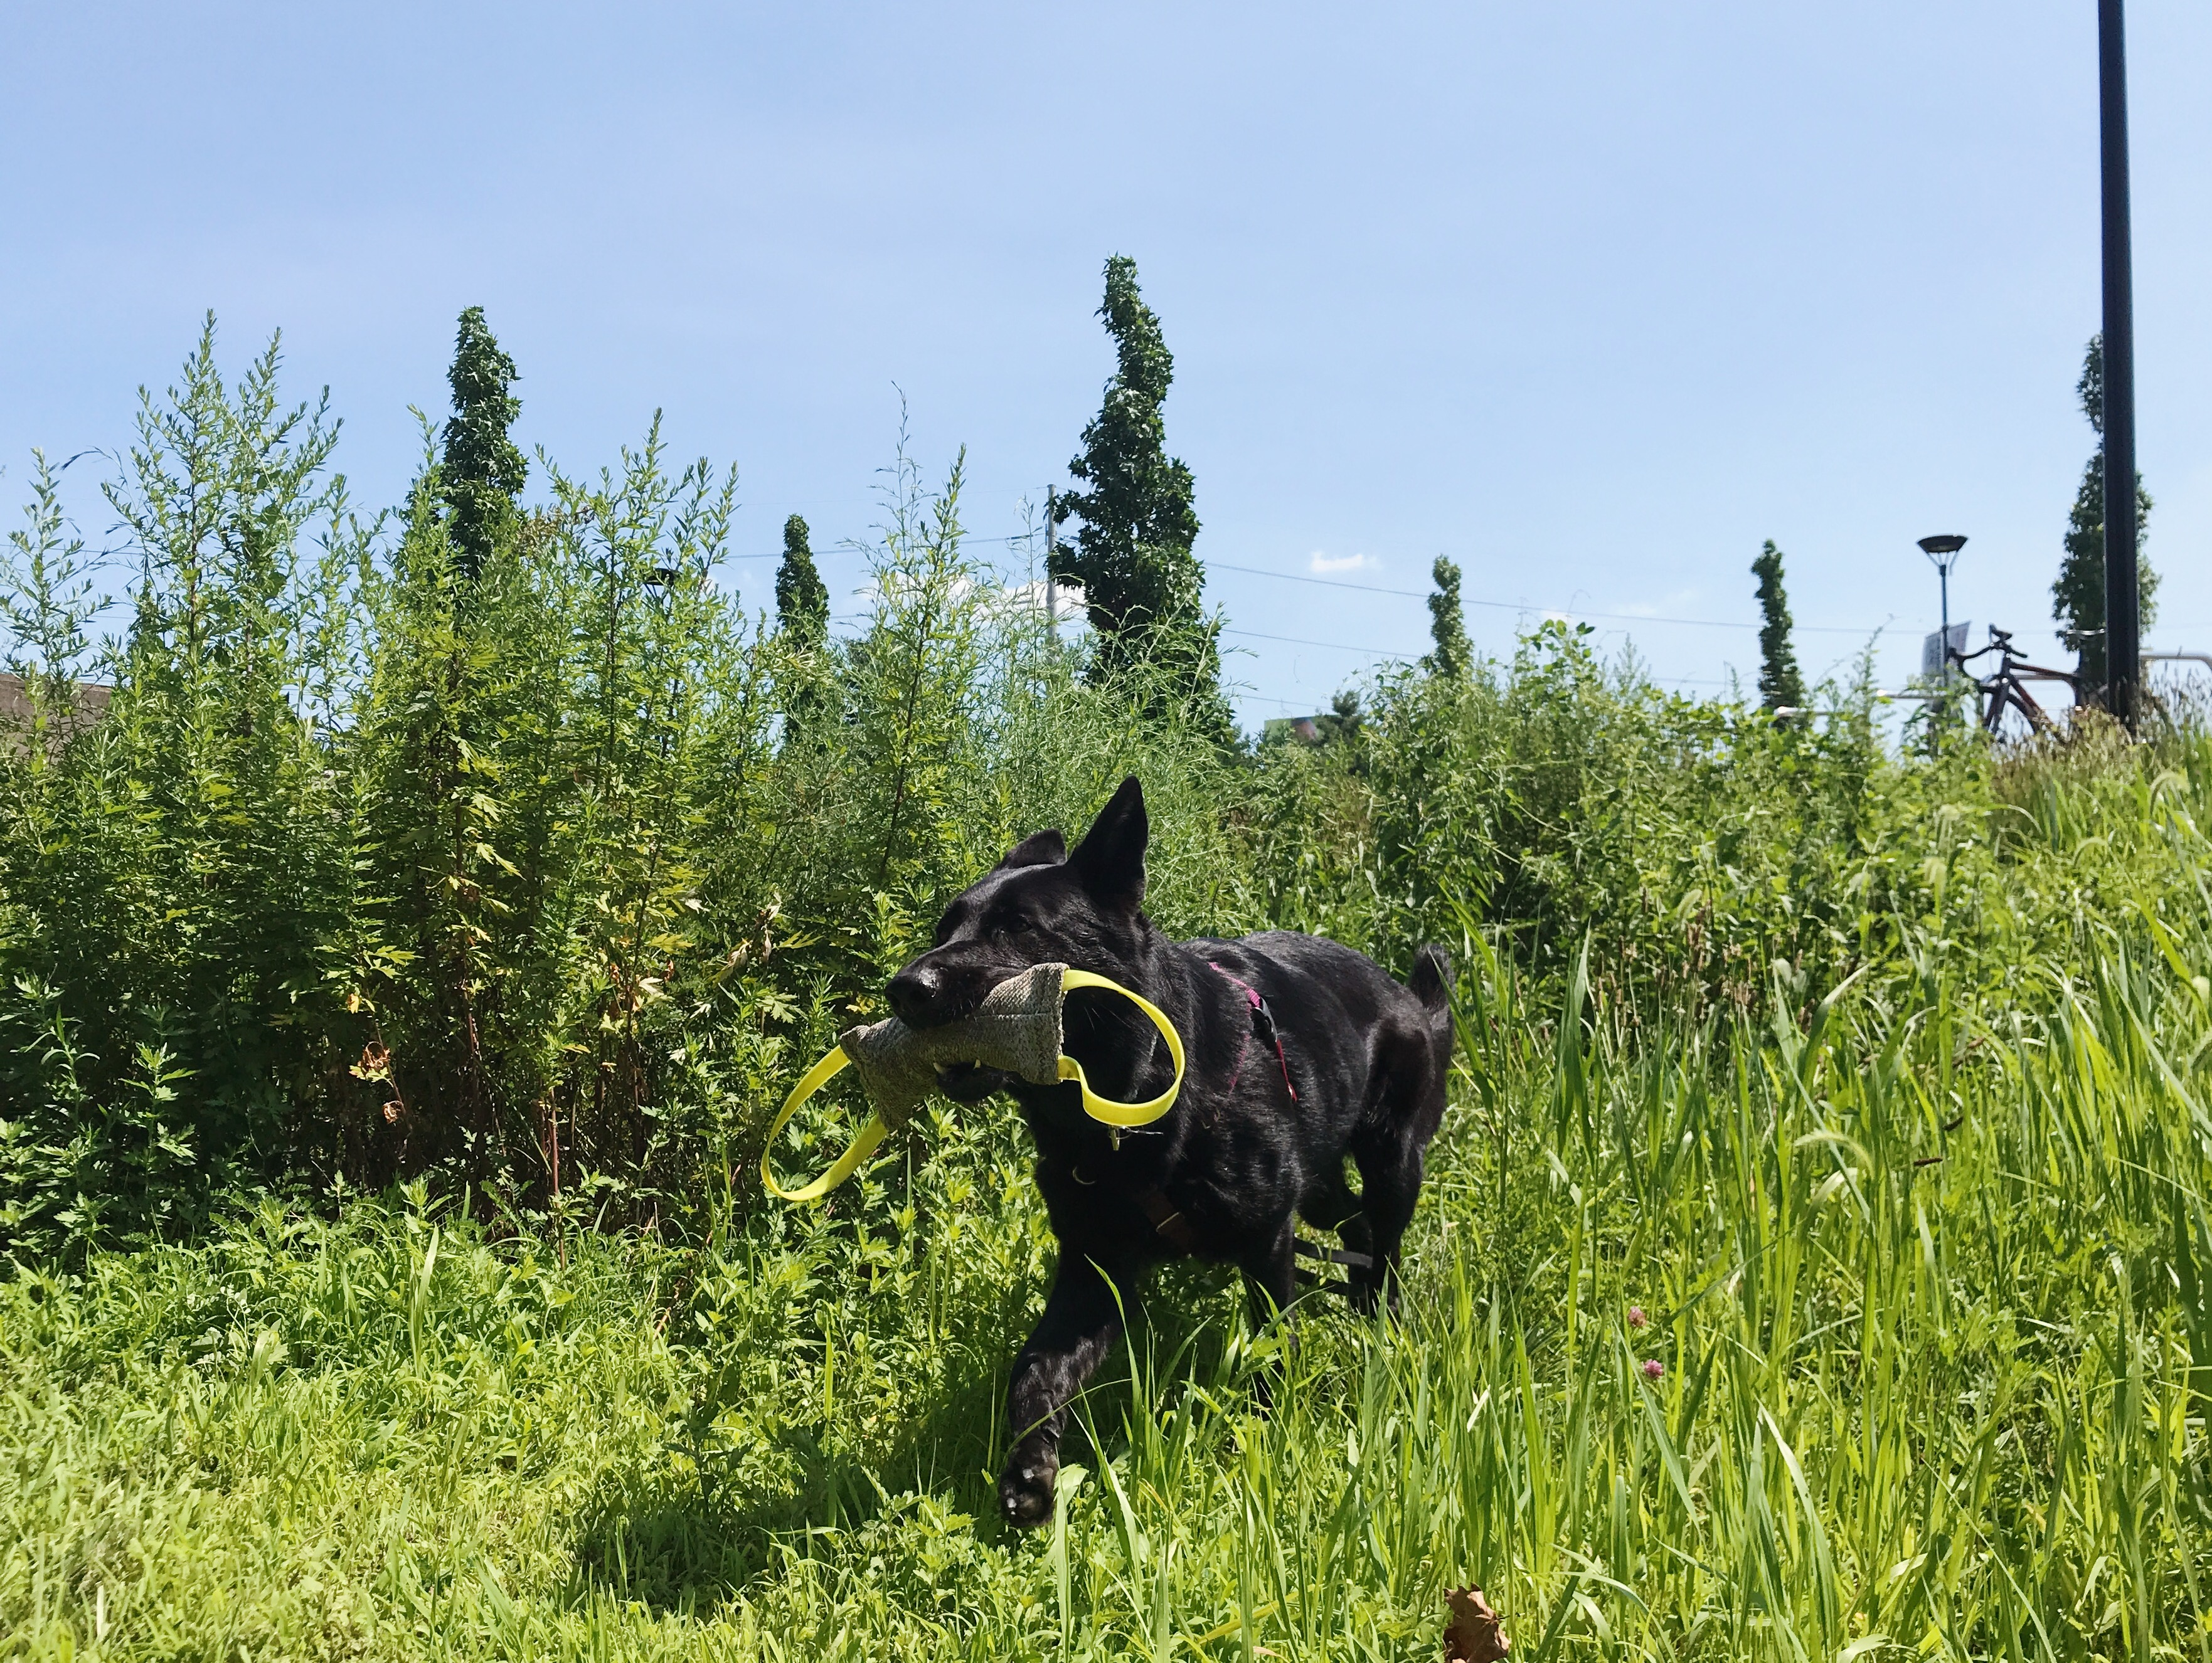
Hunt and Drive Test: Behavioral Evaluation
3 Part Evaluation
  1st evaluation – 2 minutes of toy engagement (TTT)
  2nd evaluation – searching for toy in tall grass (TTF)

Slide 8
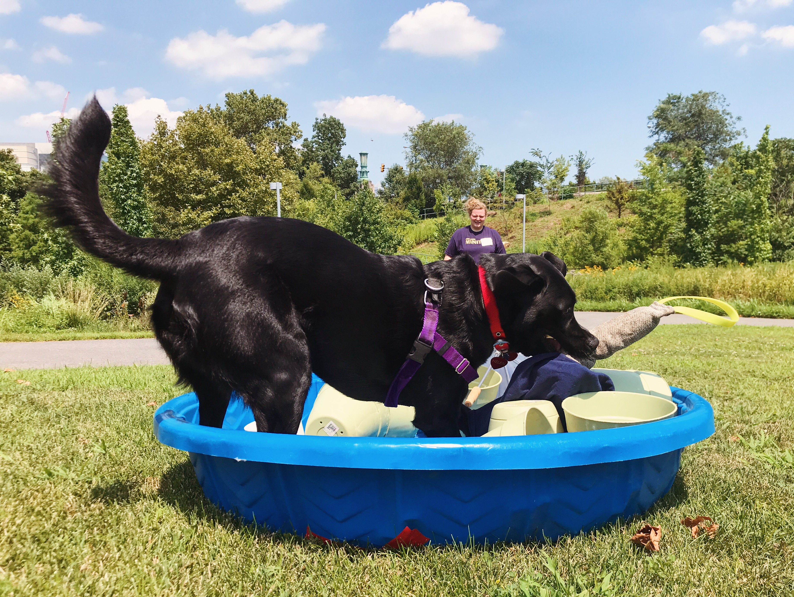
Hunt and Drive Test: Behavioral Evaluation
3 Part Evaluation
  1st evaluation – 2 minutes of toy engagement (TTT)
  2nd evaluation – searching for toy in tall grass (TTF)
  3rd evaluation – searching for toy in a pool filled with distractors (P)

Slide 9
Data Collection
Many behavioral tests are scored using a predetermined scoring system
  Observers of the test (usually trainers or other researchers) perform the scoring
While scoring systems can be a reliable method of observation¹, we undertook a full behavioral analysis for this project
  Durations and frequencies of all behaviors were collected by watching videos of the tests
1. Wilsson, E. & Sinn, D. L. Are there differences between behavioral measurement methods? A comparison of the predictive validity of two ratings methods in a working dog program. Applied Animal Behaviour Science 141, 158–172 (2012).

Slide 10
Analysis
Data from all three tests was separated by age
  3, 6, 9, and 12 months separately
  Age combinations were also analyzed: 3+6 months, 3+6+9 months, and 3+6+9+12 months
Variables to include in the model were determined using stepwise analysis
Prediction Profiler was used to look at influence of variables on DP success

Slide 11
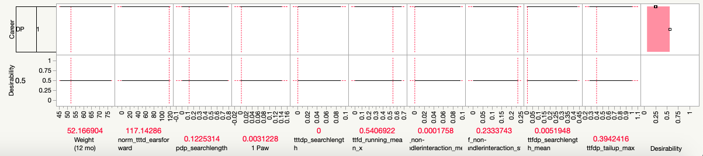
Analysis
Prediction Profiler for complete data set (i.e. all ages) when desirability for DP is maximized

