Slide 1
Using Text Explorer to Inform and Enhance Risk and Issue Application Development
JMP Discovery Summit
Tucson 2019
SAND2019-11202 C - Appendix
Presented by:
Scarlett Marklin, Sandia National Laboratories
Yvonne Petrova, Sandia National Laboratories

Slide 2
“JMP” into Text Analytics
blind analyzing
answer the questions
fun
powerhouse
coding skills
blind pre-processing

Slide 3
The Problem at Sandia
More consistent and accurate records of risks and issues
Clear understanding of text from previous seven years
Enhancements and more streamlined data capture
    Classify and identify categories of issues, risks, actions and results
      Analyze each field separately
      Analyze causal and not causal
Now what?!?!

Slide 4
Data Quality
Unstructured
Difficult to navigate
Empty fields, excessive text fields, references to other documents
No baseline from which to start
Automate pre-processing!
JMP 14 Pro Text Explorer

Slide 5
JMP 14 Pro Text Explorer
Option to Show Text
Manage stop words, phrases, recodes, and stem exceptions
Summary Statistics
Add/Remove stop words interactively
Alphabetical and Count Ordering
Default Values
Regular Expressions

Slide 6
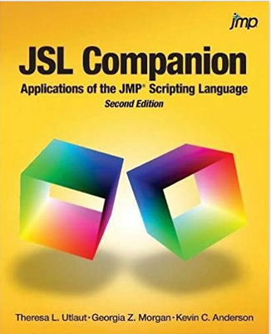
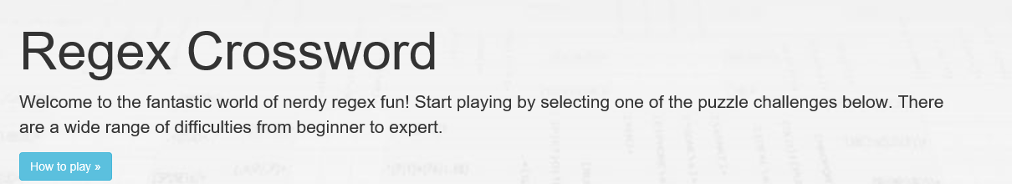

Resources
JMP Community https://community.jmp.com/
JMP books within JMP itself
JSL Companion: Application of the JMP Scripting Language
Regex Buddy https://regular-expressions.info
Regex Crossword https://regexcrossword.com/

Slide 7
Outcomes
Recommendations
More robust data
Categories
Stronger results
Improvements
Gaps & Inconsistencies
Enhancements

