Slide 1

Application of JMP(R) Data Mining and Multivariate Analysis Tools in Coffee/Tea Health (2019-US-30MP-197)
Featuring PCA-based analysis on Starbucks Coffee/Tea Drinks
Patrick Giuliano, Morill Learning Center
Mason Chen, Stanford OHS
Anna Wu, UCLA Dept of Psychology/Neuroscience
2018 IEOM Paris, P.2278-2288
2019 STEAMS Competition 2nd Place
Accepted by 2019 ASA SDSS Conference Oral Presentation
Accepted by 2019 JMP Discovery Conference Tucson

Slide 2
Project Objectives
Is drinking coffee/tea healthy for patients with cardiovascular disease?
How to select the healthiest coffee/tea based on its nutrition composition?
Can we derive a commercial health index for coffee/tea products?

Slide 3
STEAMS Aspect
Science: study coffee/tea antioxidant and cardiovascular disease
Technology: learn coffee & tea process & product
Engineering: establish “health index” model for consumers to select healthy product
AI: apply Principle Component Analysis (PCA)
Math: understand Linear Algebra and Eigen Analysis
Statistics: linear fit correlation and regression model

Slide 4

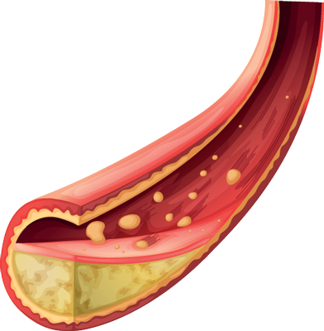
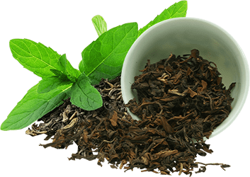
Coffee/Tea Unhealthy?
Coffee/tea provide abundant antioxidants which reduce oxidative stress that damages cells
Oxidation contributes to disease progression
Nutrient content depends on processing/roasting
Coffee intake (3-5 cups per day) is inversely related to CVD risk
Green tea reduces LDL cholesterol and triglycerides
SCIENCE/ TECHNOLOGY
Notes:
https://www.health.harvard.edu/heart-health/brewing-evidence-for-teas-heart-benefits

Slide 5

Cardiovascular Disease
Conditions that lead to heart disease: high cholesterol, high blood pressure, and other chronic health problems, including type 2 diabetes
Eat less than 300 mg of dietary cholesterol each day, avoid trans fats, less than 1500 mg of sodium each day, low saturated fat
Dietary flavonoids make an important contribution to health, especially heart disease
SCIENCE
Basic Flavonoid Structure
Notes:
https://medlineplus.gov/ency/article/002436.htm

Slide 6
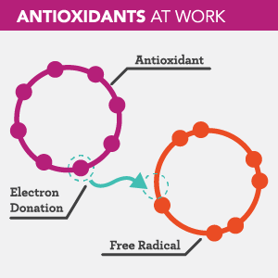

Flavonoids & Antioxidants
Antioxidant activity of flavonoids reduce free radical formation and scavenge free radicals
Free radicals are atoms or groups of atoms with an odd number of electrons.
These highly reactive radicals cause cells to function poorly or die
The principle micronutrient antioxidants are vitamin E, beta-carotene, and vitamin C
SCIENCE
Vitamin C
Notes:
https://nccih.nih.gov/health/antioxidants/introduction.htm
https://www.google.com/search?q=vitamin+c+structure+and+antioxidant+properties&source=lnms&tbm=isch&sa=X&ved=0ahUKEwiogbXQ2dbcAhWSLHwKHUf-BS8Q_AUICigB&biw=1304&bih=702#imgrc=3a6tykzkxDD5sM:

Slide 7

Collect Nutrition Data
1
2
3
4
5
6
TECHNOLOGY/ ENGINEERING
7
8
9
10
11
12
Focus on Starbucks’ most popular ones: Espressos, Frappuccinos, Freshly Brewed Coffee, Cold Brew and Iced Coffees, Refreshers, and Tea
Record nutrition information of each product
Notes:
Sampling within each category of drink is called “Stratified (Random) Sampling”! See backup slide for a formal definition.

Slide 8
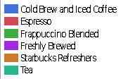
Collect Nutrition Data
TECHNOLOGY/ ENGINEERING
Take stratified random sample within Drink Categories.
Record nutrition factors.
Notes:
Sampling within each category of drink is called “Stratified (Random) Sampling”! See backup slide for a formal definition.

Slide 9
Science Health Index
A Science- Health Index was developed on the basis of each of the input variables from the dataset, taking into account the Scientific Research and applying weighting coefficients with a positive or negative sign depending on whether detrimental to (negative) heart disease prevention.
Science-Health Index =-2 * Calories + -2 * "Total Fat (g)" + -2 * "Saturated Fat (g)" + -2 *"Cholesterol (mg)" + -2 * "Sodium (mg)" + -1 *"Total Carbohydrates (g)" ) + 2 * "Dietary Fiber (g)" + -2 *"Sugars (g)" ) + 1 * "Protein (g)" + 2 * "Caffeine (mg)"
ENGINEERING
Notes:
Reference the table created/ Impact Assessment (explaining why we assigned each coefficient to the corresponding variable) “used the science to assign the weighting coefficients)
The standardization revealed the 9 healthiest drinks according to Health Index Rating, as listed below, where they were, generally: freshly brewed, cold brew and iced coffees and had among the lowest calories, fat, saturated fat, cholesterol and sugar content, as well as the highest protein content with moderate to higher caffeine content.

Slide 10
Linear Algebra & Machine Learning
Linear algebra is the study of linear sets of equations and their transformation properties.
A good understanding of linear algebra is essential for understanding and working with many machine learning algorithms, especially deep learning algorithms.
Eigenvalues and Eigenvectors capture the structure of matrices by allowing us to factor or decompose matrices (finding the directions- eigenvector of the stronger signal/noise ratio- eigenvalues)
MATHEMATICS

Slide 11
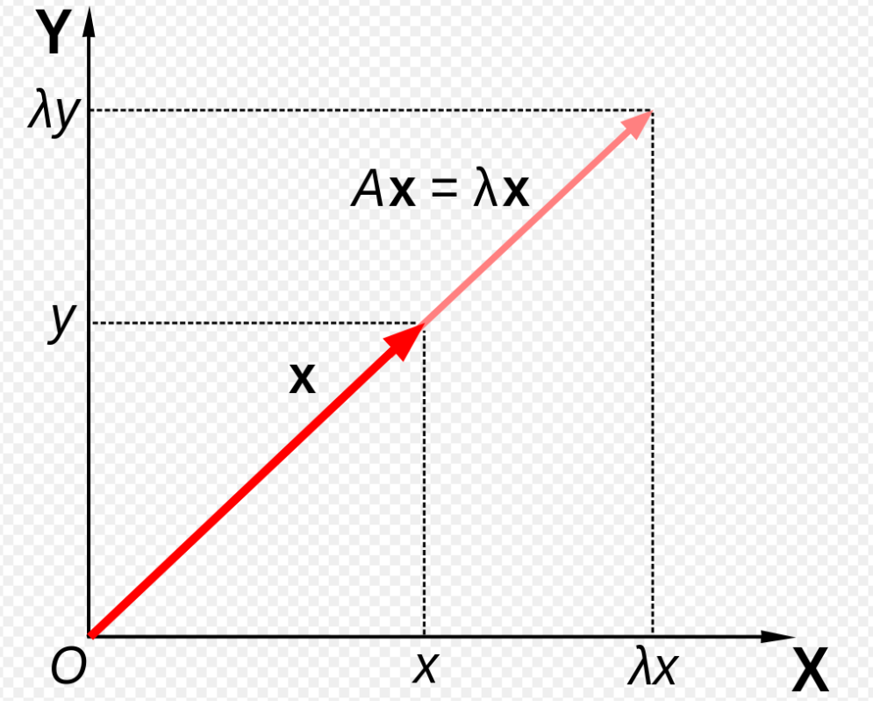
Eigenvalues & Eigenvectors
Matrix A acts by stretching the vector x, not changing its direction, so x is an eigenvector of A and λ is the eigenvector
MATHEMATICS
Eigenvalue and Eigenvector are used in next Principle Component Analysis in order to understand the Coffee/Tea Nutrition Patterns and derive the Health Index

Slide 12
Principal Components Analysis
Principal component analysis is to derive a small number of independent linear combinations (principal components) that capture as much of the variability
Principal component analysis is a dimension-reduction technique, as well as an exploratory data analysis tool
Each principal component is calculated by taking a linear combination of an eigenvector of the correlation. The eigenvalues represent the variance of each component.
ARTIFICIAL INTELLIGENCE

Slide 13
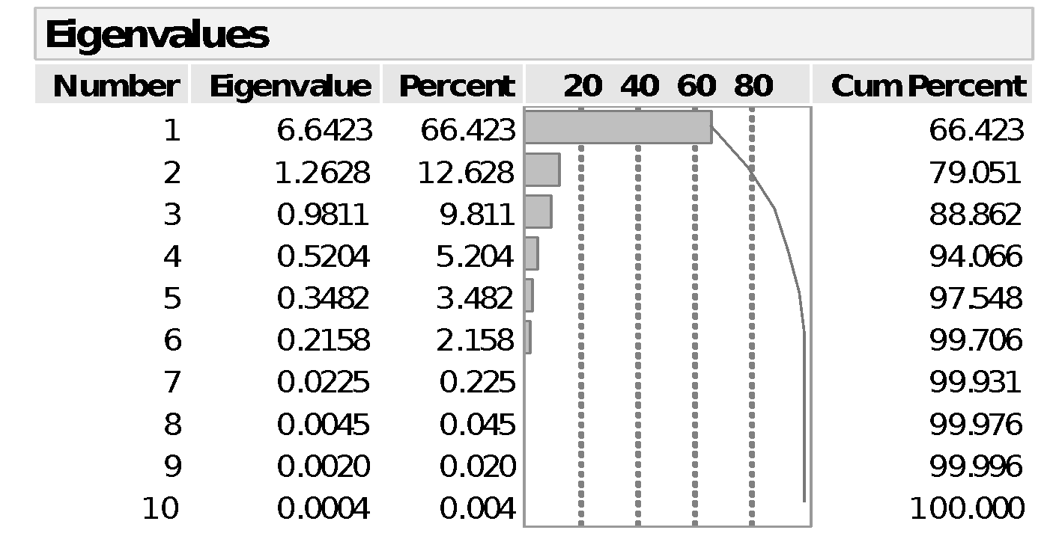
JMP PCA Results
66.4% and 12.6% of variation as attributable to Principal Components 1 (Prin 1) and 2 (Prin 2).
~ 80% of the total variation is explainable on the basis of the first two out of 10 Principal Components (Pareto 80%-20% rule).
MATH / STATISTICS
Notes:
TALKING POINT! Pareto’s principle is the “80/20 rule”. 20% of the effort results in 80% of the result. “Less is more.” “Follow the path of the minimum resistance that leads to the path of the maximum result.”

Slide 14
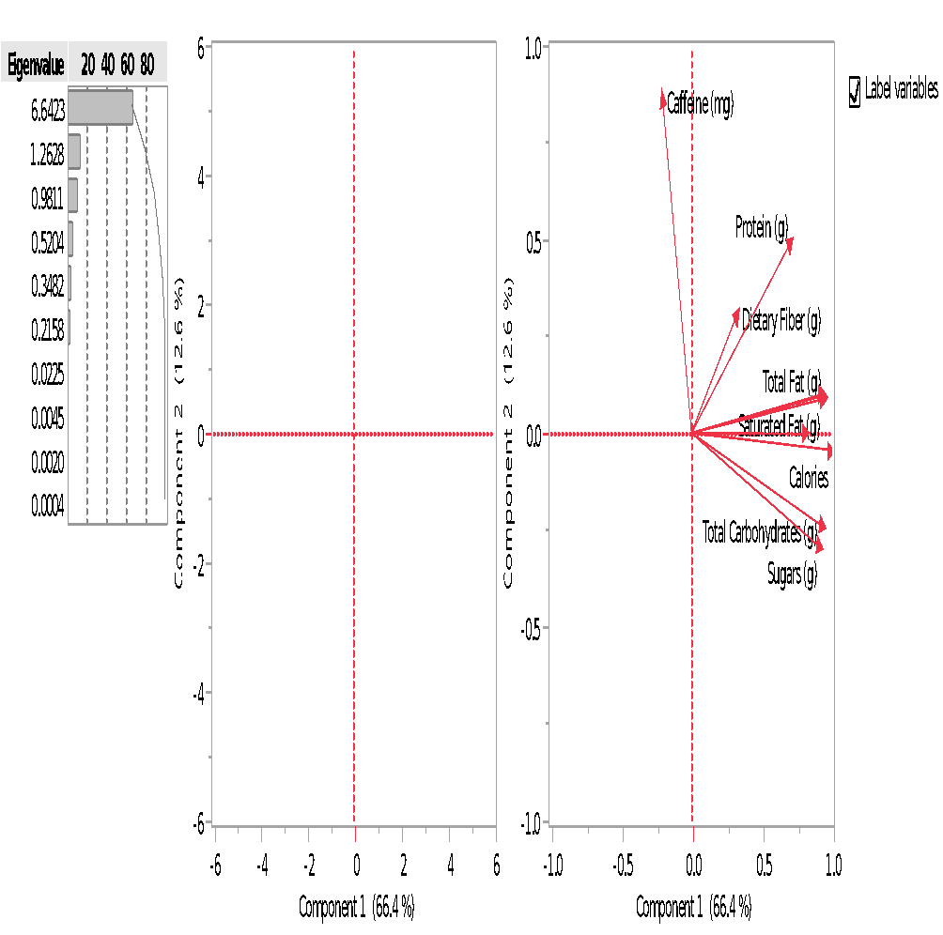
JMP PCA Loadings Plot
The Loadings Plot graphs the unrotated loading matrix between the variables and the components.
The closer the value is to 1 the greater the effect of the component on the variable.
MATH / STATISTICS
1st Principle Comp. is more attributed to the unhealthy nutritions such as Sugars, Calories…
2nd Principle Comp. is more related to healthy nutritions such as Caffeine and Dietary Fiber
Notes:
TALKING POINT! Pareto’s principle is the “80/20 rule”. 20% of the effort results in 80% of the result. “Less is more.” “Follow the path of the minimum resistance that leads to the path of the maximum result.”

Slide 15

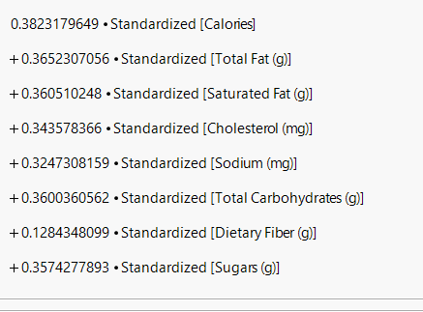
PC1 =
So the coefficients are eigenvectors of PC1
MATH / STATISTICS

Slide 16
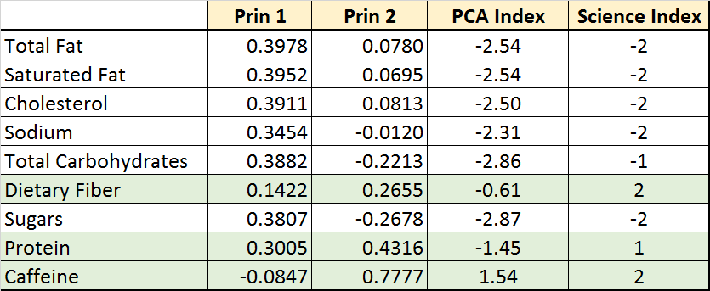
Derived PCA-Health Index
After Z-Transformation, Prin 1 and Prin 2 are derived from JMP PCA analysis
Derive PCA-Health Index= -Eigenvalue 1* Prin 1 + Eigenvalue 2* Prin 2
PCA method can help derive Health Index
Eigenvector2
Eigenvector1
MATH / STATISTICS

Slide 17
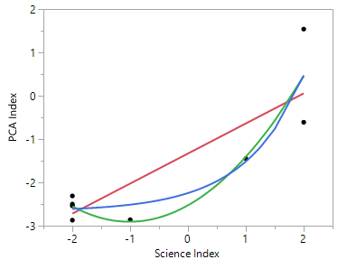
PCA-Index vs. Science-Index
Compare two Health Index: (1) Science-Index based on Scientific Research, (2) PCA-Index derived by the first two Principle Components’ Eigenvalue and Eigenvector
Correlation is relatively strong (R^2 = 70%-80%)
By adding the remaining principle components, the correlation may exceed 90%
MATH / STATISTICS

Slide 18
Include More Principle Components?
Row Eigenvectors Prin1 Prin2 Prin3 Prin4
Standardize[Calories] 0.991 -0.029 0.024 0.068
Standardize[Total Fat (g)] 0.943 -0.091 0.184 -0.192
Standardize[Total Carbohydrates (g)] 0.934 -0.078 -0.123 0.219
Standardize[Saturated Fat (g)] 0.930 -0.075 0.195 -0.235
Standardize[Sugars (g)] 0.927 -0.170 -0.105 0.202
Standardize[Cholesterol (mg)] 0.886 -0.073 0.248 -0.290
Standardize[Sodium (mg)] 0.839 0.118 -0.099 0.304
Standardize[Protein (g)] 0.711 0.419 0.111 0.111
Standardize[Dietary Fiber (g)] 0.334 0.766 -0.465 -0.224
Standardize[Caffeine (mg)] -0.355 0.520 0.710 0.175
MATH / STATISTICS
It’s hard to judge that Principle Components 3 & 4 are attributed to Healthy or Unhealthy Nutritions
All Principle Components are orthogonal to each other
If the first two principle components are related to Healthy and Unhealthy Nutritions respectively, then the remaining principle components should behave neutral on health index

Slide 19
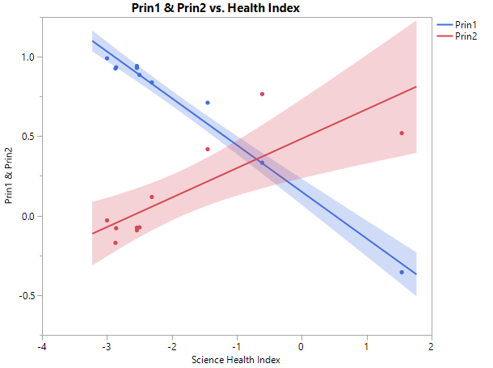
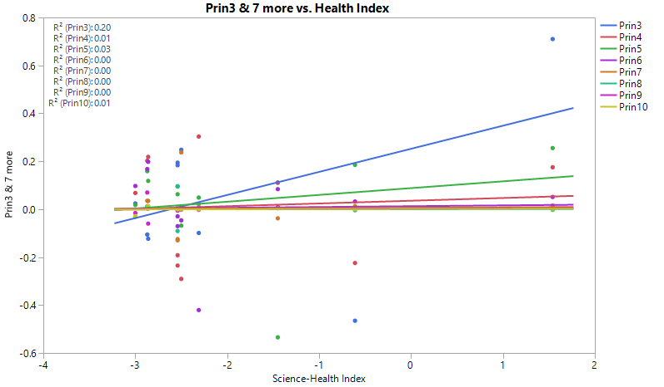
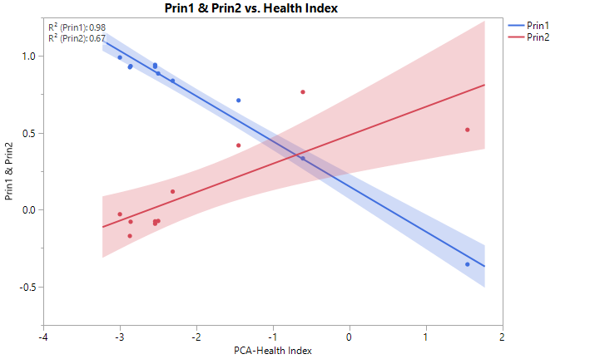
Principle Components vs. Health Index
The first two principle components are strongly correlated to the Science and PCA Health Index
The remaining weaker principle components have little correlation to Health Index
MATH / STATISTICS

Slide 20
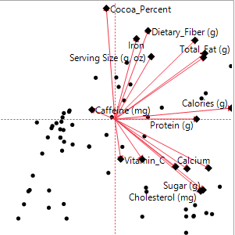
Principle Component Analysis
Coffee/Tea
Chocolate
MATH / STATISTICS
Similar Loading Plot patterns: 1st Principle related to unhealthy nutrition and 2nd principle related to healthy nutrition

Slide 21
Cluster Summary Corroborates Loading Plot Patterns
Coffee/Tea
Cluster Summary identifies same Top 3 factors as loading plot!
MATH / STATISTICS
Dietary fiber and Protein separated from Carbs, Sugar, Fat

Slide 22
Increasing Cluster “Discrimination”
Exploit steepest slope relationship on Sugars vs Protein *Caffeine to get increased differentiation among clusters.

Slide 23
Increasing Cluster “Discrimination”

Slide 24
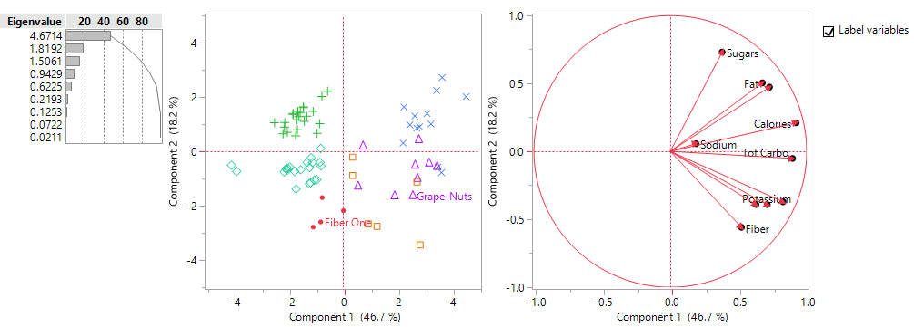
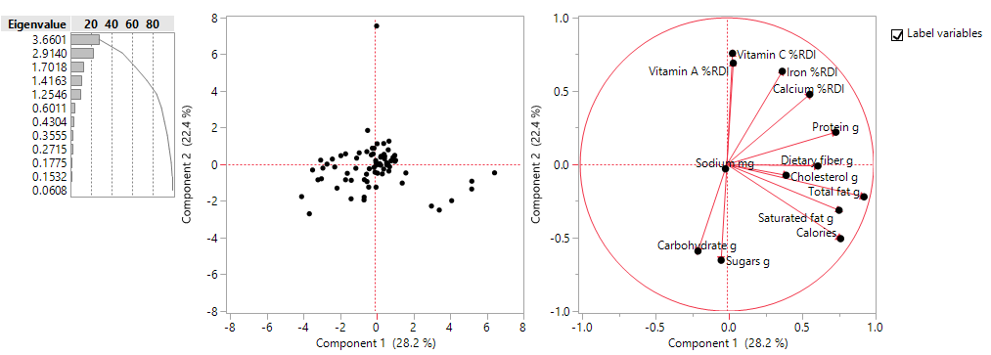
PCA: Comparison to other Foods
Loadings Plot pattern are different among four foods products
In general, the unhealthy nutritions are near the X-Axis (1st Principle Component)
The healthy nutritions are near the Y-Axis (2nd Principle Component)
This PCA Loading Plots may be a powerful tool to differentiate healthy foods based on the first 2 Principle Components
Coffee/Tea
Cereal
MATH / STATISTICS
Chocolate
Candy

Slide 25
Conclusions
Utilized the Principle Component Eigen Analysis to study the Coffee and Tea nutritions.
The first two principle components have contributed to 79% variance based on Eigenvalues.
The first principle component is attributed to the unhealthy nutritions such as Sugars, Total Fat…
The second principle component is related to the healthy nutritions such as Caffeine and Dietary Fiber.
Two health index are derived: (1) by scientific research, and (2) by PCA method.
Two methods have about 70%-80% correlation.

Slide 26
Conclusions
The PCA method has shown great potential to help conduct scientific research (Coffee/tea, extends to other foods)
Conducted (K-means) Cluster analysis which corroborates principal components analysis (indicates same clustering pattern relationship among variables).
Identified and exploited steepest slope relationship on Sugars vs Protein*Caffeine to get increasing “differentiation” among the clusters.
  Sugars Vs.
    Protein*Caffeine (Bilinear Interaction term)

Slide 27
Questions?
Thank you!
We’d like to acknowledge the significant contribution of Dr. Charles Chen, Ph.D. (Applied Materials), who provided creative inspiration and ideation for this project topic.

