Slide 1

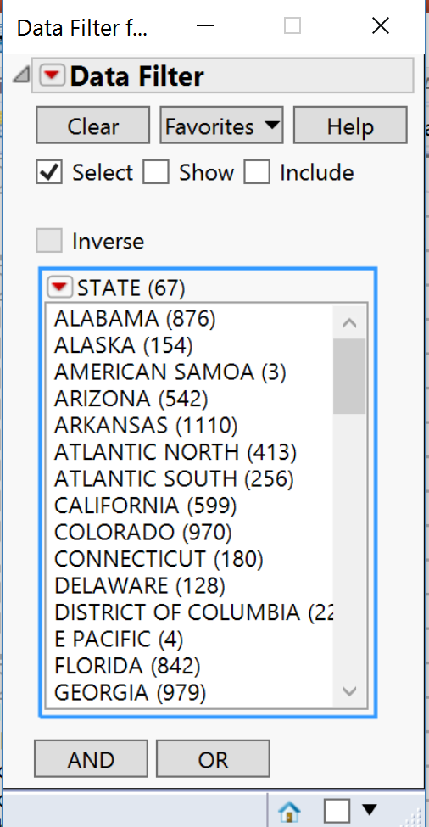
Hacking the JMP® Data Filter
Philip D. Brown
Douglas Data Consulting, LLC
Abstract
Introduction
Whether used interactively or via JSL, JMP's data filter is a powerful tool. There are a host of built-in features and options that provide variety of ways to filter and create subsets of data.
In this poster we demonstrate a method of creating a reusable Data Filter object that can be fully customized. For instance, options not relevant to a particular application can be hidden and new user-defined options added, including custom titles.
Several of these Data Filter Objects can used to compose novel user interfaces for data query and extraction.
The Data Filter can be invoked once there is a JMP data table open. Once invoked, the default filter window appears and presents a listing of all the columns in the data table. One can add as many columns to the filter as desired, ultimately ending up with hierarchy of variables by which the data table can be filtered.

Slide 2
Hacking the JMP® Data Filter
Philip D. Brown
Douglas Data Consulting, LLC
Anatomy of the JMP Data Filter Object
Data Filter XML Document
We first examine the anatomy of the JMP Data Filter Object to answer such questions as: What are the key components? How are they arranged? What components can/cannot be changed?
This is done by expressing the Data Filter object as an XML document so that the XPath language can be used to access and manipulate the object’s underlying components. In general, all JMP generated display output can be converted into an XML document.
The Data Filter is not a display object by default. In order to access and manipulate its XML document, the Data Filter Object must be first wrapped in a formal display box container such as H List Box, V List Box, etc. Only then can the XPath commands be issued.

Slide 3
Hacking the JMP® Data Filter
Philip D. Brown
Douglas Data Consulting, LLC
Anatomy of the JMP Data Filter Object
Key Data Filter Display Elements
The XML representation of the Data Filter includes every display element used in the object, though some may not be visible. We are only interested in the key display components that are visible by default, so they can be modified.
Here are the XPath commands that address every visible component of the default JMP Data Filter.
dfObj = H ListBox( Data Filter[] )
dfObj << xpath("//OutlineBox")
dfObj << xpath("//ButtonBox[ text()=‘Clear’]”);
dfObj << xpath("//ButtonBox[ text()=‘Favorites’]”);
dfObj << xpath("//ButtonBox[ text()=‘Help’]”);
dfObj <<xpath("//CheckBoxBoxItem[text()=‘Select’]”);
dfObj <<xpath("//CheckBoxBoxItem[text()=‘Show’]”);
dfObj <<xpath("//CheckBoxBoxItem[text()=‘Include’]”);
dfObj <<xpath("//CheckBoxBoxItem[text()=‘Inverse’]”);
dfObj << xpath("//ListBoxBox")
dfObj << xpath("//ButtonBox[ text()=‘AND’]”);
dfObj << xpath("//ButtonBox[ text()=‘OR’]”);

Slide 4
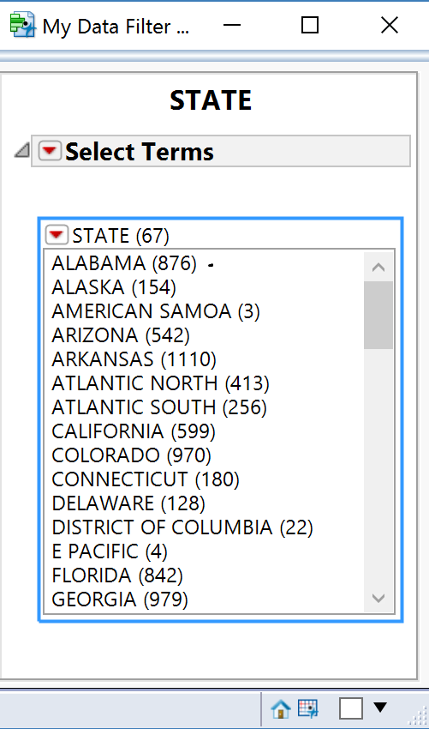
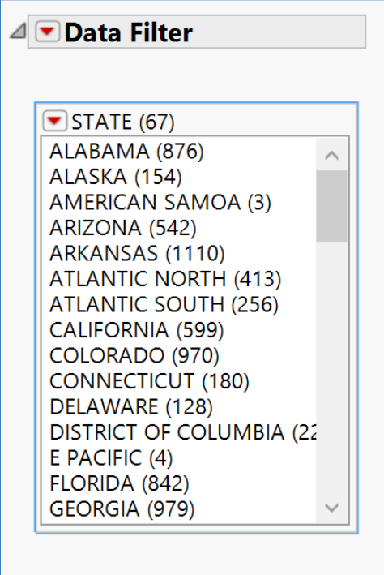
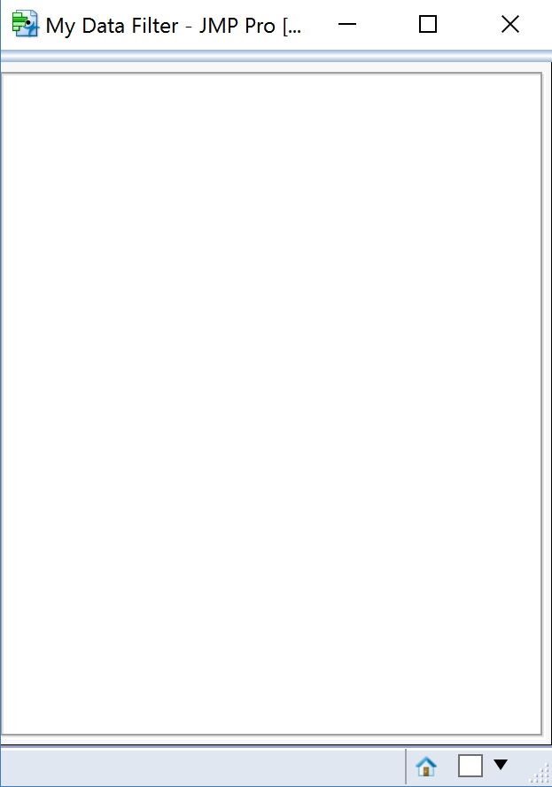
Hacking the JMP® Data Filter
Philip D. Brown
Douglas Data Consulting, LLC
Hacking the Data Filter Object
1. Modifying Display Tree
2. New Display Assembly
It is now possible to “hack” the object. This is done in two parts:
1. The default Data Filter Object is modified by adding and/or removing elements of its display tree.
2. The modified Data Filter Object is assembled with other elements to create a new display object that can be used just like any of the Display Box objects native to JMP.
In order to actually use the “hack”, the procedures described are packaged into a re-usable JSL function.
e.g. These commands remove all checkboxes and buttons from the display.
e.g. A Window with a white background panel and grey bevel serves as the “container”. A title for the panel may be set if desired.
Since the Data Filter Object was converted to a Display Box, it can be added easily:
dfObj << xpath("//OutlineBox/descendant::CheckBoxBox")) << visibility("collapse")
dfObj << xpath("//OutlineBox/descendant::ButtonBox")) << visibility("collapse")
newfilterContainer << append(dfObj );

Slide 5
Hacking the JMP® Data Filter
Philip D. Brown
Douglas Data Consulting, LLC
Packaging the Hack
NewDataFilter Example
The procedures are packaged into a function called NewDataFilter that has three inputs.
table → Target data table for filter
colList → List of columns chosen for filter.
title → Title of filter display (optional)
Each time NewDataFilter is called, it creates a Namespace with several members. Some key members are:
dfObj → Data filter object
display → Display assembly
dt → Reference to target data table
dtCols → Reference to list of columns chosen
This namespace represents unique instance of the hacked data filter object.
myDataFilter = NewDataFilter(
                Data Table( "stormdata_2013" ),
                {:STATE, :EVENT_TYPE},
                “Key Parameters“
              );
myDataFilter =
          New Namespace(
          "#44",
              {
                andButton = DisplayBox[ButtonBox],
                clearButton = DisplayBox[ButtonBox],
                dfObj = Data Filter[],
                dfOutline = DisplayBox[OutlineBox],
                display = DisplayBox[BorderBox],
                dt = Data Table( "stormdata_2013" ),
                dtCols = { :STATE, :EVENT_TYPE },
                favButton = DisplayBox[ButtonBox],
                helpButton = DisplayBox[ButtonBox],
                incChkBox = DisplayBox[CheckBoxBox],
                invChkBox = DisplayBox[CheckBoxBox],
                name = "#44",
                orButton = DisplayBox[ButtonBox],
                selChkBox = DisplayBox[CheckBoxBox],
                showChkBox = DisplayBox[CheckBoxBox],
                titleBox = DisplayBox[TextBox]
              }
          )

Slide 6
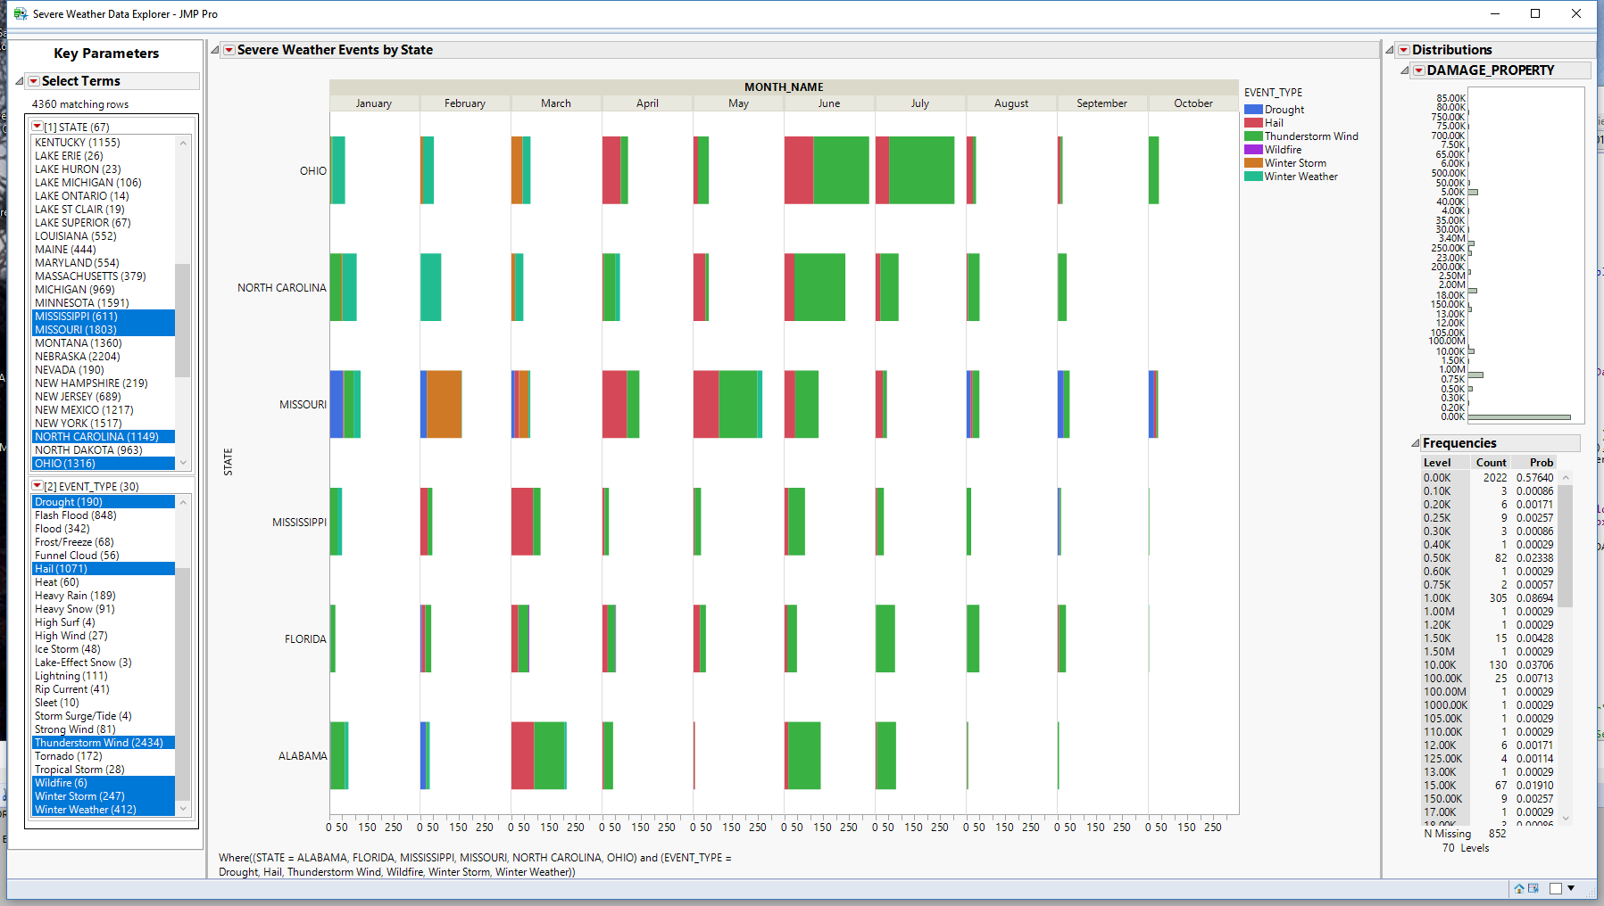
Hacking the JMP® Data Filter
Philip D. Brown
Douglas Data Consulting, LLC
NewDataFilter Output
The members of the output Namespace can now be used as needed. For example, the display member can be included as part of a user interface window:
myWindow =
    New Window( "Severe Weather Data Explorer",
        H Splitter Box(
          myDataFilter:display,
          Graph Builder(
            Show Control Panel( 0 ),
            Variables( Y( :STATE ),
              Group X( :MONTH_NAME ),
              Overlay( :EVENT_TYPE )
            ),
            Elements( Bar( Y, Legend( 14 ),
            Bar Style( "Stacked" ) ) )
          ),
          Distribution( Column( :DAMAGE_PROPERTY ) )
        )
    );
The Data Filter member can be altered:
myDataFilter:dfObj << Match(
  filterColumns( :STATE, :EVENT_TYPE),
  Where( :STATE == {"ALABAMA", "FLORIDA", "MISSISSIPPI", "MISSOURI", "NORTH CAROLINA", "OHIO"} ),
  Where(:EVENT_TYPE == {"Drought","Hail", "Wildfire", "Thunderstorm Wind","Winter Storm","Winter Weather"} )
);

Slide 7
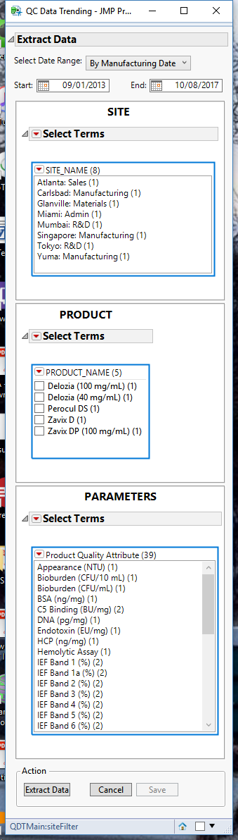
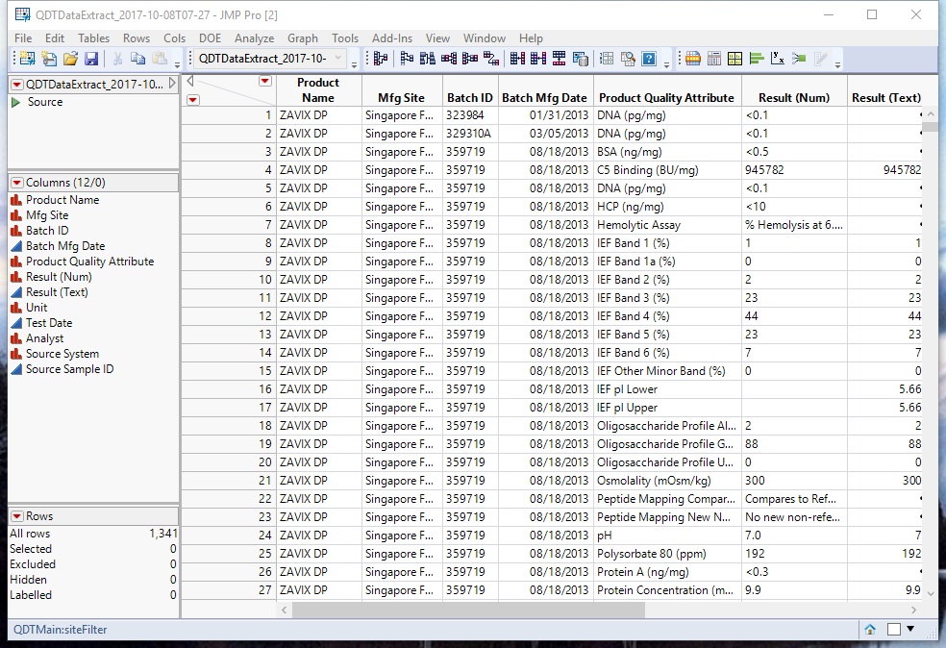
Hacking the JMP® Data Filter
Philip D. Brown
Douglas Data Consulting, LLC
Real-World Example: Database Query Interface
The techniques described were used to create a database query interface. The key goal was to provide a clear, and simple tool for extracting data from a Quality Control system.
Specified query variables are presented as “hacked” data filter objects, each in their own display panel. They can be arranged in a standalone window or as part of an existing JMP report window.
For each field, all the unique terms are shown along with the count. This is useful when there are misspelled or duplicate entries. It is also possible to nest the filters such that a selection in first , controls what appears in the next, and so on.

