Slide 1

Use JMP as a FinTech Robo: Portfolio Visualization and Automatically Rebalance Advisor
Hui Di
Sept. 11 2017

Slide 2
Background
FinTech Robo Advisor
Rebalancing among different financial institutes/accounts becomes a challenge
JMP as a FinTech Robo Advisor
Choose this topic because of easily understandable context
Potentially use for other Robots, such as Student Debt Management Advisor, etc.
  Complex debt situations: debts from credit cards, student loans, mortgages, etc. Navigating through debt is overwhelmingly a concern for the majority. Apart from financial stress, debt also creates a psychological strain which serves to compound the problem.

Slide 3
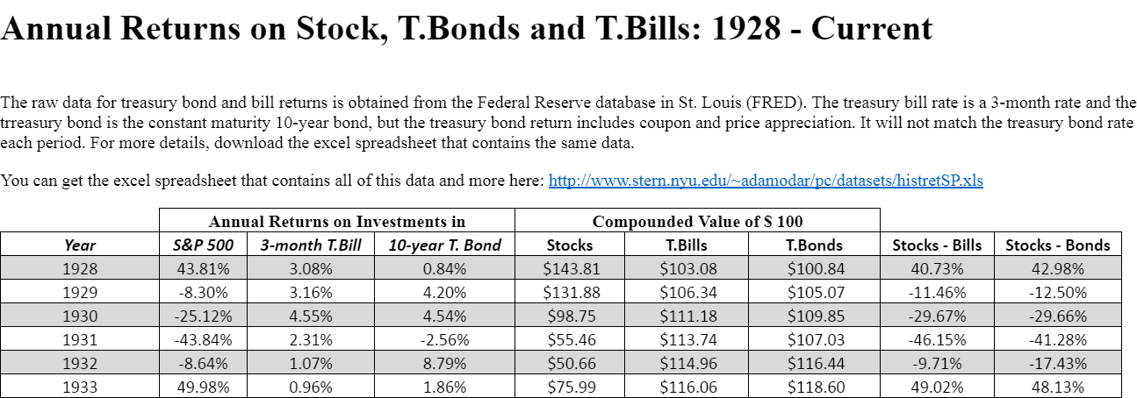
Rebalancing is necessary to protect your portfolio
Historical Data for SP500 and Bond
http://pages.stern.nyu.edu/~adamodar/New_Home_Page/datafile/histretSP.html
Historical Data analysis in JMP to see why Balanced Portfolio has advantages

Slide 4
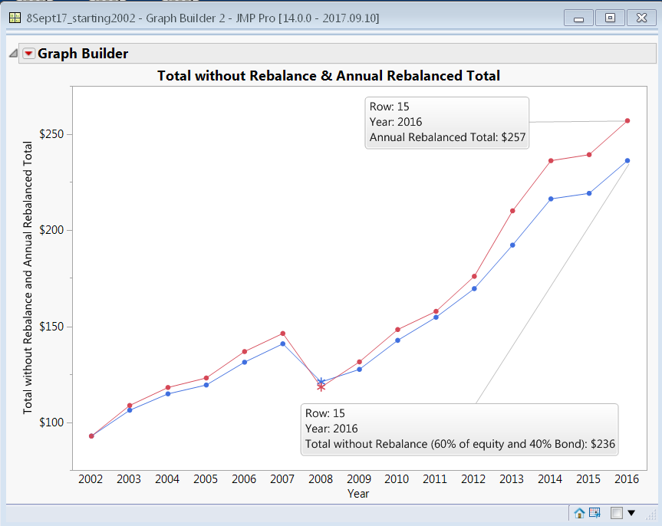
Rebalancing is necessary to protect your portfolio
Advantages of rebalancing portfolio annually
  Potential additional return (2002 - 2016)

Slide 5

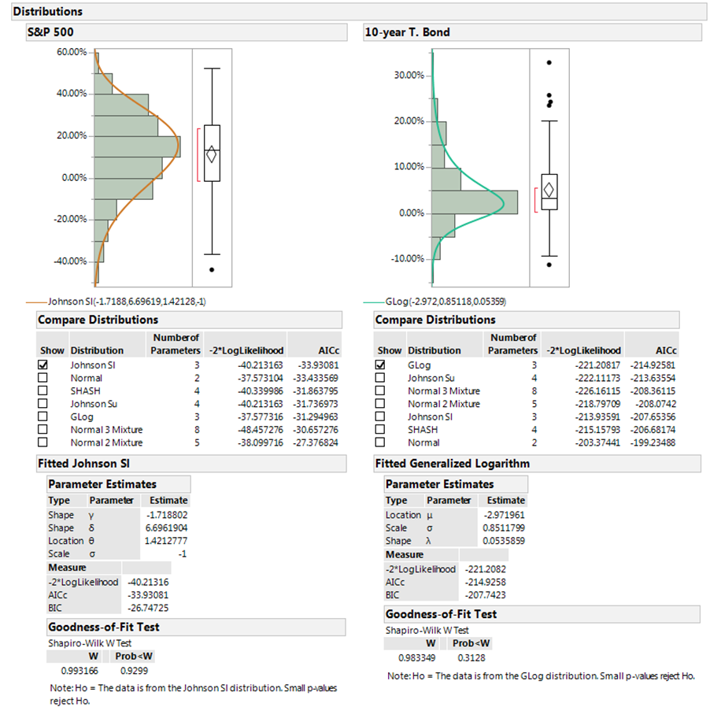
Advantages of rebalancing portfolio annually
-- Potentially lower volatility
Step 1:
Study distribution and fit distribution

Slide 6
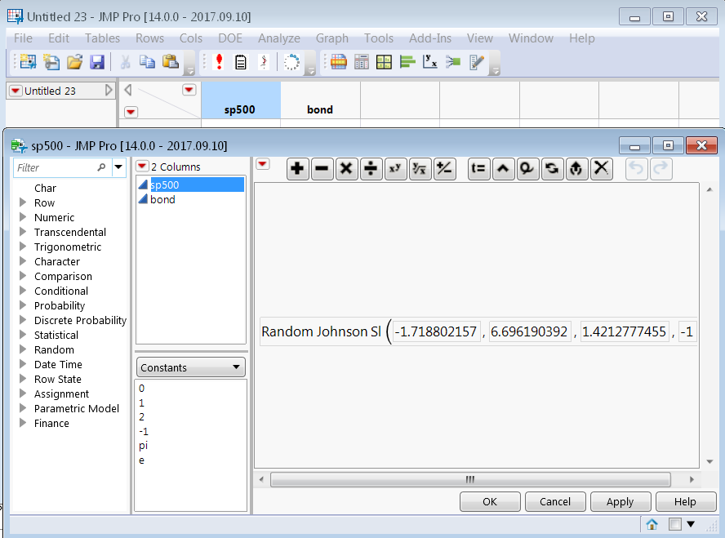
Rebalancing is necessary to protect your portfolio
Advantages of rebalancing portfolio annually
-- Potentially lower volatility
Step 2:
Create random formula from step 1.

Slide 7
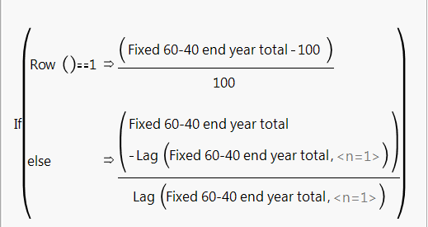
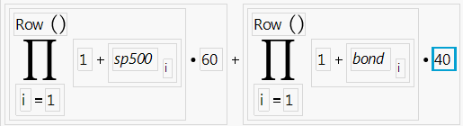
Rebalancing is necessary to protect your portfolio
Advantages of rebalancing portfolio annually
-- Potentially lower volatility
Step 3:
  Create column “Fixed 60-40 end year total” and “Fixed 60-40 portfolio return” and their formulas(Initial $100)
  Create column “Balanced 60-40 end year total” and “Balanced 60-40 portfolio return” and their formulas(Initial $100)
  (see JSL…)
  Add 1000 rows

Slide 8
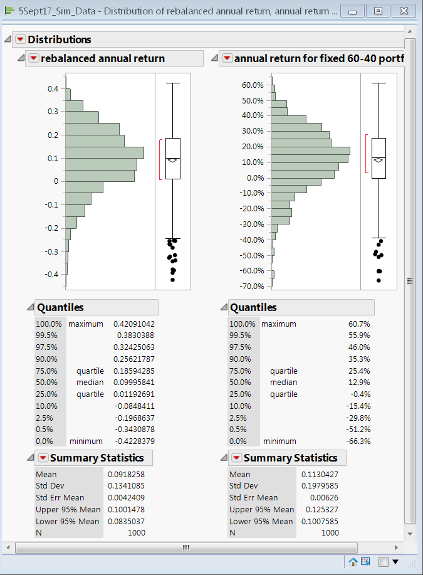
Rebalancing is necessary to protect your portfolio
Advantages of rebalancing portfolio annually
-- Potentially lower volatility
Step 4:
Launch Distributions from step 3
Notice that the standard deviation is reduced
From the data table, notice that the after 100 samples, the none balanced portfolio has about 100% stocks.

Slide 9
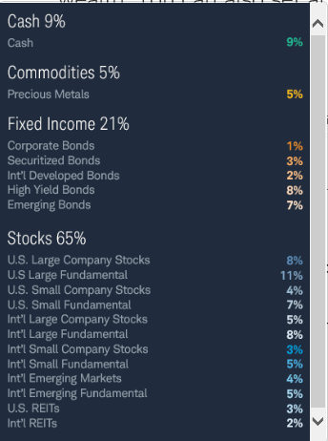
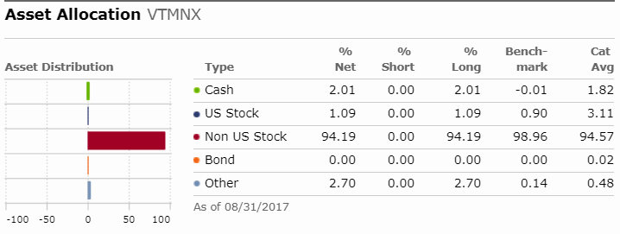
Use JMP as a FinTech Robo Portfolio Rebalance Advisor
Step 1 : Know your goal/risk and understand composition of your current Funds/ETFS
  Assets category from Charles Schwab, for an example, for a diversified portfolio (left)
  Composition info of current funds from morning star(right)

Slide 10
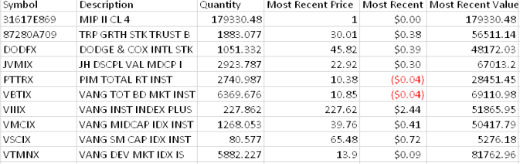
Use JMP as a FinTech Robo Portfolio Rebalance Advisor
Step 2 : Import assets from accounts of different Institutes into JMP to create a master data table
  Fidelity and Charles Schwab allow users to download to .cvs files

Slide 11
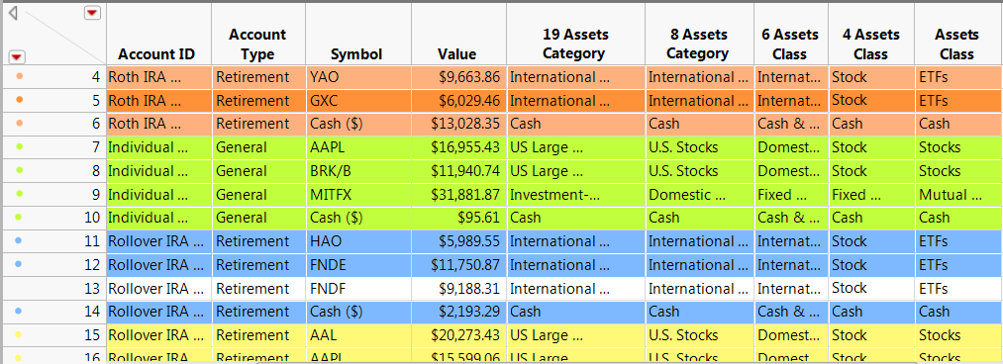
Use JMP as a FinTech Robo Portfolio Rebalance Advisor
Step 3 : Add some detailed information on funds to create your master data table
according to asset category from step 1

Slide 12
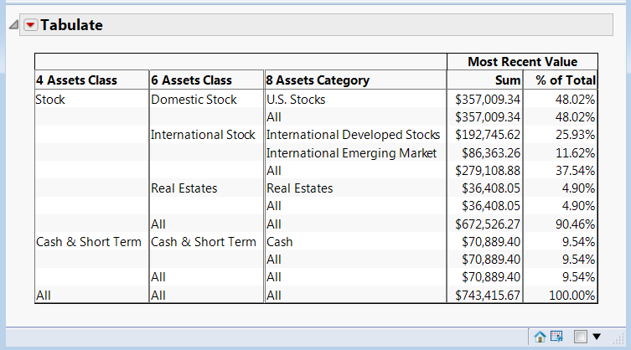
Use JMP as a FinTech Robo Portfolio Rebalance Advisor
Step 4: Visualize asset allocation for current assets
Question: some funds or ETFs are not 100% stock.

Slide 13
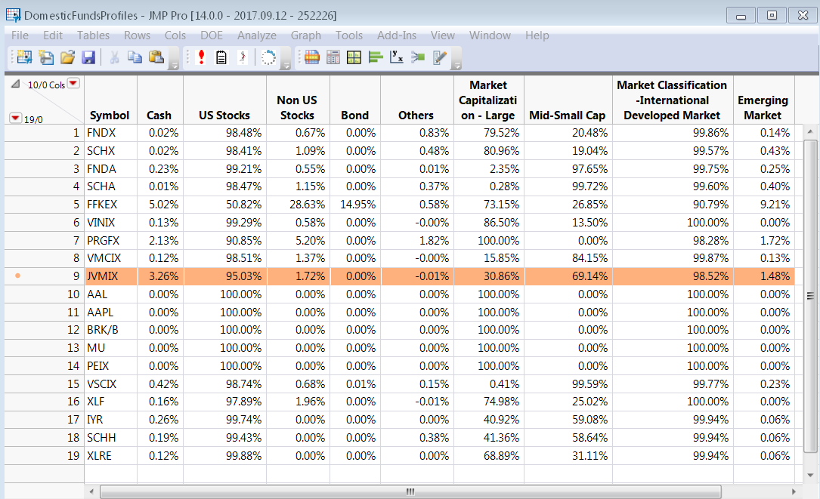
Use JMP as a FinTech Robo Portfolio Rebalance Advisor
Step 4 :
More on asset allocation for current assets
  Set up a new data table to collect funds profile. Look into details on funds composition (step 1)
  Get all assets information using virtual join to make a master data table.

Slide 14
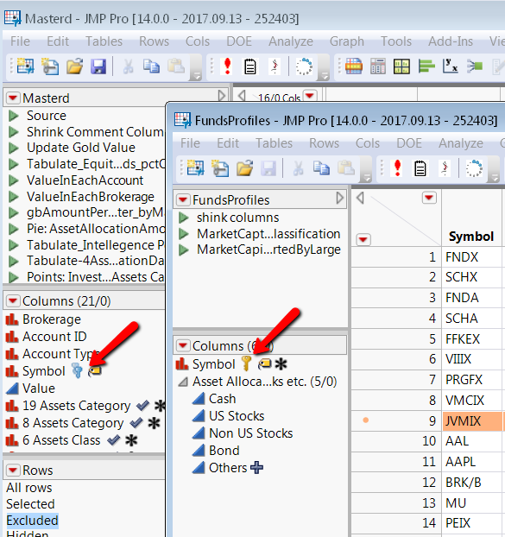
Use JMP as a FinTech Robo Portfolio Rebalance Advisor
Step 4 : continued
Set Linked ID and link
reference

Slide 15
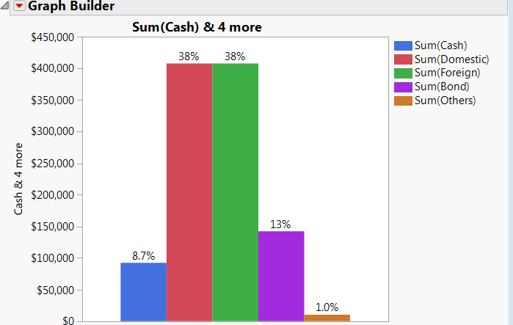
Use JMP as a FinTech Robo Portfolio Rebalance Advisor
Step 4 : continued
Actual Asset allocation among domestic equity, foreign equity, cash, bond, and others.
Notice that the equity is 76% instead of 85% from slide 12. When looking into detailed composition, the portion may differ.

Slide 16
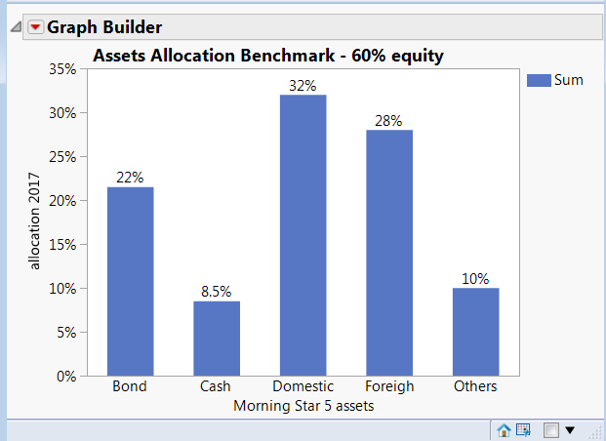
Use JMP as a FinTech Robo Portfolio Rebalance Advisor
Step 5:
Review of customer’s risk tolerance and bench mark
Rebalance using master data table and bench data table (UI or JSL)

Slide 17
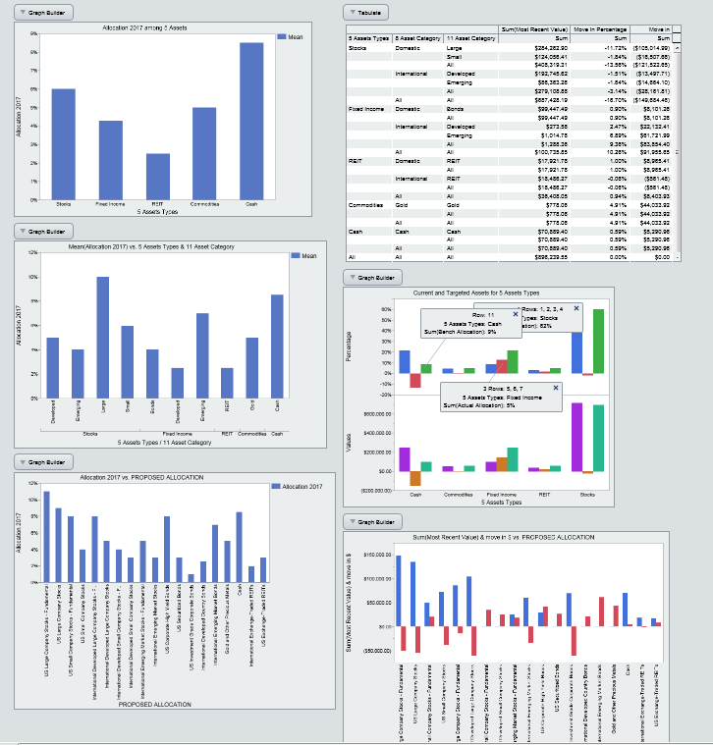
Use JMP as a FinTech Robo Portfolio Rebalance Advisor
Rebalance Summary Report in HTML5
Clients can share this from different devices and drill down to see information

Slide 18
Conclusion
The broad diversified funds or ETFs from different accounts —up to 20 asset classes in any account —means that implementing rebalancing process could be complex and challenging for an individual investor trying to manually manage his or her portfolio.
JMP allow us to simplify the portfolio management process and make rebalancing more efficient.
The re-usable script make the next rebalancing easier

