Slide 1
Creating structured tables from unstructured text logs with text explorer
Dr. Shannon conners, JMP R&D
Notes:
Hi all, I’m Shannon Conners from the JMP group. Today I’ll be sharing how I’ve been using the custom regex features in JMP’s text explorer platform to create structured data tables out of unstructured text logs. I think this approach is generally useful for anyone who wants to retrieve and parse free text from web-based reporting systems. I’d like this presentation to be informal so please don’t hesitate to interrupt me with questions along the way!

Slide 2
Fun with text
Topics for today
Intro
  Text Explorer workflows
  Introducing Jenkins
Pulling Jenkins Data
  Retrieving Jenkins data with JSL in JMP 14
  Importing Jenkins console text via JSL
  Parsing unstructured text in console logs
  Linking to web page content
Extracting structured data from logs
  intermediate process timings
  test results
  error messages
Example visualizations
Notes:
So here’s the general outline for today.
We’ll talk about a couple of different JMP text explorer workflows. I’ll introduce Jenkins, the system that generated the unstructured text that will serve as our example today. Then I’ll show some examples of how to retrieve summary data from that system as well as the unstructured text logs that Jenkins stores. I’ll show some examples of parsing out details from unstructured text logs using JMP’s custom regex functionality, found in the text explorer platform.

Slide 3
Fun with text
text explorer WOrkflows
“I don’t know what’s in my text data. Let’s see!”
Import
Discovery
Clustering
“I already know what I’m looking for. I want to make a table.”
Import
Extraction
Exploration
Notes:
When I think about working with text data, I think about two basic workflows. I know there are many more but these come first in my mind.
If you are working with a large table of documents, there may be a discovery phase where you are exploring your text data to find important words and phrases and grouping words/phrases/documents. We have had some excellent text discovery talks at Discovery, so I encourage you to check out the JMP user community for more details.
However, sometimes you already pretty much know what you’re looking for and you’re looking to move directly into an extraction phase, where you want to pull important pieces of information out of a blob of unstructured text in your table and do something useful with it. The extraction phase can be manual, automated or a bit of both. This is the main workflow that we’ll talk about today.

Slide 4
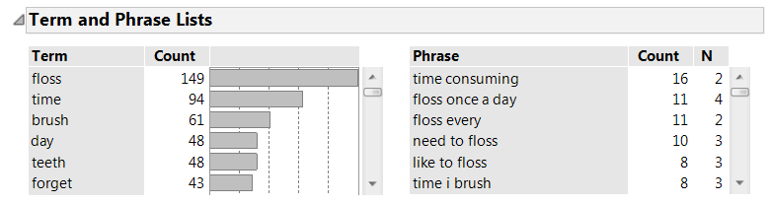

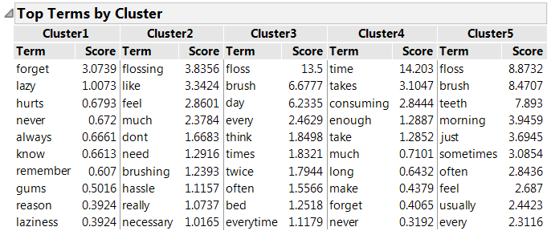

Text explorer workflows
I don’t know what’s in my text-let’s see!
Notes:
Although it won’t be our focus today, I wanted to at least mention workflow #1! Hopefully your company has moved to JMP 13 and you’ve had a chance to try this out on your own text day! If not, it’s time to bug your software admin again.
It’s pretty obvious from its name that discovery is the bread and butter of the Text Explorer platform. The basic idea, shown here with sample data, is that you’ve got a table full of text data, more than you’d ever be able to read and digest, and you want to quickly find common words, phrases, and topics. You may want to make a word cloud, to cluster terms or documents, and pull out interesting subsets to read in more detail. You’re exploring your data, trying to summarize and make sense of the major themes in it and focusing in on interesting subsets.

Slide 5
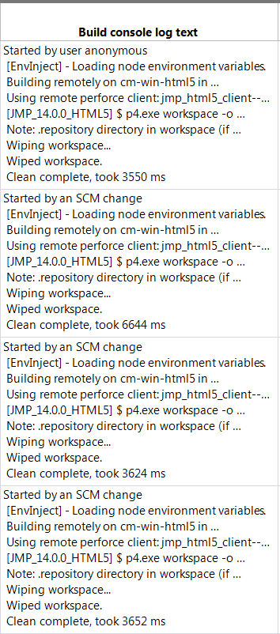
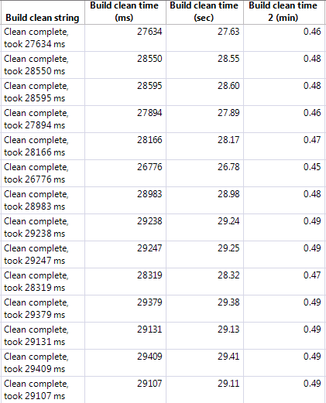
Text explorer workflow
I just want a magic wand and my table!
Notes:
However, sometimes you’re working with unstructured text that contains semi-structured information that’s a bit more complex than simple words and phrases. Running the typical text explorer workflow to find common words and phrases doesn’t make as much sense because the commonly occurring words and phrases in the document aren’t all that interesting. You may be looking for values that match a pattern, rather than trying to understand the prevalence of the values themselves. You may even already know where the info is located in your documents but you have too many rows to handle the data extraction manually.
This is a frustrating situation because you know you have the data to answer your questions, but you can’t analyze, graph or summarize it while it’s embedded inside a big blob of text.
Obviously, you need to create structure from that unstructured blob of text before you can take advantage of JMP’s analytic, visualization and filtering tools.
Here, you can see a simple example where my table contains data on the length of a clean step in a build process, but it’s embedded within several hundred lines of a text log.
Of course, JMP gives me all kinds of scripting features I can use for this kind of work. I’ve used them in various past projects, but even adapting code I’ve written for a new pattern match can be time-consuming for a horrible (and impatient) JSL programmer like me. I could ask colleagues to write the JSL for me, but they’ve got plenty of other things to do, and I usually want my results right away.

Slide 6
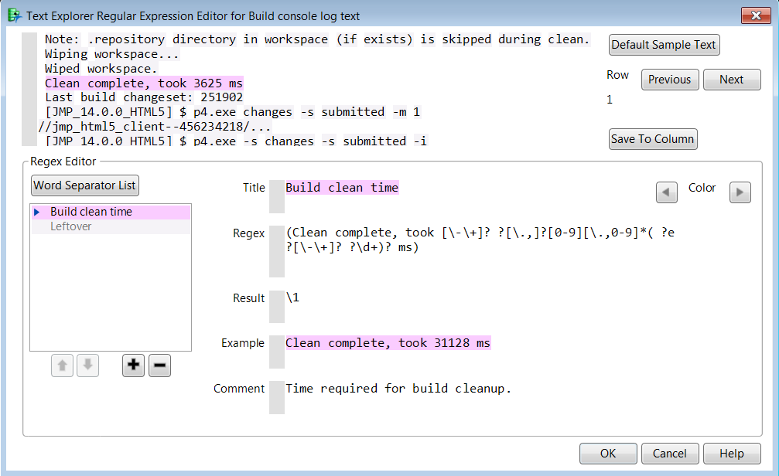
Text explorer workflow
The custom regex dialog is my magic wand
Notes:
While the Custom Regex option/dialog in Text Explorer was initially designed as a data cleanup utility, it actually turned out to be the closest thing I could get to a text extraction magic wand. This tool is launched from the Text Explorer platform, and provides an interactive way to match patterns and extract data. And the tool is itself scriptable, so rather than writing loops for each match, you can leverage the framework the platform provides and just worry about writing a valid and useful pattern match.
This dialog may not allow you the full control that JSL does in choosing pieces of the matching text, but you can combine it with other JMP tools (e.g., formula columns or the Text to Cols utility) to extract the specific word or words you want from the matching text string. I’ll show some more examples in a few minutes, but first let’s talk a bit about the text logging system that I used for this project.

Slide 7

intro
What is Jenkins?
Definitions
  “Jenkins is an open source automation server written in Java...forked from Hudson after a dispute with Oracle.” – Wikipedia
  “Jenkins is a glorified task scheduler.” – Nick Ruva, JMP
Jenkins automates development processes, saving the team from “clicking the button”
JMP uses Jenkins for builds, test automation, and automated processes for QA, doc, and crash analysis
A Jenkins server retains metadata about runs and collects verbose text logs
Notes:
Has anyone here heard of Jenkins? If your organization does any software development, it’s likely that they are using Jenkins somewhere in the process.
I’ve got two definitions for Jenkins-one from Wikipedia, which calls Jenkins an “automation server” and harkens back to its history as an open source project, forked years ago from another automation server project (Hudson) at Oracle.
I much prefer the definition one of my group members, Nick Ruva, gave me-Jenkins is basically a glorified task scheduler. It’s used to schedule many software dev tasks that need to be completed on a regular basis (e.g., after every build, nightly, weekly, etc) but are just tedious to remember to do manually.

Slide 8
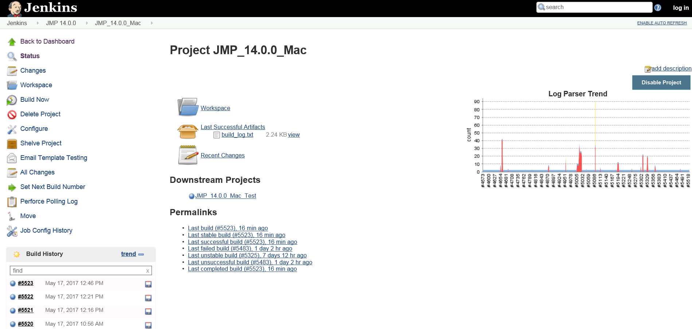
visualizations
standard reports for a Jenkins project
Notes:
A Jenkins server like the one JMP maintains can manage hundreds of projects and run repeated jobs for each project throughout the day. Every Jenkins project has its own report page so you can check its status and the results of each run.
Here’s an example of the page for the JMP Mac continuous integration build project. JMP developers are pushing code throughout the day, and this system detects that code pushes have happened and runs a build to make sure there are no compiler errors. Developers get emails about errors and warnings and fix them quickly.
The report pages for a Jenkins project gives you some basic info about each run, like its start time, and a status based on automated parsing for error messages.

Slide 9
Exporting data
Of course I need to retrieve my data!
Jenkins does not have a “point and click” csv export
JMP’s Internet Open can save HTML tables from Jenkins report pages
    It’s quick, dirty and interactive only-the web report is dynamically generated
    I began pulling Jenkins data (infrequently, interactively) a few years ago
Live demo of the basic process
  (Easy) Copy link to page
  (Easy) Paste into Internet Open dialog
  (Easy) Open as Web Page
  (Easy) Import as Data Table
  (Harder) Format data appropriately
Notes:
Standard report pages are helpful, but when I see a web report like this, my first thought is always-how can I retrieve the data so I can get it into Graph Builder with a data filter!
Unfortunately, there isn’t a point and click way to save data out directly from Jenkins projects. There is no export to CSV button. If you hunt around your server and read up on the API, you will find that Jenkins stores details in XML and JSON formats and Python can be useful for retrieving it. But what if you’re not an expert programmer and you want your data immediately?
You have basically two choices at this point-ask someone else to write some code for you while you’re standing over their shoulder, or try to scrape what data you can off the page. I’ve taken both of these paths at one point or another!
When I first started playing around with Jenkins data, I saw that JMP’s internet open feature could be useful for pulling some data directly off Jenkins pages. If you have not used JMP’s internet open feature, you may want to try it on pages that have embedded HTML tables.
[DEMO of internet open example]

Slide 10
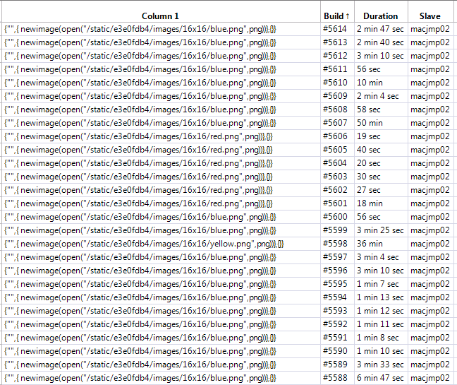
Exporting data
Problems with Jenkins web report data
Need to recode
color into Status
Bad duration
format!
Notes:
[This content will be part of the live demo of Internet open]
Unfortunately, as you can see, what I get from internet open isn’t quite ready to work with in JMP. For example, there is no build status column, though I can recode the picture name into a status. Also, the duration is shown in a format JMP can’t handle. Several other key fields-eg a date time stamp for build start time-are missing from the report data.
And while getting to the data is pretty easy, and I can script the processing of the data into something useful with a bit of work, the page is dynamically generated HTML. This means I can’t automate pulling the data via Internet Open. And it’s just not feasible to go to 6 projects per day and run Internet Open interactively and save off the data.

Slide 11
Exporting data
Improving data export with JMP 14
“REST-like” APIs retrieving XML/JSON summary data are documented at https://wiki.jenkins-ci.org/display/JENKINS/Remote+access+API
I lucked out when
    JMP 13 introduced JSON support
    JMP 14 added JSL to interact with web services and links in data tables
Special thanks to developer Bryan Boone for deciphering the Jenkins API and writing a script to pull project data for me!
Notes:
As I mentioned, Jenkins does store JSON files for each build, and JMP added native JSON support with JMP 13. But I wouldn’t have tried to attempt to retrieve those sets of files via the API until new JMP 14 features made it possible for JSL to handle this task. I’m sure it would have been possible to do this before JMP 14, but the effort would have been significantly more and probably impossible for me to understand as a novice programmer.

Slide 12
Exporting data
JMP 14 workflow for retrieving summary data
t1
t2
Jenkins project names
(1…t)
Create a new table for
project t
Import JSON for all builds
t3
tn
Notes:
I’ll be glad to share my example script for pulling summary data from Jenkins but it only works in JMP 14. After the launch in March, this and a variety of other examples that use this new functionality will be available on the JMP file exchange. Rather than boring you with JSL you can’t use at the moment, I’ll show a basic outline of what the summary data section of the script does. It can query Jenkins for a list of all project names, or you can start with a smaller list of projects of interest. Beginning with project 1, it imports JSON formatted summary details on each build row by row, pulling them from the web-based data structure and placing them into a JMP data table.

Slide 13
Exporting data
Questions that summary data can help answer
How many builds run for each project, each day/week/cycle?
How frequently do runs with unstable or failure status occur?
Is total run time changing over time?
What’s the typical run time for each project?
Did anything out of the norm happen today?
  timing change
  more/fewer runs than normal
  more failures than usual
Notes:
Clearly, using Bryan’s script to retrieve all metadata for my projects and builds from the Jenkins web logging system is incredibly helpful. It allows me to answer some basic questions about the projects using JMP graphs and summary tools. Looking at the data on a regular basis helps identify weird patterns that need investigation, or explore how changes in the system affect its performance.

Slide 14
Exporting data
Questions that summary data can’t help answer
Questions about Builds
  How variable are the times associated with pieces of a complex build process?
  Which pieces’ performance improved when we changed machines?
  Do we need to upgrade the Mac or Win hardware in a two-machine system?
  What impact did adding a proxy server have on build times?
  How often has a specific error occurred? Do we catch it correctly every time?
Questions about Test runs
  How many tests have run/failed/succeeded over time?
  How many tests run on each operating system?
  How did adding or dropping an entire browser impact test numbers and run time?
Notes:
I often have questions that summary data just can’t answer. Answering these questions requires digging into the details written out to a console log in semi-structured text that’s specific to each project. Unfortunately, Jenkins doesn’t seem to offer an API option for retrieving console logs, much less parsing them for useful details.
If you have spent any time trying to dig through text logs saved on webpages, you’ll understand why I need to get these details into a JMP table. I don’t want to have to page through a bunch of web pages to find the information I need. Besides being extremely boring, this is way too error-prone.
Here are some examples of questions I’ve wanted to answer where I’ve had no choice but to get into the console text and parse it. Of course, I could rely on someone else writing log parsing code for me, but I’m too impatient to wait for new code every time I find something new to investigate.

Slide 15
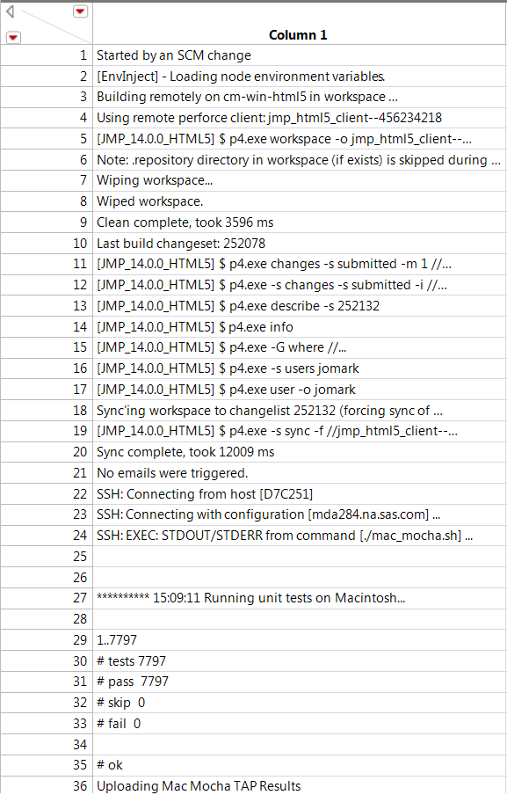
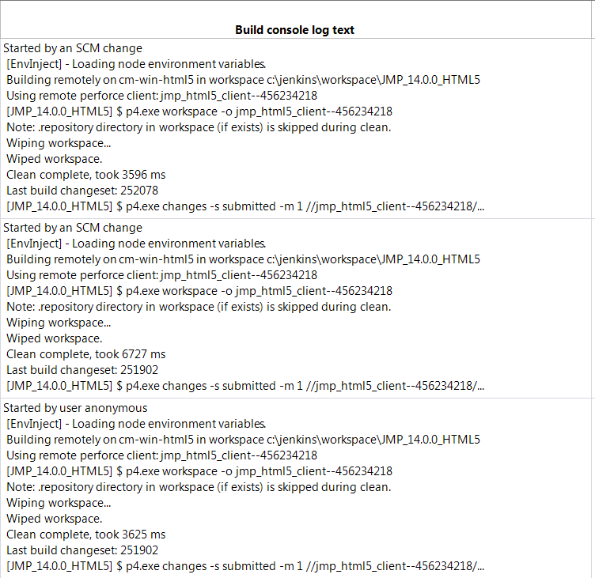
Exporting data
Jenkins log data import
  A key loop in my script adds log text for each run
+ /n
Notes:
To retrieve the console text I need, I embellished Brian’s Jenkins data retrieval script to add a new section that runs after summary data is retrieved from Jenkins via the web.
A JSL loop grabs log text for each build, using a link to the console text log stored in the table. My script opens that text as a new data table, concatenates the lines, adds newline characters for readability, and places all rows into a single cell. The script loops through all the builds for the project. At the end, I have a table with each row containing summary data, plus a text log.

Slide 16

Text processing tools
Now what?
I want to create new variables from raw log text by
  creating a new column
  matching a pattern
  extracting my match(es) into the new column
  REGEX is the key to automating the process in JMP
    JSL support
    Text Explorer custom regex editor
Notes:
If you’re a JMP user, then you know JMP always has more than one way to do any task. There are a lot of text matching and finding tools in JMP and I use many of them daily, but most aren’t ideal for automating the process of finding and pulling out text matches from long strings or documents, especially if I can’t count on them being in the same exact place in the string every time.
To me, the most useful tool JMP offers for matching and extracting patterns is built-in regular expression support available via JSL or in selected JMP utilities including text explorer.
Yes, we’re back to my magic wand!

Slide 17
Text processing tools
Custom Regex editor vs JSL REGEX
My past JSL regex scripting projects
  Food log data table
  Source code logs
  Problem records
Advantages to custom regex editor
  You do not have to write JSL regex loop syntax
  It handles multiple matches in a document
  The custom regex utility is implemented in C++ so it’s faster than JSL
  The preview allows live testing of your regex example on lines in the table
  You can create/save your own custom regexes
Notes:
If you’ve used JSL to write regex matching syntax like I have, here are a few points about how the custom regex editor compares to a scripting-only approach.
I’ve used JMP’ built in regex support via in JSL for past projects-e.g., to match item names and data from text from food log PDFs, to parse problem report numbers out of push reports in our source management system. But I’m not an expert scripter by any stretch of the imagination, so while I do eventually get the data, I may spend hours testing and debugging a pattern matching loop. And I really don’t want to wait that long.
I am very appreciative that since JMP 13 launched, I have not had to write syntax for a single JSL regex loop, yet I’m using pattern matching more than ever to access important details.

Slide 18
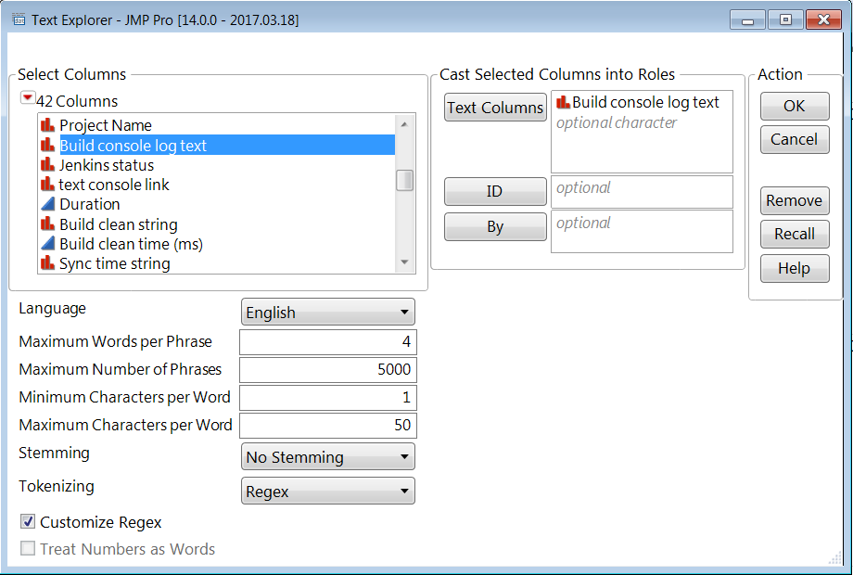
Text processing tools
How to find the regex editor
Found under Analyze > Text Explorer
Pick your unstructured text field here
Notes:
[This content will be part of the live JMP demo]
If you’ve used the JMP 13 text explorer platform, have you noticed the Customize Regex checkbox at the bottom?
When working interactively in JMP, you start the Custom Regex Editor exactly like you would start any text explorer run, by selecting your column of text data. In my case, it’s the console log column that contains the semi-structured details from my Jenkins logs.

Slide 19
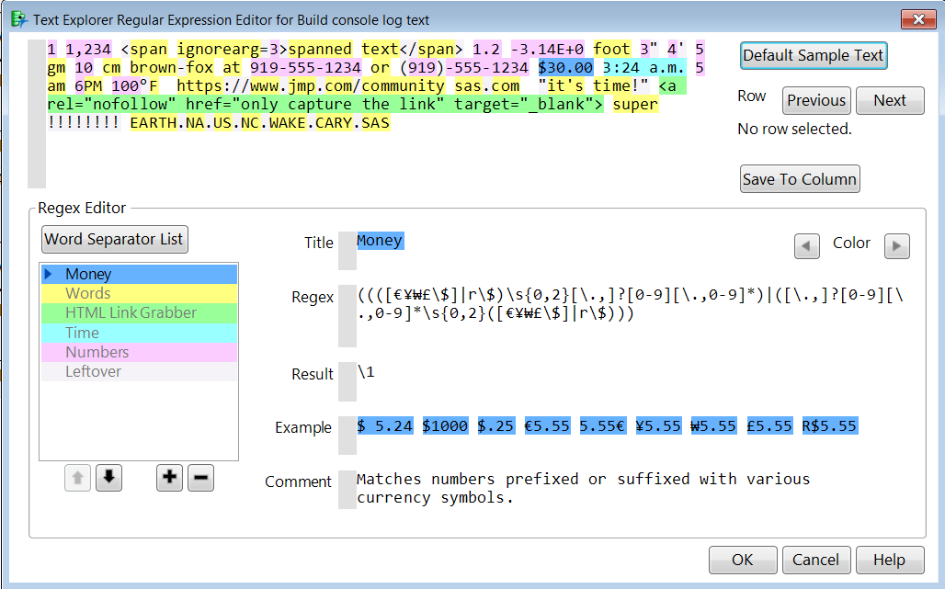
Text processing tools
Custom regex editor
Default sample text and templates
Saves matches back to data table
Notes:
[This content will be part of the live JMP demo]
When you first launch the Regular Expression editor, you’ll see
- default sample text along the top and on the left
- a list of templates that match specific information in that sample text
Note the buttons at the top right-you can use these to navigate through the rows in the table and see where matches to each template are found, and save results to a new column.
As you select templates, you can see information about each one in the panel on the right. You can adjust the title, pattern matching details, examples and provide a description of what the match accomplishes.

Slide 20
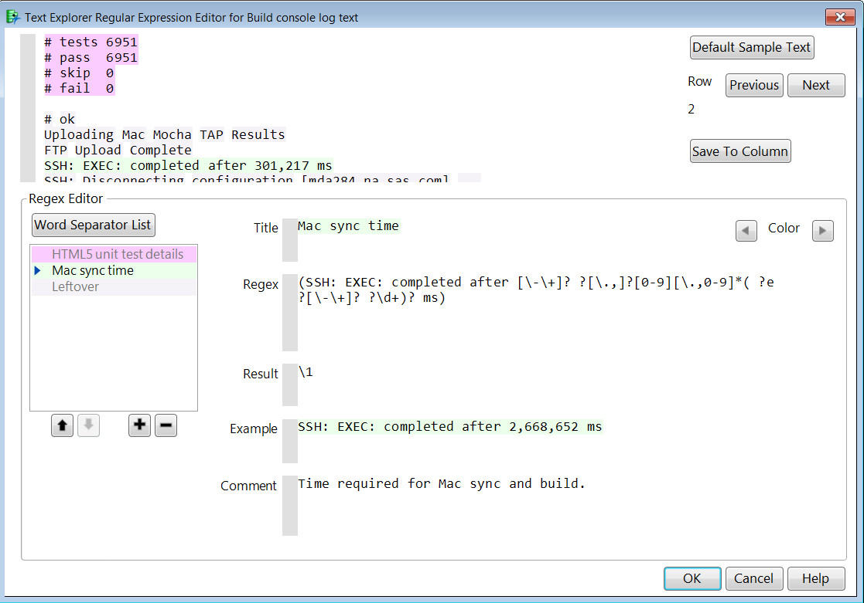
Text processing tools
Custom regex editor with custom Library items
Preview lets you scroll through a cell’s text
Specifying multiple match templates saves all output into a single delimited column
Notes:
[This content will be part of the live JMP demo]
While the built-in templates can be useful, they’re kind of generic. In most cases, you’ll want to create new custom templates to match your own patterns.
In many cases, I’ve started from a built-in template with similar elements to the one I want to create.
For example, to capture sync time info, I reused the Numbers template. I added a new title, added new match text around it, and saved the template by running the platform.
If I wanted to match multiple patterns at once, I could stack them up on the left, and they would all output to the same column.
I usually prefer to call each custom template via JSL once I’ve defined it interactively and tested it.
I run the platform via JSL separately for each library item and simply name the output column with my template name.

Slide 21
Text processing examples
Back to my questions
Questions about Builds
  How variable are the times associated with pieces of a complex build process?
  Which pieces’ performance improved when we changed machines?
  Do we need to upgrade the Mac or Win hardware in a two-machine system?
  What impact did adding a proxy server have on build times?
  How often has a specific error occurred? Do we catch it correctly every time?
Questions about Test runs
  How many tests have run/failed/succeeded over time?
  How many tests run on each operating system?
  How did adding or dropping an entire browser impact test numbers and run time?
Notes:
[This content will be part of the live JMP demo]
Let’s go back to my questions now, so I can show you how the details provided by custom regexes can help me answer a few of them. We won’t have time to answer them all in this demo, but the point is that I can now answer them with the data I have, whenever I need to.

Slide 22
Text examples
Understanding components of process times
Goal: optimize machine specs and improve performance
  Overall duration was not granular enough to know where to focus
  Needed to extract timing data for pieces of the process
Several different steps stored timing data in the logs
  Clean
  Sync
  Mac build
  Windows build
Notes:
[This content will be part of the live JMP demo]
As you know, JMP runs on Mac and Windows, and JMP has a few build and test systems that incorporate machines running both operating systems.
We’ve been through performance challenges with both systems that have led us to reconsider the hardware and resources used to complete the tasks. Our goal is always to deliver results as quickly as possible to keep teams developing code productively throughout the day.
When working with a complex system, you want to spend resources wisely, and make only the most useful requests. You want to be able to understand the timing and variability of each step so that you ask for the resources that will get you the most bang for your buck, and you want to be able to demonstrate that changes helped or hurt.

Slide 23
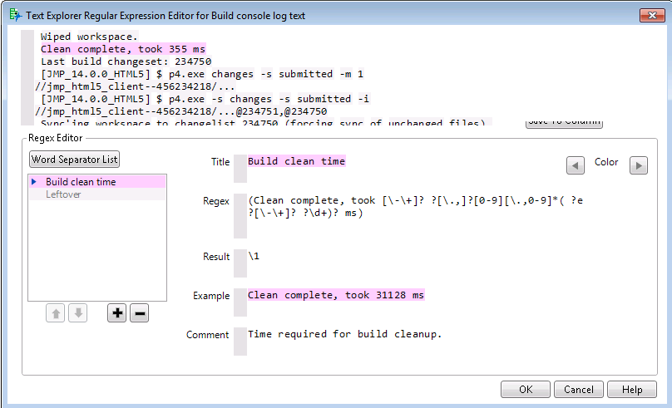
Text processing examples
Gathering timing data out of raw logs
Notes:
[This content will be part of the live JMP demo]
The first step to getting at the data your need is always identifying where the timing information is within your text logs. Fortunately, that information is pretty clear in this log.
Once I identified the pattern I was looking for, I created a custom regex that successfully matched it.
As you can see, there is even a space for example text in the regex section, so if you have a specific item to test that is way down in your table, you can try it out there.

Slide 24
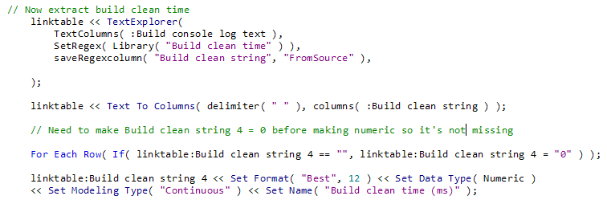
Text processing examples
Scripting a Custom regex match
Notes:
[This content will be part of the live JMP demo]
I showed you how to set up and save a match interactively, but it’s really preferable to be able to automate this process via JSL if it’s something you want to do regularly. Fortunately, you can script the custom regex utility once you have saved a match template to your library, which allows you to add parsing steps to the end of any data extraction script that you have built up so that your table is always ready to go in JMP.
This also allows you to do any post-processing steps that are needed, such as pulling out specific pieces of the matched string (e.g., the numeric part in my case) and formatting them appropriately for further analysis.
We have used similar JSL to automate our Jenkins data pull with a script that runs every day. As a result, there is always a recent copy of historical data available for troubleshooting, and the process can be run on demand at any time to retrieve the most recent data for exploration and analysis.

Slide 25
Text processing examples
Extracted build clean times
Used Text to
Columns to
extract timing
Result of my
Regex match
Two formulas
create new
duration
variables
Notes:
[This content will be part of the live JMP demo]
This example table shows the result of one of my pattern matches. At present, the text explorer custom regex utility can only return the whole match string rather than pieces of it, but I often use other scriptable JMP utilities to break apart the pieces of the text match. JMP added a Text to Columns utility a few releases ago that I like, or you can use other pattern match functions such as Words to grab the specific details you need, change their formats, and rename them as needed.

Slide 26
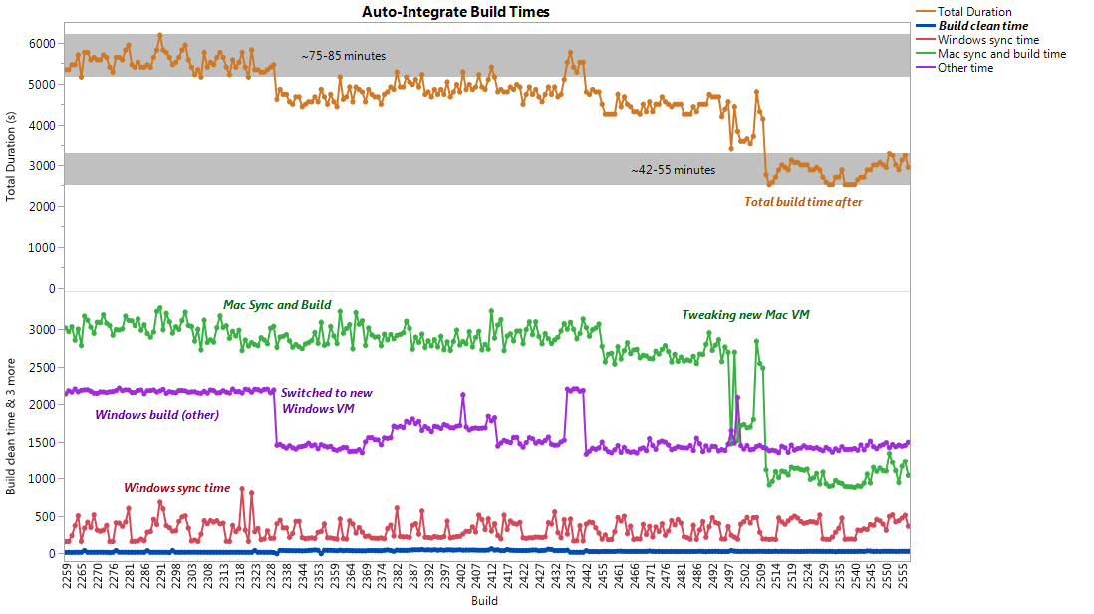
Text examples
Visualizing performance changes
Notes:
[This content will be part of the live JMP demo]
This annotated graph builder graph shows one period where we worked to optimize the timing of a complex process.
You can see where we started, the whole process was taking about an hour and a half, which was far too slow.
The first change we made in the system was to move the Windows build to a more powerful machine, which shaved some time off. The changeover was not without its hiccups, as you can see we had to switch the machine back at one point to the old system to do some troubleshooting.
It became clear from looking at this timing data that the Mac machine was the big bottleneck. Changes to its configuration helped us bring that build time down too.

Slide 27
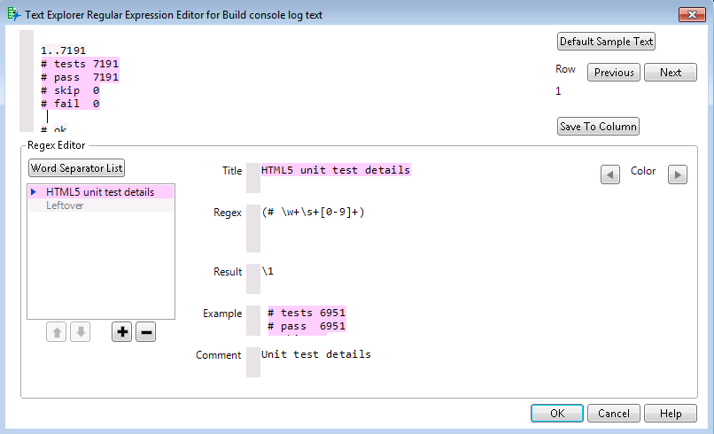
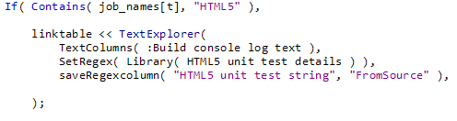
Text examples
Gathering test data out of raw logs
This is a pattern match
for test results
I then called this in my script
Notes:
[This content will be part of the live JMP demo]
Here is a slightly different example from another of our complex systems. The log for this system captures information about browser tests-how many are run, how many complete successfully, how many fail. Again, I automated the process so that information could be extracted to the data table into useful columns.

Slide 28
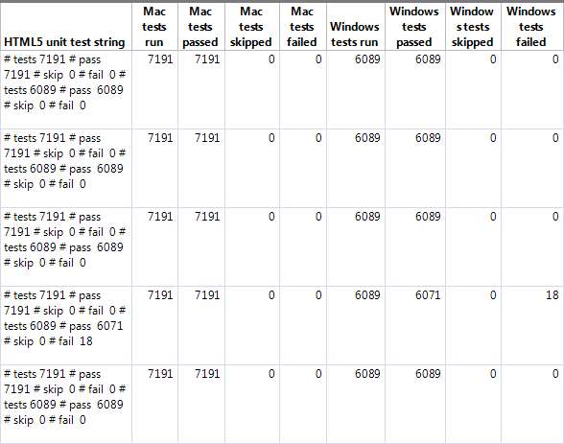
Text examples
Extracting html5 browser test results
Used Text to
Columns to
extract unit test details
Notice there are two sets of matches-Win and Mac
Notes:
[This content will be part of the live JMP demo]
After matching the whole string, I used text to columns and reformat statements similar to the ones I showed previously to pull out the numeric information about tests.

Slide 29
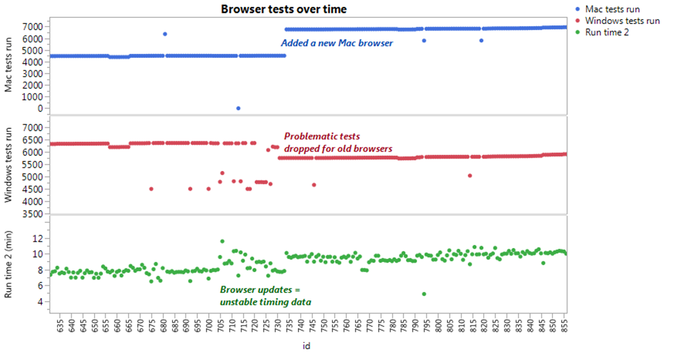
Text examples
Visualizing unit tests over time
Notes:
Extracting the test data is helpful for understanding what is going on with the performance of the system.
You can see in the bottom panel that we went through a period in this system where run time went from being pretty stable to suddenly unstable. This was a time frame where the team was updating the software in the system and evaluating the feasibility of running certain intensive tests on older browsers. This led to some changes in the system-certain tests could not run on aging software, and dropping them out left room to add a run on another browser where they could complete, on the Mac.

Slide 30
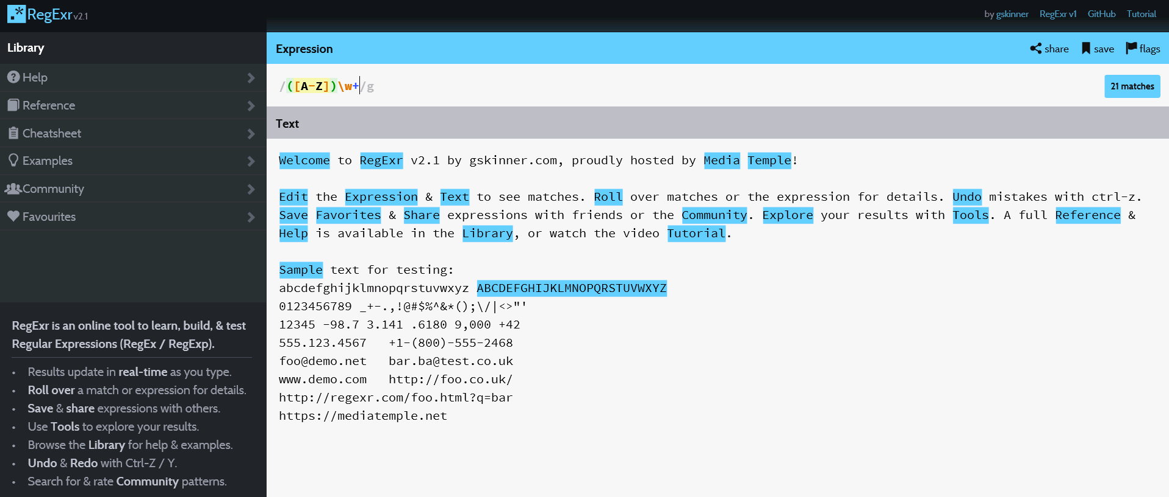
Web sites of interest
Regexr for testing regexes with your data
http://regexr.com/
Notes:
I hope I’ve shown you enough to convince you that you can use JMP to pull important information out of your text logs. I suspect a few of you are still sitting there wondering about regexes in general. Maybe this topic and pattern matching syntax are new to you. Believe me, I’ve been there! I’m no expert, but I have found a few tools out there that are extremely helpful as you get started creating your own custom pattern matches.
While the Custom Regex dialog can be helpful for testing results of successful regexes, you may need more than the basic error checking it provides. It will let you know if your regex has an error, but not what the error is. So when I am looking at creating a new regex, I will often use the Regexr website to test and error check my regex with sample text before adding it to text explorer.

Slide 31
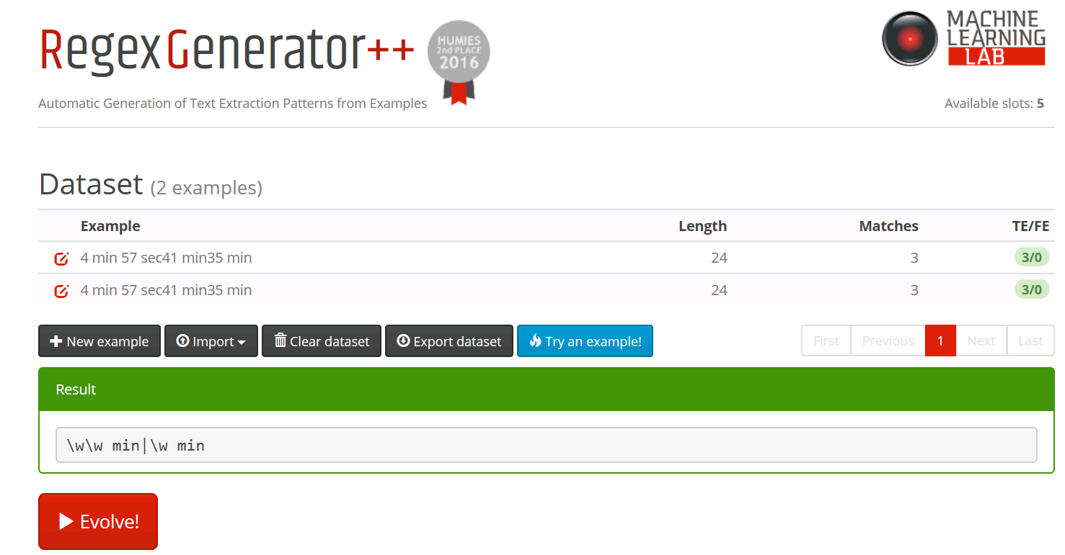
Web sites of interest
Generating new regexes from text samples
This web site generates regex matches for your examples using a genetic algorithm: http://regex.inginf.units.it/
Examples I entered
Output regex
Notes:
If the whole idea of writing a regex seems overwhelming and you don’t even know where to start creating one, you can find a lot of information online. If you prefer learning with your own examples, you may want to check out a site that my colleague Nascif recommended. It can help you actually generate a regex using several snippets of example text, which is a great way learn about how pieces of regex syntax fit together.

Slide 32
conclusions
Getting more out of your text data
You can use JMP to retrieve and process text logs
  Searching text logs manually is boring
  Regexes can help you extract critical details quickly
  JMP Text Explorer’s Custom Regex feature can be your magic wand
  Please try it and share your feedback in the JMP user community!
Notes:
A few years ago, I talked at Discovery about using custom maps to visualize my workout data in JMP. The next year, I heard from several users that they went back to their companies and shared the ideas from my talk with colleagues. Some even created their own custom maps and overlaid data on them and learned from the experience.
Once JMP 14 launches next March, you will definitely want to check out information on the new web api connection features and consider how you might use the to automate the retrieval and processing of text that your company collects. We’re already using these features to monitor systems that we use internally and have found them to be incredibly valuable.
In the mean time, you can use JMP 13 today to try out the very accessible DIY text processing tools I’ve showed today. They can help you get access to information that you’re already collecting and put it into a format that’s usable in all the wonderful tools that JMP offers you!

