Slide 1

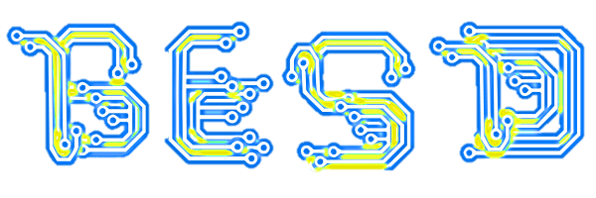
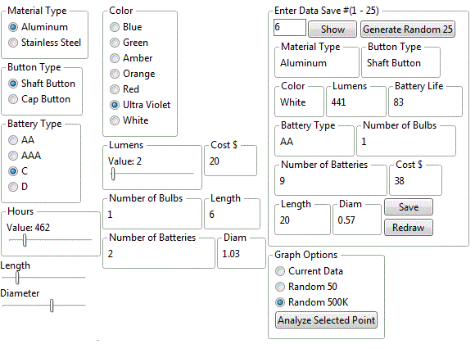
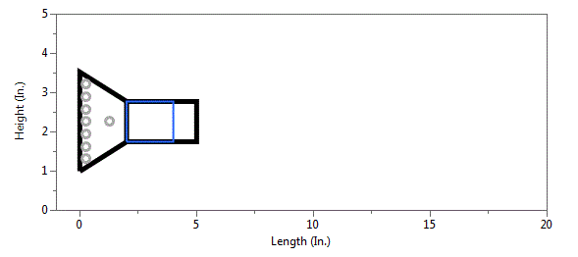
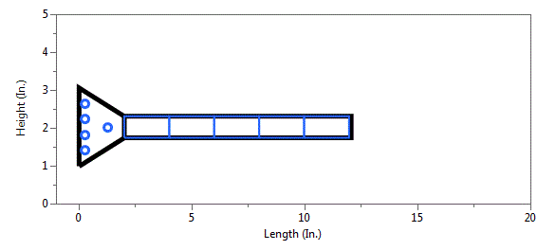
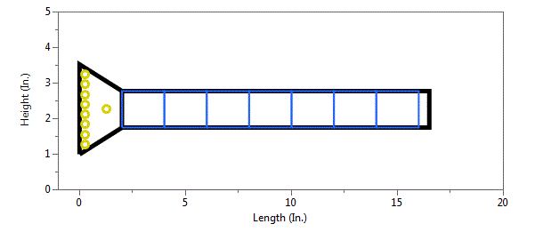
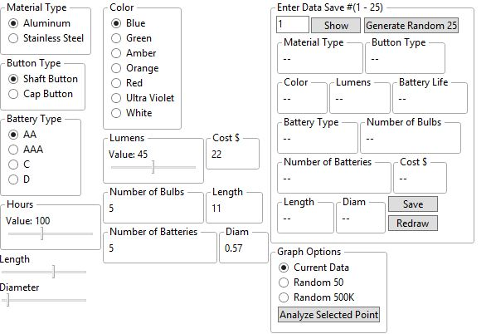
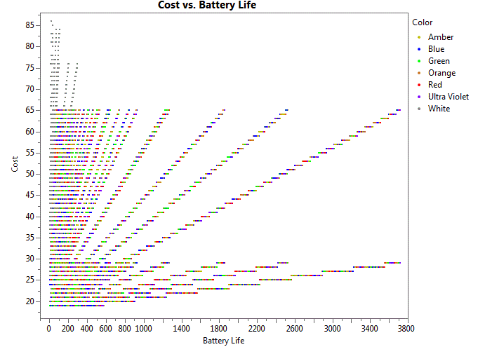
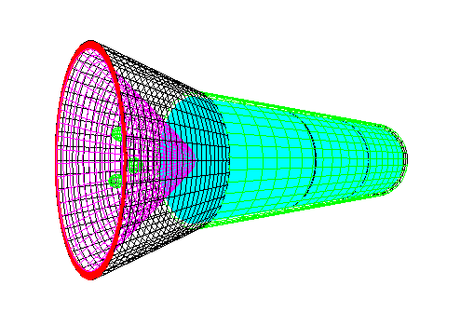
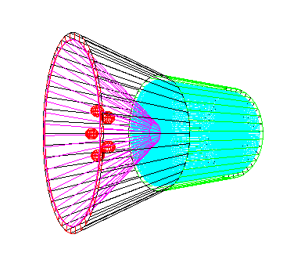
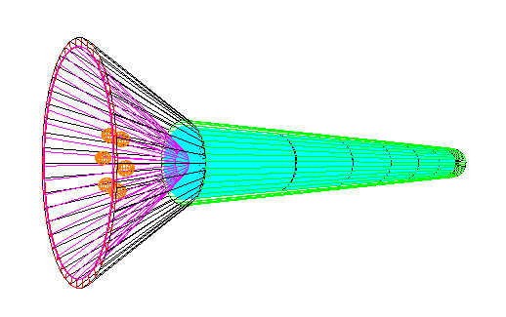
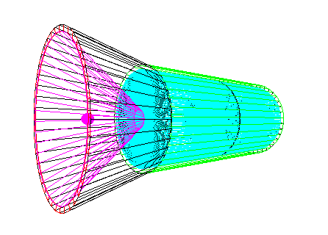
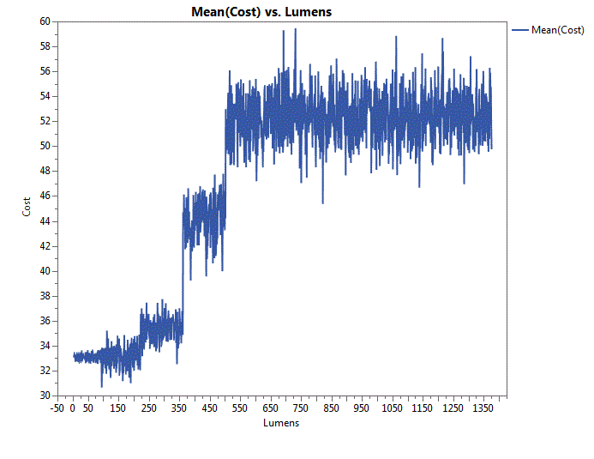
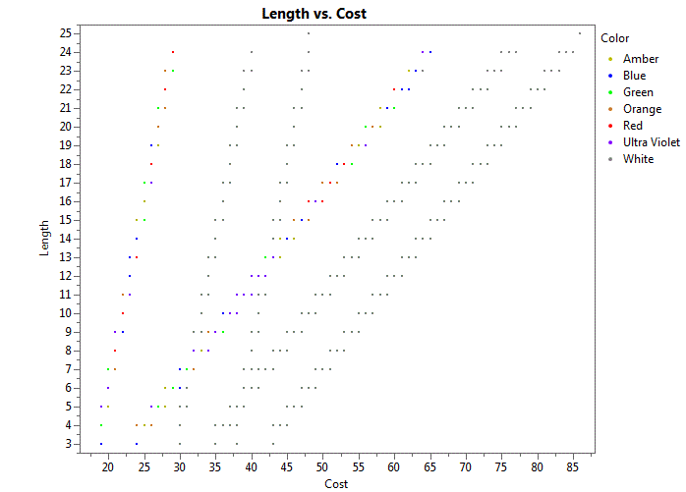
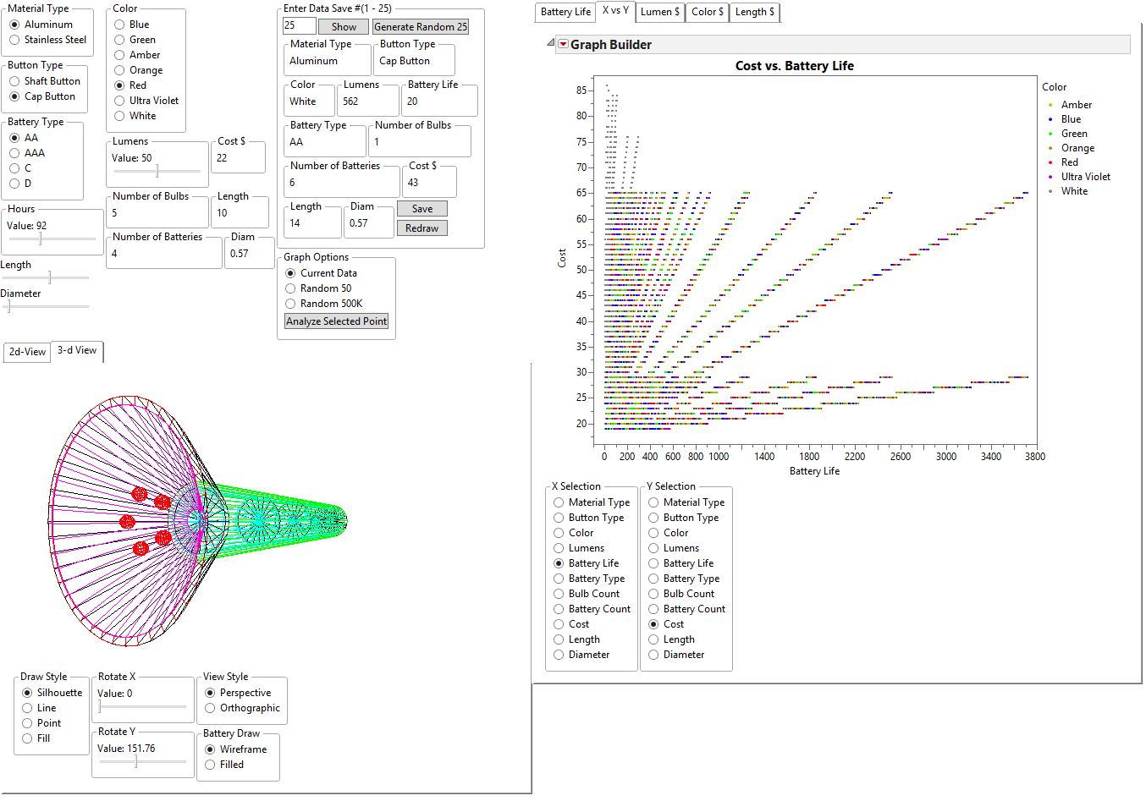
Interactive Tool for Mass-Producible LED Flashlight and Product Design Space Analysis With JSL
Troy Seletos and John Salmon, Brigham Young University (BYU)
Research Objective
Tool Features
Design Space Exploration
The need to create mass customized designs and explore design spaces is a common need among product producers.
With enabling technology, designs can be generated rapidly and cheaply allowing businesses to better explore the design space of their product.
The research objective is to develop a mass customization tool, using JMP scripting, for a LED flashlight.
Update Design Dynamically and Quickly
Additional designs can be generated, recorded, and analyzed through the interaction of JMP visualizations and scripts.
Using Monte Carlo simulations thousands of designs are generated.
Inverse design is made possible through selection of design results, which are then passed back to the input design parameters.
The tool can potentially save time and resources for redesign, design exploration, and mass customization.
Multiple, interactive parameters which update output values in real-time
Visualize Product in imbedded 2D and 3D views
JMP Tool Overview
Monte Carlo Simulation
The tools inputs include various design parameters such as material type, button type, LED color, lumens, battery life, and battery type.
The output design and responses include flashlight length, diameter, cost, number of LEDs, and number of batteries.
The tool allows the user to quickly explore the design space from a Monte Carlo simulation of 500 thousand generated designs.
Easily create custom designs
Inverse Design Analysis
Results and Conclusions
Rapidly Explore the Design Space Rapidly
Dynamic and interactive updating of flashlight design parameters
2D and 3D visualization of the product is performed in real-time
The speed and flexibility of the tool enables reverse analysis and inverse design selection
The tool is capable of generating thousands of designs per minute
Creates a high level system view of interactions
Quickly analyze the design space using 500k pre-run designs

Slide 2

The Full Tool
Return

