Slide 1

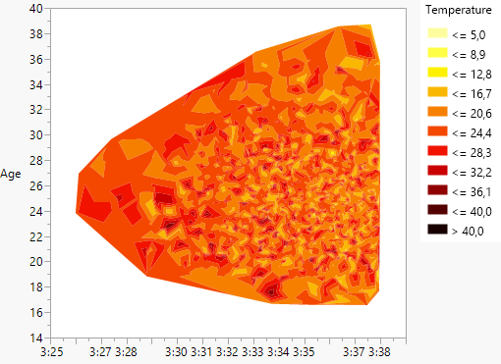
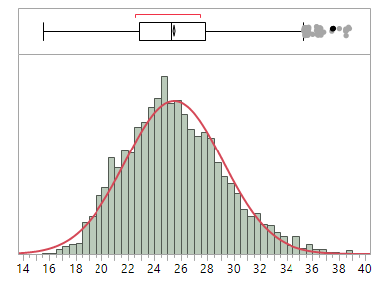
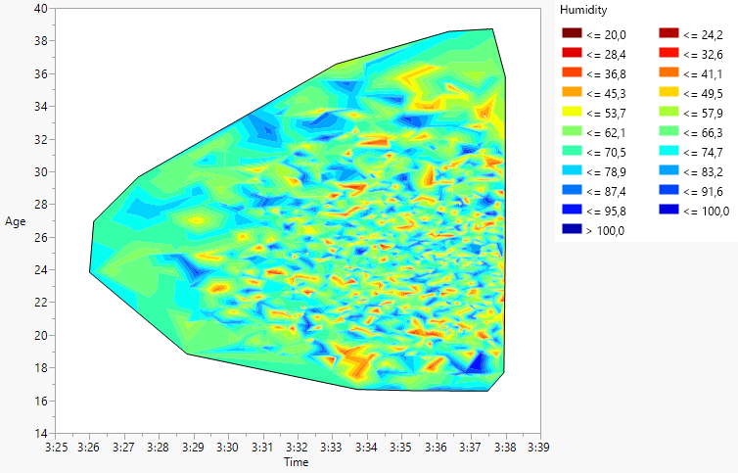
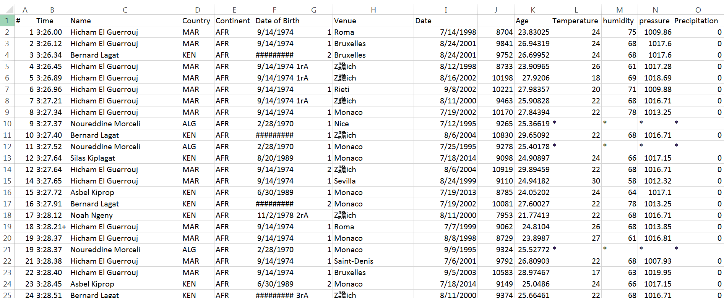
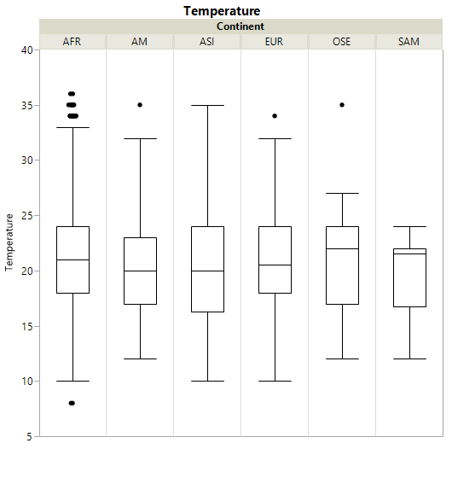
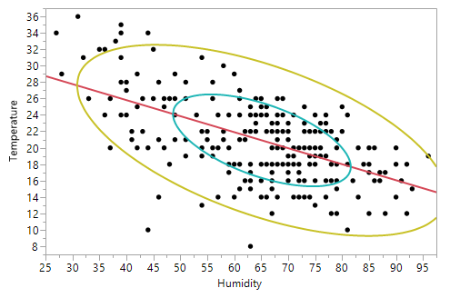
Comparison of Ages and Conditions for Best Performances in 1500m Running
Vegard Oelstad
Oklahoma State University
Abstract
Method
Conclusions
Two constant questions for athletes are when to expect to reach the peak of their careers, and what are the perfect conditions to perform at the absolute max. Track and field has some of the most extensive records for the different events, and weather reports are available from all airports, and are usually close to the venue where the best performances are made. 1500m is also considered one of the toughest events, as it measures the ability for both endurance and sprinting. The records of nationality, date, birthdate, venue, and performance were found from alltime-athletics.com, while records of pressure, humidity, temperature, and precipitation were found from weatherunderground.com. This data was then merged and analyzed using JMP to find trends and descriptive analysis. The results show age being optimal at about 25 years, the temperature 16-25°C (60-75°F), and humidity is 50-80%. There were also few differences between nationalities. From this, we can conclude that many athletes may retire too early. This wide a range also shows that the human body is very good at adapting to a wide array of conditions when being pushed to the limits.
Data was created in excel based on information from weatherunderground and alltime-athletics.com for 1500m races faster than 3:38.00, then imported to JMP 12.
Weather estimates were given from averages for the day of competition.
The data was then analyzed using descriptive statistics and stepwise modelling function in JMP.
Weather data from 1995 and earlier were in not available, and hence omitted in the weather analysis.
The most common age for peak physical performance is 25 years ±3.5 years (1 std).
Ideal weather is 16-25°C, and 50-80%.
There is no significant difference between people from the different continents, hence it could be argued there are not as great differences between people from one continent to another as one may have believed.
As seen in fig 3 (Temperature vs. Humidity plot), top performances can be reached under almost any conditions, even though there is a clear pattern for what is most frequent.
Results
Objective
Most important factors: temperature and humidity. This was found using a stepwise function in JMP 12.
16-26 °Celsius, with 50-80% humidity.
There were no noticeable differences between athletes from different continents.
Approximately 30% chance the athlete is going to be between 24 and 27 years when reaching his peak.
Find most important factors for performance in 1500m running for men.
Give estimates for the factors found in objective 1
Seek out any differences between nationalities.
References
Weatherundergound.com
Alltime-athletics.com
Notes:
All graphs are hyperlinked, and all full page graphs are hyperlinked back to the main poster.

