Slide 1

JMP Starting Statistical Thinking in Business Statistics Courses
Mary Ann Shifflet
Economics and Marketing
University of Southern Indiana

Slide 2
Econ 265: Elementary Statistics
One of the core courses in the business core
Romain College of Business
University of Southern Indiana
  Regional university
  High access
Large volume of non-quantitative, math averse, non-motivated students

Slide 3

Romain College of Business

Slide 4
The Need For Change
High DFW rate
No reinforcement in the curriculum
  Even though it is a pre-req for many classes
Job market requires data analysis skills

Slide 5
The Redesign
A problem solving focus not “here’s the data what do I do with it”.
Minimize formulas
Incorporate technology
Be innovative, not just repackage same old thing
Focus on statistical thinking
Students should see relevance of content
Heavy reliance on case studies

Slide 6
Deciding on Technology
Needed ease of use
Minimal learning curve
  For instructor and students
Easy Access
Good support
Cost considerations

Slide 7
JMP – Technology of Choice
Met all of our criteria
  Easy to use
  Previous experience with JMP
  Easy access/no cost to students
  Great support materials

Slide 8
RCOB Computer lab

Slide 9
JMP and Statistical Thinking
Based on book by Hoerl and Snee
  Statistical Thinking: Improving Business Performance
Statistical Thinking Strategy:
  Existence of variation
  Synergy between data and subject matter
  Complexity of business processes
  Sequential nature of statistical thinking
Use of JMP allows focus to be on THINKING not on calculations

Slide 10
JMP and Statistical Thinking
Demo

Slide 11
JMP and Statistical Thinking

Slide 12
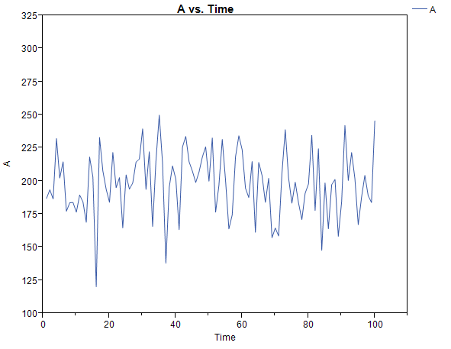
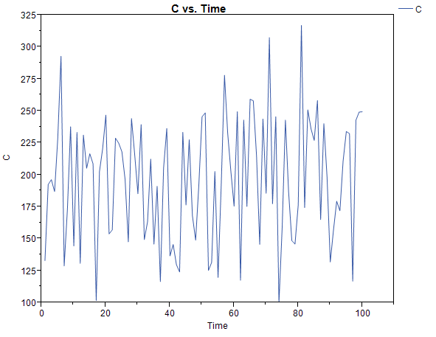
JMP and Statistical Thinking

Slide 13
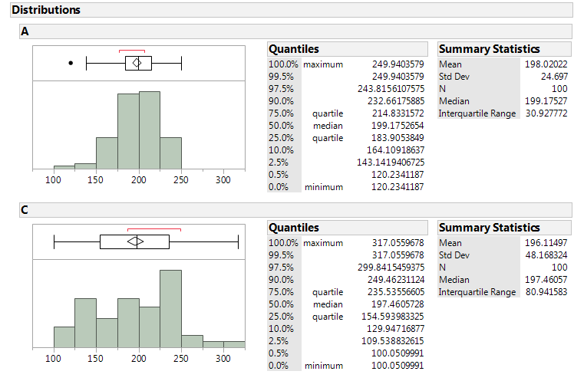
JMP and Statistical Thinking

Slide 14
The Results
Positive feedback from students
Somewhat lower DFW rates
Improvement in assessment results
% Meeting or Exceeding Expectations | n | Concepts | Information | Analytical Operations | Interpretation
Average 2008 - 2010 | 110 | 41 | 11 | 33 | 19
Fall 2013 | 40 | 80 | 50 | 60 | 30

Slide 15
Next Steps
Development of more case studies
Development of more practice exercises
More motivational materials – major specific
Incorporate JMP in other areas of business curriculum

Slide 16
Questions and Discussion

