Slide 1
Query Builder
The New JMP 12 Tool For
Getting Your SQL Data Into JMP
Eric Hill, Software Developer, JMP

Slide 2
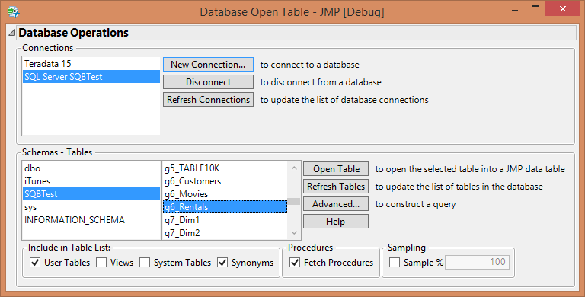
File > Database > Open Table
Limitations
  Mostly one whole table at a time
    Data is normalized
    Joins require writing your own SQL
  Need to filter? Write SQL
  Does not play well with others
    Database passwords saved in cleartext in the connection string
    No recovery from DSN mismatch
  Post-processing often required
    Data cleanup
    Modeling types, formats, spec limits, etc.

Slide 3
Demo

