Slide 1
Using Higher-Level Models to Predict Survival and How They Compare to Weibull Models
Anshuman Singh
John Korsedal
Brad Foulkes
Sep 16, 2015
GE Proprietary Information—Class III (Confidential)

Slide 2
All Rights Reserved. No part of this document may be reproduced, transmitted, stored in a retrieval system nor translated into any human or computer language, in any
form or by any means, electronic, mechanical, magnetic, optical, chemical, manual, or otherwise, without the prior written permission of the General Electric Company.

Slide 3
Contents
JMP Discovery Summit 2015 – San Diego
Introduction to GE Gas Turbine: video
Problem statement: Why more data is good for survival models?
Traditional Weibull models: why add more factors?
Finding factors: how to sort out important ones from the pack?
Complex model: how do you know when it’s a better model?
Model comparison: why take the pain?
Conclusion
**Disclaimer: The model presented here is an example, and does not represent real model. The real implementation of the model may have considerably improved benefits over traditional model.

Slide 4
Gas Turbine Operation – GE’s 9HA Intro
JMP Discovery Summit 2015 – San Diego
Gas Turbine Video
https://www.youtube.com/watch?v=3xWPfkZ1ZjQ
Tip: To navigate between the first level copy and the first level bullet, use the Indent and Outdent button on the Home Ribbon.
Once you are on the second, and third level bullets, you can Tab and Shift-Tab to go back and forth between the bullet levels.

Slide 5
Problem Statement
JMP Discovery Summit 2015 – San Diego
The traditional survival model requires ‘time to failure’ of a part.
In Gas turbines, the failure time of a part can’t always be monitored, which implies:
  Categorical Y (Failure/Suspension)
  Unbalanced data (classifier data provides less info than continuous data)
Failure can be defined as:
  An observed distress on the parts
  An observed distress on the part which can not be repaired
  A distress on the part which caused the machine to shut down.
There are more factors for each failure other than the one indicative of physics of failure. Recognizing these factors with unbalanced data is the challenge!

Slide 6
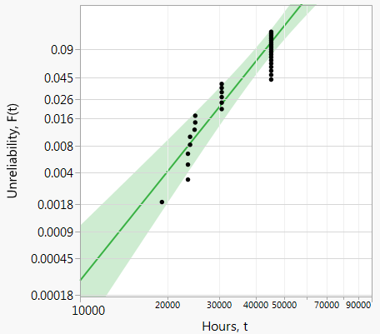
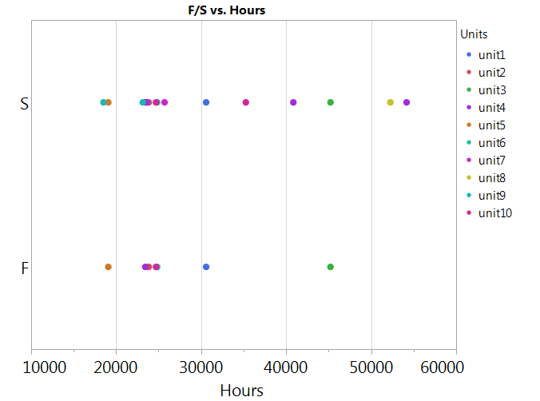
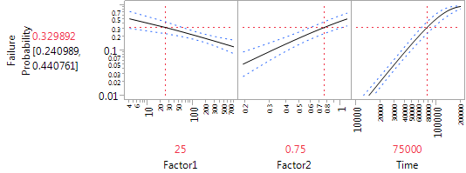
Why add more factors?
JMP Discovery Summit 2015 – San Diego
Example
Survival models are typically built from a single aging parameter
In our example on the right, it is apparent there could be other factors driving the model
By adding more factors (X’s), the uncertainty is reduced which leads to a model that can give a better understanding of the risk of a unit
Additional factors = less model variation and less uncertainty!

Slide 7
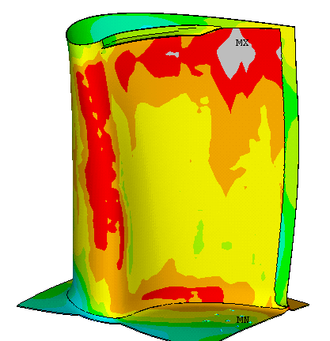
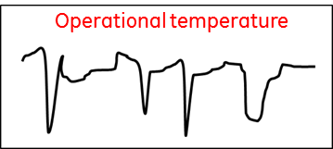
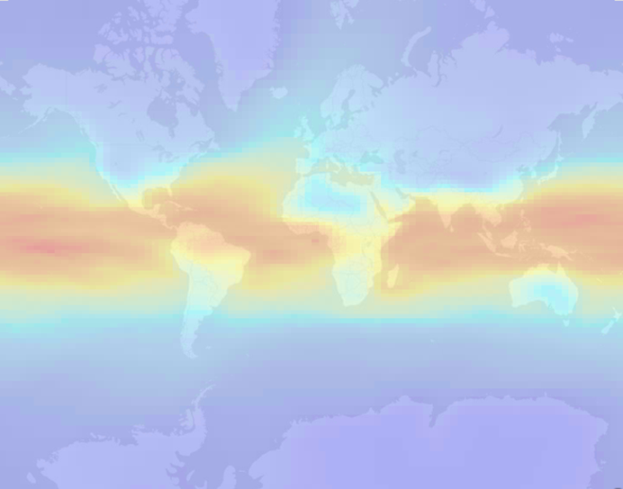
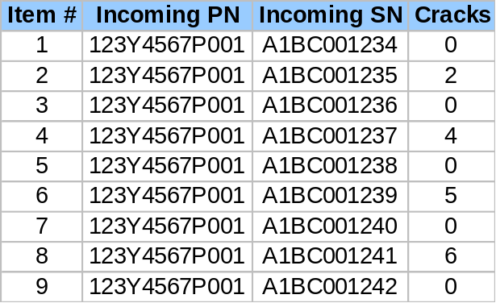
Where to get the data? The X’s
JMP Discovery Summit 2015 – San Diego
Identify the X’s that impact the model or could drive the failure mode
Factors could come from many different places
Operating Conditions
Finite element models
Environmental Conditions
Inspection Data

Slide 8
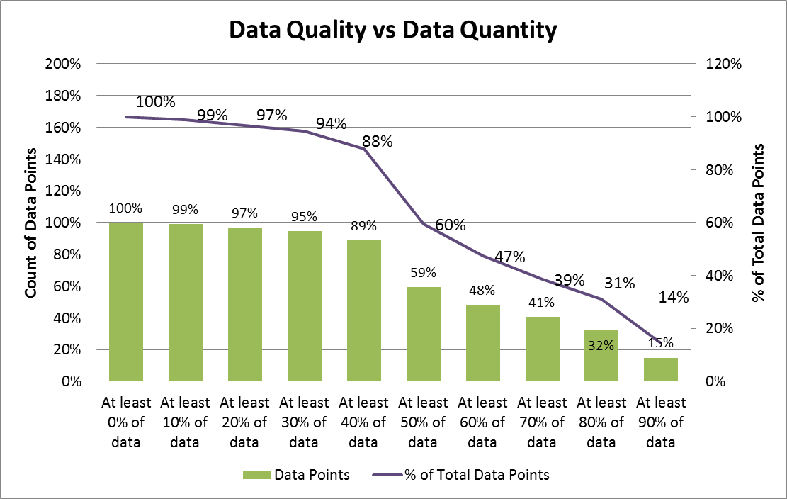
Things to consider with the data
JMP Discovery Summit 2015 – San Diego
How easily can it be gathered?
  Can you get the Xs automatically, or do you have to manually hunt for them?
Is it scalable?
  Doing it for 10 is much different than doing it for 10,000 (database/fleet)
How can it get into a model?
  Average, St. Dev, Percentiles, F(x)’s
How much data needs to be there?
  All the data is rarely available, how much is good enough? Data completeness could be a bottleneck.
These are the costs, to implement a more complex model

Slide 9
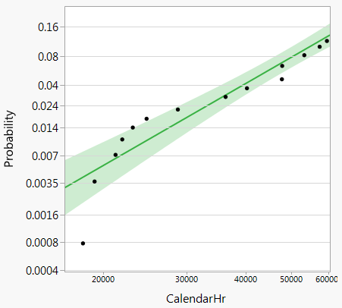
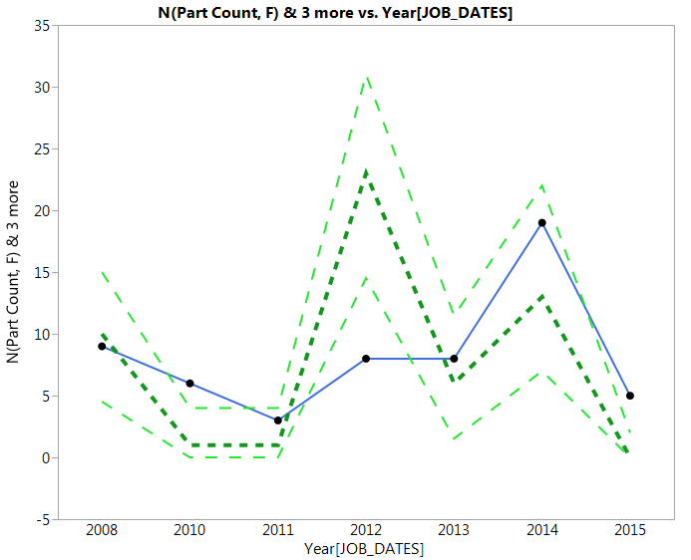
Where we’re starting from
JMP Discovery Summit 2015 – San Diego
A weibull characterizes this as a random failure mode
Back testing… does the model predict the events we saw
95% confidence
Actual Events
Predicted Events
AICc=1625 Confusion matrix gives:
Sensitivity = 43%
Specificity = 65%
 |  | Predicted
Actual |  | F | S
 | F | 25 | 33
 | S | 435 | 795
This model may not be the best at characterizing the failure mode

Slide 10
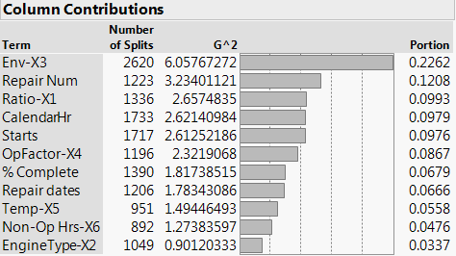

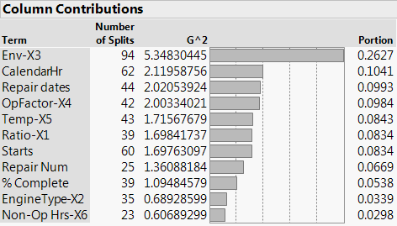
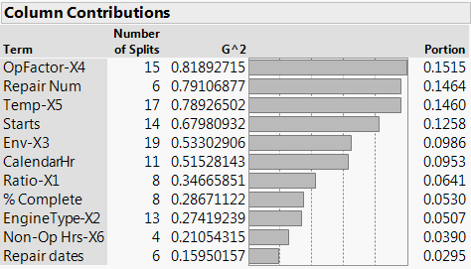
Using Complex models: Hunt for the Xs
JMP Discovery Summit 2015 – San Diego
What about validation subset and/or weighting unbalanced data?
 |  | Predicted
Actual |  | F | S
 | F | 0 | 58
 | S | 0 | 1230
Imbalanced population made the model focus on the majority class
 |  | Predicted
Actual |  | F | S
 | F | 0 | 42
 | S | 0 | 877
All training set
 |  | Predicted
Actual |  | F | S
 | F | 35 | 7
 | S | 474 | 394
With 30% validation set
With 30% validation set and weighting
Are we there yet?

Slide 11
Understanding the X’s
JMP Discovery Summit 2015 – San Diego
What do each of these X’s mean?
The list should be carefully shortened based on: understanding of the data and the physics of failure
Is Starts really a bigger X than CalendarHrs? Can it be the aging parameter?
Is it related to repair shops?
Are these correlated?
What happened on these dates?
X’s obtained from the weighted model, is our “starting point”!

Slide 12
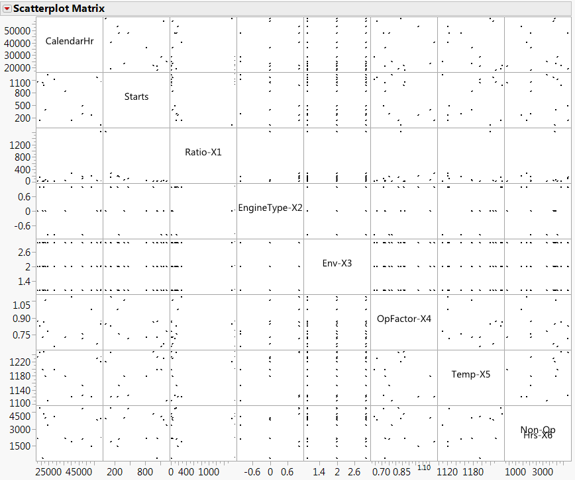
Check correlated X’s: remove duplicity
JMP Discovery Summit 2015 – San Diego
Do you see what I see?
Eliminate the duplicate effects

Slide 13
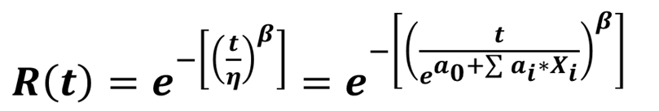

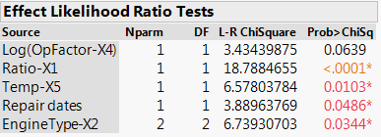
Identifying the X’s inside the model
JMP Discovery Summit 2015 – San Diego
The goal is to include the X’s as part of a survival model
Factors (Vital X)
OpFactor-X4
Repair Dates
Ratio-X1
Engine-Type-X2
Temp-X5
Model Quality
Even though OpFactor-X4 has a little higher than .05 p-value, we will check the model stability without eliminating it.
How does the model compare? Would eliminating OpFactor-X4 change the AICc?

Slide 14
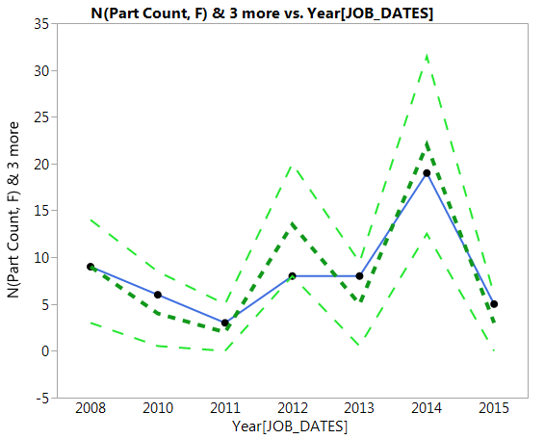
Comparison of the models
JMP Discovery Summit 2015 – San Diego
Traditional Weibull
Parametric survival using RF
AICc=1625
CM |  | Weibull model |  |  | Para. Survival
Actual |  | F | S |  | F | S
 | F | 25 | 33 |  | 28 | 30
 | S | 435 | 795 |  | 432 | 798
AICc=520
Model looks really good with 5 vital-Xs.
Are ALL of these required? Is it too costly to collect all these vital-X’s?

Slide 15
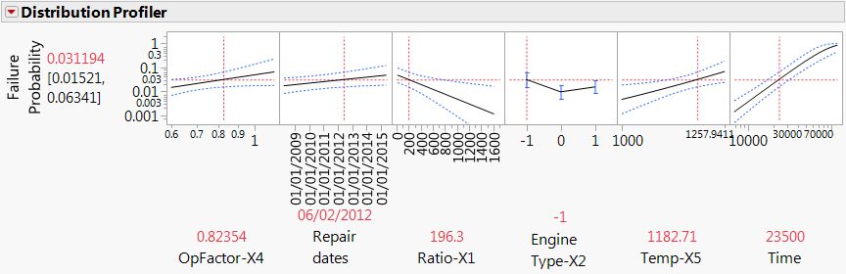
Are significant X’s practical?
JMP Discovery Summit 2015 – San Diego
Distribution Profiler of the model
Careful about your Xs… they may be significant but….
trending in wrong direction
Statistical significance may not mean practical significance

Slide 16
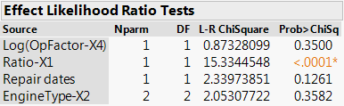
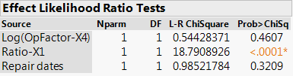


Elimination of Impractical X’s
JMP Discovery Summit 2015 – San Diego
Starting Point, AICc=519
AIC=524
Eliminating Temp-X5 will cause following changes to the model
AIC=522
AIC=521
The overall AICc still didn’t change.
AIC=519

Slide 17
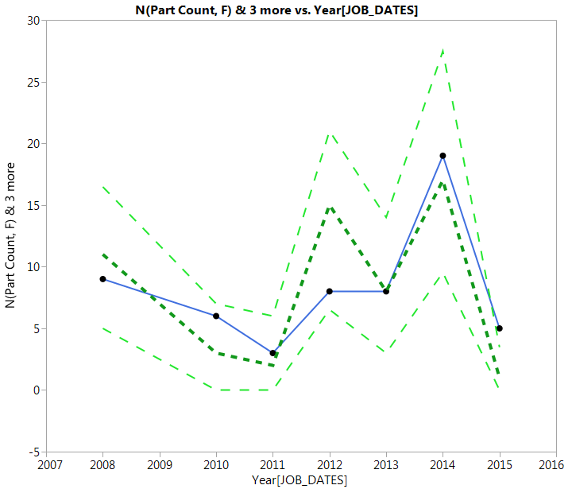
Comparison of the models
JMP Discovery Summit 2015 – San Diego
Traditional Weibull
Parametric survival using RF
AICc=1625
CM |  | Weibull model |  |  | Para. Survival
Actual |  | F | S |  | F | S
 | F | 25 | 33 |  | 33 | 25
 | S | 435 | 795 |  | 519 | 711
AICc=519
Model with carefully scrutinized vital-X’s provides a better and stable mode, is easily scalable, and less costly.

Slide 18
Conclusion
JMP Discovery Summit 2015 – San Diego
In gas turbine application, the frequency of failures and suspensions is not uniform. Hence, more data is better for a good prediction.
Including factors in a survival model can be as simple or complex as you want
    Make sure there is the foundation for data collection
    Processing data and X’s needs to be part of the process
Complex models can be great indicators of important factors, but that shouldn’t be your only tool
    Look out for erroneous correlations
Statistical parameter AICc and physics of failure could be good gauges on settling on a model.
Complex models may fit better, but they should be able to be scaled to the database level to realize their benefit.

Slide 19
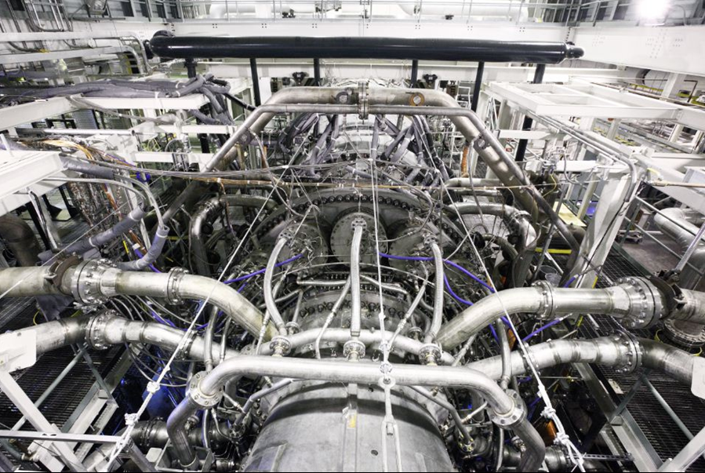
Questions?
Gas Turbine in Test Stand in Greenville, SC

