Slide 1
A Script to Help Write Scripts
Graham Blatz

Slide 2
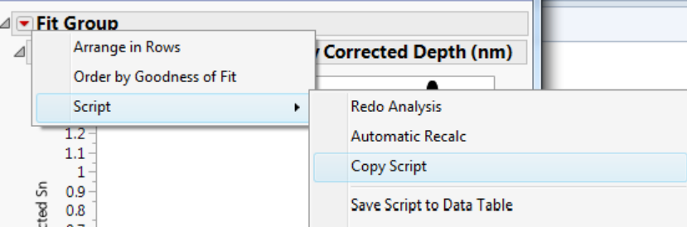
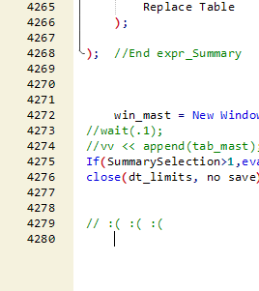
Overview
JMP is very good at providing JSL code for complex objects automatically! Make your bivariate plot as fancy as you want, then copy script.
However, these helpful code pieces can be enormous. Complex scripting and many-layered reports can lead to scripts that are cumbersome to navigate and edit.

Slide 3
Potential Solutions To Managing Long Scripts
Perfect scroll wheel prowess.
JMP 11 introduced code-folding which helped significantly. This still requires a bit of diligence by either editing a file to fold more than the default expressions which can occasionally lead to too much folding.
Modular scripting – the art of having a script execute many scripts using include(). Can still be annoying to navigate around scripts, but is arguably more functionally organized. Pieces can be edited or referenced in more than one script and edited/updated all at once. Special care is needed to manage namespaces to avoid variable collision.
Comment bookmarking, like a table of contents.
Split Screen Scripting
????????????????????

Slide 4
Inspiration
Wanted an interface that allows easier navigation of long scripts.
  Like Bookmarks
  Without disjointed, broken apart scripts. Some scripts are long without any logical way to be modular.
Began tinkering with how to get JMP to identify ‘markers’ in JSL code to break it into discernable chunks of code.
  Comments became the obvious choice, due to their lack of interaction with script execution
  Load Text File(script_path) would import a character string version of the code
  Regex() could then be used upon the long (very long) string systematically to start breaking off chunks by looking for a particular matching scheme, since comments were imported into the string.
  These Regexed pieces of code could then have something useful done to them, organized in some sort of custom windowed object that displays the pieces of a code in an easily navigable format.

Slide 5
How It Works (Regex)
Upon importing of the text file version of the script, Regex() looks for a specific kind of comment. I picked something picky and unusual that mostly stands out.
Regex( txt, "@@@@Title\((.*?)\)", "\1" )
  This looks for a comment that looks something like this:
  //@@@@Title(name_of_bookmark)
    The part that is allowed to change to be whatever is the name_of_bookmark.
  The end of the chunk is signified by:
  //@@@@END
A for-loop iterates through all of the text between these markers and holds onto, one at a time, the name of the bookmark and the code between the comment markers

Slide 6
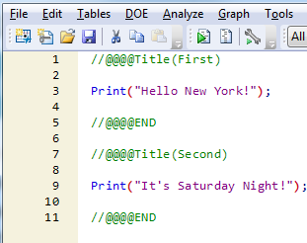
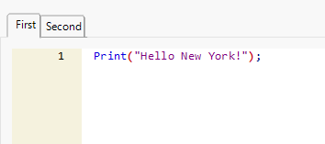
How it Works (Display Object)
TabBoxes are a personal favorite method of concisely displaying reports and other display objects. Clicking between them is easy, you can give the tabs titles, which makes a good amount of sense for bookmarking a script.
The previously mentioned for-loop sets up a TabBox() in a New Window() with the title of the box being the extracted bookmark name, using Regex(), and use a ScriptBox() object to paste the in-between code
Notice the lack of the comment indicators in the tabboxed code. Regular comments would still appear.

Slide 7
Technical Challenges
It was fairly straightforward to set up a script that pick file()’d a properly-formatted script and applied this simple for-loop, but a vast number of impractical challenges arose almost immediately.
  Running the script was…hard. The script is in a bunch of different script boxes, and running any one of them only ran that particular tab, which was less than useful.
  Saving the code was, similarly, not simple. I could copy-paste each tab one at a time which wasn’t an option. I needed a way to do this without a ton of effort.
  Running a script to open a script isn’t too awful but it felt more cumbersome than I liked. You could call this a quality of life problem.
The solutions to all of the above were developed using some ingenuity coupled with:
  Button Box()s
  Show Properties() //bless you, show properties(), bless you

Slide 8
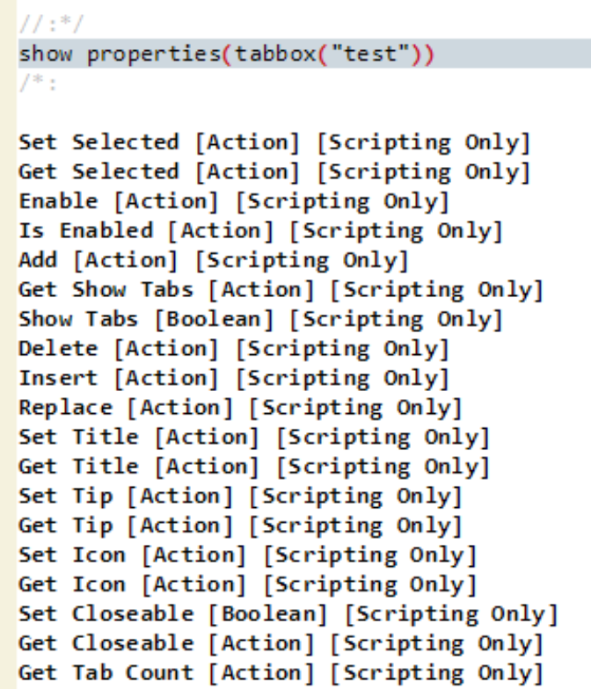
Running The Formatted Script
Solving the “Run” problem wasn’t unreasonably tricky.
  Show Properties around a pre-generated tabbox() proved an enlightening experience. The Scripting Guide .pdf is great, but you don’t really know an object until you’ve show properties()’d it.
  It can be scary at first! Your log fills up with a million unfamiliar commands and actions. JMP 12 is good at having ToolTips for most of these.
  <<Get Tab Count returned the number of tabs, and I could for-loop through the indexed tabs and extract the text from the Script Box() in each one using << get text.
  Finding the display tree location of the script box ended up being in the form: tab_reference[i][1], meaning the first display object in the ith tab.
  Each script box’s contents were concatenated as a string, separated by a return (“\!n”), parsed, and then evaluated. Eval(parse(concated_string));
  Voila! This was simply embedded in button box.

Slide 9
Saving the Formatted Script
Saving piggy-backed on the solved Run All problem. I now knew I could collect my script together, but a few wrinkles needed ironed out.
Pick File() is a good function, but it doesn’t act like a save function by default. You point, it returns a path of what you pointed at, but pick file has some fantastically flexible arguments that allow you to not only mimic the process of saving (picking a file name), but defaults what kind of file you’d like to save. My general form of this looks like:
  save_start = pick file("","",{"JMP Files|jsl"},1,1);
    I’ll let the curious reader figure out what each one actually does. ☺
Unfortunately, this always defaults to a Save As feature, meaning you have to do a replace confirmation each time.
With a path and collected script, the final thing needed was to re-add the bookmark comments, //@@@@Title() and //@@@@END to the beginning and end of each chunk. <<Get Title(i) on the tab box helped, followed by a few additional string concat()s.
The active user must be diligent to hit the created “Save” button as opposed to the provided disk button, but this should be mostly intuitive based on placement.

Slide 10
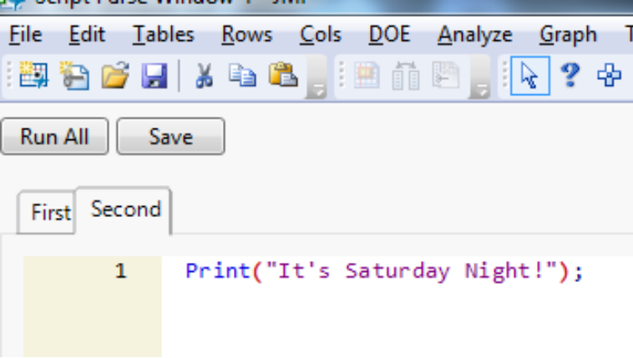
End Result
The two buttons are fairly unobtrusive, and I don’t find myself mis-clicking too many things. Ctrl+R still works for highlighted text just fine, and the new save button being near the main save button helps prevent clicking the wrong one.

Slide 11
Quality of Life Luxury Bonus Features
Having to open a script to open another script is somewhat tedious, but I was aware of an auto-run feature. Beginning a script with “//!” will cause a script to auto-execute upon opening.
Loose ideas included having a “body expression” part of the script, and somehow have a suffix function execute upon this expression to populate the tabs, but expr() ignores comments when transformed into characters, which wasn’t useful.
JSL Quote(), however, does include comments, which proved the linchpin to my puzzle. A reference to the body could then be parsed by some suffix for-loop and auto-generate my tabbed notation.
A few problems remained. My previous save function would only re-save the content in the tabs. It needed to be add in the “//!”, the JSL Quote() bit, and concatenate on the end a self-referential executable expression (the save function would need to save itself to its own file).
I encourage the curious reader to attempt to figure out the code behind this. It’s not too tricky; just an ugly set of concatenations.

Slide 12
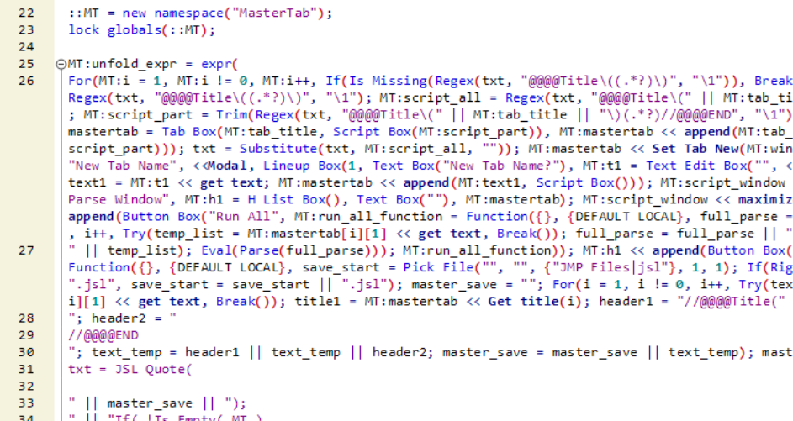
Quality of Life Features
This pre-packaged, auto-opening form eliminated a good bit of inconvenience. The code’s final bit ends up looking a little messy due to some formatting oddness, (To open an auto-open script, right click the script in your recent files and “Edit Script”), but the body of the script should be pretty clean if you want to add more tabs.
“Format Script” is also your friend.
☹

Slide 13
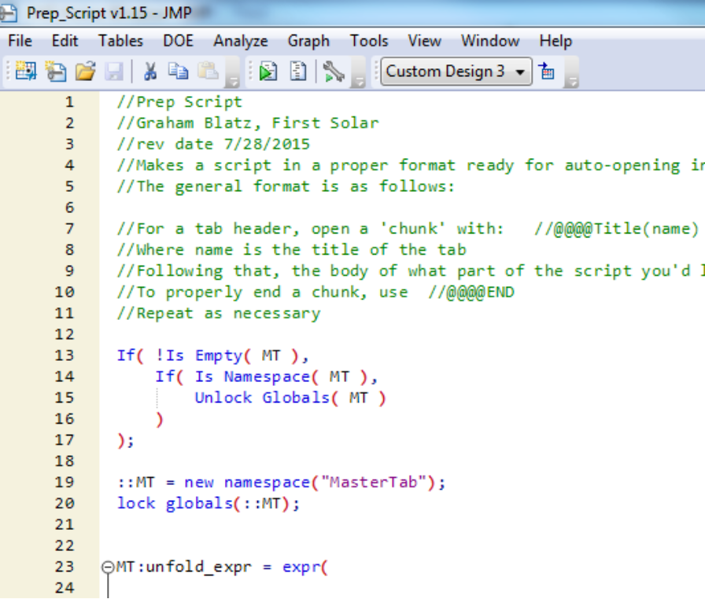
Quality of Life Features
The end result is a script you apply to a properly formatted (with all the bookmarks) script once and it should be able to take care of itself from that point forward, unless you severely mess with some locked variables.
Namespaces were also helpful for making sure clear globals() and other pesky commands that might show up in a script wouldn’t mess with the careful window and tab references.

Slide 14
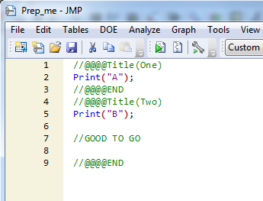


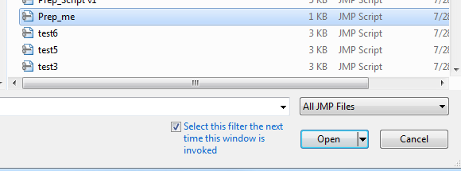
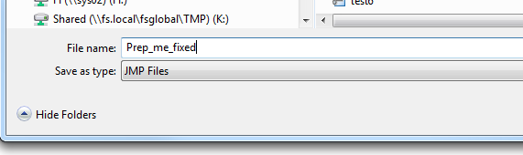
How to Prepare a Script For Easier Scripting using a Script
Have a script bookmarked and formatted properly.
Run the Prep_Script.jsl. It will prompt you to point at the script you want to format, then ask you to save it as something (same name is fine, but I advise a new name)

Slide 15
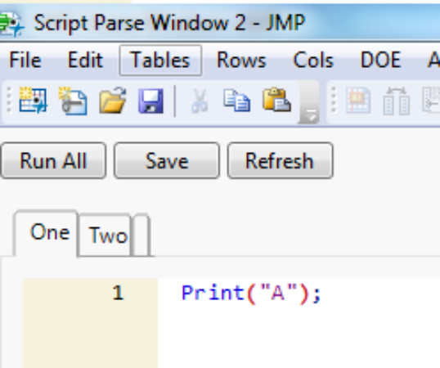
Woo!
Now it should be good to go!
  Try opening it!
  Try saving!
  Try making changes!

Slide 16
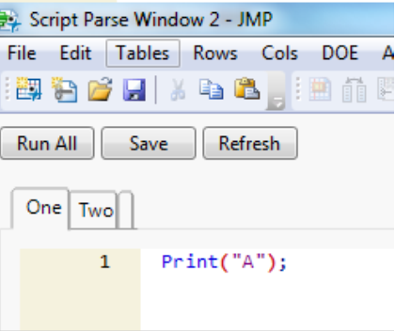
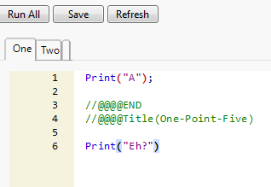
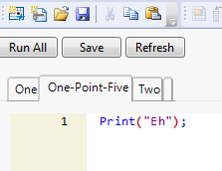
More Bonus Features
Adding a new tab is easy! Click that little box to the right of the tabs. Show Properties() told me about the nifty << Set Tab New command.
The “Refresh” button allows you to add new tabs in the middle of things by typing them into the Script Box().
  Consider the Tabs acting like the //@@@@Title() header, and the //@@@@END is invisible and implied.
  Try something like the this ->

Slide 17
Future Desired Features
The namespaces do a slight collision dance if more than one is open. Fortunately the unfold_expr is standard and has nothing to do with what’s in the JSL QUOTE(), but from a programming perspective, it’s probably a little sloppy.
  As a side note, it’s perfectly safe to have multiple instances of formatted scripts open. Originally, there was an obvious collision in the tabbox references, but JMP has, since 11, included a window namespace that allows references to stay preserved inside New Window()s, so duplicate names aren’t an issue. For whatever reason, however, the window namespace does not play nice inside a function(), so I used, perhaps, an abundance of explicitly-called MT:scoped variables.
Include() is tricky when used against “tab-formatted” scripts. The script will unfold itself before execution. Options here include simply making the include()ed script not be in this format, or being clever with a eval(parse(regex(load text file() ) ) ) kind of thing.
The “Refresh” function is buggy and I don’t know how to fix it. It’s as if the script doesn’t realize my window has closed and renames the refreshed script with a bothersome “2” at the end of the name.

Slide 18
Late Game Challenges
Strangely, one of the most difficult challenges I’ve experienced in writing this script was getting the tabbed-script window to have a name equivalent to the opened script. I’m probably missing something obvious but it not straightforward to have a script know its own name in a vacuum. That is, without some string set ahead of time that explicitly calls it out.
This would be fairly straightforward if only one formatted script was open at a time, but having two open at a time isn’t a luxury, it’s a necessity. The solution that ended up working is mildly embarrassing because I’m sure there’s a better way.
It involves creating a button inside the held window namespace that << clicks on itself to set a few important references inside the “window” namespace. Since you can’t actually access or use the window namespace outside the window, making a reference to the window itself requires code to execute after the window has been created: a paradox.
But making a useful button inside that window, then clicking it with scripting and deleting it is absolutely effective for this purpose.

