Slide 1
Unlocking the Power of Graph Builder
Xan Gregg, JMP
@xangregg

Slide 2
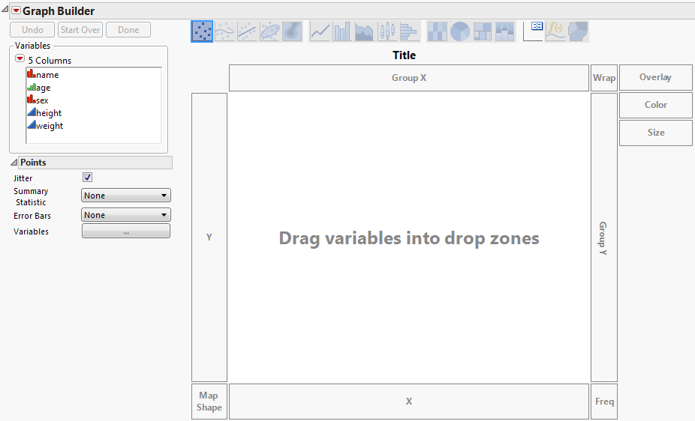
Graph Builder
The Blank Slate

Slide 3
Graph Builder
Data Table Column Selector

Slide 4
Graph Builder
Drop Zones for Variables

Slide 5
Graph Builder
Drop Zones for Variables

Slide 6
Graph Builder
Graph Elements

Slide 7
Graph Builder
Element Properties

Slide 8
Graph Builder
Legend

Slide 9
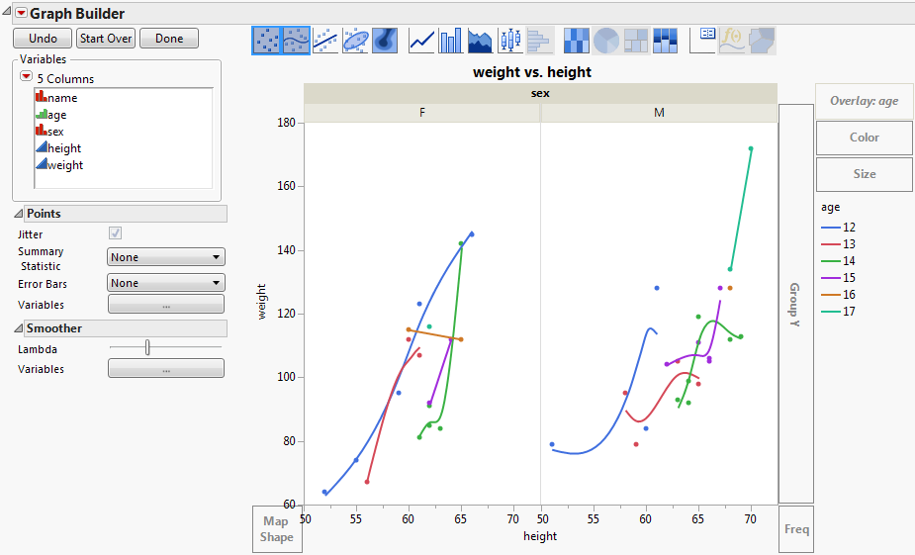
Graph Builder
Example Graph

Slide 10
Graph Builder
Four Variables

Slide 11
Graph Builder
Two Elements

Slide 12
Graph Builder
New Drop Zones

Slide 13

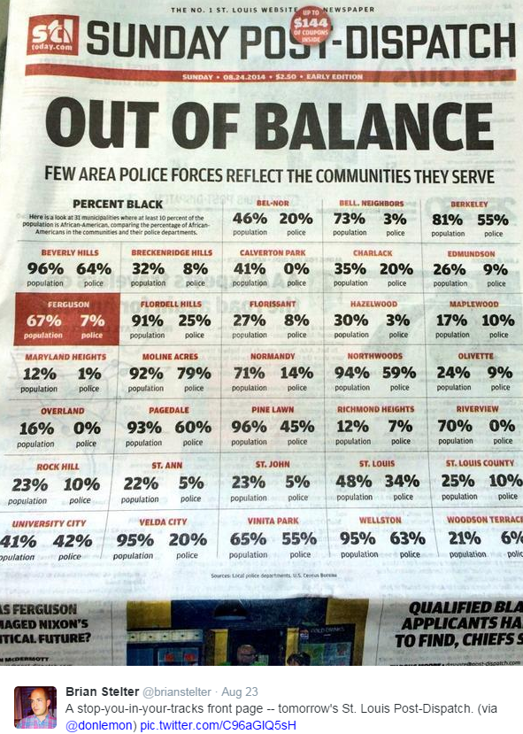
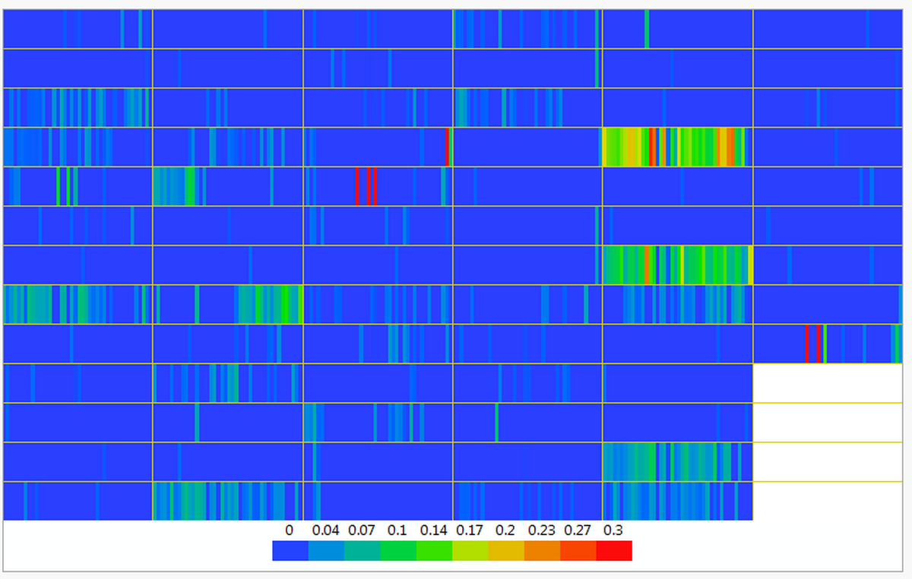
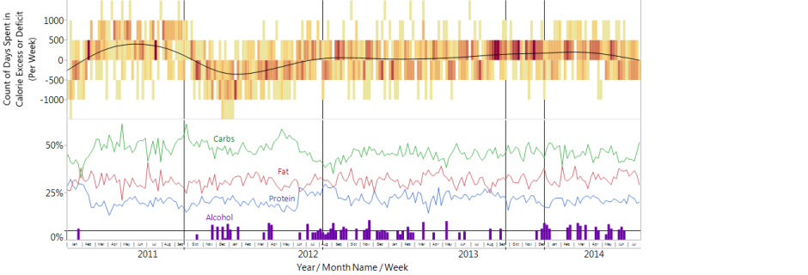
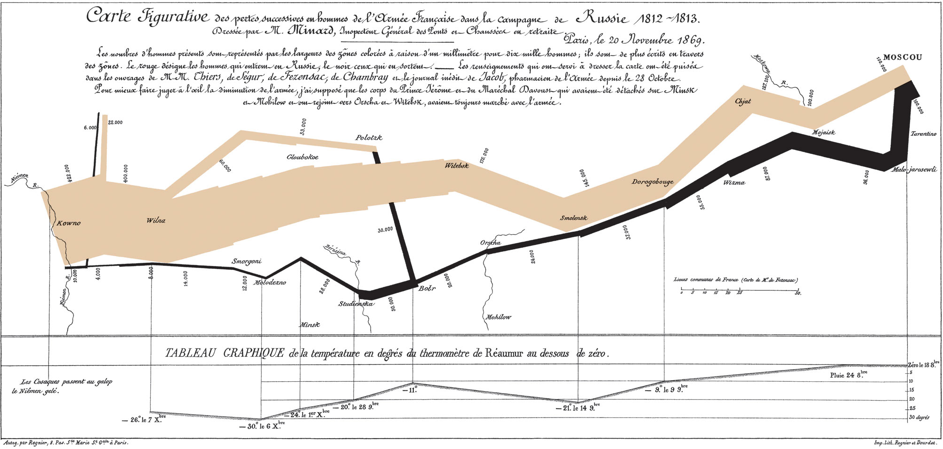
Graph Builder
DEMO

