Slide 1

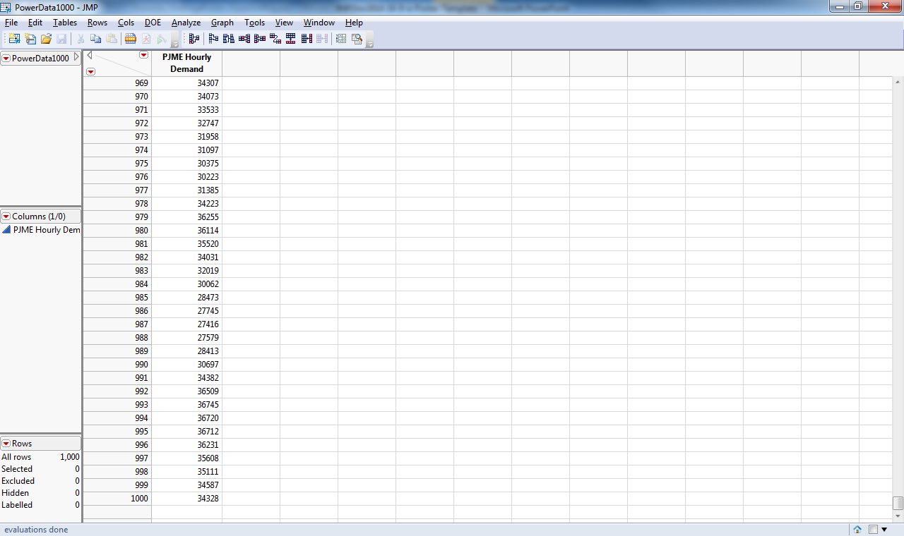
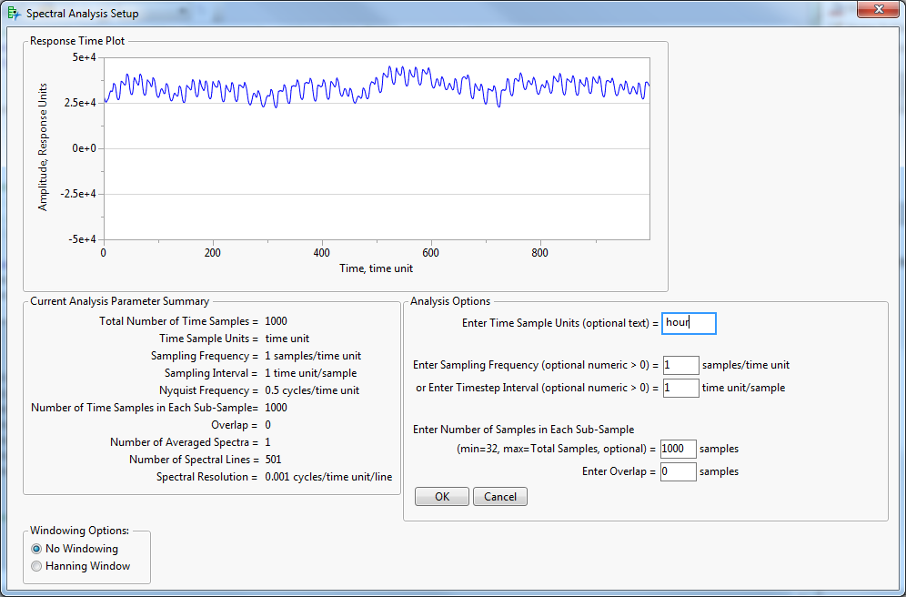
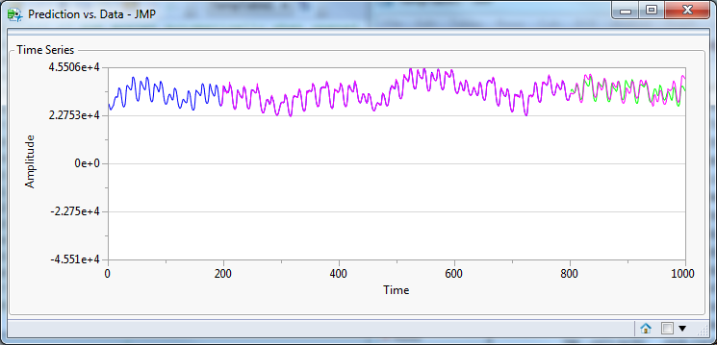
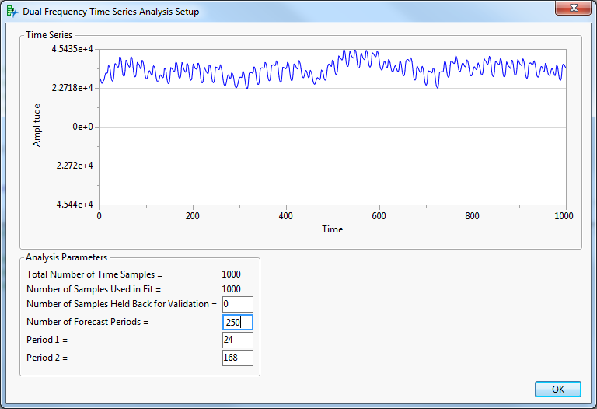

Using JMP’s Time Series Analysis Platform on Data Containing Multiple Periodic Signals
Gerald L Fish, Experistats LLC
Abstract
Time series which contain multiple periodic components present problems with the JMP Time Series Analysis Platform.
Working in conjunction with a separate Frequency Analysis Script, a new Dual Frequency Script has been developed to ease the analyst’s burden and reduce modeling time.
The new script is demonstrated on hourly power demand data.
Dual Frequency Time Series Script – In Action
Run Dual Seasonality Script with Holdback
ReRun Dual Seasonality Script for Forecast
Prepare
Input Data
Identify Frequencies
About The Author and Experistats LLC
Jerry Fish is President of Experistats LLC, a training and consulting company dedicated to improving client processes and products through proven Lean Six Sigma techniques and customized software.
Phone: 859-433-6231. Email experistats@gmail.com

Slide 2
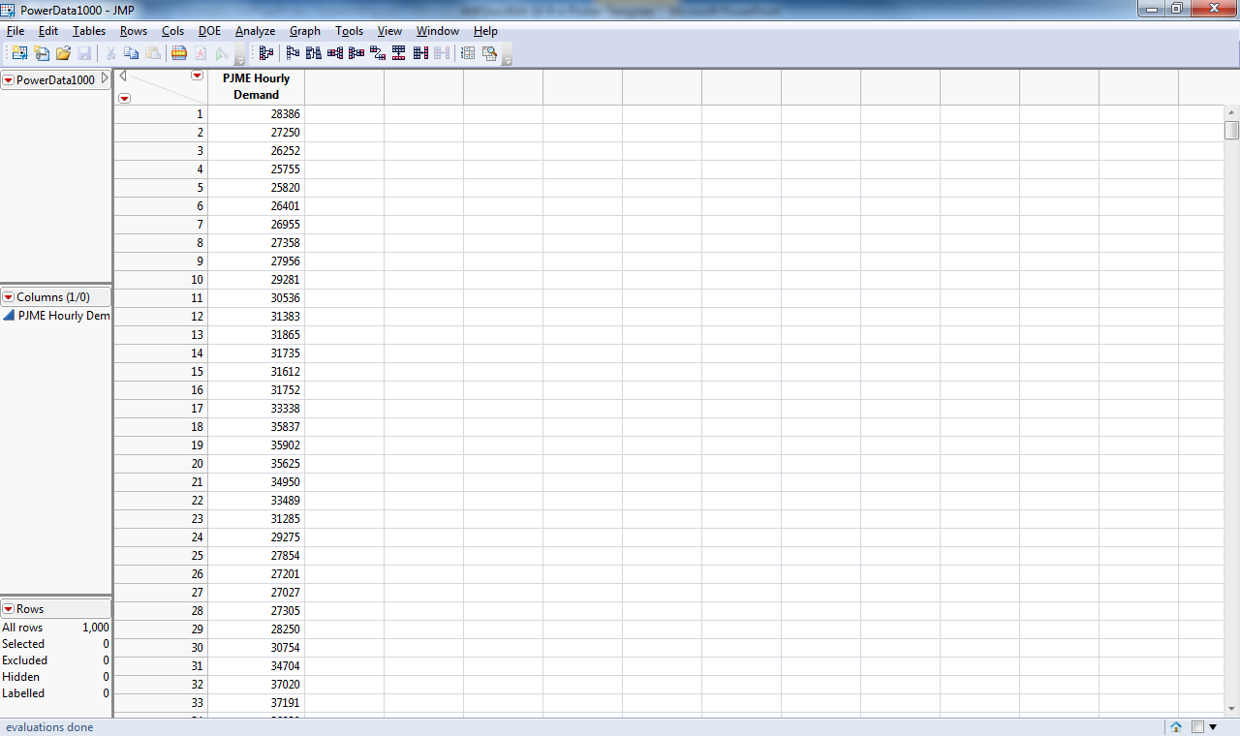
Prepare Input Data
Hourly load data from PJME Website
  Pennsylvania/New Jersey/Maryland East
  First 1000 hrs of 2013
  www.pjm.com/markets-and-operations/energy/real-time/loadhryr.aspx
Return

Slide 3
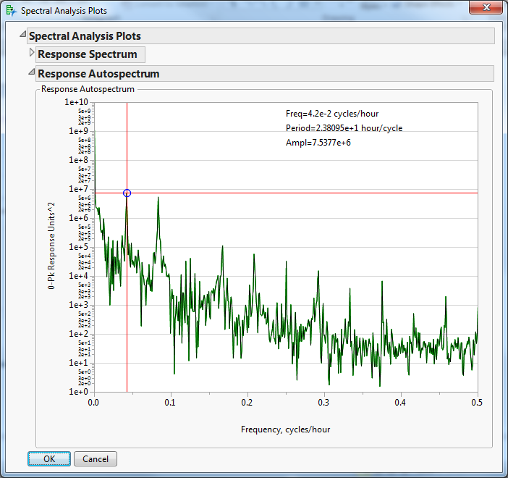
Identify Frequencies of Interest
Time Signal
Frequency Spectrum
Period1 = 24 hrs
Period2 = 168 hrs
Frequency Analysis Script by Experistats LLC
(see JMP paper at 2014 JMP Discovery Summit)
Return

Slide 4
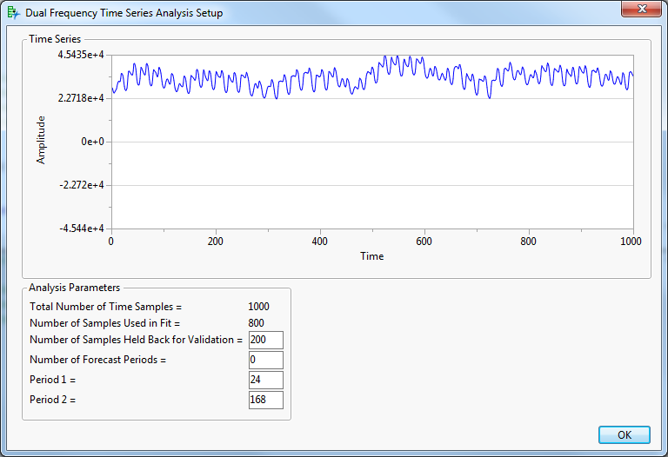
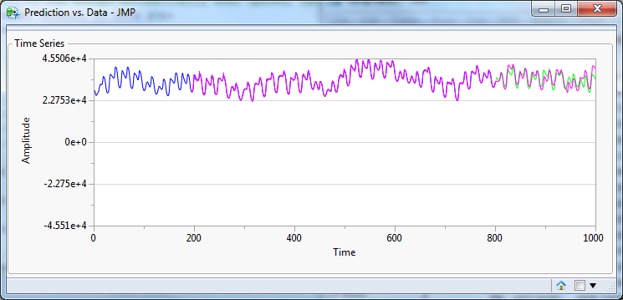
Run JMP Script for Dual Frequency Time Series Analysis
Blue = Original Data
Pink = Fitted Model
Green = Holdback Data
Holdback 200 points to ensure good fit
Input periods of interest (24 & 168 hrs)
Fit appears good
Return

Slide 5
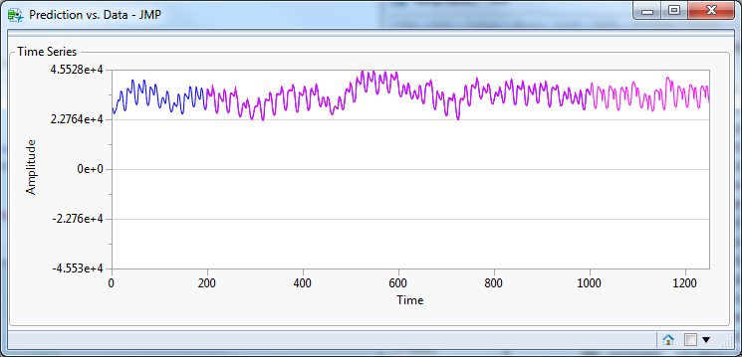
Using JMP’s Time Series Analysis Platform on Data Containing Multiple Periodic Signals
Gerald L Fish
Experistats LLC
Blue = Original Data
Pink = Fitted Model
No Holdback
Forecast 250 hrs beyond end of 1000 points
Input periods of interest (24 & 168 hrs)
Return

