Slide 1


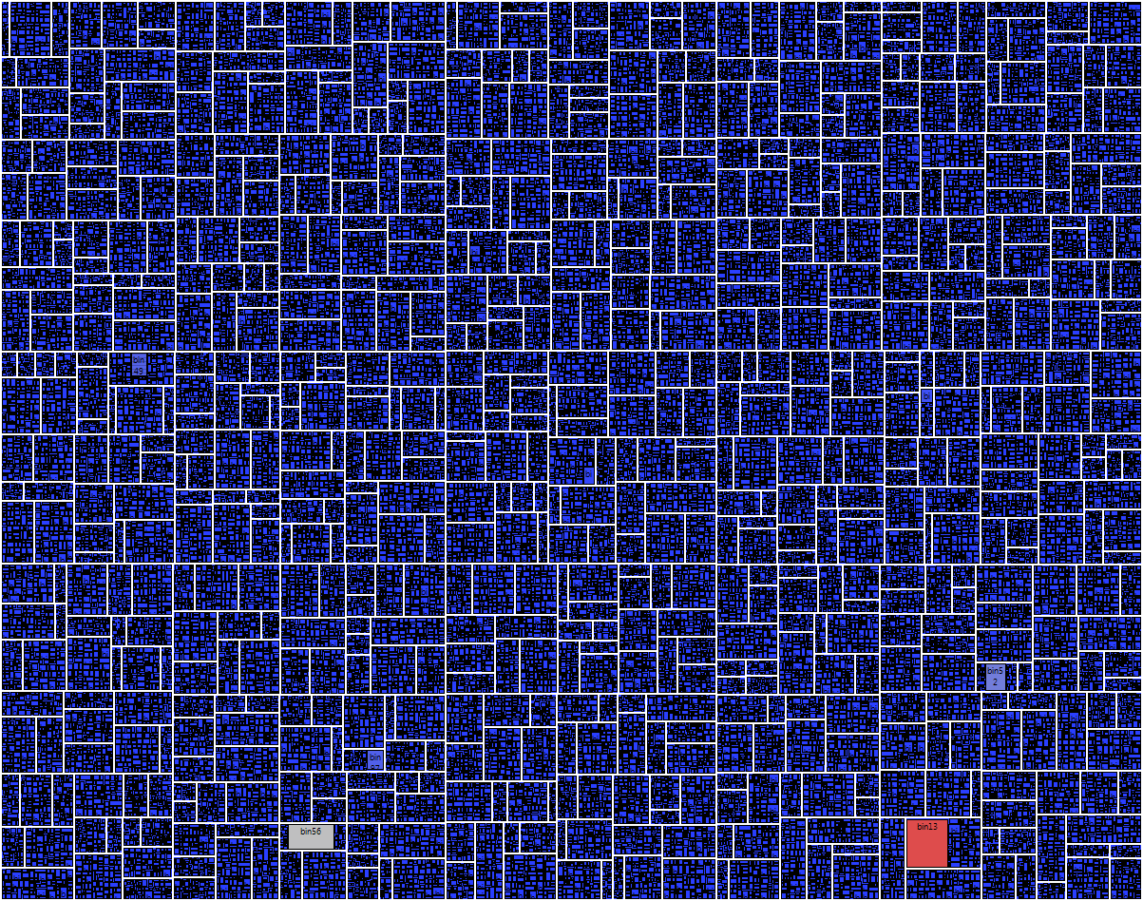
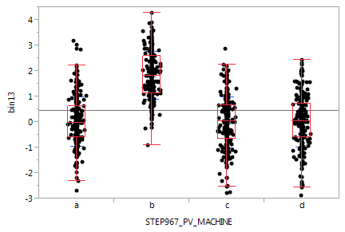

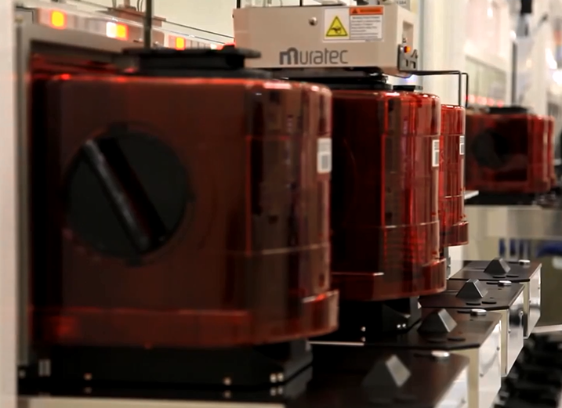
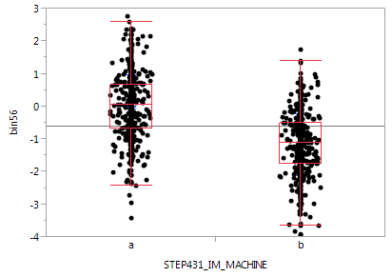
BigYield… an interactive yield dashboard
Landon S Jensen, Principal Engineer
IM Flash Technologies, LLC
Motivation
Method
Implementation
IM Flash produces tens of thousands of NAND flash memory wafers per week
  Each wafer visits hundreds of processing steps
  Each process step is supported by a set of tools
  Each wafer is tested for quality and performance
Quickly sourcing yield issues to tool/step is critical to operational and business success
JMP11 introduced the Response Screening platform, for large-scale analysis. Important features include:
  Fast multi-core parallel processing
  Robust methods to help deal with messy/missing data
  False Discovery Rate adjustments for multiple testing
JSL scripting for automated pipeline and value-added customization
  Query test and manufacturing history data from database (1 week of simulated data is used for demonstration, 1000 lots and 1000 process steps)
  User Dialog to select inputs/options
  Response Screening results pushed to TreeMap with added local data filter and column switcher interactions
  One-click drill-down implemented through column formulas
    Selected( Row State( Row() ) )
Add-in solution automatically delivered to end-users
Visualization/Interaction
TreeMap (space-constrained visualization of hierarchies)
  sub-units within tools, tools within steps, steps within functional areas
Interactive dashboard features to filters and switch size/color
One-click drilldown to detailed plots
References
IM Flash - A Behind the Scenes Look: How We Make Our Product
JMP® 11 Specialized Models
JMP® 11 Scripting Guide, Second Edition

Slide 2
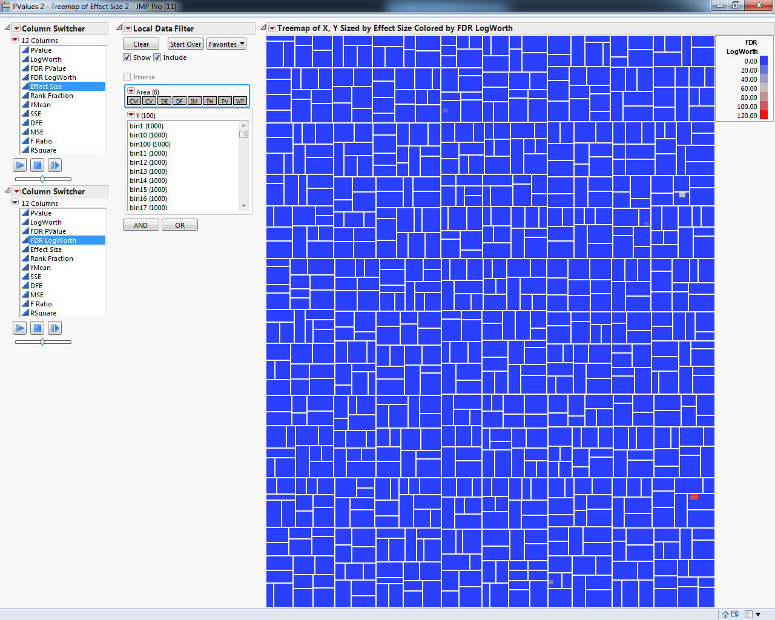
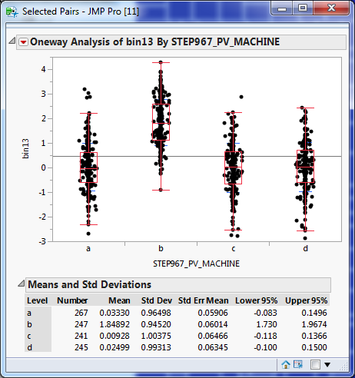

Slide 3
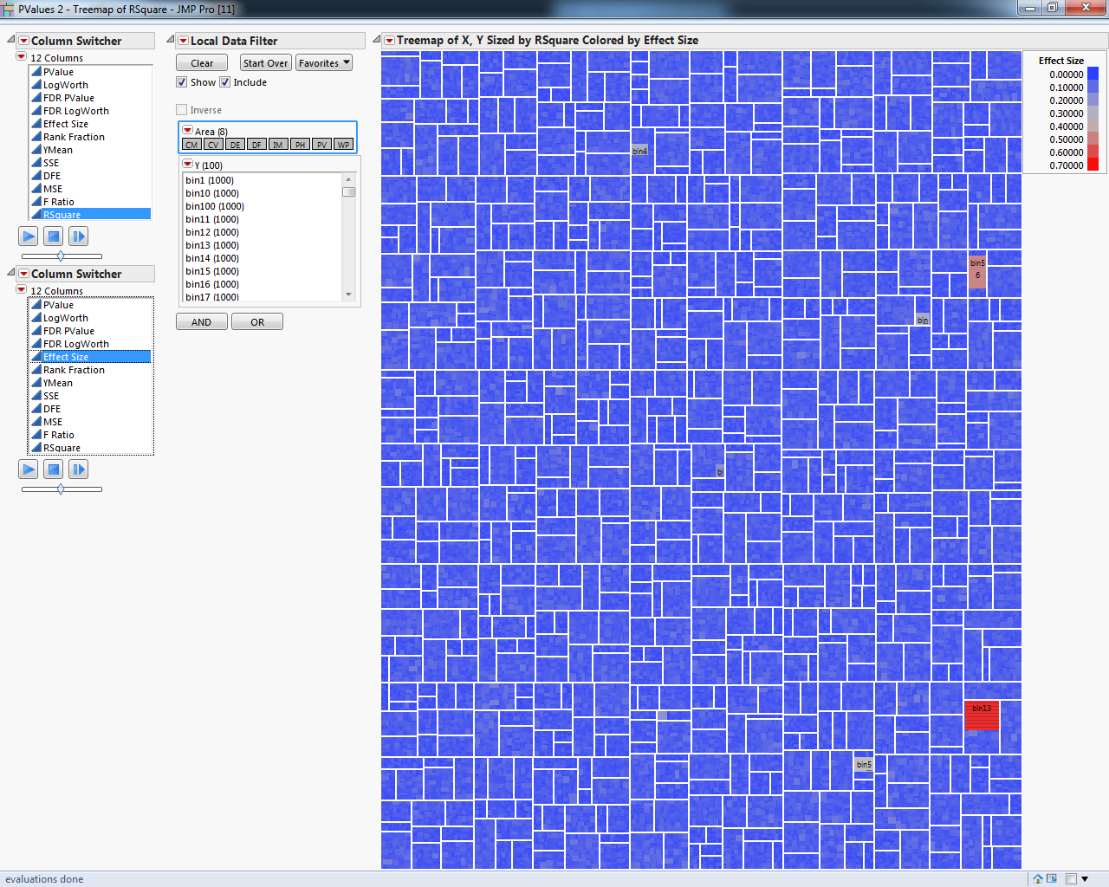
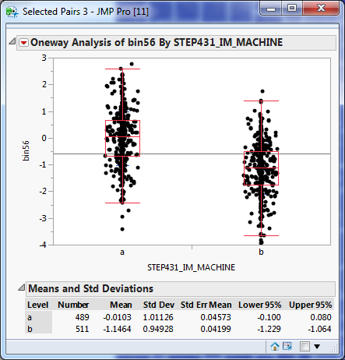

Slide 4
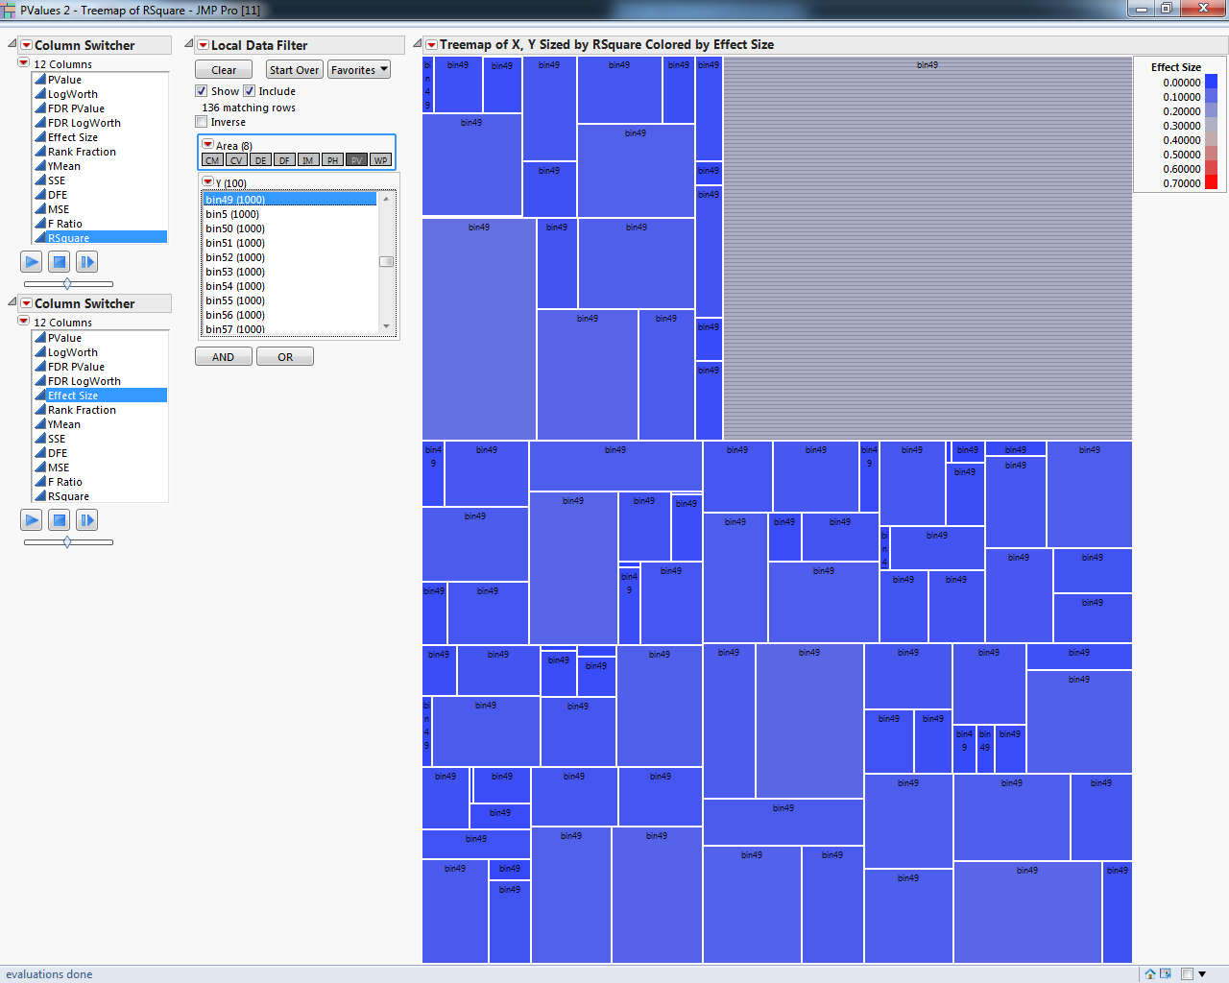
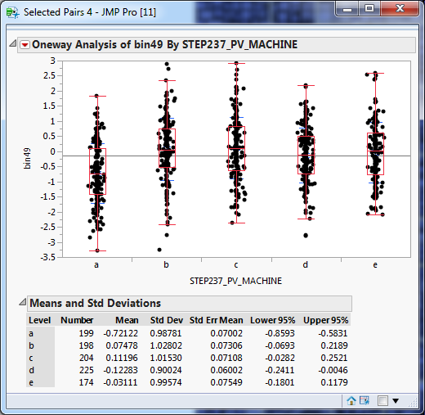

Slide 5

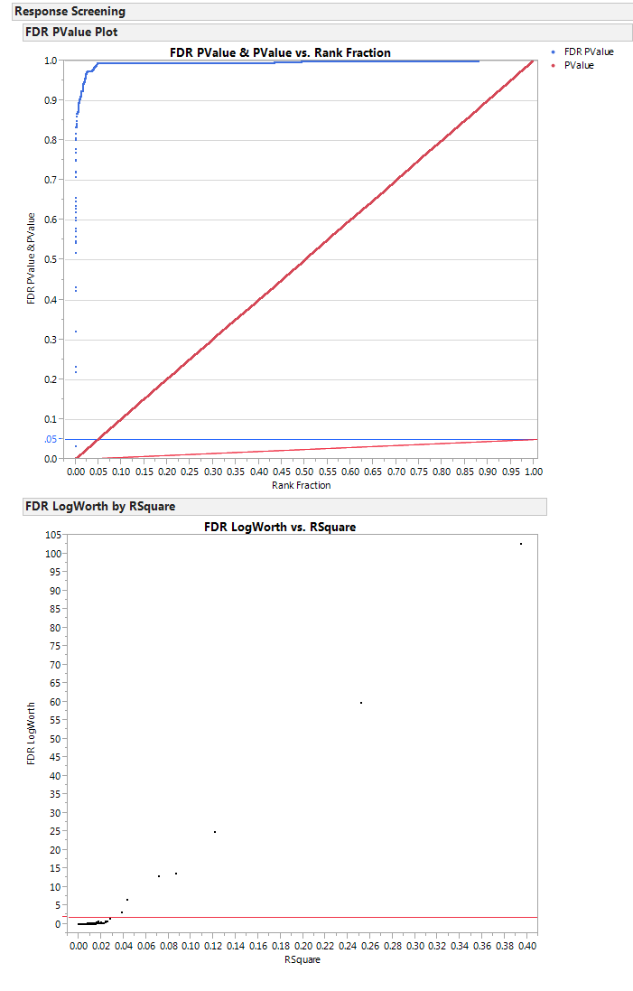
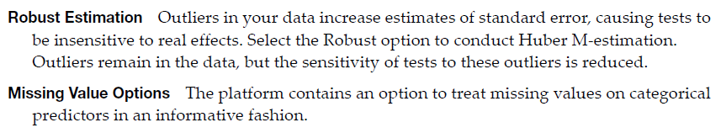
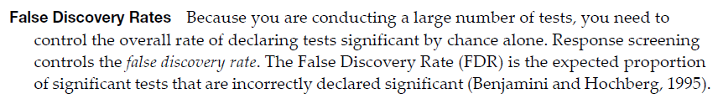
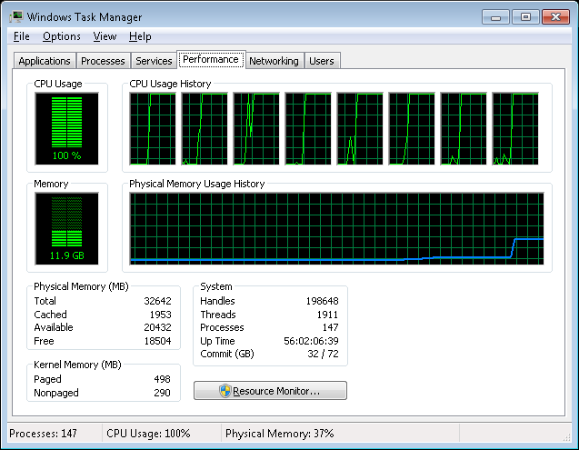
Response Screening (features)

Slide 6
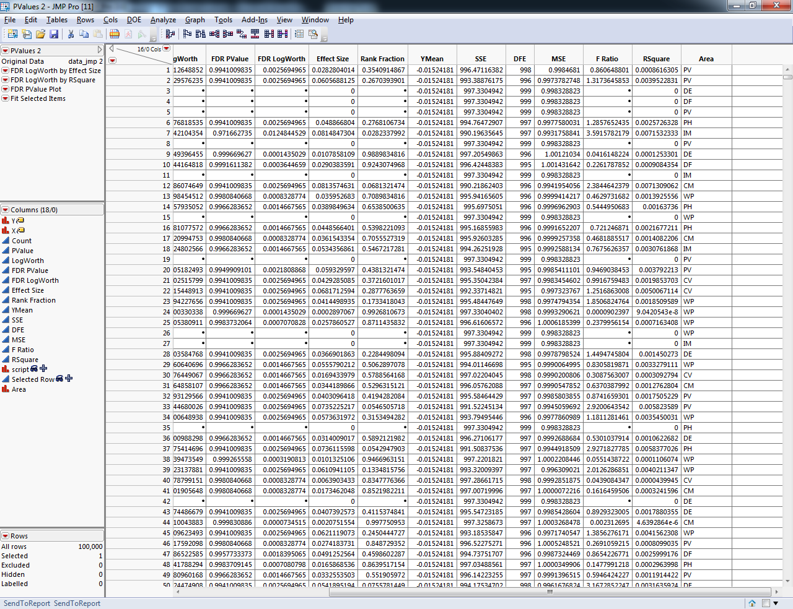
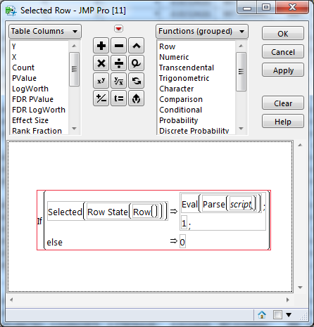
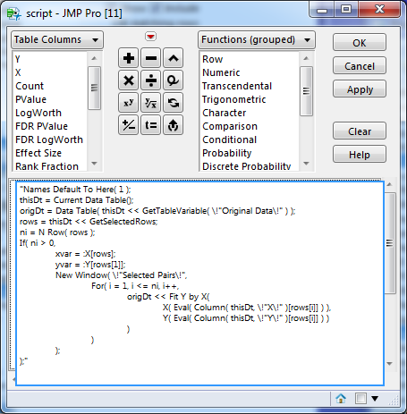
JSL Details

