Slide 1


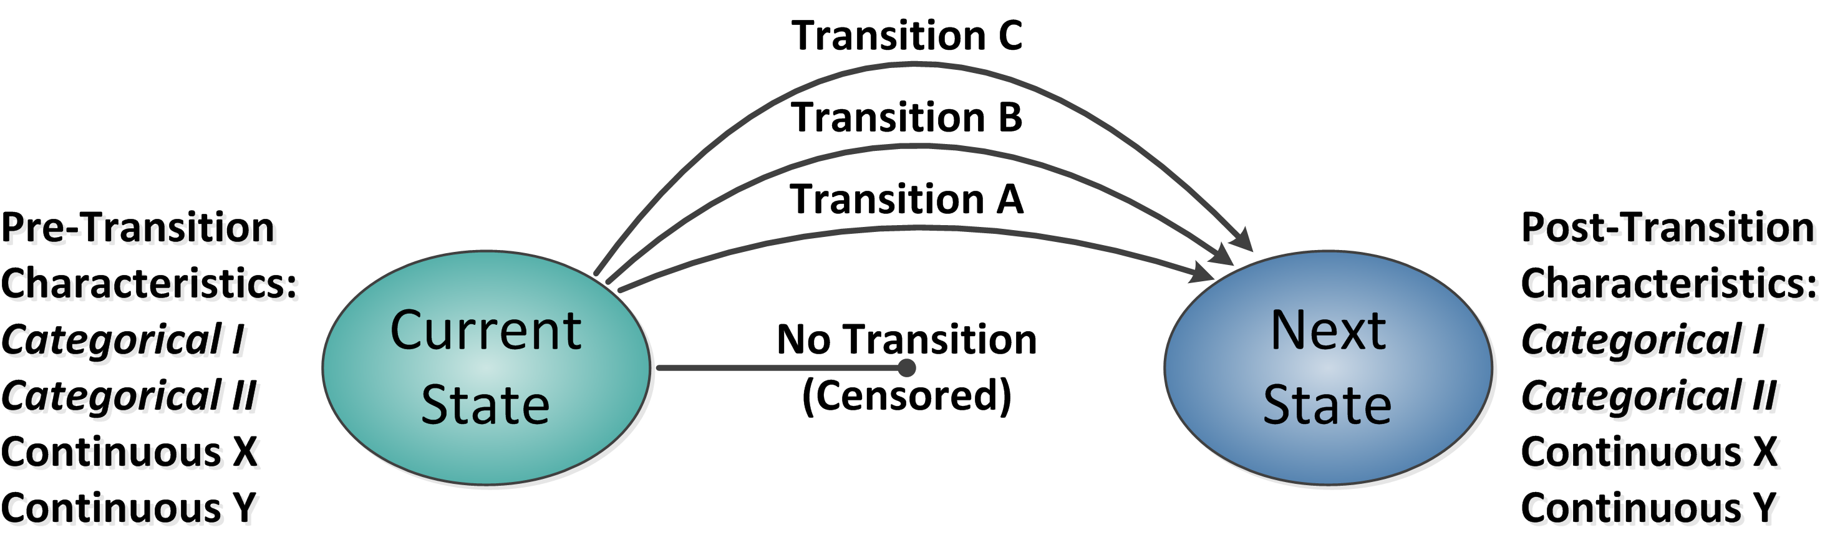
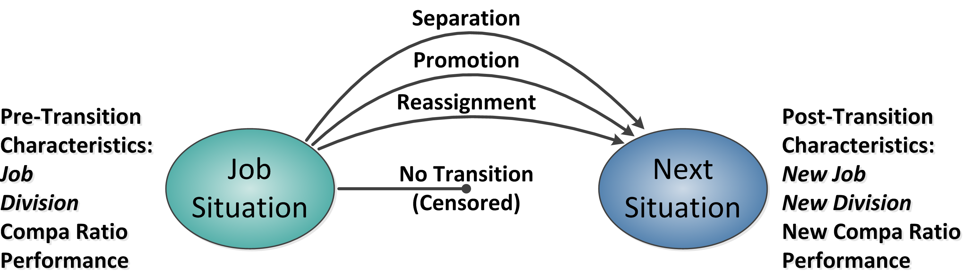
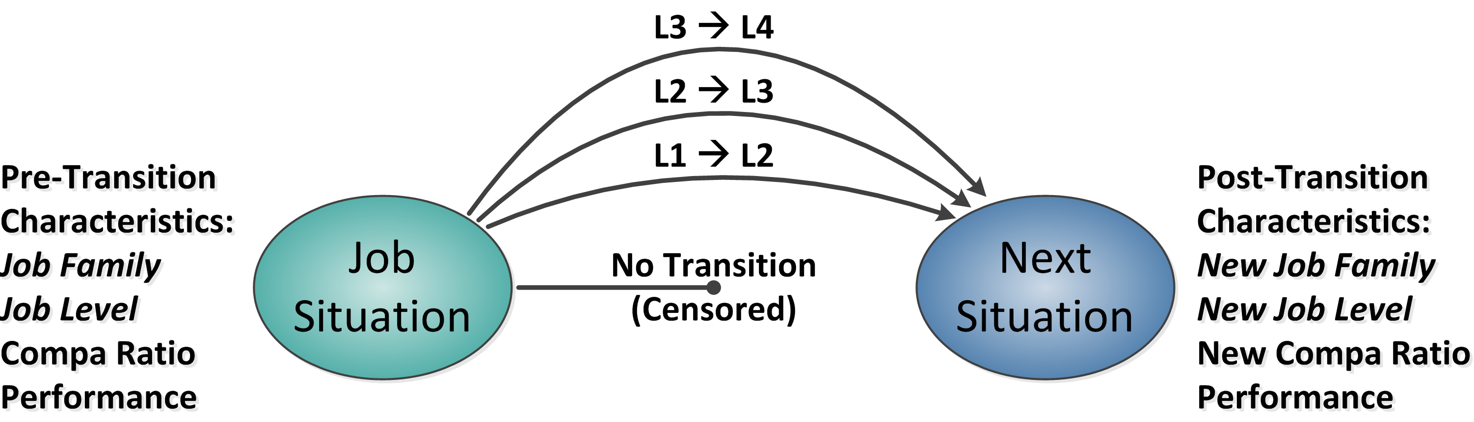
Personnel Mobility Assessment Using JMP® Survival Platforms
Thor D. Osborn
Sandia National Laboratories
Abstract
Objectives
Generic State Transitions
Regardless of sector, purpose, or structure, enduring organizations experience a continuous flow of personnel entering, exiting, and moving within the organizational structure. These flows are commonly considered in the contexts of recruiting and hiring, retention, and personnel development, where organizational effectiveness depends upon crafting working conditions and incentives that encourage appropriate rates of movement. Short-term aggregate measures of these rates are often misleading due to sample size and fluctuations in the business environment. Such movements can, however, be viewed as a series of transitions between job situation states, with associated residence durations, the endpoints of which may be known or bounded. Consequently, they are eminently suitable for analysis using JMP’s family of survival and life distribution analysis platforms to yield probabilistic models reflecting persistent organizational characteristics. Practical benefits of this approach include a deeper and more nuanced understanding of the relationship between personnel flows, management decisions, and environmental shifts. This poster frames the analytical construct, necessary assumptions, and conducive organizational characteristics, illustrated with simplified examples.
Frame personnel movements analysis as corollary to survival analysis
Outline duration extraction from personnel records
Show benefit of sample distortion correction
Demonstrate analysis using open source data to explore gender bias in a mid-sized firm
Use derived models to depict organizational behavior patterns and challenges
Internal Movement Transitions
Modeling Approach
Survival analysis methods address transition times between defined states bounded by observable transitions (e.g., “alive” to “dead”)
Personnel records of transitions between job situation states enable duration calculations
Situation and transition identification are guided by analytical objectives and the quantity and qualities of available data
Job Level Transitions
Click on graphics to enlarge

Slide 2
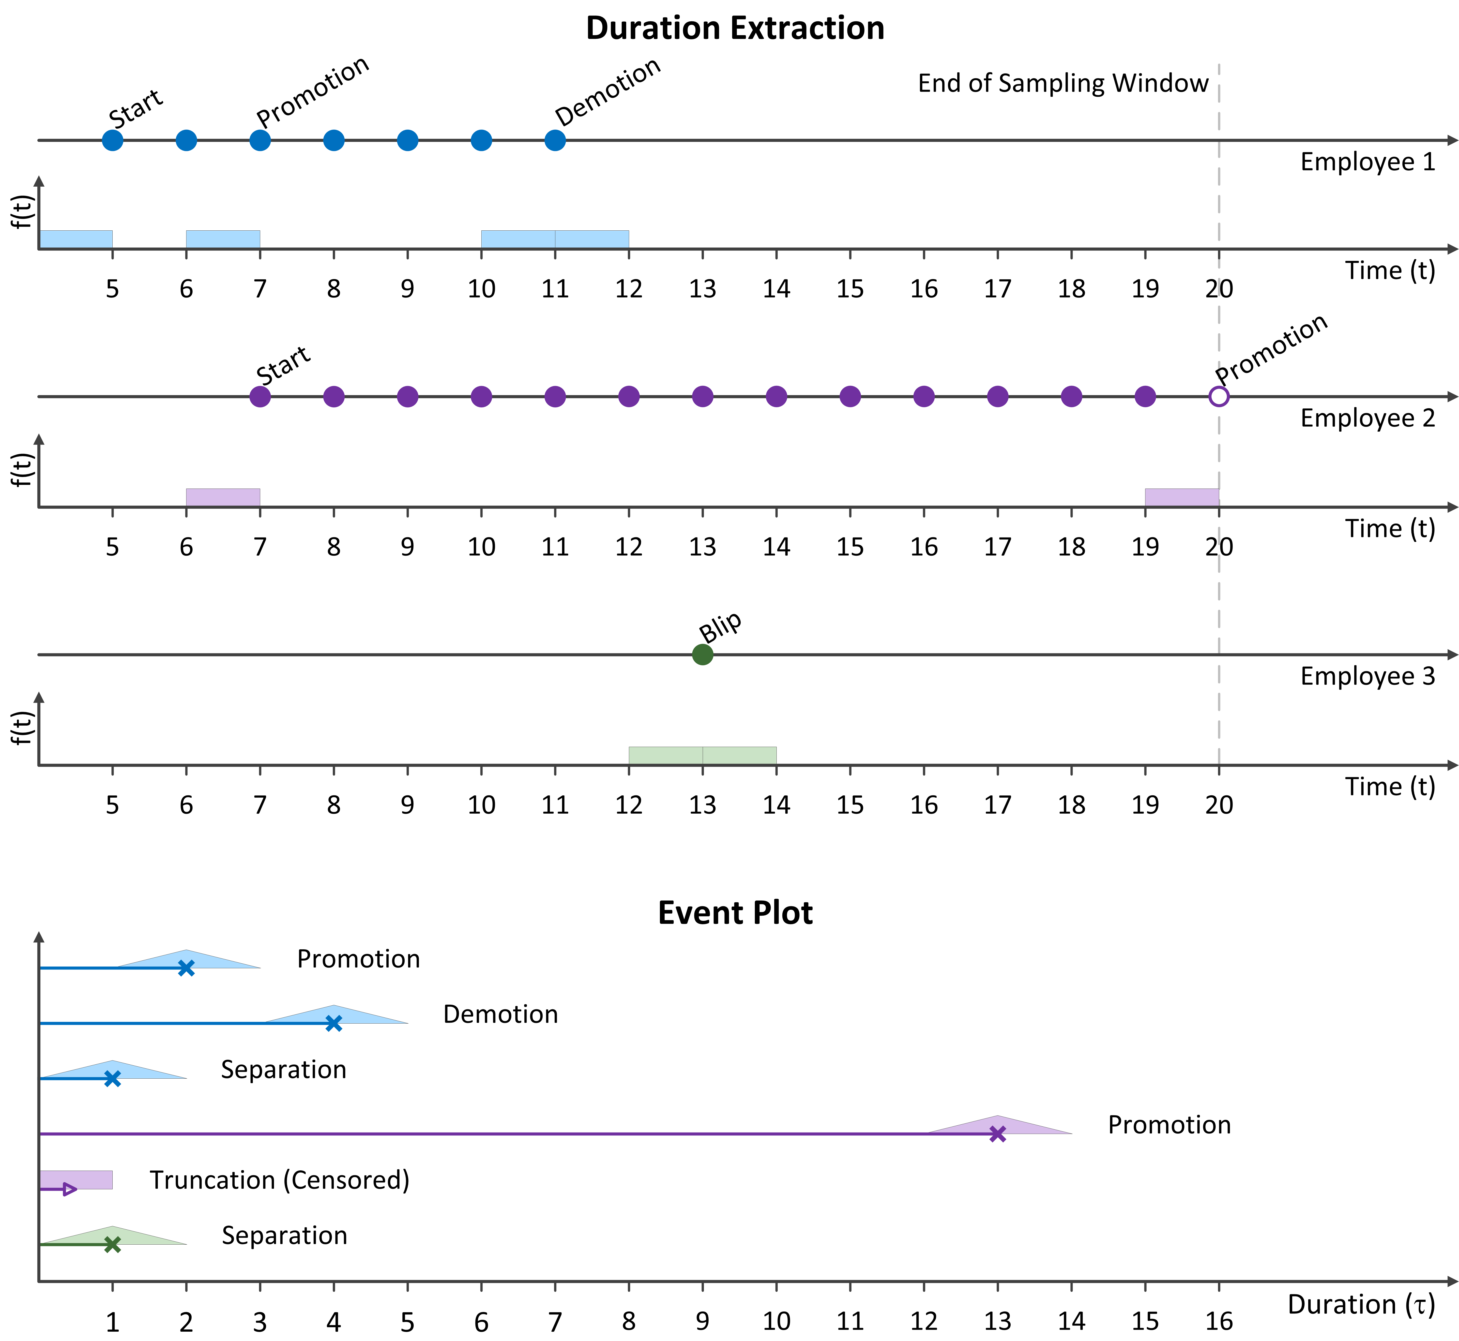
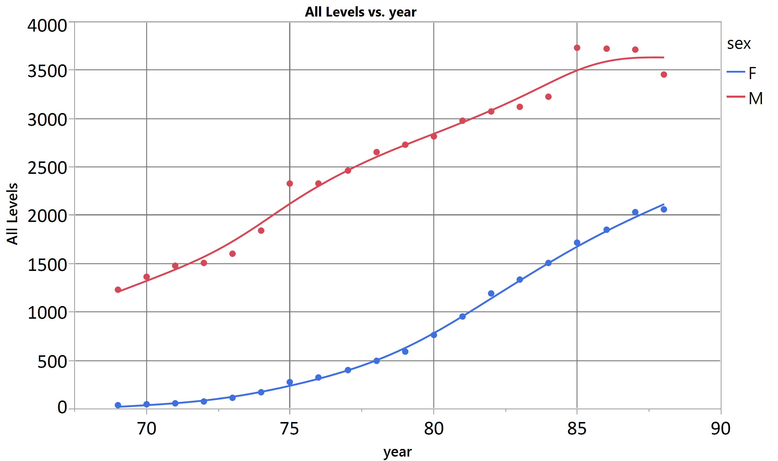
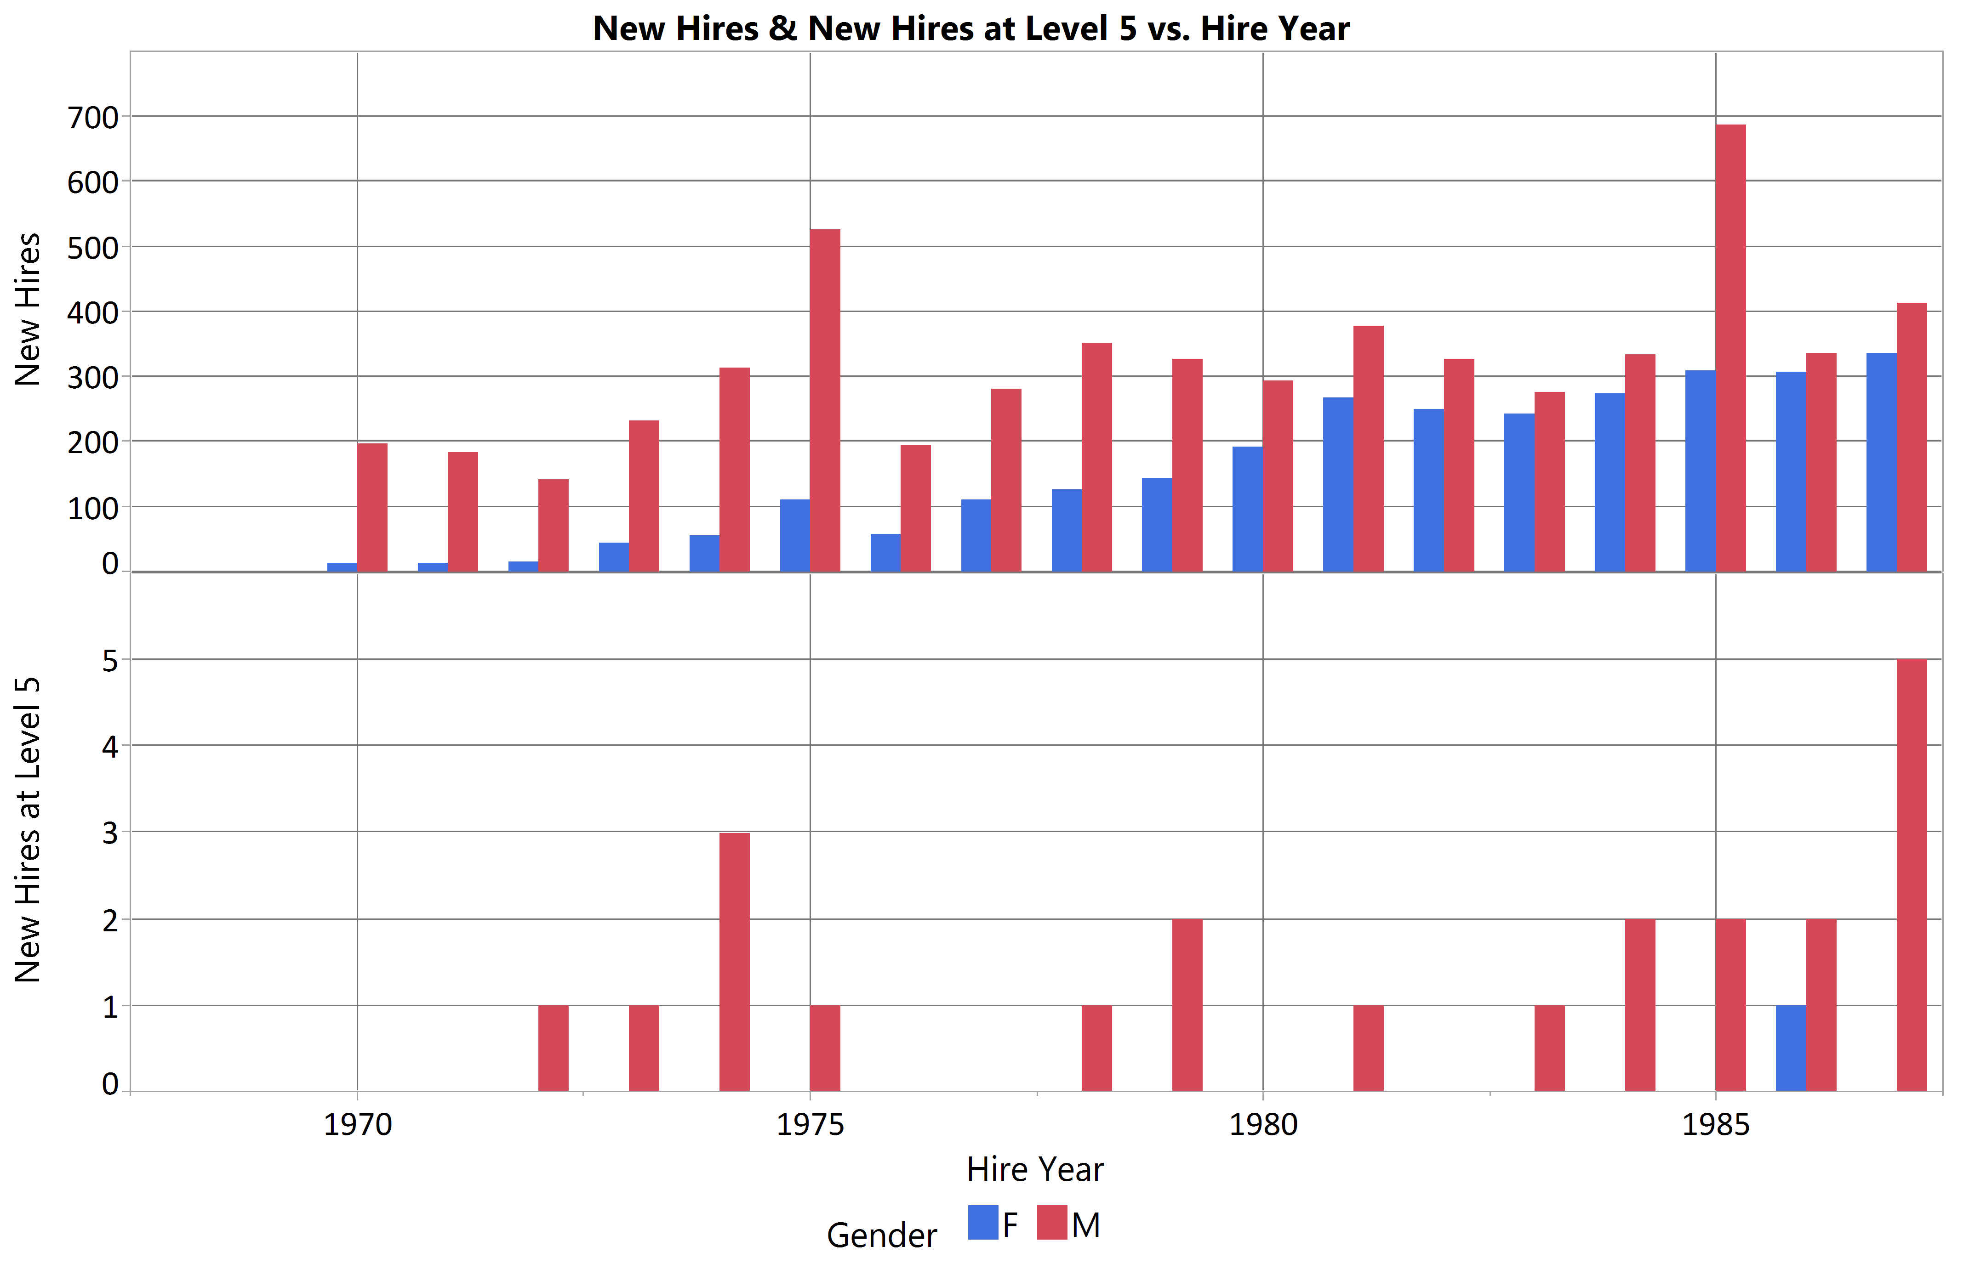
Personnel Mobility Assessment Using JMP® Survival Platforms
Thor D. Osborn
Sandia National Laboratories
Duration Extraction
Open Source Data
Asynchronous Transition Sampling
Personnel internal movement data are typically recorded in modern Human Resources information management systems as transitions between defined situations on a specified date, thus a typical sequence for an individual could be:
External → Job Situation 1 (Hire)
Job Situation 1 → Job Situation 2 (Promotion)
Job Situation 2 → External (Separation)
Interpretive logic can be written using subscripted formulas in JMP to determine the durations of Job Situation 1 and Job Situation 2 based on context and sequence of events.
Special attention may be needed to ensure consistent interpretation of internal lateral movements between subunits of the organization. For example, reorganizations involving re-labeling without changing business objectives might be treated as non-events, but if the subunit manager also changes, that could be considered a change in Job Situation, depending on analytical objectives.
Baker, Gibbs, and Holmstrom made extensive study of the annual management personnel records from 1969 – 1988 for an unstated mid-sized U.S. corporation, referred to herein as BGH Organization or BGHO. An eight-level hierarchical structure pertaining to most of the management jobs in that organization was developed (Baker, 1993), enabling structured analysis of a simple career progression. An anonymized version of the BGHO data has been made available for research purposes.
Given that the data were sampled only at year-end, Job Situation transitions may have occurred at any time during the preceding year, and interpretation of durations differs somewhat from that described at left.
Data Extraction Detail View
BGHO Data Summary Trends
On-Roll Gender Composition
Hiring Gender Composition
Click on graphics to enlarge

Slide 3
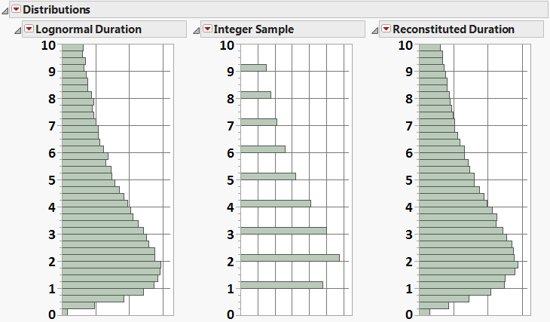
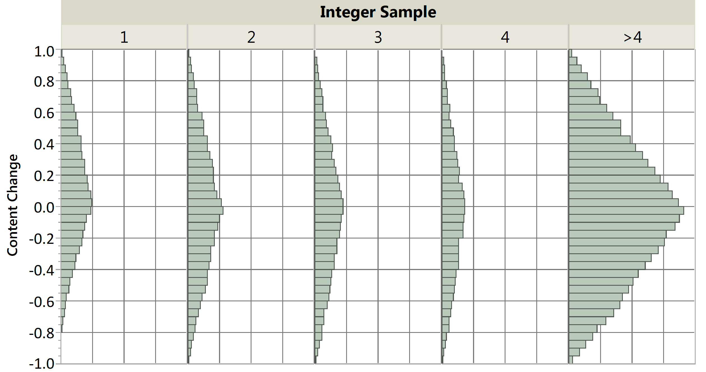
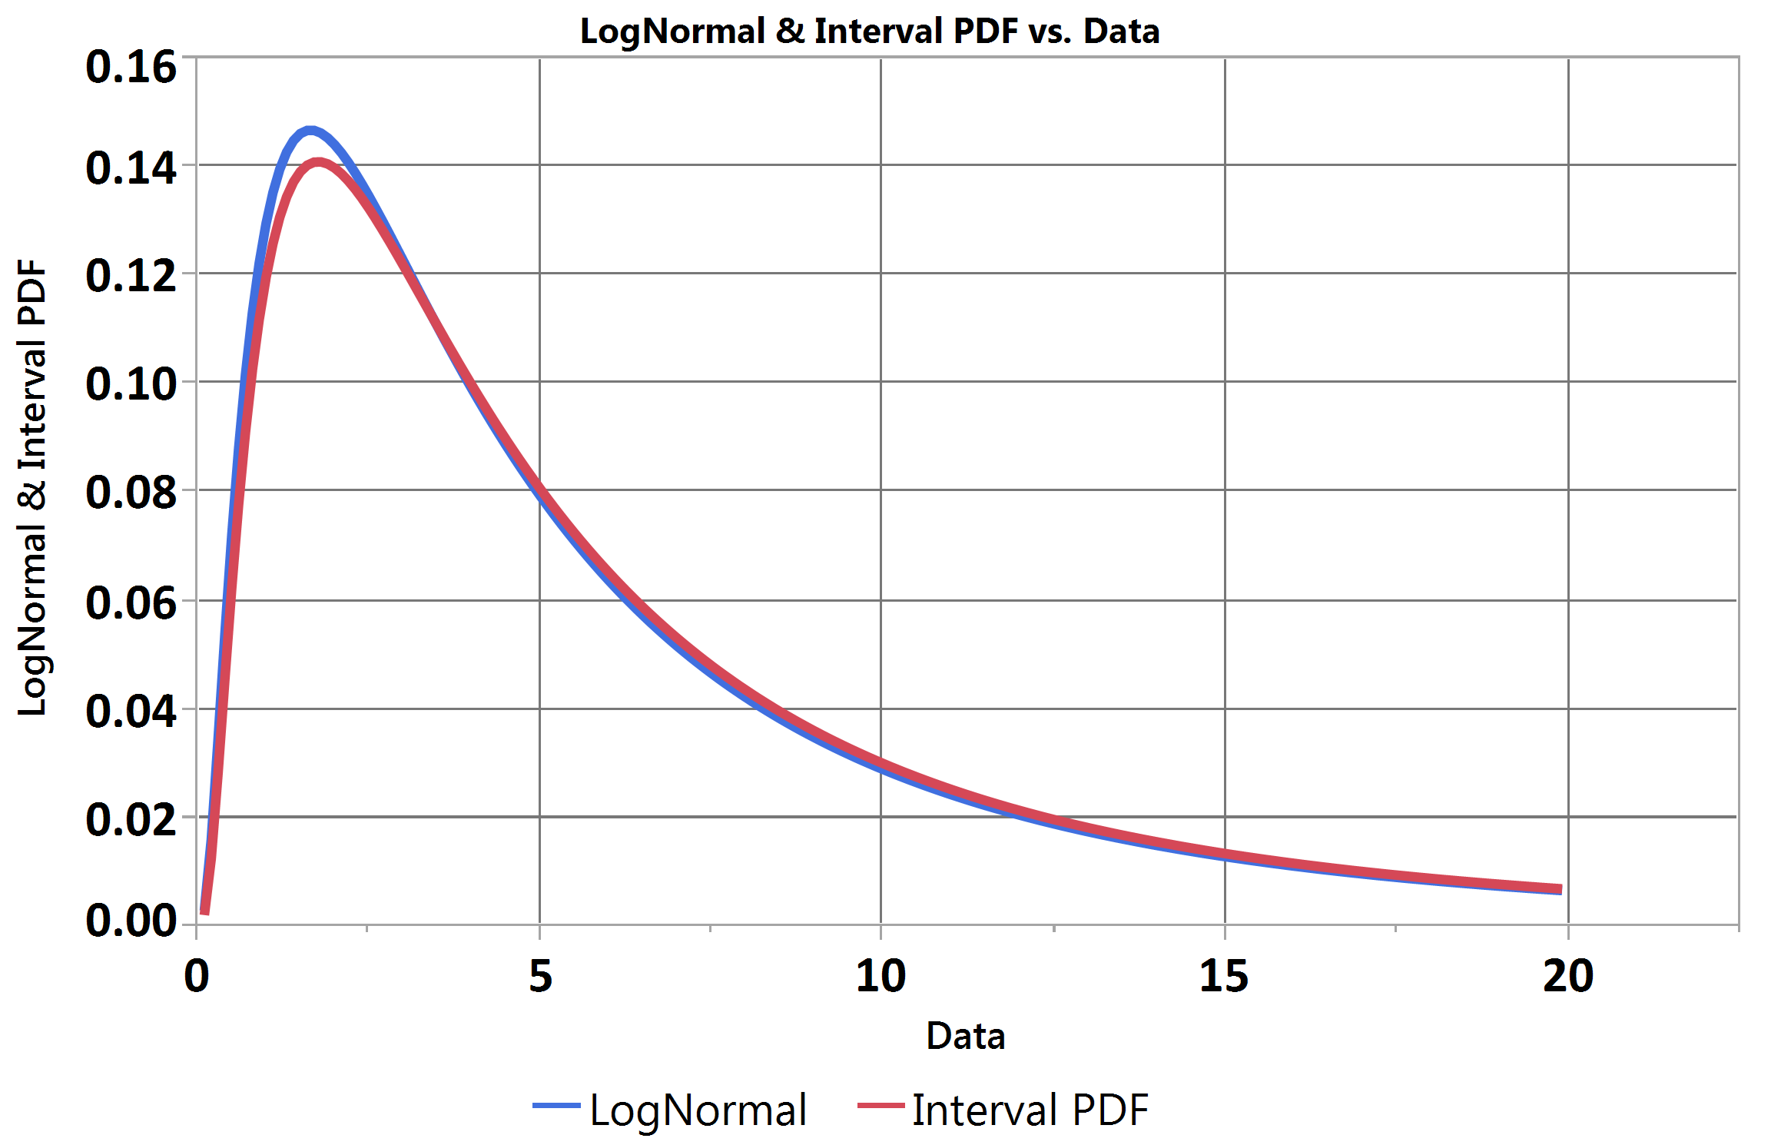
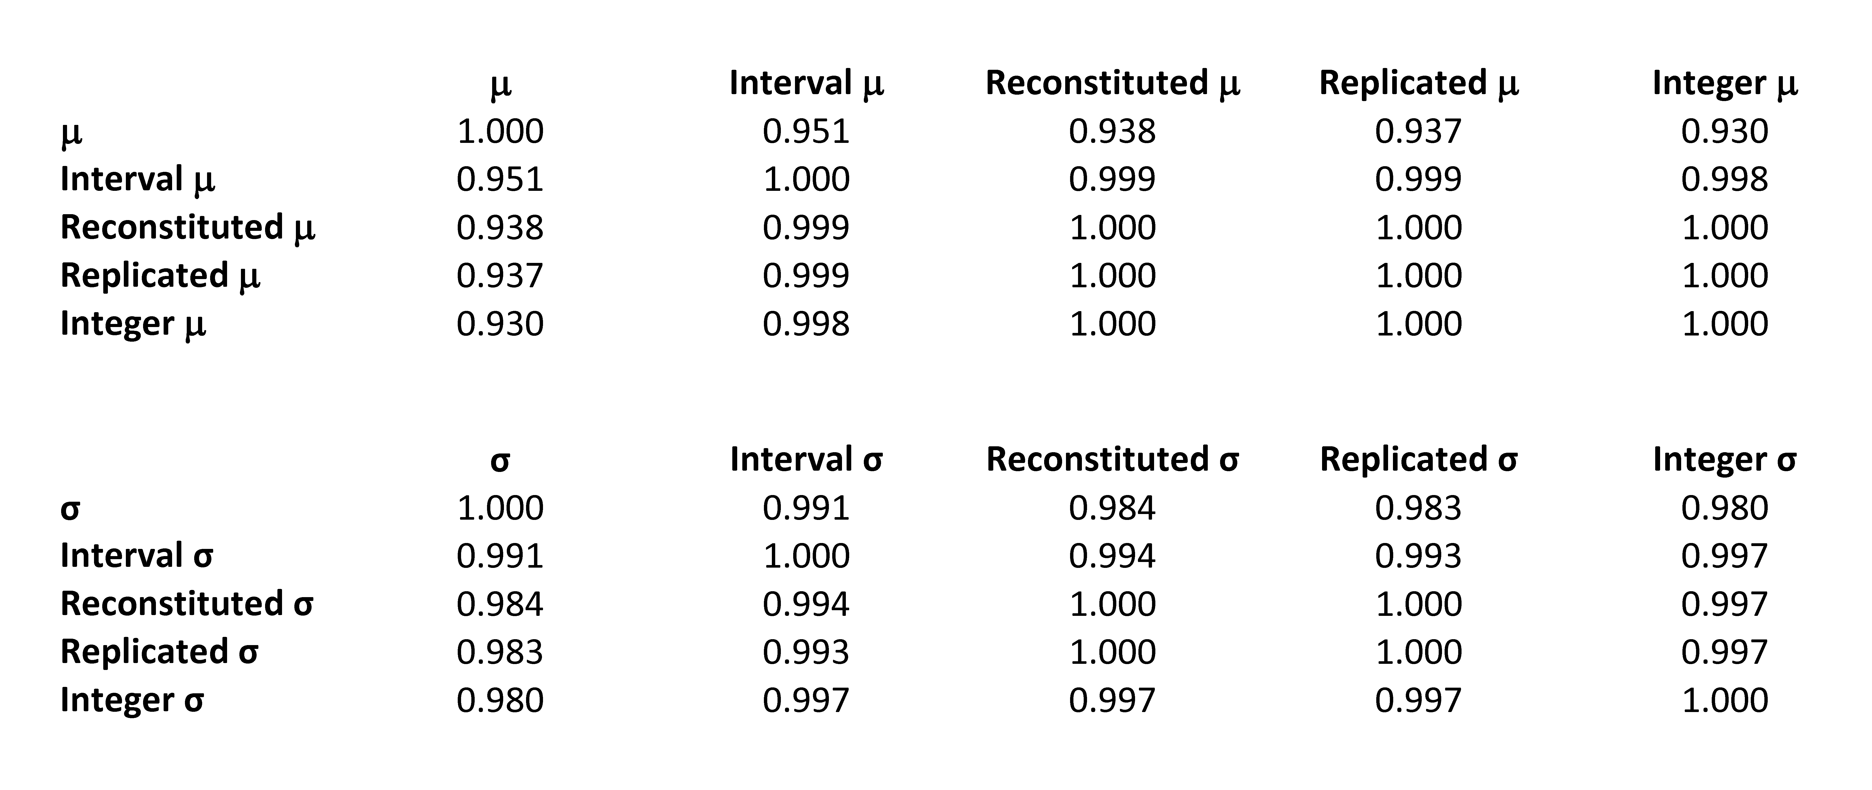
Personnel Mobility Assessment Using JMP® Survival Platforms
Thor D. Osborn
Sandia National Laboratories
Sampling Distortion
Impact of Periodic Sampling
Sampled Data Error Profile
Periodic sampling distorts duration profile, reducing quality of survival model fit
Periodically sampled data error profile is approximately triangular as expected (see Job Situation Duration Extraction)
Original distribution can be approximately reconstituted by adding a triangular random dither to the integer periodic samples
Fitting Distorted Data
Comparison of Fitting Methods
Comparison of Distribution PDFs
Integer sampled data may be treated as interval censored over ±1 range
Alternatively, distribution may be reconstituted by applying triangular random dither to integer samples
N-replication and reconstitution of integer sampled data may be handled using 1/N frequency input to Survival platform
Interval censoring approach yields most reliable fit
Reconstitution yields second best fit and enables competing cause analysis
Interval censoring yields best correlation to original Log-Normal distribution parameters (μ = 1.5, σ = 1) in analysis of simulated data
Click on graphics to enlarge

Slide 4
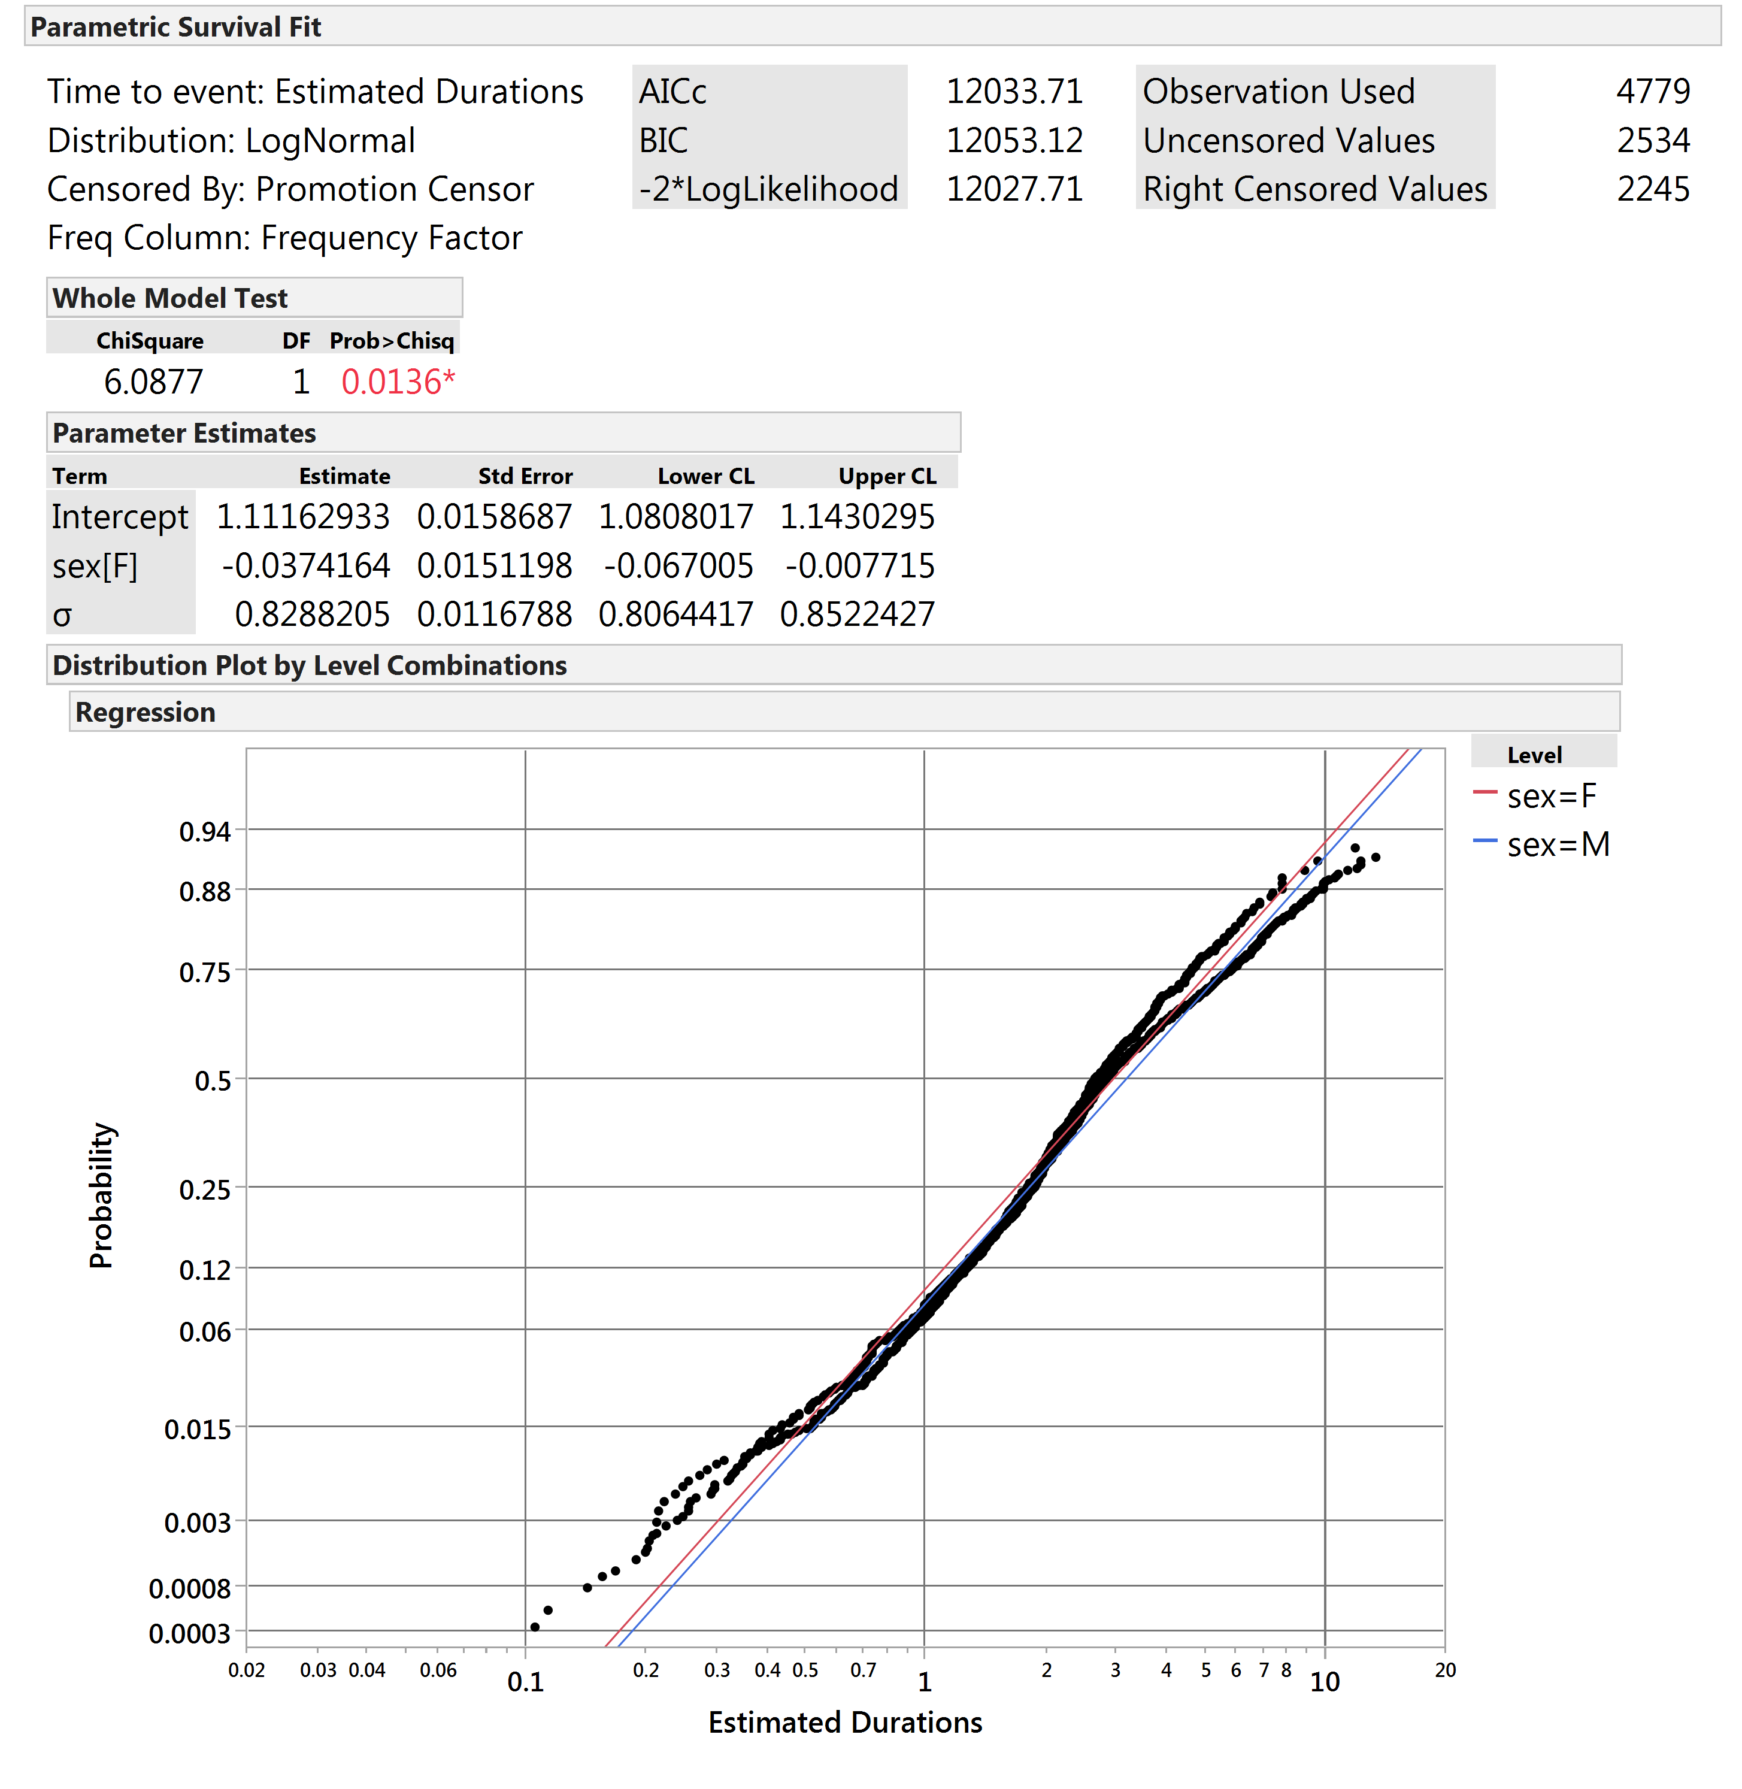
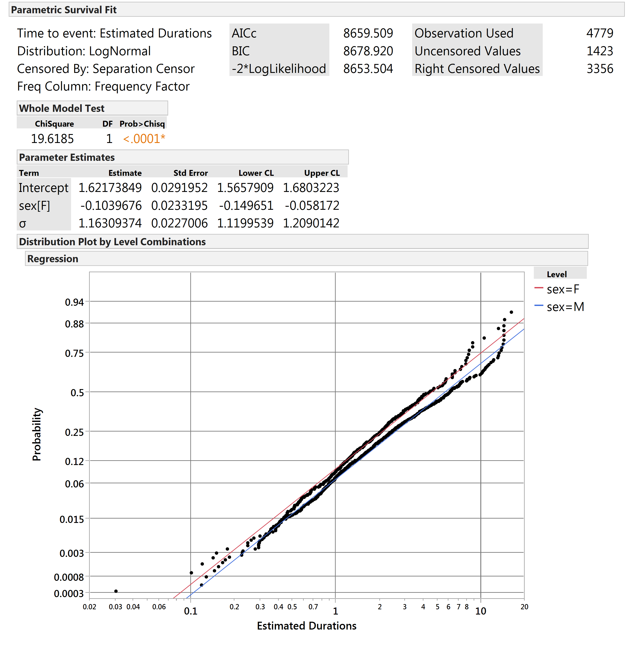
Personnel Mobility Assessment Using JMP® Survival Platforms
Thor D. Osborn
Sandia National Laboratories
Parametric Survival Analysis
Example: Promotions from Level 2
Example: Separations from Level 2
Applies JMP’s Parametric Survival platform to the durations extracted from BGHO data
Gender (sex) used as the sole Location Effect variable
Competing cause censoring approach applied to enable calculation of transition probabilities in context of competing pathways – i.e., complete duration observations for focal pathway uncensored, all truncated duration observations and observations for other pathways right-censored
Probability models for Promotion, Demotion, and Separation determined separately for pathways leaving each incumbent Job Level
Probability models saved and joined into unified table for subsequent progression simulation
Aggregate pathway models (no location effect) used where data insufficient for separate fits
Significant Gender effects for both Promotion and Separation pathways out of Level 2
Higher probability of Separation than Promotion for both genders
Click on graphics to enlarge

Slide 5
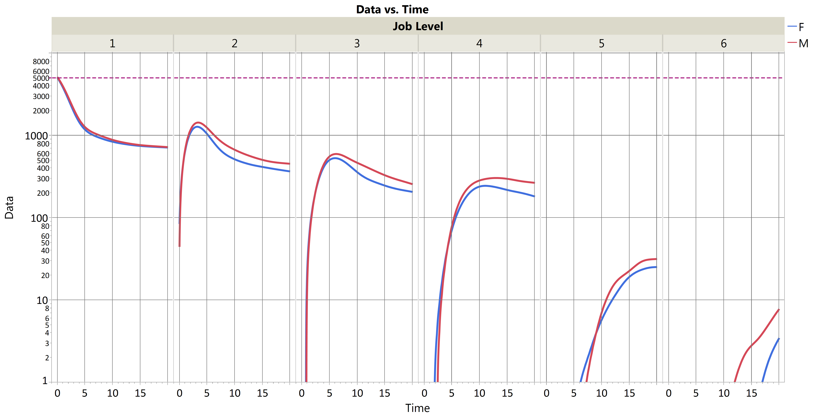
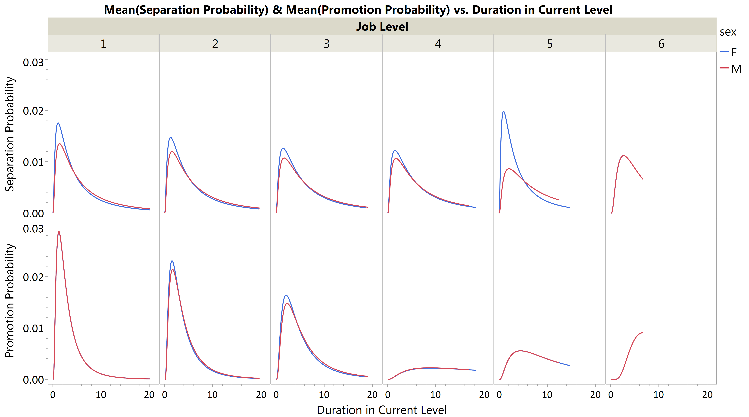
Personnel Mobility Assessment Using JMP® Survival Platforms
Thor D. Osborn
Sandia National Laboratories
Level Progression Scenario
Extracted Model Progression
Probability Comparison by Level
Modeled level progressions illustrate impact of gender on probability vs. time of an individual starting at Level One achieving higher job levels
Progression Scenario assumes 10,000 managers, evenly split between Male and Female, all starting at the same time
The Level Progression Scenario applies the extracted Promotion, Demotion, and Separation transition models by level to the progression of Level 1 managers over 20 years
Simulation progresses by small time increments (e.g., 0.1 years) calculating incremental probabilities of transition pathways out of current Job Level, checking all pathways simultaneously against a unit random value, then updating each individual
The population impact of external hiring is not included in the Progression Scenario – only internal progression is addressed
Logarithmic scale is used due to the high rate of attrition between Levels 1 - 6
Model Progression Results
Gender Effect on Probabilities
Most personnel depart the organization from the Level 1 manager role
Attrition between Levels 2 – 4 is more gradual, then accelerates between Levels
4 – 6
Women are promoted to higher levels at comparable rates to men but then depart more rapidly
Male and Female managers progress similarly up to Level 5
Female managers are slightly more likely to separate from the organization at Levels
1 – 4, but also have slightly higher promotion rates from those levels
Females are much more likely to separate at Level 5, contributing to the gender imbalance in Level 6
Click on graphics to enlarge

Slide 6
Personnel Mobility Assessment Using JMP® Survival Platforms
Thor D. Osborn
Sandia National Laboratories
Discussion
Conclusions
References
Analysis of BGH Organization data shows that despite comparable promotion rates for Male and Female managers throughout the lower levels, few women occupied positions in Level 5 or above. Separation rates were slightly higher for women than men throughout the lower levels of management, but dramatically higher for the few women reaching Level 5. Since few women were hired into BGHO at Level 5 or above, the upper ranks of management were primarily occupied by men. It would have been reasonable for Female managers at BGHO to perceive a glass ceiling, possibly explaining the rapid separation rate among Female Level 5 managers.
The application of survival analysis methods to the BGHO data illuminated the underlying mechanisms behind the organization’s gender imbalances that would not be readily discerned from review of the annual results alone. Abstraction of transition data to probabilistic models enabled systematic what-if simulation for insight into the relative treatment of men and women at BGHO.
Internal movements of personnel within an organizational structure can be modeled using survival / lifetime statistical methods, given appropriate adaptations and clear definition of job situations and the transitions between
Survival distribution model fitting may be used to assess whether treatment within the organization of defined personnel groups differs significantly over time
Where personnel groups are treated differently by an organization, parametric survival models can be incorporated into simulations to explore long-term impacts in context, but absent the “noise” of short-term business cycle variations
Such simulations – based in real patterns of organizational decision making behavior – can be used to assess the degree of change in realized management policy or personnel career choice that must be achieved to effect alternative outcomes
Baker, George, Michael Gibbs, and Bengt Holmstrom, “Hierarchies and Compensation: A Case Study,” European Economic Review, 37, pp. 366 – 378, 1993.
Baker, George, Michael Gibbs, and Bengt Holmstrom, “The Internal Economics of the Firm: Evidence from Personnel Data,” The Quarterly Journal of Economics, pp. 881 – 919, November, 1994.
Baker, George, Michael Gibbs, and Bengt Holmstrom, “The Wage Policy of a Firm,” The Quarterly Journal of Economics, pp. 921 – 955, November, 1994.
Acknowledgements
The author is grateful to Professor Michael Gibbs of the University of Chicago Booth School of Business for permission to use the BGH data.
Sandia National Laboratories is a multi-program laboratory managed and operated by Sandia Corporation, a wholly owned subsidiary of Lockheed Martin Corporation, for the U.S. Department of Energy’s National Nuclear Security Administration under contract DE-AC04-94AL85000. SAND NO. 2014-16806C.

Slide 7
Personnel Mobility Assessment Using JMP® Survival Platforms
Thor D. Osborn
Sandia National Laboratories
Click on graphic to return to previous view

Slide 8
Personnel Mobility Assessment Using JMP® Survival Platforms
Thor D. Osborn
Sandia National Laboratories
Click on graphic to return to previous view

Slide 9
Personnel Mobility Assessment Using JMP® Survival Platforms
Thor D. Osborn
Sandia National Laboratories
Generic State Transitions
Click on graphic to return to previous view

Slide 10
Personnel Mobility Assessment Using JMP® Survival Platforms
Thor D. Osborn
Sandia National Laboratories
Internal Movement Transitions
Click on graphic to return to previous view

Slide 11
Personnel Mobility Assessment Using JMP® Survival Platforms
Thor D. Osborn
Sandia National Laboratories
Job Level Transitions
Click on graphic to return to previous view

Slide 12
Personnel Mobility Assessment Using JMP® Survival Platforms
Thor D. Osborn
Sandia National Laboratories
Job Situation Duration Extraction
Hire, promotion, demotion, and separation actions are assumed to be asynchronous with respect to the BGHO annual personnel records
Changes in Job Situation (transitions) between year-end records are assumed to have uniform probability of occurrence throughout the preceding year
Three example employee record timelines are depicted (blue, purple, and green dot series)
Job Situation durations are estimated as integer differences
Job Situation duration most likely profiles consist of the duration estimate plus the difference of the endpoint probability profiles – typically a balanced triangular distribution
Timeline Start records may represent new hires to BGHO, promotions from BGHO non-management roles, or for employees already on-roll prior to the sample window, the first transition from an ambiguous Job Situation to a clearly defined one
Final records prior to the end of the sampling window imply separation at some time during the subsequent year
Truncated (Right Censored) data do not represent Job Situation transitions but do represent windows of unused opportunity to make a transition and must be captured to model competing transition probabilities
Click on graphic to return to previous view

Slide 13
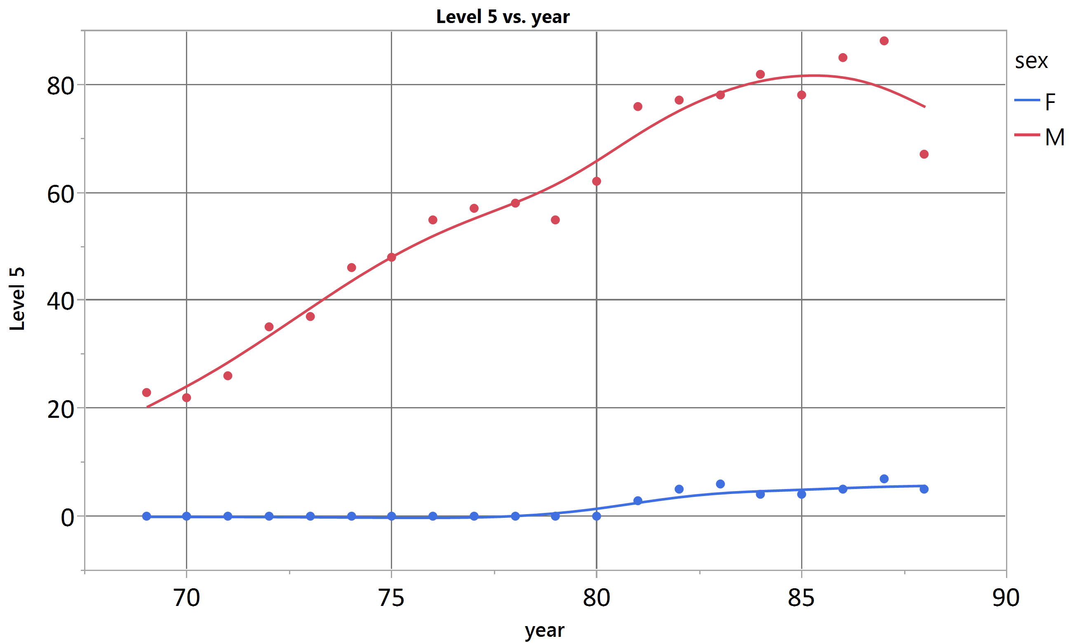
Personnel Mobility Assessment Using JMP® Survival Platforms
Thor D. Osborn
Sandia National Laboratories
BGHO Population Trend by Gender, All Managers
BGHO Population by Gender, Level 5 Managers
BGHO grew steadily between 1969 and 1988
Gender composition of BGHO management team grew from a trace in 1969 to more than one-third by 1988
Level 5 represented the beginning of upper management at BGHO
Gender composition of BGHO Level 5 never exceeded 10% females despite substantial upward trend in female participation in management over the period of observation
Click on graphic to return to previous view

Slide 14
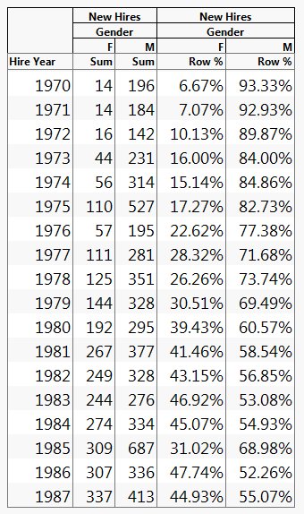
Personnel Mobility Assessment Using JMP® Survival Platforms
Thor D. Osborn
Sandia National Laboratories
Gender Balance of New Hires
Between 1970 and 1987, hires into BGHO management trended from heavily male-dominated toward approximate gender neutrality in the aggregate
Hires into management Level 5 were all men, with one exception
Click on graphic to return to previous view

Slide 15
Personnel Mobility Assessment Using JMP® Survival Platforms
Thor D. Osborn
Sandia National Laboratories
Click on graphic to return to previous view

Slide 16
Personnel Mobility Assessment Using JMP® Survival Platforms
Thor D. Osborn
Sandia National Laboratories
Click on graphic to return to previous view

Slide 17
Personnel Mobility Assessment Using JMP® Survival Platforms
Thor D. Osborn
Sandia National Laboratories
Click on graphic to return to previous view

