Slide 1
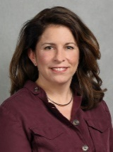


Ohio valley JMP Team – Please contact for questions
Andrea Coombs
Systems Engineer
andrea.coombs@jmp.com
Heather Davis
Account Executive
heather.davis@jmp.com
Matt Boron
Account Executive
matt.boron@jmp.com

Slide 2
JMP Training & Support Resources

Slide 3
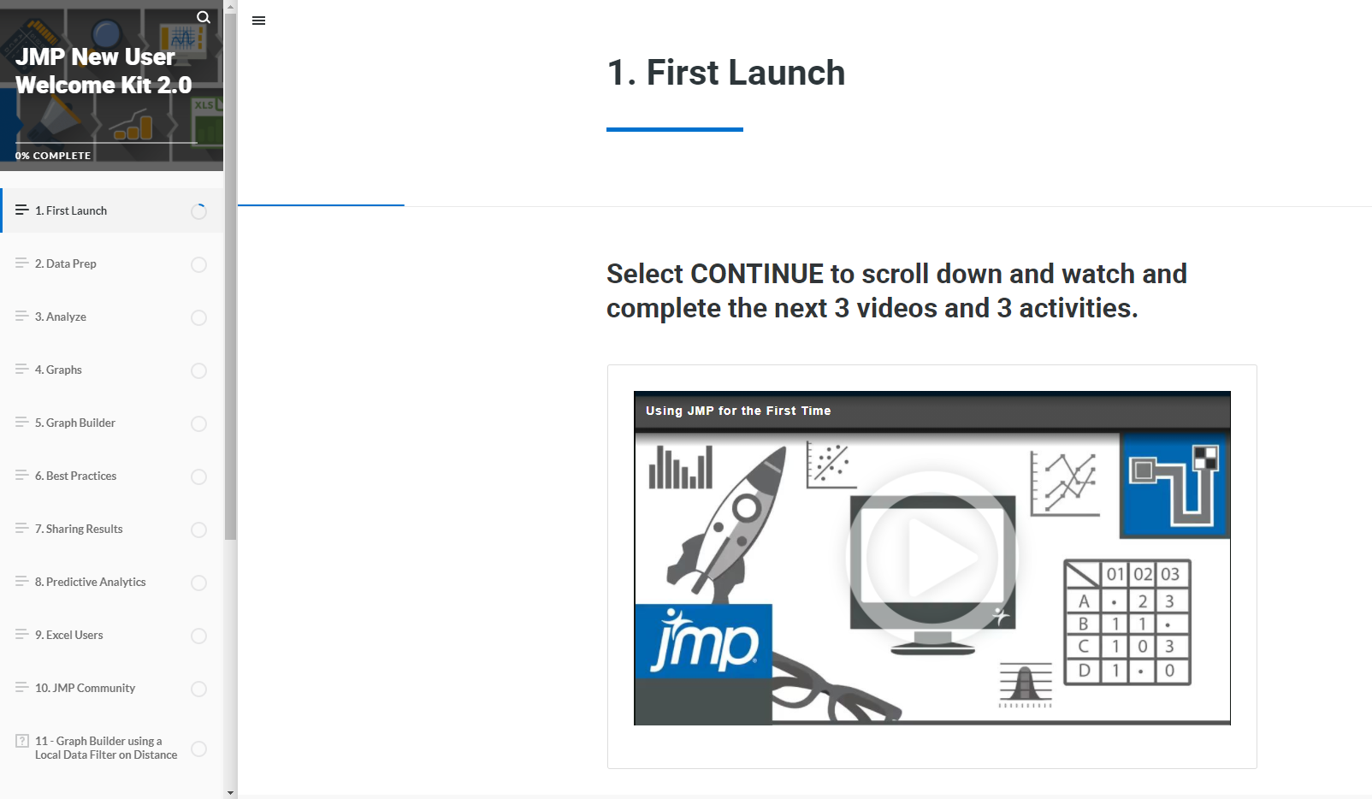
New to JMP? Start Here
JMP New User Welcome Kit
Designed to help you quickly get comfortable with the basics of JMP
Allows you to build your confidence in using the software
Comprised of 30 short, interactive videos and interactive activities
Complete at your own pace, but we suggest trying to finish the entire series in 5 days or less
Get Access: https://www.jmp.com/en_in/events/getting-started-with-jmp/new-user-welcome-kit.html

Slide 4
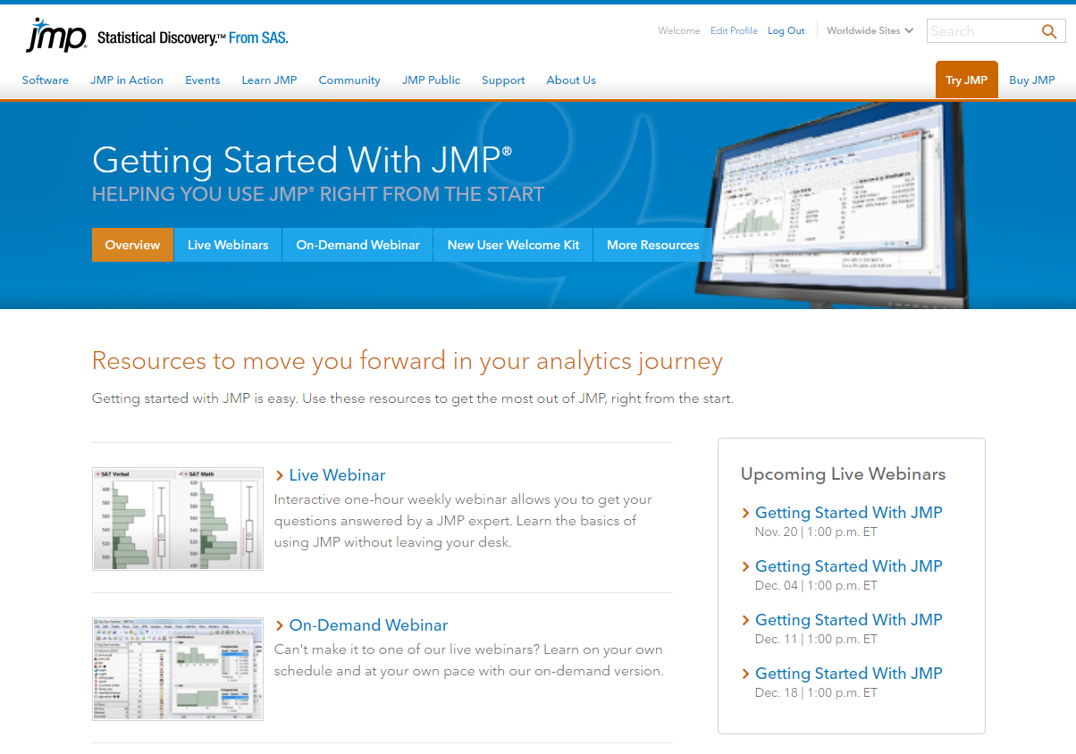
New to JMP? Start Here
Getting Started with JMP Webinars
Live and on-demand webinars designed for new or infrequent JMP users that focus on basic topics
Upcoming Live Webinar: Friday, December 4th at 1PM ET – Click Here to Register
Upcoming Live Webinar: Friday, December 11th at 1PM ET – Click Here to Register
Upcoming Live Webinar: Friday, December 18th at 1PM ET – Click Here to Register
View On-Demand Version: Click Here
Learn More or Register: https://www.jmp.com/en_us/events/getting-started-with-jmp/overview.html

Slide 5
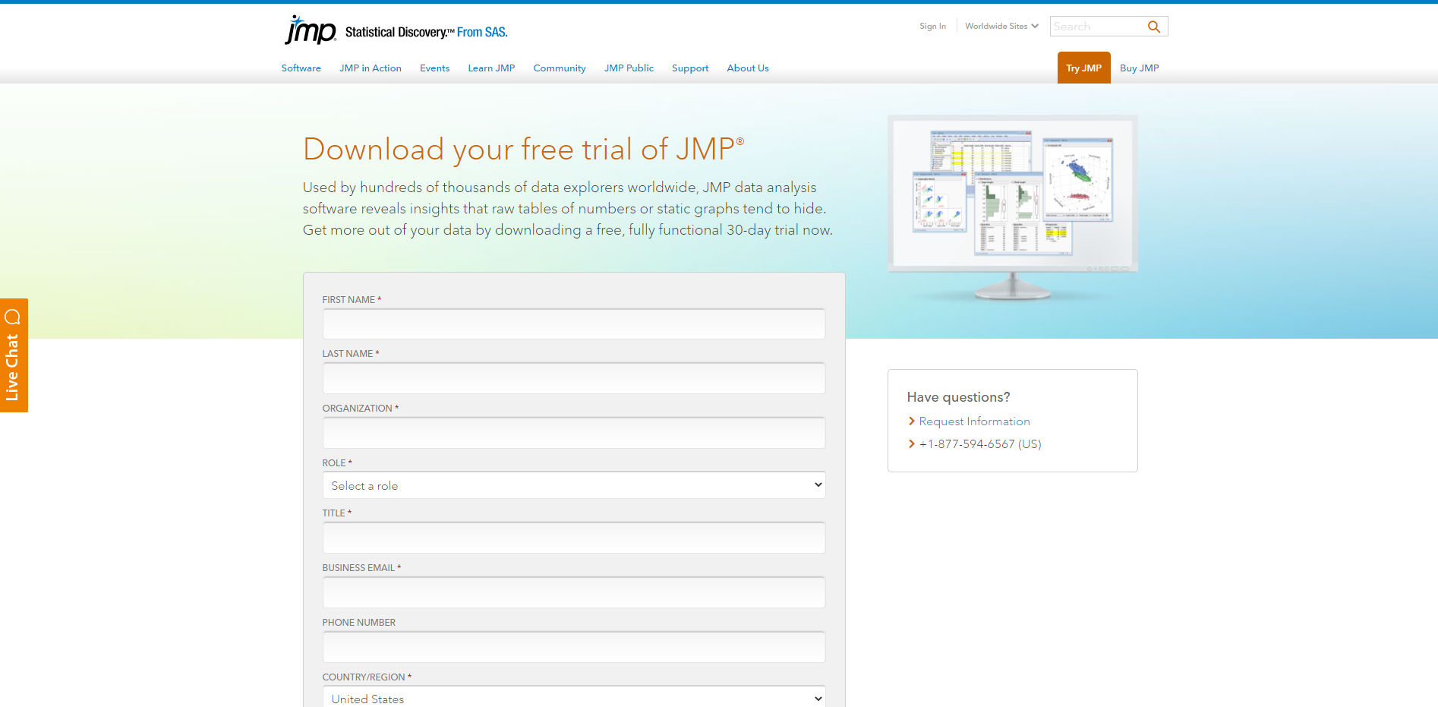
Need Access: Try JMP for Free
Download 30-Day Trial
Link to Download Trial: https://www.jmp.com/en_us/download-jmp-free-trial.html

Slide 6
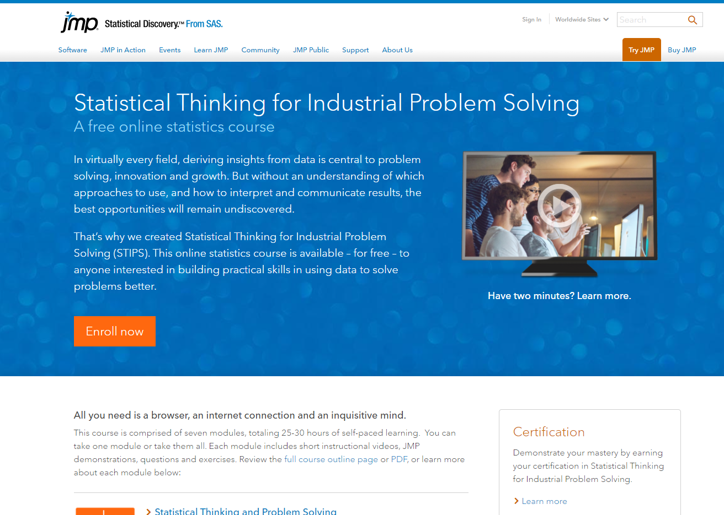
Need Help Understanding the Basics of Statistics?
Try our STIPS Courses!
Statistical Thinking for Industrial Problem-Solving (STIPS)
These are free, online statistics courses designed to teach the basics of statistics and using data to solve problems
7 Courses you can complete (See next slide for list)
Many companies require their new scientists and engineers to take these courses
On par with many college-level courses
Learn More or Register: https://www.jmp.com/en_us/online-statistics-course.html

Slide 7
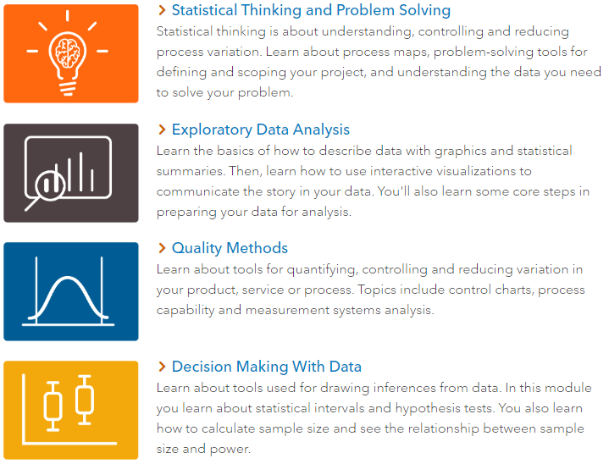
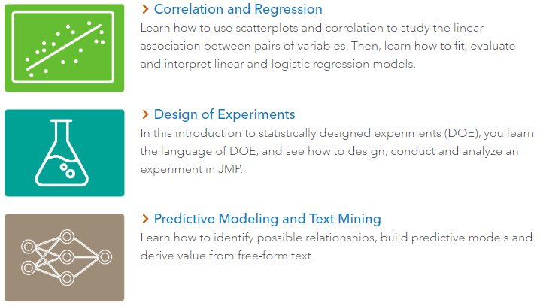
Need Help Understanding the Basics of Statistics?
Try our STIPS Courses!
Learn More or Register: https://www.jmp.com/en_us/online-statistics-course.html

Slide 8
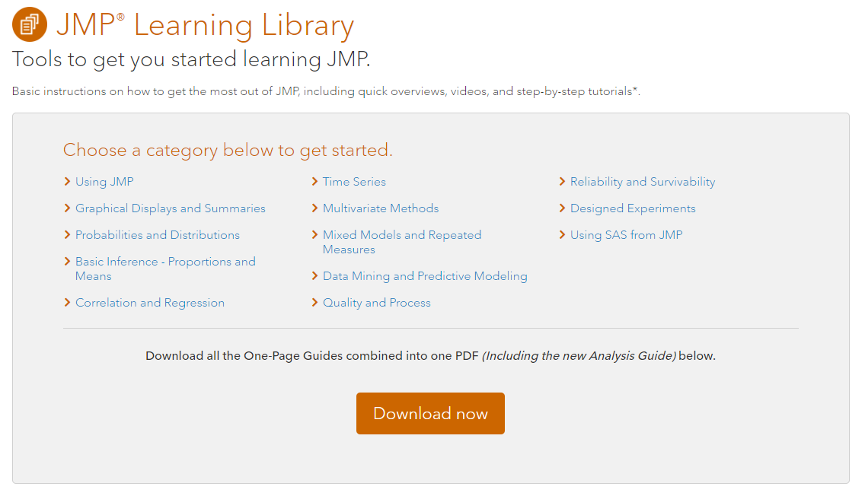
New to JMP? Start Here
JMP Learning Library
Basic instructions for getting the most out of JMP: feature overviews, videos, and step-by-step tutorials
Link: https://www.jmp.com/en_us/learning-library.html

Slide 9
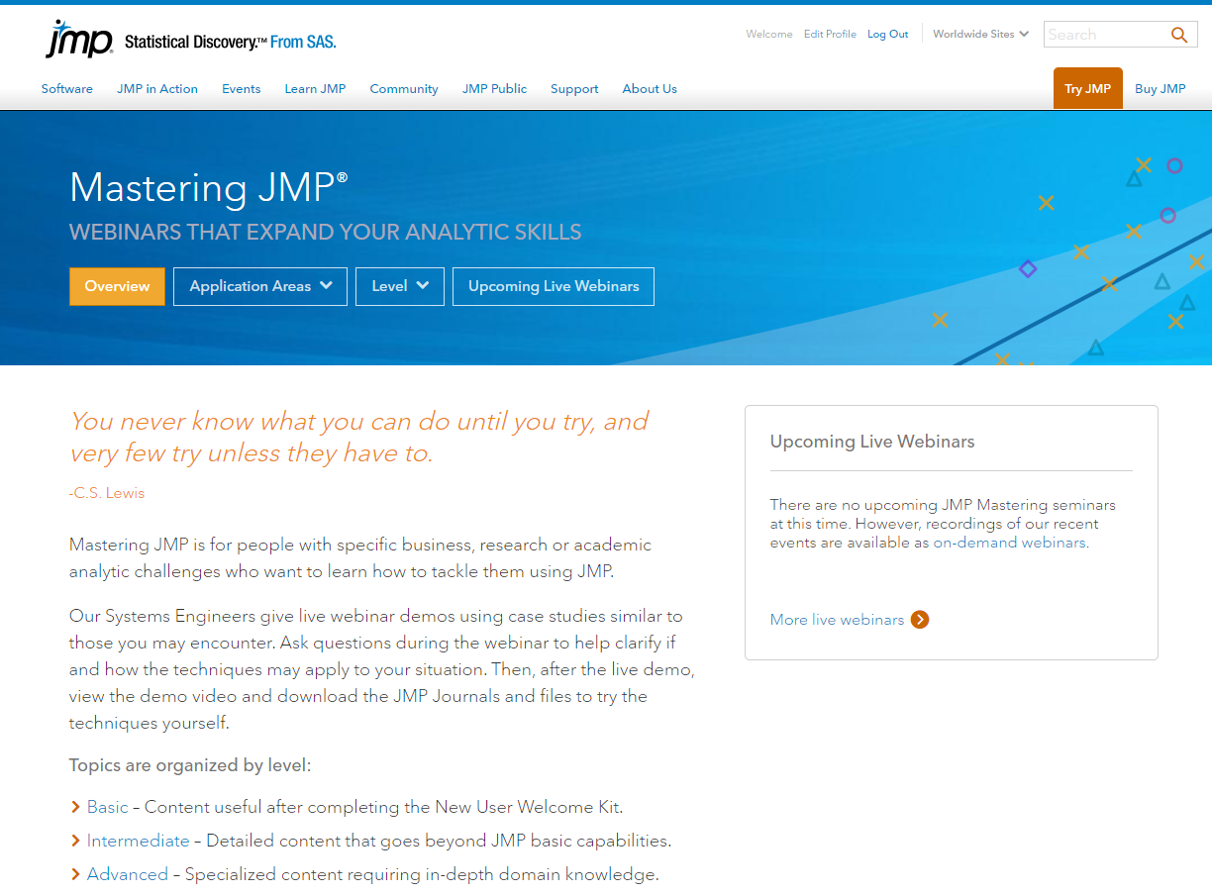
Got the Basics Covered? Now Expand Your Skills
Try our Mastering JMP Series
Live and On-Demand webinars
Sorted by Skill Level: Basic, Intermediate, and Advanced
Browse by Application Area
    Data Visualization & Exploratory Data Analysis
    Design of Experiments
    Quality Engineering, Reliability, & Six Sigma
    Statistics, Predictive Modeling, & Data Mining
    Consumer & Market Research
    Dashboard Building
    Application Development
    Life Sciences
Learn More: https://www.jmp.com/en_us/events/mastering/overview.html

Slide 10
Mastering JMP Webinar Series
Upcoming Webinars
Friday, January 8th at 2PM ET - Organizing and Getting the Most from JMP Tables: Click Here to Register
Friday, January 15th at 2PM ET - Exploratory Data Analysis and Dynamic Graphs: Click Here to Register
Friday, January 22nd at 2PM ET - Essentials of Designing Experiments: Click Here to Register
Friday, January 29th at 2PM ET - Organizing and Getting the Most from JMP Tables: Click Here to Register
Learn More: https://www.jmp.com/en_us/events/mastering/overview.html

Slide 11
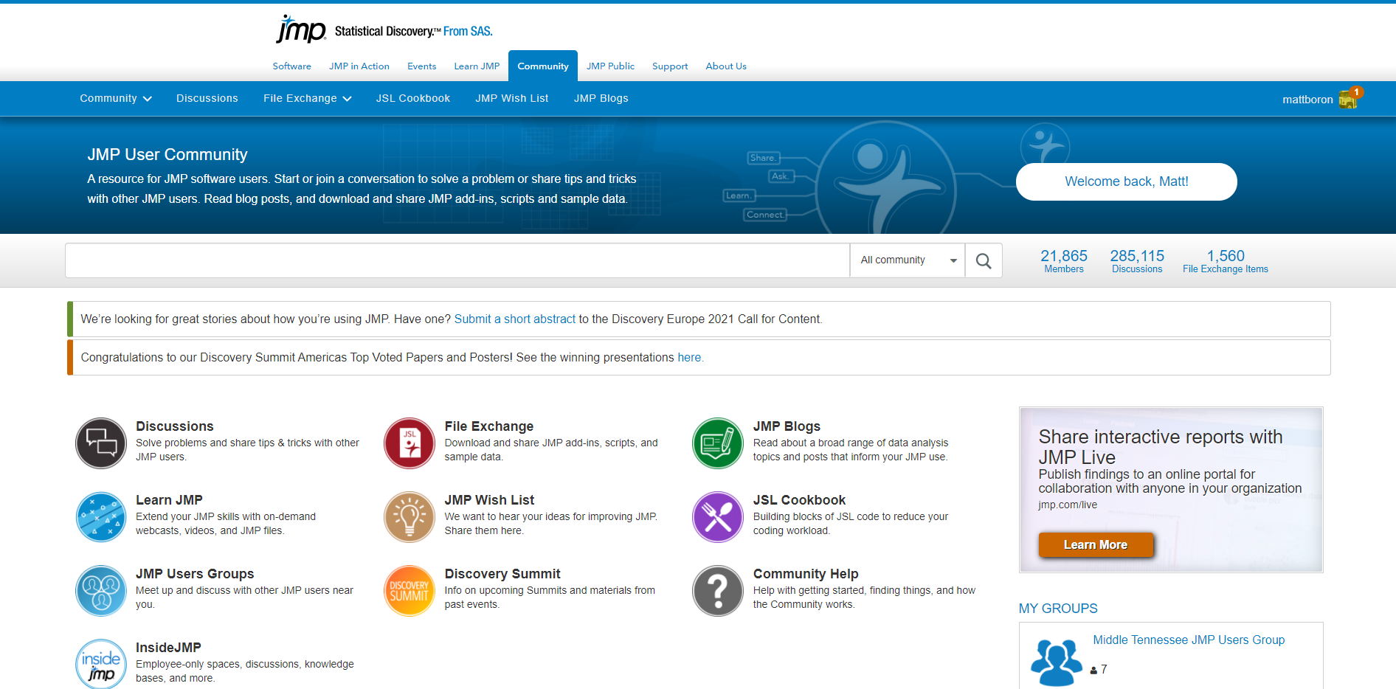
Connect with Other JMP Users
Join the JMP User Community
Link: https://community.jmp.com/

Slide 12
Connect with Other JMP Users
Area-Specific User Groups
Central Ohio JMP Users Group - https://community.jmp.com/t5/Central-Ohio-JMP-Users-Group/gh-p/central-oh-jug
Central Kentucky JMP Users Group - https://community.jmp.com/t5/Central-Kentucky-JMP-Users-Group/gh-p/central-ky-jug
Middle Tennessee JMP Users Group - https://community.jmp.com/t5/Middle-Tennessee-JMP-Users-Group/gh-p/middle-tn-jug
Link: https://community.jmp.com/

Slide 13
JMP Technical Support Services
  Covers General Support Services, Support Services for Current and Prior Releases of Software, Software Maintenance and Bug Fixes, and Problem and Product Change Notifications
  Email: Support@JMP.com
  Phone Number (US): (919) 677-8008
  Site: https://www.jmp.com/en_us/support/technical-support-services.html

Slide 14
Ohio valley JMP Team – Please contact for questions
Andrea Coombs
Systems Engineer
andrea.coombs@jmp.com
Heather Davis
Account Executive
heather.davis@jmp.com
Matt Boron
Account Executive
matt.boron@jmp.com

