Slide 1
Report Slides from the Process
Dept of Innovative Corrupting Influences

Slide 2
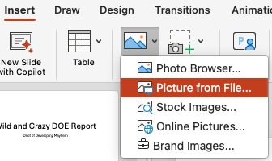
Introduction to ”The Process”
This is how to make auto-updating PowerPoint and Word documents
Step 1. Click on the Insert tab, select ”picture from file

Slide 3
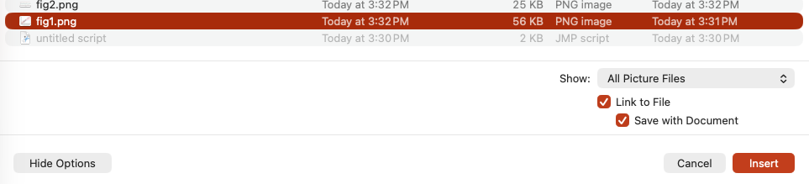
Introduction to ”The Process”
Step 2. Click the button that says “show options
Check the link to file option, and the save with doc option
Click “Insert”

Slide 4
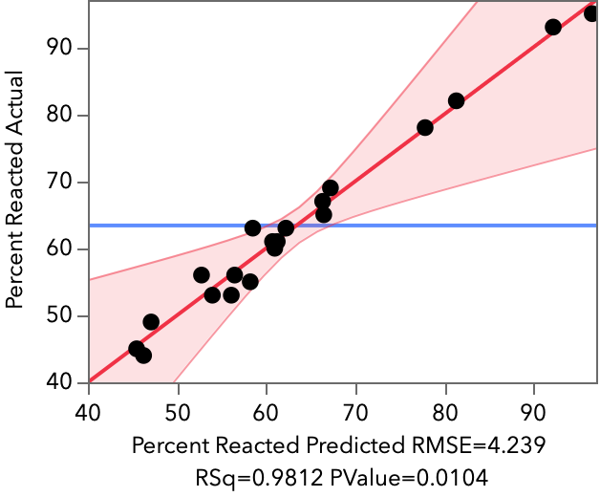
Introduction to ”The Process”
Step 3. Resize and position the figure in a convenient way.
Step 4. Repeat the process for all the figures
Step 5. Save using Save As so that you have a unique version of the file.

Slide 5
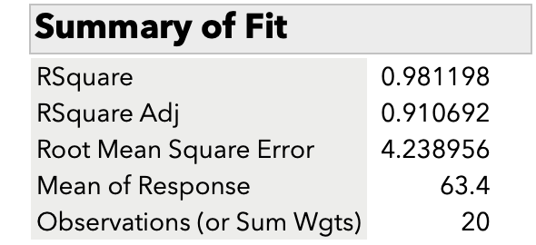
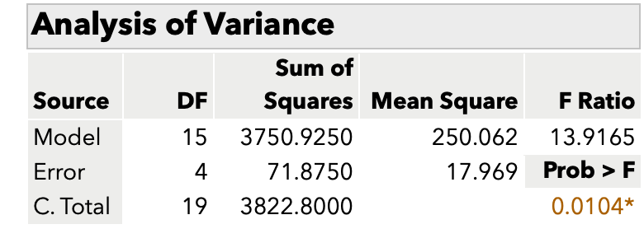
Example Report Slide 1

Slide 6
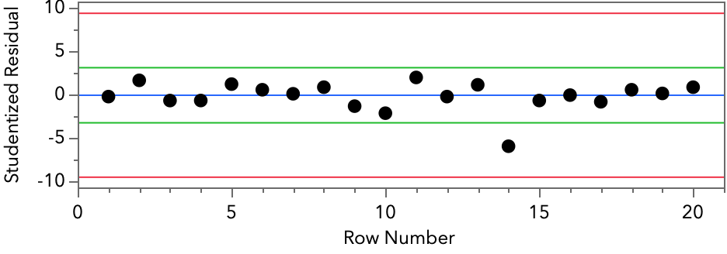
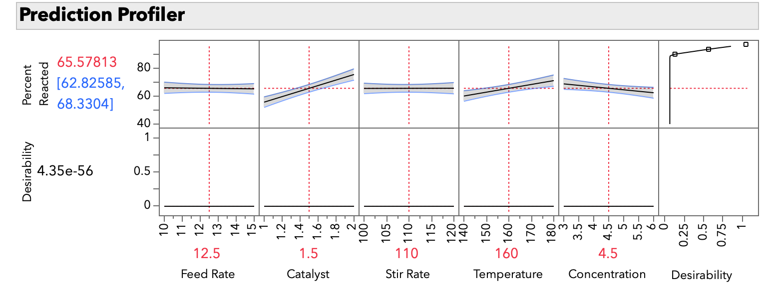
Example Report Slide 2

