Slide 1

Machine Learning Methods on industrial Data and Functional Data Explorer
Manchester, 5-7 March 2024
CUVILLIER Sophie, LEROYER Corentin
Ippon Innovation, Toulouse, France
2024-EU-30MP-1648

Slide 2


Few words about Ippon Innovation
Ippon was created in 2007 by François Bergeret, PhD in statistics. Headquarters in Toulouse, France.
Ippon is now a team of statisticians/data scientist, with extended skills in metrology, SPC and sampling, machine learning, statistics, JMP & JSL…
Ippon is JMP Partner
2

Slide 3

Outline
Machine Learning: Case Study on Industrial data
  Context: prediction of a defect on semiconductor advanced fab
  Explanation of a typical machine learning analysis workflow
  Overview of JMP and JMP Pro tools for this analysis
Introduction to Functional Data Explorer
  Context : prediction of a reject rate on drying painted sheets
  Overview of FDE platform
  Prediction with FPC scores using Fit Model platform
3
Notes:
.

Slide 4

Machine Learning with JMP:
Case Study on Industrial data
4
Notes:
.

Slide 5

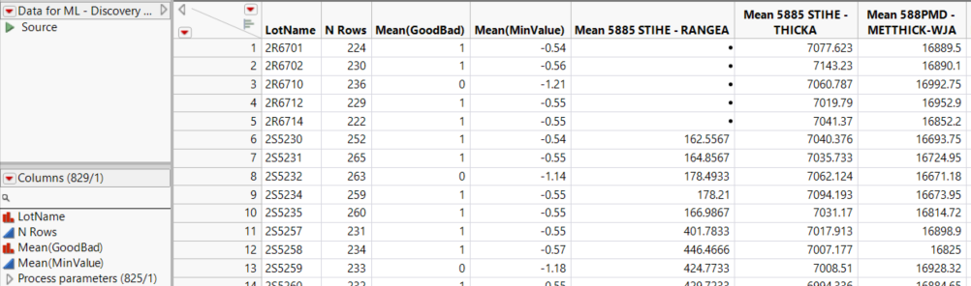
Context
Semiconductor advanced fab
Data are averaged per batches
There is a defect causing some batches to be thrown
We have in total 825 process parameters and 456 batches (N = 456).
Defect (Response)
INTERPRETATION: Determine the causes of the defect
PREDICTION: We want to be able to predict the presence of defects in batches based on process and equipment parameters in order to anticipate and relaunch products
Parameters
More than 20% of the batches are thrown away because of this defect
5

Slide 6

ANALYSIS WORKFLOW
2
4
1
3
Data Collection and Preprocessing
Model Selection and Training
Model Tuning and Optimization
Model Evaluation and Deployment
Evaluation: Evaluate the final model on the test set
Interpretability: Understand and interpret the model's predictions and variables' impact, if possible.
Deployment: Deploy the model into production
Data Cleaning: missing values, outliers, and inconsistencies
Feature Engineering: extract or create new features
Split Data: divide the dataset into training, validation, and test sets
Choose Algorithms: Regression, Decision Tree, Bootstrap Forest, Boosted Tree, SVM, Neural Networks…
Hyperparameter Tuning: Fine-tune the model's hyperparameters
Feature Selection: Identify the most relevant features or variables
6

Slide 7
Introduction to Functional Data Explorer
7
Notes:
.

Slide 8
Context
Industrial data from 2018 to 2021
We have 445 lots of painted sheets that are drying in a building
Indoor temperature and relative humidity measured each hour during the drying process
In a same lot, some painted sheets are considered to have dried poorly and are thrown away => reject rate
GOAL: We are trying to determine the effects of temperature and relative humidity on sheets reject rates
8

Slide 9
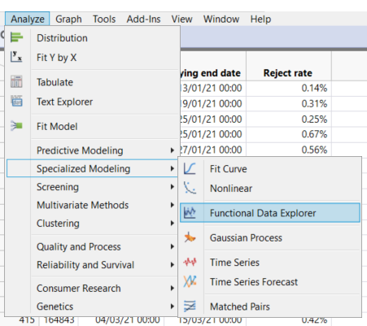
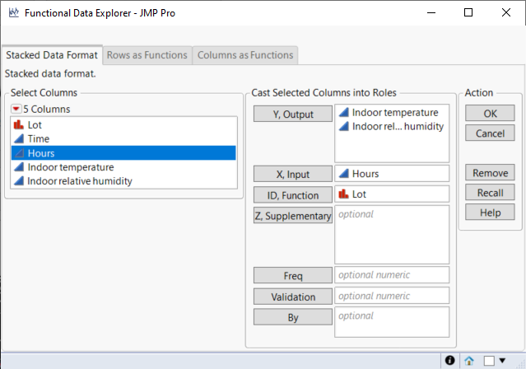
Launch the Functional Data Explorer
Here is how to launch the FDE platform to analyze the indoor temperature and the indoor relative humidity during the drying process by lot :
9

Slide 10
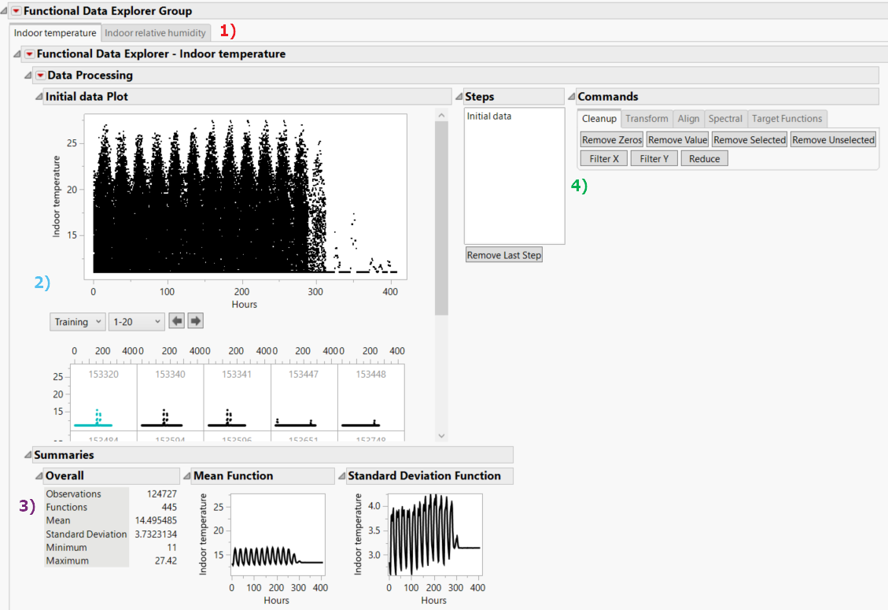
Data Processing
One tab for each parameter
Visualization of the values for each lot
Summaries with global statistics and overall mean and standard deviation across time
Buttons to help you to clean, transform or align the data, as well as specific action for spectral data
We will use Filter X button to keep only the first 240 hours of data for each lot.
10

Slide 11
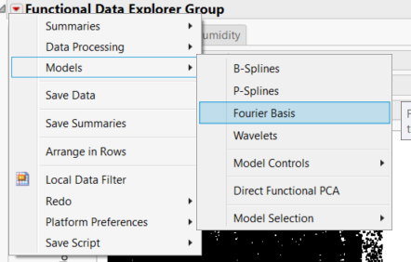
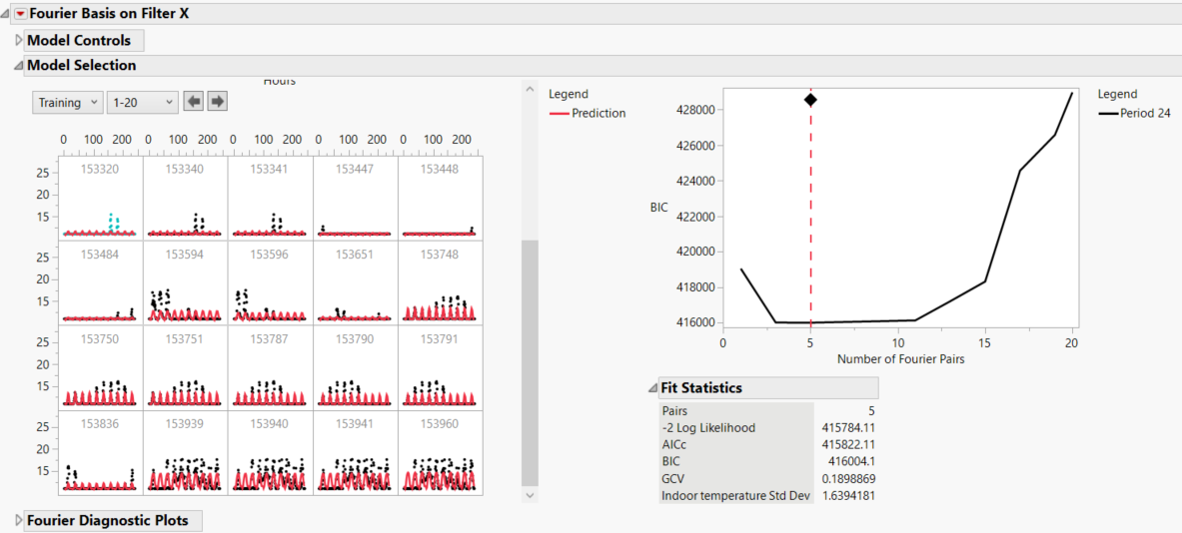
Fitting a basis function model
We fit our data with a basis function model to create a smooth function for each lot and parameter.
Here, we selected the Fourier basis model with a period of 24 points.
We fit our data with a basis function model to create a smooth function for each lot and parameter.
Here, we selected the Fourier basis model with a period of 24 points.
A BIC criterion (by default) is used to select the best number of pairs and create a red function for each lot.
11

Slide 12
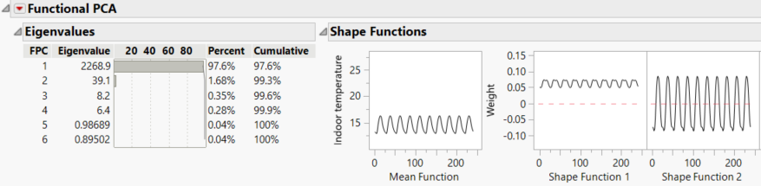
Applying a Functional Principal Component Analysis
A FPCA will be automatically performed to reduce the dimension of our data by using a combination of functions that will explain most of the variability of our data
The first FPC function explain 97.6% of the variability and seems to be related to the overall temperature during the 10 days.
The second FPC function seems to explain the variability of temperature between days and nights
For each lot, we will have a FPC score associated to each FPC function.
For example, a high FPC1 score means an overall high temperature, with a high mean temperature. A high FPC2 score means that there is a good gap in temperature between nights and days.
12

Slide 13
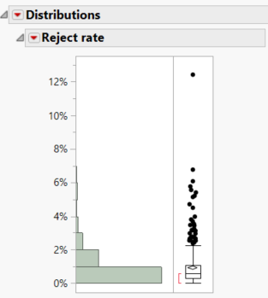
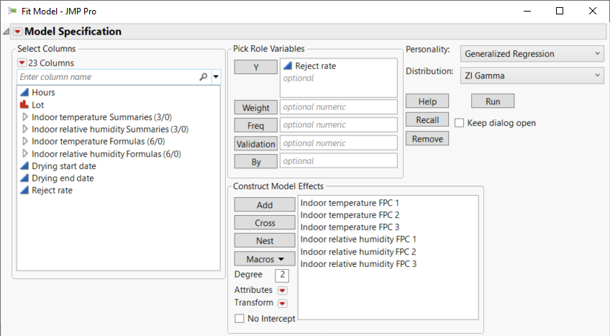
Fitting a model on FPC scores
We use a ZI Gamma distribution because we have a lot of 0% reject rate, and the distribution is very dense around 0
We retrieve the first three FPC scores of each lot for each parameter and join them in a table with the reject rate information.
Then, we launch the Fit Model platform to explain the variability of the reject rate according to the temperature and relative humidity values :
13

Slide 14
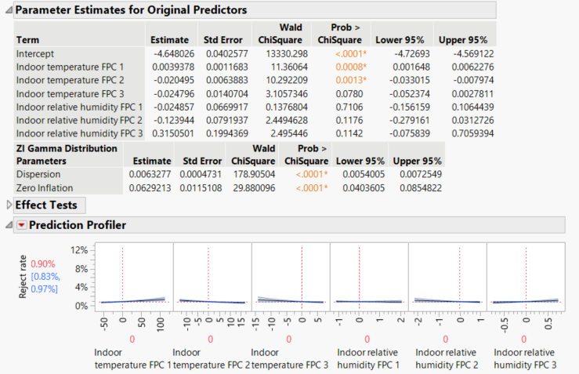

Interpretation of the results
Only the temperature seems to have an impact on the reject rate, especially the first two FPC scores.
The reject rate is bigger when the FPC1 score is higher or the FPC2 score is lower. It means that the industry rejected more sheets when the room was too warm and when the nights were as hot as the days, during summer for example.
You can see the impact of the FPC score on the temperature by using the profiler that was automatically saved into your table, and link both profilers :
14

Slide 15
Thank you for your attention
15
15

