Slide 1



Reducing the fit variation in denim jeans manufacturing
Anuja Khairnar, Helmut Hergeth, and Lori Rothenberg

Slide 2
Agenda
Background
  Company
Project Overview
  Introduction
  Manufacturing Process
  Methodology
  Results of Experiments
  Solutions
  Conclusion and Future Scope
Acknowledgement
Questions

Slide 3

About VF
$12 BILLION APPAREL, FOOTWEAR AND ACCESSORIES POWERHOUSE
It was founded in October 1899
NEARLY 70,000 ASSOCIATES in 170+ countries across the world
It has its presence in work wear, outdoor wear and Jeanswear

Slide 4
Introduction

Slide 5
Introduction
Denim jeans has become a universal phenomena
Fit has become increasingly important among consumers
Fabrics are changing and so is the process
Manufacturing denim to the perfect fit is getting difficult
Notes:
Among all the textile products, no other fabric has received such a wide acceptance as denim. It has been used extensively by people of all ages, classes and genders.
Denim jeans pass through many processes during manufacturing including washing and dry finishing with a laser to provide an attractive and fashionable look. Unfortunately, during finishing treatments denim garments lose their dimensional stability causing many difficulties with pattern adjustment before cutting the fabric. This affects the ability to obtain fixed sizes with defined measurements
Thus fit consistency is a problem for the manufacturers

Slide 6
Purpose
The purpose of this thesis research was to investigate fit variation in VF Jeanswear denim jeans.
Objectives:
Assess fit variation in Internal Manufacturing
Design a solution to reduce that variation
Implement that solution

Slide 7
Manufacturing process

Slide 8
Manufacturing denim jeans
Fiber
Pattern Cutting
Sewing
Washing and Drying
Finishing
Spinning
Dyeing
Finishing of Fabric
Weaving

Slide 9
Shrinkage and Fit
Shrinkage occurs during the entire process of manufacturing

Slide 10
Methodology

Slide 11
PROBLEM
Problem Statement: VF Jeanswear denim jeans show large deviations from the specification limits for the waist and inseam. (The team believed this contributed to a loss in sales.)
Objective: The purpose of the current study was to reduce the fit variation in the waist and inseam.
Notes:
The purpose of this study was to reduce the fit variation in denim jeans.

Slide 12

Baseline work
Waist Variation Distribution
Comparing Range of Fit of Sewing and Finishing Audit Data– 100% Cotton
Comparing Range of Fit of Sewing and Finishing Audit Data – Stretch
Cause and Effect Diagram
Process Flow Chart

Slide 13
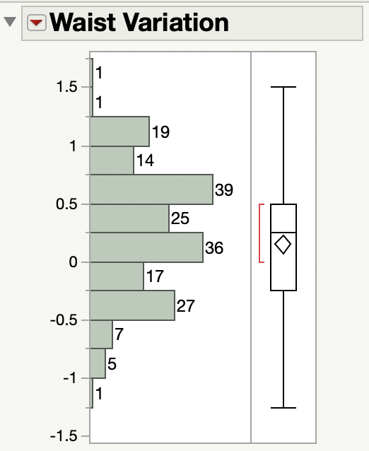
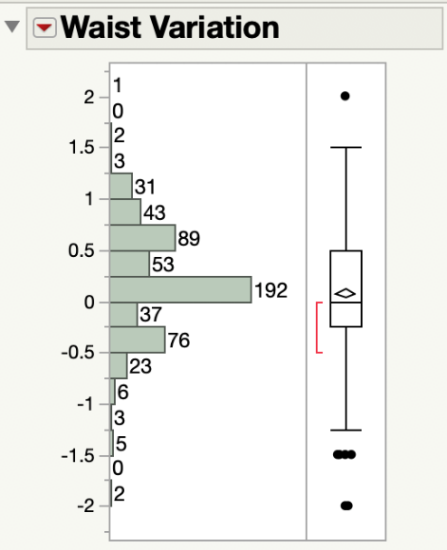
Waist Variation Distribution
Male Sizes 32*32
Female Sizes 10,12
Summary Statistics | Male 32*32 Waist
Mean | 0.15”
Std Dev | 0.54”
Range of fit | 3.24”
Summary Statistics | Female sizes 10 and 12 Waist
Mean | 0.07”
Std Dev | 0.52”
Range of fit | 3.12”

Slide 14
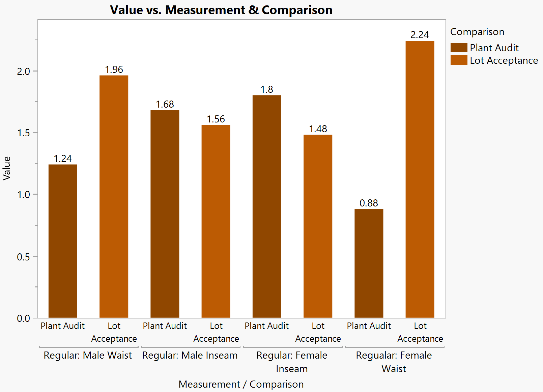
Comparing Range of Fit of Sewing and Finishing Audit Data 100% COtton
Notes:
In Inches
Sewing Plant has tolerance of -1/2 +1/2, thus it is ¼ over the tolerance for waist
Whereas finishing is >1/2 over the tolerance limits
(In regular denim the inseam doesn’t seem to get affected by finishing)

Slide 15
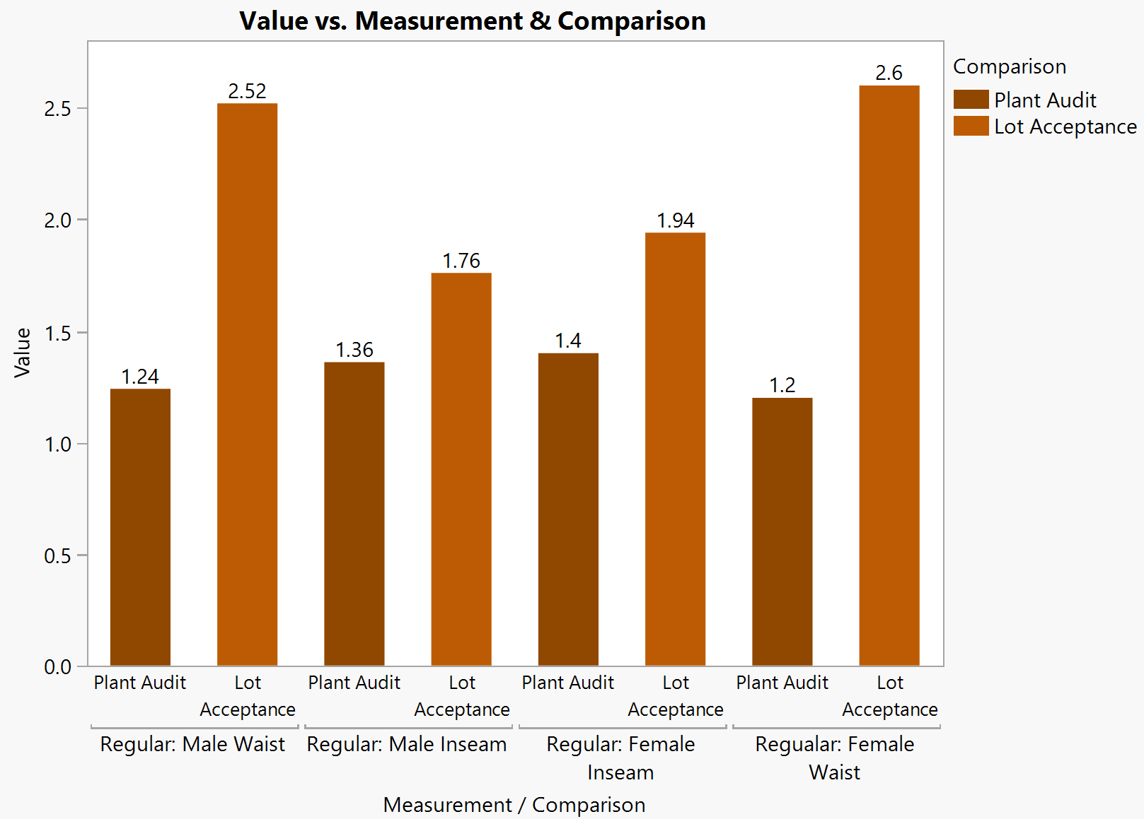
Comparing Range of Fit of Sewing and Finishing Audit Data stretch
Notes:
In Inches
Sewing Plant has tolerance of -1/2 +1/2, thus it is ¼ over the tolerance for waist
Whereas finishing is >1/2 over the tolerance limits
(In regular denim the inseam doesn’t seem to get affected by finishing)

Slide 16
Redefined Problem and objective
Problem Statement: VF Jeanswear denim jeans showed the range of fit for Men’s Waist as 3.24” and showed the range of fit for Women’s Waist as 3.12”. (The team believed this contributed to a loss in sales.)
Objective: The purpose of this study was to reduce the range in waist variation by 0.5” by April 2019. (The team believed this would result in increased sales.)

Slide 17
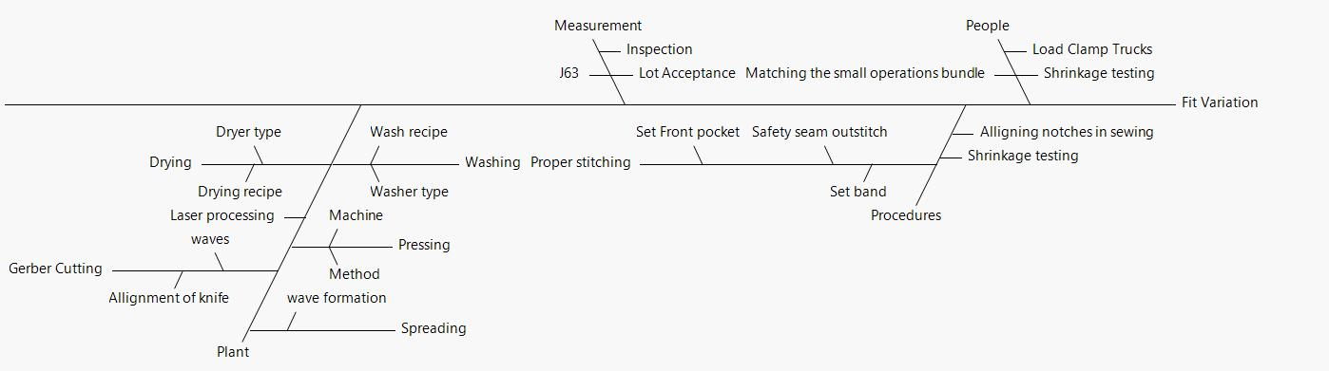
Cause and Effect Diagram

Slide 18
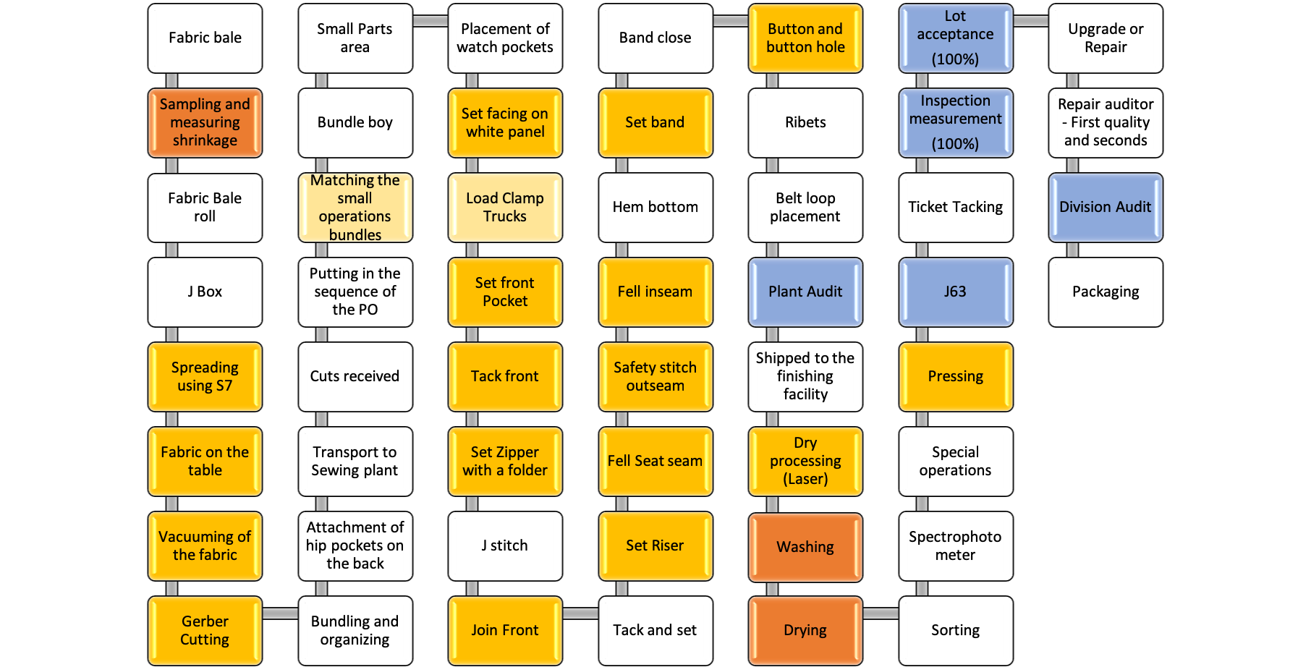
Process Flow Chart

Slide 19
Plan of Attack
Gage R&R Study
DOE
Screening
Different POs
PDL vs Industrial Washers and Dryers
Different Dryer Temperatures
Notes:
The previous plan of attack included few experiments in the Sewing and pressing segment as well, after laundry is complete we can move to these next steps.

Slide 20
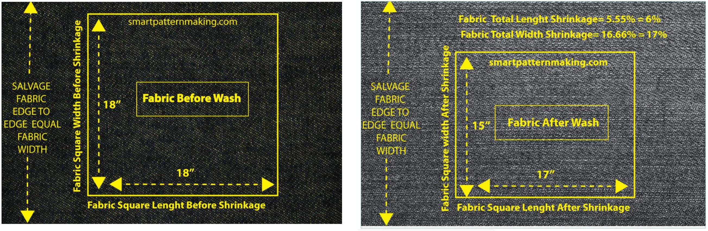
Gage R&R Study
Perform R&R for the Test Method
Shrinkage Testing
Notes:
Performing R&R on the existing method of shrinkage testing

Slide 21
Gage R&R Study
Choose 12 Fabric swatches
2 Rigid Cotton
2 Washed Cotton
2 Rigid Bi-Blend
2 Washed Bi-Blend
2 Rigid Tri-Blend
2 Washed Tri-Blend
Choose 3 Operators at random
Emanuel
Rosario
Emelda
Ask the operator to measure each fabric square 3 times in random order
Calculate the repeatability and reproducibility
Notes:
No of fill Measurements :(12 Fabrics)*(3 Operator)*(3 Measurements)
= 108 Measurements
No of warp Measurements :(12 Fabrics)*(3 Operator)*(3 Measurements)
= 108 Measurements

Slide 22
Gage R&R Study Results: Fill Measurements
Component | % of Total
Gauge R&R | 0.0162
Repeatability | 0.0129
Reproducibility | 0.0033
Part-to-Part | 99.98
%
1 RB- Rigid Bi-Blend Fabric 1
1 RC- Rigid Cotton Fabric 1
1 RT- Rigid Tri-Blend Fabric 1
1 WB-Washed Bi-Blend Fabric 1
1 WC- Washed Cotton Fabric 1
1 WT- Washed Tri-Blend Fabric 1
2 RB- Rigid Bi-Blend Fabric 2
2 RC- Rigid Cotton Fabric 2
2 RT- Rigid Tri-Blend Fabric 2
2 WB-Washed Bi-Blend Fabric 2
2 WC- Washed Cotton Fabric 2
2 WT- Washed Tri-Blend Fabric 2
Notes:
1 RB- Rigid Bi-Blend Fabric 1
1 RC- Rigid Cotton Fabric 1
1 RT- Rigid Tri-Blend Fabric 1
1 WB-Washed Bi-Blend Fabric 1
1 WC- Washed Cotton Fabric 1
1 WT- Washed Tri-Blend Fabric 1
2 RB- Rigid Bi-Blend Fabric 2
2 RC- Rigid Cotton Fabric 2
2 RT- Rigid Tri-Blend Fabric 2
2 WB-Washed Bi-Blend Fabric 2
2 WC- Washed Cotton Fabric 2
2 WT- Washed Tri-Blend Fabric 2

Slide 23
Gage R&R Study Results : Warp Measurements
Component | % of Total
Gauge R&R | 0.27
Repeatability | 0.13
Reproducibility | 0.14
Part-to-Part | 99.73
%
1 RB- Rigid Bi-Blend Fabric 1
1 RC- Rigid Cotton Fabric 1
1 RT- Rigid Tri-Blend Fabric 1
1 WB-Washed Bi-Blend Fabric 1
1 WC- Washed Cotton Fabric 1
1 WT- Washed Tri-Blend Fabric 1
2 RB- Rigid Bi-Blend Fabric 2
2 RC- Rigid Cotton Fabric 2
2 RT- Rigid Tri-Blend Fabric 2
2 WB-Washed Bi-Blend Fabric 2
2 WC- Washed Cotton Fabric 2
2 WT- Washed Tri-Blend Fabric 2
Notes:
1 RB- Rigid Bi-Blend Fabric 1
1 RC- Rigid Cotton Fabric 1
1 RT- Rigid Tri-Blend Fabric 1
1 WB-Washed Bi-Blend Fabric 1
1 WC- Washed Cotton Fabric 1
1 WT- Washed Tri-Blend Fabric 1
2 RB- Rigid Bi-Blend Fabric 2
2 RC- Rigid Cotton Fabric 2
2 RT- Rigid Tri-Blend Fabric 2
2 WB-Washed Bi-Blend Fabric 2
2 WC- Washed Cotton Fabric 2
2 WT- Washed Tri-Blend Fabric 2

Slide 24
Experiments
4 different factors:
Fabric Type- 3 Levels
Cotton - CC
Bi Blend – Bi-Blend
Tri Blend – Tri-Blend
Wash Type- 4 Levels
Rinse- LB
Stone Wash- ST
Hot Bleach - BT
Cold Bleach - LT
Washer Type- 2 Levels
High Speed Extraction- EX
No Extraction- NE
Dryer Type- 2 Levels
Dryers with Humidity Sensors- HD
Dryers with Algorithm settings- AL
Number of runs: (3 Fabric Types) * ( 4 Wash Types) * ( 2 Washer Types) * ( 2 Dryer Types) * (2 pseudo replications)
= 96 Runs

Slide 25
ExperimentS
Fabric Codes
Cotton
Bi-Blend
Tri-Blend:
Wash Recipes
Rinse
Stone Wash
Hot Bleach Wash
Cold Bleach Wash
Washer
No Extraction
High Speed Extraction
Dryer
Humidity Sensor
Algorithm
A total of 4 Measurements were taken for each run
After wash fill
After wash warp
After dry Fill
After dry warp

Slide 26
Results of experiments

Slide 27
Effect Summary for after wash
Source | p Value
Fabric Type | 0.00000
Wash Type | 0.00000
Fabric Type*Wash Type | 0.00000
Wash Type*Washer Type | 0.00000
Washer Type | 0.00199
Fabric Type*Washer Type | 0.00407
Notes:
This is Fill.

Slide 28
BOX COX (0.25) for after wash
Source | p Value
Fabric Type | 0.00000
Wash Type | 0.00000
Fabric Type*Wash Type | 0.00000
Wash Type*Washer Type | 0.00000
Washer Type | 0.21792
Fabric Type*Washer Type | 0.02516
Notes:
This is Fill. Since there were negative numbers, we flipped the scale. A positive 12 now meant high shrinkage.

Slide 29
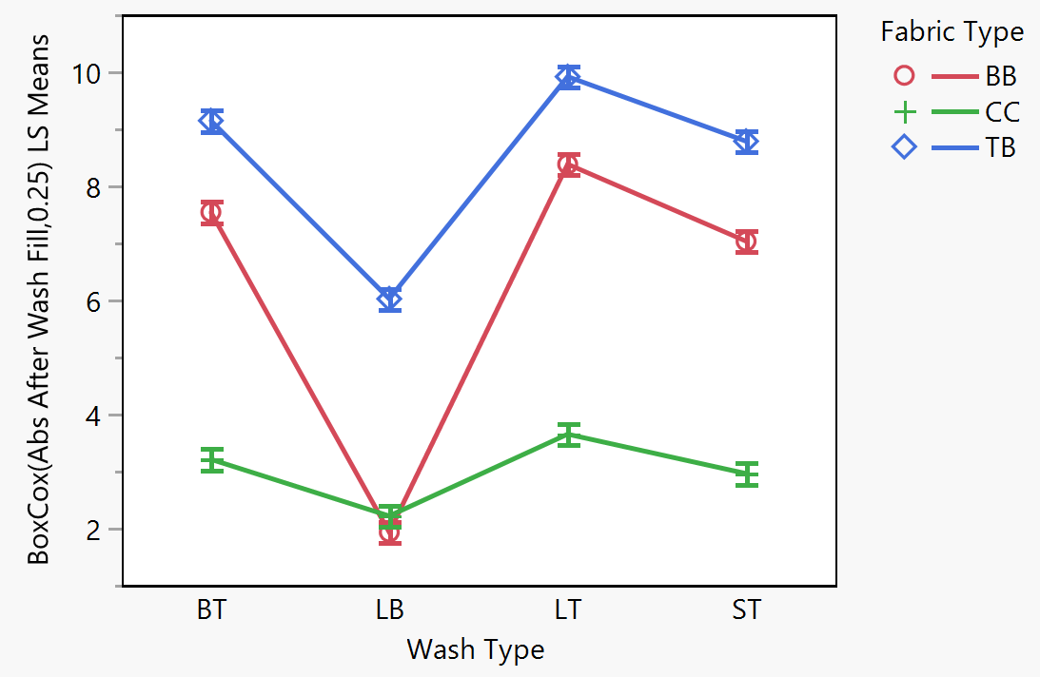
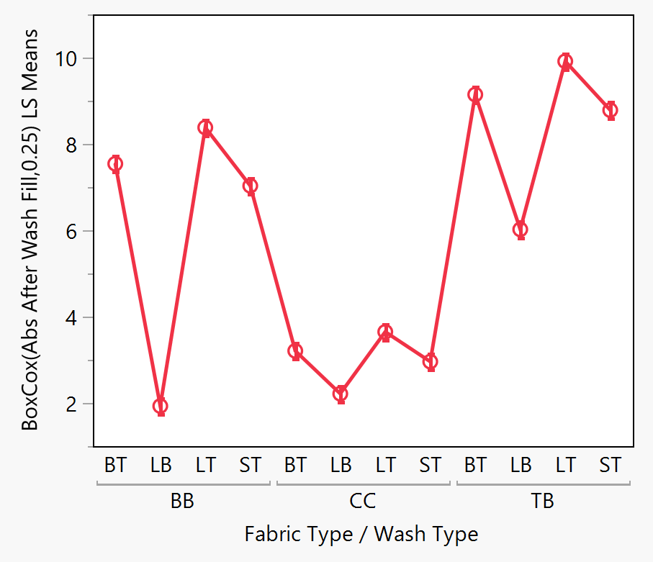
after wash results
BB | Bi-Blend
CC | 100% Cotton
TB | Tri-Blend
LB | Rinse
ST | Stone Wash
BT | Hot Bleach Wash
LT | Cold Bleach Wash
LS Means Interaction Plot of Fabric Type*Wash Type for After Wash Measurements
LS Means Plot of Fabric Type*Wash Type for After Wash Measurements
Notes:
This is Fill Results

Slide 30
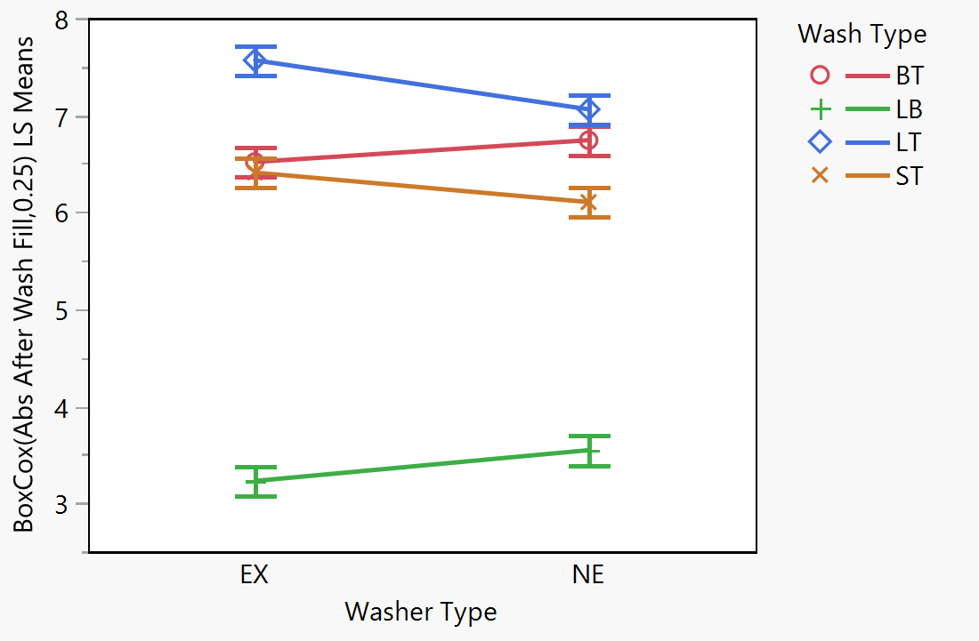
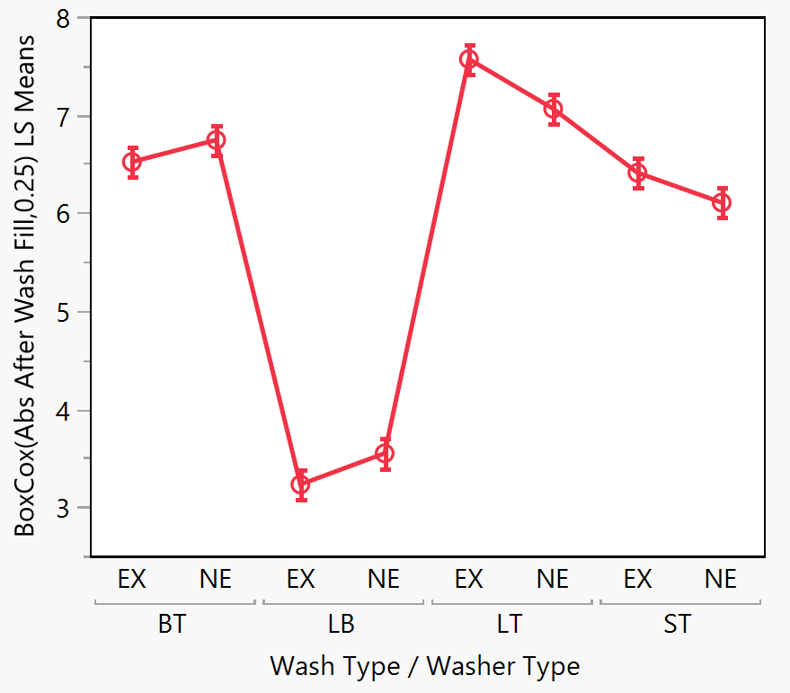
after wash results
LB | Rinse
ST | Stone Wash
BT | Hot Bleach Wash
LT | Cold Bleach Wash
EX | High Speed Extraction
NE | No Extraction
LS Means Interaction Plot of Fabric Type*Wash Type for After Wash Measurements
LS Means Plot of Fabric Type*Wash Type for After Wash Measurements
Notes:
Rinse is not significantly different for high speed extraction and no extraction – and they have the least shrinkage.
Cold bleach has the most shrinkage, although there is not a significant difference between cold bleach no extraction and hot bleach no extraction.

Slide 31
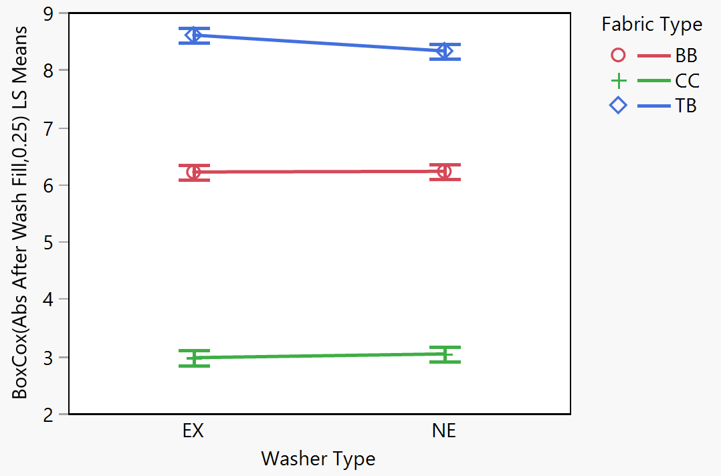
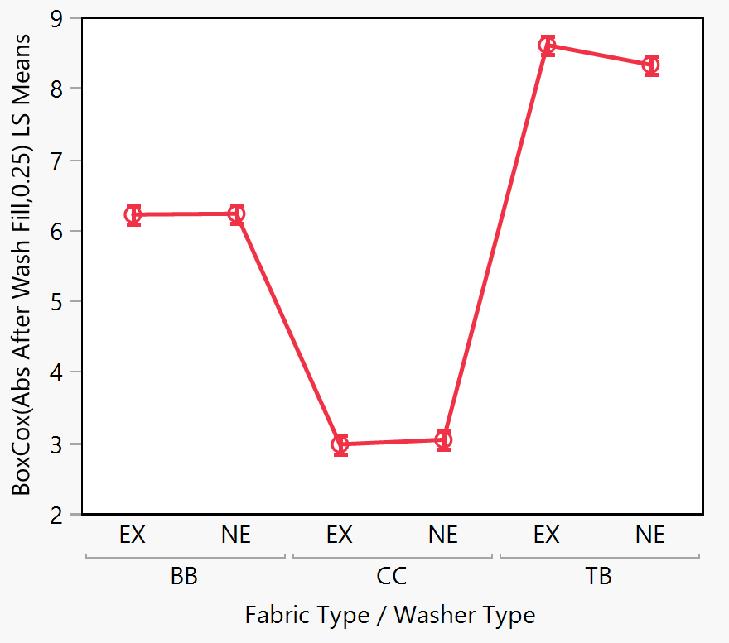
after wash results
BB | Bi-Blend
CC | 100% Cotton
TB | Tri-Blend
EX | High Speed Extraction
NE | No Extraction
LS Means Interaction Plot of Fabric Type*Washer Type for After Wash Measurements
LS Means Interaction Plot of Fabric Type*Washer Type for After Wash Measurements

Slide 32
Effect summary for after dry
Source | p Value
Fabric Type | 0.00000
Wash Type | 0.00000
Fabric Type*Wash Type | 0.00491
Notes:
This was warp.

Slide 33
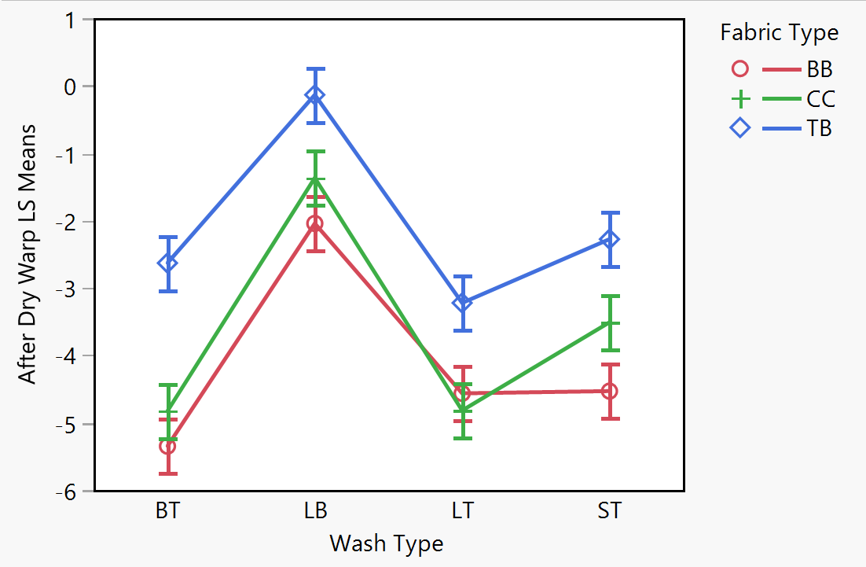
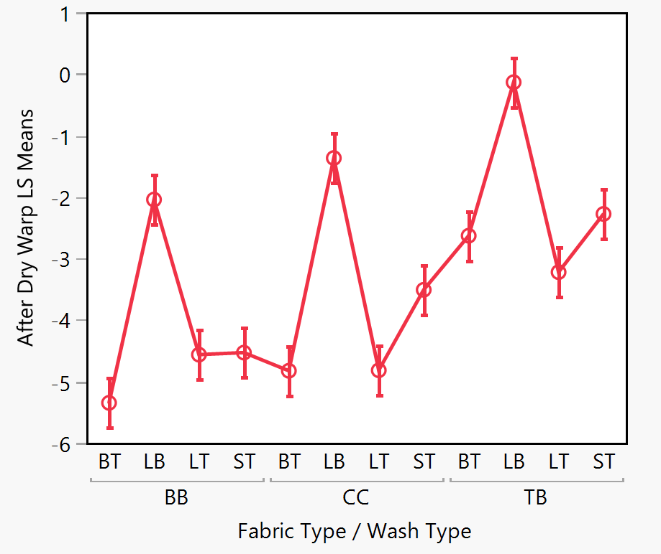
after dry results
Least Square means %
BB | Bi-Blend
CC | 100% Cotton
TB | Tri-Blend
LB | Rinse
ST | Stone Wash
BT | Hot Bleach Wash
LT | Cold Bleach Wash
LS Means Interaction Plot of Fabric Type*Wash Type for After Dry Measurements
LS Means Plot of Fabric Type*Wash Type for After Dry Measurements
Notes:
This was warp.

Slide 34
Different mills
Fabric Type
Bi-Blend
Tri-Blend
Wash Type
Rinse
Hot Bleach
Cold Bleach
PO
PO1
PO2
PO3
PO4
PO5

Slide 35
Effect summary for Different PO after dry
Source | PValue
Wash Type | 0.00000
Fabric Type*Wash Type | 0.00000
Fabric Type*PO number | 0.00000
PO number | 0.00000
Fabric Type | 0.00447
Wash Type*PO number | 0.75667

Slide 36
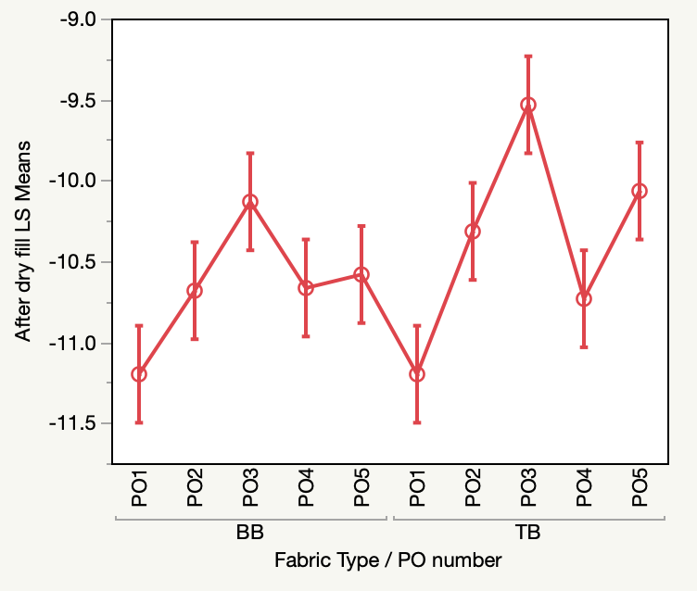
different po results
BB | Bi-Blend
TB | Tri-Blend
PO1 | Purchase Order 1
PO2 | Purchase Order 2
PO3 | Purchase Order 3
PO4 | Purchase Order 4
PO5 | Purchase order 5
LS Means Plot of Fabric Type*PO number for After Dry Measurements
Notes:
Different POs showed variation of about 1.4%

Slide 37
Different Dryer Temperatures
Fabric Type
Bi-Blend
Tri-Blend
Dryer Temp
140℉ - Dyer 14 (65 mins)
160℉ - Dryer 3 (55 mins)
180℉ - Dryer 4 (50 mins)

Slide 38
Effect Summary for different Dryer Temperature
Source | PValue
Fabric Type | 0.00000
Dryer Temp | 0.02060
Fabric Type*Dryer Temp | 0.49200

Slide 39
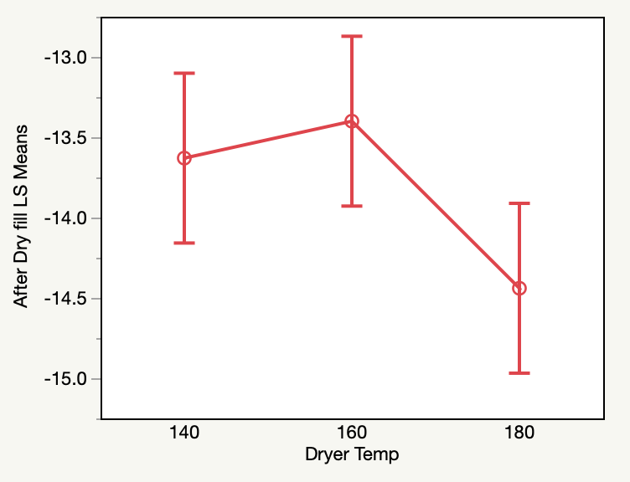
different Dryer Temperature results
140 | 140°F Temp
160 | 160°F Temp
180 | 180°F Temp
Dryer Temperature Variation

Slide 40
Product development (PDL) vs Industrial Washers & Dryers
PDL
Industrial
Fabric Type
Bi-Blend
Tri-Blend
Wash Type
Rinse
Hot Bleach
Cold Bleach
Washer
PDL Washer 1
Dryer
PDL Dryer 1
PDL Washer 2
PDL Dryer 2
Fabric Type
Bi-Blend
Tri-Blend
Wash Type
Rinse
Hot Bleach
Cold Bleach
Washer
Industrial Washer 1
Industrial Washer 2
Dryer
Industrial Dryer 1
Industrial Dryer 2

Slide 41
Effect Summary PDL vs Industrial Washers
PDL: After Wash
Industrial: After Wash
Source | PValue
Wash type | 0.00000
Fabric type | 0.00000
Fabric type*Wash type | 0.00000
Wash type*Washer type | 0.00507
Washer type | 0.04470
Fabric type*Washer type | 0.13762
Source | PValue
Wash Type | 0.00000
Fabric Type | 0.00000
Fabric Type*Wash Type | 0.00000
Wash Type*Washer Type | 0.00825
Fabric Type*Washer Type | 0.04633
Washer Type | 0.10874
Notes:
This was Fill.

Slide 42
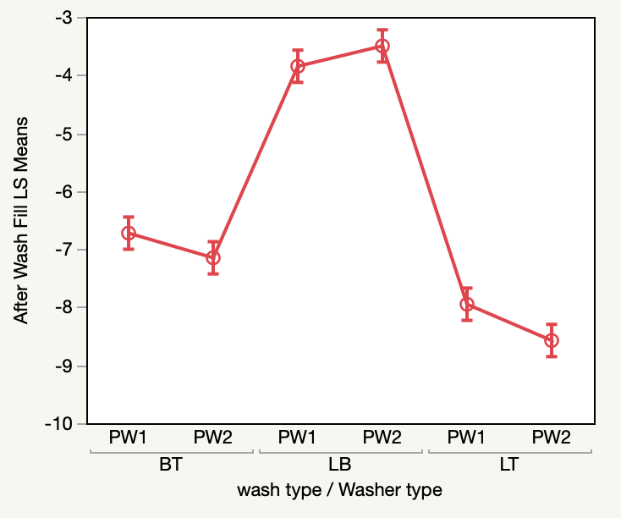
PDL After Wash Results
BT | Hot Temp Bleach
LB | Rinse
LT | Low Temp Bleach
PW1 | PDL Washer 1
PW2 | PDL Washer 2
LS Means Plot of Wash Type*Washer Type for After Wash Measurements

Slide 43
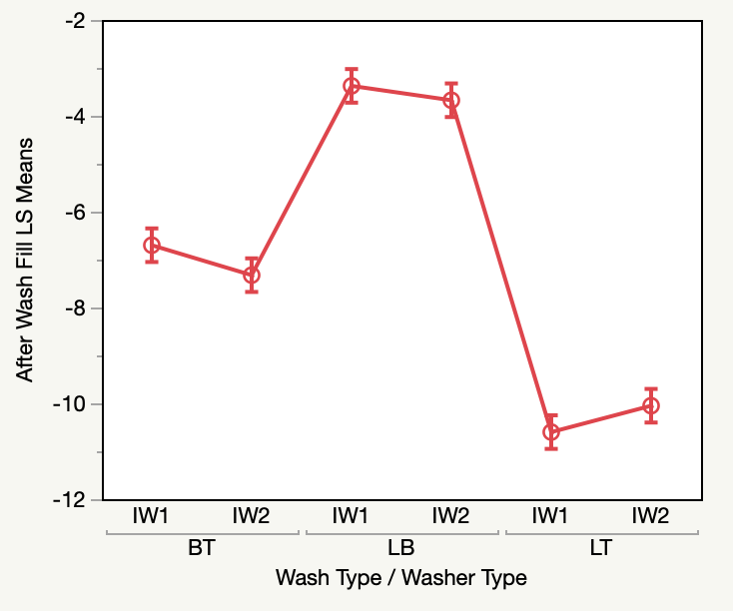
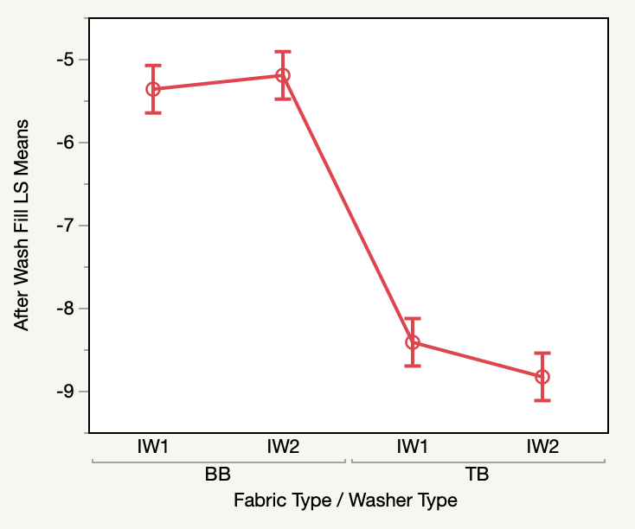
Industrial After Wash Results
BT | Hot Temp Bleach
LB | Rinse
LT | Low Temp Bleach
BB | Bi-Blend
TB | Tri-Blend
IW1 | Industrial Washer 1
IW2 | Industrial Washer 2
IW1 | Industrial Washer 1
IW2 | Industrial Washer 2
LS Means Plot of Wash Type*Washer Type for After Wash Measurements
LS Means Plot of Fabric Type*Washer Type for After Wash Measurements

Slide 44
Effect Summary PDL vs Industrial Dryers
PDL: After Dry
Industrial: After Dry
Source | PValue
Wash Type | 0.00000
Fabric Type | 0.00000
Wash Type*Dryer Type | 0.00464
Fabric Type*Dryer Type | 0.30423
Dryer Type | 0.60289
Source | PValue
Wash Type | 0.00000
Fabric Type | 0.00028
Fabric Type*Dryer Type | 0.25153
Dryer Type | 0.50153
Wash Type*Dryer type | 0.73098
Notes:
This was Fill.

Slide 45
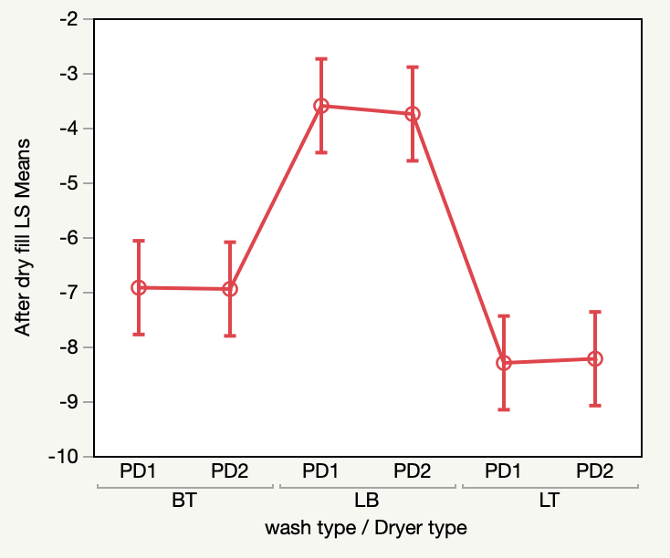
PDL After Dry Results
BT | Hot Temp Bleach
LB | Rinse
LT | Low Temp Bleach
PD1 | PDL Dryer 1
PD2 | PDL Dryer 2
LS Means Plot of Wash Type*Dryer Type for After Dry Measurements

Slide 46
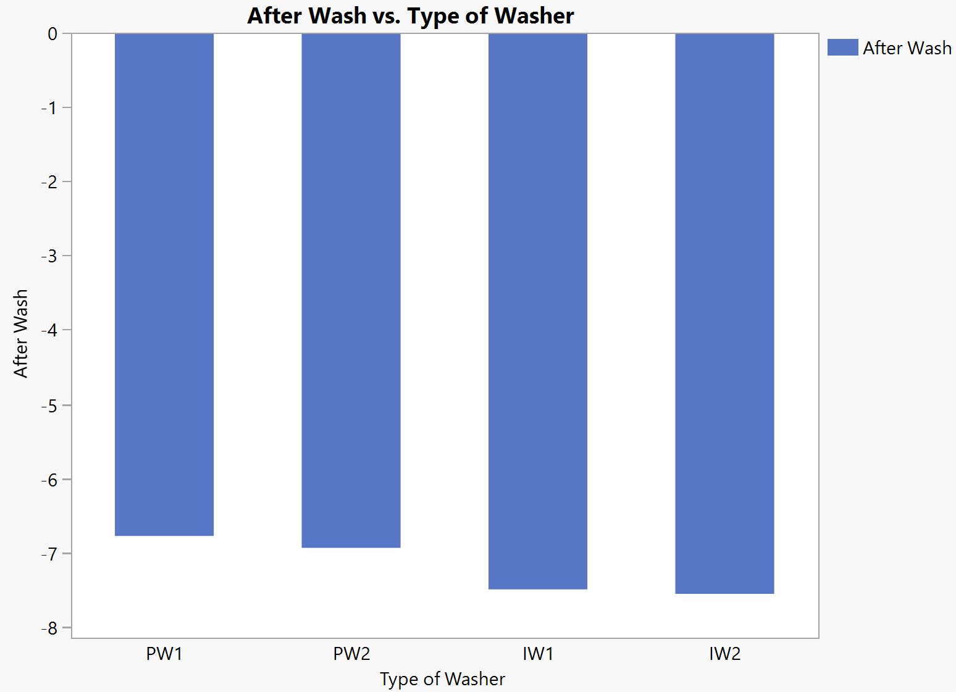
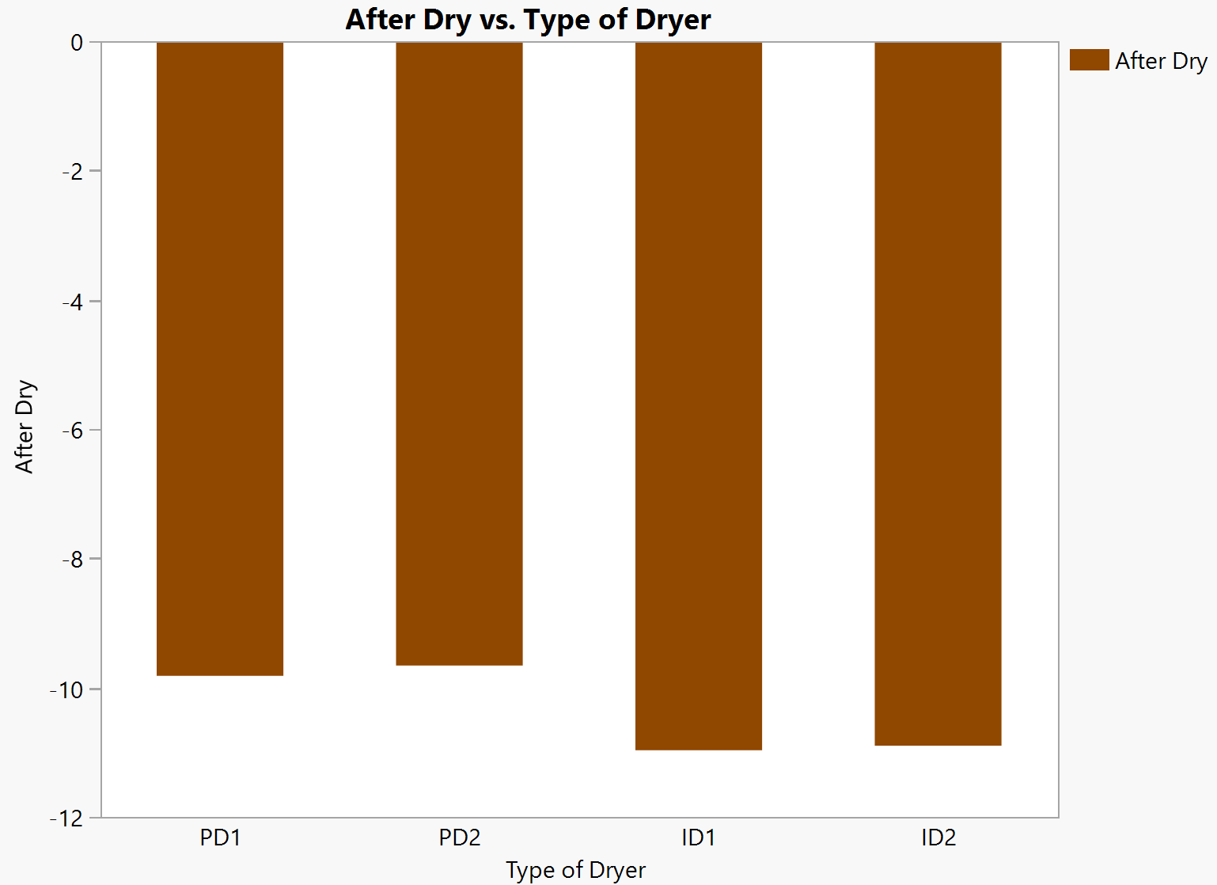
PDL vs Industrial Washers & Dryers

Slide 47
solutions

Slide 48
Improvements
Before
40% of Bi-Blend and Tri-Blend fabric Bales tested for shrinkage
PDL and
Industrial machines were different
After
100% of Bi-Blend and Tri-Blend fabric bales are tested for shrinkage
The machines are to be tested to explain differences

Slide 49
changes
Current
Before
40% of Bi-Blend and Tri-Blend fabric Bales tested for shrinkage
After
100% of Bi-Blend and Tri-Blend fabric bales are tested for shrinkage
Future
Before
PDL performed better than Industrial machines
After
Mechanical Testing of PDL and Industrial Machines

Slide 50
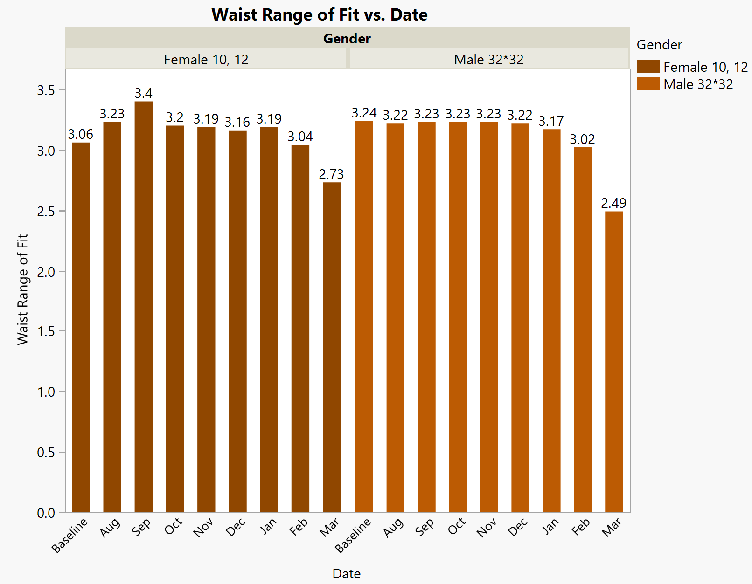
Results after change
Notes:
After VF started to work on the recommendations, they changed their measurement metric to Range of Fit and used Trend charts of their range by month to monitor continual progress. VF was going through large corporation changes at the time and the actual monitoring was addresses after the company split into two separate entities.
Implemented in Feb and Anuja was gone at the end of February – that’s why only March data is included

Slide 51
Conclusion and future scope

Slide 52
Conclusion & Future Scope
  Range of Fit for Men’s Waist variation has come down from 3.24” to 2.49” which is a 23.1% decrease in Range. Similarly, the Range of fit for women’s Waist has come down from 3.12” to 2.73”, which is about a 12.5% of reduction in Range of Fit.
  Working with the mill on improving the fabric, as PO had significant differences in mean
  PDL and industrial machines show a 1% difference in shrinkage on average, so more study is needed
  Dryer temperature did not give sufficient data in my experiments for us to switch to 140℉ from 160℉
  Tri Blends need to be studied further and collected data can be used to understand its behavior

Slide 53
Limitations
Time
Lack of Data
Location of Experimentation
No constant access to information

Slide 54
Aknowledgements
Dr. Helmut Hergeth, Advisory Committee Co-Chairman
Associate Professor,
TATM
Dr. Lori Rothenberg, Advisory Committee Co-Chairman
Associate Professor,
TATM
Dr. Peter Hauser, Committee Member
Professor,
TECS
At VF,
James Booth, VP of Operations Excellence , VF Corporation.,
Christian Woodman, Director of Quality, VF Jeanswear.,
Carole Mcfee, Senior Manager of Quality Control, VF Jeanswear,.
Paty Ruiz, Quality Manager, VF Jeanswear.,

Slide 55
Questions?

Slide 56
Thank you

Slide 57
References
M. Sanchez, Chapter 3 Denim and jeanswear : product , markets and the industry. (2009), 11–22.
Chavan, R. B. (2015). Indigo dye and reduction techniques. Denim: Manufacture, Finishing and Applications. Elsevier Ltd. https://doi.org/10.1016/B978-0-85709-843-6.00003-2
China Gerber Cutter. (n.d.). Retrieved April 1, 2019, from https://www.made-in-china.com/showroom/indochinoshanghai/product-detailFMdnhDUuZeAi/China-Gerber-Gtxl-Automatic-Cutting-System.html
Choudhary, A. K., Sikka, M. P., & Bansal, P. (2018). The study of sewing damages and defects in garments. Research Journal of Textile and Apparel, 22(2), 109–125. https://doi.org/10.1108/RJTA-08-2017-0041
CLASSIC JEANS | Weekend designer. (n.d.). Retrieved April 1, 2019, from https://wkdesigner.wordpress.com/2008/10/07/classic-jeans/
Denim and Jeans Manufacturing Process. (n.d.). Retrieved April 1, 2019, from https://clothingindustry.blogspot.com/2017/11/denim-jeans-manufacturing-process.html
Denim Jean Workshop | UAL. (n.d.). Retrieved April 1, 2019, from https://www.arts.ac.uk/subjects/fashion-making-and-pattern-cutting/short-courses/sewing-skills/denim-jean-workshop-lcf
Dhouib, S., Khedher, F., & Sakli, F. (2016). A new approach to predict the fabric shrinkage in denim garments after finishing treatments. Journal of the Textile Institute, 107(3), 364–375. https://doi.org/10.1080/00405000.2015.1034928
El-Ghezal, S., Babay, A., Dhouib, S., & Cheikhrouhou, M. (2009). Study of the impact of elastane’s ratio and finishing process on the mechanical properties of stretch denim. Journal of the Textile Institute, 100(3), 245–253. https://doi.org/10.1080/00405000701757925
Essential Denim Knowledge: How Yarn Is Spun. (n.d.). Retrieved April 1, 2019, from https://www.denimhunters.com/essential-denim-knowledge-how-yarn-is-spun/
Fall, C. (n.d.). Warp and Weft in Embroidery Fabrics. Retrieved April 11, 2019, from https://www.thesprucecrafts.com/warp-and-weft-1177681
Greenlee, A.-R. (n.d.). Introduction to AutoCAD. Retrieved from https://www.unm.edu/~bgreen/autocad/AutoCAD 1.pdf
How Denim Is Made: The Spinning Process. (n.d.). Retrieved April 16, 2019, from https://www.denimhunters.com/how-denim-is-made-spinning/
Id, C. R. E. F., Nrc, M. L., & Library, M. (2019). Rapid #: -14225409 CROSS REF ID : LENDER :

Slide 58
References
Kan, C. W., & Yuen, C. W. M. (2009). Evaluation of the performance of stretch denim fabric under the effect of repeated home laundering processes. International Journal of Fashion Design, Technology and Education, 2(2–3), 71–79. https://doi.org/10.1080/17543260903302329
Khan, M. M. R., & Mondal, M. I. H. (2012). Bleach Washing Combined with Pumice Stone.
Khedher, F., Dhouib, S., & Sakli, F. (2013). The Effect of Seaming on Cloth Shrinkage During Finishing Treatment of Denim Garments. Research Journal of Textile and Apparel, 17(4), 90–102. https://doi.org/10.1108/RJTA-17-04-2013-B011
Mason, R. L., Gunst, R. F., & Hess, J. L. (n.d.). Statistical Design and Analysis of Experiments With Applications to Engineering and Science Second Edition. Retrieved from www.copyright.com.
McQueen, R. H., Batcheller, J. C., Moran, L. J., Zhang, H., & Hooper, P. M. (2017). Reducing laundering frequency to prolong the life of denim jeans. International Journal of Consumer Studies, 41(1), 36–45. https://doi.org/10.1111/ijcs.12311
Neckář, B., & Das, D. (2007). Modelling of yarn shrinkage due to washing. Journal of the Textile Institute, 98(6), 479–482. https://doi.org/10.1080/00405000701463896
Our Company :: VF Corporation (VFC). (n.d.). Retrieved April 1, 2019, from https://www.vfc.com/our-company#overview
J. McLoughlin, S. Hayes and R. Paul. (2015a). Denim: Manufacture, Finishing and Applications. Denim: Manufacture, Finishing and Applications. Elsevier Ltd. https://doi.org/10.1016/C2013-0-16377-5
Paul, R. (2015b). Denim and jeans: An overview. Denim: Manufacture, Finishing and Applications. Elsevier Ltd. https://doi.org/10.1016/B978-0-85709-843-6.00001-9
Presidential input support helps farmers double 2017 cotton yield - NewZimbabwe.com. (n.d.). Retrieved April 1, 2019, from https://www.newzimbabwe.com/presidential-input-support-helps-farmers-double-2017-cotton-yield/
Retail Sales Tip:It’s Not About How Neatly Your Merchandise Is Stacked. (n.d.). Retrieved April 11, 2019, from https://www.retaildoc.com/blog/retail-sales-merchandising-pant-stackers
Rope Dyeing - Heddels. (n.d.). Retrieved March 18, 2019, from https://www.heddels.com/dictionary/rope-dyeing/
Weaver, B. P., Hamada, M. S., Vardeman, S. B., & Wilson, A. G. (2012). A Bayesian approach to the analysis of gauge R&R data. Quality Engineering, 24(4), 486–500. https://doi.org/10.1080/08982112.2012.702381
Wwd, K., & Vol, N. Y. (2016). Denim In-Depth : Looking For The Edge, 211, 48–50.

