Slide 1
Approaches to Comparisons
with JMP® 17
Mark Bailey
Senior Analytics Software Tester
Jianfeng Ding
Senior Research Statistician Developer

Slide 2
Introduction
Statistical inference can help the comparison of two populations
Comparing two or more populations is a common task.
The comparison leads to a decision between two hypotheses.
Samples from the populations are often collected for the comparison.
Statistical inference provides valuable information about the samples.
  Is there sufficient evidence to reject one hypothesis about the populations?
A clear statement of the hypotheses is essential to making the correct choice of the test for the comparison.

Slide 3
Hypotheses of Statistical Tests
Two mutually exclusive ideas that include the only possibilities
The alternative and null hypotheses represent mutually exclusive statements about the populations. No other hypothesis is possible.
The alternative hypothesis states the conclusion that we claim.
  It serves to represent the populations.
  It requires sufficient evidence to overthrow the other hypothesis.
The null hypothesis states the opposing conclusion that must be overcome by strong evidence.
  It serves as a reference for comparison.
  It is assumed to be true.

Slide 4
Current Situation
Understanding hypothesis testing is in transition
Statistical training historically presented only one way of using the two hypotheses.
The most often taught statistical tests are used to demonstrate sufficient evidence to conclude there is a difference between the populations.
The resulting lack of understanding can lead to misuse of the tests.
The choice of the test
  is not a matter of what data is collected or how the data is collected
  is strictly a matter of the stated hypotheses for the purpose of the comparison.

Slide 5
Goal of Comparison: Demonstrate a Difference
Explicit statement of hypotheses is necessary for clarity of test
Example 1: demonstrate that a temperature change causes a new outcome (difference)
  We claim that a new level of the response will result from a change in the process temperature.
  A designed experiment is used to randomly sample from a population for a low temperature condition and from a population for a high temperature condition.
Two hypotheses:
  H₀: temperature does not affect the outcome (reference, assumed to be true)
  H₁: temperature affects the outcome (only if evidence is strong enough to reject null)

Slide 6
Goal of Comparison: Demonstrate Equivalence
Explicit statement of hypotheses is necessary for clarity of test
Example 2: demonstrate that a temperature change does not cause a change in the outcome (equivalence)
  We claim that a planned change in the process temperature to improve yield will not change the level of an impurity in the product.
  A designed experiment is used to randomly sample from a population for a low temperature condition and from a population for a high temperature condition.
Two hypotheses:
  H₀: temperature affects the outcome (reference, assumed to be true)
  H₁: temperature does not affect the outcome (only if evidence is strong enough to reject null)

Slide 7
Test for Difference or Equivalence?
The key is the statement of the hypotheses
The two examples use identical data but different tests.
The choice of the test is not about the data, it is about the claim and the proper statement of the hypotheses.
Remember that statistical tests, or hypothesis tests, are unidirectional.
  They serve to reject the null hypothesis with a high probability when it is false.

Slide 8
Comparisons in this Presentation
The methods covered today are introduced in JMP 17
Equivalence Tests
  Demonstrate that two populations are practically equivalent, non-inferior, or superior
  Tests are based on comparisons of population parameters (e.g., mean, proportion)
Method Comparison
  Demonstrate that two measurement systems provide practically equivalent measures
    Deming regression
    Passing-Bablok regression
    Bland-Altman analysis

Slide 9
What Are Equivalence Tests?
Hypothesis Testing
(Aim at Difference)
Two-Sided
H₀: θ_{T} = θ₀
Hypothesis Testing
(Aim at Similarity)
H₁: θ_{T} ≠ θ₀
H₀: θ_{T} ≥ θ₀
H₁: θ_{T} < θ₀
One-sided Lower
Two One-sided Tests (TOST)
H₀: θ_{T} ≤ θ₀ - Δ or θ_{T} ≥ θ₀ + Δ
H₁: θ₀ - Δ < θ_{T} < θ₀ + Δ
H₀: θ_{T} ≤ θ₀ - Δ H₀: θ_{T} ≥ θ₀ + Δ
Noninferiority
H₀: θ_{T} ≤ θ₀ + Δ H₀: θ_{T} ≥ θ₀ - Δ
Superiority
One-sided Upper
H₀: θ_{T} ≤ θ₀
H₁: θ_{T} > θ₀
H₁: θ_{T} > θ₀ - Δ H₁: θ_{T} < θ₀ + Δ
H₁: θ_{T} > θ₀ + Δ H₁: θ_{T} < θ₀ - Δ

Slide 10
When Should We Use These Tests?
Tests | Definition | Example | Test
Equivalence | Test whether two groups are equivalent. | A generic drug vs Name-brand | TOST (Two One-sided)
Noninferiority | Test whether one group is almost as good (not much worse) than the other group. | A faster manufacturing process vs Standard process | One-sided
Superiority | Test whether one group is better than the other group by more than a stated margin. | A new fertilizer vs Current fertilizer | One-sided

Slide 11
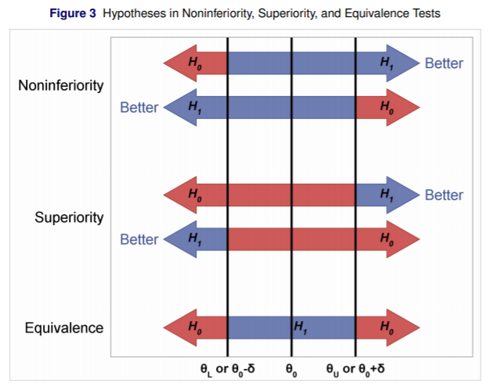
How to Set the Hypothesis
Larger is better
Smaller is better
H₀: θ ≤ θ₀ - Δ
H₁: θ > θ₀ - Δ
H₀: θ ≥ θ₀ + Δ
H₁: θ < θ₀ + Δ
H₀: θ ≤ θ₀ + Δ
H₁: θ > θ₀ + Δ
H₀: θ ≥ θ₀ - Δ
H₁: θ < θ₀ - Δ
H₀: θ ≤ θ₀ – Δ or θ ≥ θ₀ + Δ
H₁: θ₀ – Δ < θ < θ₀ + Δ
Equivalence and Noninferiority Testing Using SAS/STAT® Software (John Castelloe and Donna Watts)

Slide 12
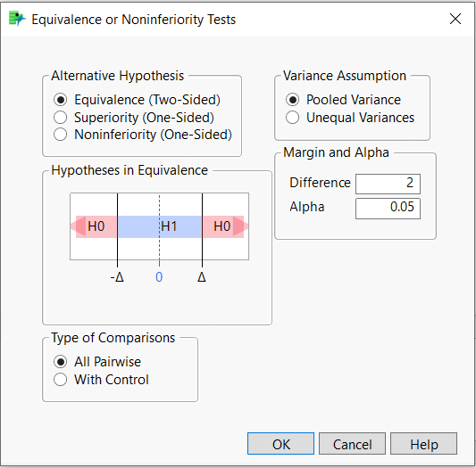
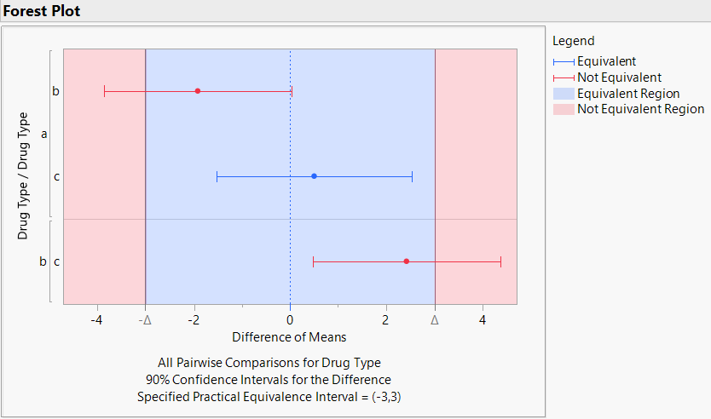
Equivalence, Noninferiority and Superiority Tests
In JMP® 17
Continuous Data: Comparing normal means (Oneway)
Categorical Data: Comparing response rates (Contingency)
Features: Easy to select a test and interpret results

Slide 13
Demonstrate
Equivalence Tests

Slide 14
Method Comparison
Standard practice for measurements
It is assumed that a standard method exists to measure the level of some quantity, for example, the temperature or potency of a drug.
A new method is developed. Its performance must be comparable to the standard method.
  International Union of Pure and Applied Chemistry (IUPAC)
  United States Pharmacopeia (USP)
  International Committee for Harmonization (ICH)
  National Committee for Clinical Laboratory Standards (NCCLS)

Slide 15
Method Comparison
Comparison by identity
The test method ideally returns the same value as the standard method.
A scatter plot of the test method versus the standard method should show the data agree with the identity line, Y = X.
Data points do not perfectly agree due to measurement error.
Regression analysis can determine the best fit line for the data.
The estimated model parameters can be compared to the identity line.
  H₀: Intercept ≠ 0 or Slope ≠ 1 (not equivalent)
  H₁: Intercept = 0 and Slope = 1 (equivalent)

Slide 16

Method Comparison
Comparison by regression
$$Y=a+bX+ε,ε=N(0,σ)$$
Ordinary least squares linear regression assumes that:
  Y and X are linearly related (linear in the model parameters)
  statistical errors are in Y, no errors are in X
  statistical errors are independent of Y (constant for all Y)
  no data exert excessive influence on the estimates

Slide 17
Method Comparison
Comparison by regression
Method comparison data usually violate these assumptions, however.
  There are measurement errors in the standard method, too.
  The errors are not constant. (Constant CV, not constant SD)
  Outliers are present that strongly influence the parameter estimates.
Other regression methods are required.
  Deming regression simultaneously minimizes the least squared error in Y and X.
  Passing-Bablok regression is a non-parametric method based on the median of all possible pair-wise slopes. It is resistant to outliers and non-constant errors.

Slide 18
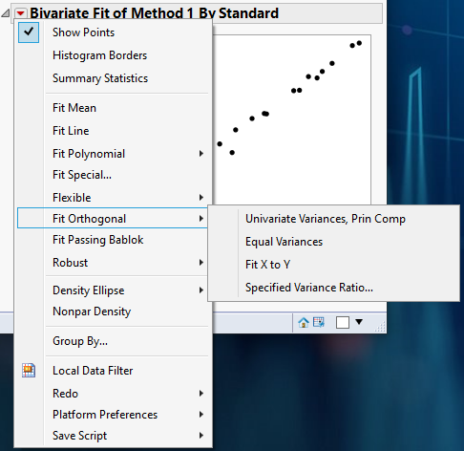
Method Comparison
Deming regression
JMP provides Deming regression in the Bivariate platform through the
Fit Orthogonal command.
Deming regression can estimate the errors in Y and X, assume that the errors in Y and X are equal, or use a given ratio of Y and X error.

Slide 19
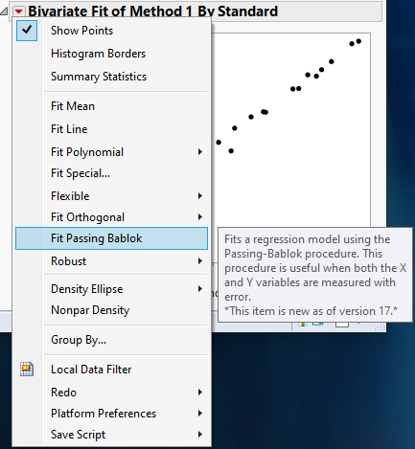
Method Comparison
Passing-Bablok regression
JMP 17 provides Passing-Bablok regression in the Bivariate platform through the Fit Passing Bablok command.
Fit Passing Bablok includes checks for the assumptions that measurements are highly, positively correlated and exhibit a linear relationship.

Slide 20
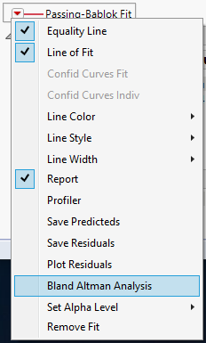
Method Comparison
Comparison by difference
Bland-Altman analysis compares the pair-wise differences (Y) to the pair-wise means (X) to assess bias between the two values.
The results are presented in a scatter plot of Y versus X for examination and for identification of anomalies in the Matched Pairs platform.
The report also presents the hypothesis tests.

Slide 21
Demonstrate
Method Comparison

Slide 22
Thank you!

