Slide 1
Coding with continuous and mixture variables to explore more of the input space
Micol Tresoldi, Xinjie Tong
Dow Chemical Company
JMP SUMMIT AMERICAS 2022

Slide 2
Outline
Objective of the Study
Initial Approach
Problem
Alternative Coding Strategy
Building the equivalent model
Reanalyzing the data

Slide 3
Objective: Find an Optimal Recipe
The objective of the research project is to find a formulation recipe such that the formulation exhibits optimal properties.
More specifically, any formulation is judged by looking at two properties which in turn need to meet certain specifications.

Slide 4
Making the Formulation
The formulation recipe calls for 4 ingredients: Factor A, Factor B, Factor C, and Factor D.
For Factor A, Factor B and Factor C, the amount to put in the recipe is fixed, but there are multiple ways of making Factor A, Factor B and Factor C. So, the composition of each of these 3 factors needs to be decided on its own, before these factors can be used in the final recipe.
For Factor D, there is only one way of making it, but the amount of Factor D to put in the final recipe is variable.
Thus, in making the formulation, one needs to decide:
How to make Factor A
How to make Factor B
How to make Factor C
How much of Factor D

Slide 5
Structure of the Problem
Input Variable
Factor A
Factor B
Factor C
X1 (Factor D quantity)
Options
2 possible ways of making it: Only raw material A1 Only raw material A2
3 possible ways of making it: Only raw material B1 Only raw material B2 50-50 Blend of B1 & B2
4 possible ways of making it: Only raw material C1 Only raw material C2 Only raw material C3 50-50 Blend of C1 & C2
4 possible amounts: 5, 10, 15, 20
Variable Type
Categorical w/ 2 levels
Categorical w/ 3 levels
Categorical w/ 4 levels
Continuous w/ 4 levels
Response | Variable Type | Specs
Y1 | Continuous | > 17
Y2 | Continuous | > 2.6
Categorical
or
Numeric
?
Come up with a DOE to understand the performance of the different options & identify the optimal recipe

Slide 6
Statistical Model Assumed when Designing the Experiment
M = 1 + Factor A + Factor B + Factor C + X1 +
Factor A * Factor B + Factor A * Factor C + Factor B * Factor C +
X1 * Factor A + X1 * Factor B + X1 * Factor C +
X1^2 + X1^2 * Factor B +
X1^3
Main Effects
2-way Inter
Quadratic
Cubic

Slide 7
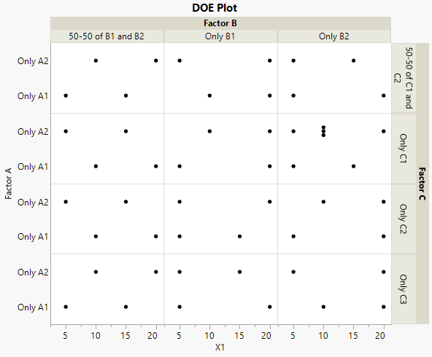
Design of Experiment – 51 Runs

Slide 8
Now it’s the time to go make 51 formulations

Slide 9
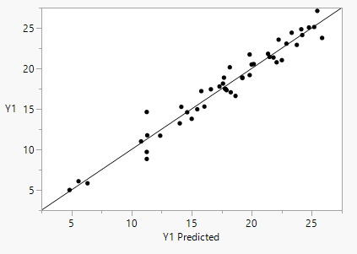
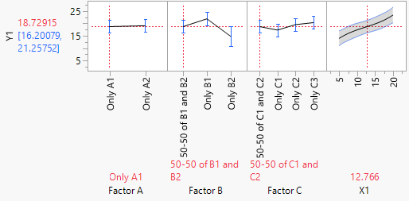
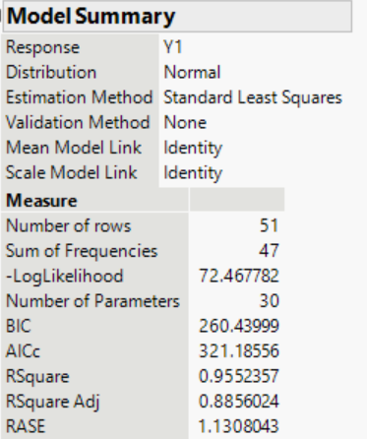
Analysis of the collected data – Results for Y1
After collecting the data from the DOE, we estimate a Gaussian model for Y1 using the model we specified at the DOE stage.
Predicted vs Actual
Profiler
Model Summary

Slide 10
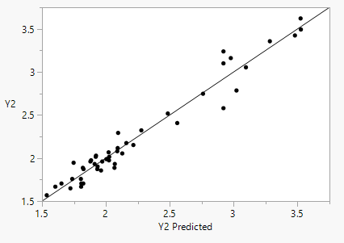
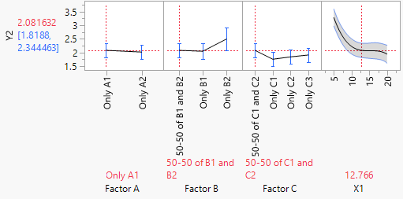
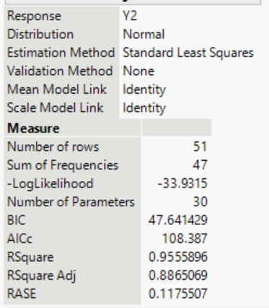
Analysis of the collected data – Results for Y2
After collecting the data from the DOE, we estimate a Gaussian model for Y2 using the model we specified at the DOE stage.
Predicted vs Actual
Profiler
Model Summary

Slide 11
Getting Predictions for Potential Recipes
After estimating the models, we want to see if there is any optimal recipe.
How?
Super easy using JMP® Pro 16 Profiler Features
We can simulate thousands of potential alternative recipes and, for each of these hypothetical recipes, we can compute the predicted mean value of Y1 and Y2, and then establish whether any of those meet both criteria.

Slide 12
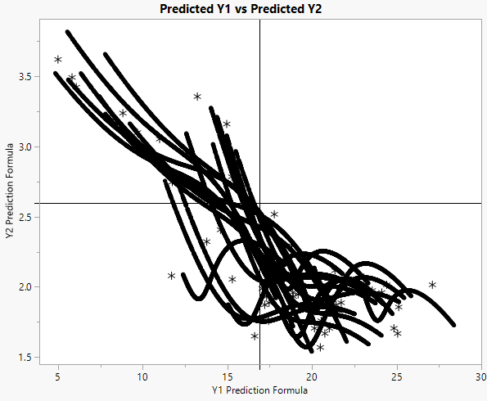



Is there any Potential Recipe meeting Both Specs?
Response | Specs
Y1 | > 17
Y2 | > 2.6
Unfortunately, NONE of the 30K hypothetical formulations meets both requirements …
So, what to do?
Go back to the beginning of the problem

Slide 13
Nature of Input Variables
So far :
Factor A is categorical with 2 levels
Only A1
Only A2
However, since we can mix A1 and A2 to make Factor A,
then we can also code it as :
A1 Content is continuous with 2 levels
1 = Only A1
0 = Only A2
Implicitly, A2 Content = 1 – A1 Content
A1 Content varies from 0 to 1
→ this gives us the flexibility of considering
many (infinite) more mixtures of A1 and A2
to make Factor A

Slide 14
Nature of Input Variables
So far :
Factor B is categorical with 3 levels
Only B1
Only B2
50-50 Blend of B1 & B2
However, we can also code it as :
B1 Content is continuous with 3 levels
1 = Only B1
0.5 = 50-50 Blend of B1 & B2
0 = Only B2
Implicitly, B2 Content = 1 – B1 Content
B1 Content varies from 0 to 1
→ this gives us the flexibility of considering
many (infinite) more mixtures of B1 and B2
to make Factor B

Slide 15
Nature of Input Variables
So far :
Factor C is categorical with 4 levels
Only C1
Only C2
Only C3
50-50 Blend of C1 & C2
However, we can also code it as :
C1 Content is continuous with 3 levels
1 = Only C1
0.5 = 50-50 Blend of C1 & C2
0 = Either Only C2 or Only C3
C2 Content is continuous with 3 levels
1 = Only C2
0.5 = 50-50 Blend of C1 & C2
0 = Either Only C1 or Only C3
C3 Content is continuous with 2 levels
1 = Only C3
0 = Either Only C1 or Only C2
Mixture

Slide 16
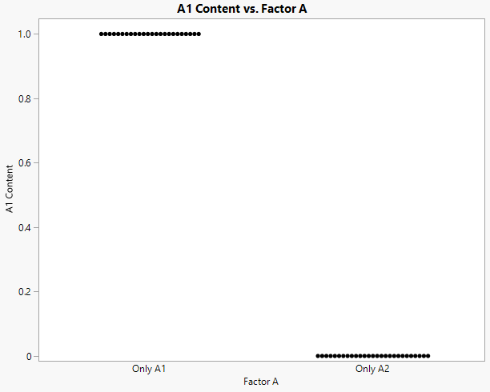
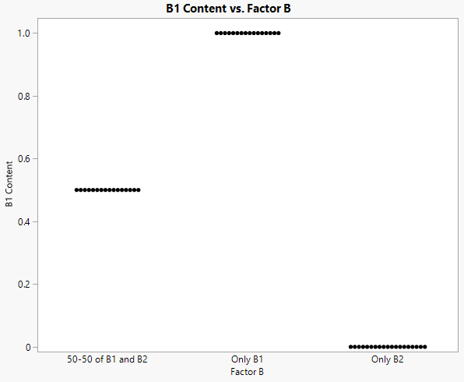
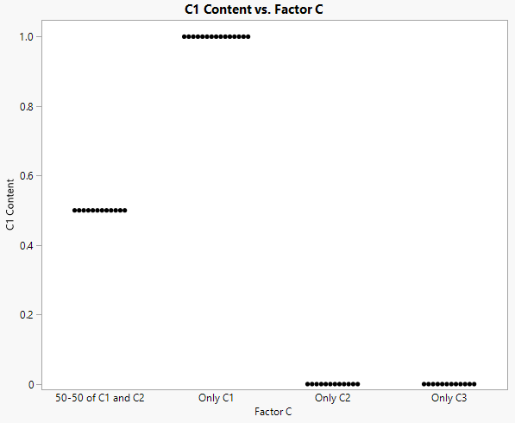
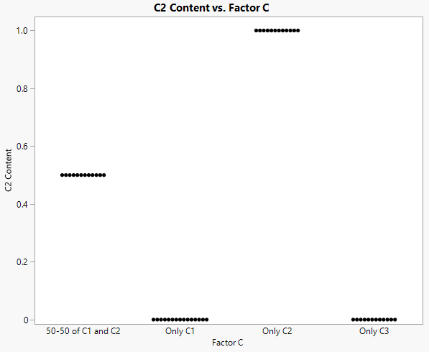
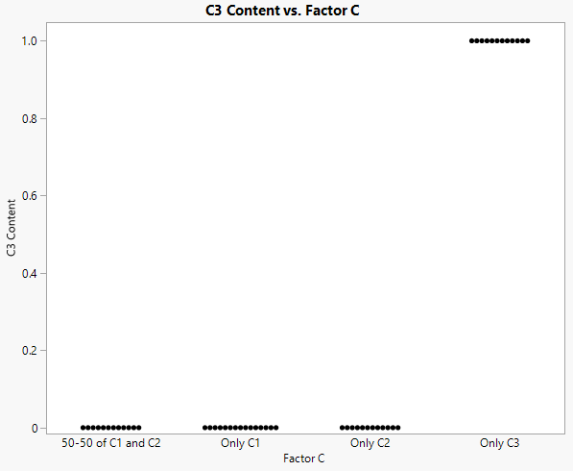
From Categorical To Continuous Coding

Slide 17
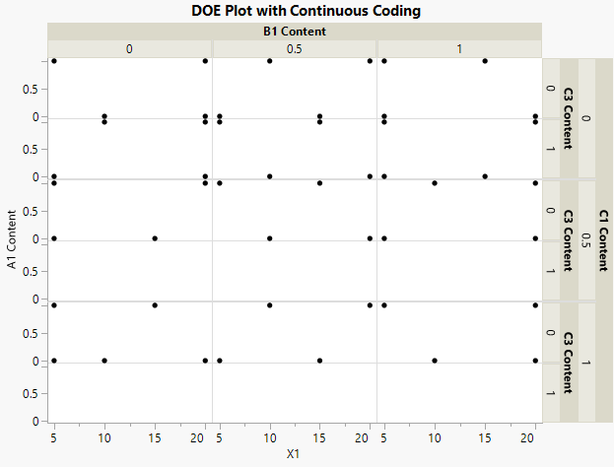
Design with Continuous Coding

Slide 18
How to convert the Statistical Model?
Categorical Coding
Continuous Coding
M = 1 + Factor A + Factor B + Factor C + X1 +
Factor A * Factor B + Factor A * Factor C + Factor B * Factor C +
X1 * Factor A + X1 * Factor B + X1 * Factor C +
X1^2 + X1^2 * Factor B +
X1^3
?
Let’s do it in many small steps

Slide 19
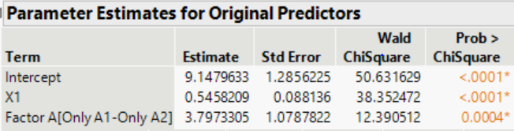
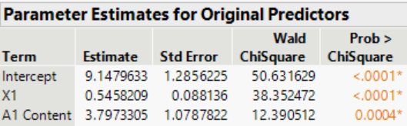

How to convert the Statistical Model?
Let’s start from a main effects model
Categorical Coding
Continuous Coding
M = 1 + X1 + Factor A
M = 1+ X1 +
A1 Content
2 levels
linear
1 Coeff
1 Coeff
Only A2 → A1 content = 0
=
+
*0

Slide 20
How to convert the Statistical Model?
Let’s start from a main effects model
Categorical Coding
Continuous Coding
M = 1 + X1 + Factor A
M = 1+ X1 +
A1 Content
2 levels
linear
1 Coeff
1 Coeff
Only A1 → A1 content = 1
+
=
+
*1

Slide 21
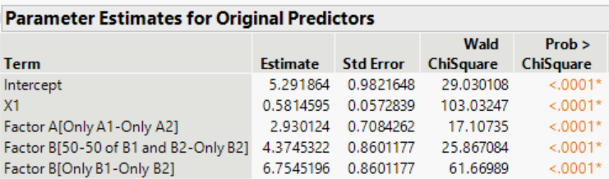
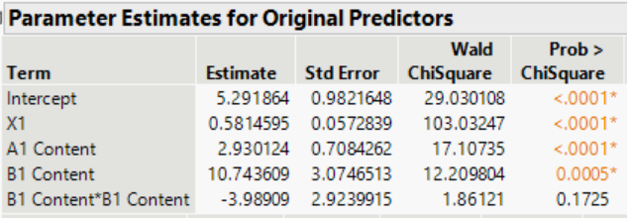


How to convert the Statistical Model?
Let’s start from a main effects model
Categorical Coding
Continuous Coding
M = 1 + X1 + Factor A + Factor B
M = 1+ X1 + A1 Content +
B1 Content + (B1 Content)^2
2 levels
3 levels
linear
linear + quadratic
1 Coeff
2 Coeff
1 Coeff
2 Coeff
Only B2 → B1 content = 0
=
+
*0
*0

Slide 22

How to convert the Statistical Model?
Let’s start from a main effects model
Categorical Coding
Continuous Coding
M = 1 + X1 + Factor A + Factor B
M = 1+ X1 + A1 Content + B1 Content + (B1 Content)^2
2 levels
3 levels
linear
linear + quadratic
1 Coeff
2 Coeff
1 Coeff
2 Coeff
Only B1 → B1 content = 1
+
=
+
*1
*1^2

Slide 23

How to convert the Statistical Model?
Let’s start from a main effects model
Categorical Coding
Continuous Coding
M = 1 + X1 + Factor A + Factor B
M = 1+ X1 + A1 Content + B1 Content + (B1 Content)^2
2 levels
3 levels
linear
linear + quadratic
1 Coeff
2 Coeff
1 Coeff
2 Coeff
50-50 of B1 & B2 → B1 content = 0.5
+
=
+
*0.5
*0.5^2

Slide 24
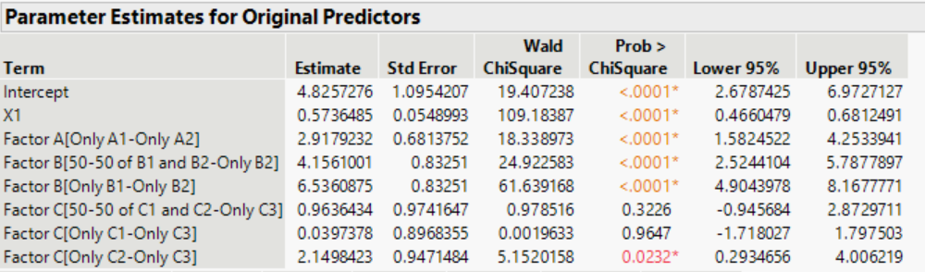
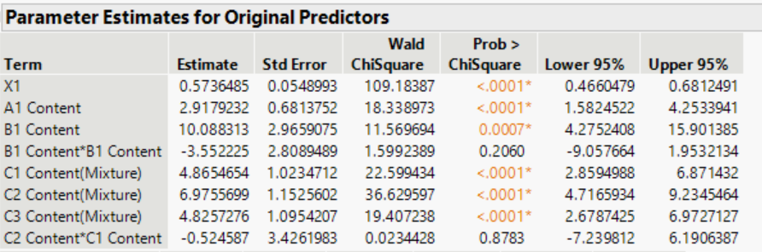


How to convert the Statistical Model?
Let’s start from a main effects model
Categorical Coding
Continuous Coding
M = 1 + X1 + Factor A + Factor B + Factor C
M = 1+ X1 + A1 Content + B1 Content + (B1 Content)^2
C1 Content + C2 Content + C3 Content +
C1 Content * C2 Content
2 levels
3 levels
4 levels
1 Coeff
2 Coeff
3 Coeff
3 Coeff (4 – 1 intercept)
Only C3 → C1 & C2 content = 0
C3 content = 1
=
+
+
*1
*0
*0
*0

Slide 25
How to convert the Statistical Model?
Let’s start from a main effects model
Categorical Coding
Continuous Coding
M = 1 + X1 + Factor A + Factor B + Factor C
M = 1+ X1 + A1 Content + B1 Content + (B1 Content)^2
C1 Content + C2 Content + C3 Content +
C1 Content * C2 Content
2 levels
3 levels
4 levels
1 Coeff
2 Coeff
3 Coeff
Only C2 → C1 & C3 content = 0
C2 content = 1
+
=
+
+
*0
*0
*1
*0

Slide 26
How to convert the Statistical Model?
Let’s start from a main effects model
Categorical Coding
Continuous Coding
M = 1 + X1 + Factor A + Factor B + Factor C
M = 1+ X1 + A1 Content + B1 Content + (B1 Content)^2
C1 Content + C2 Content + C3 Content +
C1 Content * C2 Content
2 levels
3 levels
4 levels
1 Coeff
2 Coeff
3 Coeff
Only C1 → C2 & C3 content = 0
C1 content = 1
+
=
+
+
*0
*1
*0
*0

Slide 27
How to convert the Statistical Model?
Let’s start from a main effects model
Categorical Coding
Continuous Coding
M = 1 + X1 + Factor A + Factor B + Factor C
M = 1+ X1 + A1 Content + B1 Content + (B1 Content)^2
C1 Content + C2 Content + C3 Content +
C1 Content * C2 Content
2 levels
3 levels
4 levels
1 Coeff
2 Coeff
3 Coeff
50-50 of C1 & C2 → C1 & C2 content = 0.5
C3 content = 0
+
=
*0.5
+
*0.5
*0.5^2
+
*0

Slide 28
How to convert the Statistical Model?
Now that we have converted all main effects, we can convert the interactions following the same logic.
The only caution is to remove main effects when interacting with all mixture variables
Categorical Coding
Continuous Coding
M = 1 + X1 + Factor A + Factor B + Factor C +
M = 1+ X1 + A1 Cont + B1 Cont + (B1 Cont)^2 +
C1 Cont + C2 Cont + C3 Cont +C1 Cont * C2 Cont

Slide 29
How to convert the Statistical Model?
Now that we have converted all main effects, we can convert the interactions following the same logic.
The only caution is to remove main effects when interacting with all mixture variables
Categorical Coding
Continuous Coding
M = 1 + X1 + Factor A + Factor B + Factor C +
M = 1+ X1 + A1 Cont + B1 Cont + (B1 Cont)^2 +
C1 Cont + C2 Cont + C3 Cont +C1 Cont * C2 Cont
Factor A * Factor B +
Factor A * Factor C +
Factor B * Factor C
A1 Cont * (B1 Cont + (B1 Cont)^2 ) +
A1 Cont * (C1 Cont + C2 Cont + C3 Cont +C1 Cont * C2 Cont ) +
(B1 Cont + (B1 Cont)^2 ) * (C1 Cont + C2 Cont + C3 Cont +C1 Cont * C2 Cont)

Slide 30
How to convert the Statistical Model?
Now that we have converted all main effects, we can convert the interactions following the same logic.
The only caution is to remove main effects when interacting with all mixture variables
Categorical Coding
Continuous Coding
M = 1 + X1 + Factor A + Factor B + Factor C +
M = 1 + X1 + A1 Cont + B1 Cont + (B1 Cont)^2 +
C1 Cont + C2 Cont + C3 Cont +C1 Cont * C2 Cont
Factor A * Factor B +
Factor A * Factor C +
Factor B * Factor C
A1 Cont * (B1 Cont + (B1 Cont)^2 ) +
A1 Cont * (C1 Cont + C2 Cont + C3 Cont +C1 Cont * C2 Cont ) +
(B1 Cont + (B1 Cont)^2 ) * (C1 Cont + C2 Cont + C3 Cont +C1 Cont * C2 Cont)
X1* Factor A +
X1 * Factor B +
X1 * Factor C
X1* A1 Cont +
X1* (B1 Cont + (B1 Cont)^2 ) +
X1* (C1 Cont + C2 Cont + C3 Cont +C1 Cont * C2 Cont ) +

Slide 31
How to convert the Statistical Model?
Now that we have converted all main effects, we can convert the interactions following the same logic.
The only caution is to remove main effects when interacting with all mixture variables
Categorical Coding
Continuous Coding
M = 1 + X1 + Factor A + Factor B + Factor C +
M = 1 + X1 + A1 Cont + B1 Cont + (B1 Cont)^2 +
C1 Cont + C2 Cont + C3 Cont +C1 Cont * C2 Cont
Factor A * Factor B +
Factor A * Factor C +
Factor B * Factor C
A1 Cont * (B1 Cont + (B1 Cont)^2 ) +
A1 Cont * (C1 Cont + C2 Cont + C3 Cont +C1 Cont * C2 Cont ) +
(B1 Cont + (B1 Cont)^2 ) * (C1 Cont + C2 Cont + C3 Cont +C1 Cont * C2 Cont)
X1* Factor A +
X1 * Factor B +
X1 * Factor C
X1* A1 Cont +
X1* (B1 Cont + (B1 Cont)^2 ) +
X1* (C1 Cont + C2 Cont + C3 Cont +C1 Cont * C2 Cont ) +
X1^2 +
X1^2 * Factor B +
X1^3
X1^2 +
X1^2 * (B1 Cont + (B1 Cont)^2 ) +
X1^3

Slide 32
Fitting the Gaussian Model with Continuous Coding
Now we can estimate the equivalent Gaussian model for Y1 and Y2 using the continuous coding.
The predicted values are obviously exactly the same!
Predicted with Categorical Coding
Predicted with Continuous Coding

Slide 33
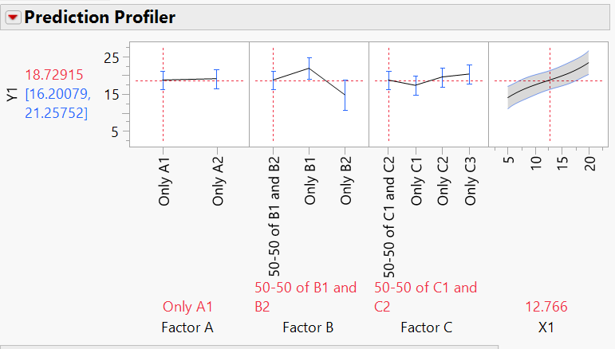
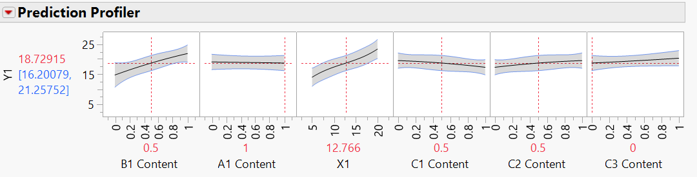
Power of Continuous Coding
However, if we look at the profilers …
With continuous coding, we have much more power of interpolation!

Slide 34

Assumptions Behind Interpolation
What are the assumptions behind this interpolation?
The relations with the responses are
Linear in the amount of A1 Content
Quadratic in the amount of B1 Content
Quadratic in the amount of C1 Content
Quadratic in the amount of C2 Content
Linear in the amount of C3 Content
Interpolation can be questionable if these assumptions are not valid

Slide 35
Getting Predictions for Potential Recipes with Continuous Coding
Now that we can have access to much more of the input space,
we want to see if there is any optimal recipe.
How?
Super easy using JMP® Pro 16 Profiler Features
Again, by simulating thousands of potential alternative recipes and, for each of these hypothetical recipes, computing the predicted mean value of Y1 and Y2, and establishing whether any of those meet both criteria.

Slide 36
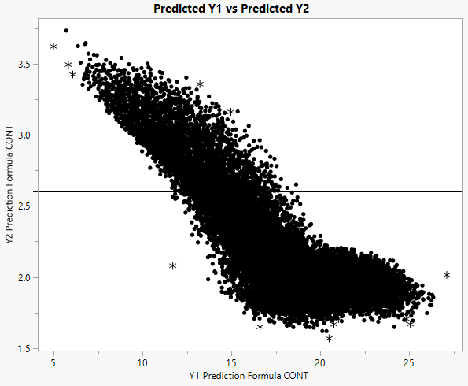


Is there any Potential Recipe meeting Both Specs?
Using Categorical Coding
Using Continuous Coding
With categorical coding, we don’t find any good potential recipe
Thanks to continuous coding, we find some good potential recipes

Slide 37
Thank You!

Slide 38
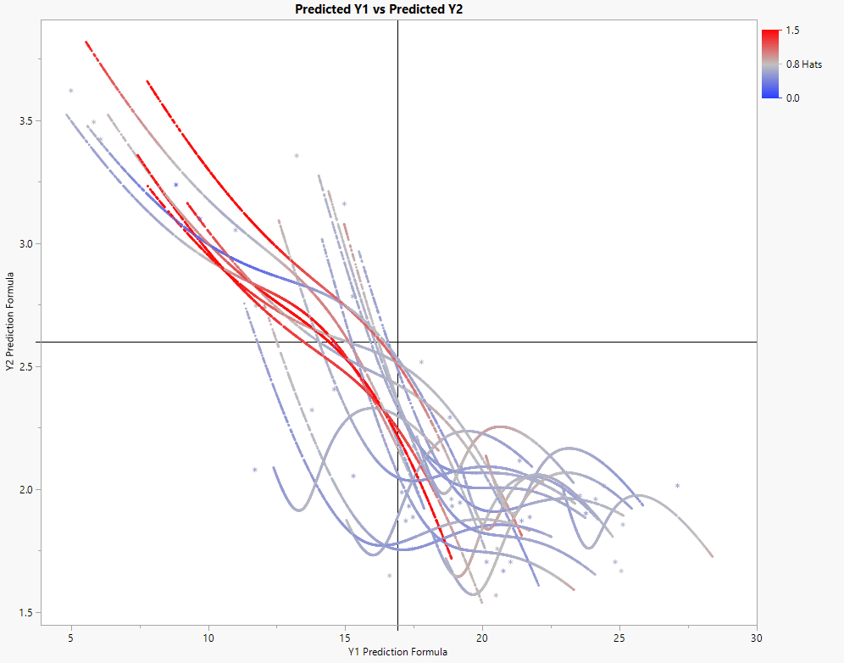
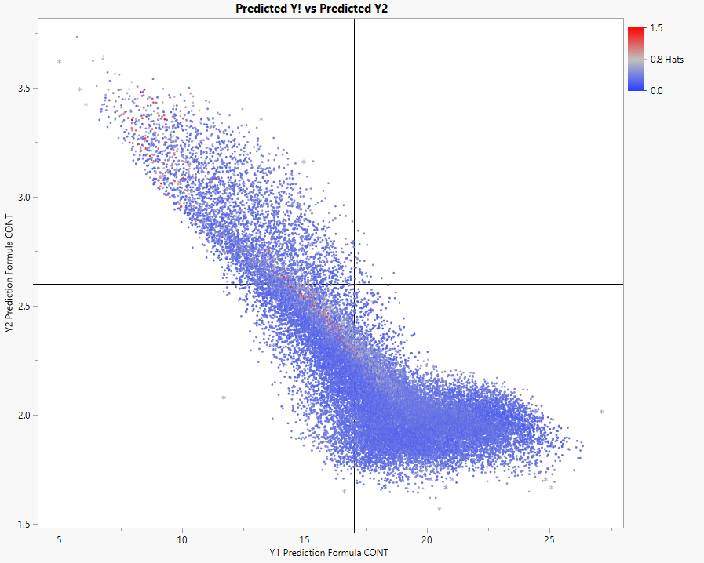
Hat values to Check on Extrapolation
Using Categorical Coding
Using Continuous Coding

Slide 39
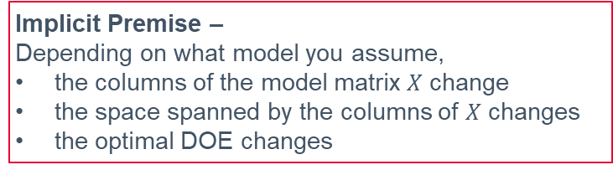
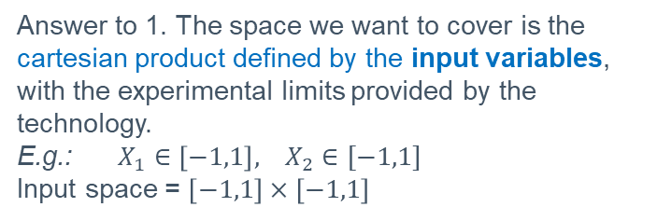
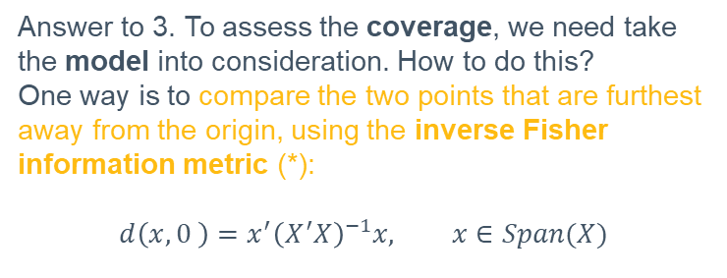
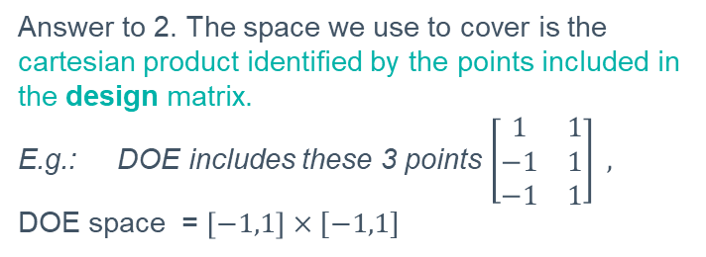
Extrapolation – deep dive
To assess how much the “DOE is covering the space”, we first need to clarify
what space we want to cover
what is the space we use to cover
what we mean by cover
Implicit Premise –
Depending on what model you assume,
the columns of the model matrix $X$ change
the space spanned by the columns of $X$ changes
the optimal DOE changes
Answer to 1. The space we want to cover is the cartesian product defined by the input variables, with the experimental limits provided by the technology.
E.g.: $X_{1}∈\left[−1,1\right], X_{2}∈[−1,1]$
Input space = $\left[−1,1\right]×\left[−1,1\right]$
Answer to 3. To assess the coverage, we need take the model into consideration. How to do this?
One way is to compare the two points that are furthest away from the origin, using the inverse Fisher information metric (*):
$$d\left(x,0 \right)=x^{′}{\left(X^{′}X\right)}^{−1}x, x∈Span(X)$$
Answer to 2. The space we use to cover is the cartesian product identified by the points included in the design matrix.
E.g.: DOE includes these 3 points $\left[\begin{matrix}1 & 1 \\ −1 & 1 \\ −1 & 1\end{matrix}\right] ,$
DOE space = $\left[−1,1\right]×[−1,1]$
(*) Montgomery, D. C. (2017). Design and analysis of experiments.
John wiley & sons.

Slide 40
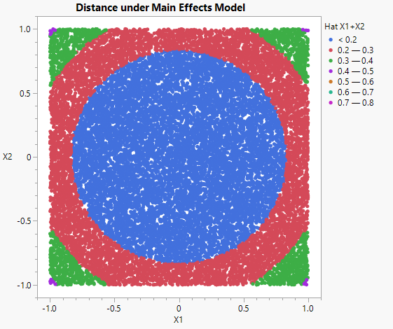
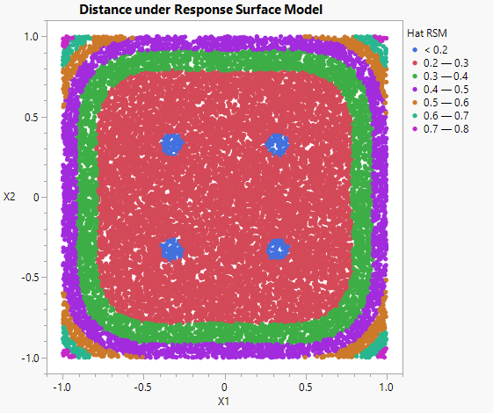

Extrapolation – Impact of the model choice
$$d\left(x,0 \right)=x^{′}{\left(X^{′}X\right)}^{−1}x$$

Slide 41
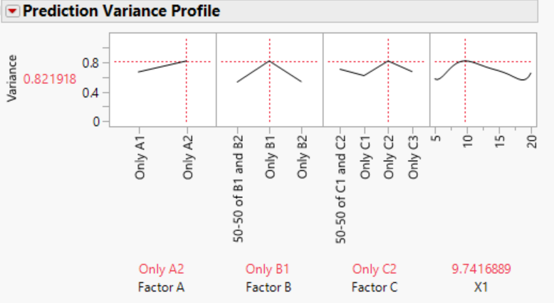
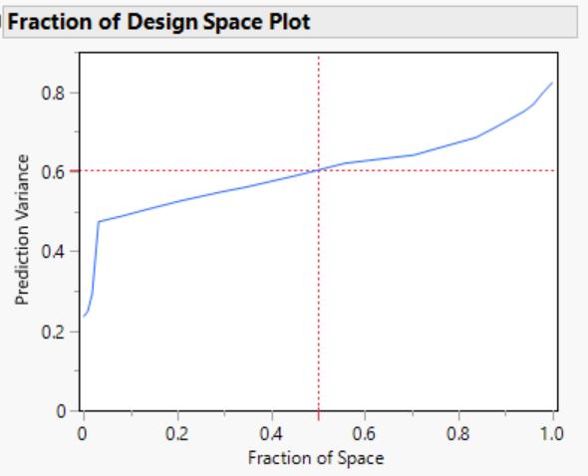
Design of Experiment – Variance Profile

Slide 42
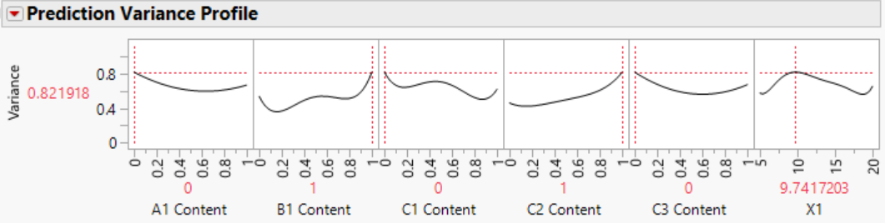
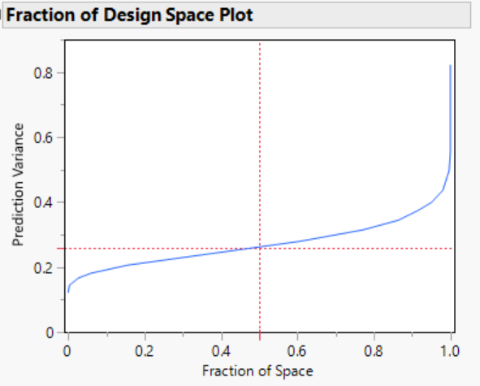
Design of Experiment – Variance Profile
Categorical Coding
Continuous Coding

Slide 43
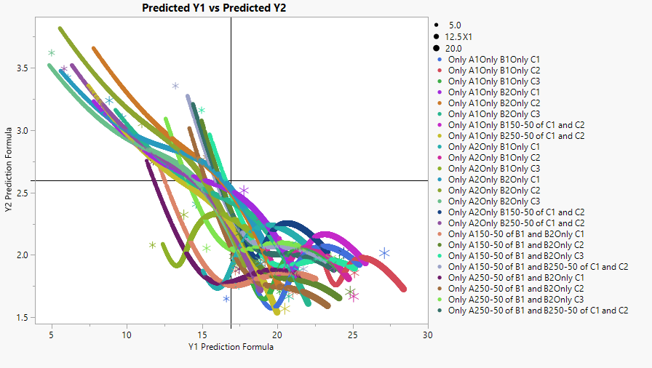
Plotting Y1 versus Y2 for different combinations of inputs
2*3*4 = 24 factorial combinations

Slide 44
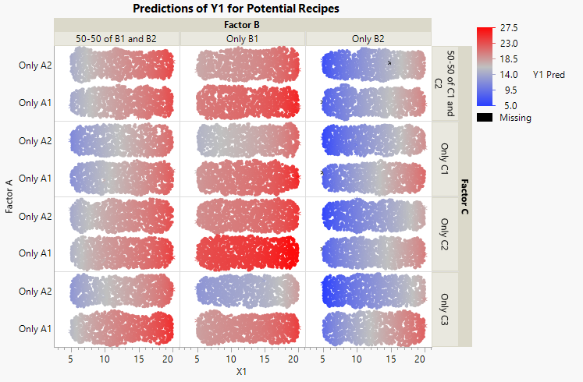
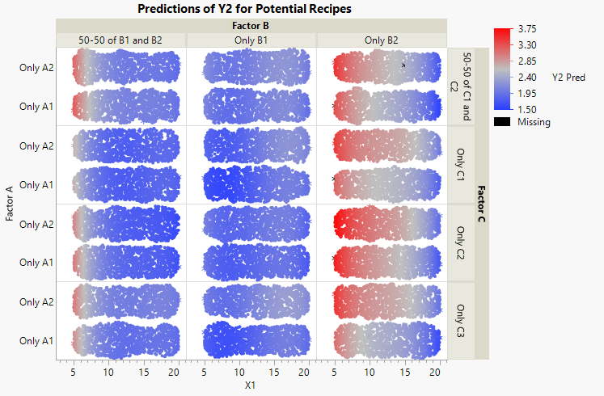
Getting Predictions for Potential Recipes
After estimating the models, we want to leverage the learning.
How?
Super easy using JMP Pro Profiler Features
By simulating thousands of potential alternative recipes and, for each of these hypothetical recipes, computing the predicted mean value of Y1 and Y2.

Slide 45
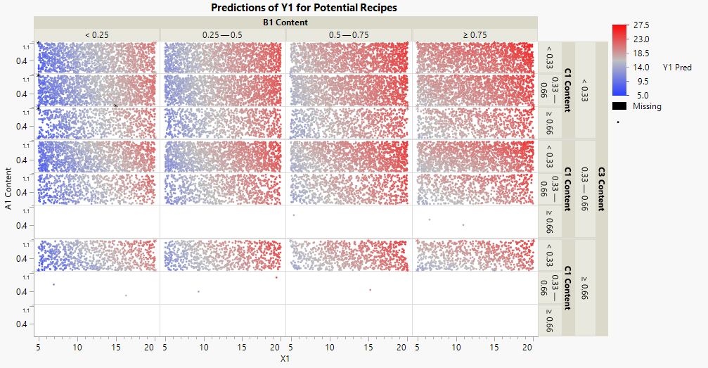
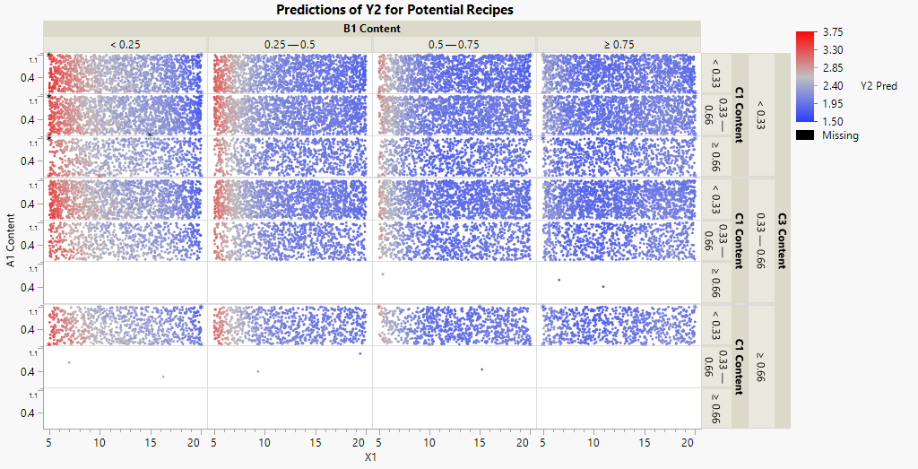
Getting Predictions for Potential Recipes with Continuous Coding
After estimating the models, we leverage the learning by simulating thousands of potential alternative recipes and, for each of these hypothetical recipes,
we compute the predicted mean value of Y1 and Y2.

