Slide 1

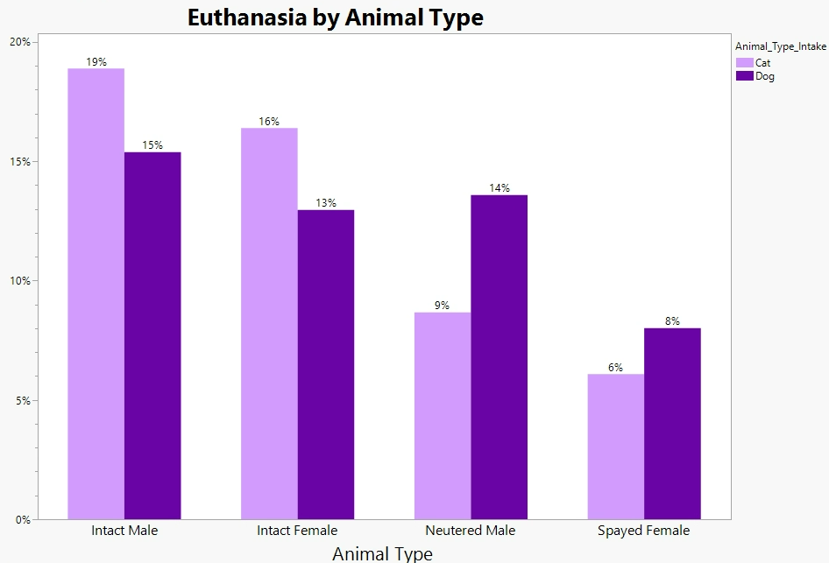
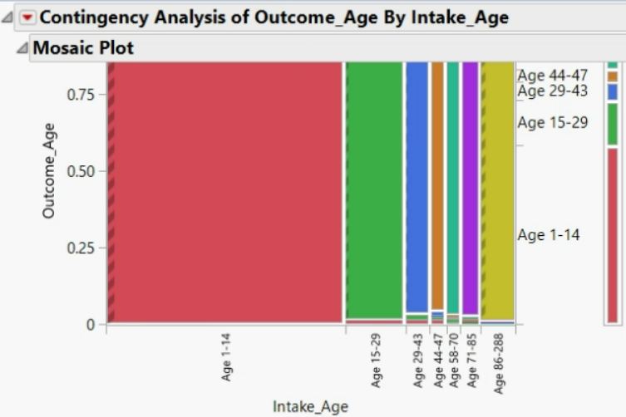
Euthanasia in Animal Shelters:
Why are felines and canines being put down?
Replace with logo
Introduction Data Overview Data Exploration
Each year about 920,000 animals are euthanized annually.
Using JMP Pro we identify key factors that contribute to the euthanization of a ​canines and felines
Using these insights, Animal Shelter funds can be properly channeled to relevant sectors to minimize deaths
Further, predictions can be made on what animals will be euthanized
There are about 67K observations of cats and dogs in the animal shelter of which 3,171 animals were euthanized
The distribution of euthanized cats and dogs were equal
Visualizations portray stray animals to be most prone to euthanization
Kittens and pups under the age of 15 months contribute to about 25% and 13% of euthanized animals, respectively
Intact males and females of cats and dogs are most prone to euthanization
Data Source | Austin's Open Data Portal
Number of observations | 130,000
Unique Identifier | Animal_ID
Predictive Modelling
Model Training
Model Tuning
Predictions
Evaluation
Logistic Regression, Random and Boosted Forests were trained on 67K samples
Model parameters were tuned for best classification results
Predictions were made for Training and Validation data
Best model was chosen based on various metrics
Data Processing
Standardize units and binned age variable
Grouped breeds &colors
Filtered cats and dogs
Assumptions of variables tested
70:30 Training/Validation split used
Significant variables interpreted with Logistic Regression
Predictions done using Bootstrap and Boosted Forests to solve class imbalance
Model parameters tuned (depth of trees, learning parameter, feature selection)
Results Recommendations References & Acknowledgements
Category | Cats | Dogs
Sex | Intact cats are at least 55 times more likely to be euthanized than Neutered/Spayed Cats | Intact dogs are at least 7 times more likely to be euthanized than Neutered/Spayed dogs
Breeds | Mixed breeds are 2.2 times more likely to be euthanized than Pure breeds | Pit Bull Mix breeds are 2-3 times more likely to be euthanized than all other breeds
Age | Cats that are 4.5-6 years are more likely to be euthanized than younger cats | Dogs under 1.2 years are the lest likely to be euthanized
Intake Type | Owner-surrendered cats are 2 times more likely to be euthanized than strays | Owner-surrendered dogs are 2 times more likely to be euthanized than strays
We would like to thank our professors Dr. Goutam Chakraborty and Dr. Miriam McGaugh for mentoring this analysis.
References:
Scotney, R. L., McLaughlin, D., & Keates, H. L. (2015). A systematic review of the effects of euthanasia and occupational stress in personnel working with animals in animal shelters, veterinary clinics, and biomedical research facilities. Journal of the American Veterinary Medical Association, 247(10), 1121-1130.
Intake animals should be properly neutered and spayed
Bootstrap Forest classifier can be used to prioritize animals
Following categories of animals should receive priority for shelter funding and medicinal research -
  Cats over dogs
  Cats aged 4.5-6 years and dogs over 1.2 years
  Owner-surrendered animals over stray animals
  Pit-Bull Mix dog breeds and Mixed cat breeds over other breeds
Notes:
Single sided poster!

Slide 2
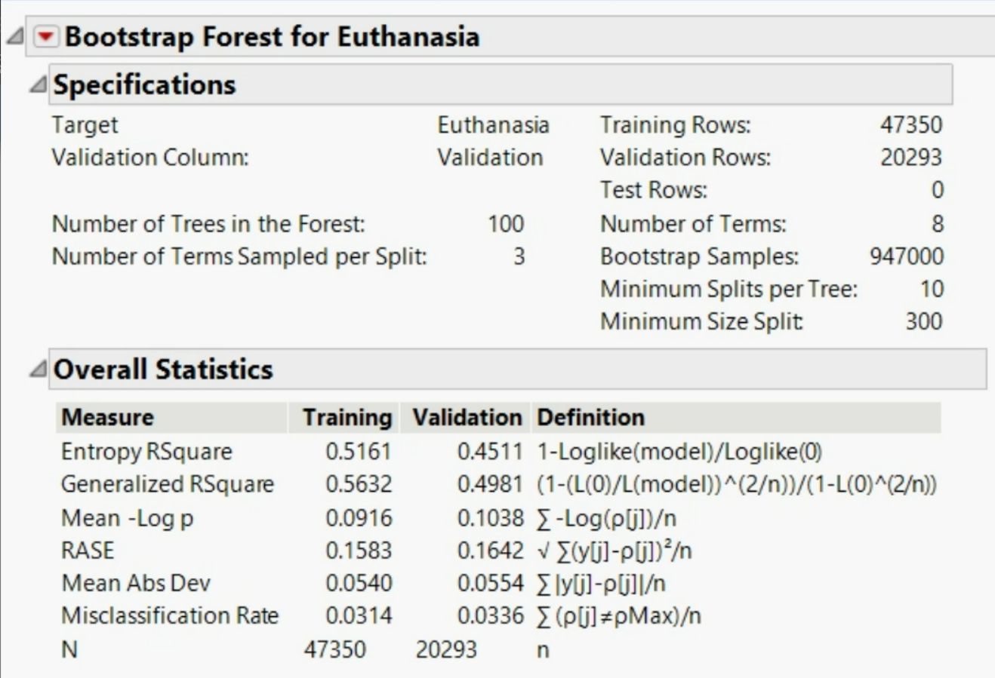
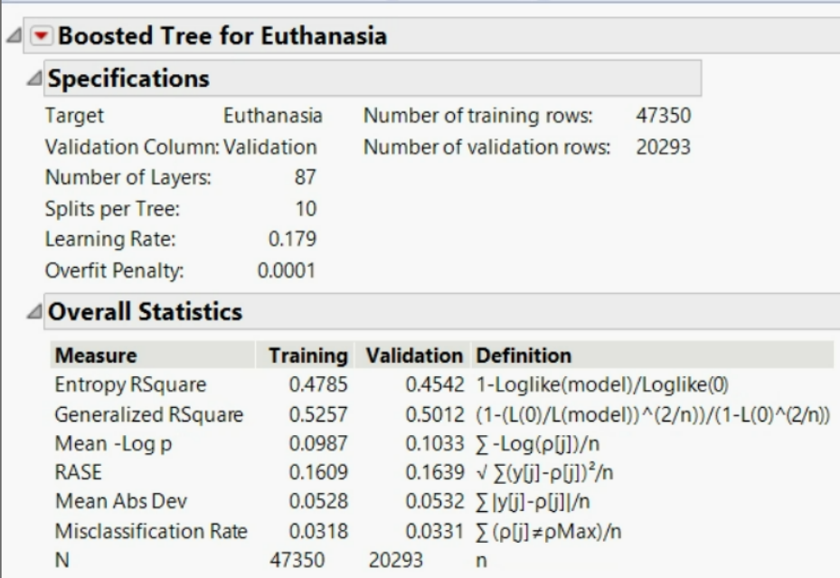
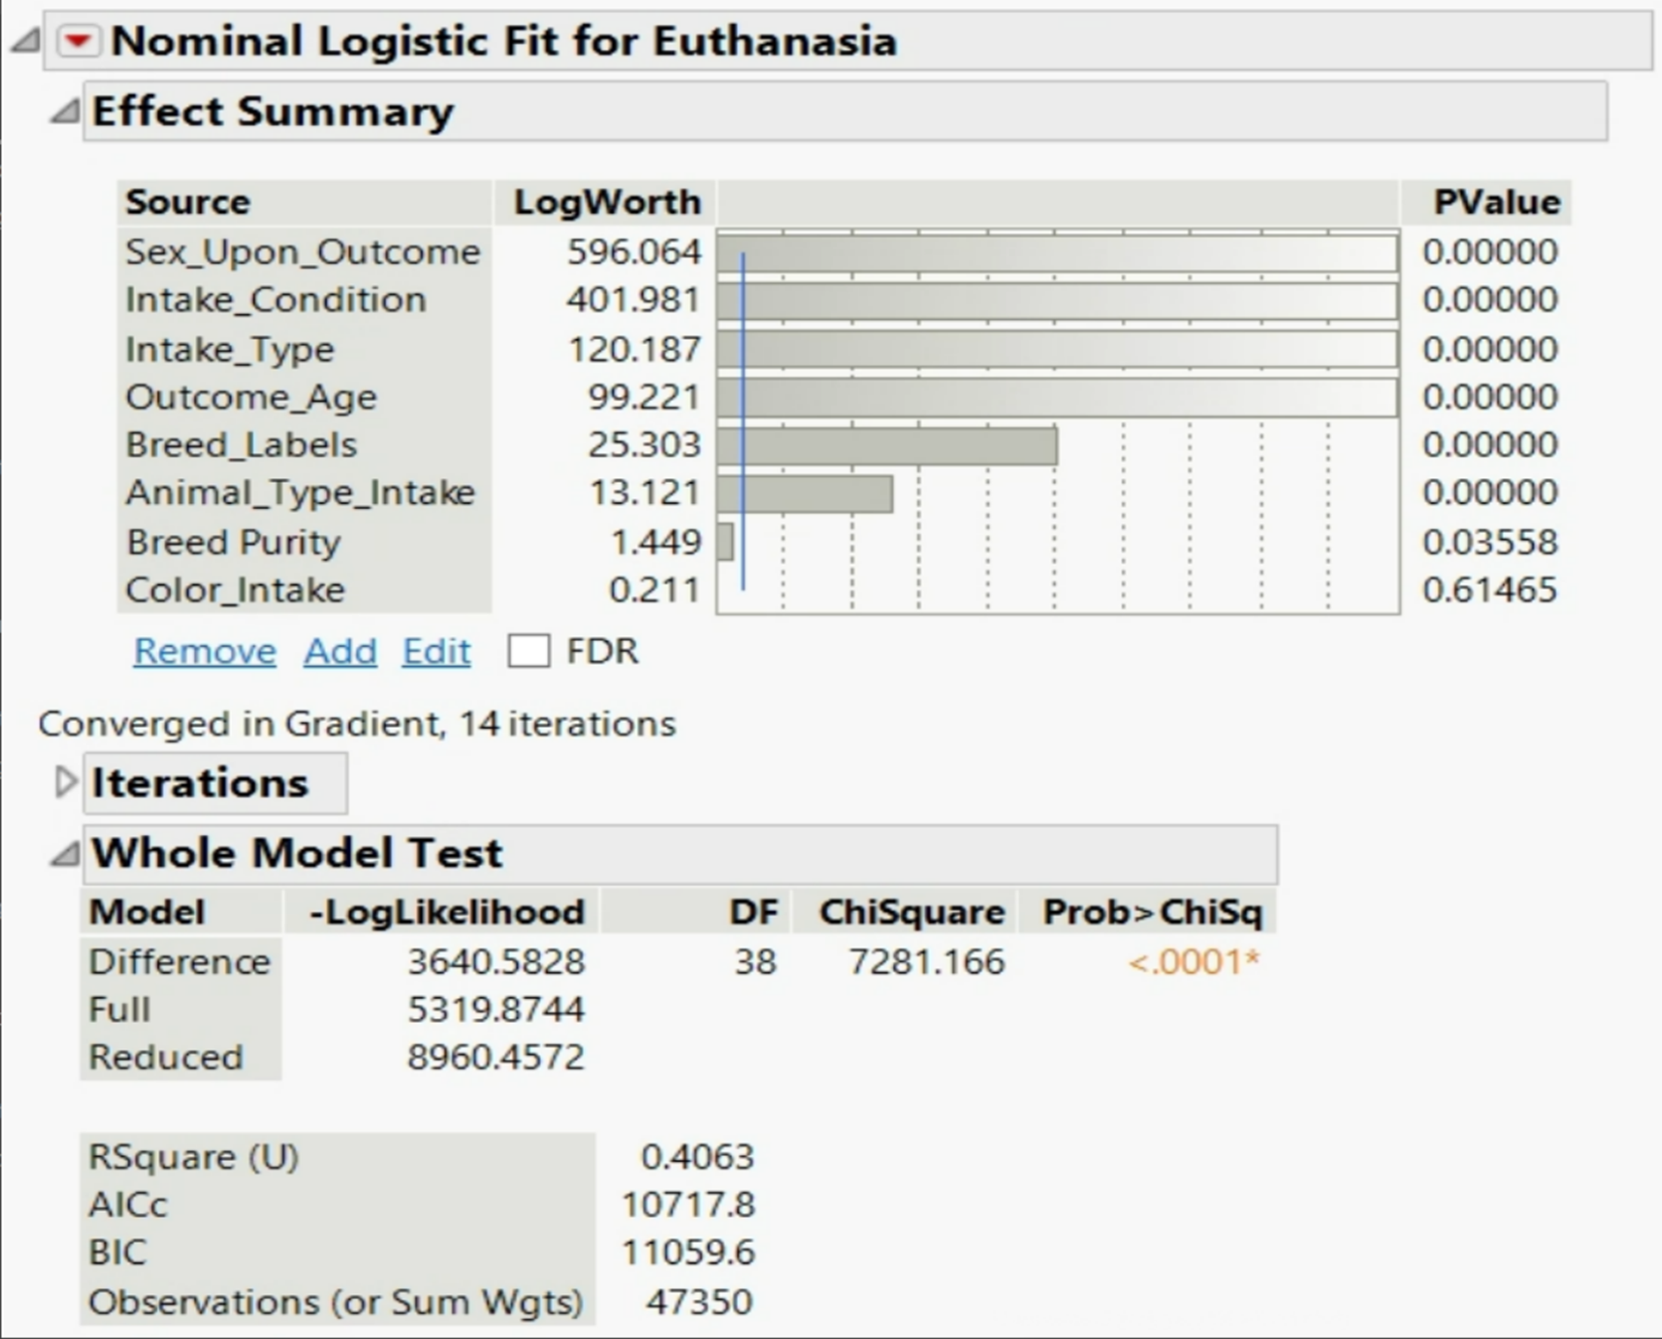
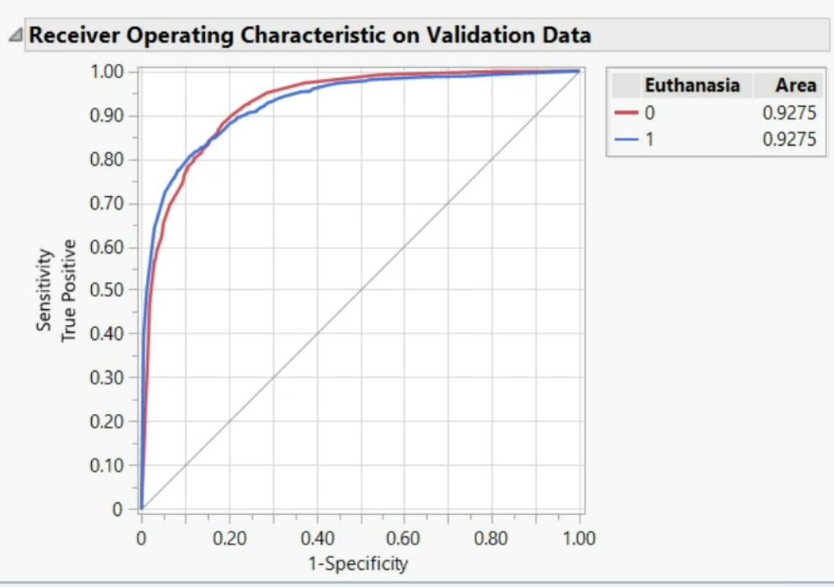
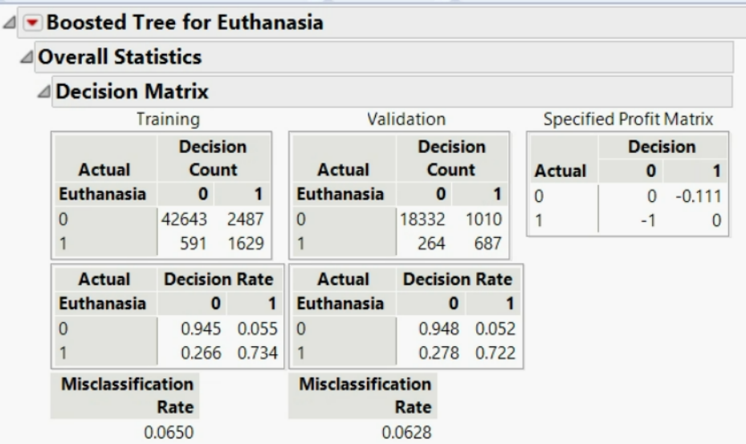











Euthanasia in Animal Shelters:
Why are felines and canines being put down?
Models
Model Comparison
Bootstrap Forest
Boosted Forest
Classification Threshold = 0.1 | LOGISTIC REGRESSION | BOOTSTRAP FOREST | BOOSTED FOREST
SPECIFICITY | 72.03% | 73.7% | 72.23%
MISCLASSIFICATION | 8.48% | 7.25% | 6.82%
AUC | 88.87 | 92.65 | 92.61
R-SQUARE | 40.63% | 49.52% | 48.9%
Nominal Logistic Regression

