Slide 1


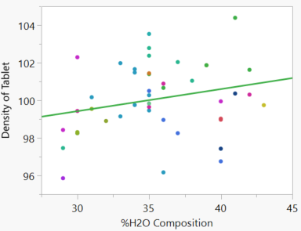

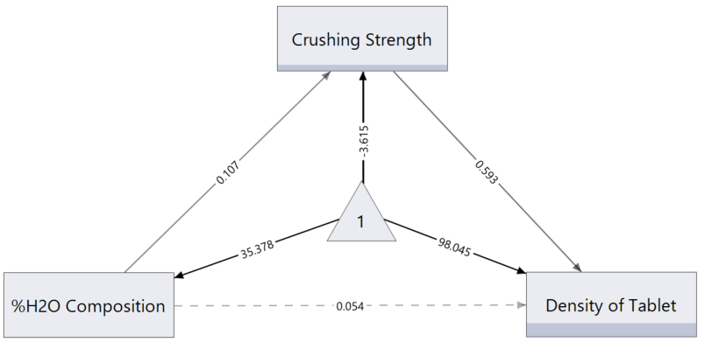
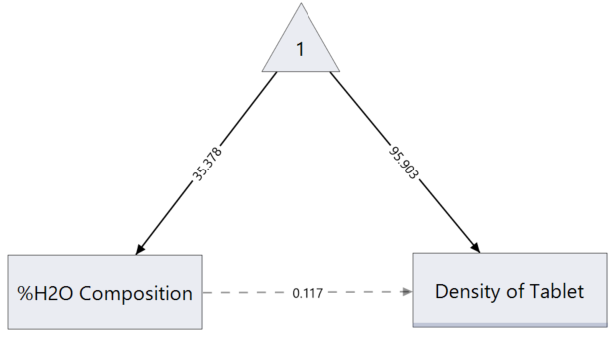
Linear Regression in Structural Equation Modelling
Case Study Traditional Linear Regression
Industrial process to manufacture pharmaceutical tablets
Involves many controllable and uncontrollable variables
There are three key metrics of a “good” tablet
We will explore only one of these metrics, Density of Tablet
%H₂O Composition is one controllable variable that may influence this metric
We expect the water to affect the tablet density, but could it affect other variables?
Linear regression is the classic way to approach the problem
Linear regression may fail to give the full picture of the system…
Method to relate one variable to another by a linear relationship
Follows the equation: Y = mX + C
This fit can be displayed graphically for more visual analysis of the data
The line of best fit is essentially the “model” that predictions should be made from
We can plot %H₂O Composition against Density of Tablet (mg/cm³) , from the tablet case study data
Gives us the resulting plot
Yields the Y = mX + C form of the equation of the line of best fit
It is important to make note of these values:
  m = 0.117
  C = 95.903
Density = 0.117(%H₂O) + 95.903
Linear Regression in SEM Mediation in SEM
Solid lines show statistically significant correlations, regardless of magnitude (broken lines not statistically significant)
Number 1 in triangle gives the SEM scale
The arrows indicate a correlation
This is the same example of linear regression as before just explained as an SEM
The m value is the path coefficient between the X and Y variables
The C value is the path coefficient between the SEM constant and the Y variable
The value from the SEM constant to the X variable gives the X-intercept
What if other variables have an effect in the system?
One example is the case of Mediation Variables
Introduces the indirect effects of variables as well as direct effects
This appears in the tablet case study in the form of the following SEM
Crushing Strength is the mediation variable since it effects the Density but is also affected by the %H₂O Composition
Direct effects can still be observed through the %H₂O to Density connection
Indirect effects can be calculated through the other “route” to the Density
Notice the indirect pathway is a solid line
New coefficients and another y-intercept
Density = 0.054(%H₂O) + 0.593(C.S.) + 98.045
References & Acknowledgements
Performing SEM analysis of systems in this way gives further insight into the whole system by highlighting relationships that may initially be hidden
Through this analysis we have discovered that:
  Relationship between %H₂O Composition and Density of Tablet through crushing strength is statistically significant
  Crushing Strength and Density of tablet are highly correlation
This means when we make changes to the system this is the correlation that we would want to focus on rather than the more obvious direct effect
A big thank you to Christian Stopp, who provided the underlying data set on this case study.
Another thanks to Phil Kay for encouraging the exploration of the topics discussed in this poster.
Notes:
Single sided poster!

