Slide 1





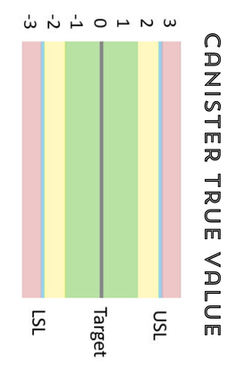






Silo Solution:
DECENTRALIZE ANALYTICS TO IGNITE A DATA REVOLUTION
Christian Bille
Statistician Scientist
Bavarian Nordic
Anders Laraignou
PhD Fellow in Educational Design
Anders Greis
Facilitator, MA in rhetorics, Strategic Impact Installer

Slide 2

The problems
WHY DATA DOESN’T STICK & SPREAD
Christian Bille

Slide 3


The problems
WHY DATA DOESN’T STICK & SPREAD
Christian Bille
It doesn’t stick
It doesn’t spread
We don’t know the concepts well enough to make them operational in the long run
We can’t convince our organisations to invest in JMP/DoE and analytical maturity

Slide 4
The solutions
WHAT MAKES DATA STICK & SPREAD
Christian Bille
It doesn’t stick
It doesn’t spread
LEARNING DESIGN
STRATEGIC COMMUNICATION

Slide 5
The solutions
WHAT MAKES DATA STICK & SPREAD
Christian Bille
LEARNING DESIGN
STRATEGIC COMMUNICATION
Anders Laraignou
PhD Fellow in Educational Design
Anders Greis
Facilitator, MA in rhetorics, Strategic Impact Installer

Slide 6
The solutions
HOW DO WE MAKE KNOWLEDGE STICK
Anders Laraignou

Slide 7

The solutions
LEARNING DESIGN
Anders Laraignou
DESIGNING LEARNING THAT STICKS

Slide 8

The solutions
LEARNING DESIGN
Anders Laraignou
DESIGNING LEARNING THAT STICKS

Slide 9
The solutions
LEARNING DESIGN
Anders Laraignou
DESIGNING LEARNING THAT STICKS

Slide 10

The solutions
LEARNING DESIGN
Anders Laraignou
EXPERIENCE AND LEARNING THROUGH GAMEBASED SCENARIOS

Slide 11
The solutions
LEARNING DESIGN
Anders Laraignou
MAKING IT STICK
Embodied learning through game-based experience

Slide 12
The solutions
WHAT MAKES DATA STICK & SPREAD
Christian Bille
LEARNING DESIGN
STRATEGIC COMMUNICATION
Anders Laraignou
PhD Fellow in Educational Design
Anders Greis
Facilitator, MA in rhetorics, Strategic Impact Installer

Slide 13
The solutions
STRATEGIC COMMUNICATION
Anders Greis
Facilitator, MA in rhetorics, Strategic Impact Installer
Christian Bille
Making it spread
STRATEGIC COMMUNICATION

Slide 14

The solutions
STRATEGIC COMMUNICATION
Anders Greis
Facilitator, MA in rhetorics, Strategic Impact Installer
Christian Bille
as seen through the
engine of a used Citröen

Slide 15
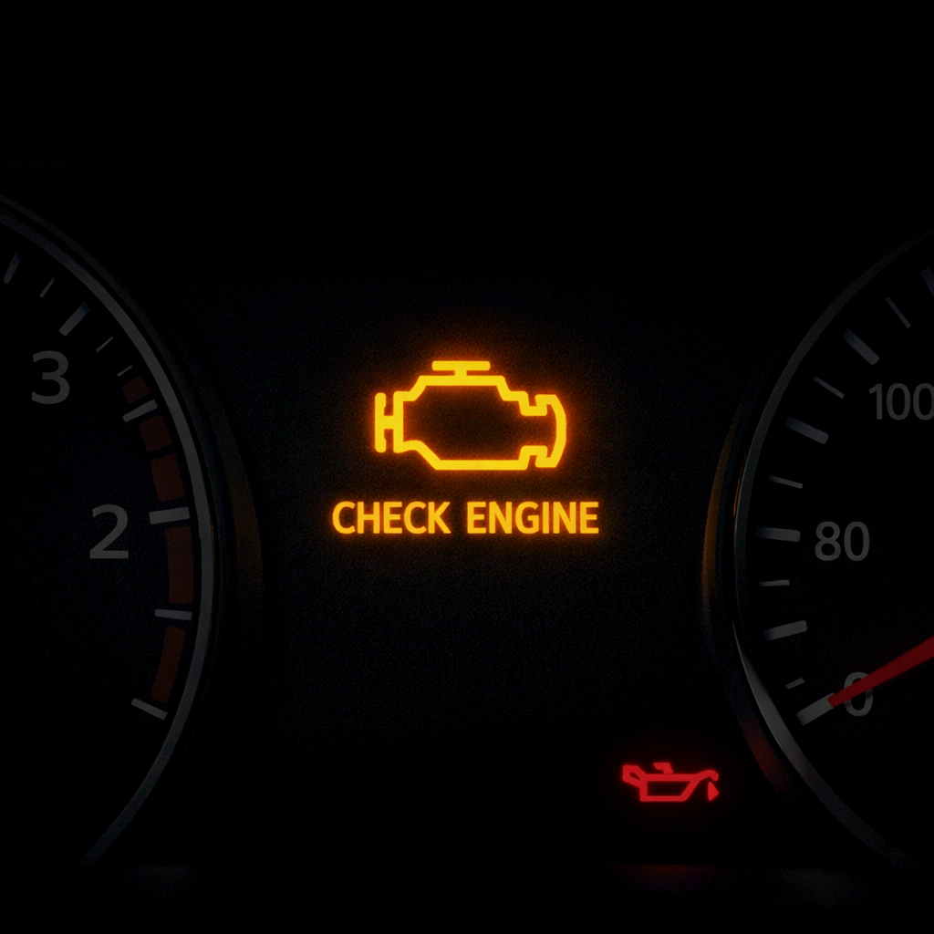

The solutions
STRATEGIC COMMUNICATION
Anders Greis
Facilitator, MA in rhetorics, Strategic Impact Installer
Christian Bille

Slide 16


The solutions
STRATEGIC COMMUNICATION
Anders Greis
Facilitator, MA in rhetorics, Strategic Impact Installer
Christian Bille

Slide 17
The solutions
STRATEGIC COMMUNICATION
Anders Greis
Facilitator, MA in rhetorics, Strategic Impact Installer
Christian Bille
1
2
X | Y | Z

Slide 18
The solutions
STRATEGIC COMMUNICATION
Anders Greis
Facilitator, MA in rhetorics, Strategic Impact Installer
Christian Bille
1
2
X | Y | Z

Slide 19
The solutions
STRATEGIC COMMUNICATION
Anders Greis
Facilitator, MA in rhetorics, Strategic Impact Installer
Christian Bille
1
2
X | Y | Z

Slide 20
The solutions
STRATEGIC COMMUNICATION
Anders Greis
Facilitator, MA in rhetorics, Strategic Impact Installer
Christian Bille
STRATEGIC COMMUNICATION IS
Calibrating the system
Creating impact towards the right people
Rhetorics applied
Understanding how the system connects
Making analytical maturity spread

Slide 21
An example
LEARNING MSA BY GOING TO MARS
Anders Greis
Facilitator, MA in rhetorics, Strategic Impact Installer
Christian Bille

Slide 22

The company
WHAT IS DATA TOGGLER
Christian Bille
Statistician Scientist
Bavarian Nordic
Anders Laraignou
PhD Fellow in Educational Design
Anders Greis
Facilitator, MA in rhetorics, Strategic Impact Installer
Analytical maturity
& data analytics
Strategic
communications
Gamebased learning design
Signup at datatoggler.com

